Slide 1

Status of H0/H- dumps
Thanks to:
C. Maglioni,
A. Patapenka,
C. Pasquino,
A. Perez,
N. Mariani
M. Delonca – LIU meeting

Slide 2

Outline
Layout and constraints (reminder)
Numerical results
Brazing tests
Conclusion & next steps

Slide 3
Layout and constraints (reminder)

Slide 4
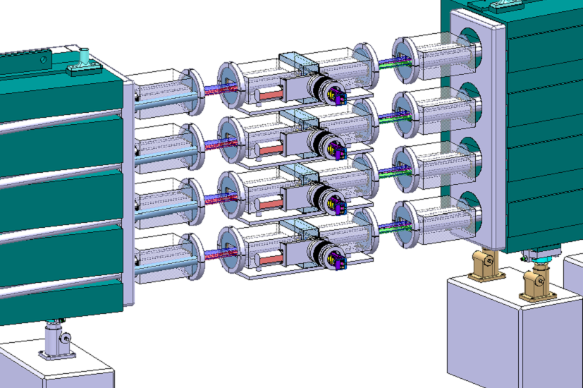
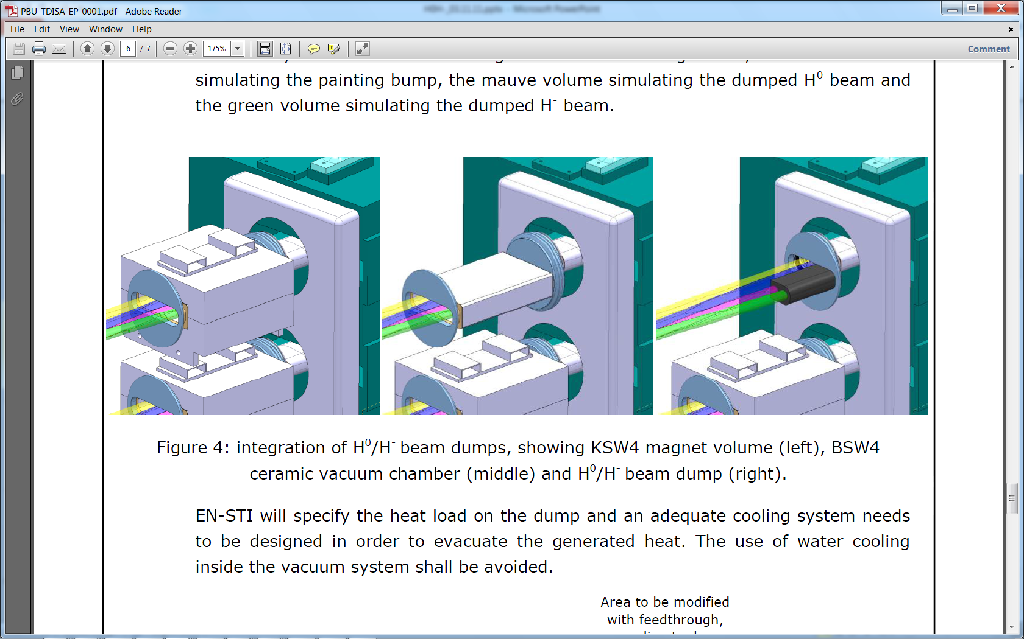
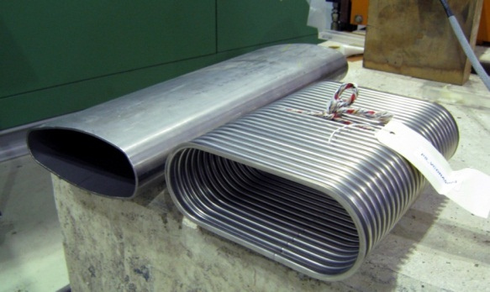
Dump space and layout
EDMS 1163508
KSW4 Magnet
Ceramic chamber
H0/H- dump
New baseline for vacuum chamber: Inconel.
Possibility of using the vacuum chamber for supporting the dump?
Development of the chamber in collaboration with EN-STI.

Slide 5
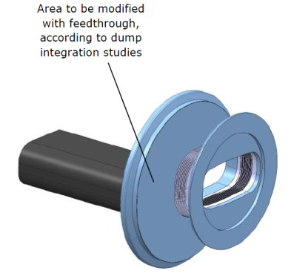
Dump space and layout
Area to be modified for dump support and cooling.
What should be integrated within this area?
At the BACK
Cooling system
Beam monitoring instrumentation
In FRONT
Use of the vacuum chamber?
Mechanical solution with shrinking?
Brazing?
Support system

Slide 6
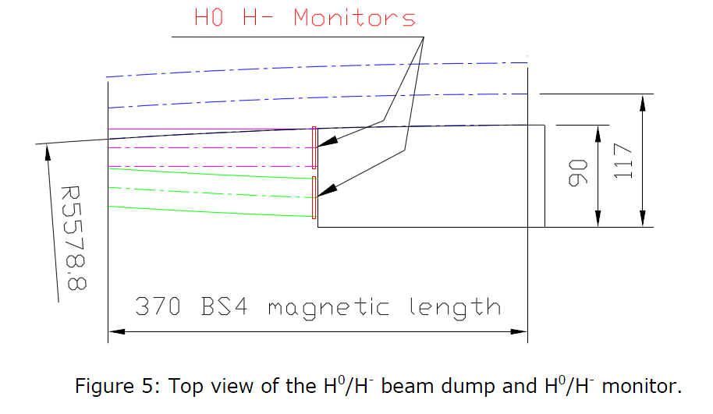
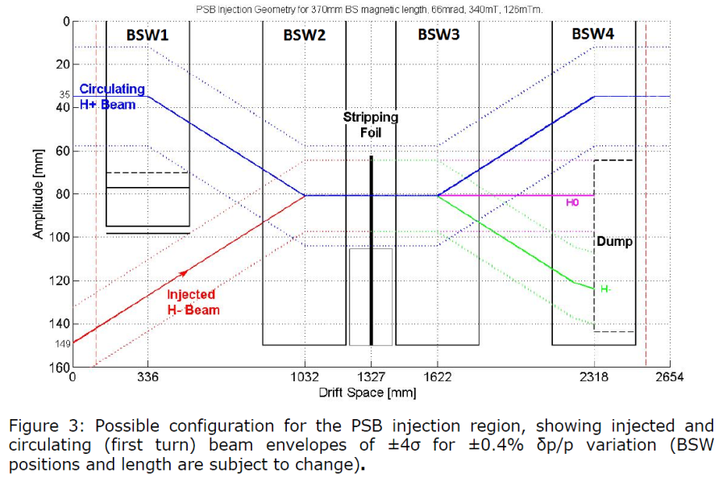
Loading cases
3 type of beams:
H⁻: injected or foil failure
H⁰: unstripped particles (depend on foil efficiency)
98% efficiency (operational case)
90% efficiency (degraded case)
H⁺: stripped particles
¼ Linac 4 pulse, interlock after one pulse.
Steady state, 2% of all H⁰ .
Steady state, 10% of all H⁰ .
H- impact angle: assumed ~33mrad (J. Borburgh)

Slide 7
Material considerations
From specification EDMS 1069240, the material should:
Be completely non-magnetic
Induces little eddy current
Be at least slightly conductive (to not electrically being charged)
Ceramic materials are considered as good candidates.
8 ceramics were individuated and compared taking into account:
Mechanical properties
Thermal properties
Electrical properties
Degassing
Activation
Silicon Carbide appears to be the most suitable candidate.

Slide 8
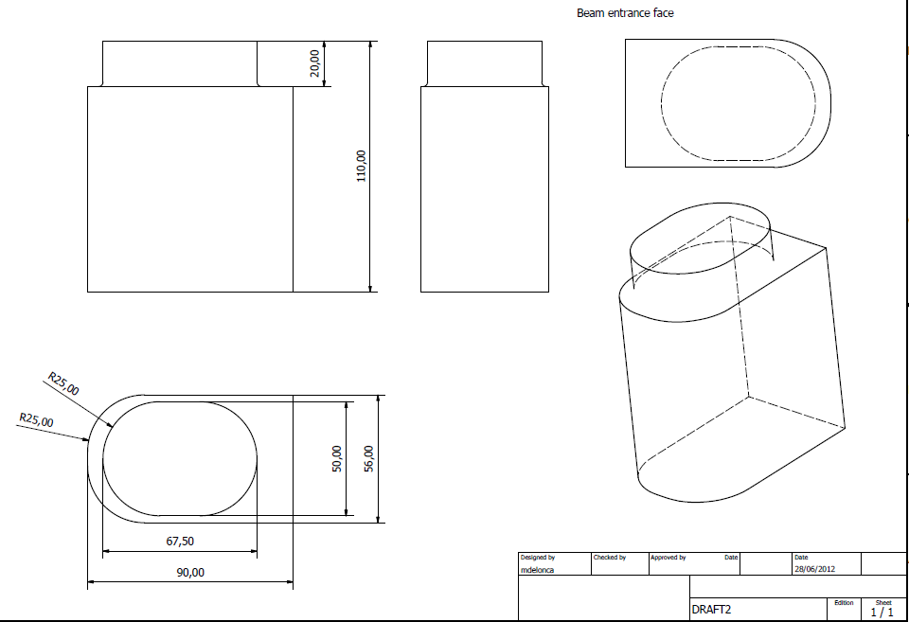
Actual dump design
Reminder:
Internal height of vacuum chamber ≈ 63 mm:
Only 3.5 mm are available all around the dump for:
Wires for dump monitoring
Support (if needed)
Brazing

Slide 9
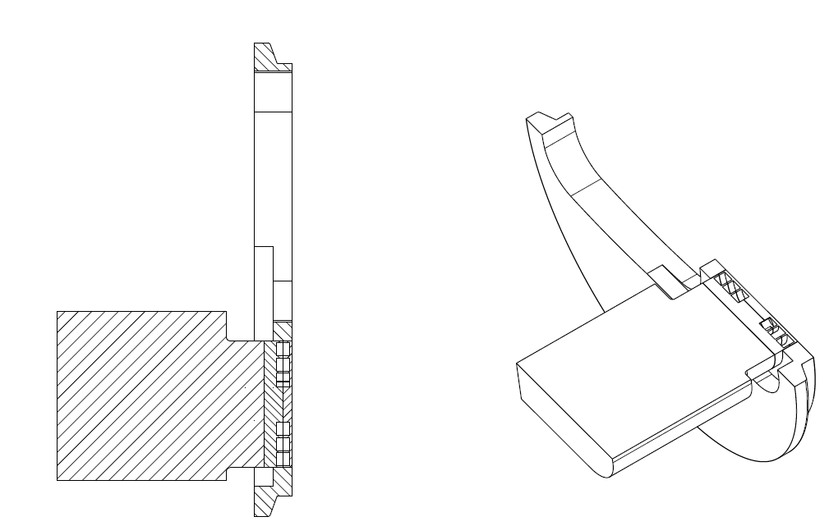
Support (baseline)
Fixation by brazing:
Detailed design starting soon with EN/MME.
Stainless Steel Flange
Brazed part
Mo piece
Cooling channels
SiC dump
In this case, the support and the cooling are guaranteed by the brazing.

Slide 10
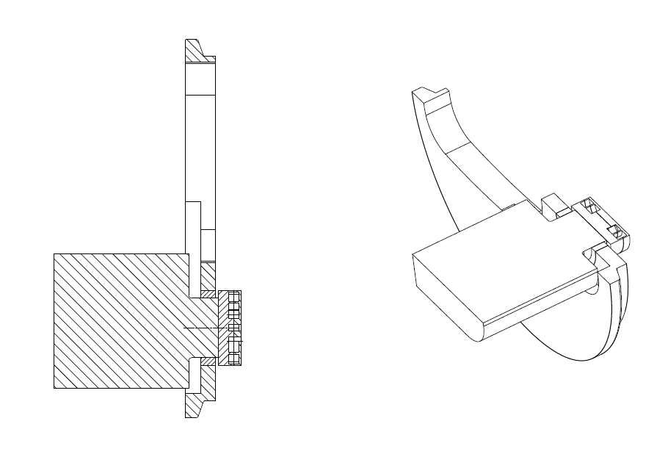
Support (back-up solution)
Fixation by shrinking:
A clamping system would be positioned behind the Cu piece to press it onto the SiC dump.
Stainless Steel Flange
Shrinking
Cu piece (clamped)
Cooling channels
SiC dump
In this case, the support is ensured thanks to the shrinking and the cooling is ensured by the Mo piece.
Shrinking ring

Slide 11
Numerical results

Slide 12
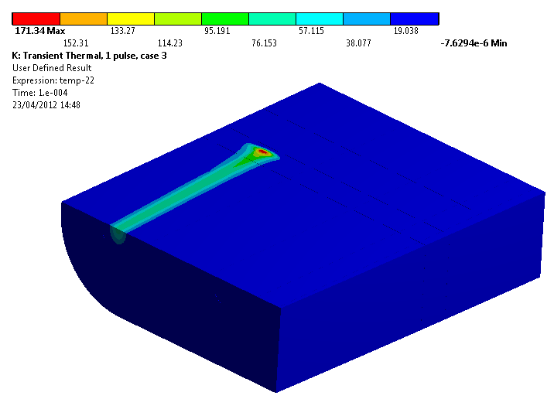
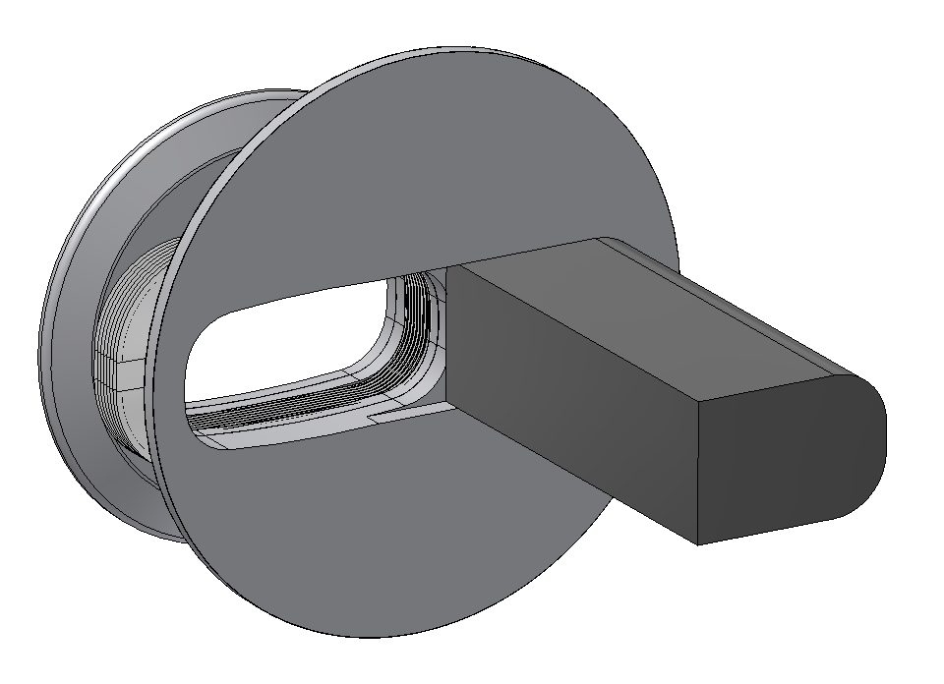
Instantaneous ∆T - SiC
Case 3
Half dump BOTTOM view, T due to 1/4 Linac4 pulse (3)
H- beam
33mrad
Service Temperature = 1900 °C

Slide 13
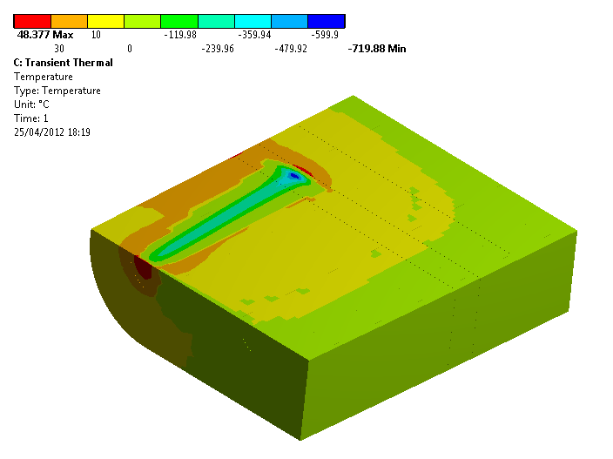
Instantaneous eq. Stassi – SiC
Case 3
Fixed support from the back.
Half dump BOTTOM view, T due to 1/4 Linac4 pulse (3)
H- beam
33mrad
Static Limit in tension: 390 Mpa Safety factor _{tension}: 7.9
Static Limit in compression: 3900 Mpa Safety factor _{compression}: 5.1

Slide 14
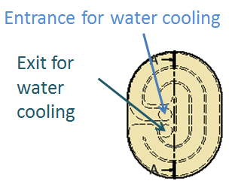
Steady operation - SiC
Water outlet
Active cooling zone
Water inlet
Analysis done considering the ceramic chamber geometry. Results should remain similar with the Inconel chamber.

Slide 15
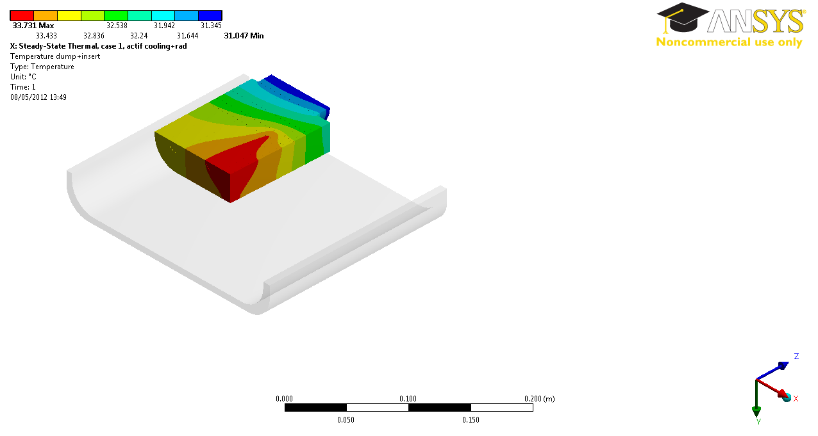
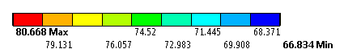
Steady operation - SiC
Case 1
Half dump BOTTOM view, T due to steady-state operation
Case 2
Circulating H+ beam
H⁰ beam
T acceptable for vacuum? To be confirmed.
Contact for brazing considered as perfect!

Slide 16
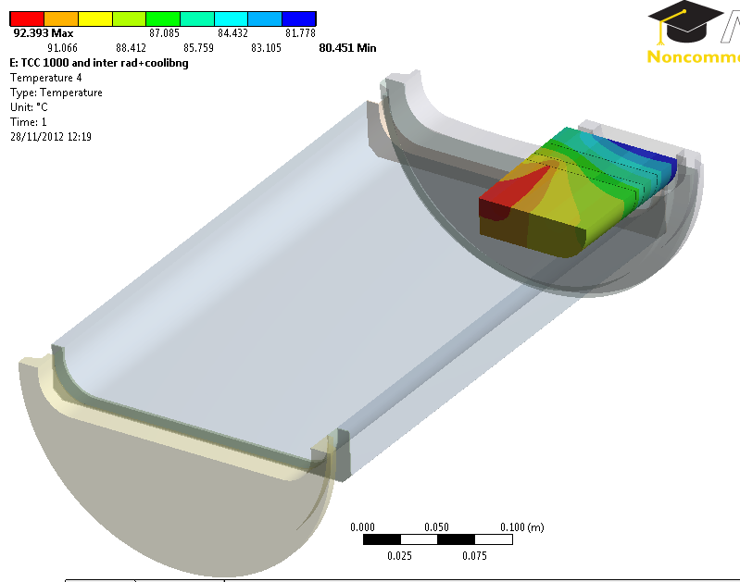
Steady operation - SiC
Half dump TOP view, T due to steady-state operation
Contact for brazing considered as not perfect (TCC=1000 W/m².K)
For comparison, TCC for brazed jaws for collimators in two different type of Cu:
10 000 W/m².K
T acceptable for vacuum? To be confirmed.

Slide 17
Brazing tests

Slide 18
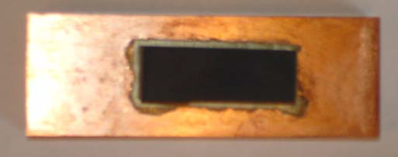
Brazing tests
The brazing between the dump core and the metallic insert should allow:
The dump to be supported (totally or in part),
The good heat exchange for an efficient cooling.
Brazing tests already have been conducted at CERN to braze SiC with Copper (2009, EN/MME, N. Mariani et all):
 | Echantillon 1 | Echantillon 2
Cu | 65*50*12 mm³ | 55*20*12 mm³
SiC | 40.5*24.7*8 mm³ | 24.7*9.6*8 mm³
“big” size
“small” size
In both cases: Ag-Cu-Ti brazing alloy used (840 °C).
Similar (smaller) than our case

Slide 19
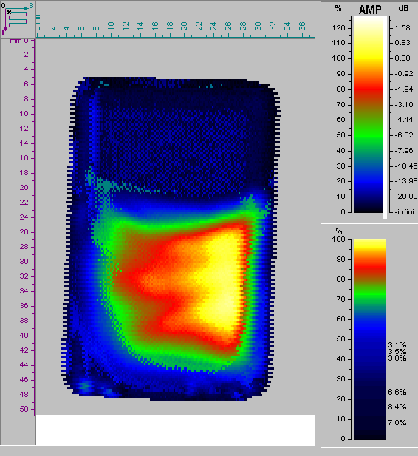

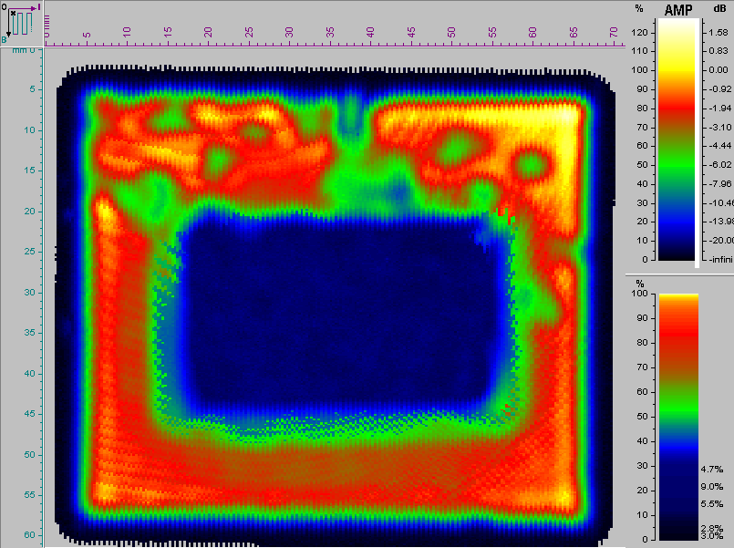
Results “big” size
Visual inspection
Cracking visible of SiC and propagation in 55% of the material.
Ultrason
Joint braze -> OK except on sides
Ultrason

Slide 20
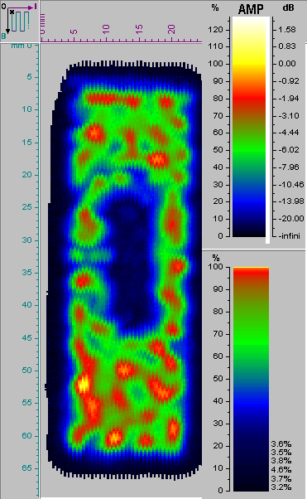
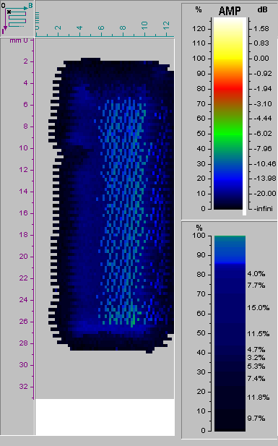
Results “small” size
Ultrason
Ultrason
Joint braze -> OK
No cracking visible on SiC.
Even thought the CTE of SiC and Cu are different, a joint braze is possible with “small” size (25*10 mm² for SiC)

Slide 21
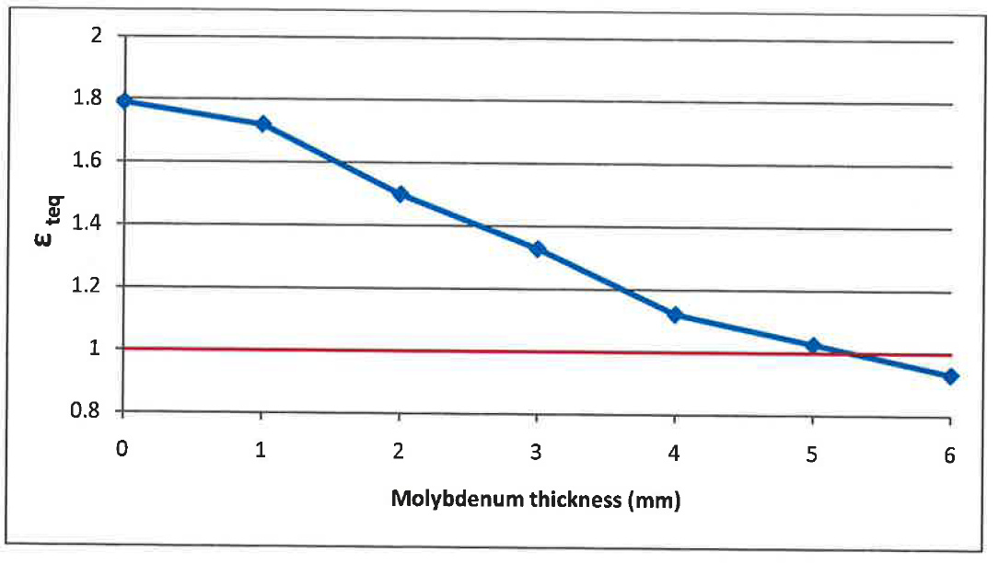
Brazing test: numerical results
Analysis with Molybdenum and copper.
Size for Mo sample: 40*20*10+ t mm³ (similar to “big size” one).
Our case: thickness=30 mm
Failure
Safe
2009 results were OK for small size for Cu/SiC but shown breaking for big size.
There are planning good results for Mo/SiC.
Sources: FEM Modeling of Phase II Collimators Jaw’s SiC inserts for brazing Tests – N. Mariani

Slide 22
New brazing test
For this project, a campaign of tests has been started:
Vacuum tests
Brazing tests
Characterization of material tests
Our baseline uses Mo (better than Cu for SiC brazing). Study in collaboration with EN/MME.
Choice of the company for the samples of SiC:
Able to provide the final piece
Properties of the different SiC
Price
ESK

Slide 23
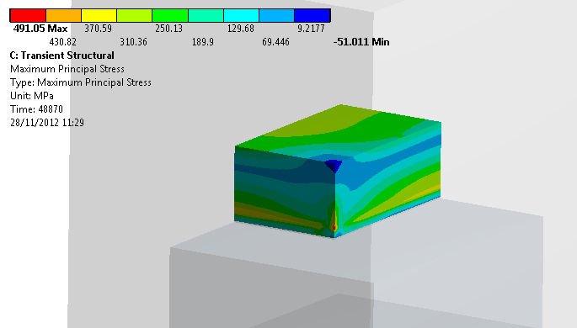
Brazing test: numerical results
Benchmark of 2009 tests (Cu-SiC, 2009 sizes)
Crack initiation
Propagation
Tensile Strength SiC: 250 MPa

Slide 24
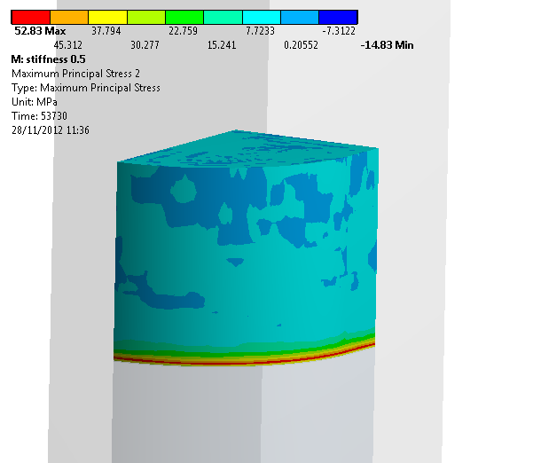
Brazing test: numerical results
Preliminary results.
New size (dump size)
Limit in tension for SiC: 250 Mpa:
Safety Factor: 4.8.
To be confirmed with appropriated properties for brazing alloy.

Slide 25
Next steps and conclusion

Slide 26
Conclusion & next steps
Vacuum tests to be done (samples received)
Brazing tests to be performed (SiC samples received, Mo samples to be delivered)
Dynamic analysis
Cooling circuit integration
Integration of beam instrumentation

Slide 27
Thanks for your attention

Slide 28
Backup slides

Slide 29
Material considerations
From specification EDMS 1069240, the material should:
Be completely non-magnetic
Induces little eddy current
Be at least slightly conductive (to not electrically being charged)
Ceramic materials are considered as good candidates.
8 ceramics were individuated:
Graphite (CNGS/TDE)
Boron Nitride (TDI)
Boron Carbide
Alumina (used for the ceramic chamber)
Aluminum Nitride
Al300 (97,3% of Alumina)
Silicon Nitride
Silicon Carbide

Slide 30
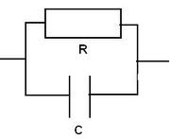

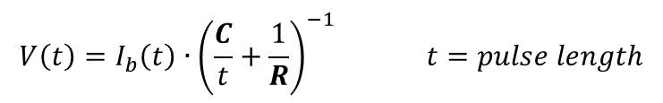
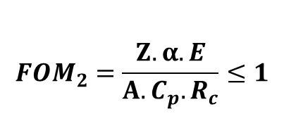

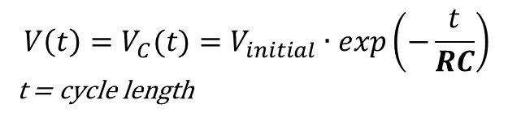
Material considerations
Thermal consideration:
Mechanical consideration:
$${FOM}_{2}=\frac{Z.α.E}{A.C_{p}.R_{c}}≤1$$
${FOM}_{1}=\frac{T^{∗}}{T_{c}}≤1$
Electrical consideration:
Beam Charge: parallel RC model
NO Beam Discharge: series RC model
$$V\left(t\right)=I_{b}\left(t\right)∙{\left(\frac{C}{t}+\frac{1}{R}\right)}^{−1} t=pulse length$$
$${V\left(t\right)=V}_{C}(t)=V_{initial}∙exp\left(−\frac{t}{RC}\right)$$
t = cycle length

Slide 31
Material considerations
Only Graphite and Silicon Carbide fulfill the electrical requirements BUT graphite is bad for vacuum.

Slide 32
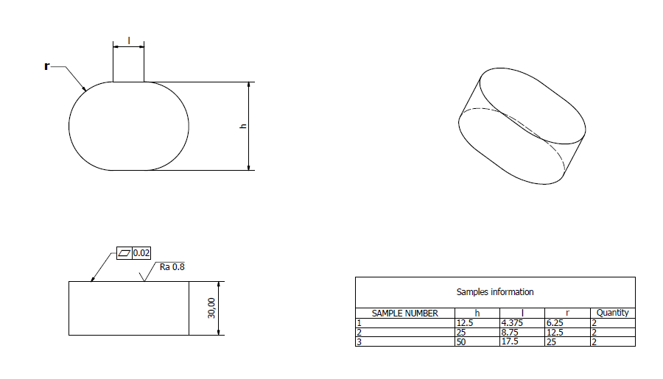
Brazing test
Sample dimensions:
2 samples of each dimensions and each SiC type + 4 samples of each dimensions for Mo:
12 samples of SiC,
12 samples of Mo.

Slide 33
Brazing test
For this project, a campaign of tests has been started:
Vacuum tests
Brazing tests
Characterization of material tests
First step: choice of materials for metallic part:
CTE as close as possible from the SiC one (to minimize cracking risk when cooling down after brazing)
Thermal conductivity to be maximize (for an efficient cooling)
Chosen material: Molybdenum

Slide 34
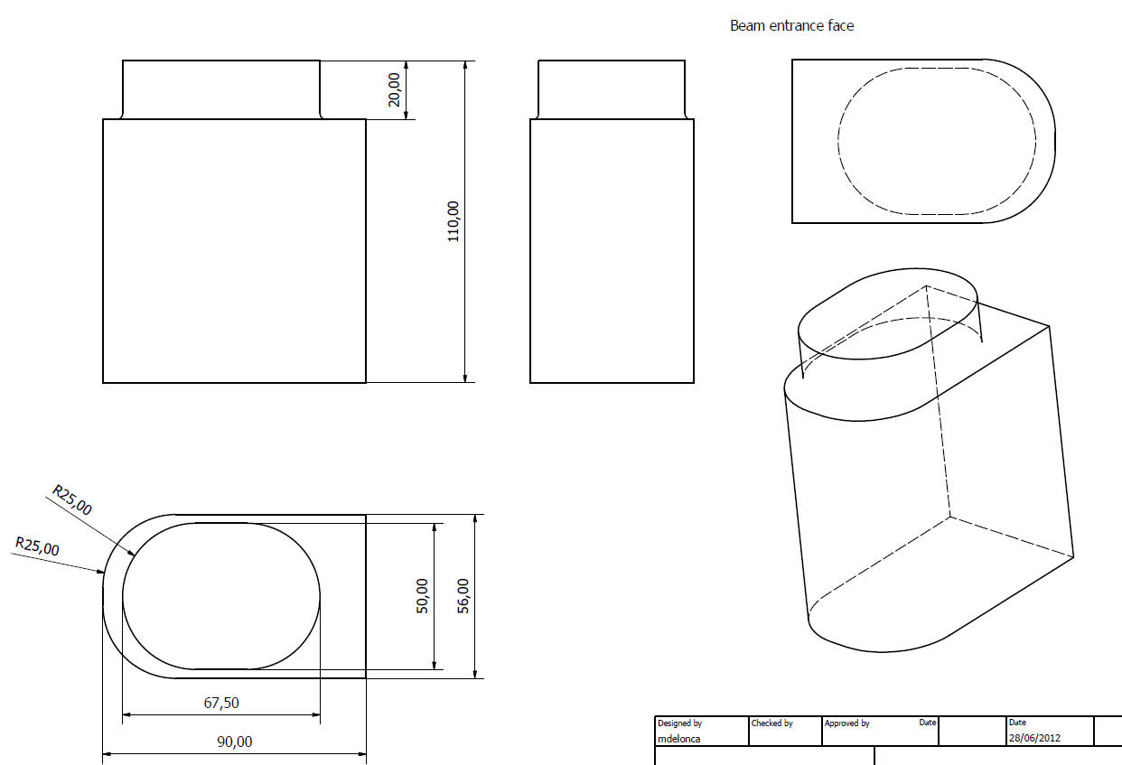
Brazing test
Second step: choice of company producing the SiC:
Able to produce the final part with the required dimensions and specifications

Slide 35


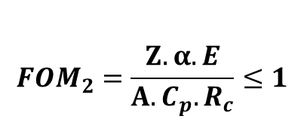
Brazing test
$${FOM}_{2}=\frac{Z.α.E}{A.C_{p}.R_{c}}≤1$$
${FOM}_{1}=\frac{T^{∗}}{T_{c}}≤1$
$$Electrical$$
$$considerations$$

Slide 36
Brazing test
Second step: choice of company producing the SiC:
Price for sample order
Companies able to provide dump piece:
ESK
EkaSiC G
EkaSiC T
St Gobain
2 samples of each dimensions and each SiC type (ESK SiC only)

