Slide 1
BISMV & H₀-H⁻ psb injection
VACUUM REQUIREMENTS
C. Pasquino, P. Chiggiato, J. Hansen

Slide 2
Outline
BISMV vacuum layout;
Graphite outgassing tests;
Simulation results;
PSB injection vacuum layout;
Simulation results;
SiC outgassing rate measurements;
Conclusions and actions.

Slide 3
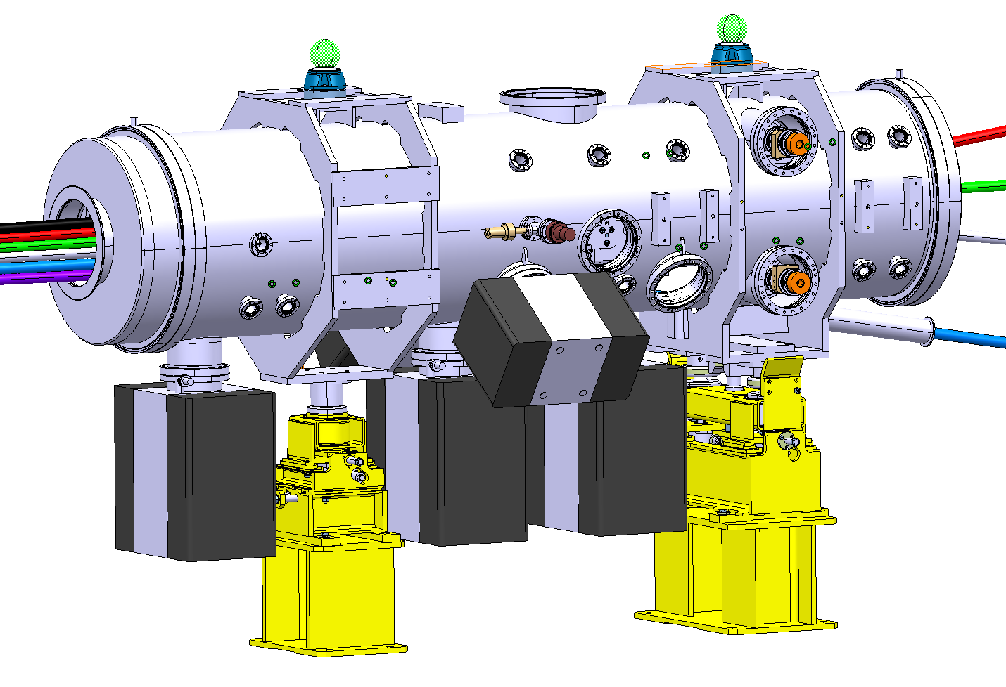
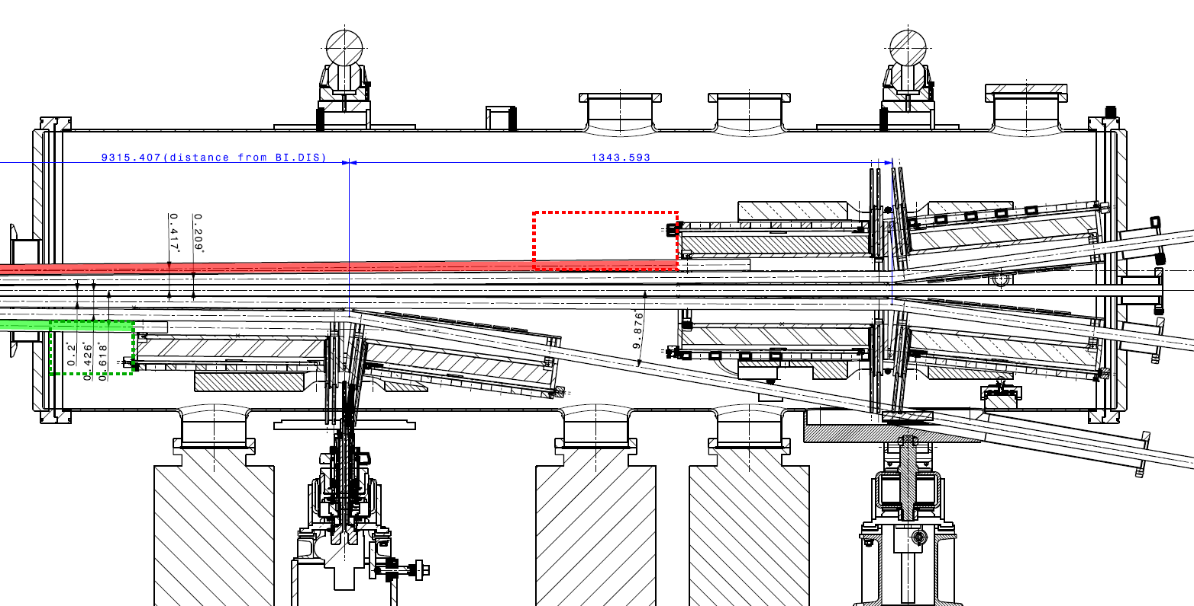
BISMV – vacuum layout
3 Sputter Ion pumps Starcell 500
2 Sputter Ion pumps Starcell 300

Slide 4
Bismv – gas loads
Unbaked tank = water vapor outgassing
Graphite dumps:
thermal outgassing
Magnets outgassing, measured by I. Wevers (EDMS 1097059)

Slide 5
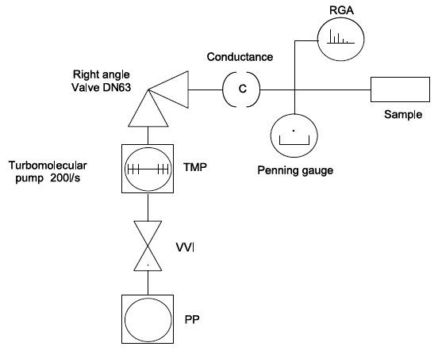
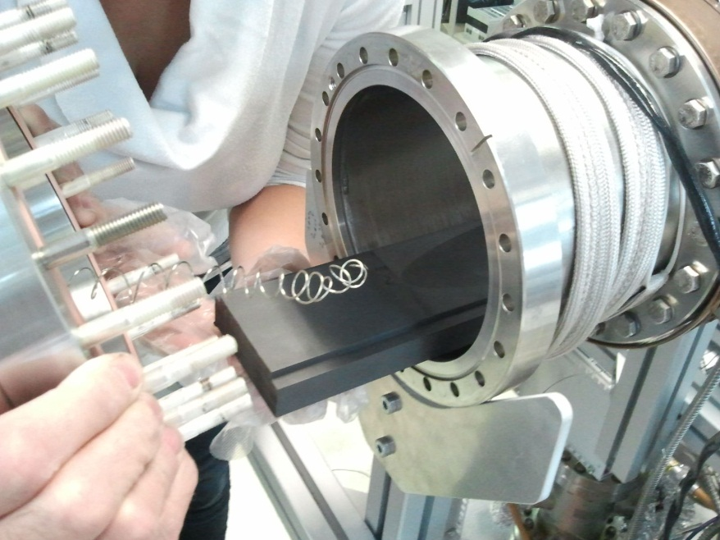
Graphite outgassing test: pumpdown and thermal outgassing
R4450 LHC collimator graphite
Furnace treatment, 2 hours at 950 ◦C
Bakeout ≈ 24 hours at 200 ◦C
Measurement procedure:
Pumpdown of 24 hours
Bakeout
Step of ∆T = 25 ◦C from room temperature to 200 ◦C
Same procedure is followed for the background signal measurement.
In a second measurement campaign a thermocouple was inserted directly to the graphite block to check the effective temperature reached by the latter.

Slide 6
Graphite outgassing test: pumpdown
1st time: | A few hours only after the vacuum firing treatment;
2nd time: | Following the first measurement and 24 h exposure to the lab air;
3rd time: | Following the second measurement and weeks of exposure to lab air.
Outgassing at 10 hours of pumpdown
The more the graphite is exposed to air the more it outgas.
1st and 2nd measurement | ≤4*10⁻¹⁰ mbar l/s cm²
3rd measurement | 2*10⁻⁰⁹ mbar l/s cm²
EDMS DOCUMENT : 1254422

Slide 7
Graphite outgassing test at different temperatures
Equivalent to 2500 cm² of SS at RT
TEMPERATURE
with BG subtracted
Thermal outgassing at 200 ◦C is 4 orders of magnitude higher than at 50 ◦C
PRESSURE

Slide 8
Electrical network – vacuum analogy simulations
+
P _{tot} = 3*10⁻⁹ mbar
+
P _{tot} = 1*10⁻⁸ mbar
Water vapor outgassing at 100 hours of pumpdown;
Outgassing at 50 ◦C and at 200 ◦C from the graphite;
H₂ outgassed from the bulk metal & magnets;
Scrapers or pickups are calculated as equivalent to a dump outgassing
NO HEATING OF THE SURROUNDING CONSIDERED.

Slide 9
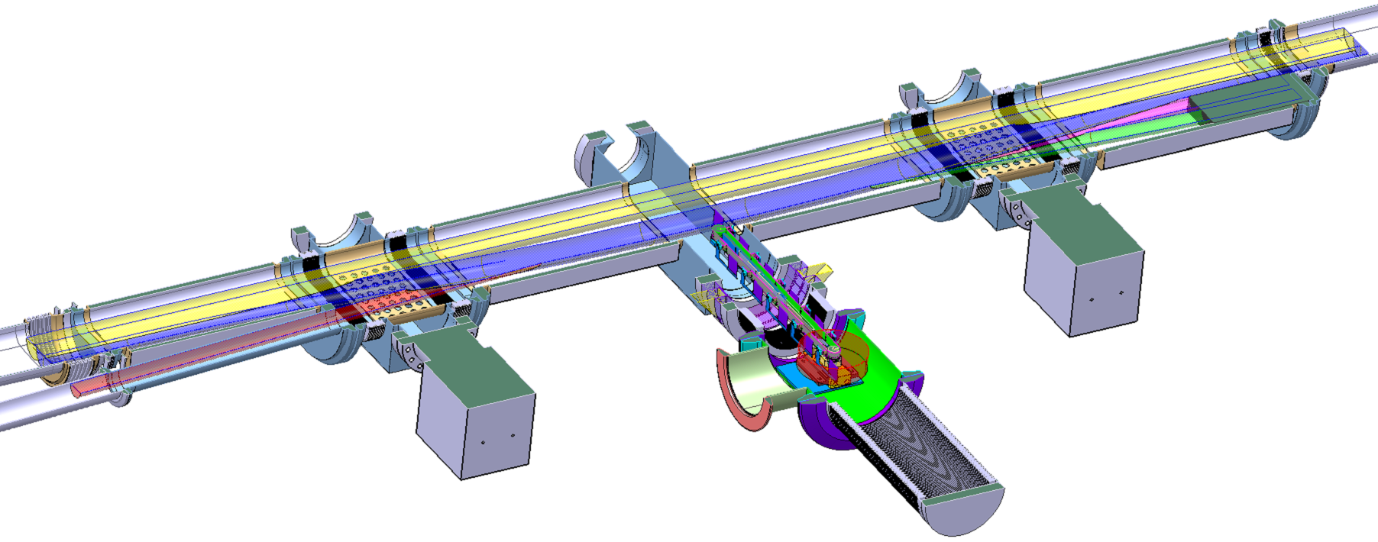
PSB H- Injection: vacuum layout
Gate Valve
RF shield
PSB ring
Internal dump
SIP 2
Linac 4 H-
SIP 1
Stripping foil

Slide 10
Electrical network – vacuum analogy simulations
Ptot = 3*10⁻⁹ mbar
H₂O driven
If the graphite is treated at the furnace, baked and actively cooled (50 ◦C) the 75 l/s SIP can cope with this extra gas load.
H₂ driven
Ptot = 6*10⁻⁹ mbar
Water vapor outgassing at 100 hours of pumpdown;
Outgassing at 50 ◦C and at 175 ◦C from the graphite;
NO HEATING OF THE SURROUNDING CONSIDERED.

Slide 11
SiC outgassing rate measurements: pumpdown
EkaSiC T plus and EkaSiC G tested in pumpdown:
No cleaning
No heat treatment
Tested as received (vacuum fired by the company?)
It outgasses as a metallic surface!
No difference between the two different grades.

Slide 12
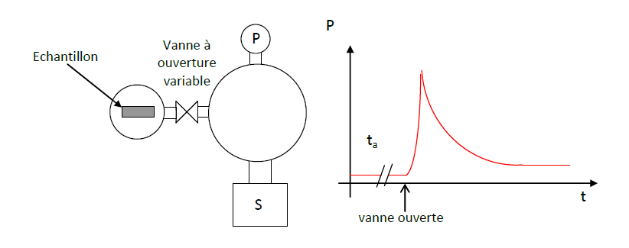
SiC outgassing rate measurements: accumulation measurements 1/2
After a bake-out at 150 ◦C, the system is cooled down at room temperature: the variable leak valve is closed in order to isolate the sample from the system.
It is possible to measure the outgassing as a function of the heating temperature.
The evaluation of the background is mandatory.

Slide 13
SiC outgassing rate measurements: accumulation measurements 2/2
Degassing values at room temperature (20 ◦C) with BG subtracted!
 | Q H₂ | Q CH₄ | Q CO | Q CO₂
 | Torr l/s cm² | Torr l/s cm² | Torr l/s cm² | Torr l/s cm²
EkaSiC G | 1.2*10⁻¹³ | 1.7*10⁻¹⁵ | 3.5*10⁻¹⁵ | 9.9*10⁻¹⁵
We are background limited…
By heating the sample, we can evaluate the outgassing as function of different heating temperatures: the last heating steps on the EkaSiC G are on-going.
The evaluation of the background as function of the heating temperature is needed to calculate the samples outgassing..

Slide 14
Conclusions and actions
The BISMV and the PSB H – injection area have been considered from the vacuum point of view;
The R4450 graphite outgassing has been tested at different temperatures from room temperature up to 200 ◦C;
The results of the simulations show that the graphite is compatible with UHV systems only IF:
Vacuum firing at 950 ◦C for 2 hours;
In – Situ bake out at 200 ◦C for 24 hours;
Working temperature of the graphite block T = 50 ◦C.
Outgassing rate measurements of the SiC are on going but from the very first results, it looks very promising for UHV applications.

