Slide 1
RP Status for the PSB Injection Dumps
R. Froeschl

Slide 2
Head Dump - Inputs
Load assumptions from EDMS 963395
Operational year has 2 phases
LLRF setup
max. 1 week at the beginning of the operational year
278e10 pps
Normal operation
17e10 pps
Geometry
Drawings from Thierry Masson
Dump core made out of Graphite
Magnet implemented
Water cooling circuit only very schematic

Slide 3
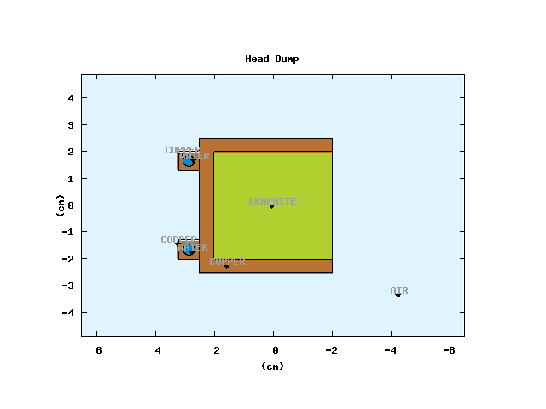
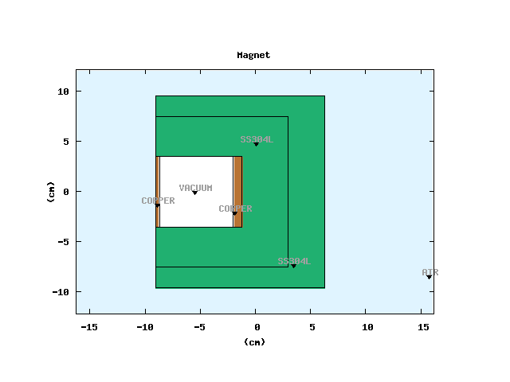
Head Dump - Geometry
Dump
Magnet

Slide 4
Head Dump - FLUKA simulations to estimate
Decrease of dose rate with time for 2 scenarios
At the end of the LLRF setup week
At the end of the operational year
Two time horizons
< 7days
to estimate interventions in the tunnel
< 2 years
to estimate repair after removal from the tunnel
Validate material choice

Slide 5
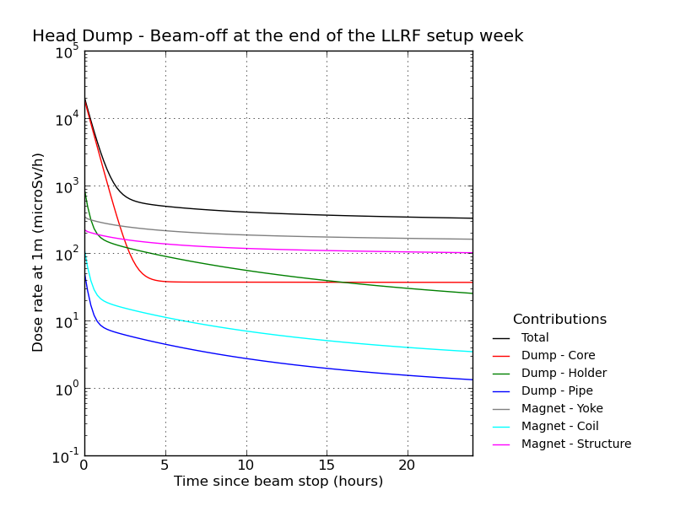
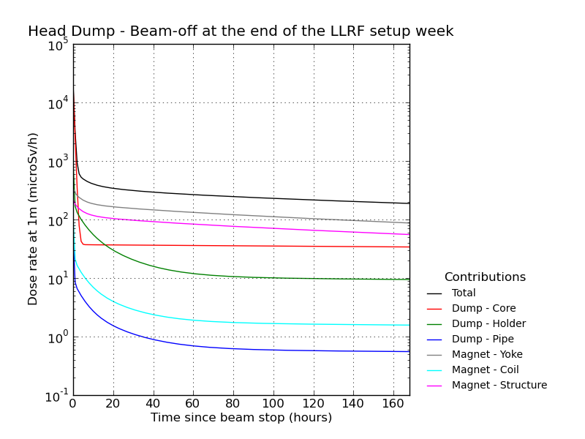
Head Dump – Interventions Stop at end of LLRF week

Slide 6
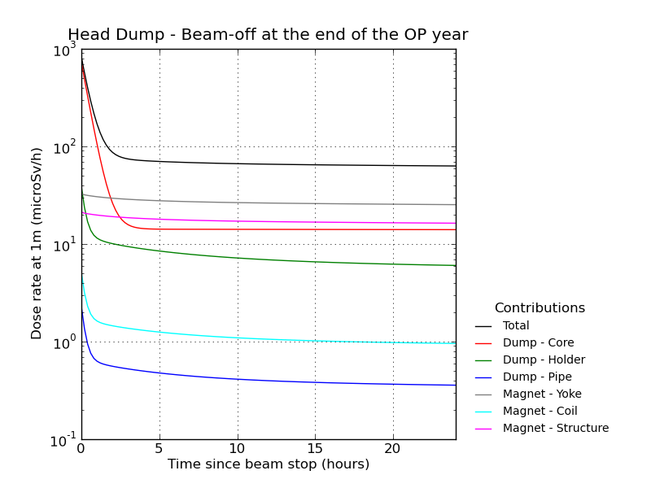
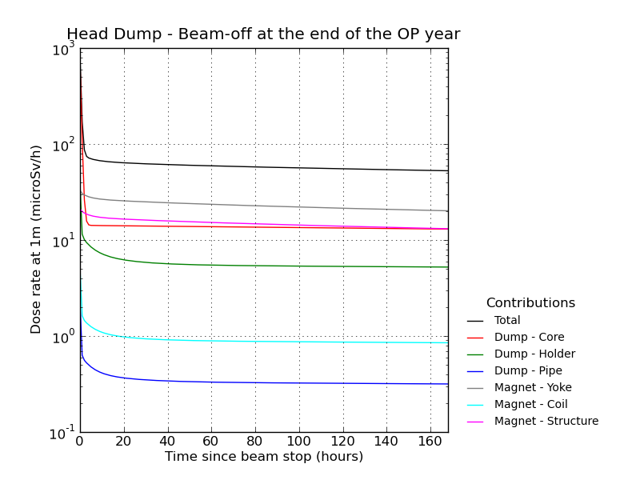
Head Dump – Interventions Stop near end of operational year

Slide 7
Head Dump - Interventions
After 3 hours, the magnet is the dominant source of radiation
Decrease of dose rate slows down significantly after 3 hours
Waiting time before access of 3 hours seems reasonable
Expected dose rate at 1m
less than 700 µSv/h (LLRF week)
Should clarify whether the LLRF setup has to be done with the full current stated in EDMS 963395
less than 100 µSv/h (normal operation)

Slide 8
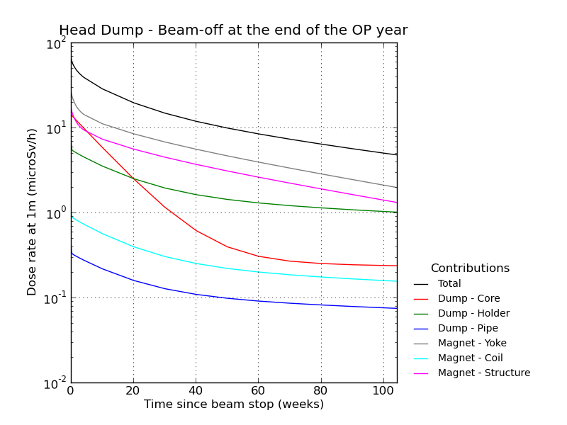
Head Dump – Repair Stop near end of operational year
Contribution of the dump core for repair after removal from the tunnel is small compared to the yoke
Graphite is a good choice from an RP point of view

Slide 9
Head Dump - Water activation
Tritium production
4.6 kBq/year (LLRF setup week + normal operation)
Be-7
Still to be assessed, no show-stopper expected due to low tritium production level
Short lived activation products
Still to be assessed , no show-stopper expected due to low tritium production level

Slide 10
H⁰/H⁻ Dumps - Inputs
Load assumptions from EDMS 963395
Continuous load
9.61e18 H⁻/y at 14.2 W
Foil degradation
max. 8 hours for about 10 times per operational year
7.99e17 H⁻/y at 71 W
Geometry
FLUKA geometry from C. Maglioni
Dump core made out of SiC
Magnet implemented
No water cooling circuit implemented yet

Slide 11
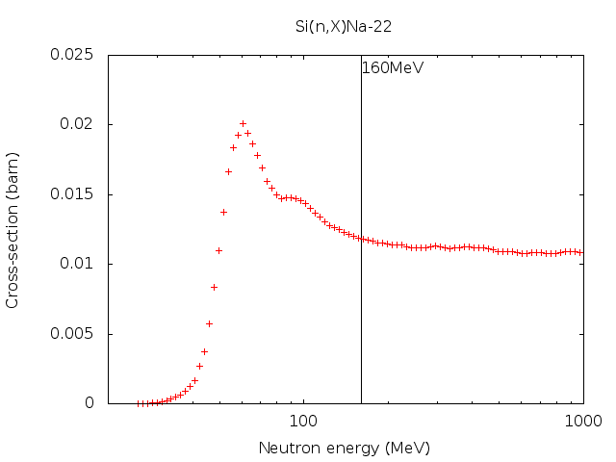
H⁰/H⁻ Dumps – Production of Na-22 from Si
Dominant radionuclide after first operational year even for 1 day cool-down
3.7 GBq
1.23 mSv/h @ 1meter
Factor 6 higher than the magnet (Mn-54)
Half-life of 2.6 years
511 keV(180%)
1274 keV (99.94%)

Slide 12
H⁰/H⁻ Dumps – Future studies
Scenarios with dumps inside the magnets
Intervention scenarios
Additional shielding
Scenario with dumps extracted from the magnets
Water cooling

Slide 13
Conclusions
Head Dump
H⁰/H⁻ Dumps
Graphite is a well suited material for the dump core from an RP point of view
After 3 hours dose rates dominated by the magnet and not by the dump
Tritium production very low
Connection to the (then) underground PSB water cooling circuit should be ok
Dump core is the dominant contributor to the dose rate
Na-22 (half-life 2.6 y) is the dominant radionuclide
Up to a couple of mSv/h at 1 meter distance if unshielded
Shielding options as a function of intervention/removal scenarios to be studied
Water cooling to be studied

