Slide 1

TOTEM luminosity independent cross section measurements
Elastic cross sections
LHC optics estimation
Frigyes Nemes
Eötvös University
on behalf of the
TOTEM collaboration
http://totem.web.cern.ch/Totem/
Low-x Workshop, Paphos
2012, 27 June – 1 July

Slide 2
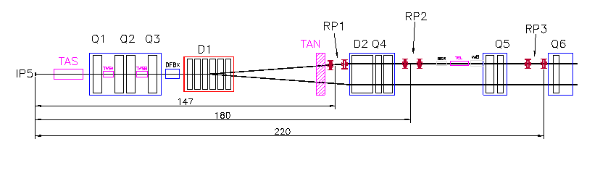
Experimental layout of the TOTEM experiment
T1: 3.1 < η < 4.7
T2: 5.3 < η < 6.5
T1
10.5m
T2
CASTOR (CMS)
14m
RP147
RP220

Slide 3
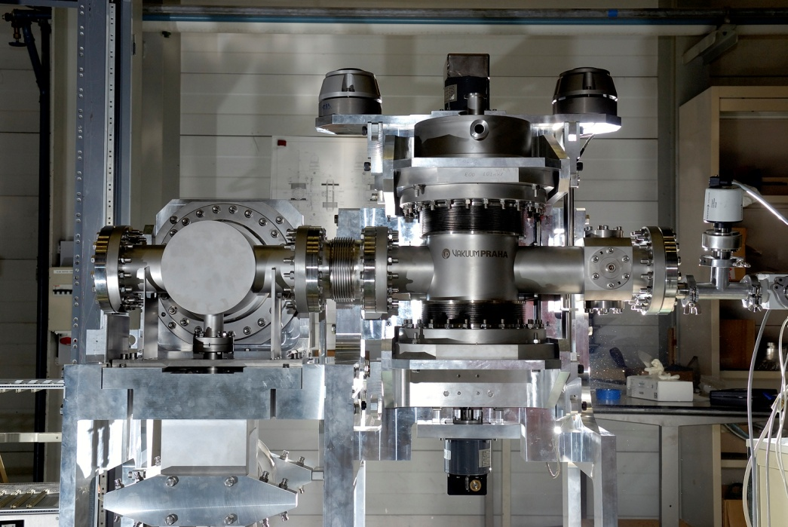
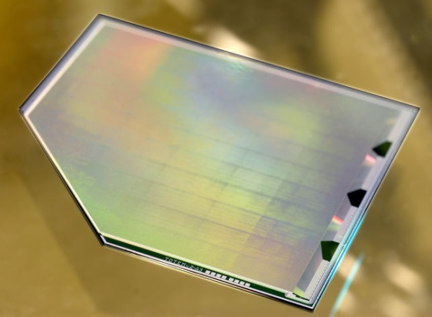
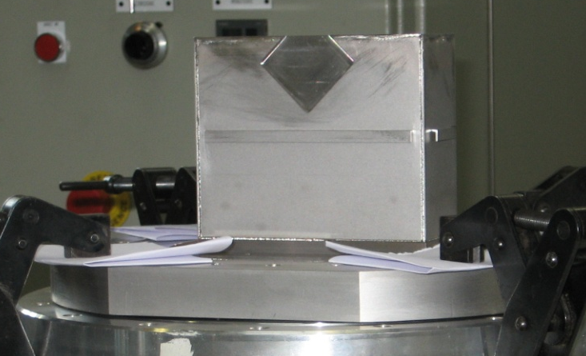
Roman Pot stations
RP stations
2 units at about 5 m distance
Measurement of very small proton scattering angles (few µrad)
Vertical and horizontal pots mounted as close as possible to the beam
BPM fixed to the structure gives precise position relative to the beam
Overlaping detectors: relative alignment
(10 µm inside unit between 3 RPs)
RP unit: 2 vertical, 1 horizontal pot + BPM
Horizontal RP
Vertical RPs
BPM
3.5 cm
10 planes of edgeless detectors
Si edgeless detector
1 Roman Pot

Slide 4
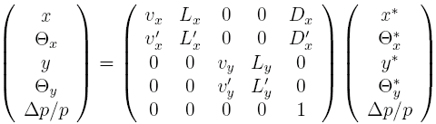
LHC optics in brief
Proton position at a given RP (x, y) is a function of position (x*, y*) and angle (Θ_{x}*, Θ_{y}*) at IP5:
measured
reconstructed
RP
IP5
The effective length and magnification expressed with the phase advance
Beam size and divergence at IP5 and RP
describes the spread of primary vertex and beam size at RP
beam divergence @IP5 limits the angle measurement precision

Slide 5
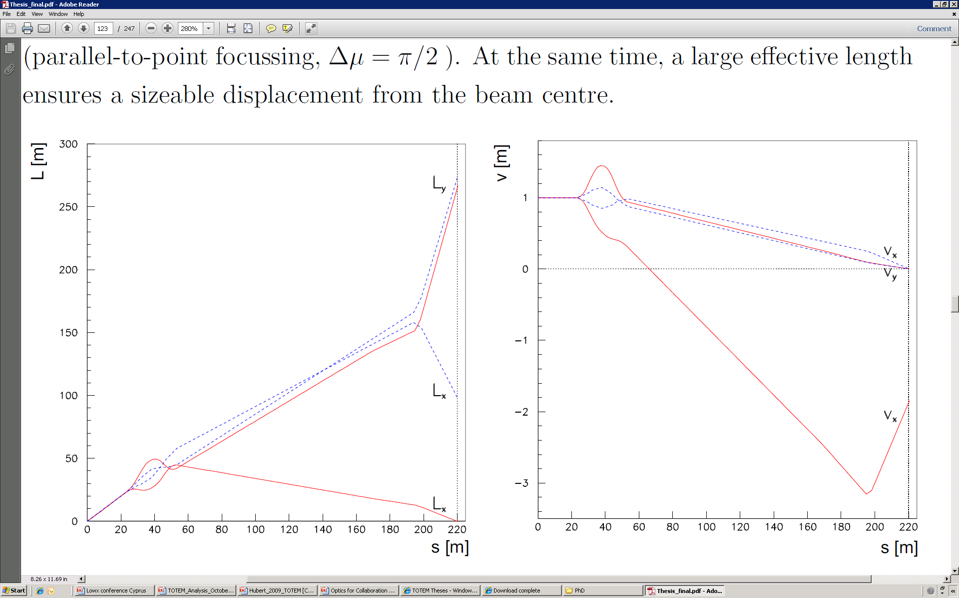
High β*=1535 m target optics
β* = 1535 m is the target optics. Requires different injection optics. Properties:
beam divergence σ_{Θ*} ≈ 0.3 μrad, vertex size σ_{IP} ≈ 450 μm
Δμ_{x,y} = π/2 → ν_{x,y} = 0. Parallel-to-point focusing eliminates the large vertex contribution
the large (270 m) vertical effective length L_{y} pushes protons vertically into RP acceptance
acceptance in momentum transfer, |t| > 2 · 10⁻³ GeV², with 10 σ_{beam size@RP}
Effective lengthsfrom IP5 to RP @220 m
Magnification from IP5 to RP @220 m
β*=90 m
β*=1535 m
β*=1535 m

Slide 6
LOW β*=3.5 m OPTICS

Slide 7
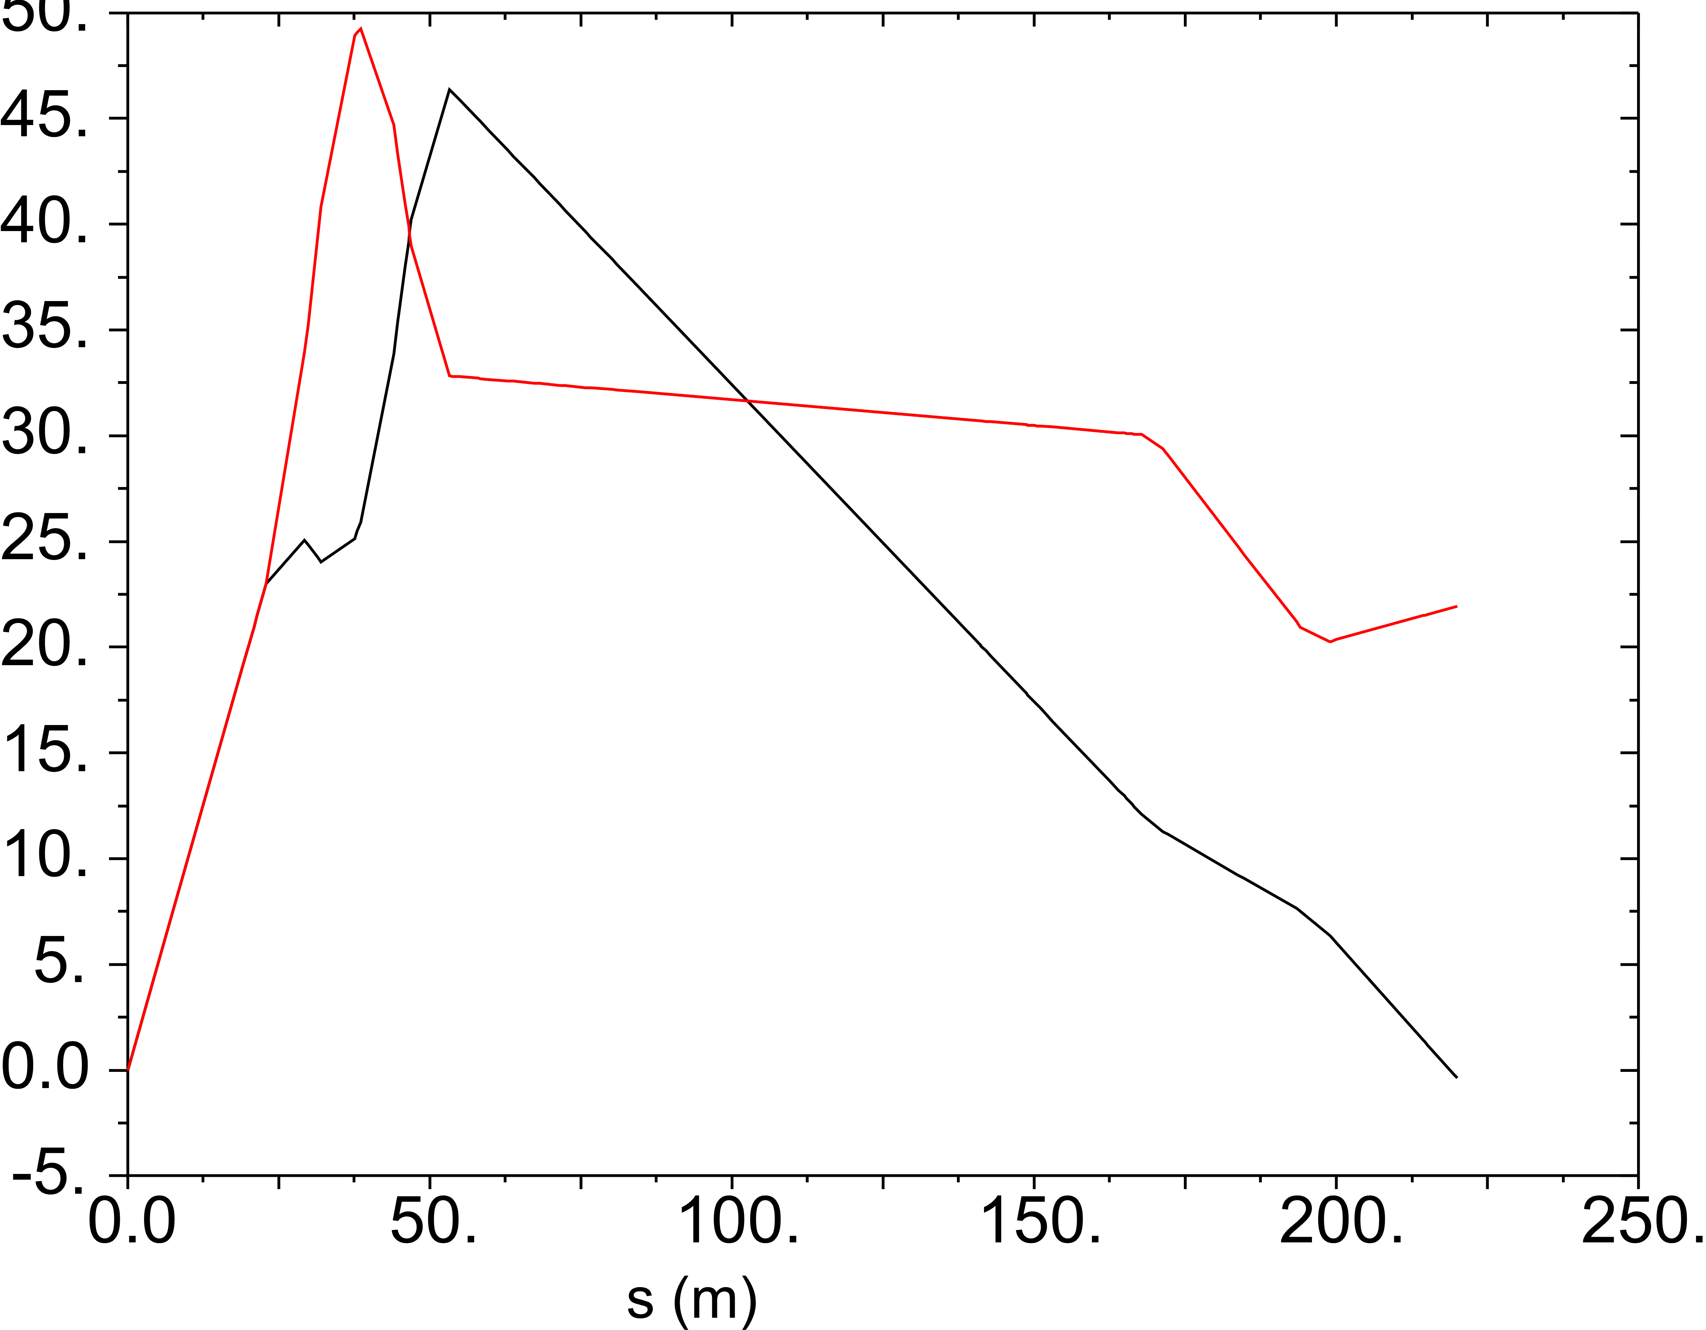
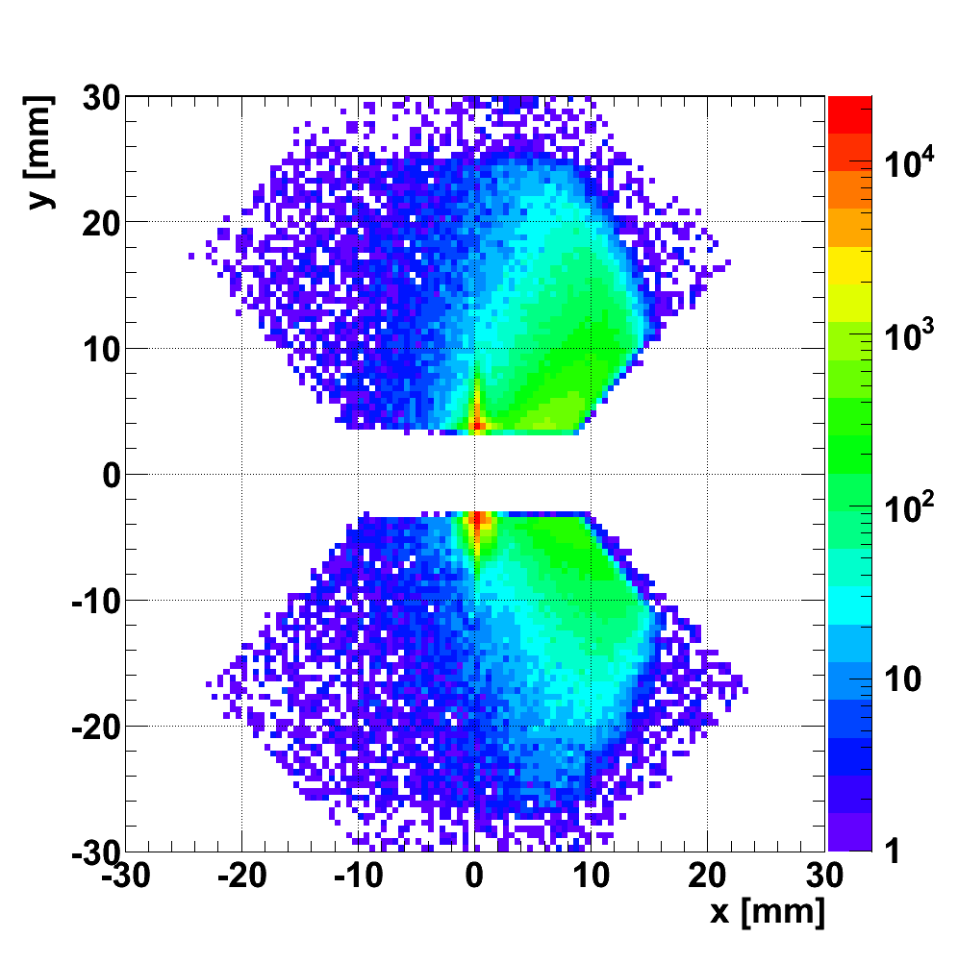
Low β*=3.5m optics
Objective:
    to measure elastic scattering at high |t|
Properties of the optics:
σ_{IP} ≈ 37 μm (magnification is not crucial)
L_{x} ≈ 0, L_{y} = 22.4 m
beam divergence σ_{Θ*} ≈ 17-18 μrad
Data sources to improve our optics
understanding:
TIMBER database magnet currents
FIDEL team conversion curves,
implemented with LSA
WISE field harmonics,
magnet’s displacements`
L_{y}
Effective lengths
β*=3.5 m
L_{x}
t = -p² θ²
Sector 56
Elastically scattered proton
candidates
ξ = Δp/p
The intercepts of all selected reconstructed
tracks in a scoring plane transverse to
the beam at 220 m
Sector 45

Slide 8
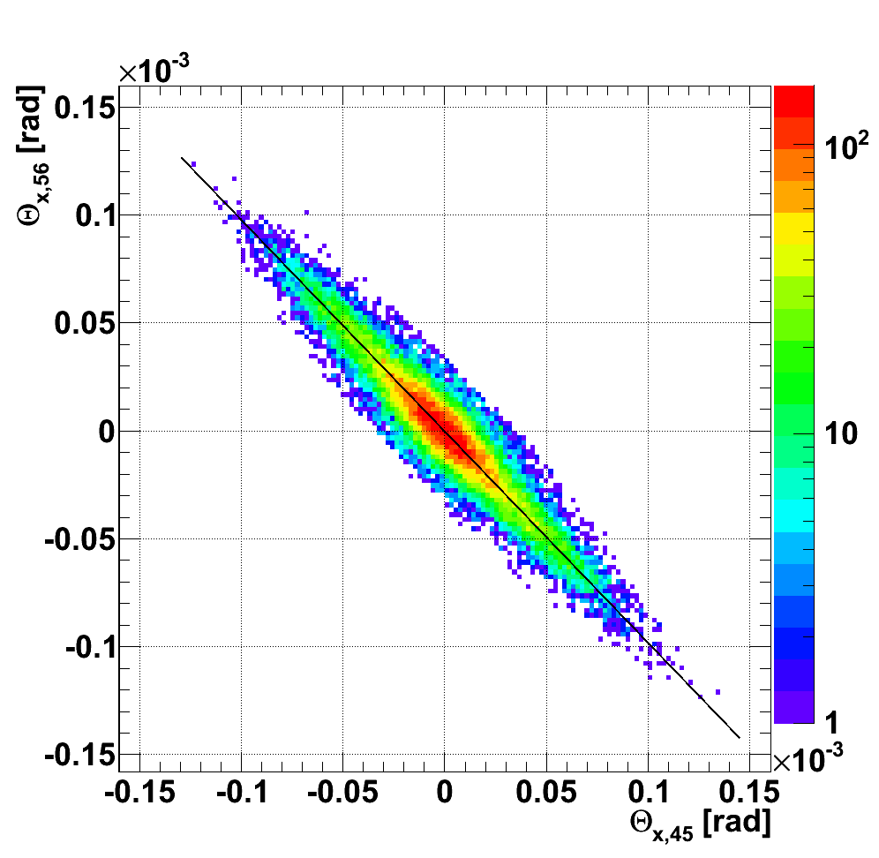
The effect of machine imperfections β*=3.5m
Machine imperfections:
Strength conversion error, σ(B)/B ≈ 10⁻³
Beam momentum offset, σ(p)/p ≈ 10⁻³
Magnet rotations, σ(φ) ≈ 1 mrad
Beam harmonics, σ(B)/B ≈ 10⁻⁴
Power converter errors, σ(I)/I ≈ 10⁻⁴
Magnet positions Δx, Δy ≈ 100 μm
Imperfections alter the optics !
Perturbed element | δL_{y,b1}/L_{y,b1} [%]
MQXA.1R5 | 0.98
MQXB.A2R5 | −2.24
MQXB.B2R5 | −2.42
MQXA.3R5 | 1.45
MQY.4R5.B1 | −0.10
MQML.5R5.B1 | 0.05
Δp/p | −2.19
Constraints from proton tracks in the Roman Pots β*=3.5m
Optics imperfections can be determined from proton
tracks measured in the Roman Pots. The method is based on:
elastic events are easy to tag
the elements of the transport matrix are mutually correlated
elastic scattering ensures that
R₁

Slide 9
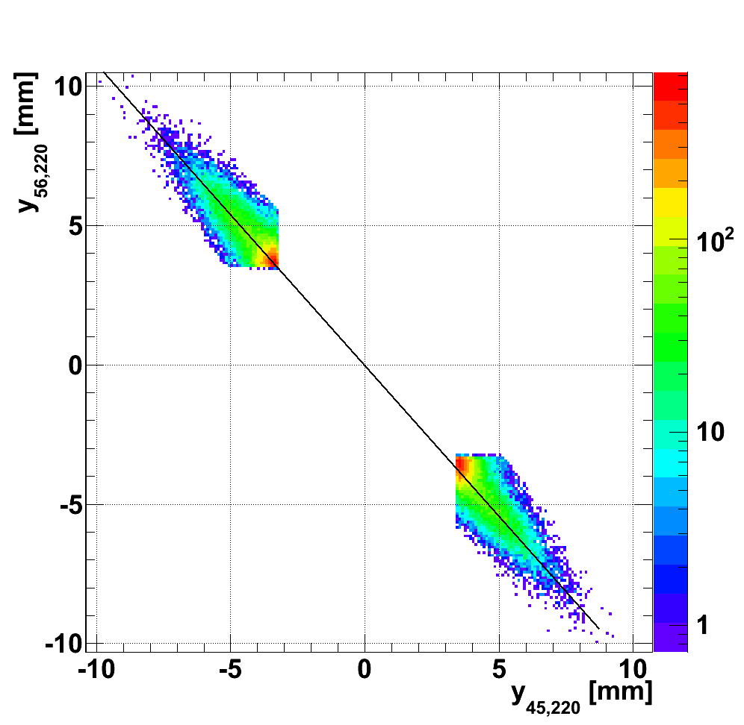
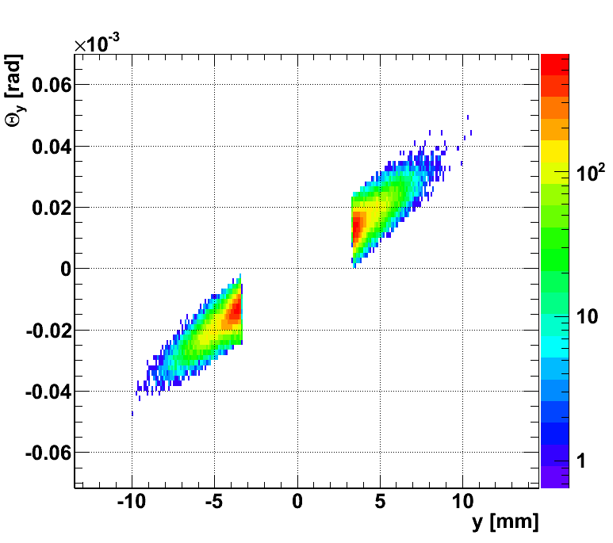
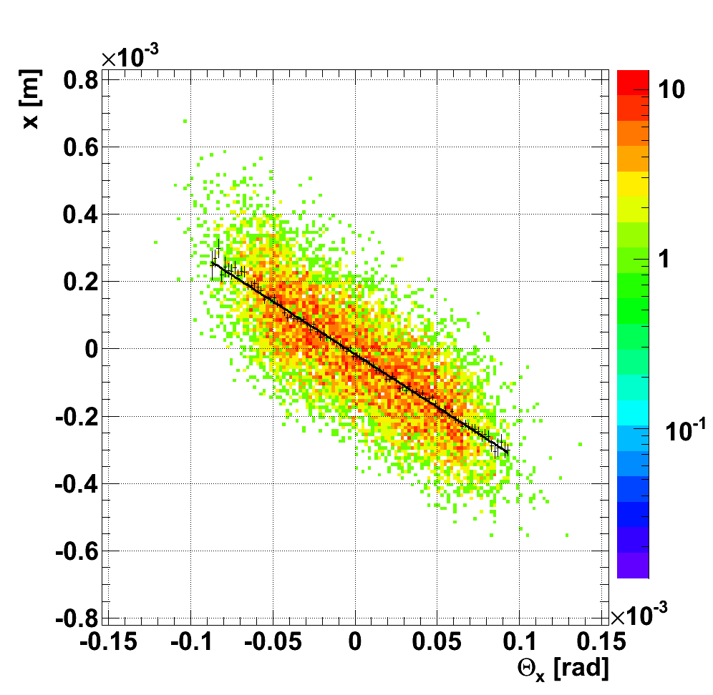
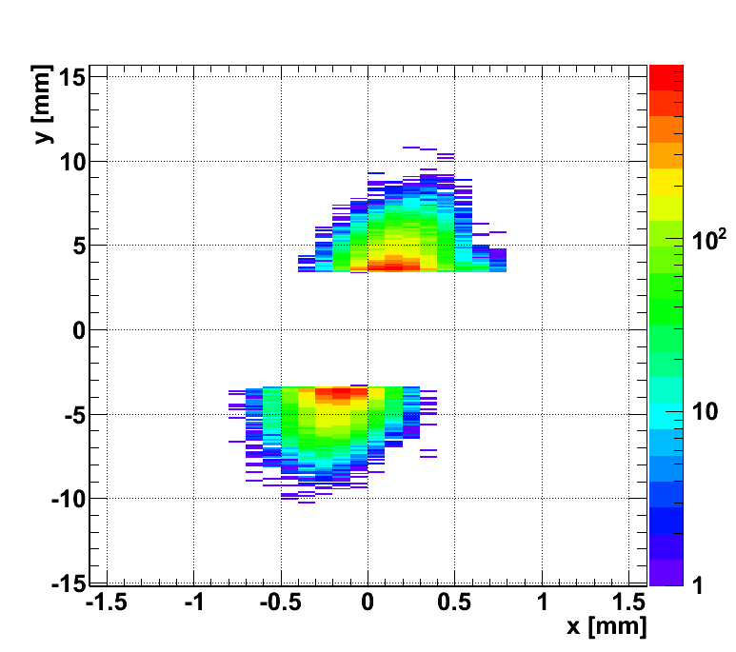
Matching the optics β*=3.5m
R₁
On the basis of constraints R₁-R₁₀ the optics can be estimated.
R₂
Calculated ratios
R₁-R₁₀
Match
Measured ratios
R₁-R₁₀
dL_{x}/ds, L_{y}
R_{3,4}
R_{5,6}
R_{7,8,9,10}

Slide 10
Monte-Carlo confirmation of the method (presented @IPAC 2012)
The Monte-Carlo study included the
effect of:
magnet strengths
beam momenta
displacements, rotations
kickers, field harmonics
elastic scattering Θ-distributions
Conclusion: for β*=3.5m TOTEM can measure the transfer matrix between IP5 and RPs with a precision
Optical function relative error | Before |  | Matched
 | Mean [%] | RMS [%] | Mean [%] | RMS [%]
δL_{y,b1}/L_{y,b1} | 0.77 | 3.0 | 5.7 · 10⁻³ | 9.9 · 10⁻²
δ (dL_{x,b1}/ds)/(dL_{x,b1}/ds) | 1.0 | 1.1 | -1.2 · 10⁻¹ | 2.1 · 10⁻¹
δL_{y,b2}/L_{y,b2} | 2.0 | 3.8 | 1.5 · 10⁻¹ | 9.5 · 10⁻²
δ (dL_{x,b2}/ds)/(dL_{x,b2}/ds) | -1.14 | 1.2 | -7.6 · 10⁻² | 2.1 · 10⁻¹
RMS < 0.2 %
Relative error distribution before and after matching

Slide 11
ELASTIC SCATTERING WITH β*=3.5 m

Slide 12
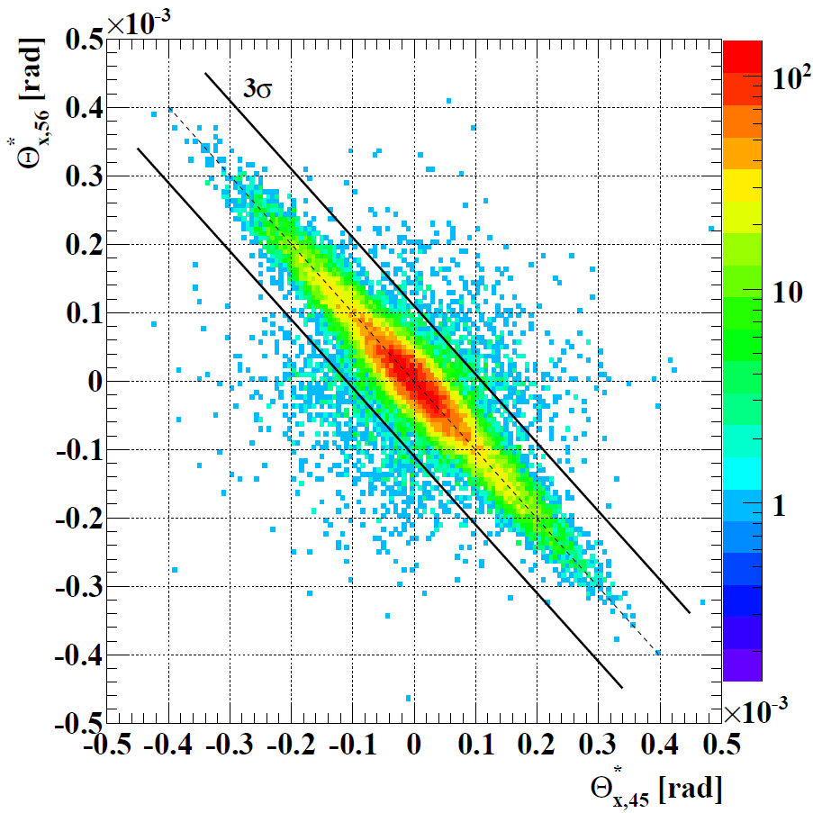
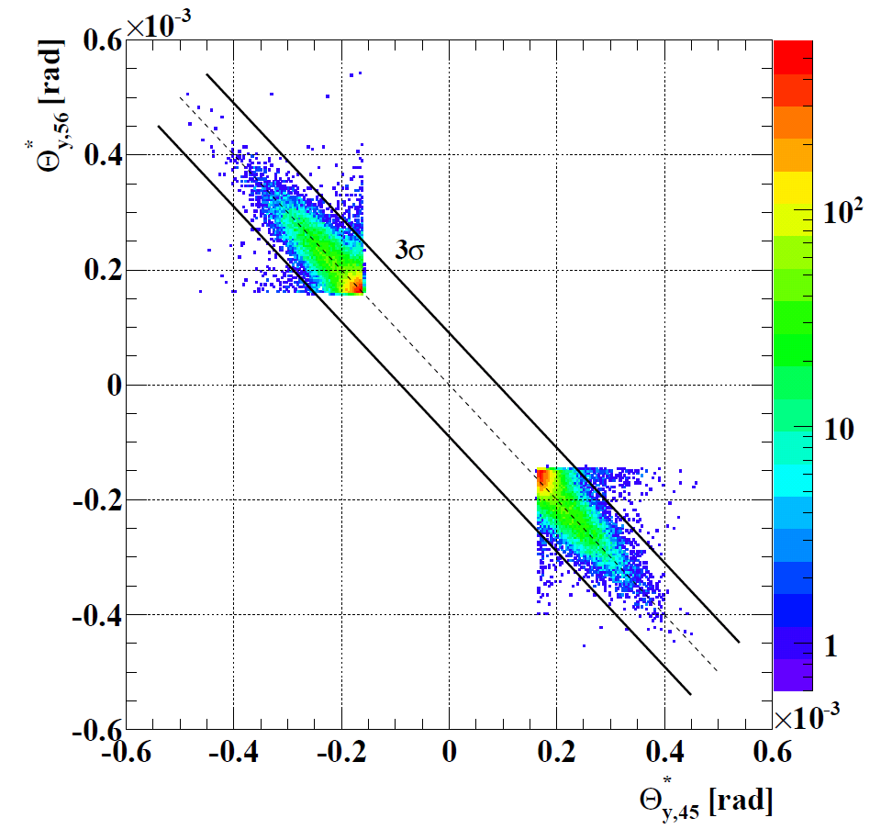
Elastic scattering with β*=3.5m
Results (the matched L_{y} and dL_{x}/ds are used for reconstruction):
RP approaches the beam down to 7 σ_{beam size@RP}
published in EPL 95 (2011) 41001
ξ ≈ 0
Beam divergence
Collinearity Θ_{x}
Spread in agreement with beam
divergence (17-18 μrad)
Collinearity Θ_{y}

Slide 13
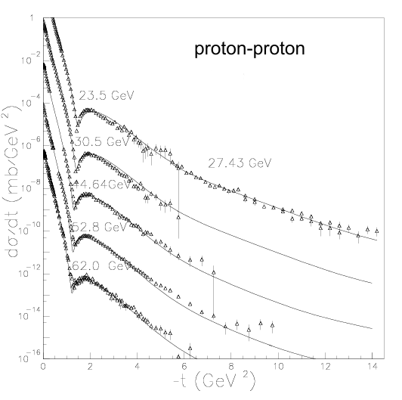
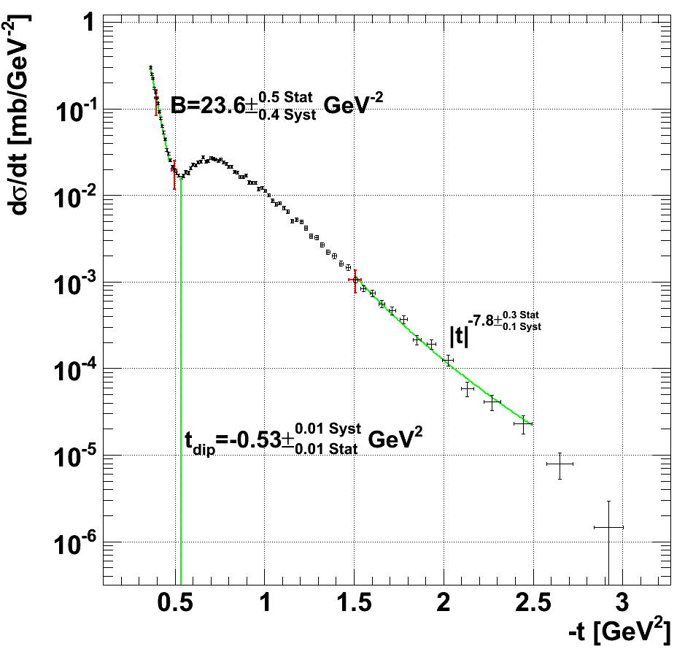
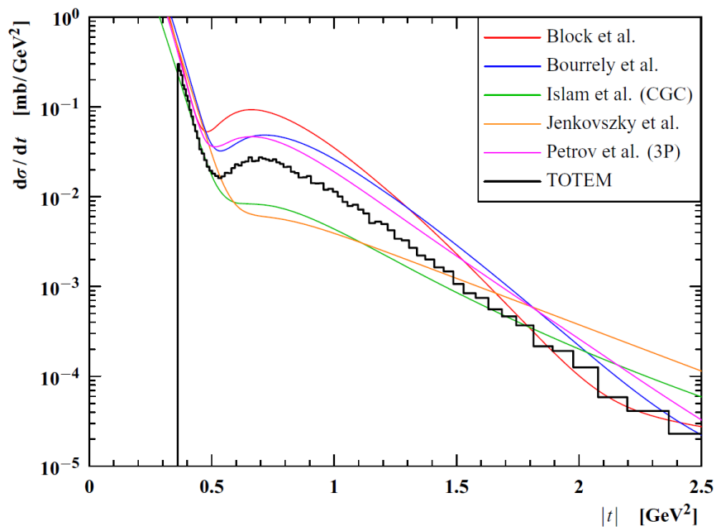
Final result: unfolded elastic scattering distribution β*=3.5m
Proton-proton dσ/dt
@ISR
Published in EPL 95 (2011) 41001:
|t| range spans from 0.36 to 2.5 GeV²
below |t| = 0.47 GeV² exponential e^{-B|t|}
behavior
dip moves to lower |t|, proton becomes
“larger“
1.5 - 2.0 GeV² power low behavior |t|^{-n}
The measured dσ/dt compared with predictions of several models

Slide 14
HIGH β* = 90 m OPTICS AND RESULTS

Slide 15
β*=90 m optics in general
β* = 90m optics achievable using the standard LHC injection optics. Properties:
σ_{Θ*} = 2.5 μrad, L_{x} ≈ 0, L_{y} ≈ 260 m
vertex size σ_{IP} ≈ 212 μm
Acceptance: |t| > 3 · 10⁻² GeV² , RP distance from beam center 10 σ_{beam size@RP}
parallel to point focusing only in vertical plane @RP220
Effective lengths from IP5 to RP @220 m
β*=90 m

Slide 16
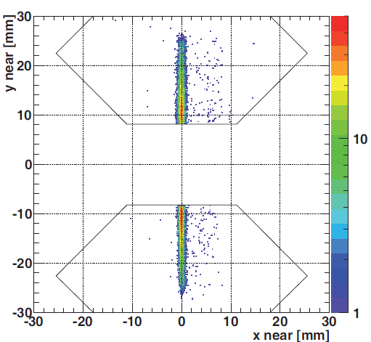
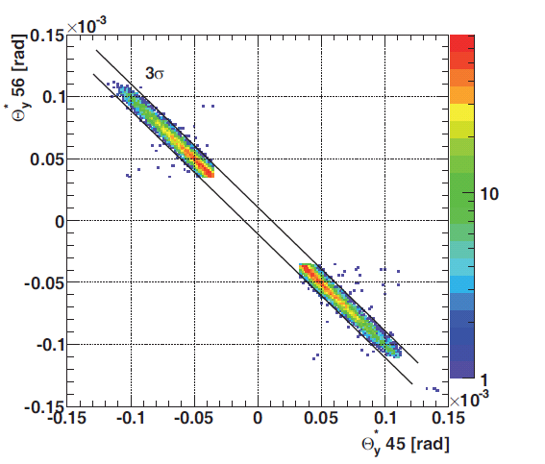
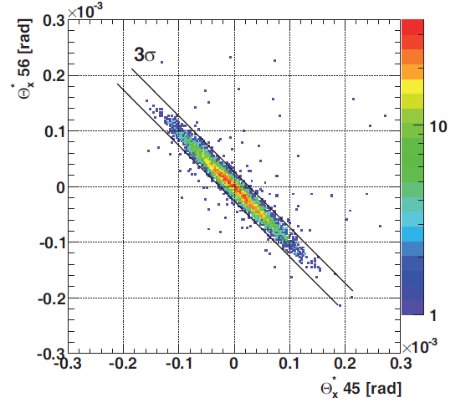
Very clean data obtained with β*=90 m
The properties of the measured data:
divergence is reduced with respect to 3.5 m optics
(from 17-18 μrad to 2.5 μrad)
lower background compared to 3.5 m ( < 0.1%)
uncertainty of luminosity 4% (CMS)
low intensity bunches and β*=90 m -> no pile-up
from single diffraction
RP at 220m
Beam divergence
Collinearity Θ_{y}
Collinearity Θ_{x}

Slide 17
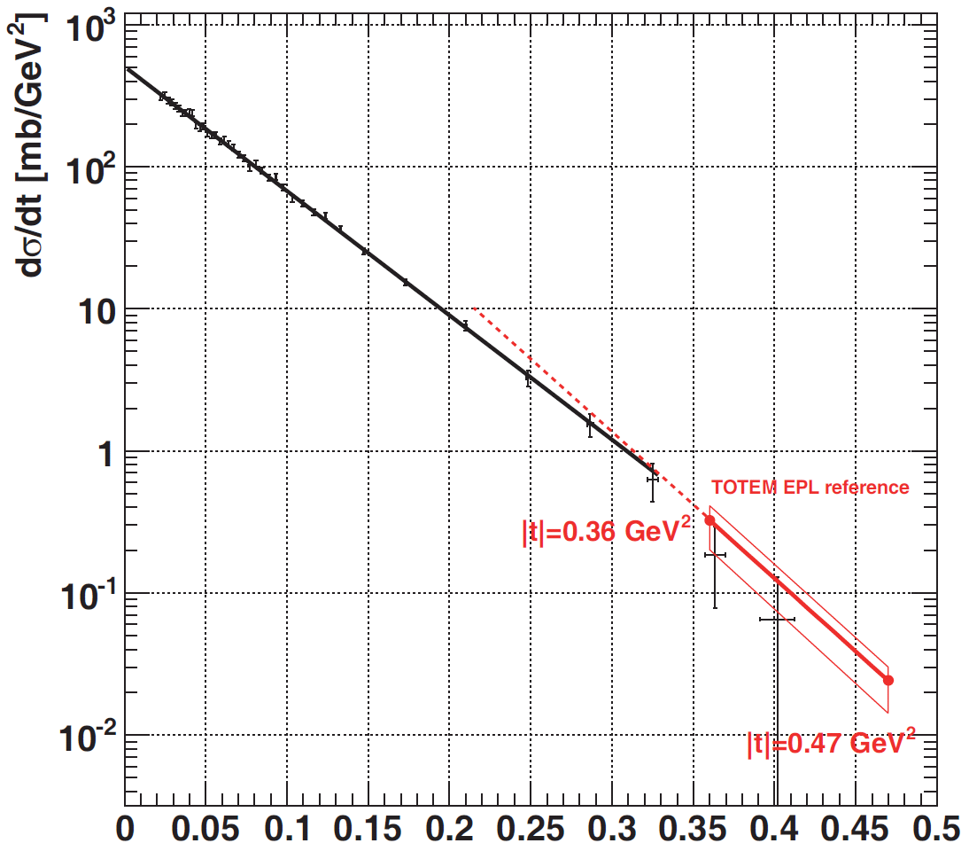
Intermediate β*=90 m optics: robustness
Objectives:
First measurement of σ_{tot} elastic scattering in a wide |t| range
inclusive studies of diffractive processes
measurement of forward charged multiplicity
Sensitivity of the effective length L_{y} :
1 ‰ perturbations magnet strength, beam momenta
Conclusion: not necessary to improve our understanding
about β*=90 m optics
Perturbed element | δ_{Ly,b1}/L_{y,b1} [%]
MQXA.1R5 | 0.14
MQXB.A2R5 | −0.23
MQXB.B2R5 | −0.25
MQXA.3R5 | 0.20
MQY.4R5.B1 | −0.01
MQML.5R5.B1 | 0.04
Δp/p | 0.01
Obtained dσ/dt with β*=90 m optics
Published in EPL 96 (2011) 21002
Properties:
|t| range of the new set is 0.02 - 0.33 GeV²
B = (20.1 ± 0.2^{stat} ± 0.3^{syst}) GeV⁻²
confirms that B increases with √s
excellent agreement between the two measurements with different optics
β*=90 m
Superimposed
fits with the
combined datasets
β*=3.5 m

Slide 18
Obtained dσ/dt with the most recent result
RP@ 10 σ_{beam size@RP}
(RP @ 6.5, 5.5, 4.8 σ_{beam size@RP} )
EPL 95 (2011) 41001 (2010 Oct data)
EPL 96(2011) 21002 (2011 June data)
To be published (2011 Oct data)

Slide 19
Total Cross-Section with 4 methods
    Low luminosity (CMS) + Elastic dσ/dt + Optical th. ( EPL 96(2011) 21002 )
      depends on CMS luminosity for low-L bunches, elastic efficiencies and on ρ
    High luminosity (CMS) + Elastic + Optical theorem (to be published)
    High luminosity (CMS) + Elastic + Inelastic (to be published)
      minimizes dependence on elastic efficiencies and no dependence on ρ
    Elastic ratios + Inelastic ratios + Optical theorem (to be published)
      Eliminates dependence on luminosity
σ_{ΤΟΤ} = 98.3 ± 2.0 mb
σ_{ΤΟΤ} = 98.6 ± 2.3 mb
σ_{ΤΟΤ} = 99.1 ± 4.4 mb
σ_{ΤΟΤ} = 98.1 ± 2.5 mb

Slide 20
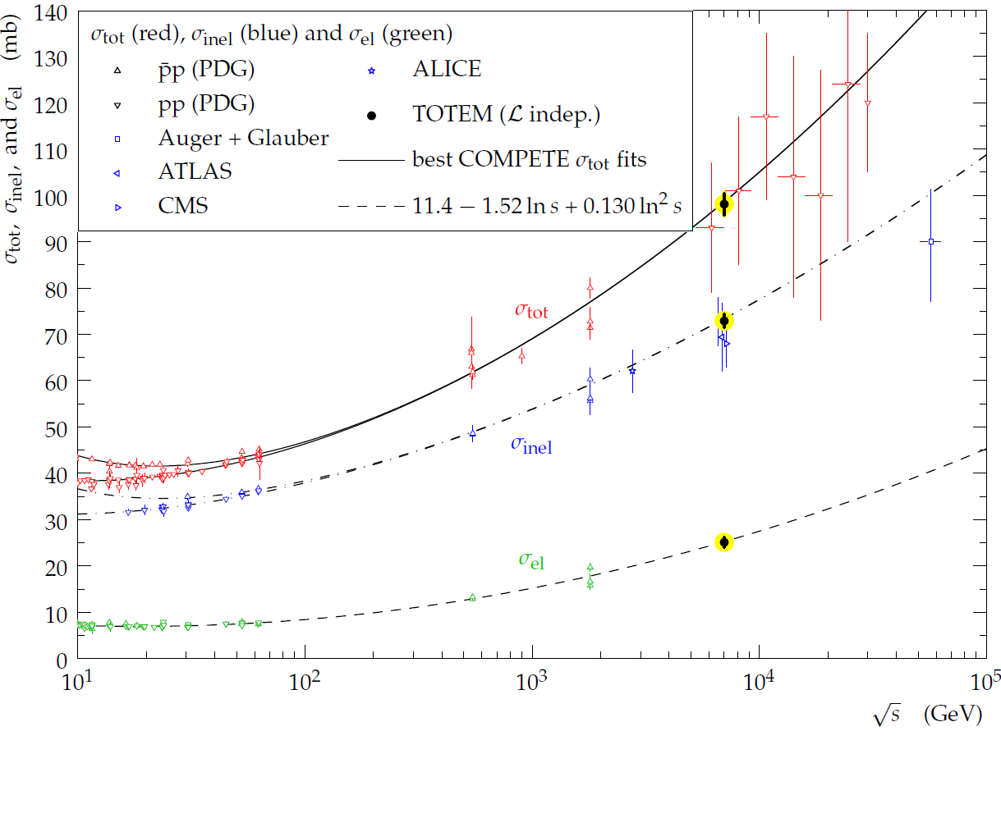
Total Cross-Section with the luminosi
The result of the 4 methods on one plot:

Slide 21
Conclusions
TOTEM has measured the inelastic and elastic cross sections and the total cross section with the luminosity independent method at √s=7 TeV
Very soon these measurements will be repeated at √s=8 TeV
Measurement of elastic scattering at very low-t and determination of the ρ parameter will be in reach during the high β (β*= 500 m) run
Several analyses on diffractive physics are going on, results are expected soon

Slide 22
Thank you for you attention !

Slide 23
Backup part

Slide 24
Luminosity calibration
TOTEM is able to determine the CMS luminosity:
Elastic and inelastic rates are used
Obtained luminosity values

Slide 25
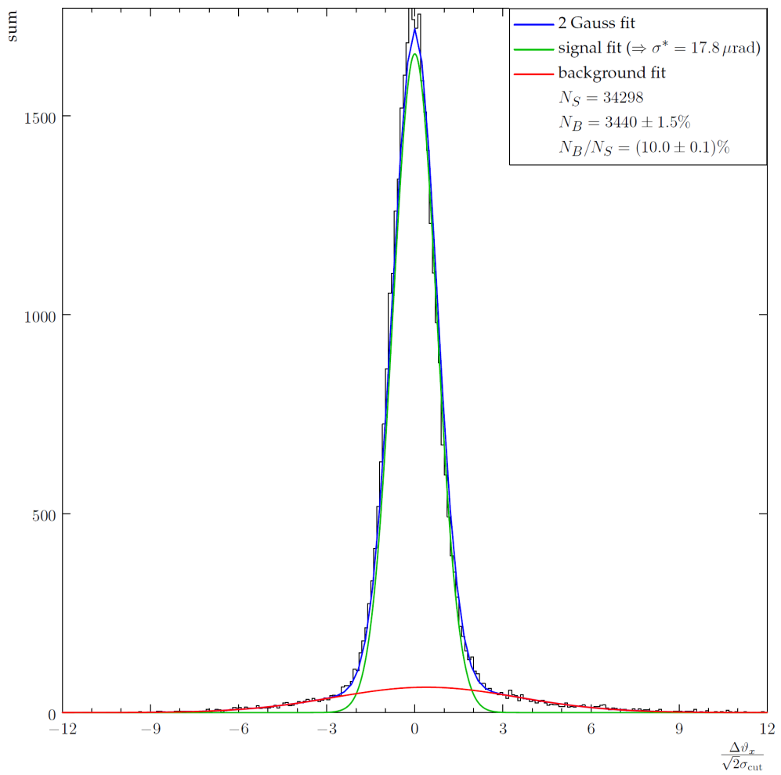
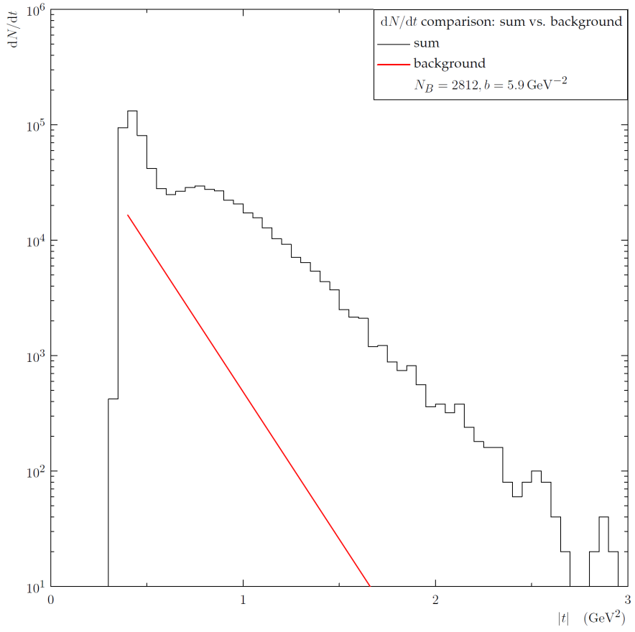
Background and resolution determination β*=3.5m
–– signal
–– background
–– combined
B/S = (8±1)%
σ*=17.8μrad
(beam divergence)
Data
Combined background (t)
Δθ_{x}/sqrt(2)
-t [GeV²]
Signal to background normalisation
Signal vs. background (t)
(also as a function of Δθ_{y})
σ* → t-reconstruction resolution:
|t|=0.4GeV²: B/S = (11±2)%
|t|=0.5GeV²: B/S = (19±3)%
|t|=1.5GeV²: B/S = (0.8±0.3)%

Slide 26
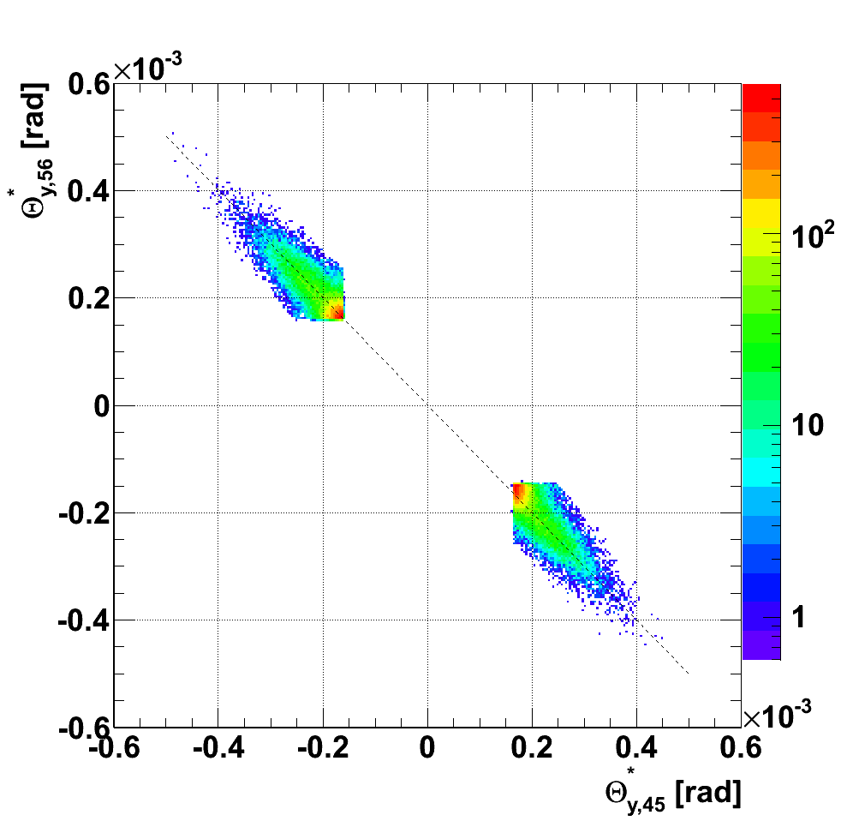
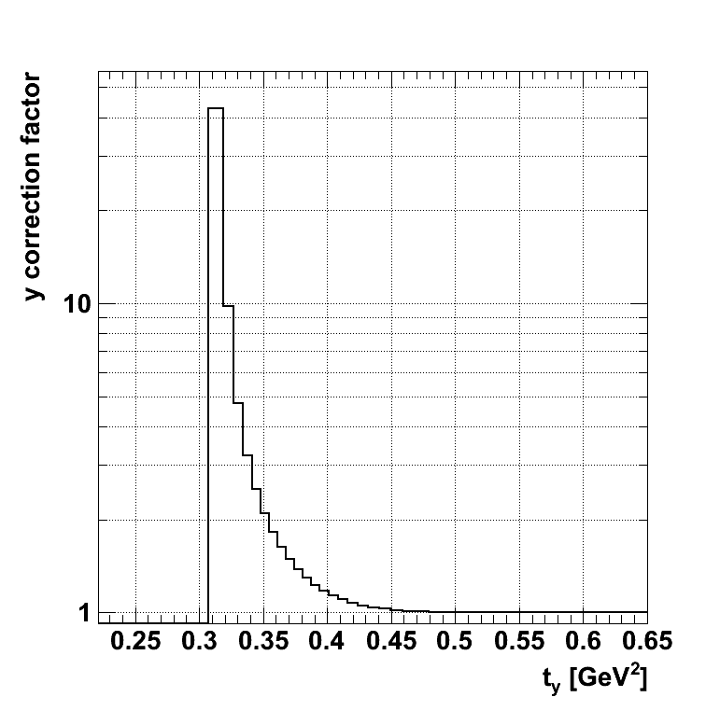
t_{y}-acceptance corrections β*=3.5m
|t_{y}| (diagonal 1)
|t|<0.36GeV² removed
Beam divergence
|t_{y}| (diagonal 2)
Missing acceptance in θ_{y}*
Correction error (t_{y}):
0.31 GeV² : 30%
0.33 GeV² : 11%
0.35 GeV² : 2%
0.4 GeV² : 0.8%
0.5 GeV² : 0.1%

Slide 27
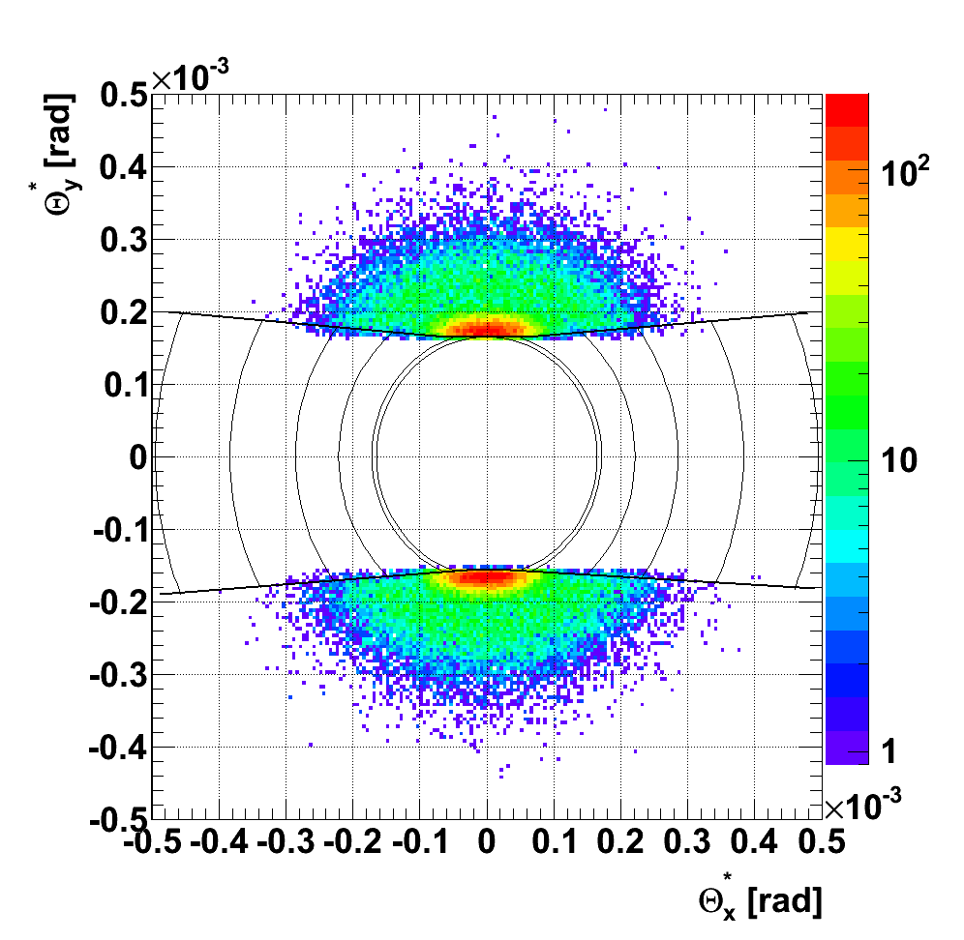
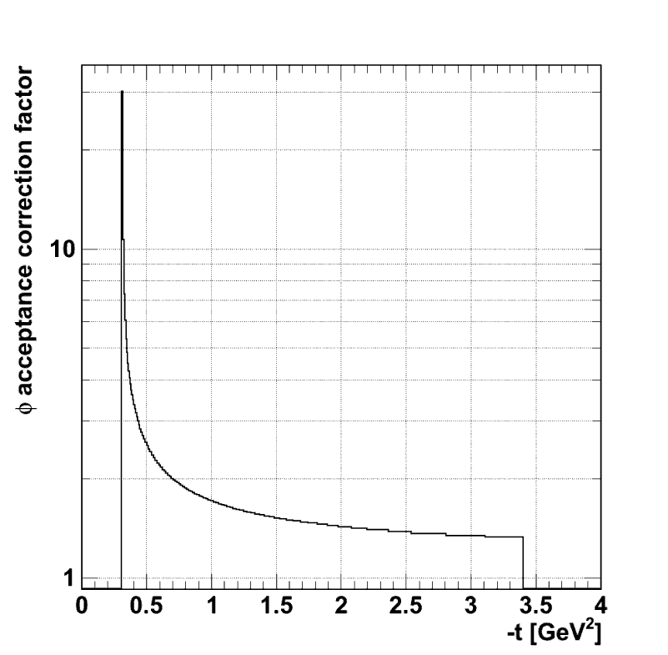
Acceptance corrections β*=3.5m
Total ϕ-acceptance correction
No. | t [GeV²] | Θ* [rad] | Accepted ϕ (2 diag.) [°] | ϕ accept. correct. factor
1 | 0.33 | 1.65E-04 | 38.6 | 9.3±4.7%
2 | 0.36 | 1.71E-04 | 76.4 | 4.7±1.8%
3 | 0.60 | 2.21E-04 | 162.5 | 2.2±0.3%
4 | 1.00 | 2.86E-04 | 209.8 | 1.7±0.1%
5 | 1.80 | 3.83E-04 | 246.3 | 1.5
6 | 3.00 | 4.95E-04 | 269.0 | 1.3
Accepted ϕ(t)
Diagonal 1
1 2 3 4 5 6
ϕ
Θ*
|t|<0.36GeV² removed
Diagonal 2
Accepted ϕ(t)
Critical at low t-acceptance limit

