Slide 1

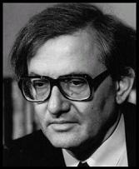
INITIAL energy density in LHC P+P collisions
ZIMÁNYI SCHOOL 2012
December 3-7.
Budapest, Hungary
04 Dec 2012
M. Csanád &T. Csörgő

Slide 2
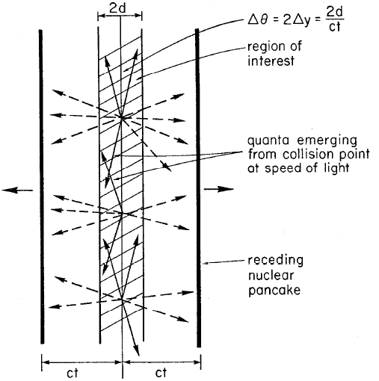
The Bjorken-estimate
The original idea: energy density based on dE/dy
QGP critical ε: ≤1 GeV/fm³ (from ε_{c}=6-8×T_{c}⁴)
Result (1900x cited)
Needs correction!
Ref.: Phys.Rev. D27 (1983)

Slide 3
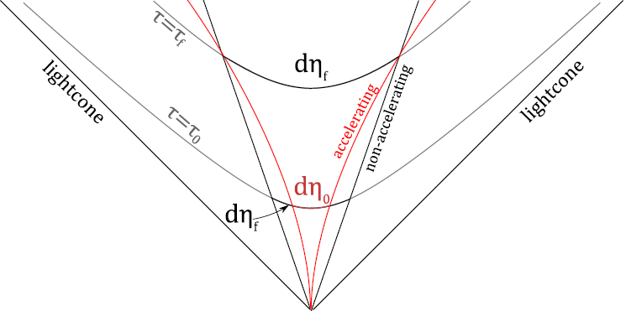
An advanced estimate
Fact: dn/dy not flat
Finiteness & acceleration
Need accelerating solution
of relativistic hydro
Two modifications:
  y≠η & η_{final} ≠η_{initial}
Corrected initial energy density:
Work needed to accelerate!
Correction w.r.t. EoS:

Slide 4
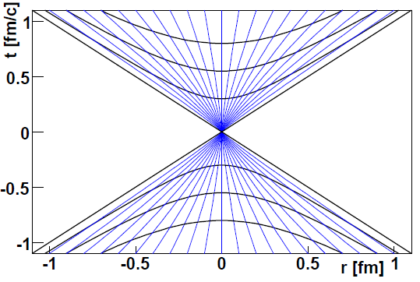
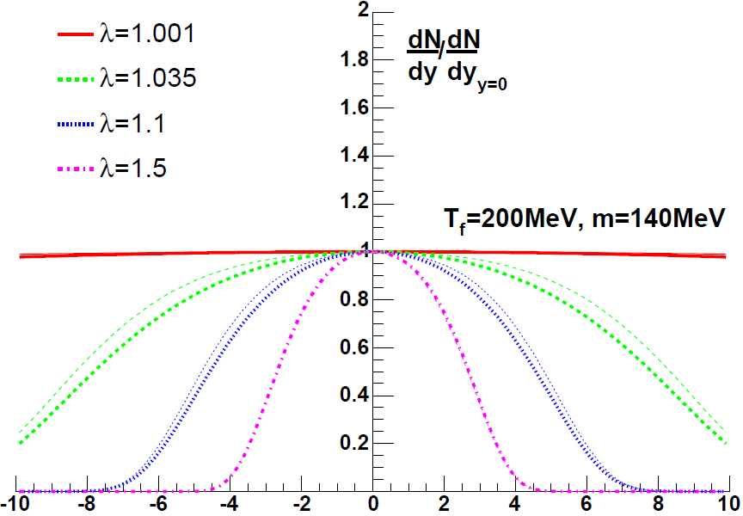
A solution of relativistic hydro
Velocity: tanh(λη)
Acceleration: λ≠1
Density: (τ/τ₀)^{λ}
dn/dy calculable!
Compare this to RHIC data!
dn/dy measurement yields advanced initial ε estimate
Significant correction at RHIC!
Reference: Phys.Lett. B663 (2008) 306-311 (nucl-th/0605070)

Slide 5
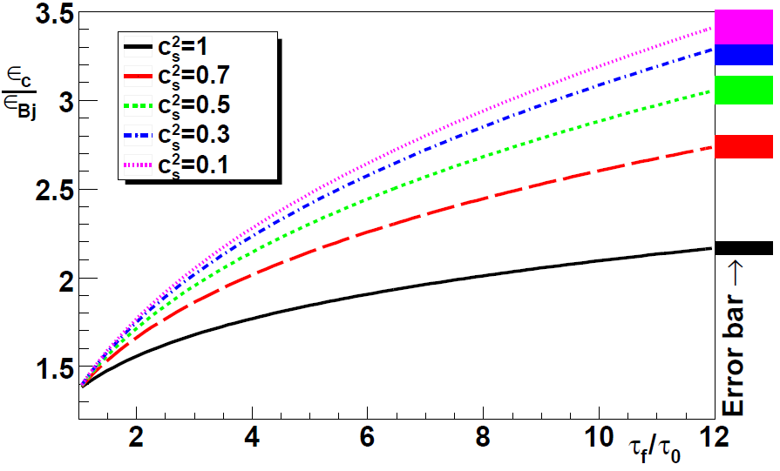
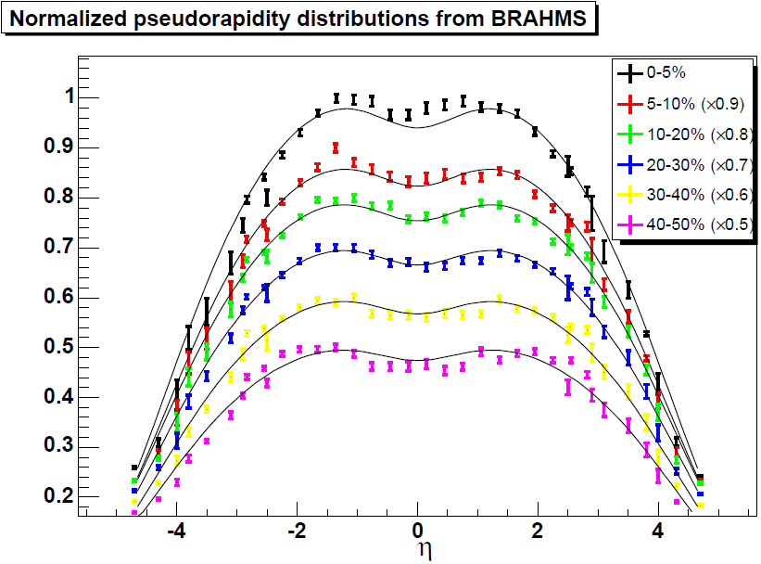
Initial energy density at RHIC
Bjorken estimate from BRAHMS: 5 GeV/fm³
Advanced estimate gives:
Correction: 2-3x, result 15 GeV/fm³, QCD agreement!
Corresponds to T_{ini} ≅ 2T_{c} ≅ 340 MeV
Confirmed by photon spectra at PHENIX, published 2010
Reference e.g.: J.Phys.G35 (2008) 104128 (arXiv:0805.1562)

Slide 6
Initial energy density at LHC
Rough estimate possible via the Bjorken formula
  Number of particles at midrapidity: 5.89 (CMS, ALICE)
  Average energy: ⟨m_{t}⟩=0.562 GeV (CMS)
  Initial radius of the system R: ~1.081 fm (TOTEM, σ_{inel})
  Formation time τ₀: 1 fm/c (conservative estimate)
Energy density from this:
Just below critical? Important question!

Slide 7
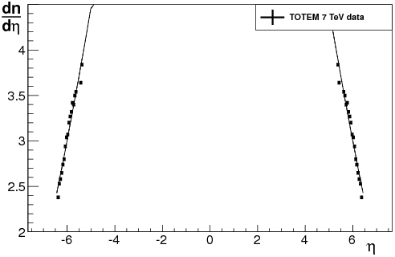
Correction from initial acceleration
Initial acceleration pushes outer volume elements
This modifies the dn/dη distribution
Estimate acceleration from it!
λ = 1: no acceleration
TOTEM fit: λ =
1.073±0.001±0.004
Without EoS: 20%

Slide 8
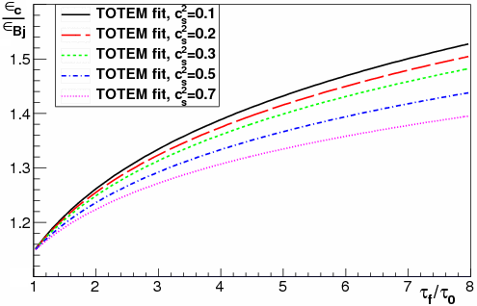
Advanced estimate
Fit result: λ=1.073
Conservatively: c_{s}²=0.1
~25% correction
Input parameters:
  dN/dy at midrap.: 5.89
  Average m_{t}: 0.562 GeV
  Area: 3.67 fm²
    From cross sections
  Freeze-out time / form. time: at least 2
Bjorken result: 0.90 Gev/fm³
Corrected result: 1.14 GeV/fm³

Slide 9
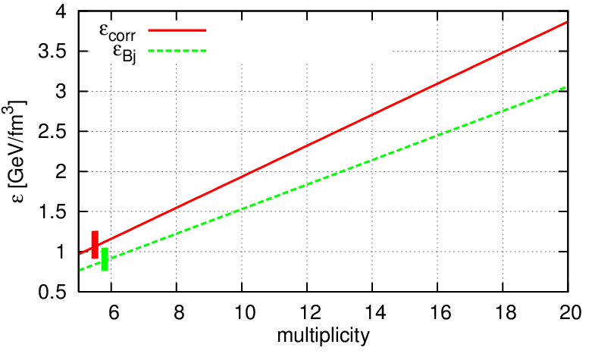
Dependence on particle number
Several multiplicity classes, 6-20, even 30 seen!

Slide 10
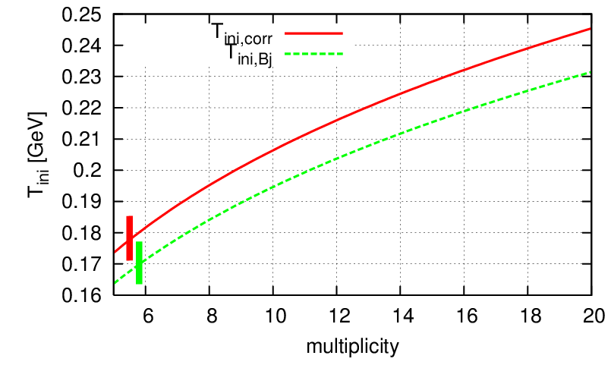
Initial temperature estimate
Temperature from ε~T⁴

Slide 11
Sources of uncertainties
For the correction factor ε/ε_{Bj} :
  Fit parameter λ
  Statistical error (from the data)
  Speed of sound c_{s}²
  Duration τ_{f}/τ_{i}
For the original Bjorken-estimate:
  Main uncertainty source: multiplicity at midrapidity dN/dy
  Area (if taken from cross-section): very precise
  Formation time
  Average transverse mass

Slide 12
Systematic uncertainties
All sources of uncertainties:
Conclusion:
  ε_{ini}= (1.14 ± 0.01(syst) ^{+0.21} _{-0.16} (syst)) GeV/fm³
parameter | value | statistical uncertainty | systematic uncertainty
λ | 1.073 | 0.1% | 0.4% (from data)
c_{s}² | 0.1 | - | -2%+0.2% (if 0.05<c_{s}²<0.5)
τ_{f}/τ₀ | 2 | - | -4%+10% (if ratio 1.5…4)
τ₀ | 1 fm/c | - | understimation on ε
R (from σ_{inel}) | 1.081 fm | 0.5% | 1.5% (from data)
⟨m_{t}⟩ | 0.562 GeV/c² | 0.5% | 3% (from data)
dN/dη | 5.985 | 0.2% | 3% (from data)

Slide 13
Is it unprecedented? Consequences?
Bjorken and Landau worked out hydro for pp and pA
Success of hydro to describe h+p, with <n> = 7-8...
Phys.Lett. B422 (1998) 359-368
Bjorken: it is not hadrons that play billiard balling
If p+p is a complex system:
  Radial flow
  V2 scaling
  HBT radii scaling
  Low mass dilepton enhancement?
  Direct photon enhancement?
R_{AA} might not be the best measure: divide by length scale?

Slide 14
Summary
Experimentally widely used Bjorken est.
Advanced estimate: acceleration work, from dn/dη
Results on the initial ε for c_{s}²=0.1, at τ_{f}/τ_{ini}=2
From TOTEM data: ε_{ini}= (1.14 ± 0.01 ± 0.2) GeV/fm³
  This at dN/dy=6 & linearly rises with multiplicity!
Critical energy density: 1 GeV/fm³
Results not incompatible with supercrit. sQGP phase

