Slide 1
Title
Bernd Dehning
CERN BE/BI

Slide 2
Notes and Actions from last Meeting
BGI/IPM: It was agreed to investigate the possibility to modify the chambers such as to make it compatible with the beam-gas vertexing method. Mariusz, Massi
Prototype system:
  minimal setup and a specific use-case that could prove the value of such a device.
  measure the absolute beam sizes at all energies/intensities and in particular during the ramp (evn if averaged over all bunches)
    => Bernd, Rhodri: specify more exactly the goals of the prototype system
    => Massi: investigate availability of prototype detectors
    => Plamen: simulate prototype detector with modified BGI, evaluate performance
Location:
  Beta, detector inner radius, (Gianluigi, Stefano, Massimo)
  longitudinal length, need about 7 m with gas bump
  uncertainties on beta (comment: talk in emittance working group by G. Trad, http://xxx)
  Gas target (Giuseppe, Adam)
Full scale system:
  What emittance range
  What statistical accuracy at which time intervals
  Which absolute precision
  BI/Plamen: specify more exactly the goals of the full scale system for LHC
Minutes of 1st meeting: https://indico.cern.ch/conferenceDisplay.py?confId=213774

Slide 3
Agenda
1. BGV detector design studies - toy simulation with prototype and full detector (Plamen)
2. Detector and gas target specifications (Massi)
3. Outcome of investigations of BGI layout modifications in LS1 (Mariusz)
4. Layout considerations and requirements for the ECR (Bernd)
AOB

Slide 4
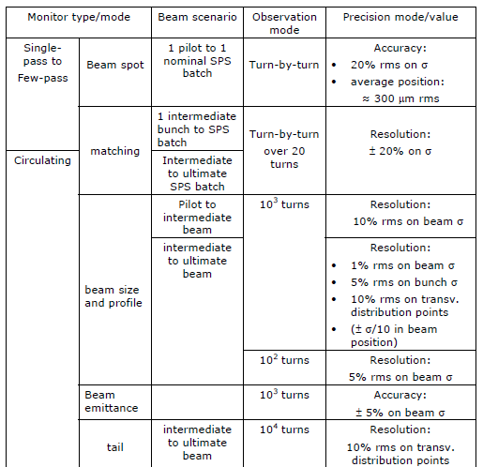


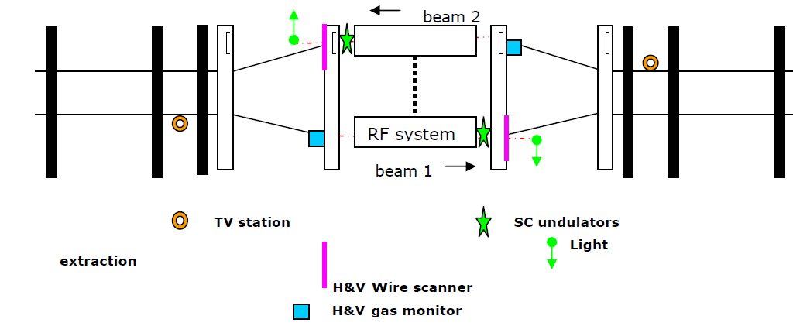
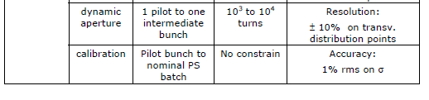
Beam Size and Emittance Measurement Resolution & Accuracy
D3
D4
Q5
Q6
Q7
Specification
  Bunch by bunch resolution of
  5 % in 0.1s
  Accuracy 5 % on emittance in 0.1s
  => 3.5% from beam size and 3.5 % from beta uncertainly
  => 1.8 % beam size accuracy (dsig/sig=1/2 depsi/epsi)
Goal for Vertex detector
  Bunch by bunch measurement in all operation condition
  Absolute accuracy

Slide 5
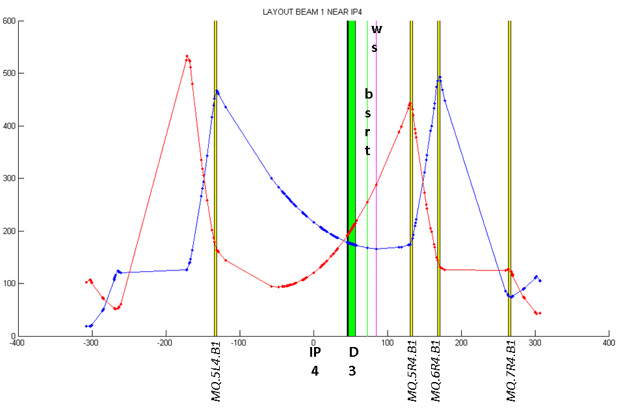
IP4 with right side emittance monitors
Vertex detector proposal
BGI
Equal Beta in cell 6 and a beta ratio of 2 in cell 5; free area in both cells
Drawing G. Trad

Slide 6
ECR
Requirement for ECA (Engineering Change Request)
  Detailed description
    Functionality, Layout (in tunnel, at please of electronics), electronics hard and software structure
  Reasons for change
    (reasons for additional emittance monitor, goal from specification)
  Impact on coast, schedule and performance
    Developement plan for test system an proposal for final setup?
  Impact on other items

Slide 7
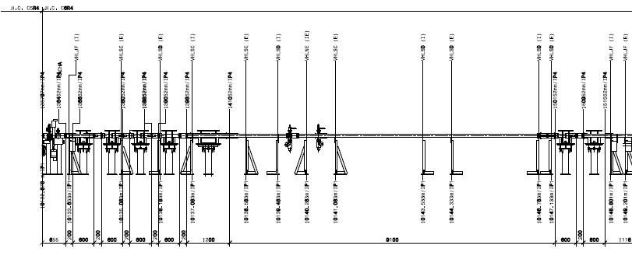
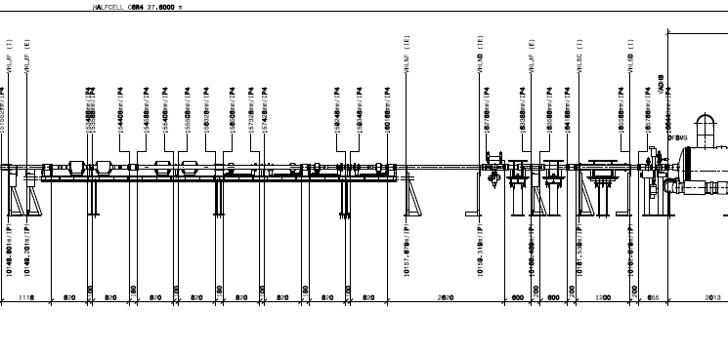
Cell 6R4

Slide 8
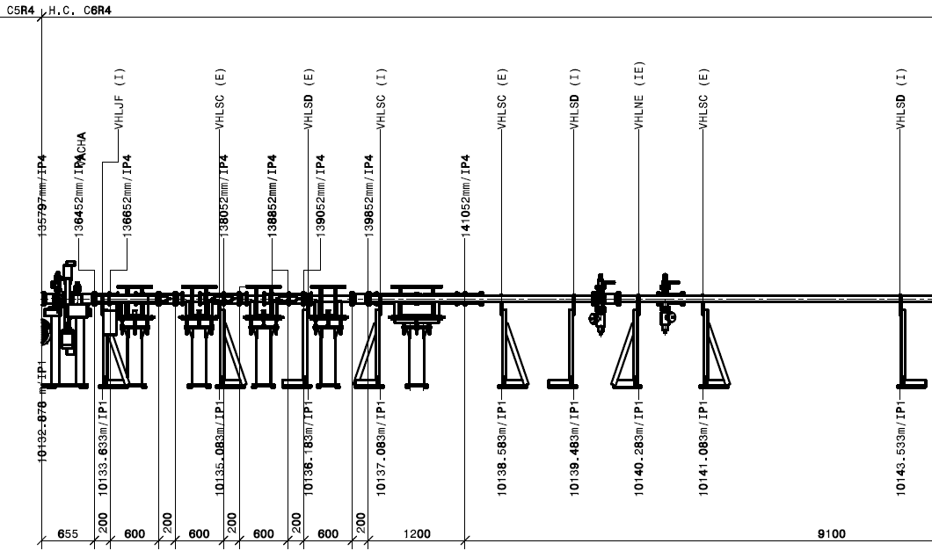
Cell 6R4 near Q5

Slide 9
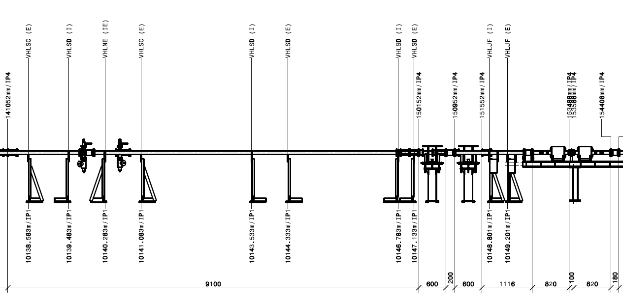
Cell 6R4 near Q6

Slide 10
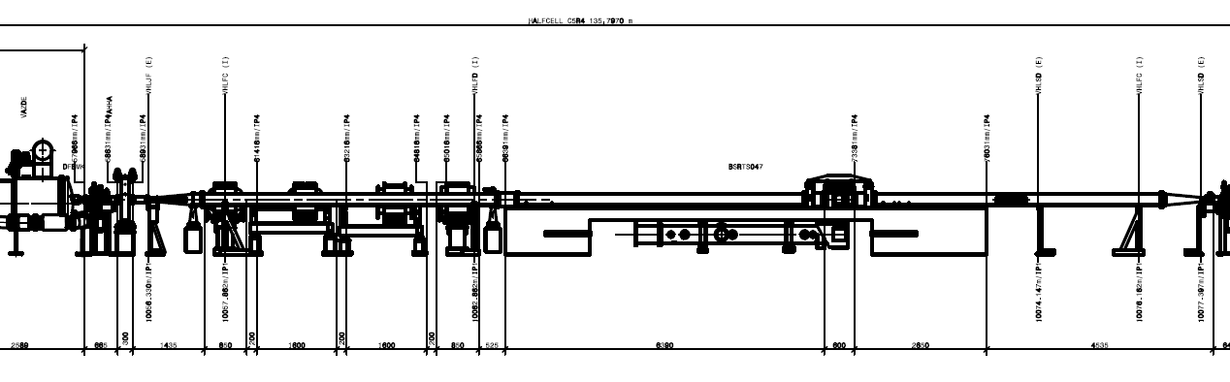
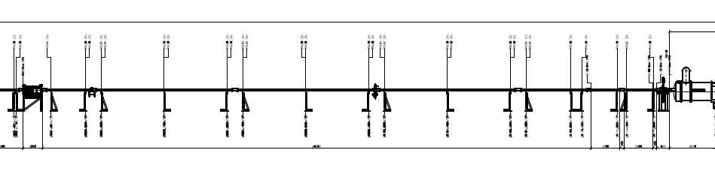
5R4

