Slide 1



HBT and Collective Flow at Mid-Rapidity in
d+Au and Au+Au collision systems
QUARK MATTER 2014
XXIV INTERNATIONAL CONFERENCE ON ULTRARELATIVISTIC NUCLEUS-NUCLEUS COLLISIONS
May 19 - 24, 2014
N. N. Ajitanand
for the PHENIX Collaboration

Slide 2
Outline
Motivation
d+Au Flow
d+Au HBT
Scaling in HBT
Conclusions

Slide 3
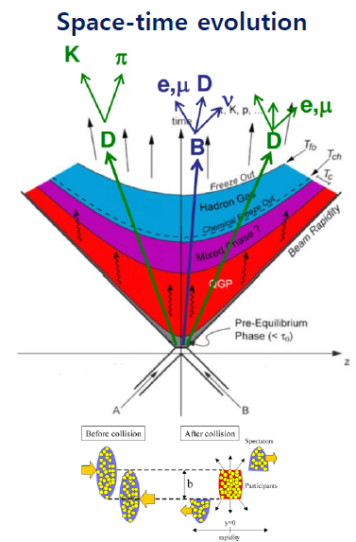
Motivation
It is generally accepted that in relativistic A-A collisions a QGP medium is formed which signals its presence through long range correlations.
It was thought that p+p and p+A collisions are not capable of forming such a medium because of the small system size.
Recent experiments at the LHC have seen long range correlations in p+p and p+A systems in high multiplicity events
What about d+Au at RHIC ?

Slide 4
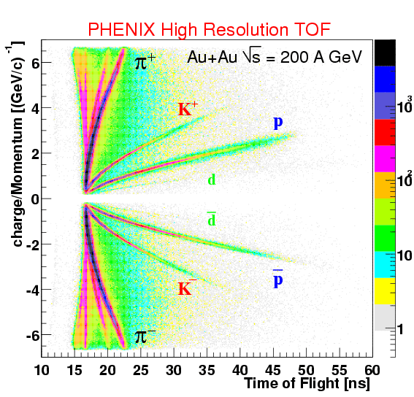
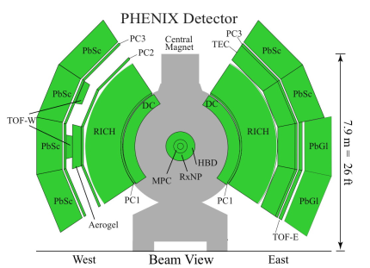
Detector
The PHENIX detector at RHIC
Zero Degree Calorimeter (ZDC) & Beam Beam Counter (BBC)
Vertex and centrality determination
Drift Chamber (DC) & Pad Chamber (PC)Tracking information
Electromagnetic Calorimeter (EMC) ,
Time-of-Flight Detector (TOF)PID information
Good acceptance
Very good 𝜋-𝝟 separation

Slide 5
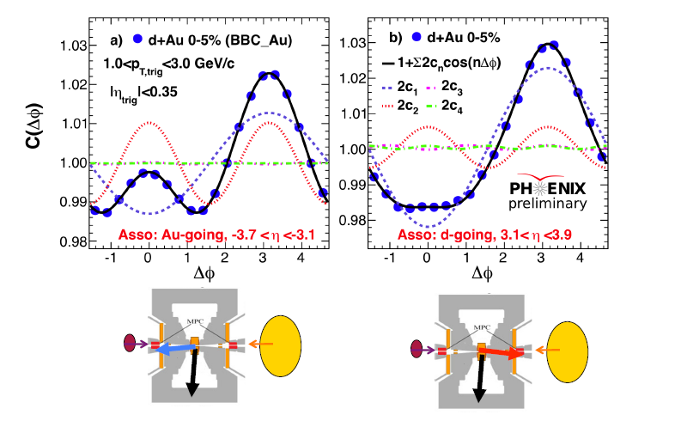
“Au-going” vs “d-going”

Slide 6
d+Au flow

Slide 7
d+Au flow
arXiv:1404.7461
peripheral subtracted
Mass ordering of v2
mass splitting for d+Au at RHIC is less than that for p+Pb at LHC
Maybe due to lower radial flow at RHIC
pT dependence of v2
d+Au results at RHIC ~ than for p+Pb at LHC

Slide 8
Both CGC and hydrodynamic expansion models describe certain features of the large angle correlations
Next we look at small angle (HBT) correlations which carry information specifically about the
space-time extent of the system at freeze-out
Common trends in A+A and p+A systems in HBT
measurements would be a strong indication of
a commonality of the underlying physics

Slide 9
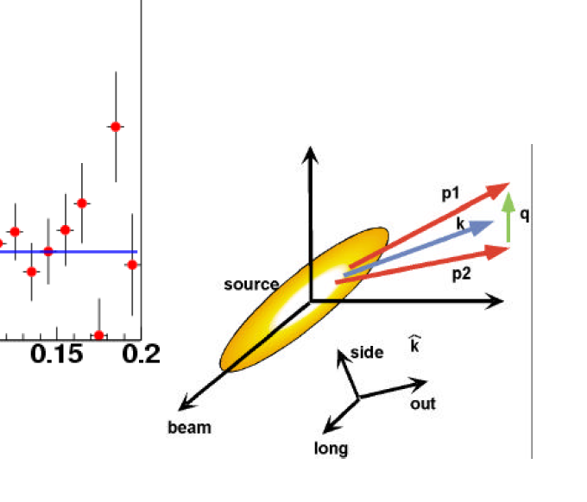
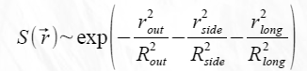
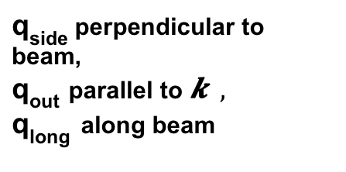
HBT Methodology
Space-momentum correlation function
S : 3D Gaussian Source distribution
𝝍 : final state interactions
In longitudinally co-moving frame correlation can be written as :
q_{side} perpendicular to beam,
q_{out} parallel to $\vec{k} ,$
q_{long} along beam

Slide 10
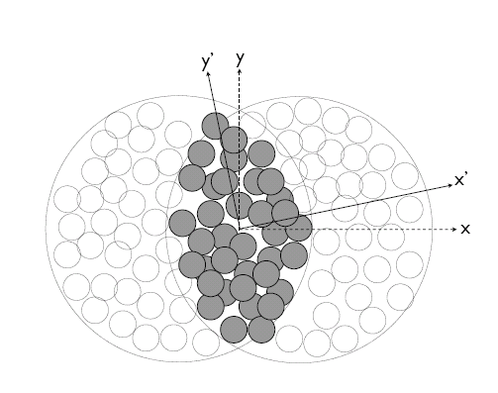

Bjorken energy density vs N_{part}
Initial Parameters for peripheral
Au+Au and central d+Au
Au
Au
N_{part} dE_{T /} dη ε
Au+Au 16.7±1.1 19±.1.5 0.71 0.5
d+Au 15.7±1.6 22±1.5 0.44 2.5
d
Au
σ_{x} & σ_{y} → RMS widths
of density distribution
Glauber Model
initial size

Slide 11
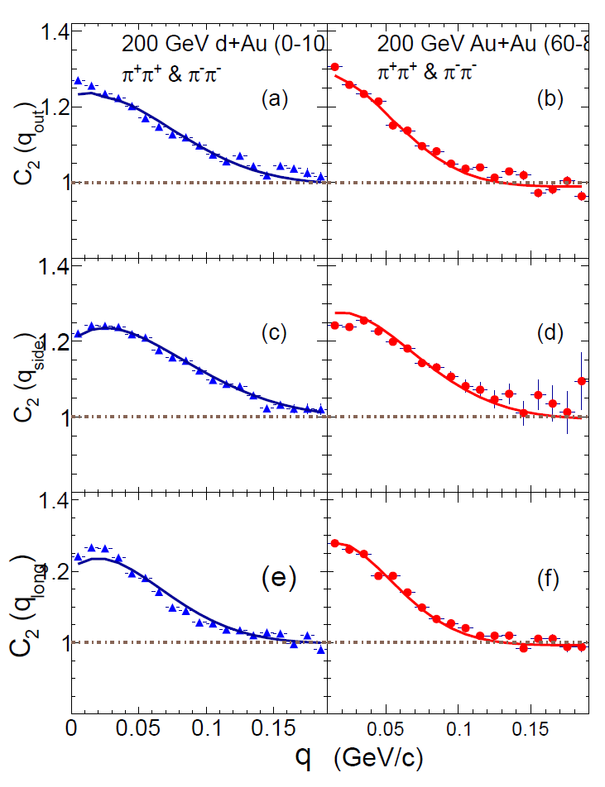
N_{part} <k_{T}>
Au+Au 16.7±1.1 0.39
d+Au 15.7±1.6 0.39
HBT Correlation functions at similar
N_{part} and k_{T}
_{d+Au broader than Au+Au}
_{implying a smaller Rside}

Slide 12
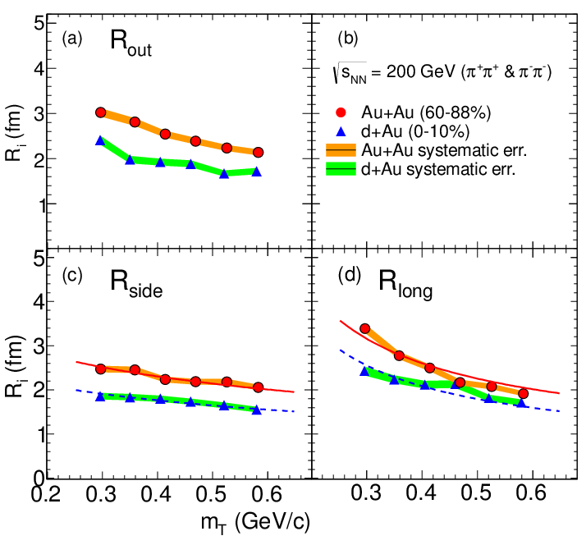
dAu HBT
arXiv:1404.4946
Similar m_{T} dependence
observed in d+Au and Au+Au
As expected from space
momentum correlations
Introduced by
hydrodynamic expansion
Blast Wave Fit defined by
expansion velocity
and temperature at freeze-out
Smaller size for d+Au
m_{T} Dependence

Slide 13
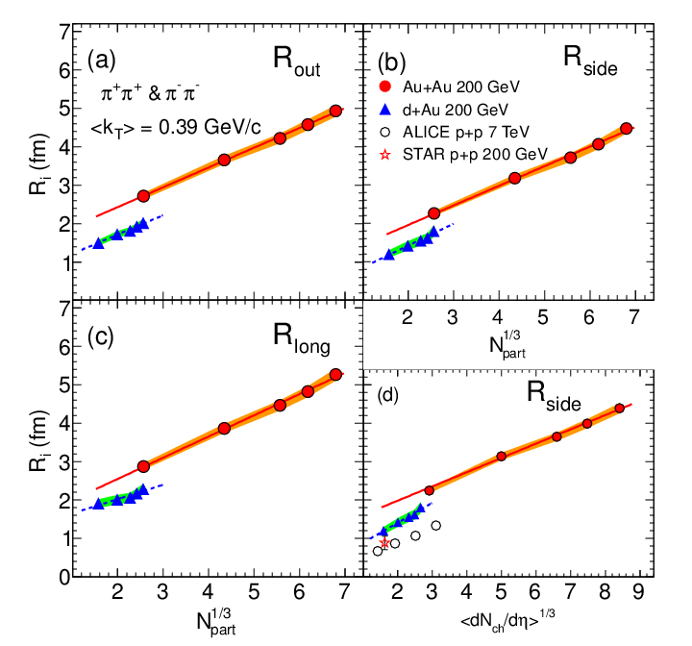
Scaling in HBT
arXiv:1404.4946
Pion HBT radii as a function of
d+Au and Au+Au do NOT scale together

Slide 14
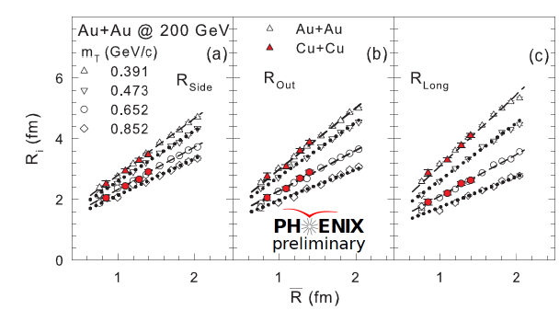
Scaling in HBT
Hydro models associate a larger expansion time with a larger initial size Does it make a good scaling parameter ?
σ_{x} & σ_{y} → RMS widths
of density distribution
Pion HBT radii scale
with
Linear dependence of transverse expansion on initial geometry

Slide 15
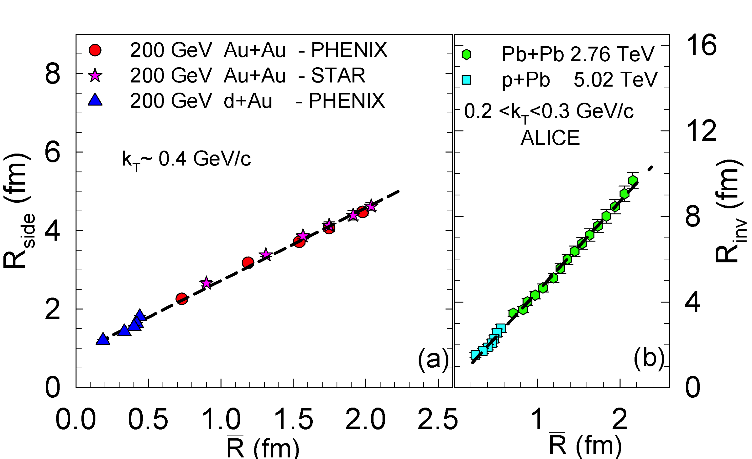
Scaling in HBT
Application of scaling to d+Au and p+Pb
arXiv:1404.4946
Linear dependence and good scaling seen between p/d+A and A+A systems Implies radial expansion in d+Au collisions

Slide 16
dAu HBT
arXiv:1404.4946
R_{out} / R_{side} ~ 1
short emission duration
Freeze-out volume
V ~ R_{out} x R_{side} x R_{long}
V(d+Au) < V(Au+Au)
mT dependence of V is similar

Slide 17
Measures of emission duration
Non-monotonicity in R_{out}/R_{side}
Subtract √2R to (over) estimate expansion

Slide 18
Emission duration and expansion/lifetime
Non-monotonicity magnified with (R_{out})² – (R_{side})²
R_{side}/R_{long} indicative of expansion/lifetime

Slide 19
Summary and Conclusions
v2 in d+Au at RHIC is comparable to that in p+Pb at LHC
Mass splitting of v2 at RHIC is smaller than in p+Pb at LHC
Smaller Radial flow at RHIC
m_{T} dependence of HBT radii are similar for d+Au and Au+Au
Implies similar expansion dynamics
HBT radii scale with across systems
Results suggest radial expansion in d+Au collisions as seen in
hydro-dynamic evolution with final state scattering
A CGC calculation of the HBT results presented here would be quite useful
Non-monotonic √_{SNN} behavior of HBT signals observed

