Slide 1



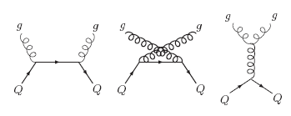
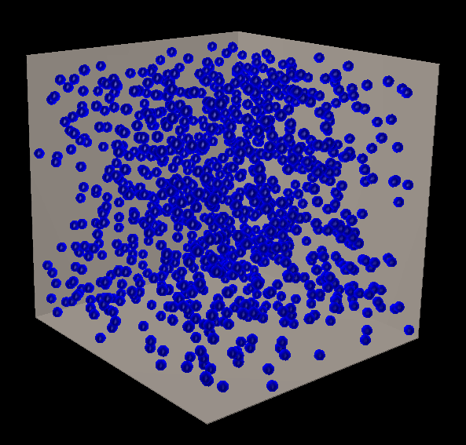
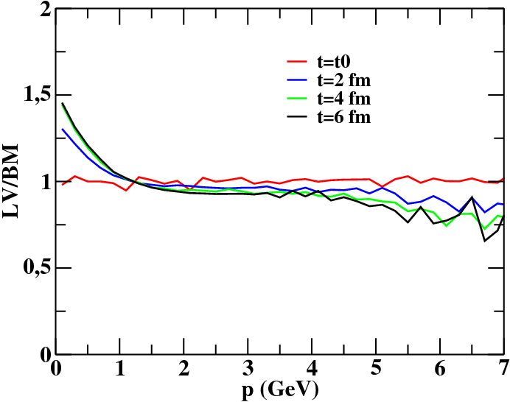
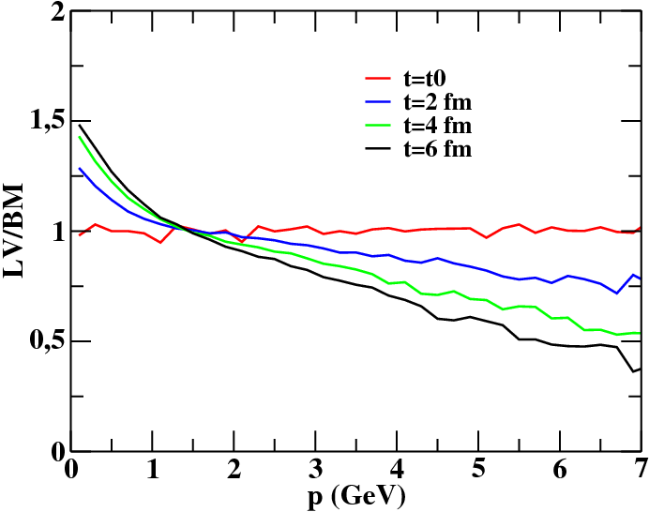
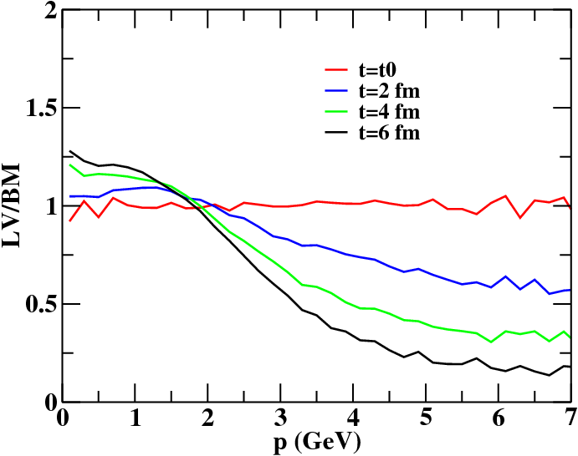
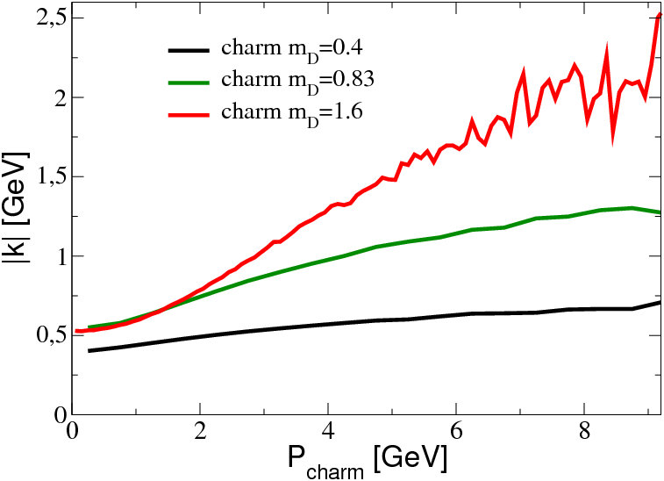
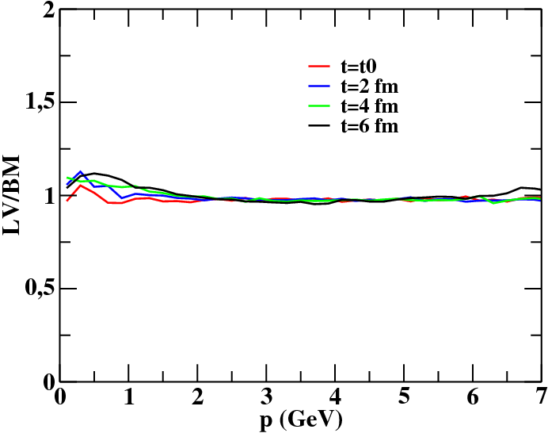
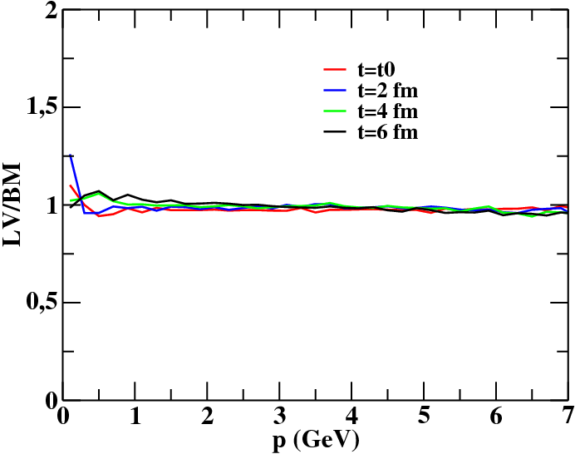
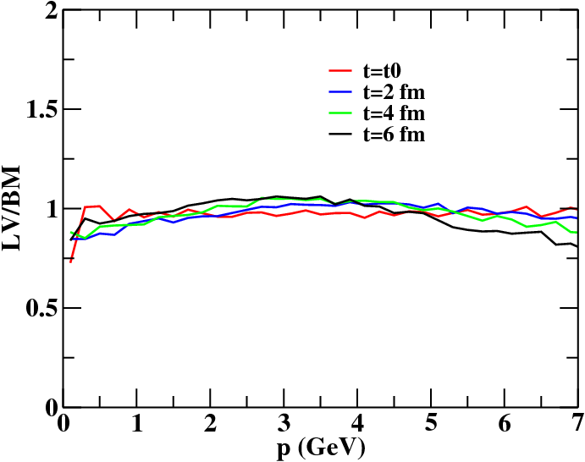
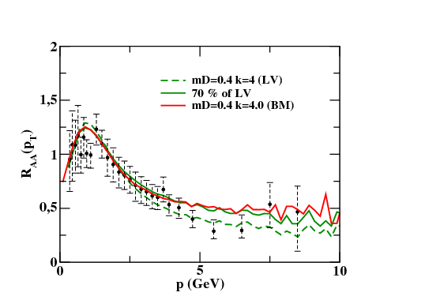
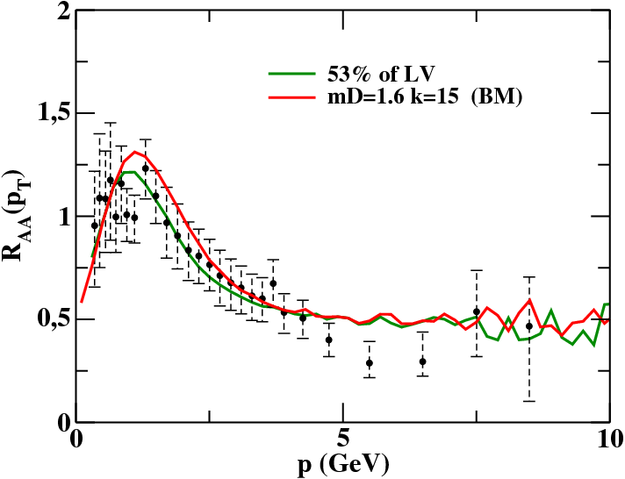
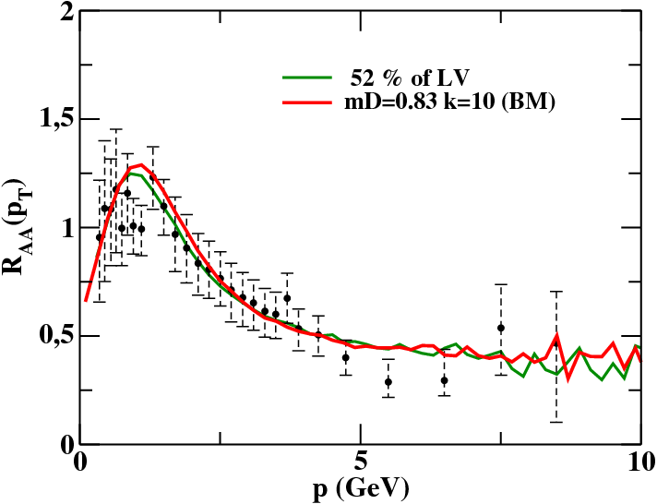
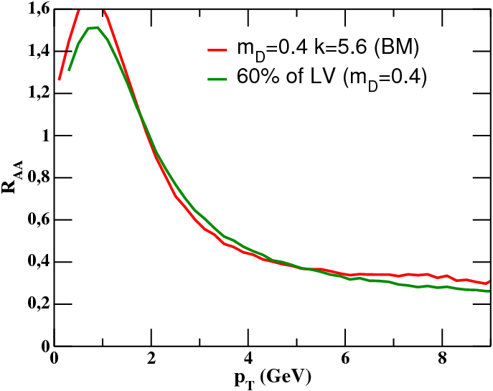
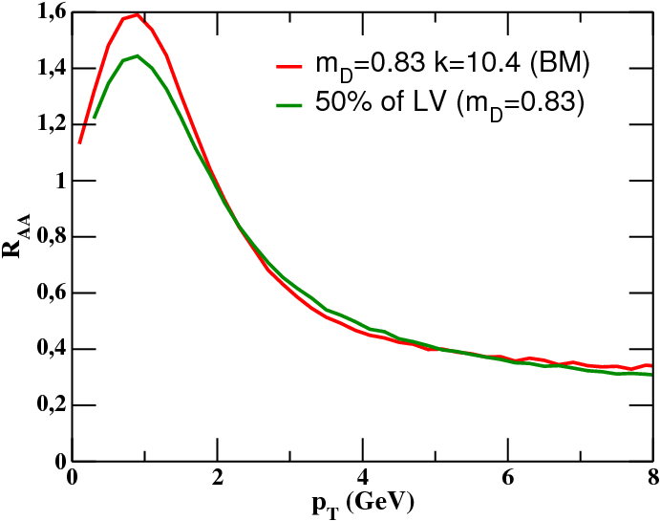
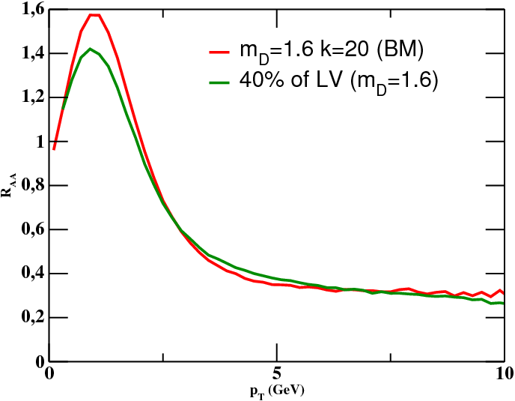
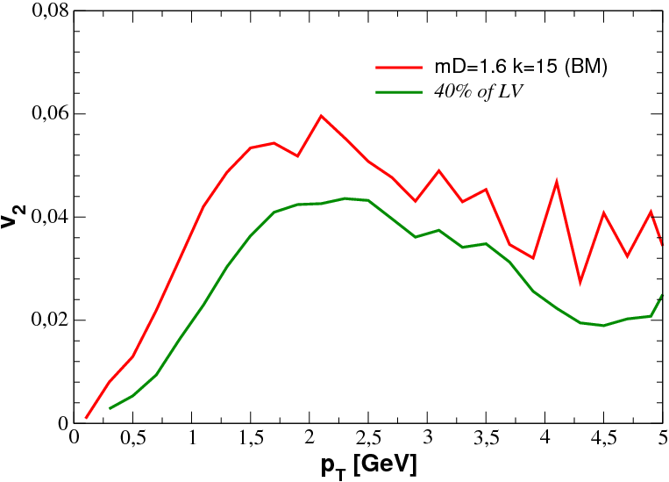
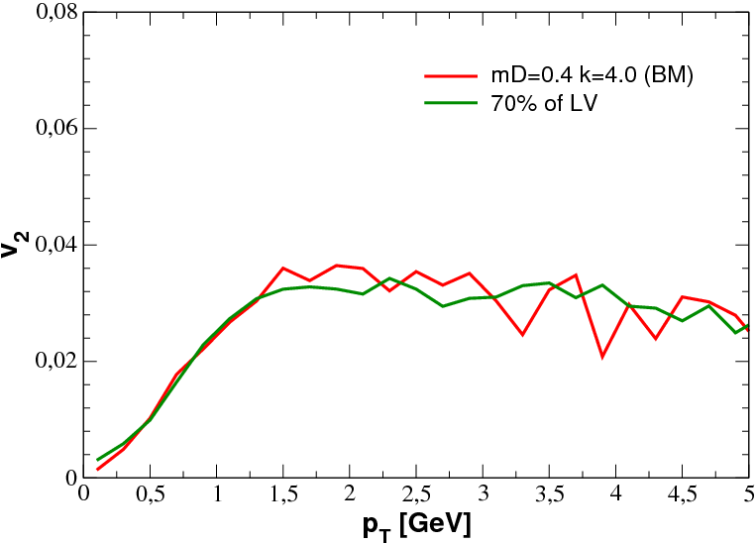
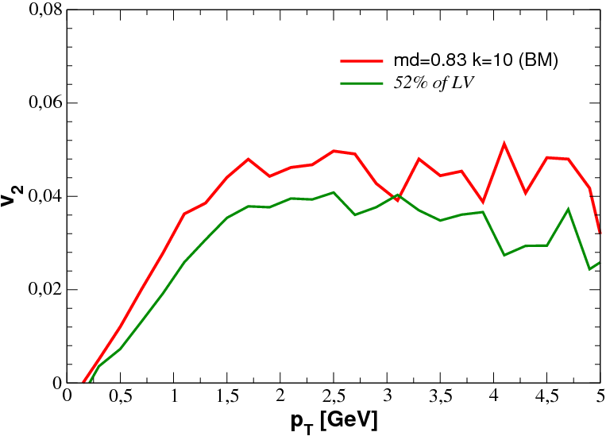
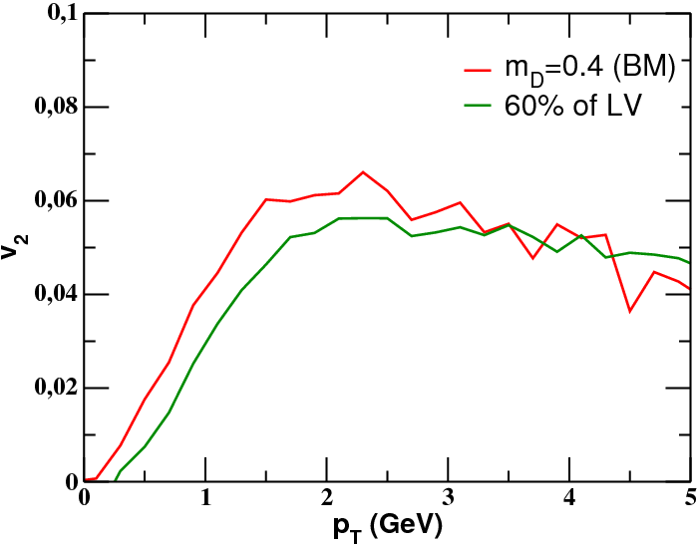
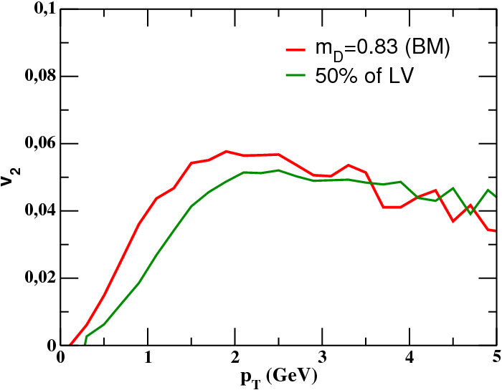
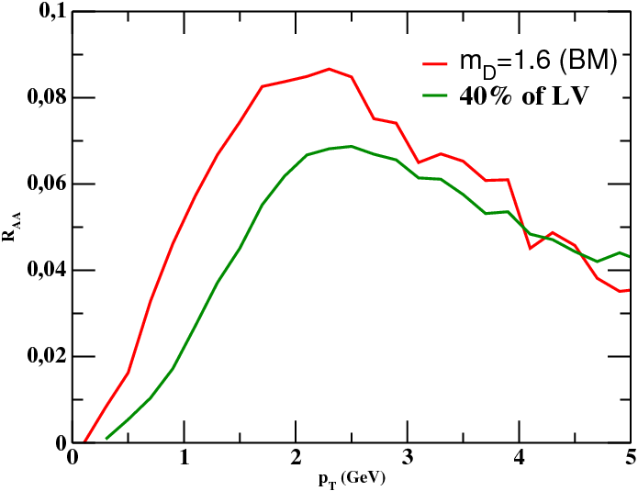
The puzzling relation between the R_{AA} and the v₂ for heavy mesons in a Boltzmann and in a Langevin approach
F. Scardina, S.K. Das, S. Plumari, V.Greco
University of Catania, INFN-LNS
Two different approaches for the Propagation of Heavy quark in the QGP
The heavy quarks (HQ), Charm and bottom, are ideal probes to study the Quark Gluon Plasma (QGP). HQ are considered heavy for a two-fold reason: first, typical of particles physics, is that the mass is much larger than Λ_{QCD} which make possible the evaluation of the cross section and momentum spectra within the next to lead order; the second more inherent to plasma physics is that their masses are much larger than the temperature and therefore they may expect to decouple from the medium and moreover their thermal production in the QGP is expected to be negligible. Therefore they are produced mainly in the initial hard parton scatterings of nucleon-nucleon interactions being witness of the entire-space time evolution of the system and can reveal important information about the properties of QGP. Both at RHIC and LHC energies it has been observed a puzzling correlation between the nuclear suppression factor R_{AA} and the elliptic flow v₂ that has challenged all the existing models. The propagation of heavy quarks through the quark-gluon plasma (QGP) has been quite often treated within the framework of Langevin equation (LV), i.e. assuming the heavy flavor momentum transfer is small or the scatterings are sufficiently forward peaked. We address a direct comparison between the Langevin dynamics and the Boltzmann collisional integral (BM).
Transport approach
Fokker Planck approach
Boltzmann equation (B-E)
Describes the evolution of the one
body distribution function f(x,p) of the bulk and also of Heavy Quarks
Fokker Planck equation
The Fokker Planck equation can be derived from the Boltzmann equation expanding the collision integral in terms of the transferred momentum k making the assumption that k is << than the momentum p of the HQ.
Collision Integral
Drag and Diffusion
Coefficients
Transition rate for collisions of Heavy quarks with heath bath changing the HQ momentum from p to p-k
The Fokker-Planck equation is
equivalent to an ordinary stochastic differential equation :
The Langevin equation (L-E)
is the deterministic friction (drag) force
C_{ij} is a stochastic force in terms of independent
Gaussian-normal distributed random variable ρ=(ρ_{x},ρ_{y},ρ_{z})
To solve numerically the B-E we divide the space into a 3-D lattice and we use the standard test particle method to sample f(x,p).
C₂₂ is solved using a stochastic algorithm consisting into the evaluation of the collision probability P₂₂ for each couple of particle in the cells.
The covariance matrix and Γ are related to the
diffusion matrix and to the drag coefficient by
[S. K. Das , F. Scardina, V. Greco arXiV:1312.6857],[J. Uphoff, O. Fochler, Z. Xu and C. Greiner PRC 84 024908; PLB 717]
[B. Zhang, L. W. Chen and C. M. Ko, Phys. Rev. C 72 (2005) 024906][P. B. Gossiaux, J. B. Aichelin PRC 78 014904]
[D. Molnar, Eur. Phys. J. C 49(2007) 181]
[H. van Hees, V. Greco and R. Rapp, Phys. Rev. C73, 034913 (2006) ],[G. D. Moore, D Teaney, Phys. Rev. C 71, 064904(2005)]
[S. Cao, S. A. Bass Phys. Rev. C 84, 064902 (2011) ], [Majumda, T. Bhattacharyya, J. Alam and S. K. Das, Phys. Rev. C,84, 044901(2012)]
[T. Lang, H. van Hees, J. Steinheimer and M. Bleicher arXiv:1208.1643 [hep-ph]],[C. Young , B. Schenke , S. Jeon and C. Gale PRC 86, 034905 (2012)]
pQCD evaluation of σ, A_{i} and B_{ij}
Simulations in a static medium
Simulations in which a particle ensemble in a
box evolves dynamically
Bulk composed only by gluons in thermal
equilibrium at T=400 MeV
Heavy Quarks are distributed uniformly in
coordinate space
LV/BM
Mass dependence of the LV/BM
To analyze the comparison between the Fokker-Planck approach and the Boltzmann approach we have
studied the ratio between the spectra coming from the simulations with LV and the spectra coming from the BM. In order to study the mass dependence of the approximation involved in the LV we have compared such a ratio for both charm (Mc=1.3 GeV) and Bottom (Mb=4.2 GeV). Moreover we have compared LV and BM simulating different values of the average momentum transferred k (different values of the Debye screening mass m_{D}.)
[S. K. Das , F. Scardina, V. Greco arXiV:1312.6857]
Average momentum transfer (<k>) dependence of the LV/BM
Realistic simulation of HIC
RHIC
LHC
R_{AA}(p_{T})
V₂(p_{T})
The Langevin dynamics overestimates the interaction for charms (large suppression) while in case of bottom quarks the approximation appears to be quite reasonable
However one can gets very similar R_{AA} for both the approaches just reducing the diffusion coefficient
Boltzmann is more efficient in producing v₂ for fixed R_{AA} especially for large average momentum transfer
This together with a coalescence hadronization mechanism may quenches the puzzling RAA and v2 observations

