Slide 1




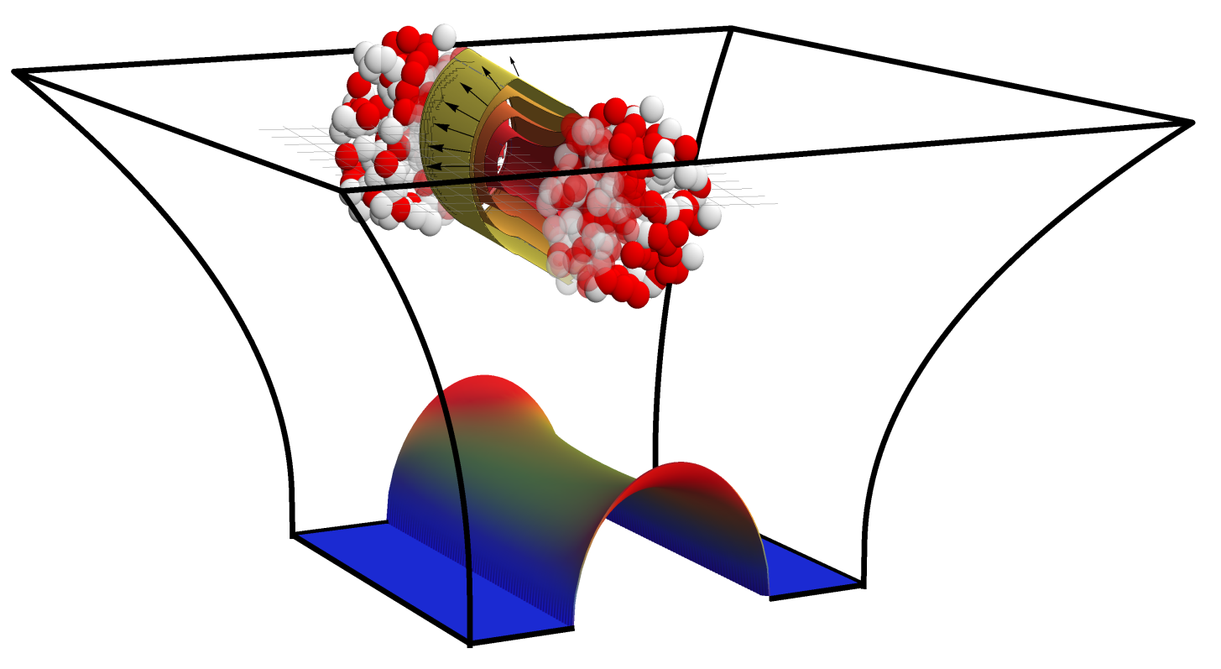

Collisions in AdS: the road to experiments
Towards more realistic models of the QGP thermalisation
Work with Michał Heller, David Mateos, Jorge Casalderrey, Paul Romatschke and Scott Pratt
References: 1305.4919 (PRL 111), 1307.2539 (PRL 111), 1312.2956 (PRL), PhD Thesis
Wilke van der Schee
Supervisors: Gleb Arutyunov,
Thomas Peitzmann and Raimond Snellings

Slide 2
Outline
Wilke van der Schee, Utrecht
See talk by Romuald Janik
AdS/CFT: initial state @ strong coupling
  Only approximate to QCD at intermediate coupling (like CGC)
  Computations in simplified settings (as opposed to CGC)
  Starting to get useful conclusions for HIC ☺
Longitudinal dynamics: shocks in AdS
  From Landau to Bjorken (but not quite)
  Coherence and a universal rapidity profile
Towards experiments:
  Radial flow and transverse spectra
  (p-Pb rapidities)
  (total multiplicities)
  (directed flow)
  (baryon number)
Notes:
Many states + linearized

Slide 3
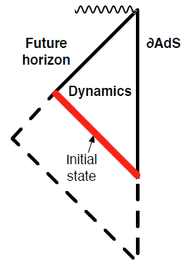
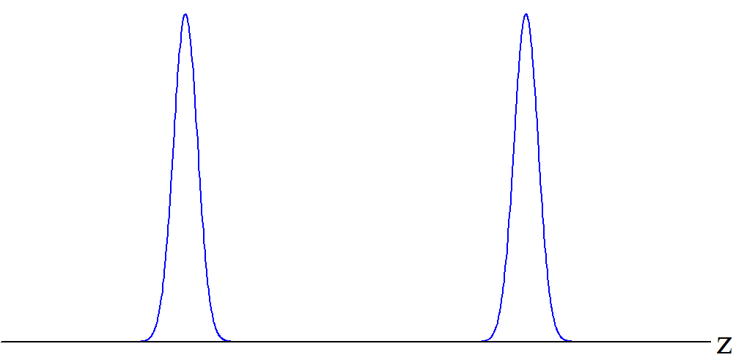
Shock waves – initial conditions
Wilke van der Schee, Utrecht
Field theory interpretation:
  Start with energy as function of space
  Demand that it moves with speed of light
  → quantum state/AdS geometry is completely fixed
Homogeneous in transverse plane (‘infinite nucleus’)
P.M. Chesler and L.G. Yaffe, Holography and colliding gravitational shock waves in asymptotically AdS₅ spacetime (2010)

Slide 4
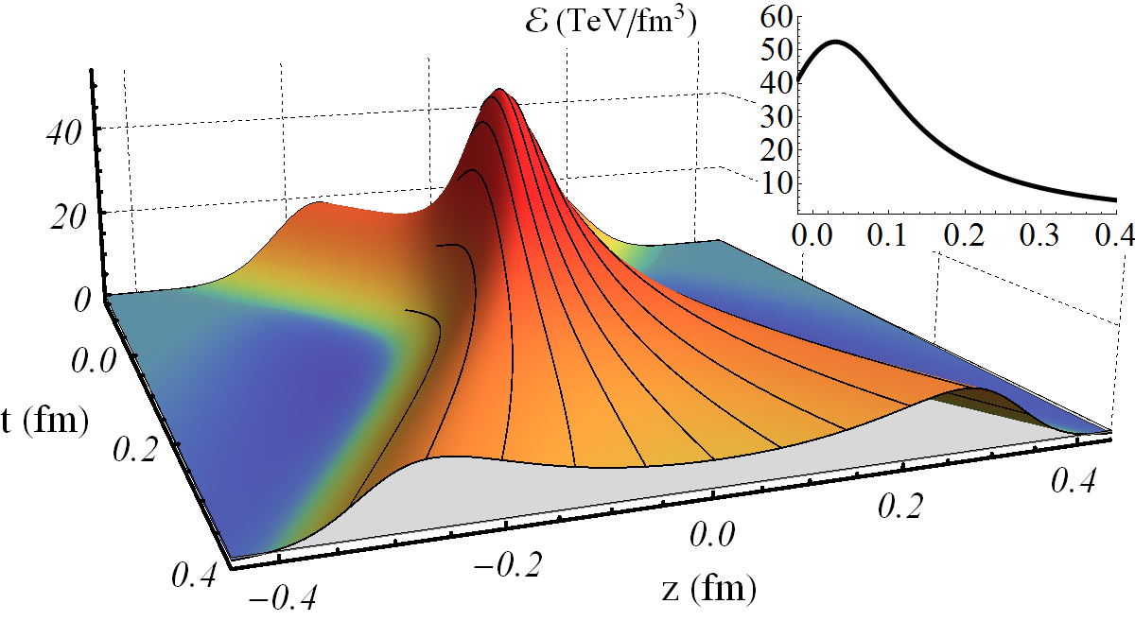
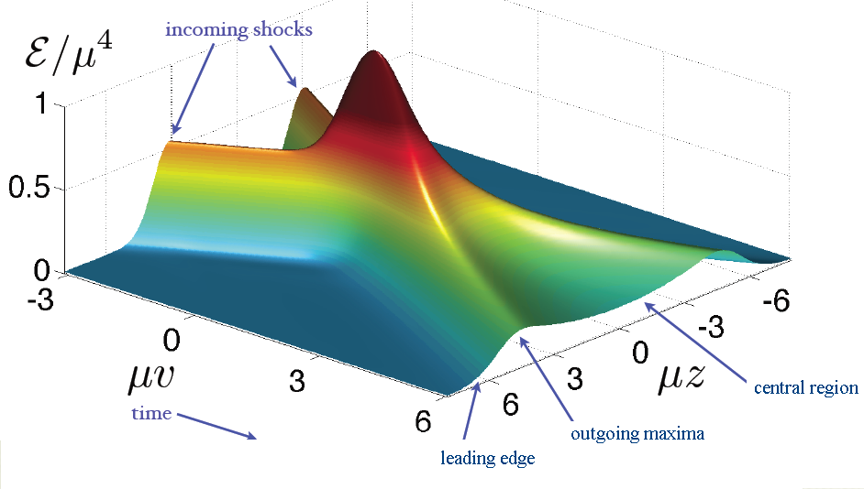
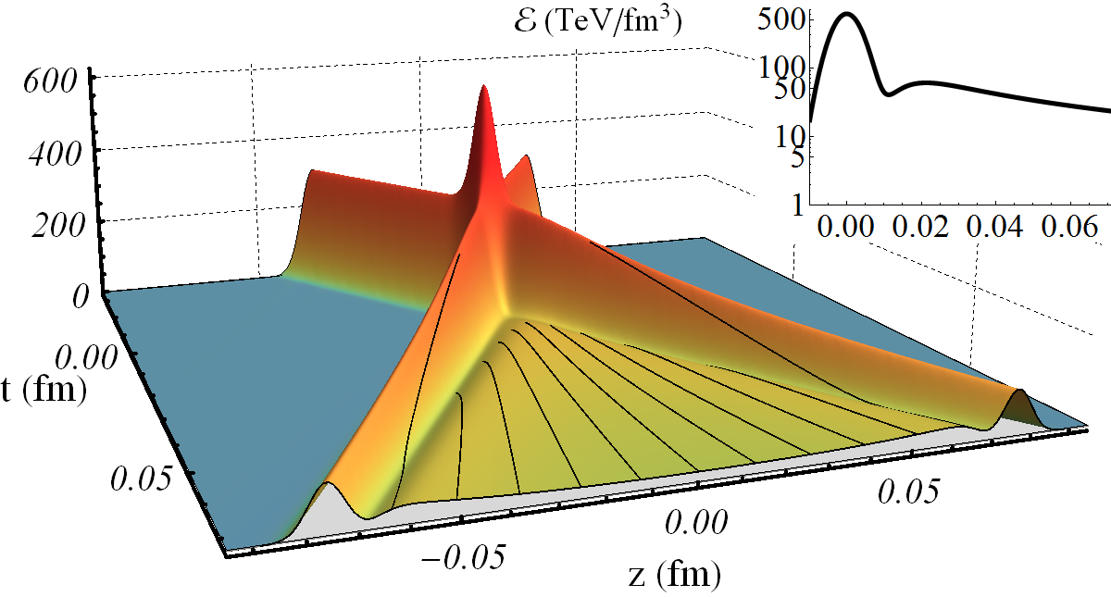
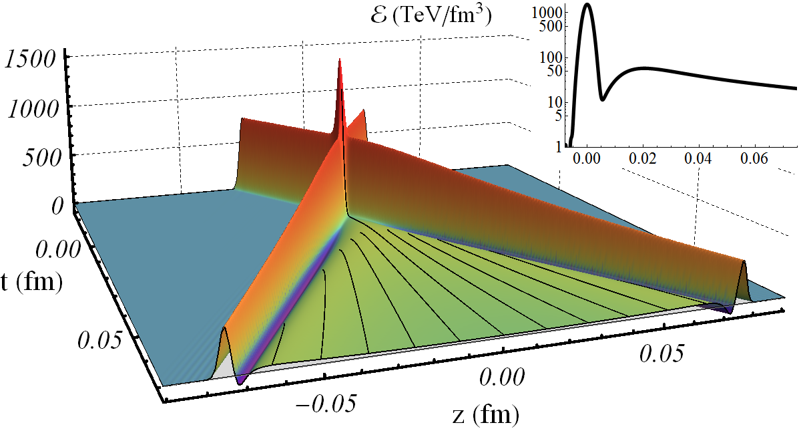
Shock waves – a dynamical cross-over
All units are fixed by total energy per transverse area at centre of central LHC-collisions
Wilke van der Schee, Utrecht

Slide 5
Shock waves – a dynamical cross-over
All units are fixed by total energy per transverse area at centre of central LHC-collisions
Wilke van der Schee, Utrecht

Slide 6
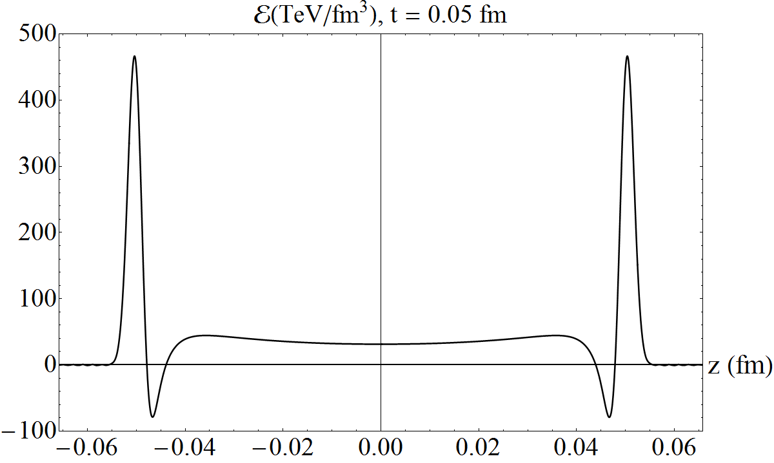
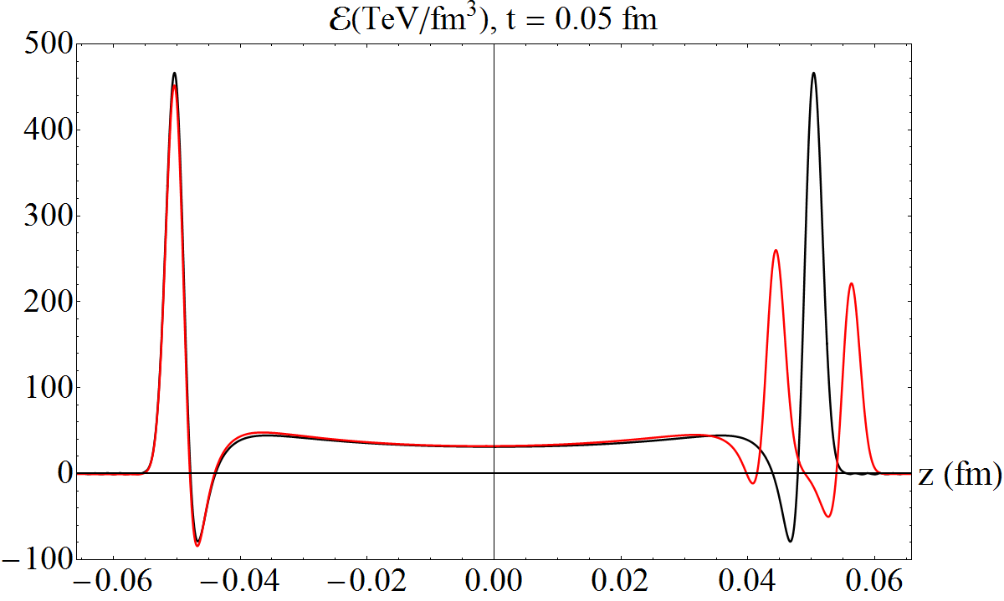
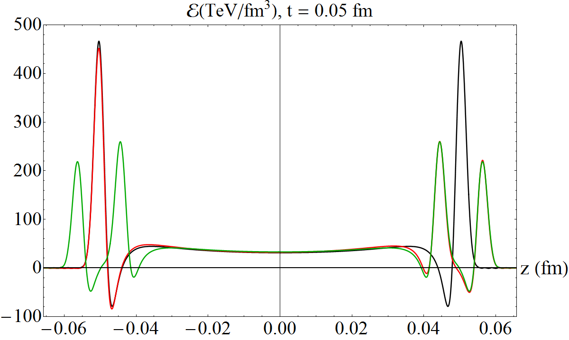
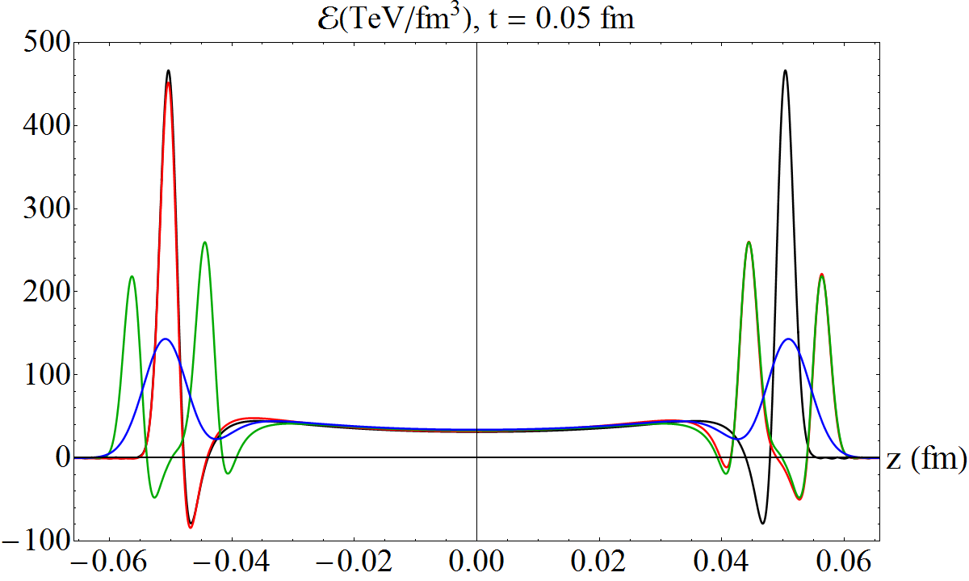
Longitudinal coherence
Wilke van der Schee, Utrecht
Comparable c.o.m. late time results for narrow shocks:
Plotted at ~ 2t_{hyd}

Slide 7
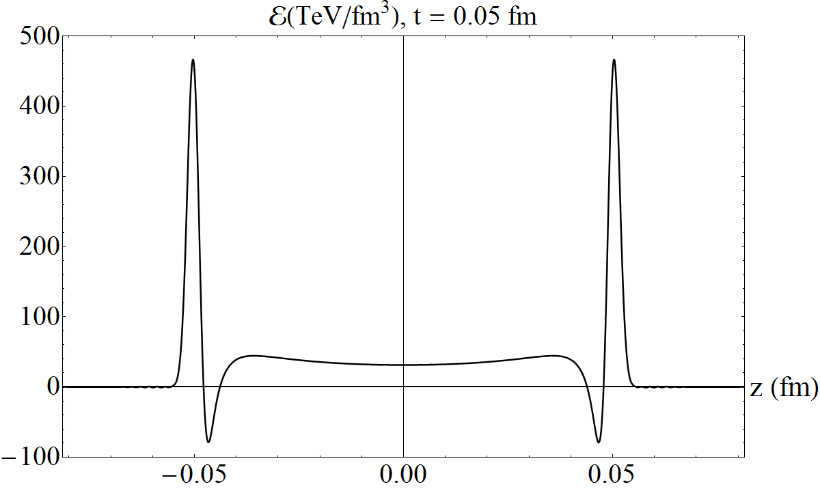
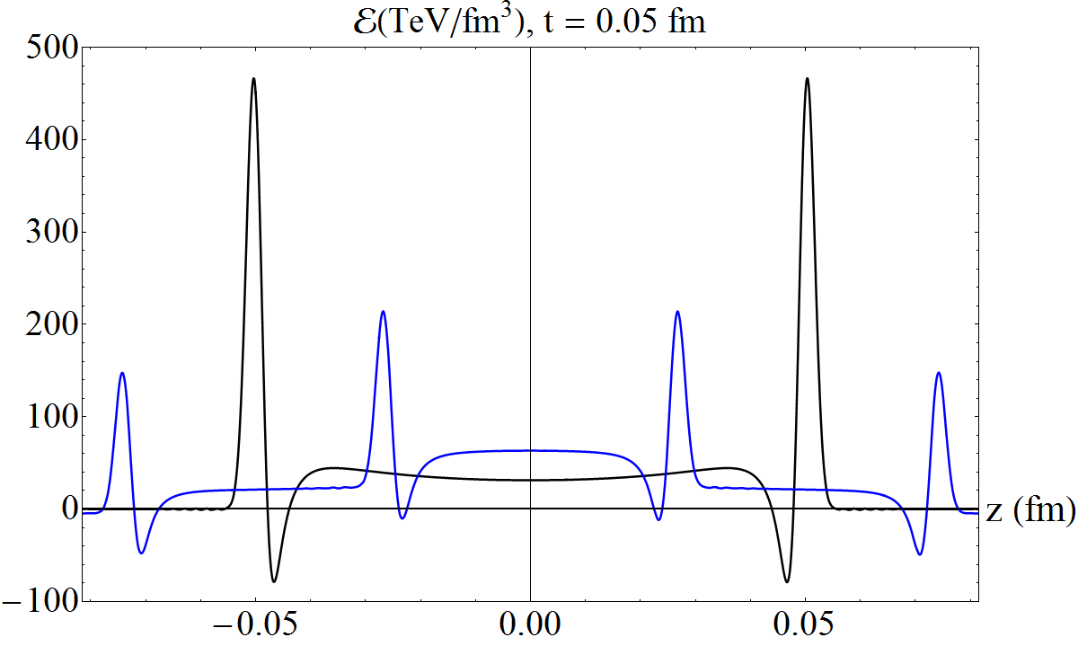
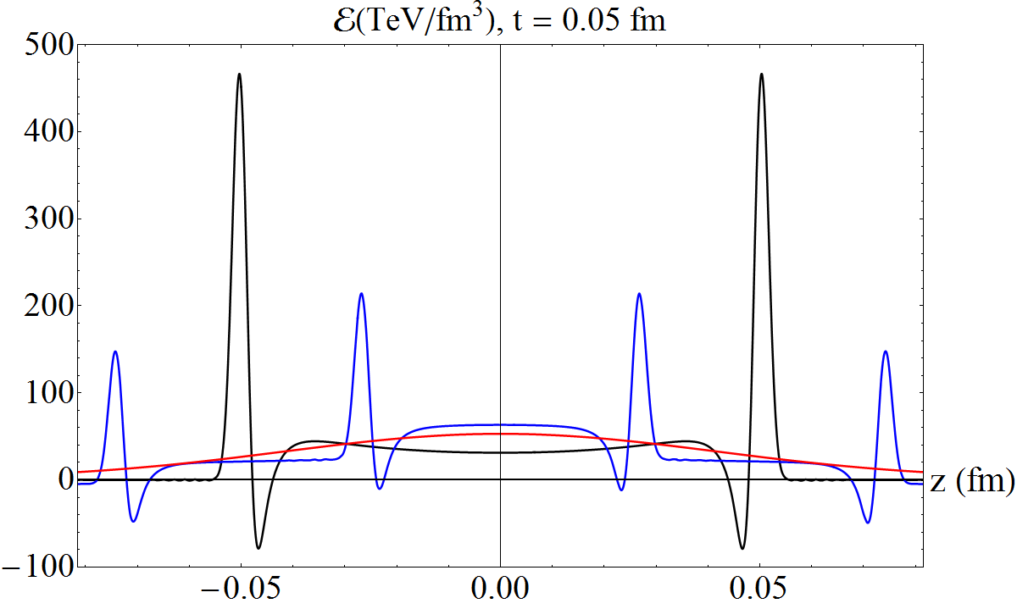
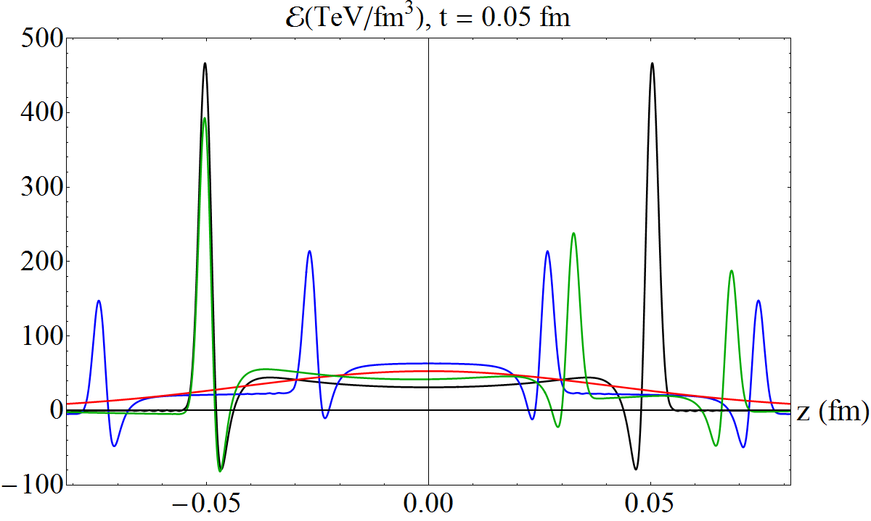
Longitudinal coherence
Wilke van der Schee, Utrecht
For shocks with large characteristic size: no coherence
Asymmetric shock gives asymmetric plasma

Slide 8
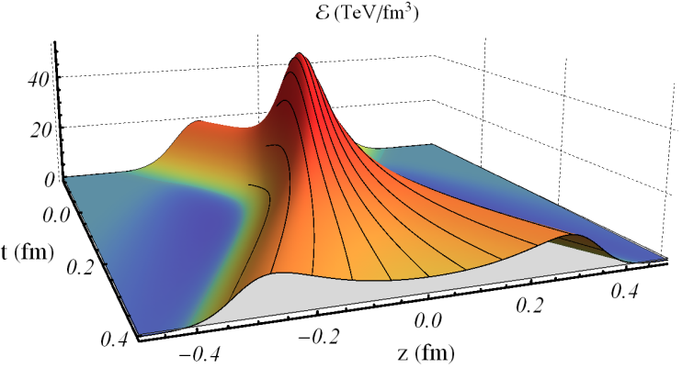
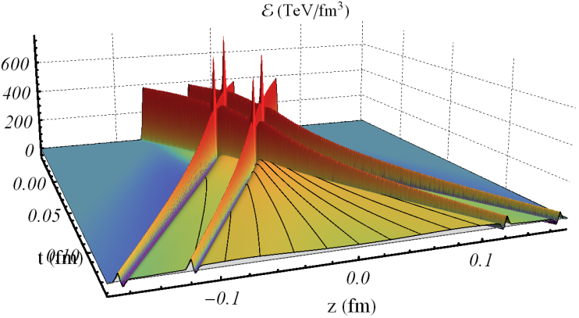
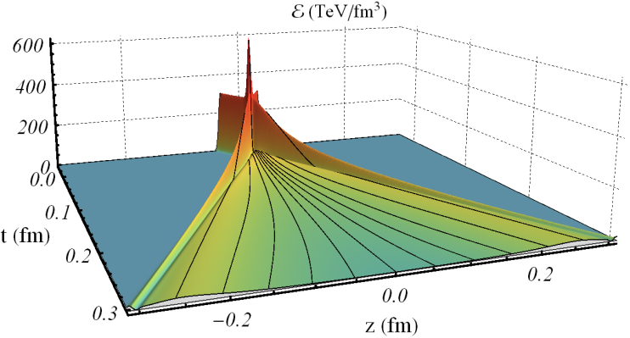
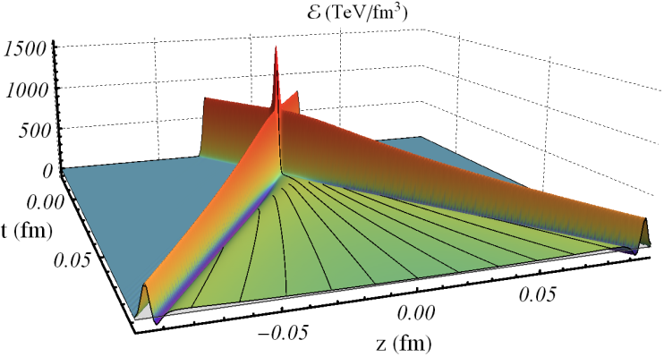
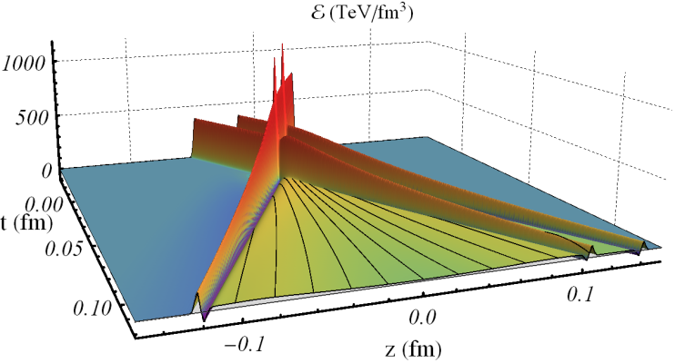
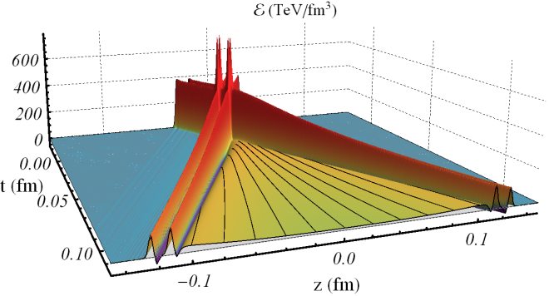
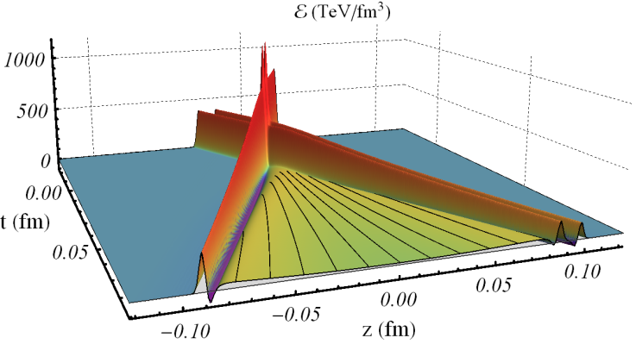
Important conclusion
Wilke van der Schee, Utrecht
Longitudinal dynamics takes place in
c.o.m. of participating nucleons
In particular, it is symmetric around mid-rapidity

Slide 9
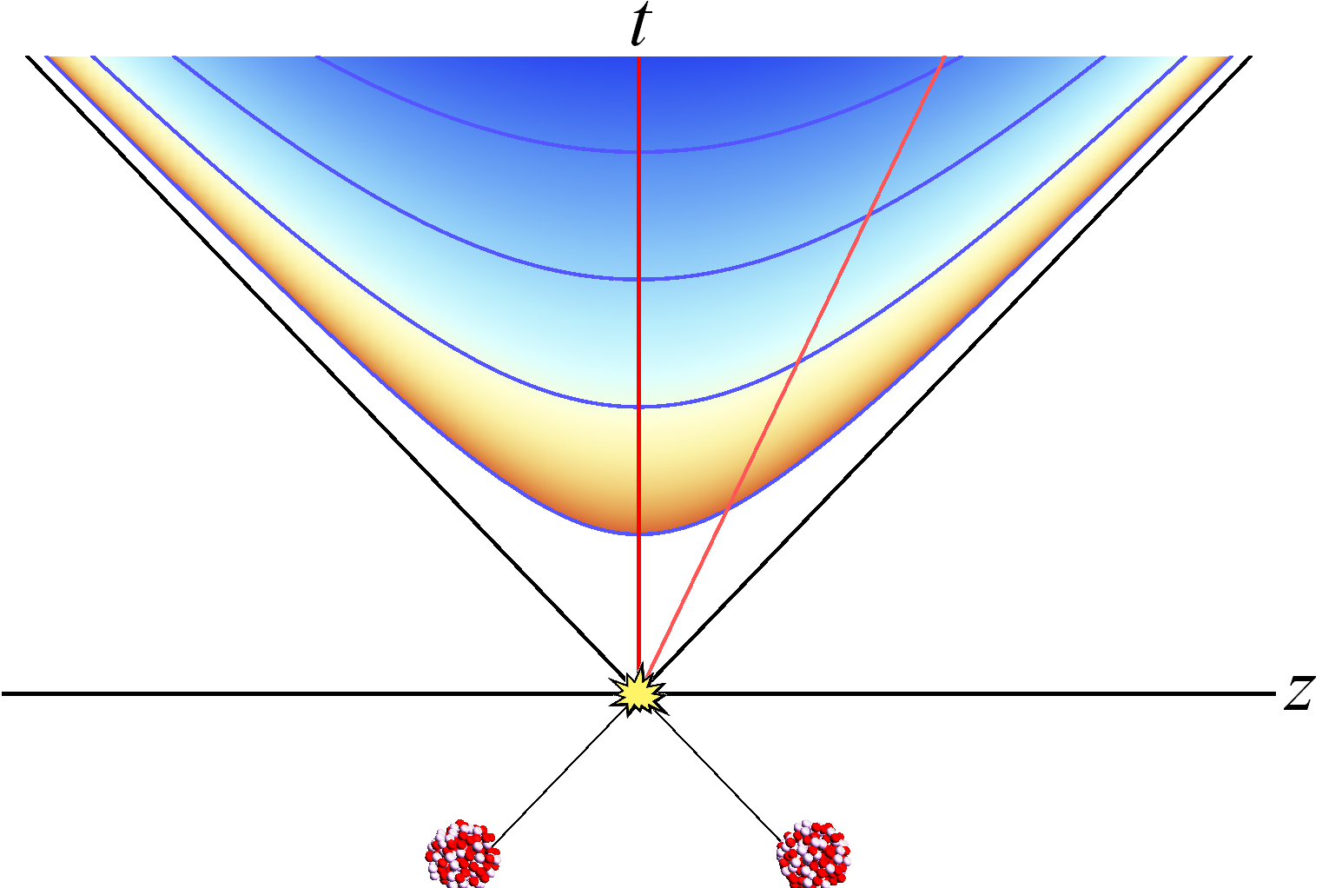
Reminder: rapidities and initial state BI
Wilke van der Schee, Utrecht
Useful coordinates in expanding plasmas:
Weak coupling: interactions follow charge
  Boost-invariant if moving on light-cone
Strong coupling: interactions follow energy
  Receives γ-factor on boosting, even if v ≈ c

Slide 10
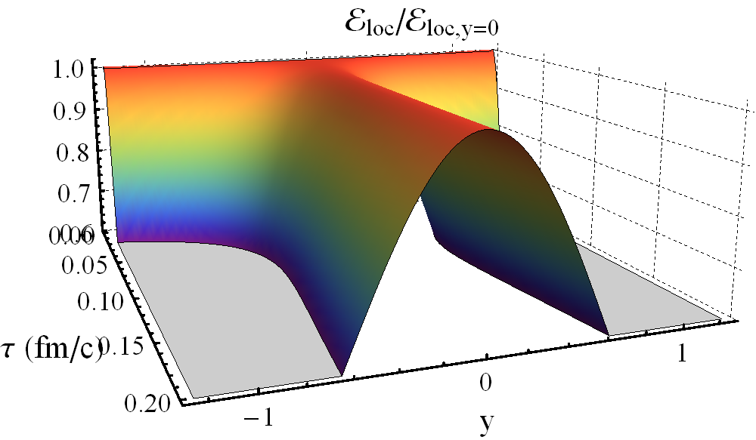
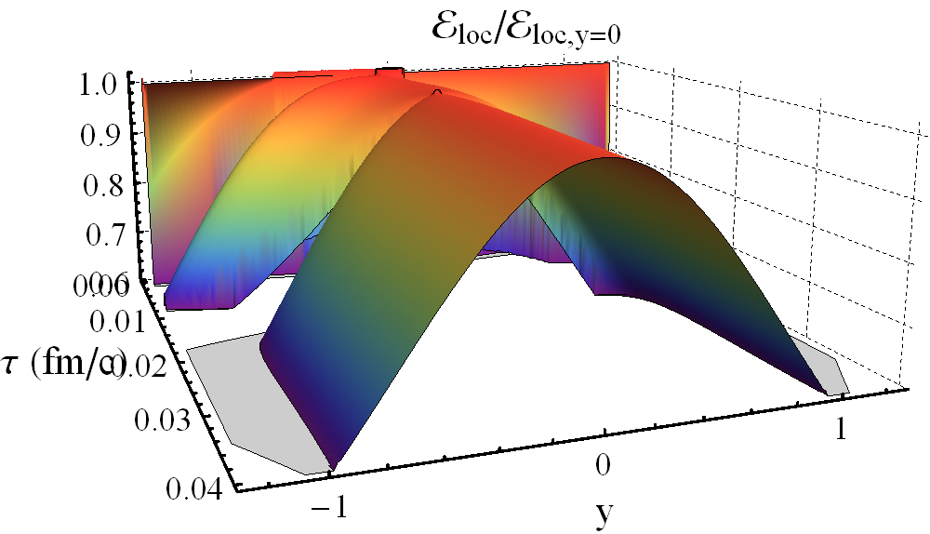
A universal rapidity profile
Wilke van der Schee, Utrecht
How is plasma energy distributed in longitudinal direction?
Coherence: high energy profile is universal!
Low energy:
High energy:

Slide 11

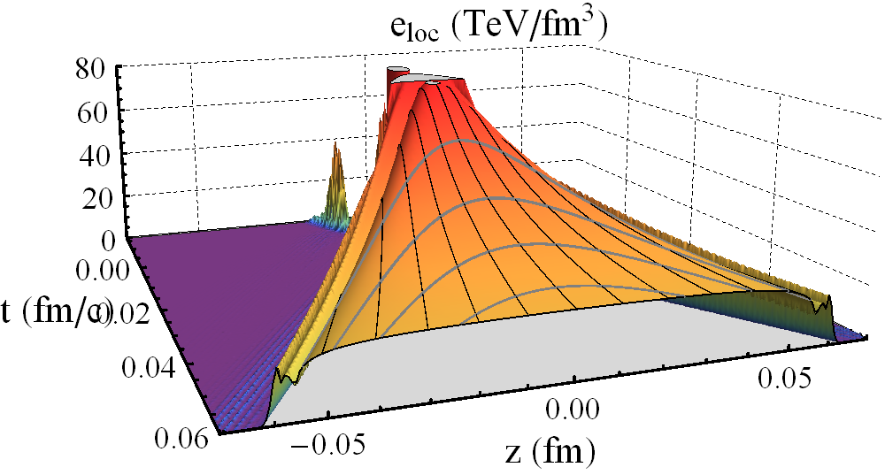
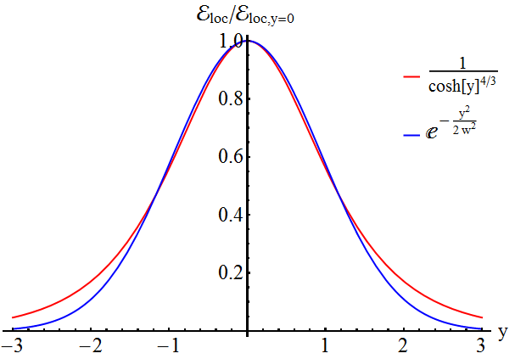
Even clearer in real space-time
Main message
Wilke van der Schee, Utrecht
Local energy density, flat in z
Approximation: decay in time
  Rapidity Gaussian, or perhaps
Why flat? Don’t know, but robust computation.

Slide 12
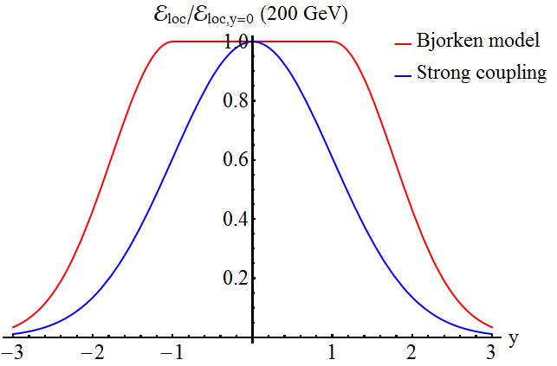
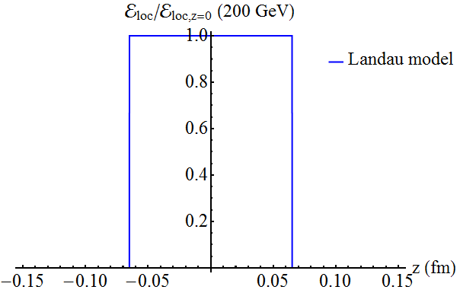
Longitudinal HIC physics: Landau vs Bjorken
Wilke van der Schee, Utrecht
Bjorken: boost-invariant at high energies and mid-rapidity
Landau: completely equilibrated at moment of overlap
Strong coupling: universal Gaussian rapidity, width ~ 0.95
P. Bozek, I. Wyskiel, Directed flow in ultrarelativistic heavy-ion collisions (2010)

Slide 13
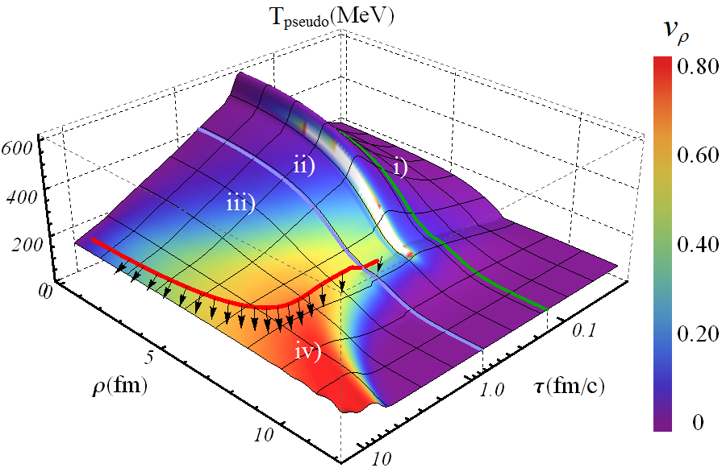
A fully dynamical model of a HIC
Work with Paul Romatschke and Scott Pratt
i) Small time expansion of colliding shocks (central)
ii) Numerical GR (extra parameter)
iii) Viscous hydro
iv) Hadronic
cascade
Boost-invariant
P. Romatschke and D. Grumiller, On the collision of two shock waves in AdS₅ (2008)
WS, Holographic thermalization with radial flow (2012)

Slide 14
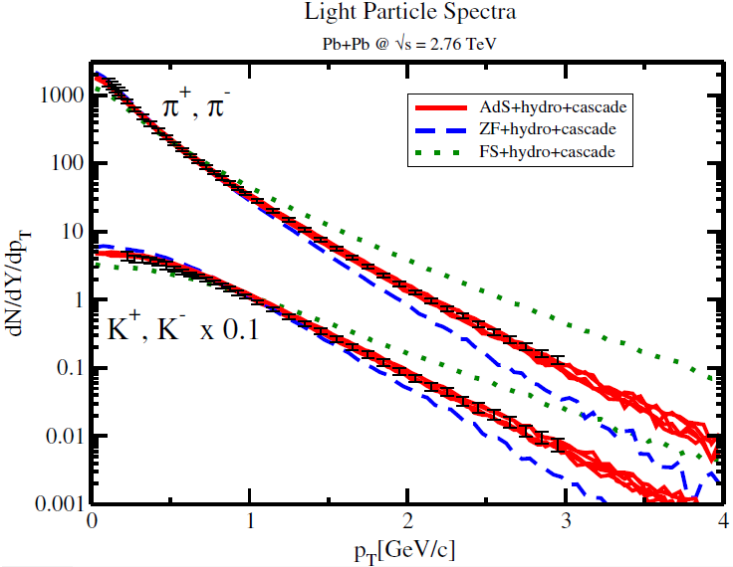
Boost-invariant radial flow
Wilke van der Schee, Utrecht
Spectra ☺

Slide 15
Discussion
Wilke van der Schee, Utrecht
A universal rapidity profile
  Initial state: constant temperature at fixed time, with Bjorken velocity
  Longitudinal coherence: p-Pb symmetry
Lessons at infinite coupling
  Strong coupling ≠ full stopping
  Evolution thermalises dynamically, fast and with large anisotropy
Towards experiments:
  Radial flow and transverse spectra
  p-Pb rapidities (maximum @ c.o.m.), directed flow, thermal photons (?),
  total multiplicities (~factor 2 too high @ LHC), baryon number
Future: correct for infinite coupling approximation
  Include finite coupling corrections
  Try phenomenological models
Notes:
Future: obvious

Slide 16
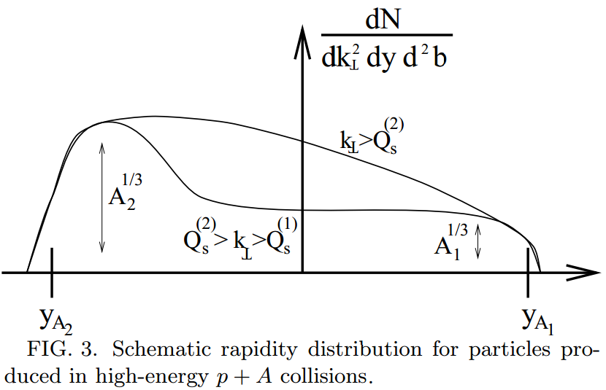

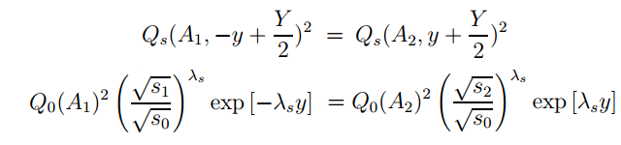
Perturbative QCD
Wilke van der Schee, Utrecht
Coherence: trivial and/or experimentally disfavoured?
Perturbative QCD: interaction crucially depends on charge
  c.om.: same energy, but not the same charge!
Particle production ~ saturation
Maximum at equality:
A. Dumitru and L. McLerran, How Protons Shatter Colored Glass (2001)
B. Xiao, Multiplicity and transverse energy of produced gluon in relativistic heavy ion collision (2005)

Slide 17
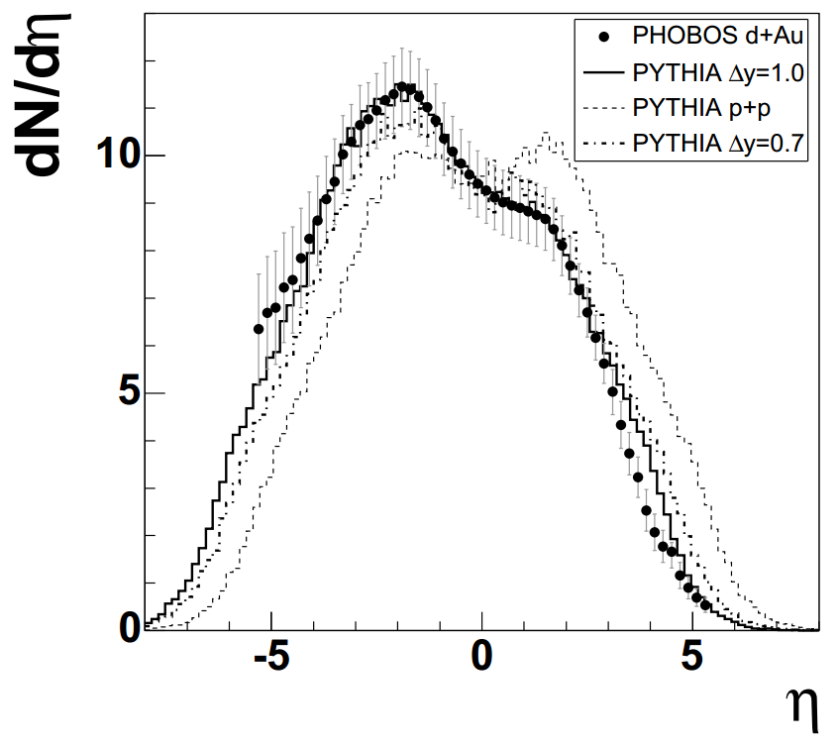
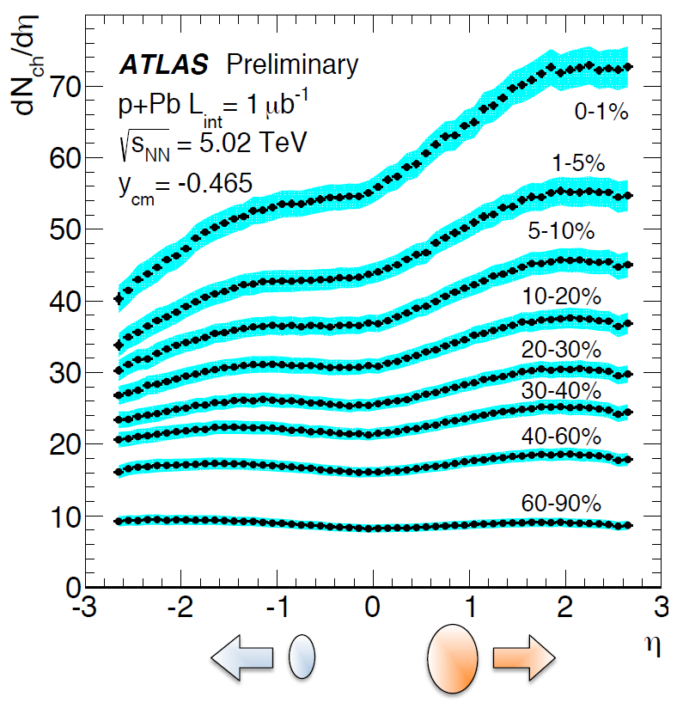
p-Pb symmetry, a prediction?
Wilke van der Schee, Utrecht
Subtlety converting rapidity → pseudo-rapidity
  Many interesting articles by Peter Steinberg
P. Steinberg, Inclusive Pseudorapidity Distributions in p(d)+A Collisions Modeled With Shifted Rapidity Distributions (2007)
ATLAS presentation

Slide 18
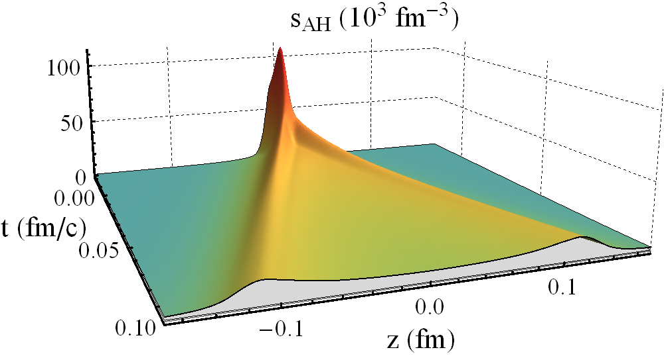
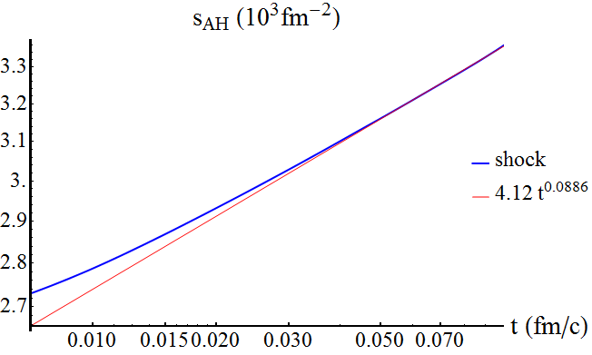
Entropies and multiplicities
Wilke van der Schee, Utrecht
Plasma hadronises around T~170MeV
# of particles ~ local energy or entropy (~E/T)
Entropy is approximately conserved (η small)

Slide 19
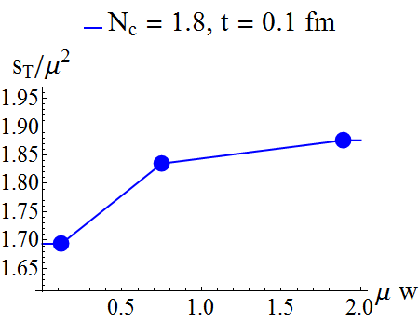
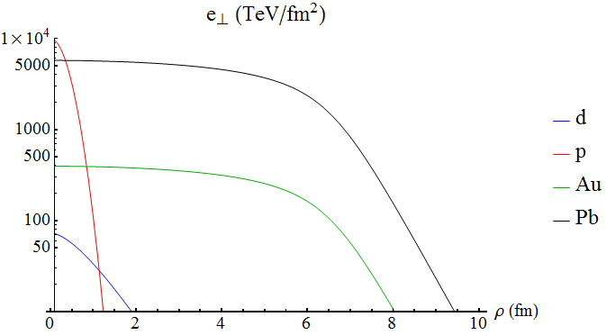
Apparent horizon
Wilke van der Schee, Utrecht
Total entropy (per transverse area) mildly depends on w
Step: assume small gradients in transverse plane

Slide 20
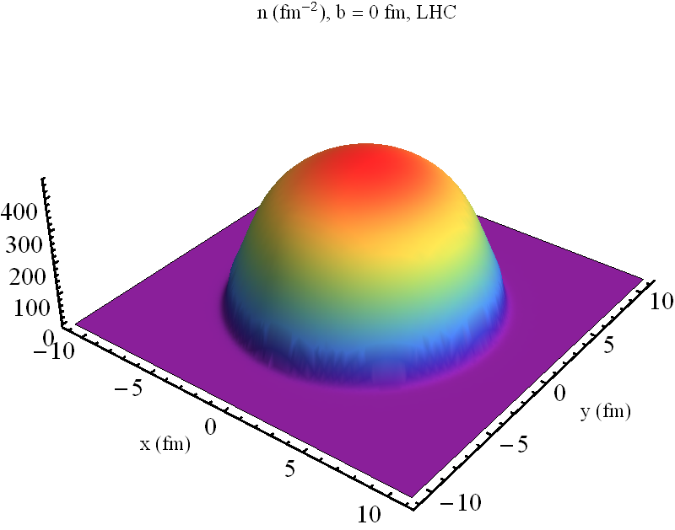
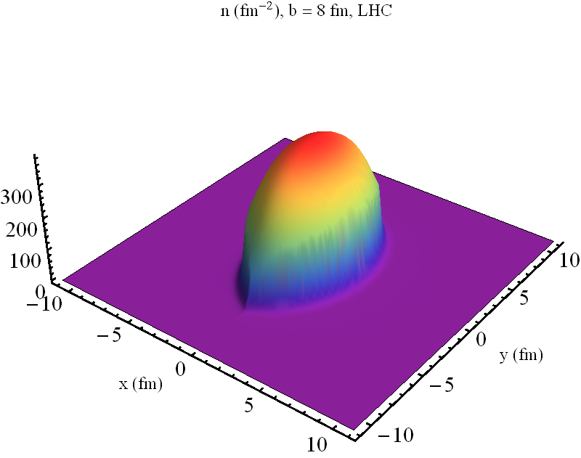
Example multiplicities
Wilke van der Schee, Utrecht
Two examples of entropy per transverse area

Slide 21
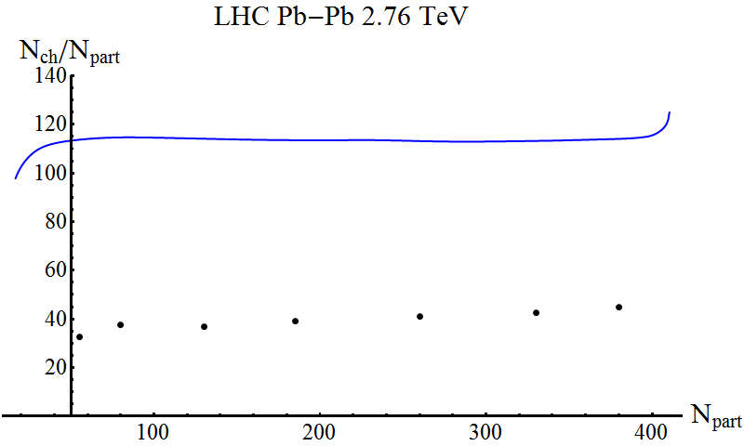
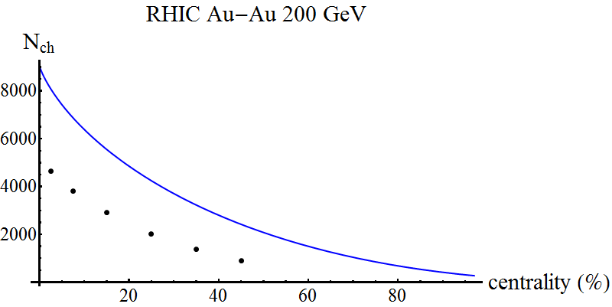
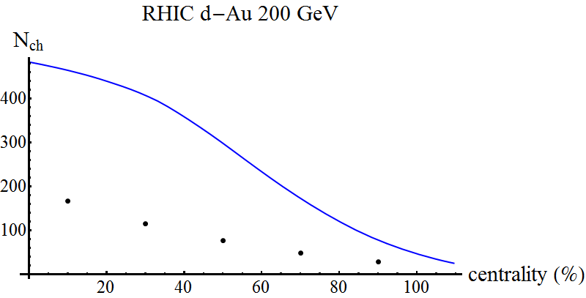
Multiplicity plots
Bulk Properties of Pb-Pb collisions at √s_{NN} = 2.76 TeV measured by ALICE (2011)
Pseudorapidity distributions of charged particles from Au+Au collisions at the maximum RHIC energy, √s_{NN} =200 GeV (2001)
Wilke van der Schee, Utrecht
Several corrections:
  No spectators (-15%)
  Event-by-event fluctuations
  More viscous effects?
  Shape deuteron? N_{part}?
  Weak coupling effects

Slide 22

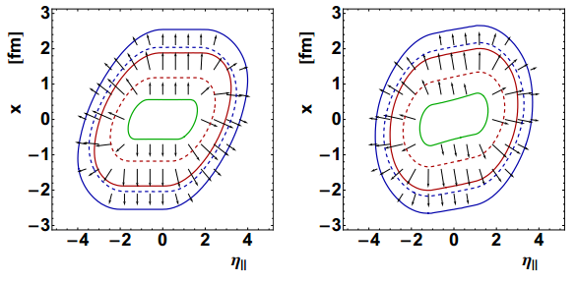
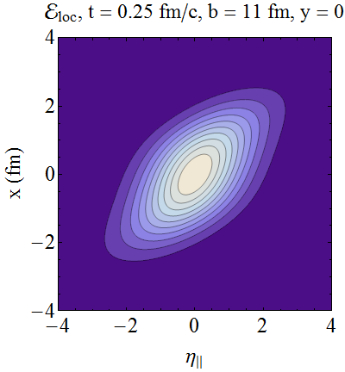
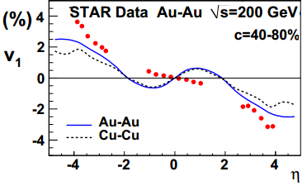
A consequence: directed flow
Wilke van der Schee, Utrecht
In non-central collisions there is directed flow:
‘Standard’ boost-invariant coherent model conflicts with experiment
  Either tilt,
  Or use narrow Gaussian rapidity profile
P. Bozek, I. Wyskiel, Directed flow in ultrarelativistic heavy-ion collisions (2010)

Slide 23
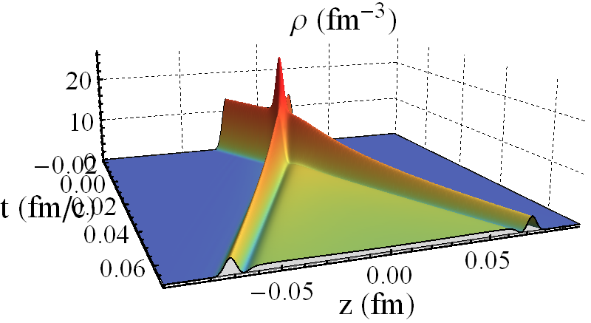
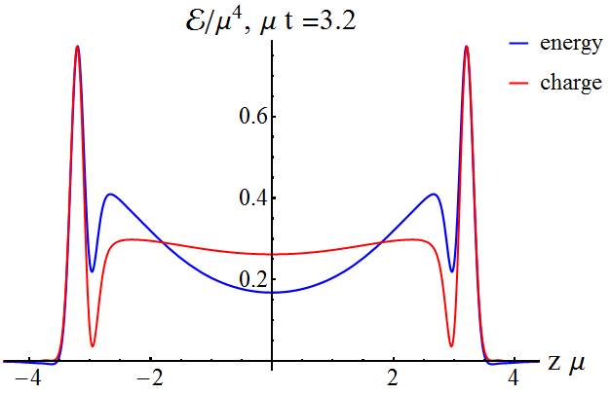
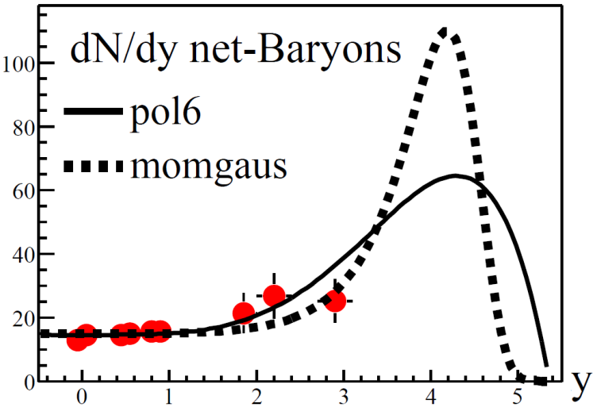
Baryon number and conserved charge
Wilke van der Schee, Utrecht
Pure gravity doesn’t have conserved charge
  Add vector field
Does net charge end up at high y?
  Preliminary: no or maybe...
BRAHMS, Nuclear Stopping in Au+Au Collisions at √s_{NN} = 200 GeV(2003)

Slide 24



Local energy density flatter in real time!
Wilke van der Schee, Utrecht
Instead of proper time, try real time local energy density:
Numerically hard at high rapidities
  Perhaps constant local energy density in real time?
  Velocity seems close to boost-invariant: (but changes?)

Slide 25

Example collision
Wilke van der Schee, Utrecht
Can also give input for hydro etc...

Slide 26


Pressure anisotropy
Wilke van der Schee, Utrecht
Pressure, energy starts at zero, grows
Can give large negative longitudinal pressure:

Slide 27



Initial state versus thermal fluctuations
Wilke van der Schee, Utrecht
Result: little longitudinal initial state fluctuations
  As opposed to transverse fluctuations!
T. Springer and M. Stephanov, Hydrodynamic ﬂuctuations and two-point correlations (2012)

Slide 28

Shock waves from the bulk
Wilke van der Schee, Utrecht
Interesting interplay between temperature & width:
  Non-linearity roughly comes from horizon
  Touches front-end latest: by causality!

Slide 29


Newer results – bulk understanding
Wilke van der Schee, Utrecht
UV structure is washed out in IR
  Compare energy density with area apparent horizon
Apparent horizon is almost symmetric!

Slide 30


Newer results – bulk understanding
Wilke van der Schee, Utrecht
Fine UV structure is washed out in IR
  Compare scale structure with 0.1/Temperature

Slide 31





Thermalisation/hydro in small systems?
When is hydro applicable?
  Not far-from-equilibrium (shock,
  Not when pressure is negative (unstable)
    But viscous/anisotropic hydro can apply if pressure ~ 0 (!!)
  Not in confining state
  Not in small system: (perhaps ?):
  Turbulence? (HIC typically too short?)
  Shocks: hydro applies within 0.3/T
For p-Pb and p-p collisions only few particles produced
  Naïve estimate: gives
  So it all depends on the π’s…
  AdS/CFT: hydro in small systems definitely possible

