Slide 1
HEP Activities in Japan
Sakue Yamada (KEK) at FCPPM (Marseille-CPPM) 15.01.2008
Brief History
Present Facilities and Experiments
Including future up-grades
3. Facilities under construction (J-PARC)
and R&D for future facilities(ATF2)

Slide 2
Brief History
1955 INS, Univ. Tokyo, established
1957 FF Cyclotron,
1960 FM Cyclotron
1961 Electron Synchrotron (0.75GeV → 1.3GeV)
1964 Preparation for KEK
1971 KEK, established
1976 12GeV PS
1978 Booster application Facility (sp.neutron, muon for material science)
1978 Photon factory (2.5GeV LINAC + SR, first 2nd generation SR Ring)
1986 TRISTAN e+e- 51GeV → 60GeV (Highest energy before LEP)
1993 TRISTAN II (KEK-B) (Highest luminosity, being improved)
Belle experiment is on-going.
1997 New KEK established (old KEK + INS )
2001 J-PARC construction started together with JAEA
It is to be completed this year.

Slide 3
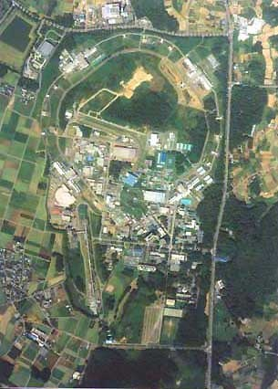
KEK
KEK-B
Belle
K2K-beamline
ATF
PS
PF
LINAC

Slide 4
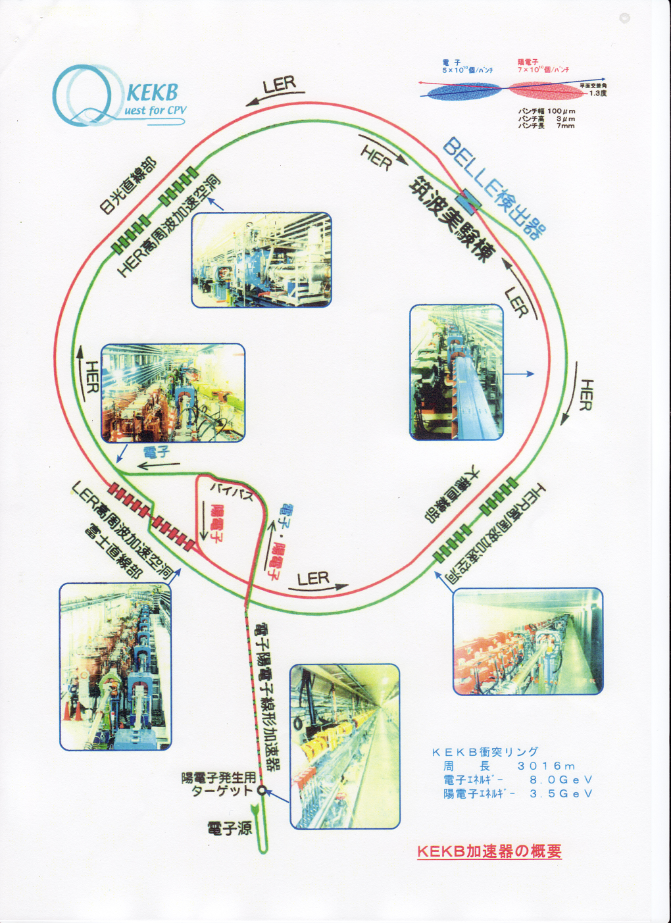
KEK-B Factory with asymmetric energies
HER RF cavities
Circumference : 3016m
E(electron): 8.0 GeV , 1.1A -> 1.24A
E(Positron): 3.5 GeV, 2.6A -> 2.0A
Luminosity
Crossing angle: 1.3 degree
Direct Injection during running
HER Cavities
Positron
Production target

Slide 5
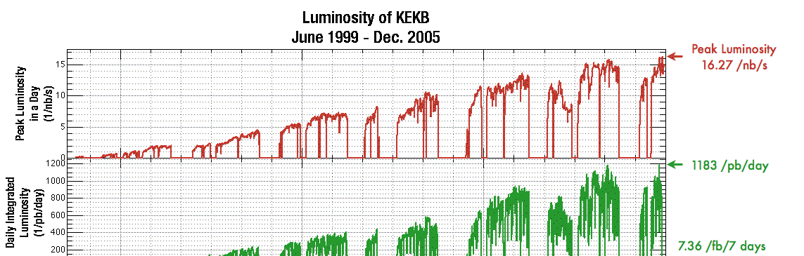
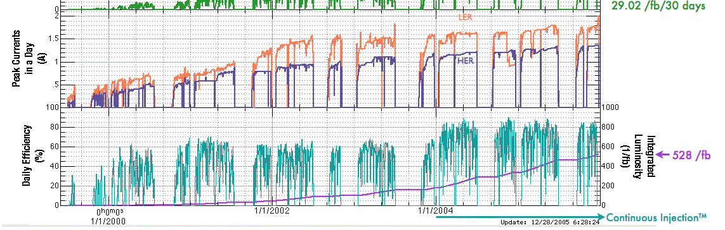

Slide 6
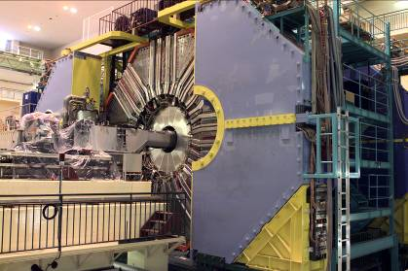
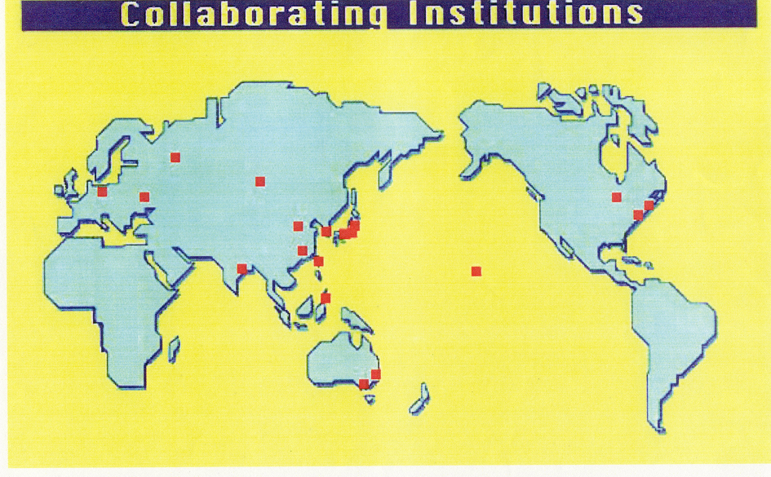
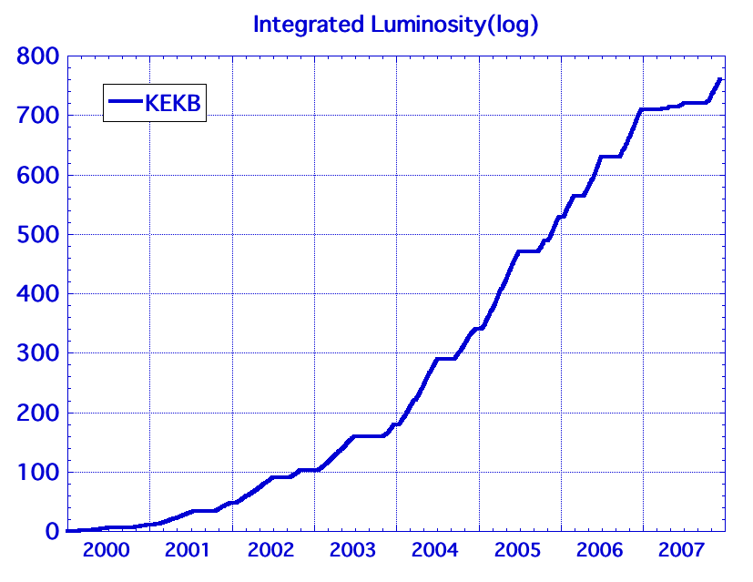
Belle Experiment
(1/fb)
Collaboration of 55 institutions from 13 Countries/region
They accumulated very large data sample, 760/fb by now.
→ High accuracy & sensitivity

Slide 7
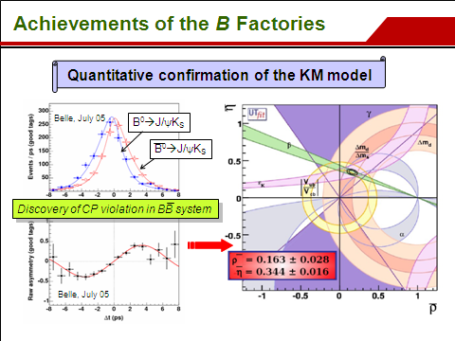

Slide 8
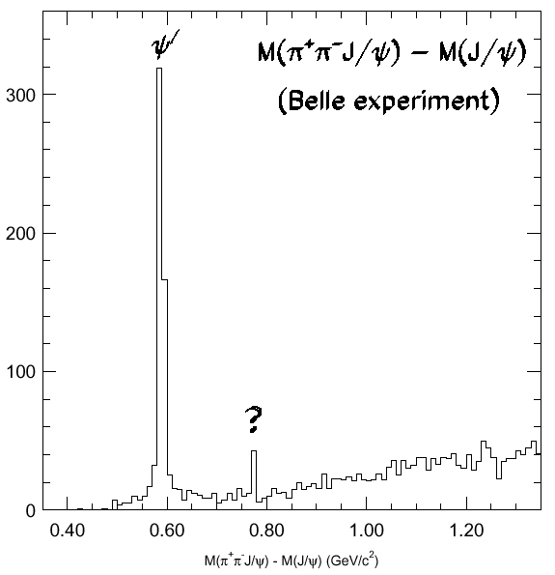
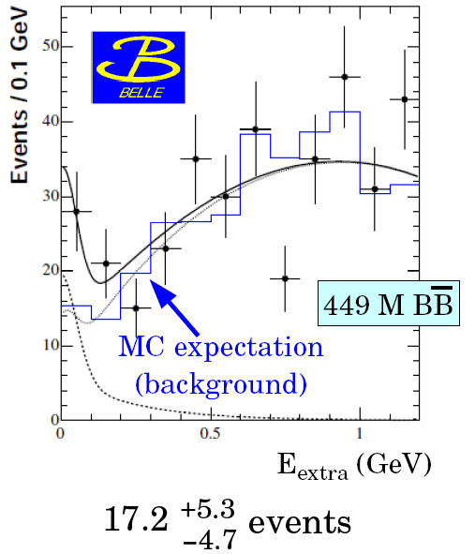
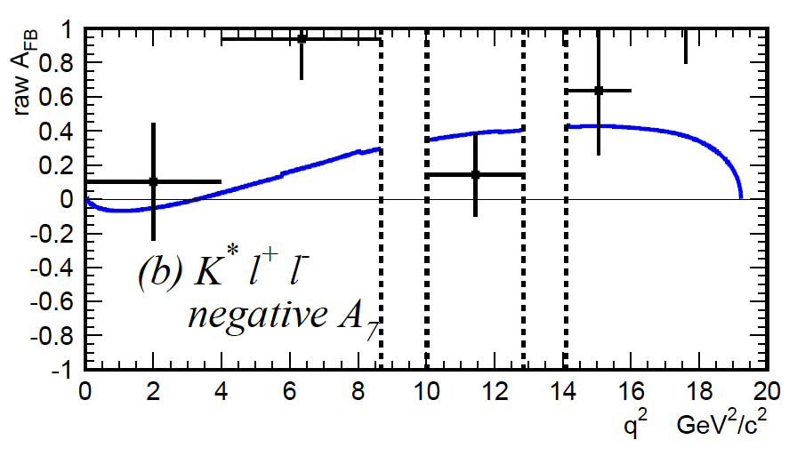
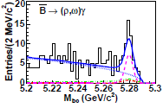
Other highlights
Many new resonances
Evidence for Bgτν
A_{FB} in BgK*l⁺l⁻
X(3872)
Z(4430)
Belle, 2005
SM
D⁰-D⁰ mixing
bgdγ transition
BgD*τν
and more…

Slide 9
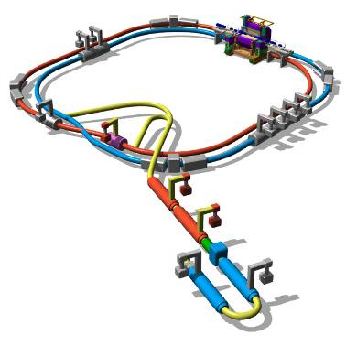
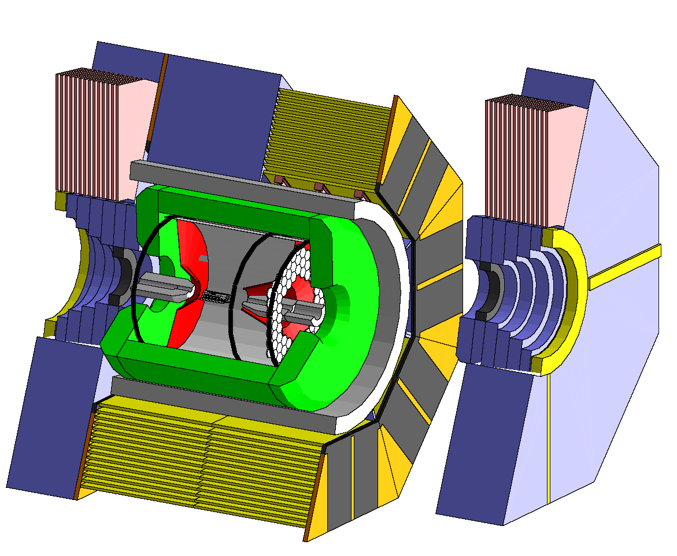
KEKB upgrade
Asymmetric energy e⁺e⁻ collider at E_{CM}=m(ϒ(4S)) to be realized by upgrading the existing KEKB collider.
Super-high luminosity ≅ 2×10³⁵/cm²/sec → 2×10 ⁹ BB per yr.
→ 2×10 ⁹ τ ⁺τ ⁻ per yr.
Belle with improved rate immunity
Higher beam current,
more RF, smaller β_{y}* and
crab crossing
→ L = 2×10³⁵/cm²/sec
http://belle.kek.jp/superb/loi

Slide 10
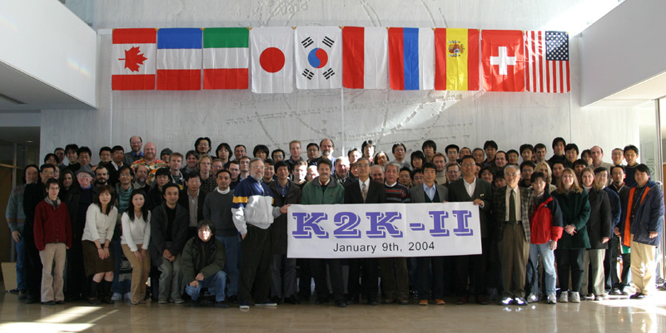
Experiments at 12 GeV PS neutrino oscillation K2K and rare Kaon decays
K2K has been completed successfully confirming the neutrino oscillation with a well defined accelerator neutrino beam.

Slide 11
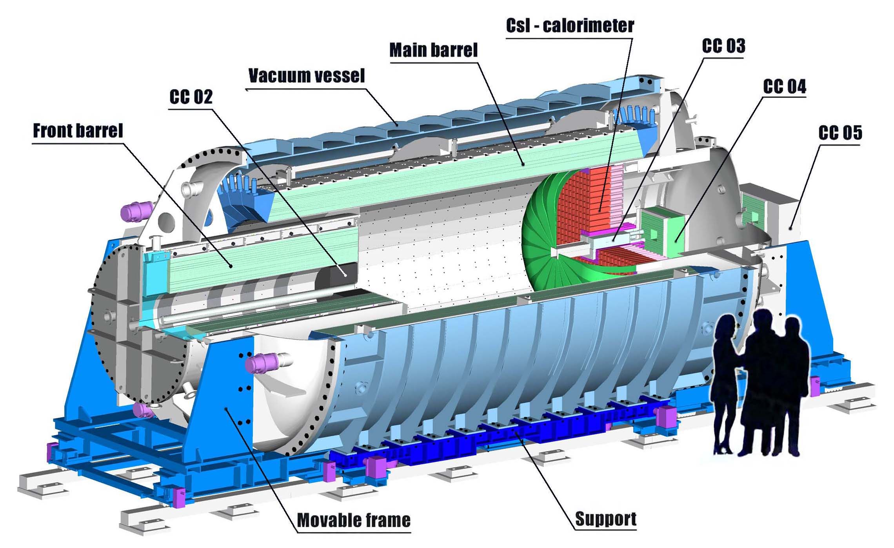
E391-a at PS (most recent rare K decay exp.)
(Dubna,FNAL,JINR,KEK,NTU, PNU and several Japanese Universities)
K⁰→π⁰νν̄
gives a direct handle on the η-parameter of CP violation.
The detector showed good performance as designed. It will move to J-PARC
K⁰ beam

Slide 12
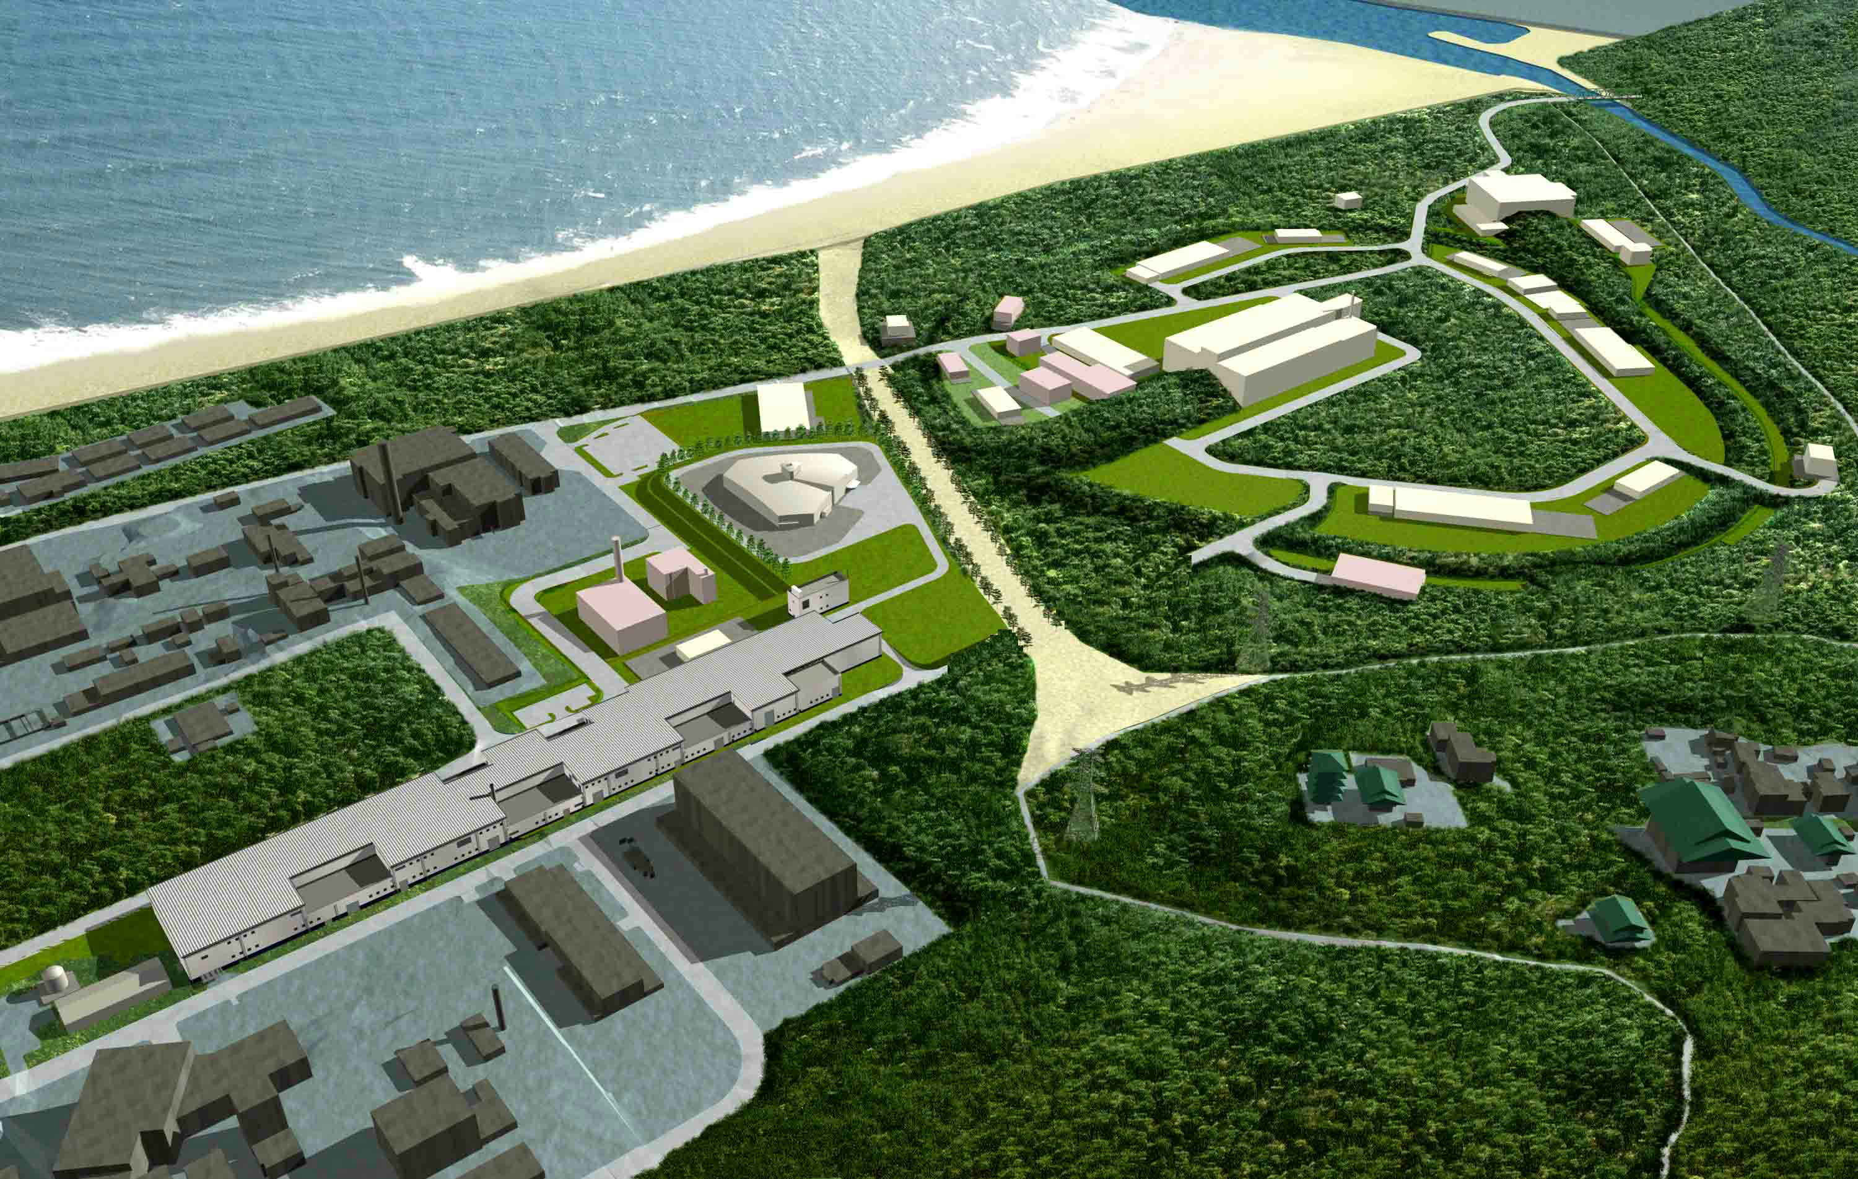
Japan Proton Accelerator Research Complex (J-PARC)
12 GeV PS activity will move to J-PARC
Materials and Life Science
Experimental Facility
Nuclear and Particle
Experimental Facility
Construction
2001~2008
Joint proj. of
KEK and JAEA
Nuclear Transmutation
Neutrino to Kamiokande
3 GeV Synchrotron
(25 Hz, 1MW)
50 GeV Synchrotron
(0.75 MW)
Linac
(350m)

Slide 13
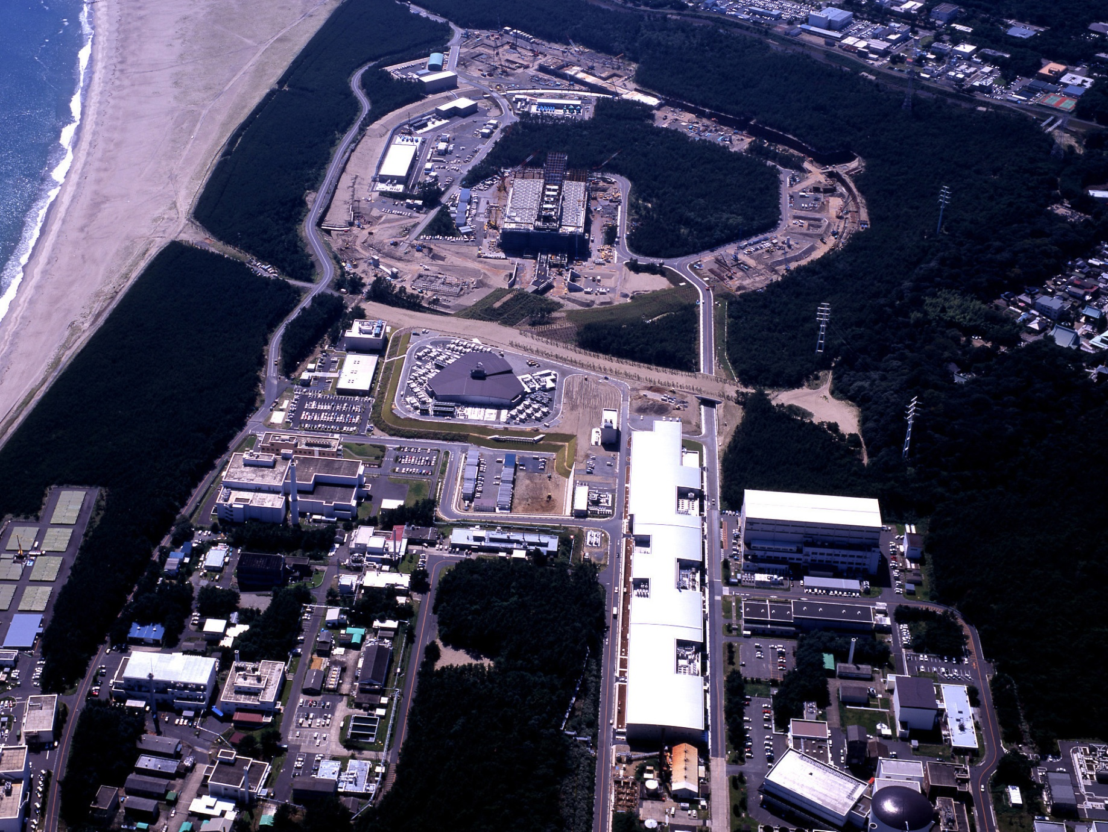
Bird’s-eye view
[ As of Feb.2006 ]
The Hadron Hall
50 GeV MR
A round=1,568m
Materials & Life Science
Experimental Facility
3NBT
Neutrino
3GeV RCS
A round=348m
3-50BT
Construction started on Apr’01.
MR tunnel became continuous in Jun’06
Most of the public Works have been completed except for ν-line
Area for
Transmutation Experimental Facility
Linac
(330m)

Slide 14
Present status
3GeV booster ring was completed:
First beam circulation in fall 2007
50GeV ring to be commissioned from this May
Experiment starts in 2009
PAC was held in the first week of 2008 (last week)
The neutrino beam line under construction
Working very hard to keep schedule
  Both on civil construction and equipments
  Almost all beam line components will be installed in FY2008
Beam commissioning will start in Apr. 2009
  with completed beam line, MUMON, On-axis det.

Slide 15
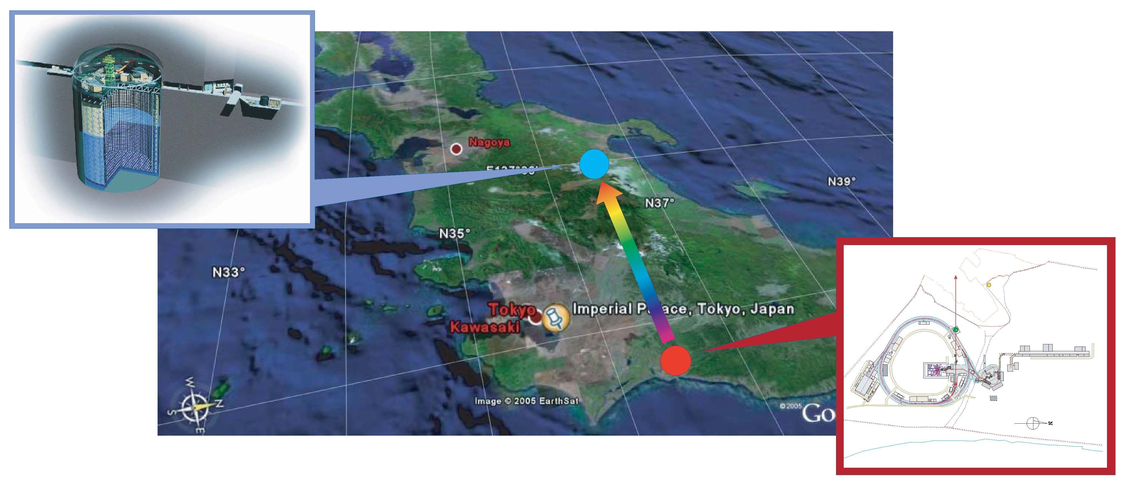
T2K experiment
J-PARC 50GeV PS
(KEK-JAEA, Tokai)
Super-Kamiokande
(ICRR, Univ.Tokyo)
295km
A next-generation long-baseline neutrino oscillation experiment, designed to observe the first signal of νe appearance, and further, δ_{CP}
  Pseudo-monochromatic, low-energy off-axis beam, tunable by changing the off-axis angle between 2º and 2.5º (Eν=0.8GeV ~ 0.65GeV)
  Quasi-Elastic interactions are dominant, suitable to minimize the electro-magnetic shower background caused by π⁰s produced in inelastic reactions

Slide 16
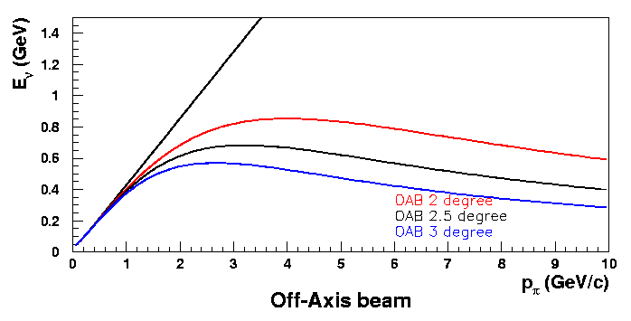
T2K Beam layout
Super-K
p
π
μ-mon
ν
off-axis
on-axis
2.0~2.5º
0m
120m
280m
295 km
Eν(GeV)
Θ =2º
2.5º
0.8
Θ =2º
Flux • σ (arbitrary unit)
Δm²_{atm} = 2.0~3.0x10³eV²
[ Eν = 0.48~0.72GeV ]
2.5º
3º
0.4
3º
0
2
4
6
Pπ (GeV/c)
0
1
2
3
Eν (GeV)
Quasi-monochromatic, tunable sub-GeV Off-Axis Beam
~ 2,200 (~1,600) νμ (CC) interactions at Super-K [OAB 2.5º, 22.5 kt-yr]

Slide 17
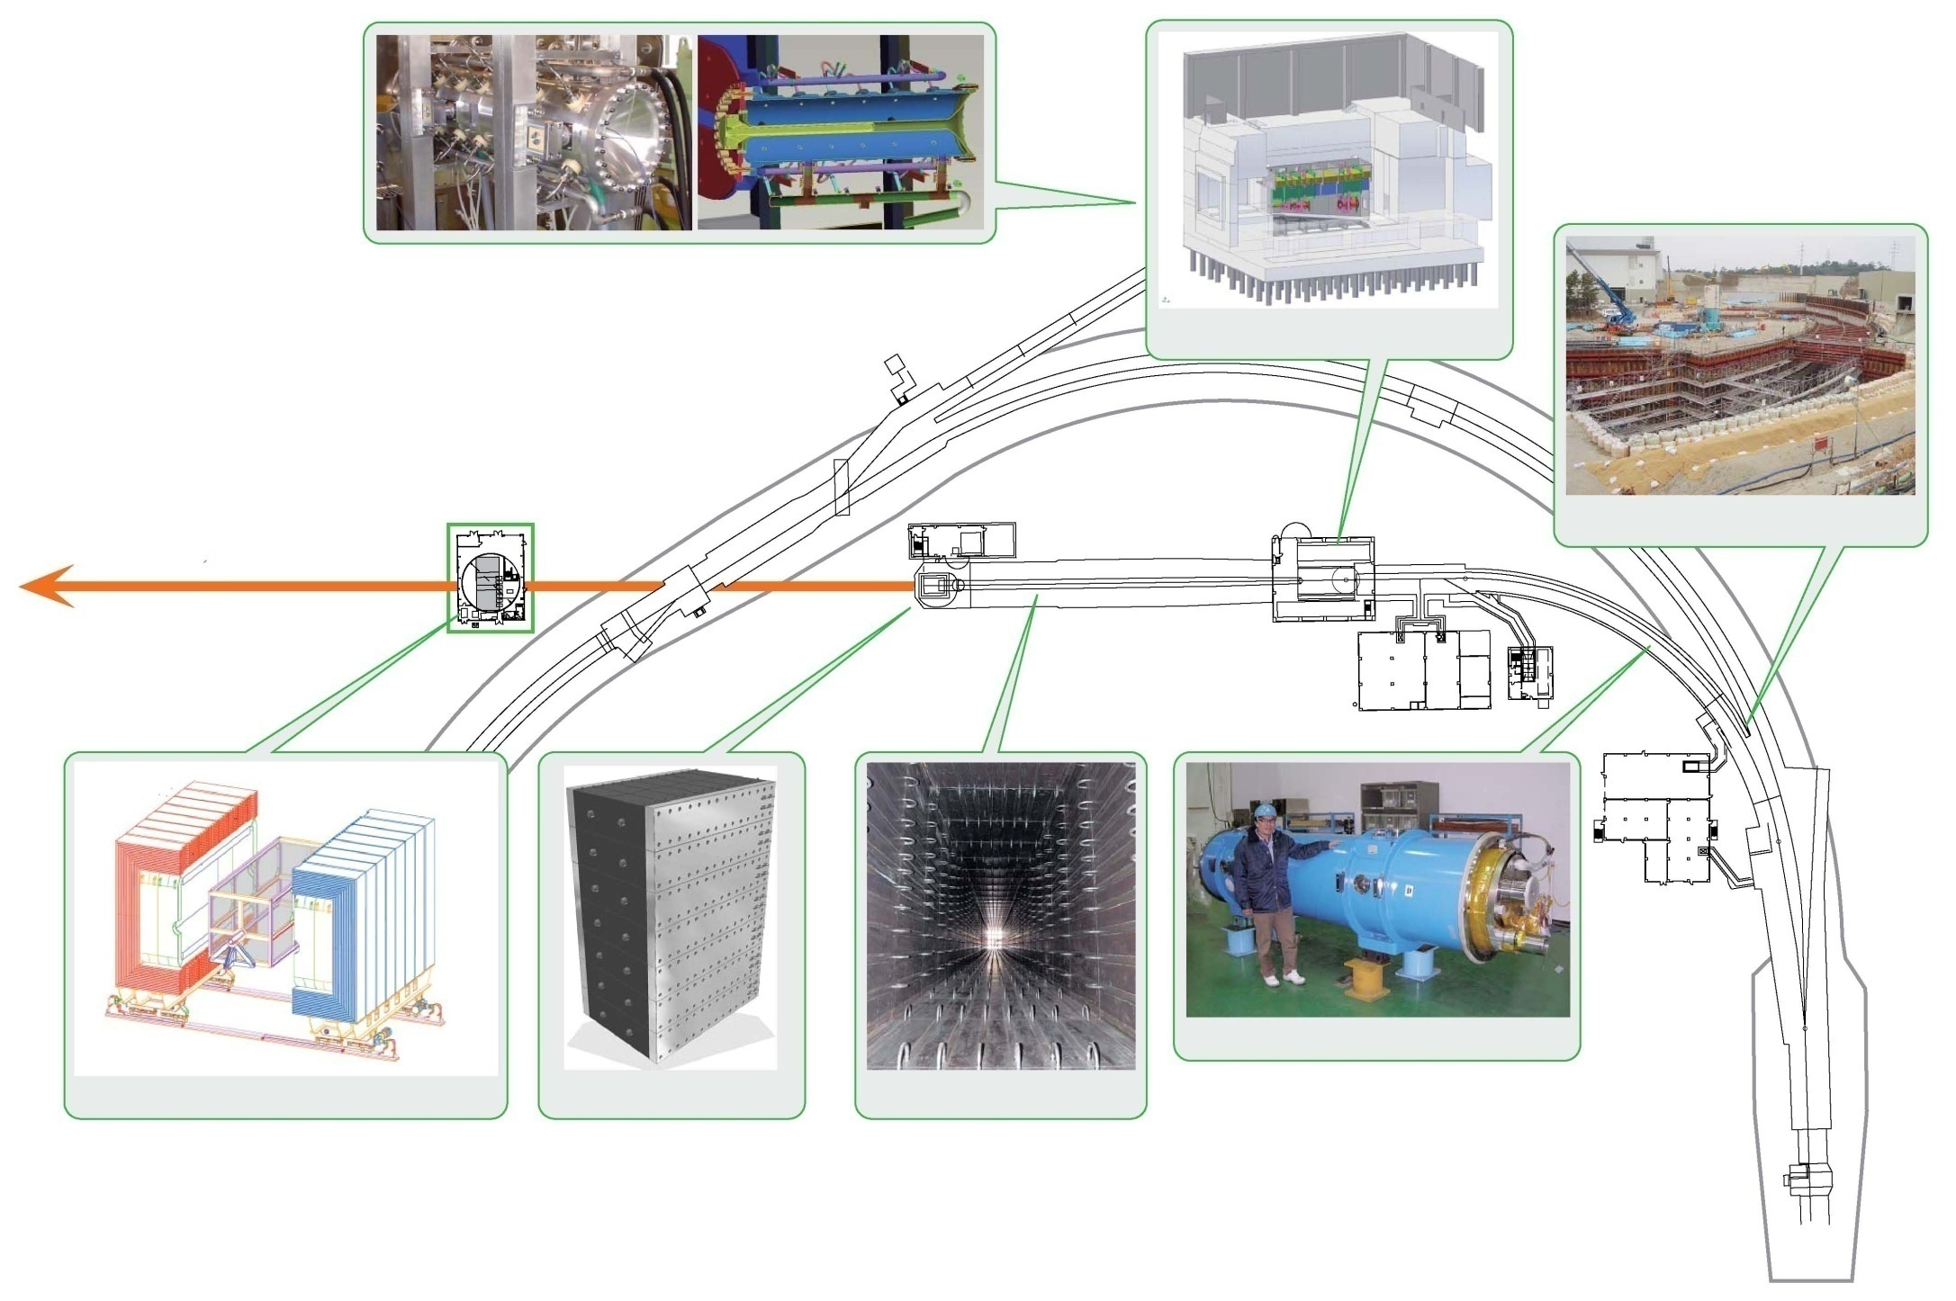
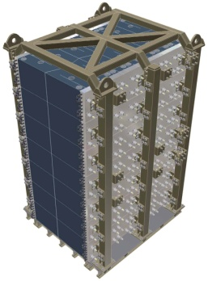
The Neutrino Beam-Line
Target-Horn System
Target Station
Muon Monitoring Pit
Final Focusing
Section
295km to
Super-Kamiokande
Preparation Section
100m
SCFM at ARC Section
Near Neutrino Detector
Beam Dump
Decay Volume

Slide 18
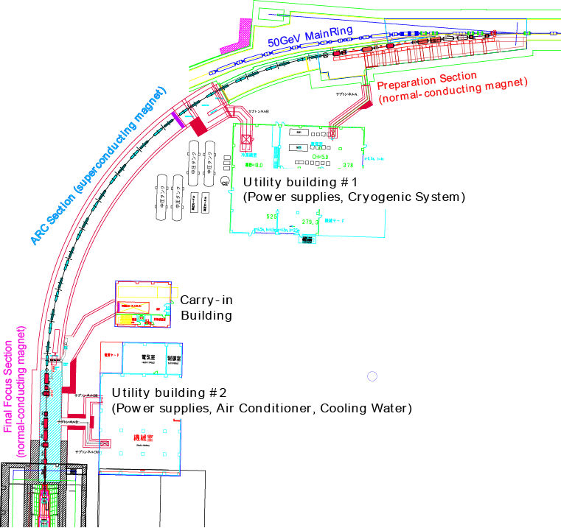
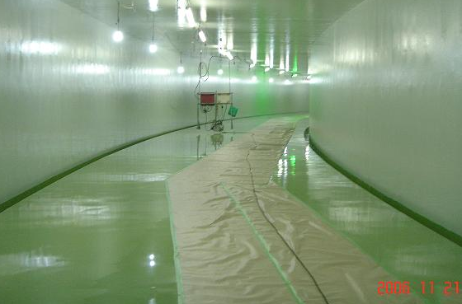
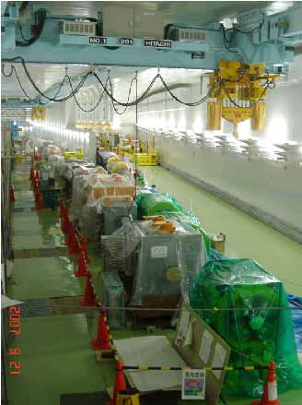
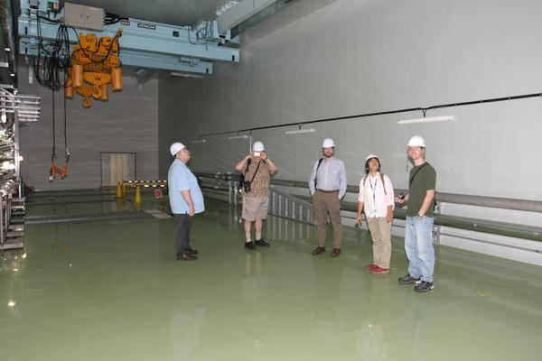
Primary Beam-line (bent inside)
ARC Section
Preparation Section
Final Focusing Section
Beam-line tunnel was completed in December, 2006
Installation is started from Prep.sec. from July ’07

Slide 19
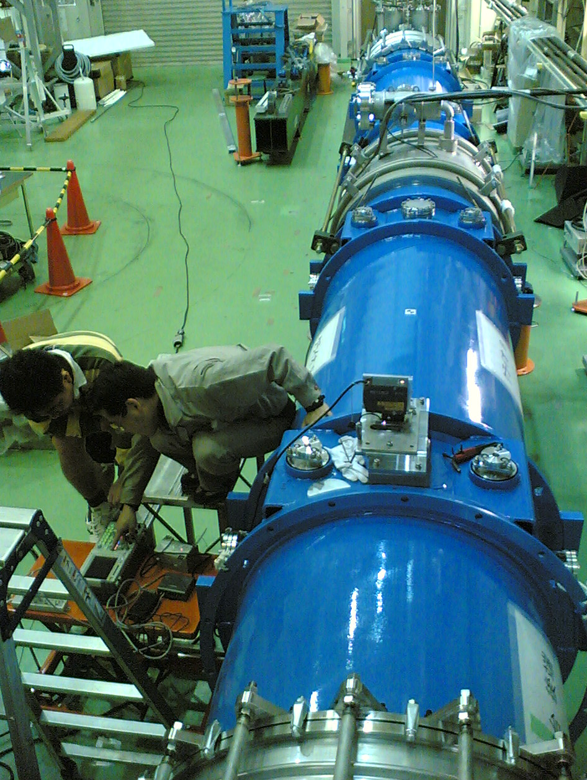
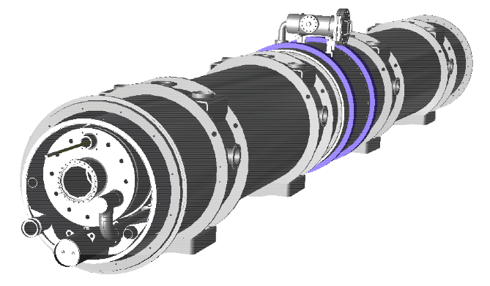
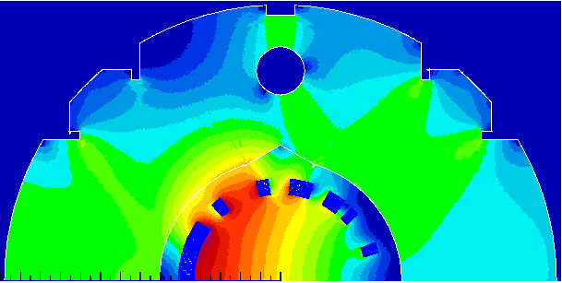
Superconducting Magnets
cold mass alignment test
  Two magnets in cryostat (“doublet”)
6 doublets in FY06,
6 in FY07, 2 in FY08
Superconducting Combined Function Magnet SCFM
28 SCFMs in total, D: 2.6 T, Q: 18.6 T/m
Length: 3.3m
Current: 7,345A @ 50GeV
Partial installation in FY07
System testing in FY’08
Magnet Safety System developed & provided by Saclay

Slide 20
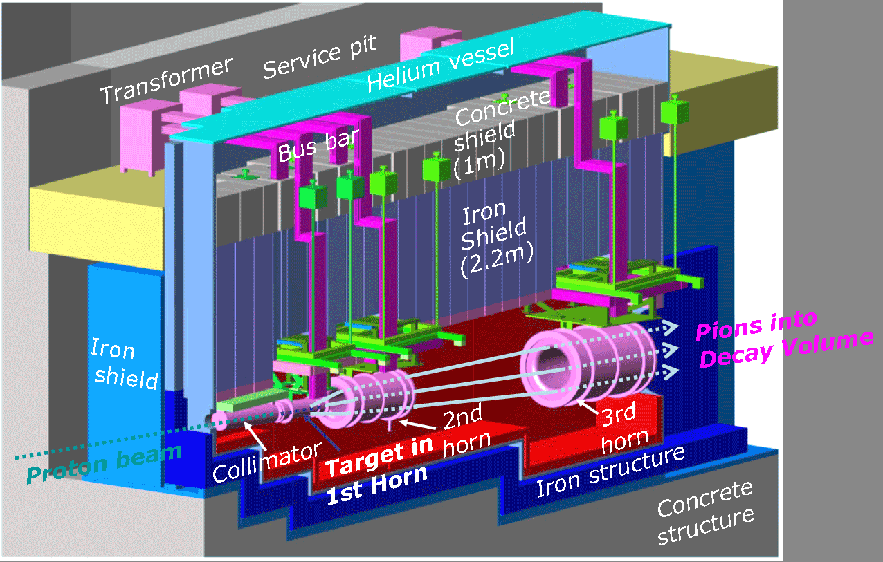
Target Area
Target, horns are installed. Filled with Helium gas (reduce Tritium, NOx production)
Highly radio-activated (~1Sv/h, cf ~10Sv@JCO, Dose meter alarm: 0.3mSv/h)
  ➔Need remote-controlled maintenance system
Need cooling (Helium vessel, radiation shield,..)

Slide 21
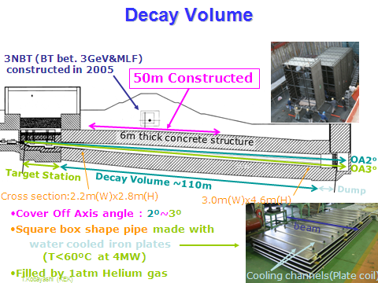

Slide 22
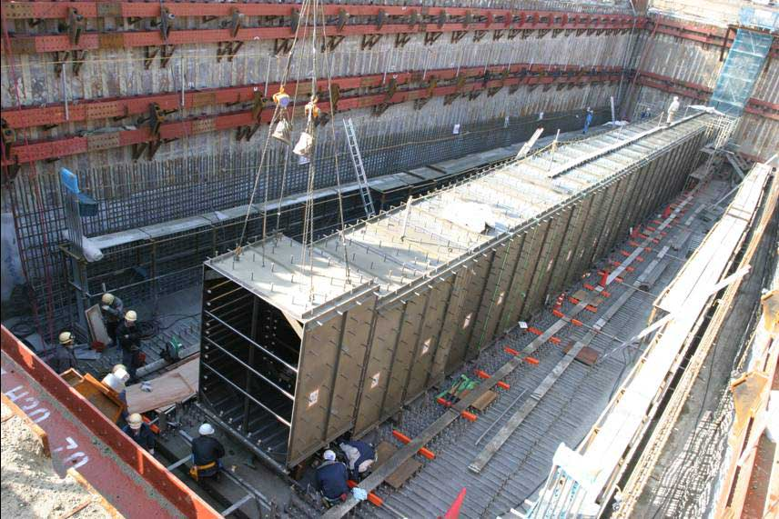
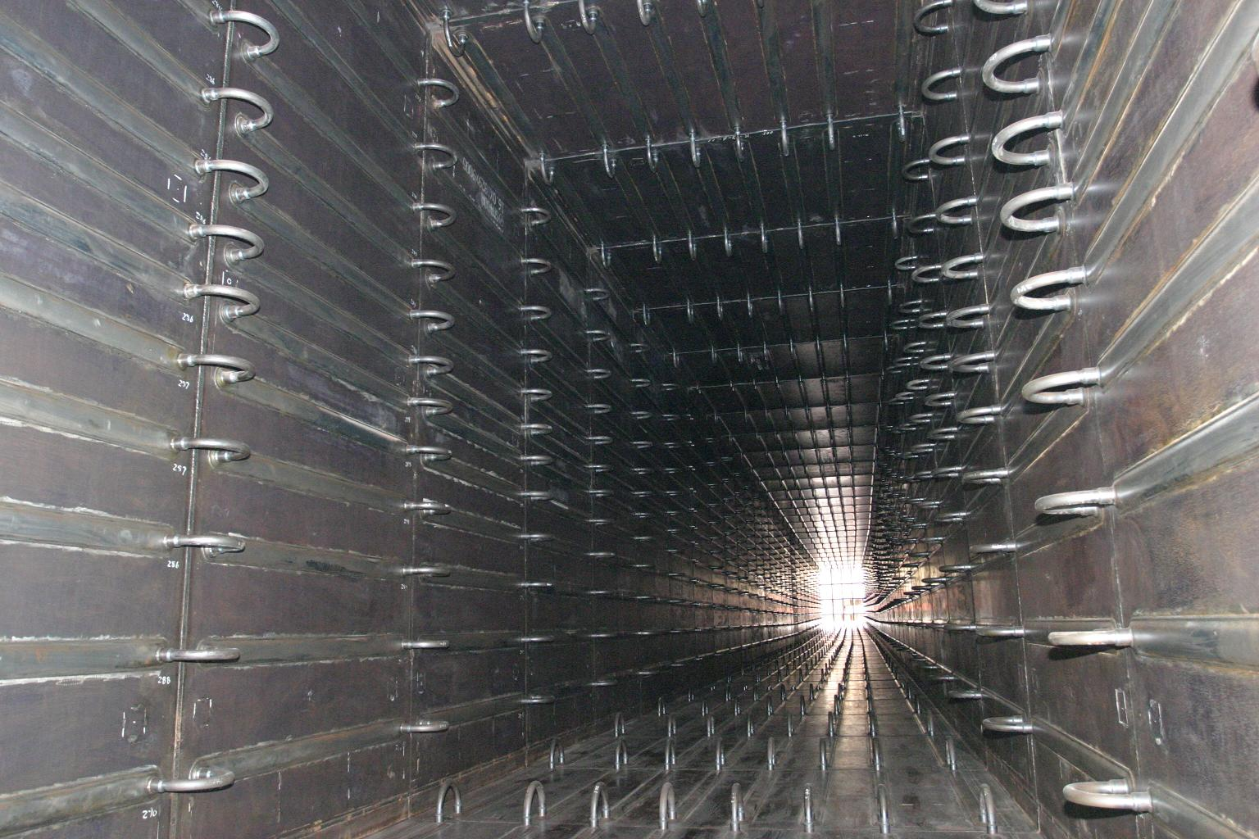
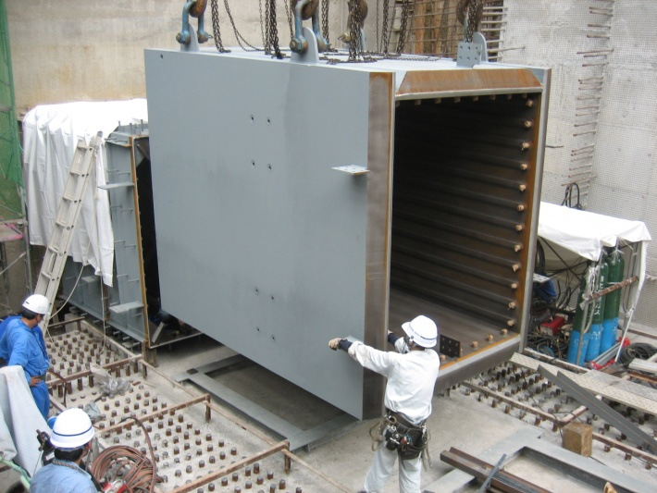
Decay Volume
Under 3NBT (FY05)
L=94m, 6m thick
concrete wall
40 paths of cooling channels
It can accept 4MW beam
(w/o tolerance).
Upstream

Slide 23
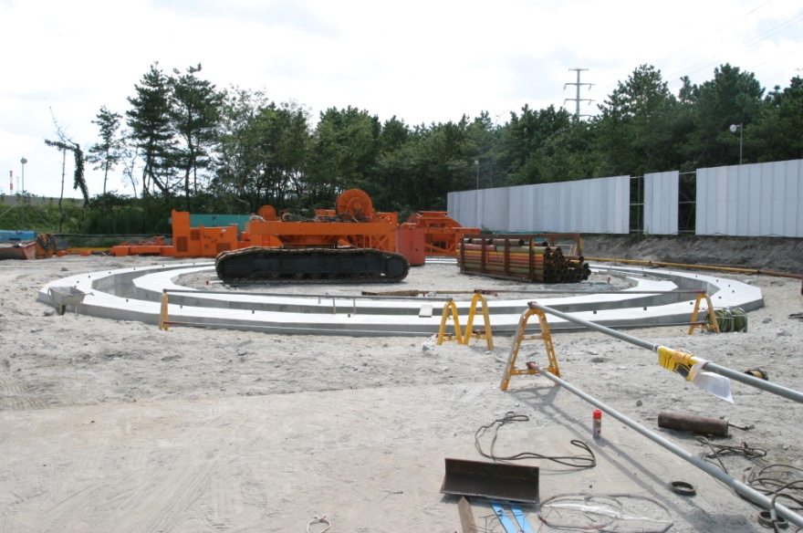
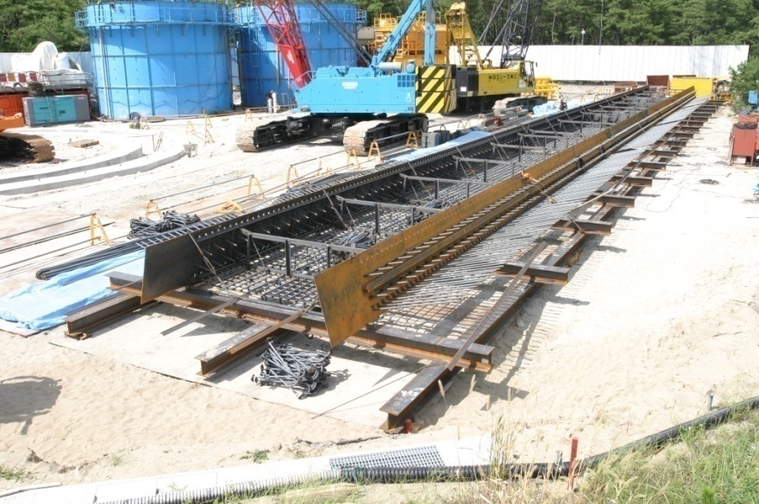
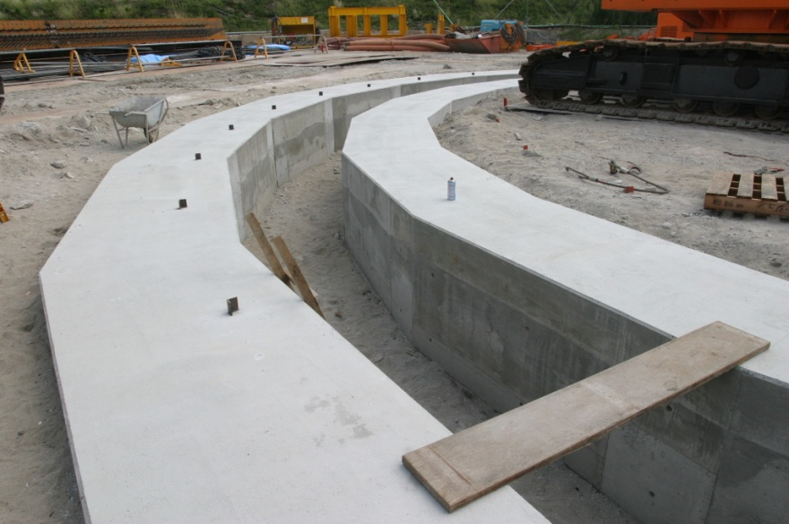
ND280 pit construction
17.9m
Status of September 19
Guide wall was completed
Frame is being build
Excavation for wall is being prepared
Guide wall to install frames
and make the concrete wall
Reinforcement frame for
ND280 pit wall

Slide 24
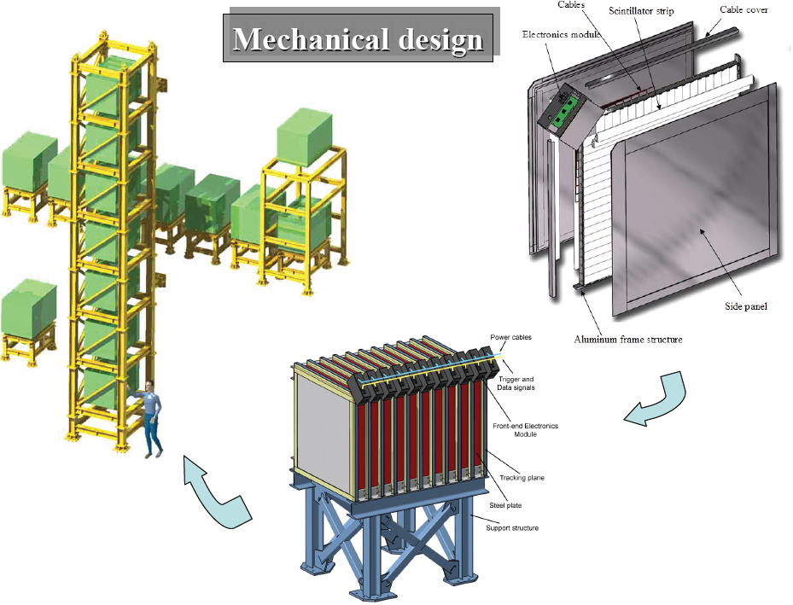
On-axis detector (INGRID)
The detector will be ready before the 1st neutrino beam (April 2009).
  Milestone & Schedule
So far,
  WLS fibers in our hand
2007 purchase-order
  Scintillators
  Photo-Sensor (HPK MPPC)
  Irons
Proto-type production in 2007
2008 purchase-order
  Electronics + DAQ
Detector assembly
  will be happen in summer 2008.
Installation, Commissioning
  will be happen in January 2009
24
Notes:
24

Slide 25
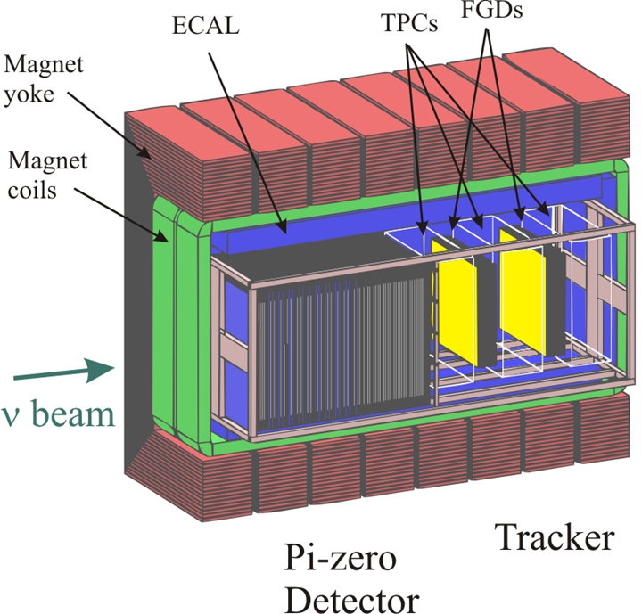
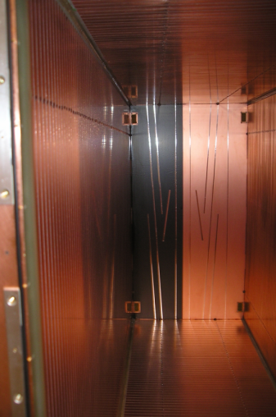
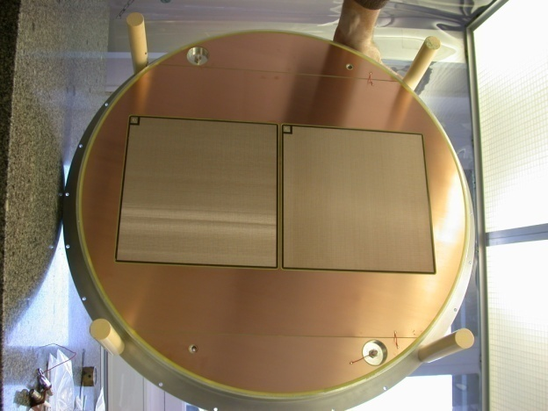
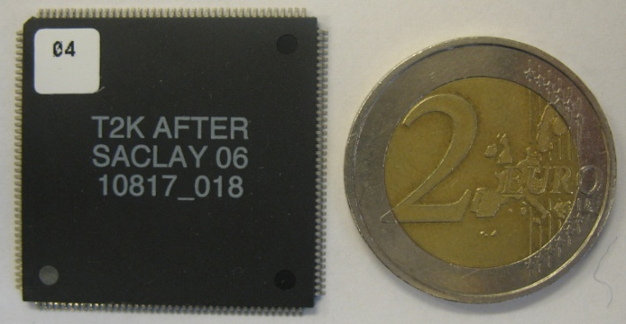
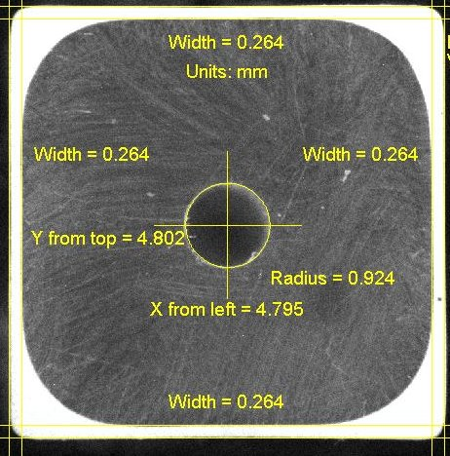
Off axis detector
R&D almost completed
Started mass production
  Scintillator bars,
Off-axis detector will be installed by summer 2009
except for some parts of ECAL.
→ It become ready for High-intensity beam run from 2009 fall.
SMRD
Micromegas
FGD scintillator bars
are produced
ASIC IC for TPC/FGD
26cm
Prototype field
Cage for TPC

Slide 26
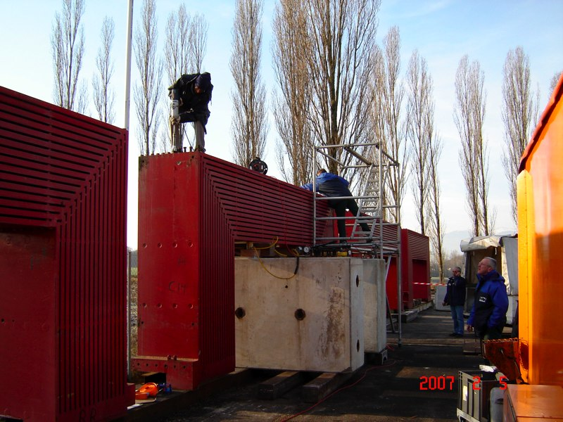
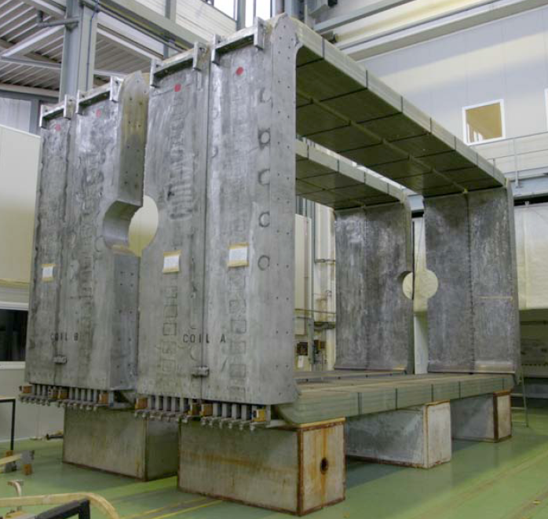
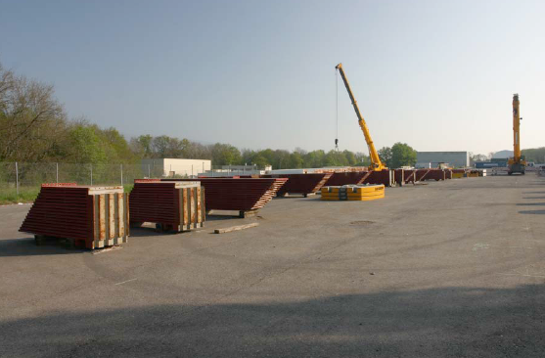
UA1 magnet
COIL
Donation from CERN
Refurbishment work done
Public tender for shipping opened at CERN
Re-assembling test in Oct.
Seismic analysis and reinforcement design being done
Will (must) be installed in the hole in Apr~Jun 2008
Specification for installation being prepared
26
Notes:
26

Slide 27
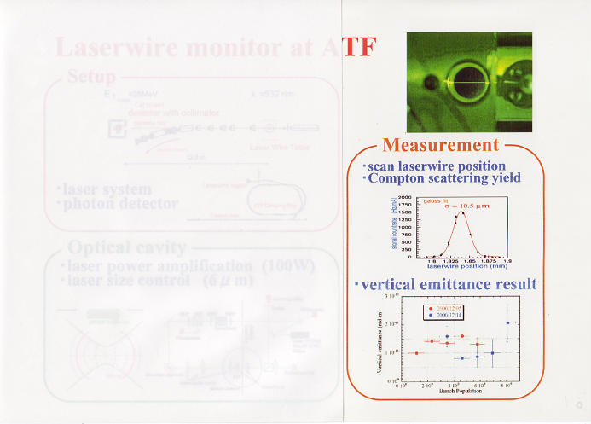
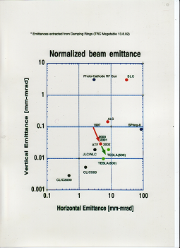
ATF and ATF2 for ILC R&D
ATF showed already a good beam emittance needed for TESLA.
Various new technologies for the emittance measurement, e.g. LASER wire method.
The high quality beam is used for the international studies of beam delivery system of ILC, needed in the EDR preparation. France is one of the key players of ATF2 collaboration.
LASER wire

Slide 28
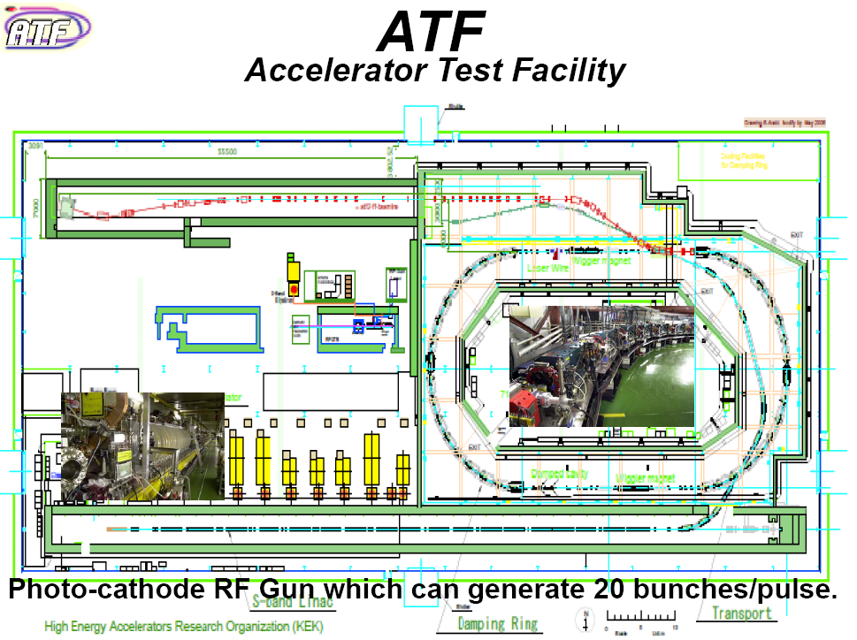
ATF2

Slide 29
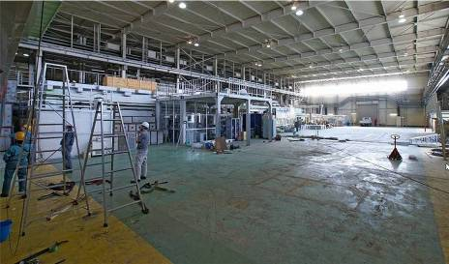




ATF2 construction
Assembly hall emptied for construction
Assembly hall before construction
Construction of reinforced floor
Construction of shielding
Photos: Nobu Toge

Slide 30
Conclusion
Rich HEP activities are on going in Japan
at KEK-B factory and PS. Both have promising future plan/new facilities, Super KEKB and J-Parc.
There are many international collaboration recently, where European increasing presence is appreciated. It balances bi-directional cooperation.
Asia is relatively young in HEP activity. But already matured enough
to make substantial contributions and
to be a good partner for Europe.

Slide 31


High Power RF Cavities besides the Super-conducting cavities
The entire straight section of the positron ring is equipped with solenoid coils in order to trap low energy electron cloud produced by SR.

Slide 32



Slide 33



Physics Motivation
Neutsino Mass and Mixing
Maki-Nakagawa-Sakata (MNS) Matrix
Weak eigenstates
“flavor eigenstates”
Mass eigenstates
m₁
m₂
m₃
Neutsino Oscillation Experiments
3 mixing angles
+ 1 complex phase
2 mass squared
differences
Near
Detectors
KEK-PS
( 6 kW )
Flight length (c·t )
Super-
KAMIOKANDE
Neutrino energy
νμ
Εν=1.3GeV
Reduction of ν_{α}
E_{ν} spectrum distortion
Appearance of ν_{β}
Neutrino Beam
disappeared
as ντ
250km
K2K: 112 events / 1999~2004, 10²⁰ pot

Slide 34


How the entire area looked 3 years ago
Fast extraction part
Ring orbit
Fast ext. beam
3NBT
Decay Volume
(excavated)
Jan.28, 2005

Slide 35




1st / 3rd Horn Operation Test
1.3x10⁶
June 30, 2006
3rd Horn
10⁶
3/9
1st Horn
1st horn
4.3x10⁵
12/8
9/4
3rd horn
6/7
3rd horn test with support module: this fall
2nd horn fablication is in progress at U.S.
April, 2007

Slide 36



Target station Helium Vessel Construction
TS
Installation for the
bottom plates has been completed
Upstream DV
Upper box on the Super-Carrier
(Nakaminato port)
Installation is going on !

Slide 37
Off-axis detector will be ready by 2009 fall run except for a part of ECAL
Aim to obtain 1st physics result from 100kWx10⁷sec beam operation by 2010 summer.

Slide 38
History of international Cooperation at oversea facilities
1972:Collaboration at DESY started
by Univ. of Tokyo/Koshiba’s group
DASP@DORIS → JADE@PETRA
→ OPAL@LEP, ZEUS@HERA
1979: Japan-US Cooperation in HEP started
Many experiments at BNL, FNAL and SLAC
Since late 1970s: Experiments at CERN developed
Hybrid BC, Heavy ion, Neutrino oscillation by a few univ.
OPAL@LEP, ATLAS&ALICE@LHC
Recently Collaborations at BES@BEPC of IHEP and in CHOOZ2

Slide 39
International Collaboration at KEK
1980s: AMY@TRISTAN
The first intern.collaboration(China,Korea,Japan,USA)
Since late 1990s :
BELLE@KEK-B
More from Asia-Pacific (Australia, India)
From Europe as well (Austria, Ljubliana, Switzerland, Russia)
K2K & Kaon Decay@PS(12GeV)
(US, Canada, Korea, Russia)
Now and in the future, more European collaborators
(France, Germany, Italy, Spain, UK)
Super KEK-B and upgrade of Belle
Long b.l. neutrino oscillation expr. T2K, K-decay @ J-PARC
ATF2 (beam studies for ILC)

Slide 40


