Slide 1
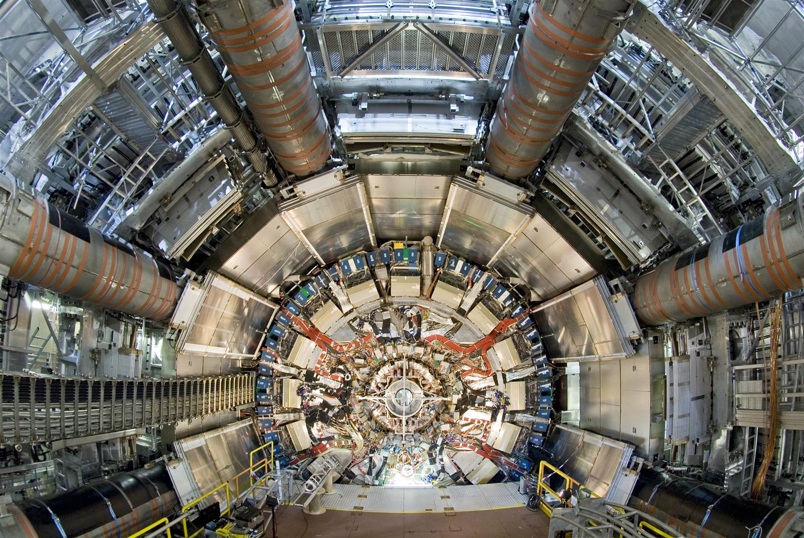
Installation and Commissioning of the ATLAS Liquid Argon Calorimeter Read-Out Electronics
TWEPP 2008
Guy Perrot on behalf of the LAr Team
15-19 September 2008

Slide 2
Introduction
ATLAS and the LAr Elements
The readout chain
Installation & Commissioning
  System Generalities
  Back-end Electronics
  Front-end Electronics
    Barrel
    Endcaps
  TTC distribution.
Noise in the detector.
Present status of the detector.

Slide 3
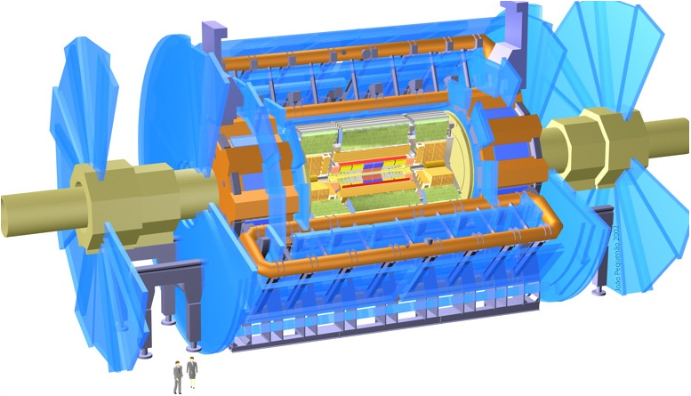
ATLAS and the LAr Calorimeters
Muon spectrometer:
Air core toroids + muon chambers
HEC
EMEC
EMB
FCAL
Calorimetry :
EM:Pb-Liquid Argon (LAr)
HAD: Fe/scintillator, Cu/W-LAr
Tracking:
Si pixels and strips
Transition radiation detector
The LAr calorimeters are hosted in 3 large cryostats.
The barrel cryostat contains the Electromagnetic (EM) barrel.
The endcap cryostats contain EM and Hadronic Endcaps and the Forward calorimeter.

Slide 4
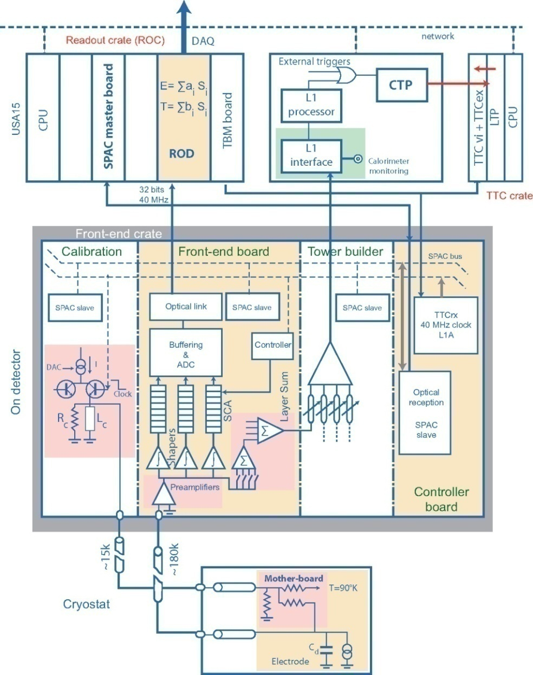
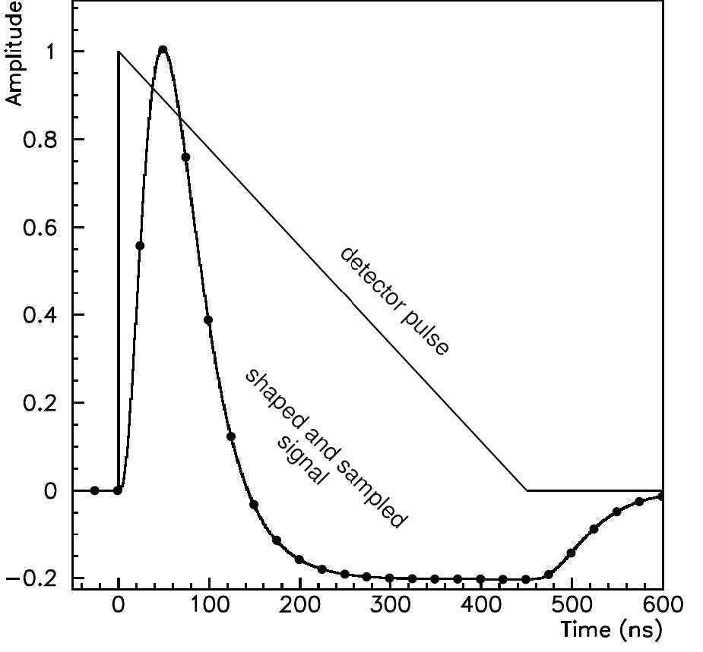
Readout Chain
ROS
5 elements in the chain: the Detector, the Front-End crate (FE), the Back-End crate (BE), The Read-Out-System PCs (ROS) and the Timing-Trigger and Control crate (TTC) .
TTC signals are transmitted from the TTC crate to both Front End (FE) and Back End (BE) crates.
Calibration boards generate a pulse on the Electrode for calibration.
The FE board amplifies, shapes and samples the signal from the electrode.
Samples corresponding to a good event (Accepted by Level 1 trigger: L1A) are digitized and transmitted to the Read Out Driver (ROD) board in the BE crates.
  Large dynamic range (10MeV to 3TeV): 3 gains per channel, 12bit ADC, digitization at 5 MHz.
  From 3 to 32 samples readout. 5 for Atlas Physics running. 32 used for many commissioning studies.
The ROD board calculates Energy (also Time and Quality depending on energy level)) from these samples and transmits the information to the Read Out System (ROS).
Back-end crate

Slide 5
Installation & commissioning
Some dates and numbers
October 2004: Barrel cryostat in the cavern.
July 2005: First BE RODs installed in USA15.
July 2005: First FE electronics installed on the Barrel.
April 2006: All 3 cryostats in the cavern.
Aug 2006: First cosmic signal recorded, Barrel (1 FE crate) with Tile calorimeter
May 2007: Back End electronics completed.
Summer 2007: FE Low voltage power supplies fully available after refurbishment.
April 2008: FE electronics refurbishment completed.
  Sept 2007: Endcap C
  Dec 2007: Endcap A
May 2008: Readout of the full calorimeter, Closure of the apparatus.
182468 Physics channels
Detector Front End (FE) System
  1524 Front End boards (FEBs)
  58 Front End crates
  58 LV power supply systems
  115 High voltage modules
  Over 1600 fibers between FE and BE
USA15 Back End (BE) System
  192 ROD boards
  16 ROD crates
  68 ROS PCs
  Almost 800 fibers between RODs and ROSes
USA15 TTC distribution System
  4 TTC crates
  6 partitions in 3 crates and one controller crate
  36 modules of 7 different types
  8 optical couplers
  Over 200 fibers to FE and BE

Slide 6
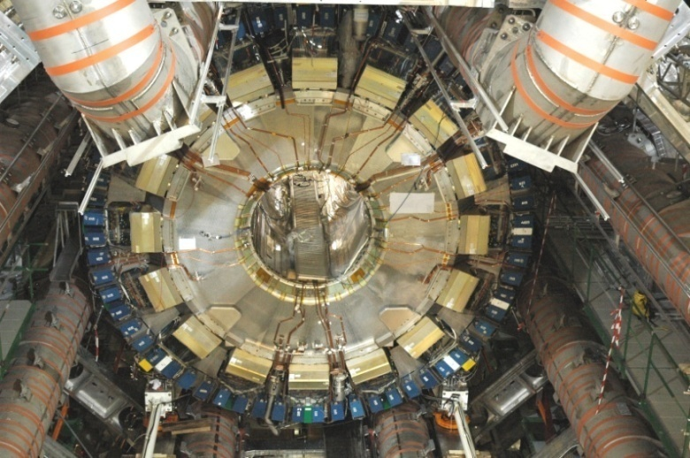
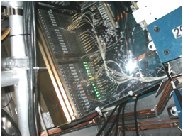
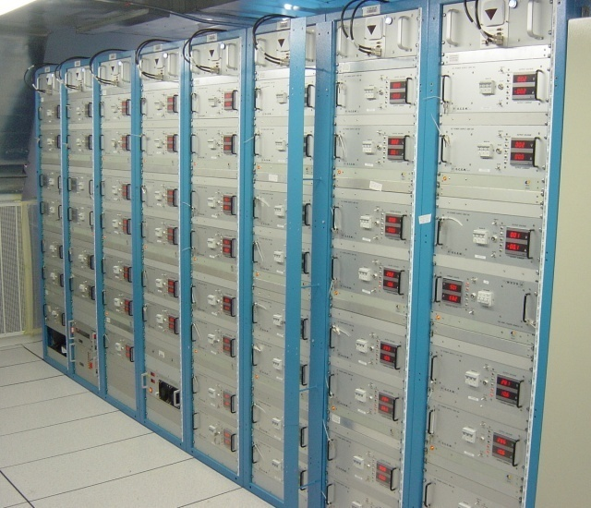
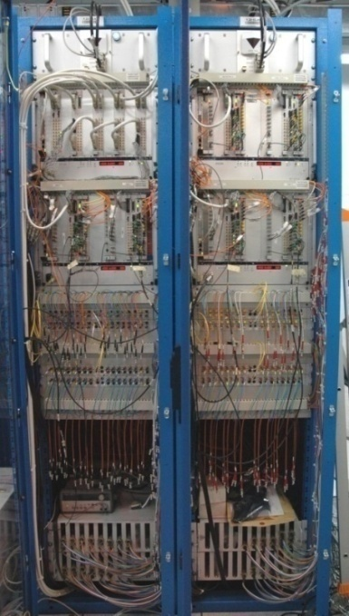
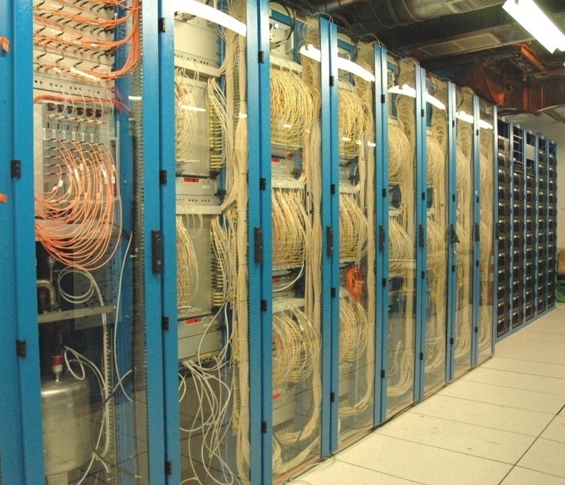
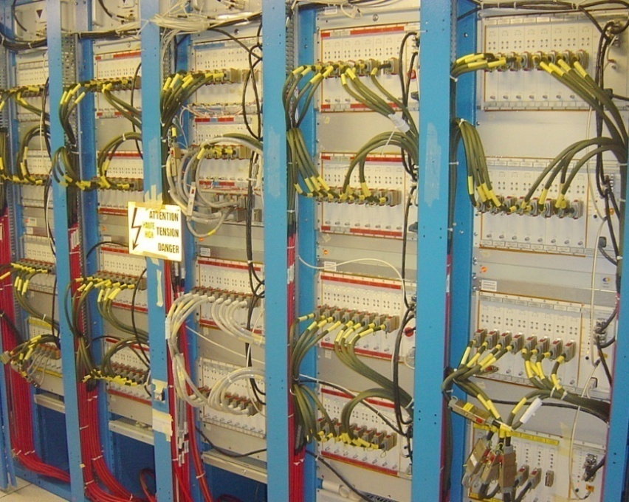
LArg Electronic Elements
LV PS
FE Crate
Barrel side view with FE Crates & PS
USA15
LV 280V Power Supplies
BE ReadOut Electronics
TTC Distribution
HV Power Supplies

Slide 7
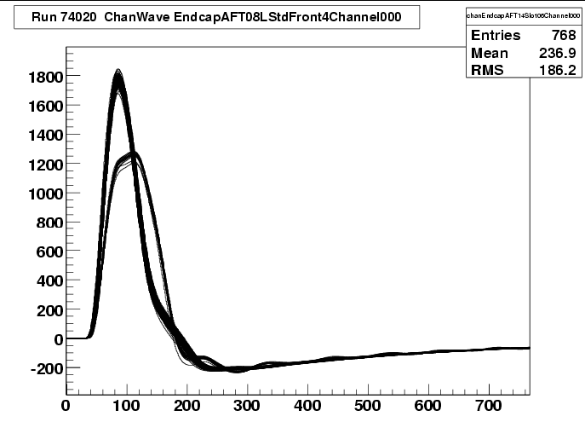
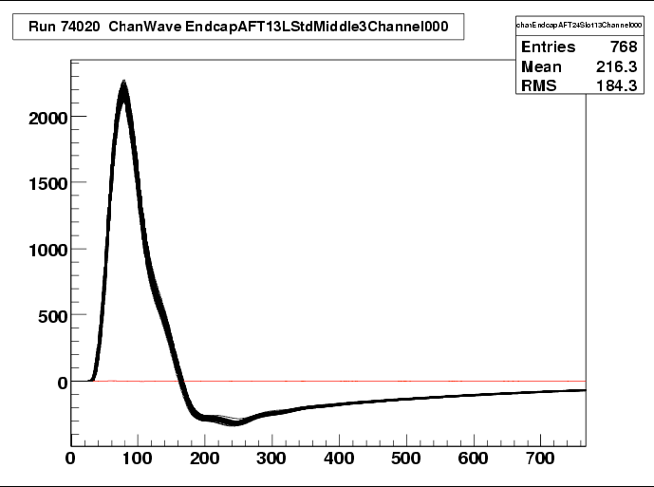
Installation & commissioning
Procedure was to install hardware and test it as soon as possible in stand alone mode. Then to leave it running, integrate it, and use it whenever possible.
Electronic for the FE was installed one crate at a time with tests including pedestals and calibration runs using a specific acquisition system.
Electronic for the BE was also installed one crate at a time and tested with an injector system to replace the FE which was not yet connected.
As soon as these elements were tested and interconnected, they were integrated in the global acquisition system.
Detector has been commissioned continuously with the available readout system doing pedestal runs, calibration runs and cosmic runs to verify its behavior and stability.
ch. 0, 4, 8, ..., 60
(all calib. line #32)
largerly distorted
Damaged Calibration channel
Examples of problem detected
Dead FEB channel
ch 94 dead Readout:
almost flat wave

Slide 8
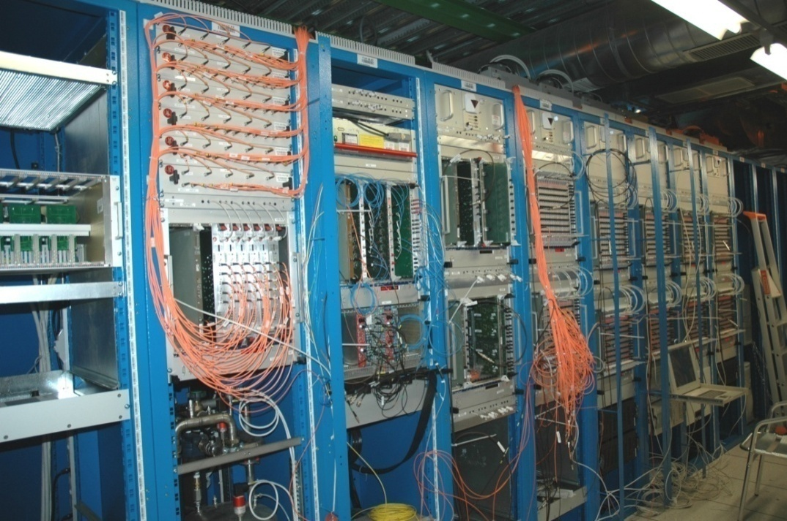
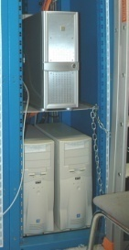
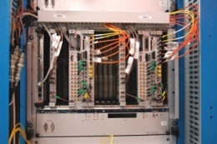
BE Installation & Commissioning
ROD installation & Commissioning
  Between August 05 and April 07, ROD crates have been filled and tested using the ROD commissioning system.
  This system was also used to distributes signals to different ROD crates to develop online readout software.
  Fibers between RODs and ROSes were commissioned between March 06 and June 07 when they were connected to the ROSes.
Final ROD commissioning with FEBs and ROSes + Event Builders.
  Started in June 07 (1st full ROD crate) and is still going on.
Optical Splitters
ROS PCs
Injectors
Half Crate under test
Injector
System
ROD Commissioning system
6 injectors with 5 outputs and 30 2 to 1 Optical Splitter provides 60 FEBs inputs (half a ROD crate)
3 ROS PCs with 7 FILAR boards allow readout of 28 ROD outputs (half a ROD crate)
TTC signals generated by the final TTC system
Comparison of the injected data with the
received data in the ROSes

Slide 9
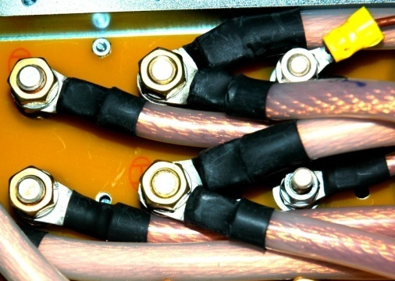
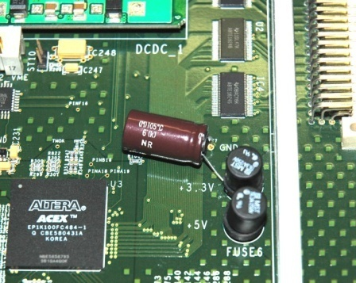
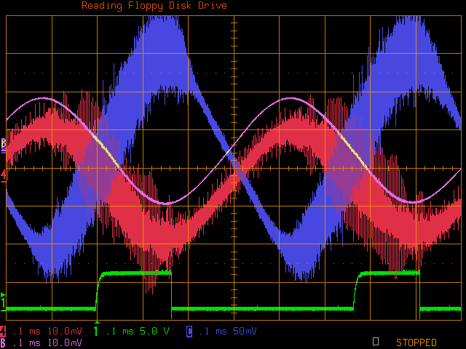
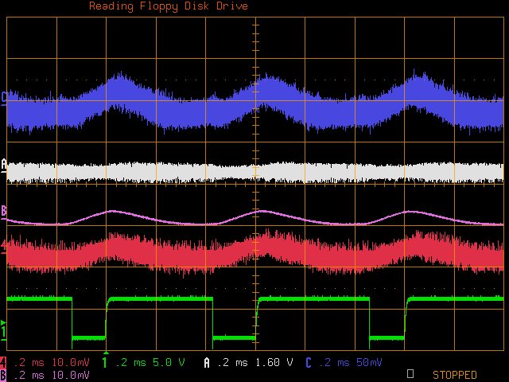
Problem in the BE System
Could not run at high speed (40 KHz L1A).
  Oscillations on 3.3V due to current surge made the power supply trip.
  Was only seen when we could exercise the crate at high speed with all FEB inputs and full parallel readout.
Solved by doubling the power cables and adding a big capacitor on each ROD
Doubling of the 1m power cables
3.3mF Capacitor added on ROD
L1A 30 KHz 10 samples raw 1/100 evts before modifications
L1A 30 KHz 12 samples raw 1/100 evts after modifications
Diff voltage 3.3v and Return (AC coupled)
Averaged on 1000 sweeps
50 mV/square
(measured on power supply)
Current averaged
Current of 3.3V 10A/square
TBM Busy
100Us/square 200Us/square

Slide 10
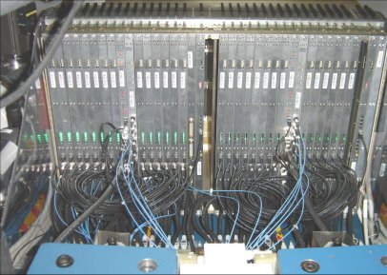
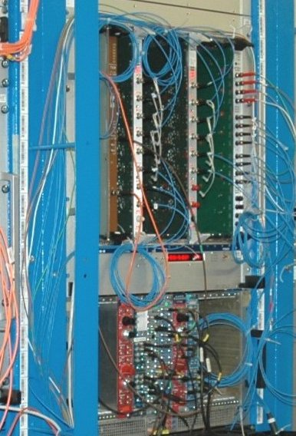
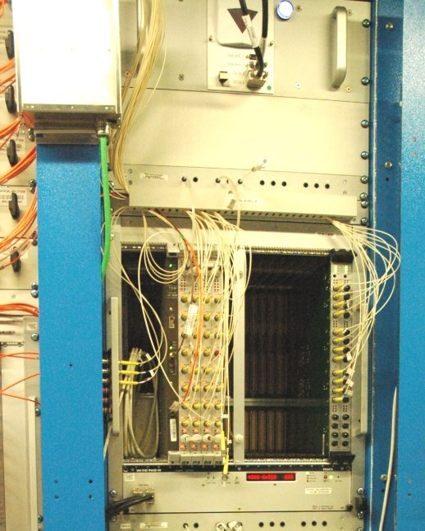
FE Installation & commissioning
FE Crate
FE Installation started on Barrel in summer 2005 and May and August 2006 for the Endcaps.
  No cooling infrastructure available for the Barrel.
  2 LV power supply and 2 cables with 48 fibers between UX15 and USA15 moved around.
3 Different BE setups used for commissioning between summer 2005 and December 2006
  One FEB read by one ROD then by LAL FEB test board for the Barrel (due to the absence of cooling).
  Full BE read out of one FE crate using standard TDAQ software for the Endcaps (cooling with a stand alone system).
Barrel FE was fully tested in summer 06 and Endcaps in December 06 but with only a few power supplies available.
All power supplies were available in August 07 after refurbishment.
Complete refurbishing of FE boards done between July 07 and March 2008 (Endcap C, A and Barrel sequentially).
First readout of the full LAr detector in May 08.
First EM BE setup
EC BE setup

Slide 11
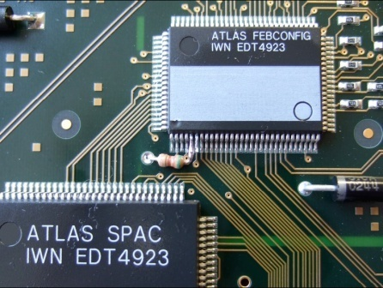
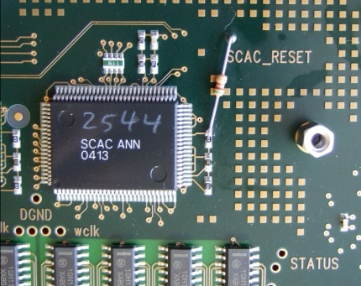
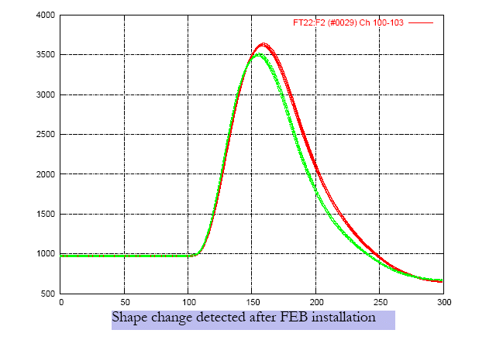
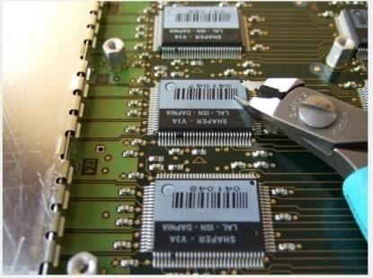
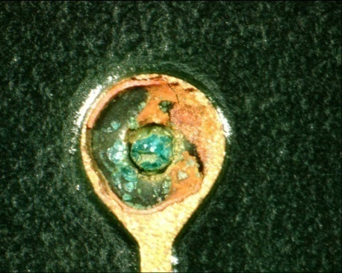
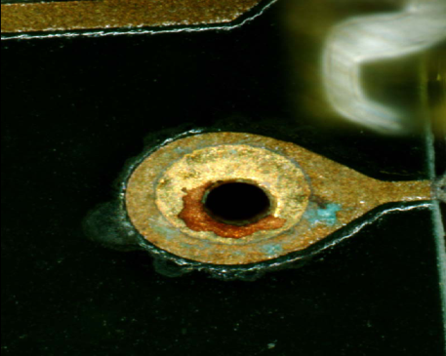
Why FE Boards Refurbishing ?
Initially: Missing voltage level adaptation on two signals between 5V DMILL chips and 2.5V DSM chips.
Risk of increasing failure for these components.
Adaptation made with a serial resistor on the used signal and a pull-up on the other after cutting trace.
Shaper constant changing after sometime. Fuses which had been burned during tests of the shaper chips for correct shape were getting reconnected.
Cutting the pins corresponding to the burned fuses of each chip solves the problem.
Corrosion on FE boards discovered during refurbishment. Was due to bad cleaning process after repair of part of the production. About 50 boards damaged beyond repair. Others recovered after new cleaning. A new batch of 40 boards is being produced for spares.

Slide 12
FE LV Power Supplies
FE Low voltage Power supplies have been plagued by failures.
A task force was setup during summer 2006 and a deep review of the power supply was done.
It led to many modifications and the replacement of many components in the design in order to be able to use these power supplies for the first years of LHC operation.
All 58 needed power supplies have been refurbished between Spring and August 07. They are all operational though one is working without its redundancy.
Meanwhile, a backup project has started with 2 companies to produce new designs and prototypes, since reliability of the refurbished supplies can’t be guaranteed for the lifetime of the LHC operations (as concluded by the review).
  Design is being completed (Oct 2008)
  Prototypes construction and evaluation (early 2009)
  LAr will decide whether exercise the option of a new full production in the first half of 2009
In June 2008, when the Barrel toroid was turned on for the first time, it was observed that the induced magnetic field in some of the Endcaps LVPS was too high.
It took 2 months to understand that the installed shielding was not wide enough, to produce new shielding plates and install them in very tight positions.

Slide 13
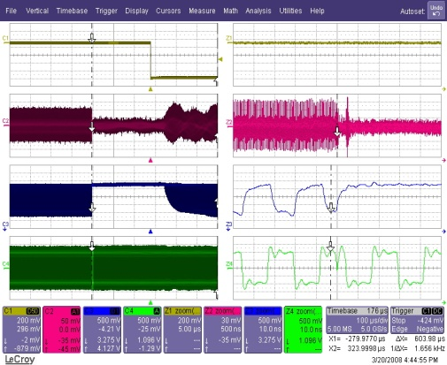
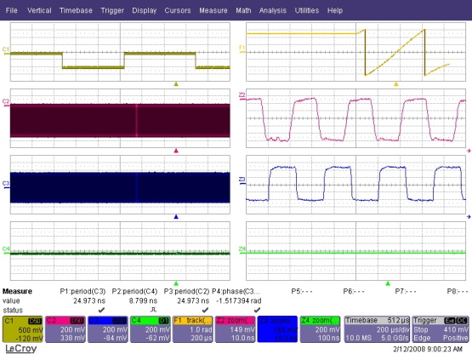
TTC System commissioning
Installation of the TTC system started in September 05. It was completed in November 05 (excluding LTPIs installed in May 08).
It was first used for BE tests and its functionalities were progressively used and tested whenever they were needed.
It was completely connected in August 07.
Real problems were only discovered when we started to use the system at high speed in long term tests (Fall 07):
  Occasional L1A getting through when the BUSY is present.
    Reason: Glitch (ns) on the Busy output of the ROD busy module due to VME accesses to its status.
    Cure: use the NIM output which filters that glitch instead of the OC TTL output.
  A few corrupted events received from FEBs during long runs (hours or days) at high rate.
    Reason: Glitch on the clock output of the LTP module due to VME accesses to its status.
    Cure: new LTP firmware.
  Looks simple but took 6 months to understand!
How does it happen:
Short glitch on the LTP output clock only happens with a VME access, a transition on the LTP internal orbit signal plus Internal LTP clock and external CTP clock having a different level.
Zoom
Clk glitch at input of TTCex phase comparator stops it for 350 Us.
This is not the expected behavior of the component!
Consequence is Phase shift between
LTP Clk (NIM) and
TTCex output Clk for a few ms until the TTCex locks again.
FEB Data starts to be corrupted, then FEB QPLL unlocks for 400 ms
Zoom of Clks

Slide 14
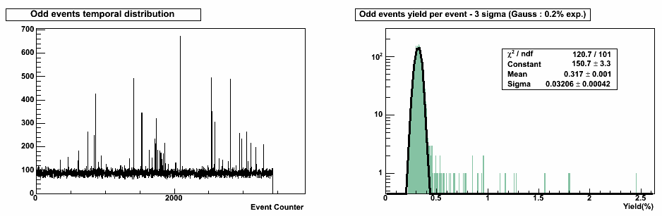
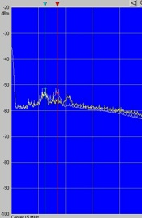
Noise Problems (1)
Noise correlated to the Tile Hadronic calorimeter power supplies have been observed with a frequency peak at 17 MHz on channels close to the heater cables inside the FEC pedestal.
Corrected by adding more filtering on the heater cables in the pedestal and modifying the Tile LV power supplies.
Noise bursts seen in cosmic runs and pedestal runs (in some events many cells many sigma above the noise).
  OddCellMonitoring tool is a very efficient tool to investigate this phenomenon.
  LVL1 output with frequency analyzer very efficient complementary tool to characterize noise bursts.
  Almost exclusively affecting the Presampler.
  Bursts with frequencies of 3.5MHz - 6MHz, every 250µs
If perfect gaussian behavior: 55 (~27k x 0.2%) odd cells expected per event.
Nice peak around 0.3% but also noise bursts!
3.5MHz - 6MHz peaks

Slide 15
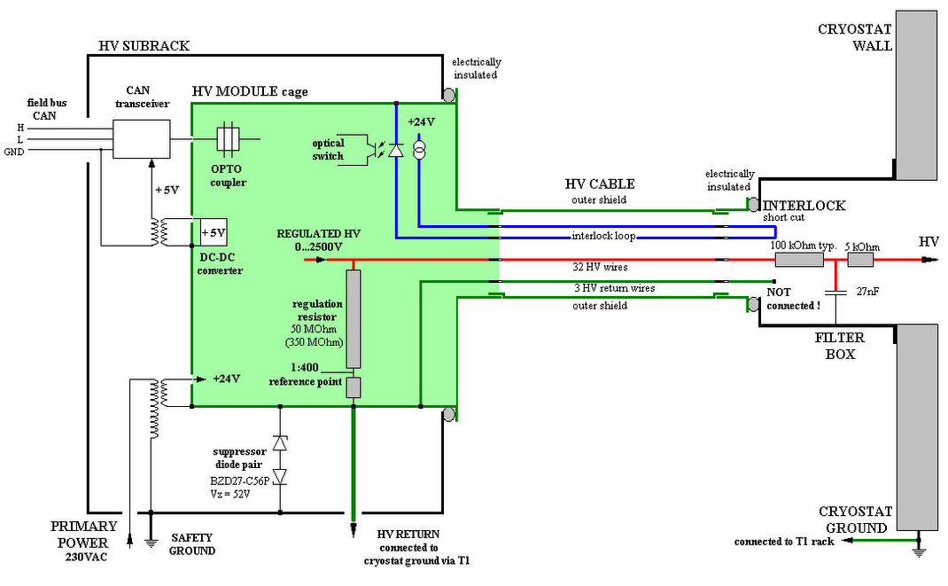
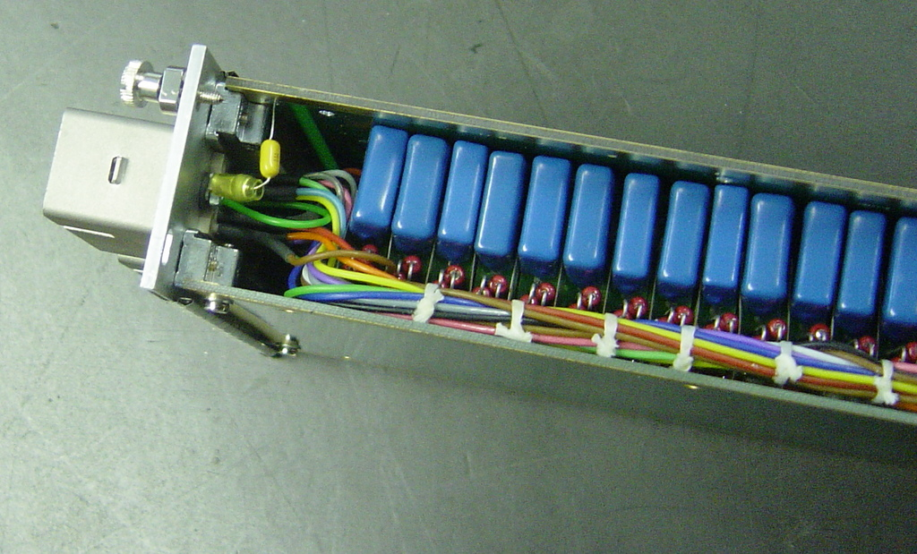
Noise Problems (2)
Investigations have shown that the noise was coming through the HV cables.
.
insulation
Cure is to add 1 μF capacitors between HV outer shield and Cryostat GND
1μF CAPACITOR
CAPACITOR 1μF
one per cable
HV Filter Box
Grounding Rules Compliant

Slide 16
Status of the LArg Calorimeter
BE
  A few remaining problems to be solved definitively( not impairing acquisition)
FE
  1 Dead LV power supply for Hadronic Encaps Preamplifiers: 1/8th of the HEC calorimeter missing
  7 FEBs (out of 1524) not sending data.
Detector
  100% working HV channels
  <1% of HV channels at reduced voltage,
  but sufficient voltage for usable signals in all cases.
  ~0.5% channels with minor problems
  (increased noise, damaged calibration lines)
Current status very satisfactory:
  Very stable readout system.
  Calibration constants stable at better than 0.1 % over a few months.
  Cosmic data taking with other ATLAS sub-detectors since 2 years .
  Very encouraging results from first LHC beam events.

Slide 17
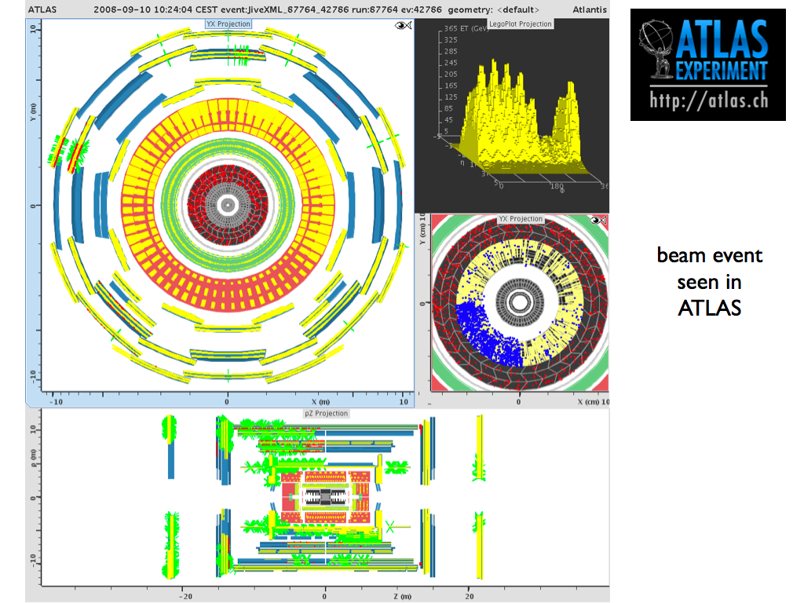
One of the First Beam Events

