Slide 1









Development of a 3.2 Gpixel Camera for the
Large Synoptic Survey Telescope (LSST)
John Oliver
LSST Camera Electronics Project Manager
For the LSST Camera Electronics Team
15-Sept-2008

Slide 2
Overview
  Major science drivers
  Critical specifications
  Telescope
  Camera
    Sensors
    Readout electronics

Slide 3
Major Science Drivers
“Synoptic survey” : Comprehensive & multipurpose
Survey entire visible sky (20,000 deg²) in five filter bands (400 nm – 1,000 nm) every 3 nights
Dark matter survey → Weak gravitational lensing
Dark energy probe → Type 1a supernovae discovery > 10³/night
Galactic structure
Near Earth Objects & Potentially Hazardous Asteroids
Transient phenomena

Slide 4
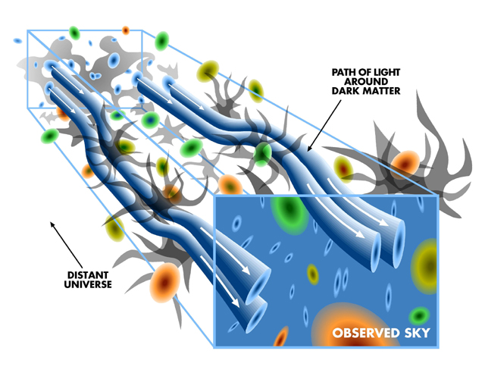
Dark Matter Survey
- Weak lensing-
Apparent rotation of elipticities of faint galaxies → Cosmic Shear
T. Tyson

Slide 5
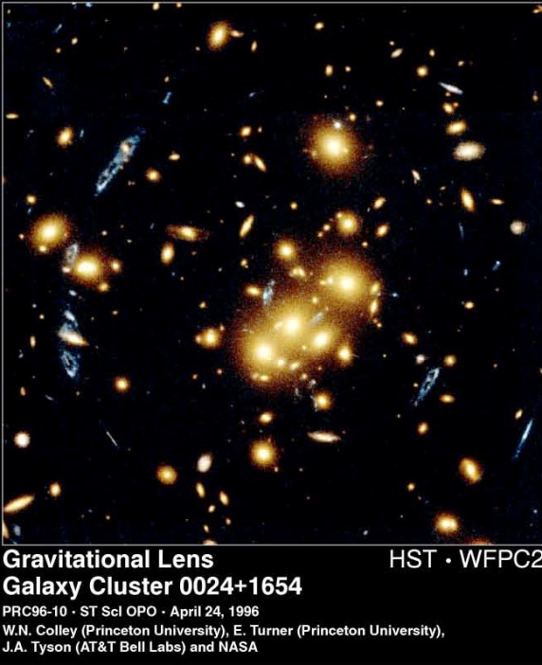
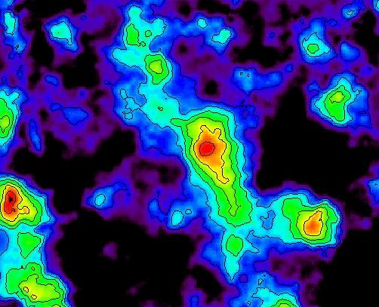
Dark Matter Survey
- Weak lensing -
Strongly lensed galaxy
Tomographic reconstruction of dark matter density from shear data
- Weak lensing -
Measurements of elipticity correlations of large numbers of faint galaxies → “cosmic shear”
T. Tyson
http://www.nsf.gov/od/lpa/news/press/00/pr0029.htm

Slide 6
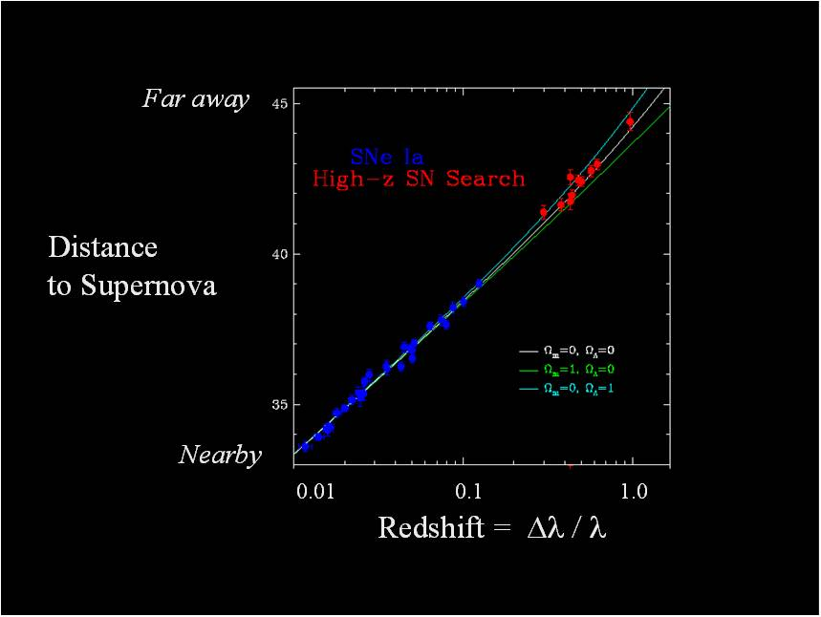
Dark Energy Measurement
- Type 1A Supernovae -
High statistics measurements of Type 1A SN → > 10³ per observing night
Redshift & distance measurement
  Fixed luminosity (standard candle) → distance
  Photometric redshift measurements in five filter bands to Z = 1.2
Deviations from linearity → Acceleration
Dark Energy
Cosmological constant

Slide 7
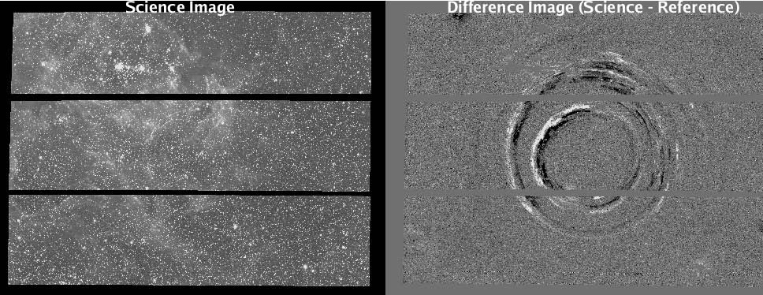
- Transient phenomena -
Differential images of SN 1987A
A. Becker, U. Washington (SDSS)

Slide 8
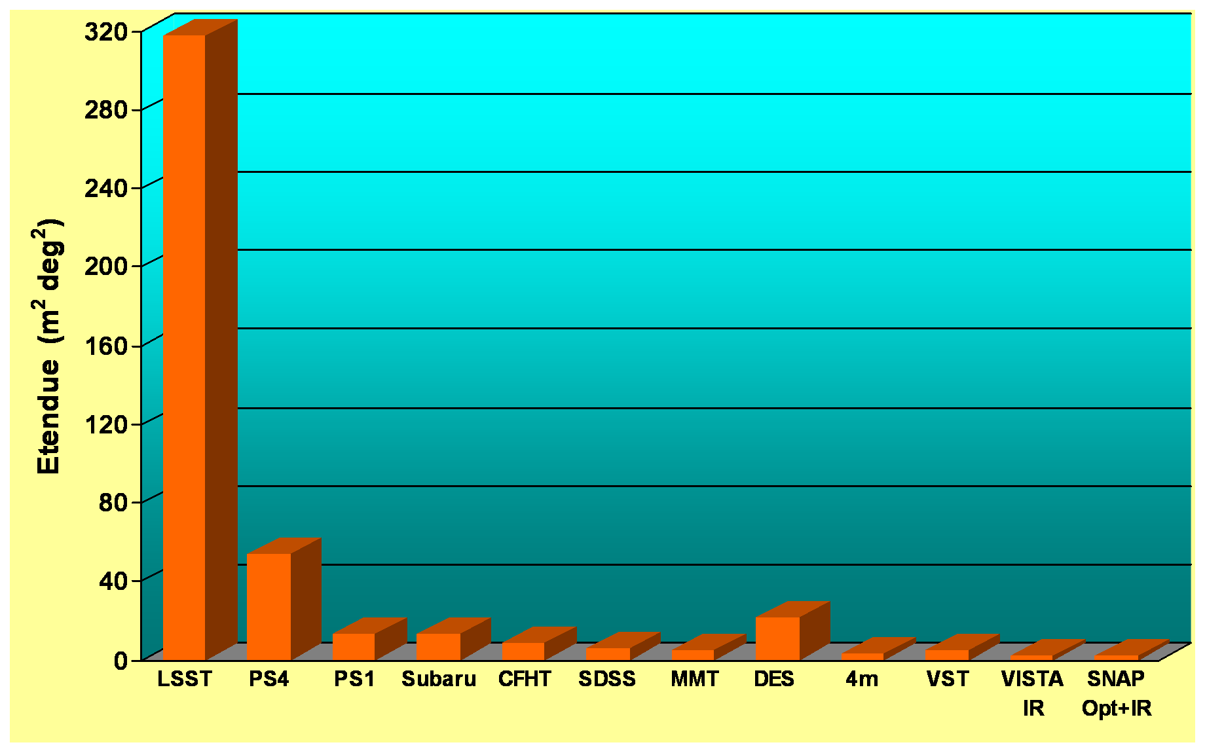
Critical Specifications
- Telescope -
Survey telescope figure of merit “Etendue” {(Dia)² x (FoV solid angle) }
Large aperture ~ 8.4 m, (6.7 m equivalent clear aperture)
Large FoV ~ 3.5 deg
Large focal plane ~ 64 cm diameter
LSST Etendue ~ 320 (deg²)(m²)
High “throughput”

Slide 9
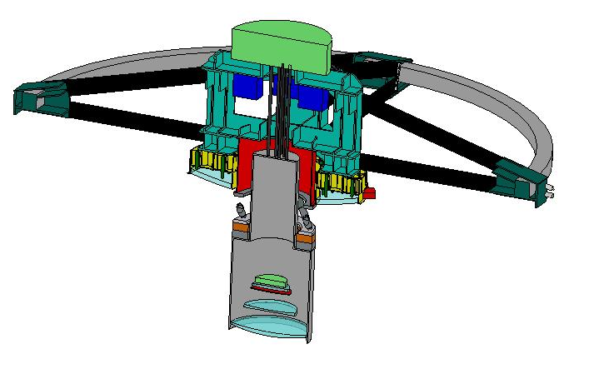
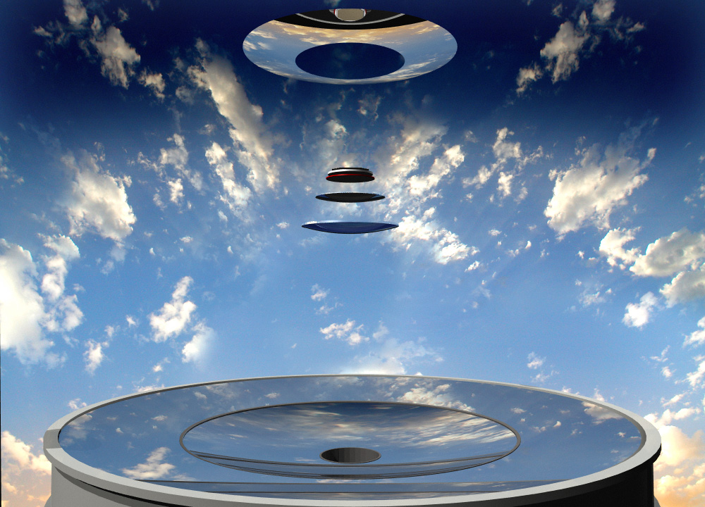
Optics
Convex secondary
Location of camera
Corrector lenses to form
flat image plane
8.4 m primary/tertiary 6.7 m effective aperture
Active optics [*]
fl~10 m →f1.2 beam
[*] Corrects gravitational sag due to mirror inclination

Slide 10
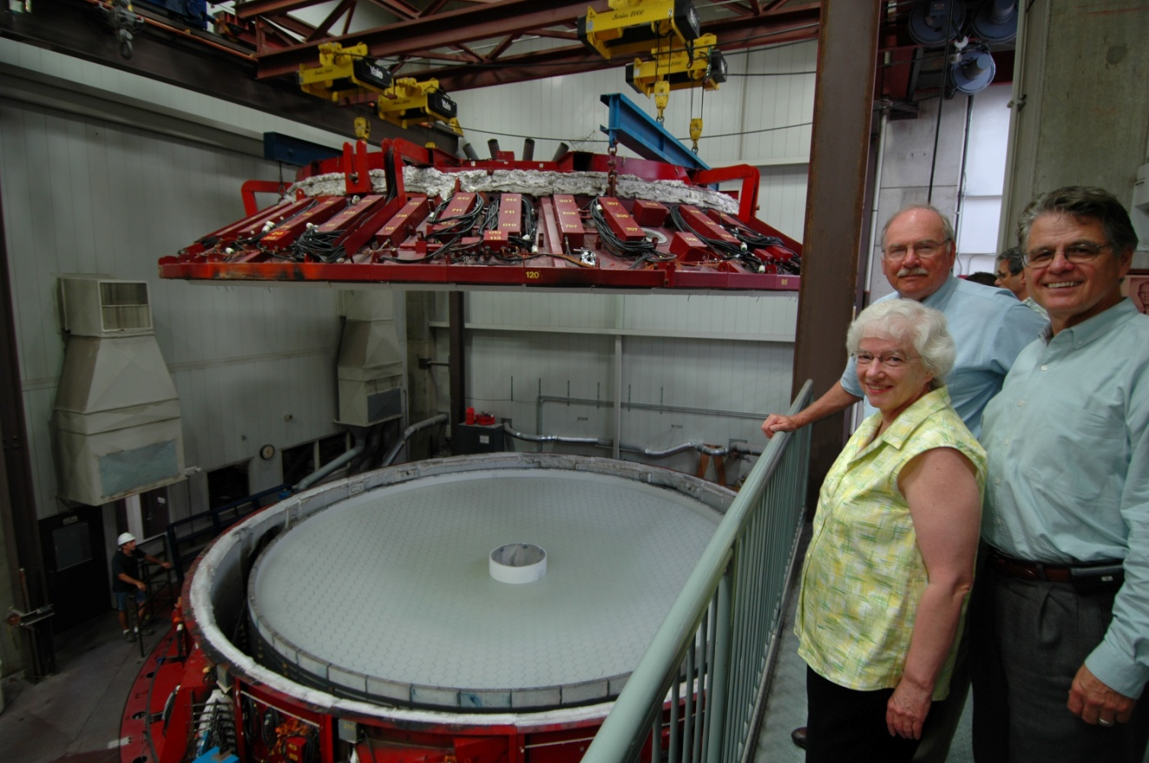
Spin casting at the Steward Mirror Lab U. Arizona
Lid is lifted from the primary/tertiary mirror blank 23-July-08
Made possible by grant from Bill Gates, Charles Simonyi – Microsoft Corp.

Slide 11
Critical Specifications
- Camera & Sensors-
Image sensors
  Large focal plane → ~ 64 cm dia
  ~ 200x 16-Mpixel CCD image sensors, 10μ pixels (0.2”) → 3.2 Gpixels
  Back side illuminated
  Small “Point spread function” – PSF (minimum spot size) < 7.5 μ (10 μ max)
  Low f-number = 1.2 ◊ must be flat to 10μ (peak-valley) across focal plane
  High quantum efficiency 400 nm – 1,000 nm (40%, 80%, 40%)
  Low leakage < ~ 1 e/s per pixel → T~ -100 C
  High “full well” capacity ~ 100,000 e/pixel
Back-to-back 15 second exposures on each piece of sky →Cosmic ray rejection
2 second readout → low dead time, high throughput
Sky shot noise limited images → CCD read noise ~ 5 e rms
Focal plane contained in a contamination free evacuated cryostat to prevent fogging of sensor surfaces
Note: Last three requirements highly constrain the readout topology

Slide 12
Critical Specifications
- Implications for readout & sensors -
Reset
Typical sensitivity S = 5 μV/e
Cg ~ 32 ff
Dominant noise source → “kTC noise”
Output
C_{g}
kTC noise easily removed by
  Correlated Double Sampling (Clamp & Sample)
  Dual Slope Integration (optimal)
CCD output “amplifier”

Slide 13
Dual Slope Integration sequence
  Reset
  Integrate baseline up
  Move charge to output fet
  Integrate signal down
For typical “science grade” CCD
CCD output
a
b
c
d
T_{int}
T_{int}
T_{read} > ~ 2 μs/pixel

Slide 14
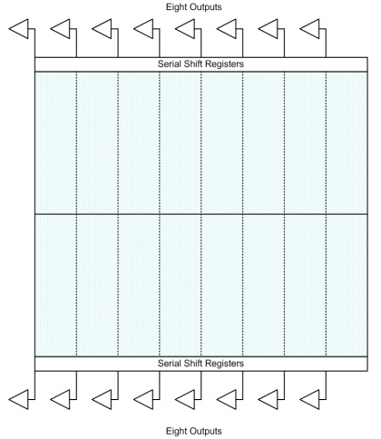
Critical Specifications
- Implications for Sensors -
  At f_{pixel-read} = 500 kpixels/sec → 32 sec Read Time (with one output amplifier)
    Each CCD must have 16 parallel outputs & electronic readout channels
    ~200 sensors → 3,200 parallel readout channels
16x segments, gap-less
½ k x 2k each
~ 40 mm x 40 mm

Slide 15
Critical Specifications
- Implications for Sensor Thickness -
Conflicting requirements →
  Small PSF
    Blue light has very small absorption length
    favors thin sensor to minimize diffusion
    favors full depletion in high resistivity silicon
  High QE in red
    Red light has very long absorption length
    Thin sensor would be transparent in red & near IR → favors thick sensor
Optimization : “Study of Silicon Sensor Thickness Optimization for LSST” [1]
  Calculations
  Simulations
[1] http://www.inst.bnl.gov/~poc/LSST/Study%20of%20sensor%20thickness.doc
LSST Sensor Working Group D. Figer, J. Geary, K. Gilmore, S. Marshall, P. O’Connor, J. Oliver, V. Radeka, C. Stubbs, P. Takacs, T. Tyson

Slide 16
Effect of sensor thickness on PSF
Beam divergence : f1.2 beam →46 deg max
Beam divergence in red, (simulation)
PSF vs Thickness : Divergence + diffusion
→Sets thickness limit

Slide 17
Effect of sensor thickness on QE
Silicon QE @ 1000 nm vs Thickness
To get > 25% QE @ - 100C →
Optimal sensor thickness = 100 μ

Slide 18
Sensor Requirements cont’
- Temperature Stability -
Sensor QE is very temperature dependent near ~ 1,000 nm
For accurate photometry, temperature stability ~ +/- 0.1C
Sources of heat
  CCD gates (small)
  CCD output amplifiers (medium)
  Heat radiation through lens (large ~ ½ W per sensor)
Heat removal by thermal straps to a cryogenic plate
Thermal control loop
  High stability temp sensors close to CCD package
  Heaters → 0 to ~ ¼ W per sensor on sensor package or cold straps

Slide 19
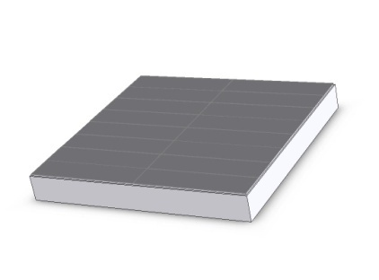
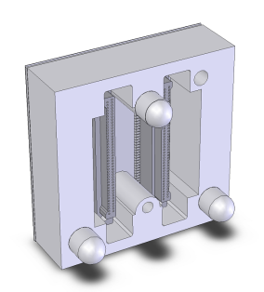
Sensor Status
An array of “study” sensors has been produced by
e2v
STA/ITL
  100μ to 150μ thickness
  All fully depleted between 10V – 25V “back window bias”
  Sizes 1 MPixels to 16 Mpixels
  Multiple output ports
  Tested @ BNL
  Not final package
“Pre-Production” sensors
  E2v
  STA/ITL
  100μ thickness
  Final packaging
  → 4 side buttable
  → flat to 6 μ (p-v)
  Expected →Fall 2010

Slide 20
Focal Plane Construction
3 x 3 arrays of CCDs are mounted into a precision “Raft”
144 Mpixels per Raft
21 Rafts are mounted onto a rigid (SiC) “Grid”
Major issues
  Each sensor has ~ 150 bond pads
  Total of ~ 30,000 bond pads
  Sensors reside in high-vacuum cryostat
  To avoid 30,000 cryostat feedthroughs, all readout electronics is placed within cryostat.
  Each Raft is modular. All its readout electronics must reside in the shadow of the Raft.
Raft electronics is divided into two sections
  Analog, front end, in cryo-zone (-100C)
  ADC/digital in warmer zone (- 40C)

Slide 21
Camera Overview
Shutter
Filters
Cryostat
FPA
Front End Electronics
- 100C
Back End Electronics
-40C
Utilities,
Timing & Control
Data fibers to
DAQ
Ethernet
High level commands

Slide 22
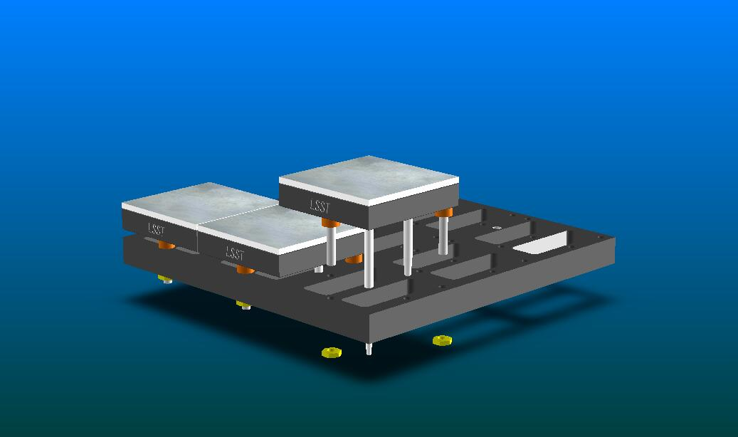
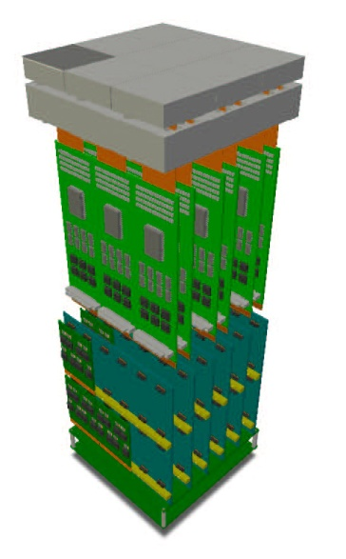
Focal Plane Construction
Raft Tower Assembly
9 Sensor Raft
Raft
FEE
BEE
Trimmed for flatness requirement during assembly
Very high image “fill factor” > ~ 90%

Slide 23
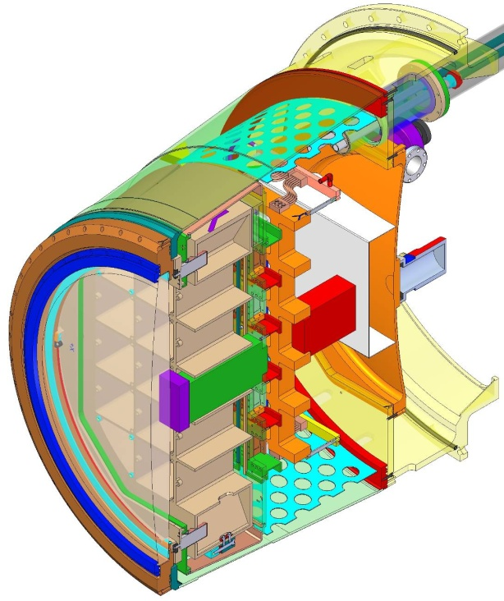
21 “Science Rafts”
4 special purpose “corner Rafts”
“Guide” sensors for telescope fine steering
Cryostat Assembly
~ 64 cm dia
“Wavefront” sensors determine mirror distortions for active mirror adjustments

Slide 24
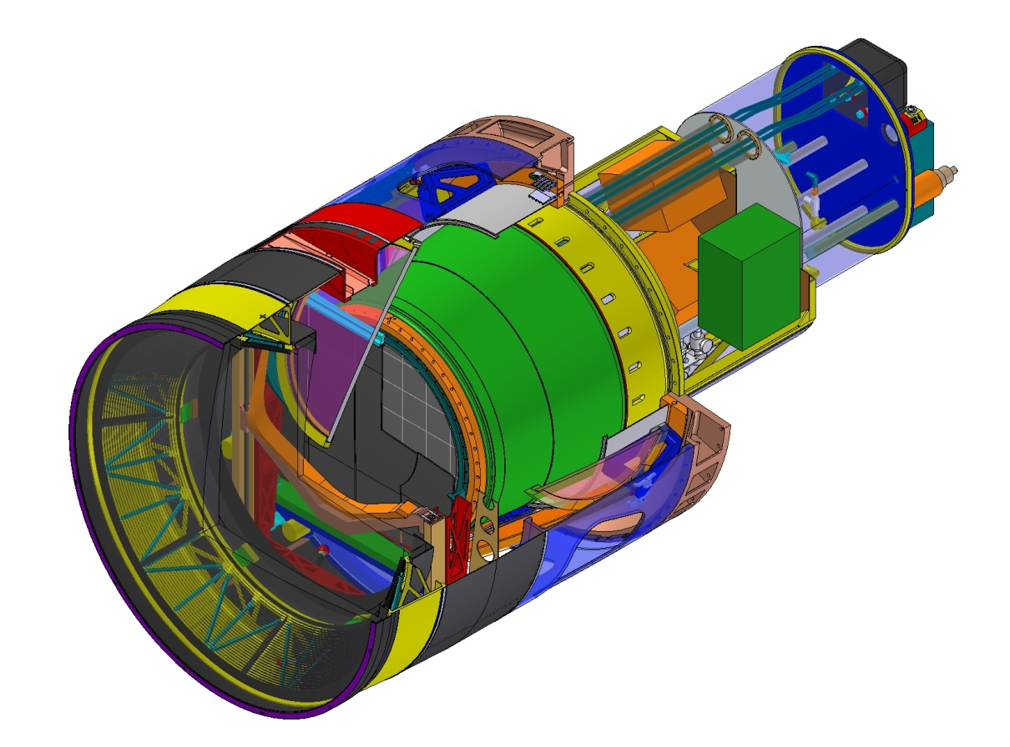
Camera with filters

Slide 25
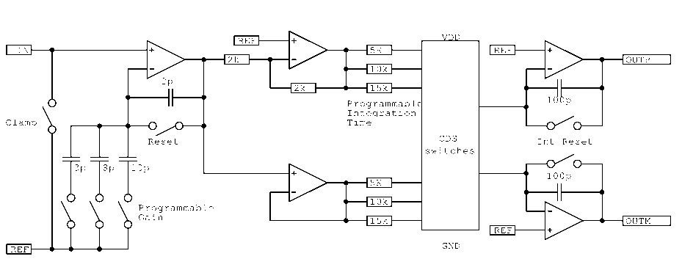
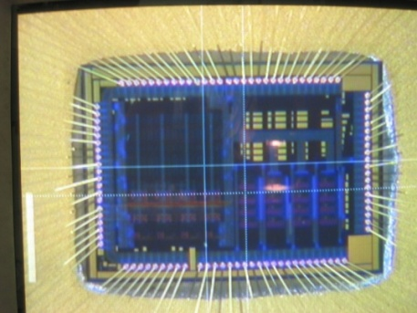
Front End Electronics
Located within “grid” : Operates at – 100C to – 120C
Each “FEB”services 24 CCD segments – 6 FEBs per Raft
Analog functionality in 2 ASICs
  Analog Signal Processing ASIC (ASPIC)
  LPNHE/IN2P3 collaboration[1] - France
  Dual Slope Integrator : Programmable gain
  Specs:
    e_{n} < ~ 5 nV/rt(Hz)
    x-talk < ~ 10⁻³ (achieved in 1st version)
  Differential output to Back End Boards (ADCs) via shielded flex cable
  8 channel ASIC, AMS 0.35μ CMOS @ 5V, ~ 25mW/ch
[1] V. Tocut, H. Lebbolo, C. De La Taille, P. Antilogus, S. Bailey, M. Moniez, F. Wicek, R. Sefri

Slide 26
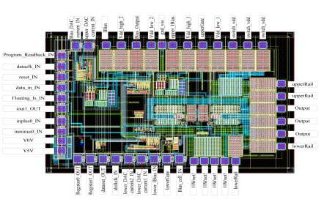
Front End Electronics – cont
Sensor Control Chip (SCC)
  ORNL – U. Tennessee [1]
  Receives LVDS signals from BEBs → Converts to Clock levels to CCDs
  Parallel gates (4), Serial gates(3), Reset(1)
  Clock Hi/Lo levels in range 0V to ~ 25V, programmable on BEB
  4 channels per chip, 2 chips per CCD.
  CCD bias level buffers in range up to ~ 30V
  ATMEL BCD-SOI process. HV to 45V
  Status
    1st submission tested & fully functional
    Some pulse shape “wrinkles” (fully understood in simulation)
    2nd submission → Fall ’08
Additional FEB functionality
  Temp sensing & other usual monitoring
  Raft heaters → Part of focal plane thermal control loop
[1] P. Stankus, C. Britton, Z. Ning, N. Ericson

Slide 27
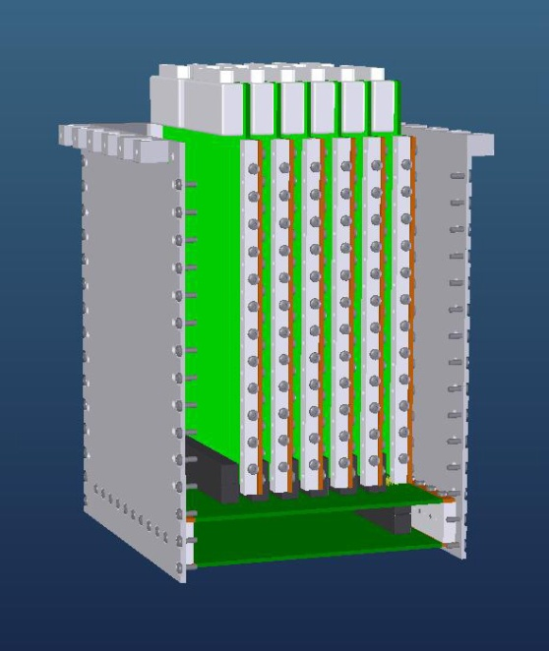
Back End Electronics
Back End Boards
Raft Control Crate
6x Back End Boards (BEBs)
24 channels ea, 18 bit 1 MHz ADCs (COTS)
Temp sensor processing
Programmable bias & clock levels for FEBs
Sensor heater control
Misc slow controls
FPGA (Xilinx) based programmable “Readout State Machine”
Collects all ADC data @ 100 MHz
All control loops stored locally
Responds to high level commands from Timing & Control Module (TCM)
All Rafts in fully synchronous operation
“Rocket i/o” data output to drive data fiber to DAQ (~1.6 Gb/s)
Power PC for non-time critical operations
Raft Control Module

Slide 28
Back End Electronics
- Data Volume -
Per image: 3.2 Gpixels → ~ 7 GB
Per minute : 4 images → ~28 GB
Per night : ~ 600 min → ~ 16 TB
Per year : → ~ 5 PB
All fibers received by “Science Data System” – (SLAC)
Public data set

Slide 29
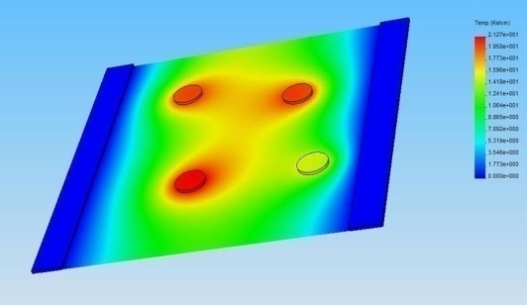
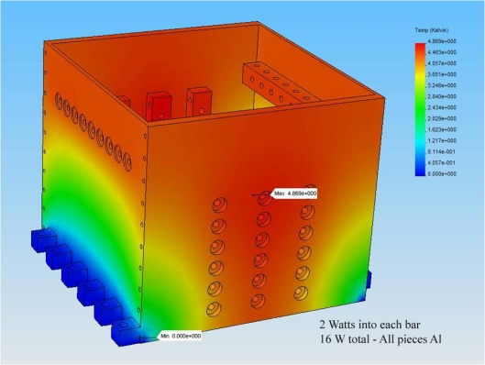
Additional Electronics Issues
Thermal management
Thermal paths & modeling
  ICs and components to ground/thermal planes
  “Chip scale” packaging
  Conduction bars
  Crates/housing
  Cold plates / cryoplates
Board level R_{t} ~ 20C/W across 2 oz copper plane
Crate level R_{t} < ~ 0.5C/W

Slide 30
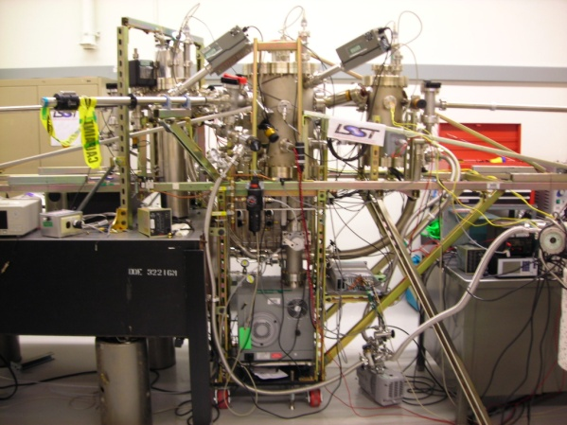
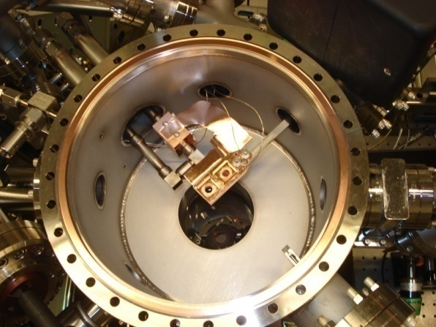
Additional Electronics Issues
Contamination & outgassing
Outgassing materials may condense on sensor surface
~ 2 m² of pcb materials in cryostat
Polyimide pcb construction (if necessary)
Parylene (vapor deposition) or similar coatings
Electronics separated from focal plane by molecular barriers (tortuous paths) and separate vacuum pumping
All in-cryostat materials tested / certified in test “Materials Test Facility” @ SLAC
Optical loss measurement over LSST pass band & residual gas analyzer (RGA)

Slide 32
CD-1
2008
2009
2010
2011
2012
2013
2014
2015
2016
2017
R & D
Camera construction
Telescope construction

Slide 33
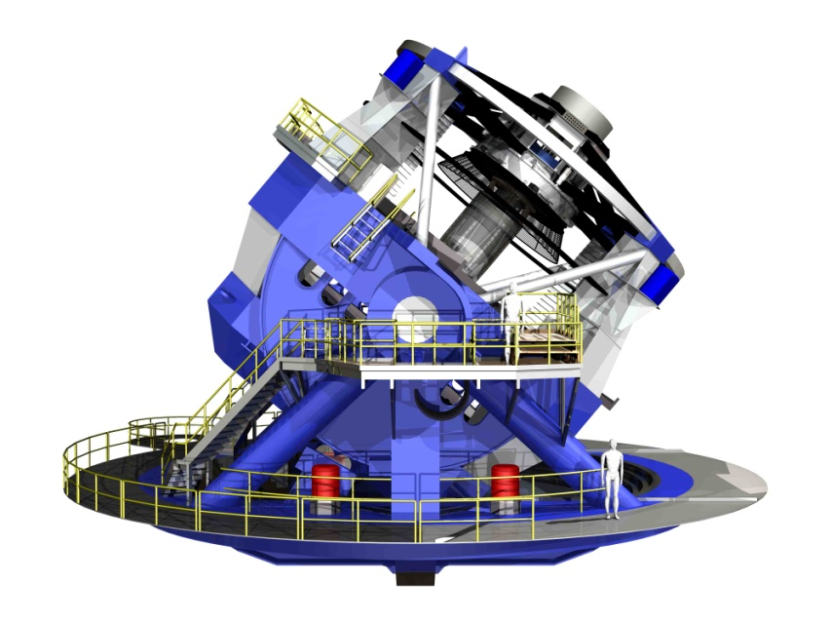
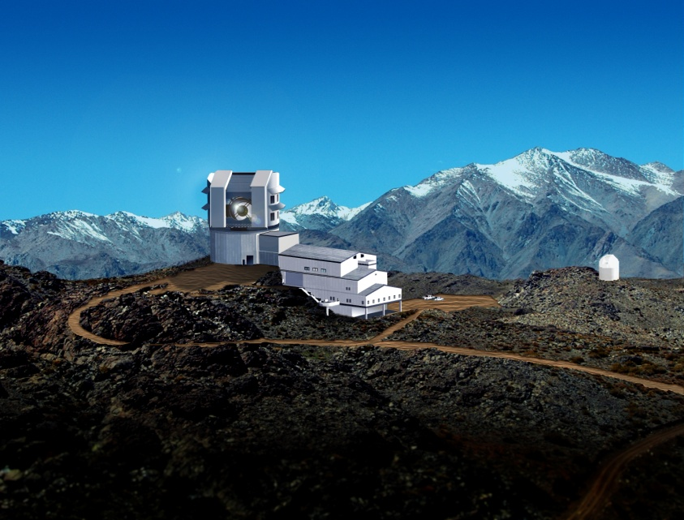
Telescope and site : Cerro Pachon, Chile

