Slide 1

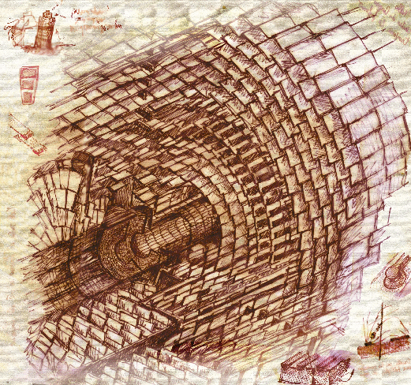

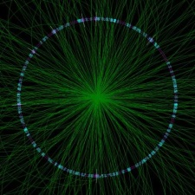

System Tests with DC-DC Converters
for the CMS Silicon Strip Tracker at -LHC
Lutz Feld, Rüdiger Jussen, Waclaw Karpinski,
Katja Klein, Jennifer Merz, Jan Sammet
1. Physikalisches Institut B
RWTH Aachen University
Topical Workshop on Electronics for Particle Physics
Naxos, Greece
September 17th, 2008

Slide 2
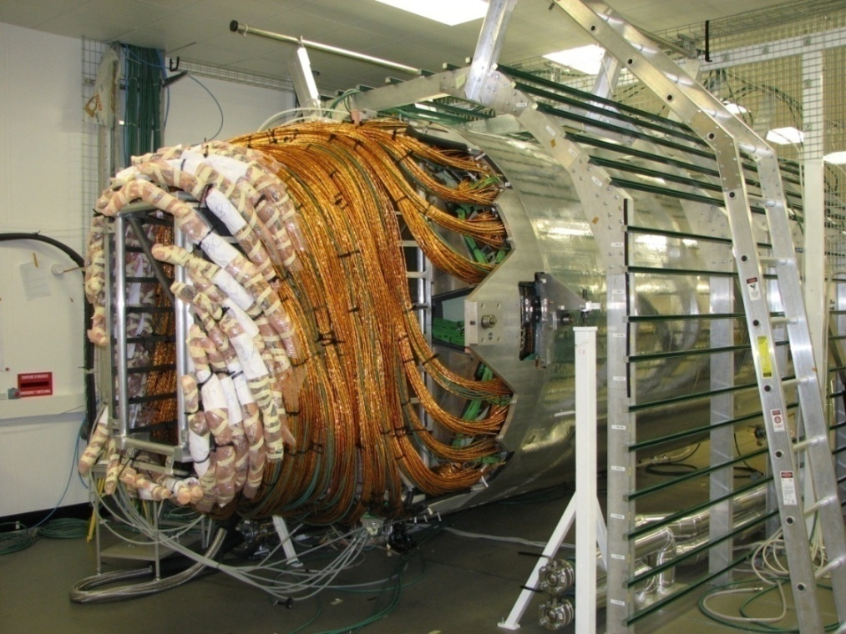
Outline
Powering the CMS Silicon Strip Tracker
DC-DC Conversion
System Test Measurements
  Commercial converters
    with internal ferrite inductors
    with external air-core inductors
  Custom converters
    CERN SWREG2 buck converter
    LBNL charge pump
Summary & Outlook
Strip tracker with cables, waiting for installation

Slide 3
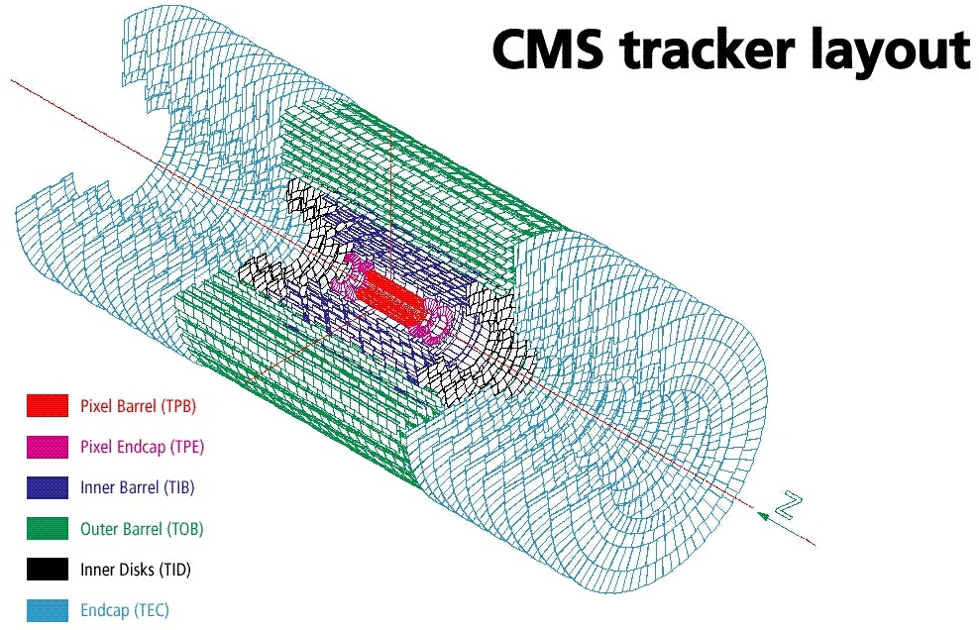
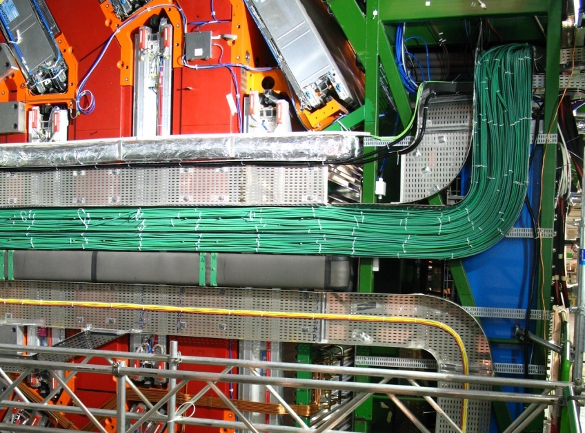
Current Strip Tracker Power Consumption
15 148 silicon strip modules a 2-3W
⇒ Strip tracker needs 33kW of power
Sensor operating temperature below -10°C
Groups of 2-12 modules are powered in parallel
Powered via ≈ 50m long cables from power supplies (PS) on balconies
⇒ Power loss in cables amounts to 34kW = 50% of total power
Complex routing of services; exchange for SLHC not considered an option

Slide 4
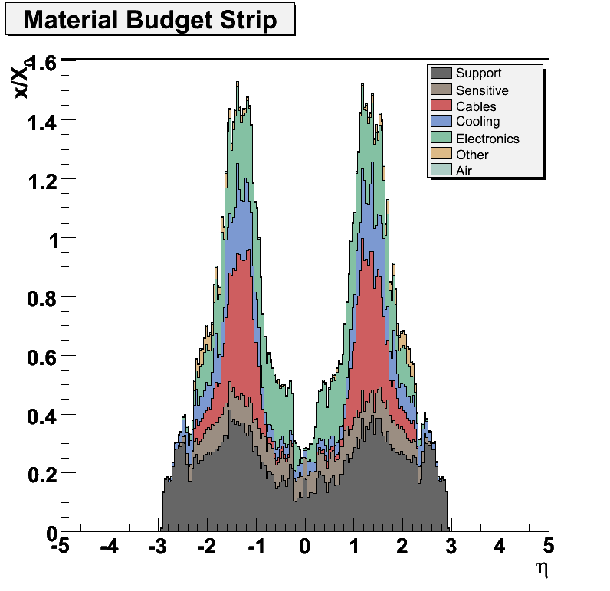
Strip Tracker Upgrade
Design of CMS tracker upgrade
still under discussion
Smaller feature size (probably 0.13μm) saves power per channel
Increase of granularity and complexity costs power
Material budget must not increase and services shall be recycled
⇒ new powering schemes need
to be exploited
R&D on powering is ramping up,
a CMS Working Group exists
since April 2008 (contact: KK)
cooling
cables

Slide 5
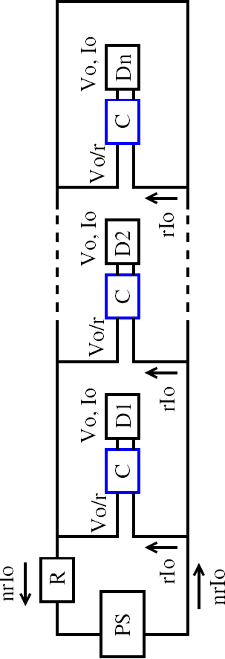
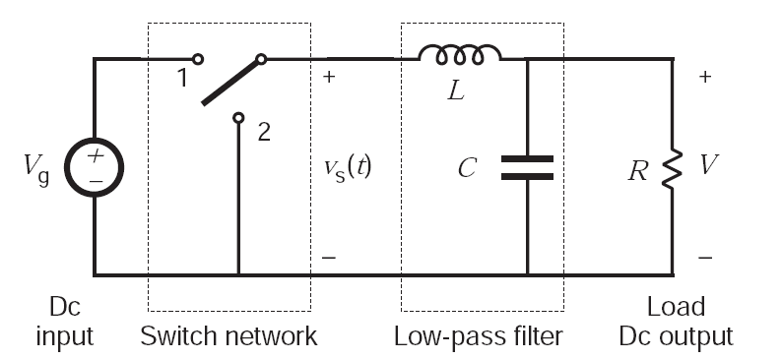
DC-DC Conversion Basics
Conversion ratio r = V_{out} / V_{in} << 1
P_{drop} = R⋅I₀²⋅n²⋅r²
Buck converter: simplest
ind.-based step-down converter
Many technologies and designs (inductor-based, capacitor-based, piezo...)
+ Classical way of module operation, powering “factorizes“ from system & module design
+ Different voltages can be provided by the same circuit
+ Flexible: several conversion steps (i.e. on substructure and on module) can be combined
- High frequency switching present in all designs → switching noise to be expected
- Efficiency typically 70-90%
- Transistors must stand high V_{in} → non-standard chip technology to be used
- Ferrites saturate in magnetic field  inductors must have air-cores → radiation of noise

Slide 6
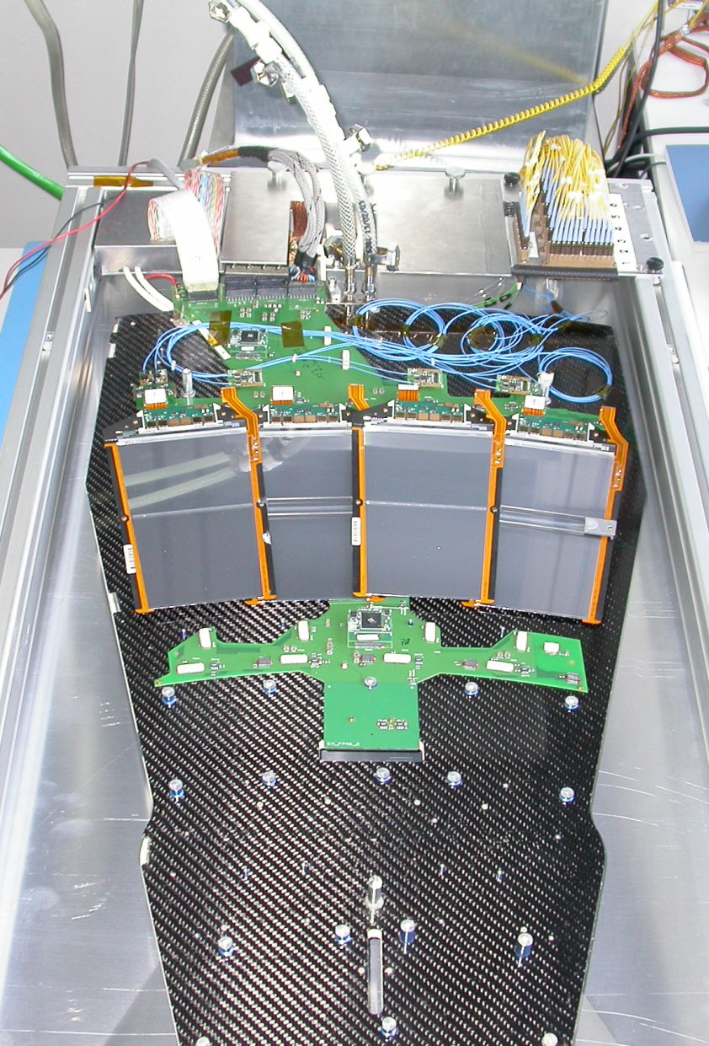
The System Test
Goal:
Understand if and how DC-DC conversion
could be used to power the upgrade strip
tracker; identify potential show-stoppers
Prototypes of tracker upgrade readout chips,
modules or substructures do not yet exist
⇒ current tracker hardware must be used!
Avoid to “tune“ R&D to current system
Still a lot can be learned with current system
Ring 6 modules
6.4
6.3
6.2
6.1
Tracker end-cap (TEC) “petal“ with four
modules powered & read out
Optical readout & control communication
Thermally stabilized at +15°C
Motherboard
(ICB)
Petal

Slide 7
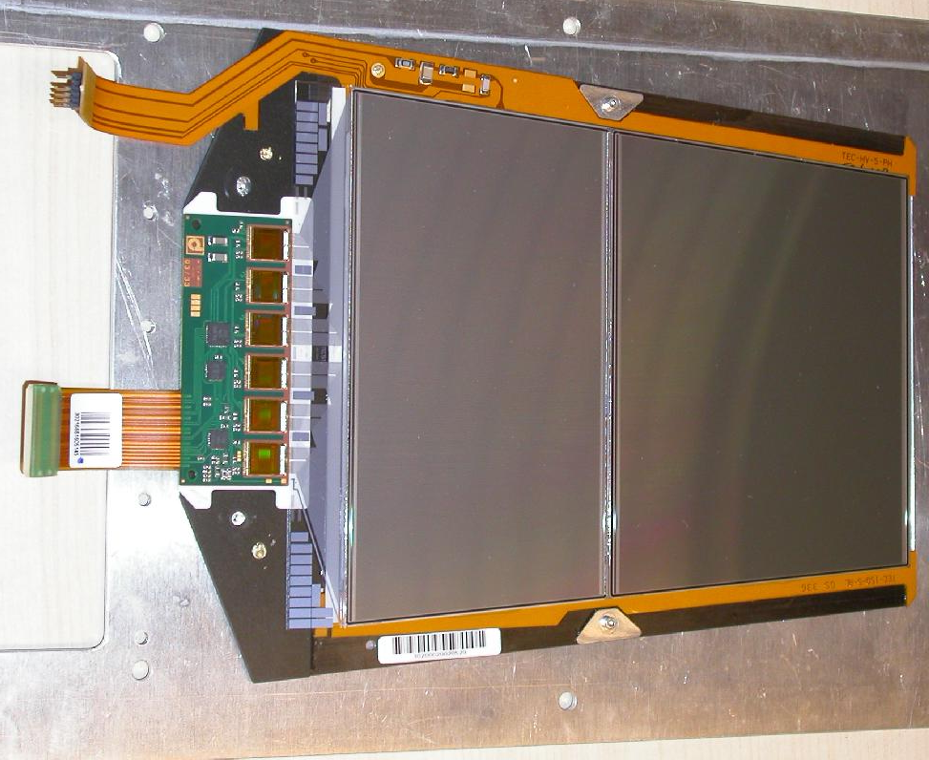
A Current CMS Strip Tracker Module
Frontend-Hybrid with
- 4 or 6 APV25 readout chips
- PLL chip for timing
- Multiplexer chip
- DCU chip for control
Typical strip module
APV25 readout chip:
- 0.25 μm CMOS
- 128 strips per APV
- analogue readout
- per channel: pre-amplifier,
CR-RC shaper, 4 μs pipeline
- τ = 50ns
Supply voltages: 1.25V & 2.5V for analogue readout and 2.5V for digital control ring
Currents per APV: 0.12A at 2.5V and 0.06A at 1.25V
Power consumption of 4 (6) APV module including optical conversion: 1.8W (2.7W)

Slide 8
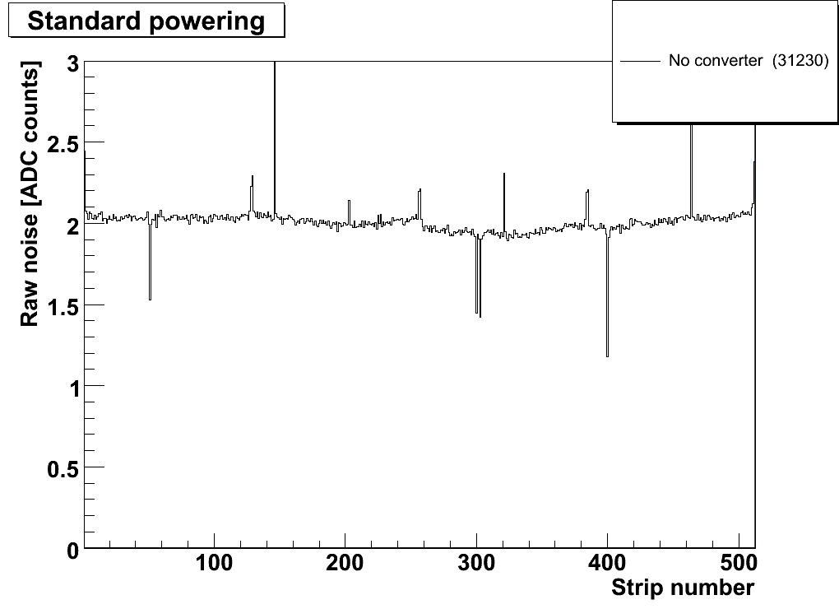
Definitions and Analysis
Pedestal = mean signal of a strip without a particle traversing the sensor
Raw (or total) noise = RMS of fluctuation around pedestal value
Common mode (CM) = common fluctuation of subset of strips, calculated per APV
The raw noise includes the common mode contribution
One module has four APVs a 128 strips = 512 strips
Most tests performed in “peak mode“ = 1 sample read out per event
A typical noise distribution
{
1 APV
Higher noise
on edge channels
(e.g. from bias ring)
Open channels

Slide 9
System Test with DC-DC Converters
Measurements with
commercial buck converters
with internal ferrite-core inductor

Slide 10
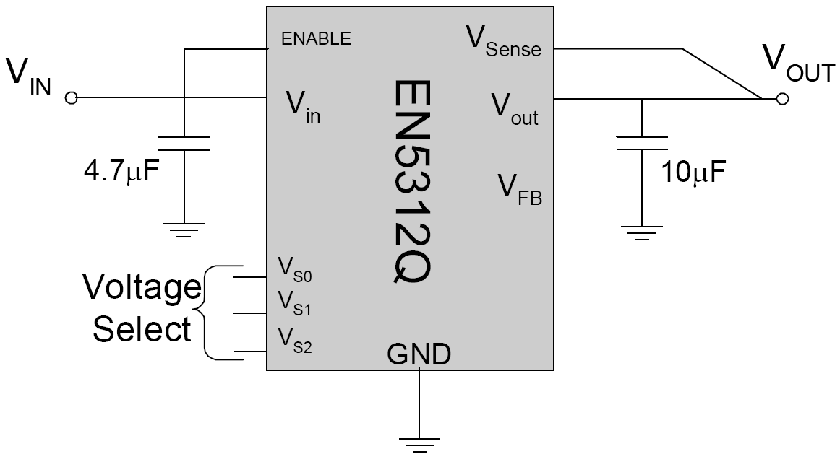
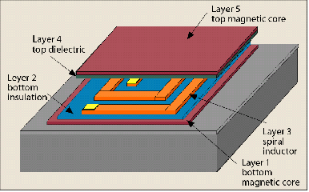
Commercial Buck Converter EN5312QI
Criteria for market survey:
High switching frequency → small size of passive components
High conversion factor
Sufficient current (~1A) and suitable output voltages (1.25V and 2.5V)
⇒ Enpirion EN5312QI:
  Small footprint: 5mm x 4mm x 1.1mm
  Switching frequency f_{s} ≈ 4 MHz
  V_{in} = 2.4V – 5.5V (rec.) / 7.0V (max.)
  I_{out} = 1A
  Integrated planar inductor
Internal inductor in MEMS technology

Slide 11
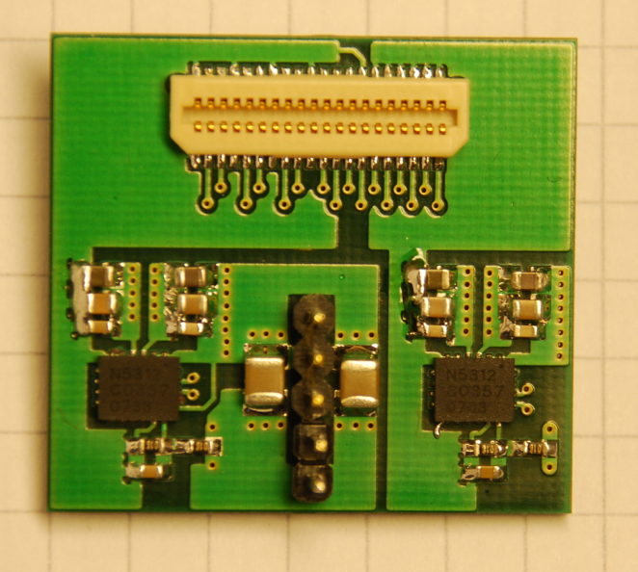
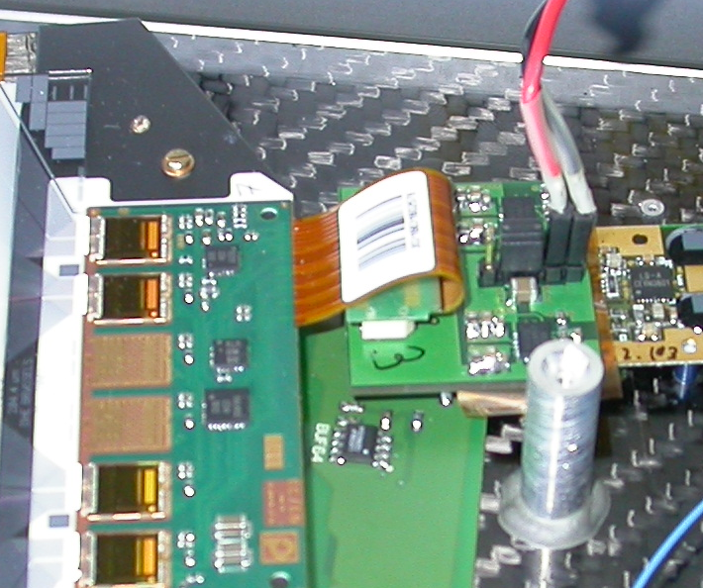
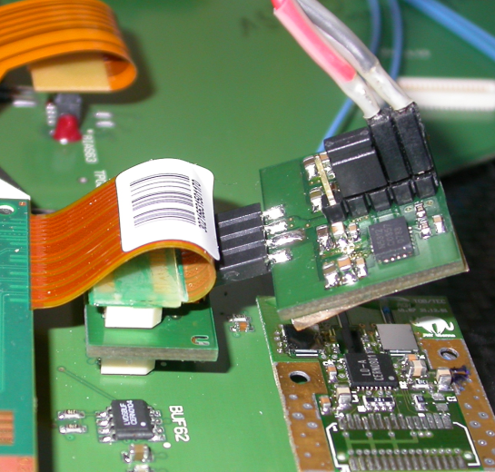
Integration onto TEC Petal
4-layer PCB with 2 converters provides 1.25V and 2.5V for front-end (FE) hybrid
One PCB per module, plugged between motherboard and FE-hybrid
Input and output filter capacitors on-board
Input power (V_{in} = 5.5V) provided externally or via TEC motherboard
Various designs
(type L: larger board with integrated connector, type S: smaller board with separate connector)
Type L
V_{in}
Type S

Slide 12
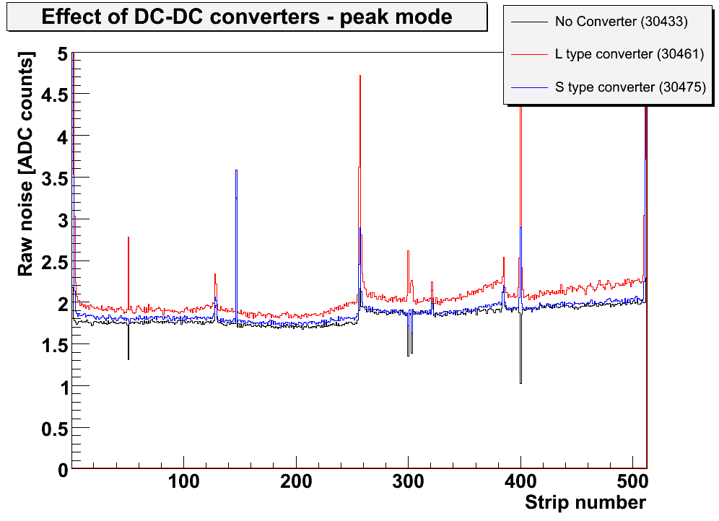
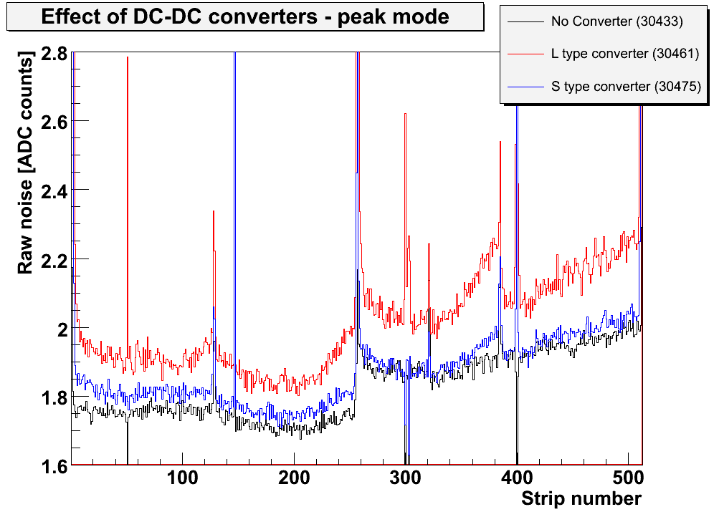
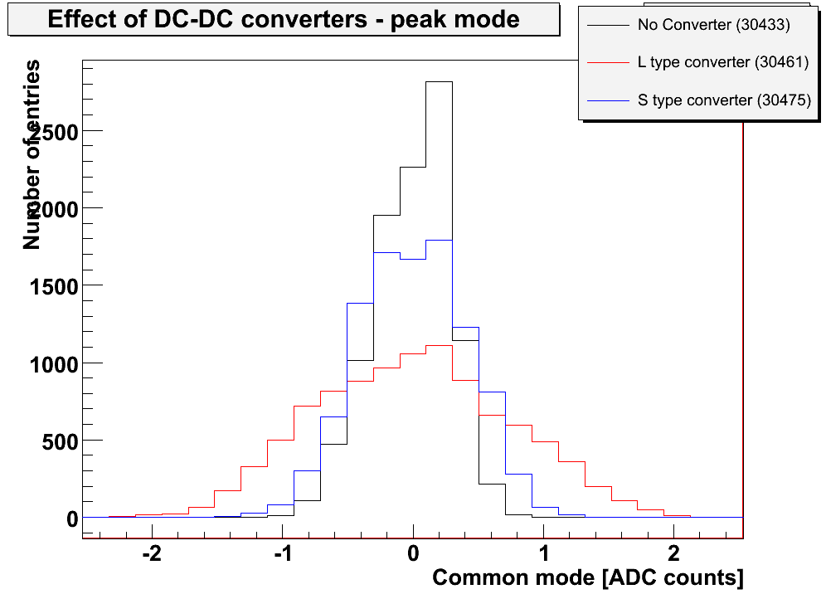
Raw Noise with DC-DC Converter
⎯ No converter
⎯ Type L
⎯ Type S
⎯ No converter
⎯ Type L
⎯ Type S
Pos. 6.4
Pos. 6.4
⎯ No converter
⎯ Type L
⎯ Type S
Pos. 6.4
Raw noise increases by up to 10%
Large impact of PCB design and
connectorization
Broader common mode distribution
Most optimization studies performed with L

Slide 13
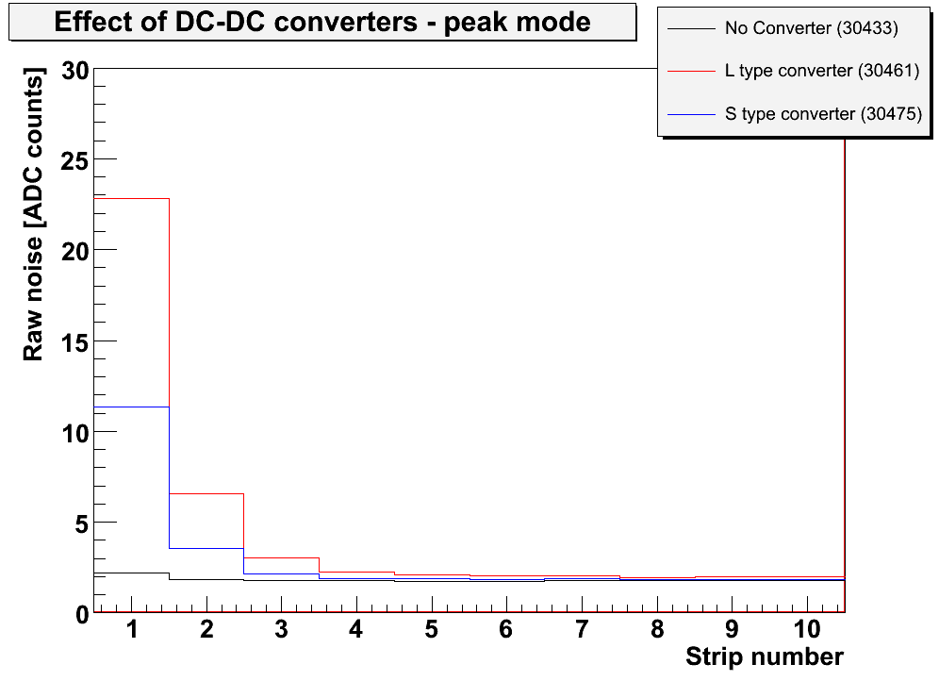
Edge Channels with DC-DC Converter
128 APV inverter stages powered via common resistor ⇒ on-chip common mode subtraction
CM appears on strips that see different CM than regular channels (open & edge channels)
Huge increase of noise at module edges and open strips with DC-DC converter
Indicates that large fraction of CM (both via 1.25V & 2.5V) is already subtracted on-chip
Visible common mode in noise distributions probably coupled in after inverter (via 2.5V line)
pre-amplifier
inverter
V250
V250
R (external)
⎯ No converter
⎯ Type L
⎯ Type S
V125
v_{CM}
Pos. 6.4
strip
v_{IN}+v_{CM}
v_{OUT} = -v_{IN}
VSS
Node is common to
all 128 inverters in chip

Slide 14
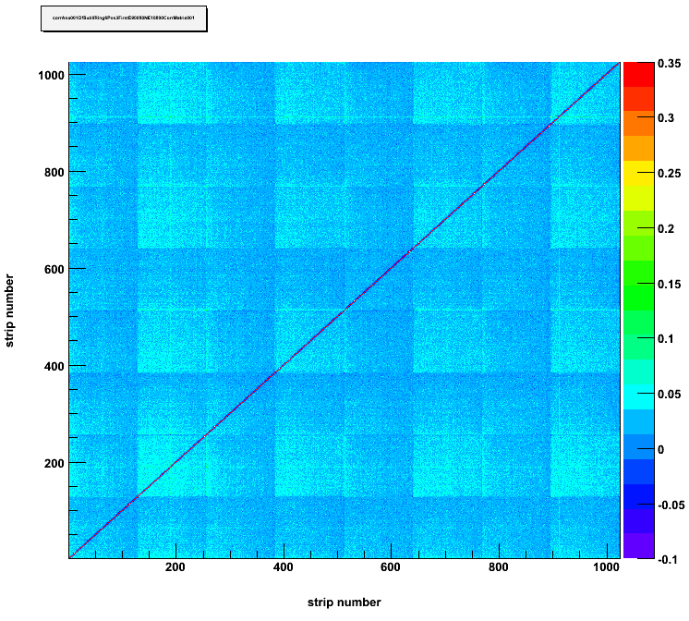
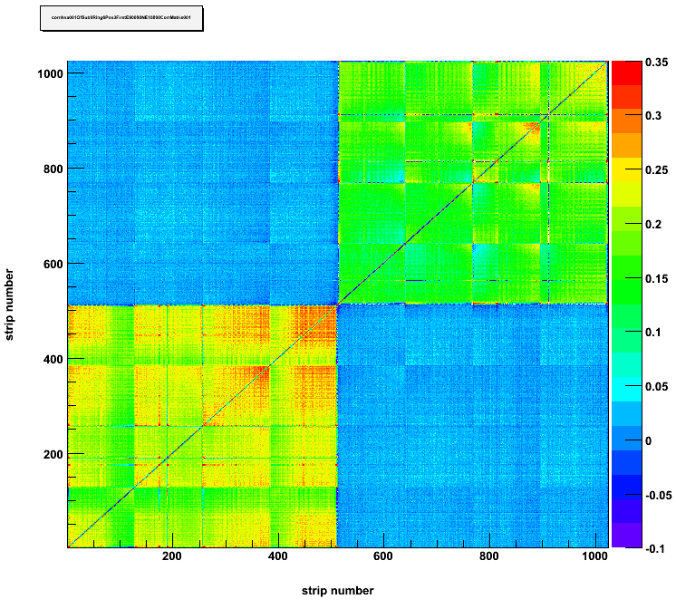
Cross-Talk
Two adjacent modules (6.3, 6.4) powered with EN5312QI converters
⇒ study correlations between pairs of strips i, j (r = raw data):
corr_{ij} = (<r_{i}r_{j}> - <r_{i}><r_{j}>) / (_{i}_{j})
Without converters
With converters on 6.3 and 6.4
Strip number
Strip number
Pos. 6.4
Pos. 6.4
Correlation coefficient
Correlation coefficient
Pos. 6.3
Pos. 6.3
Strip number
Strip number
High correlations only within single modules (= common mode)
No cross-talk between neighbouring modules

Slide 15
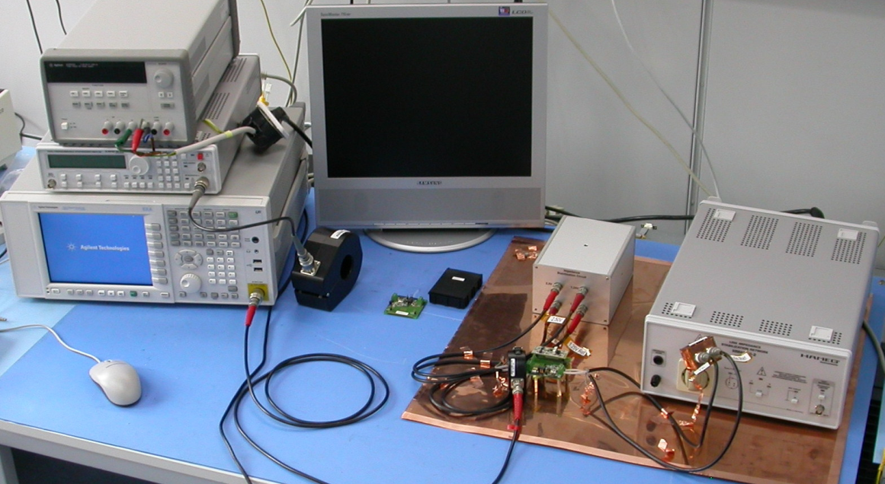
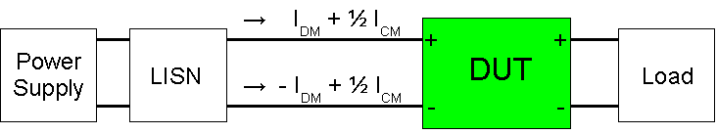
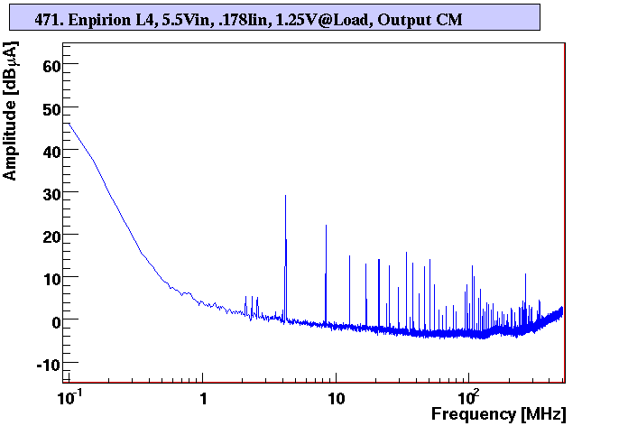
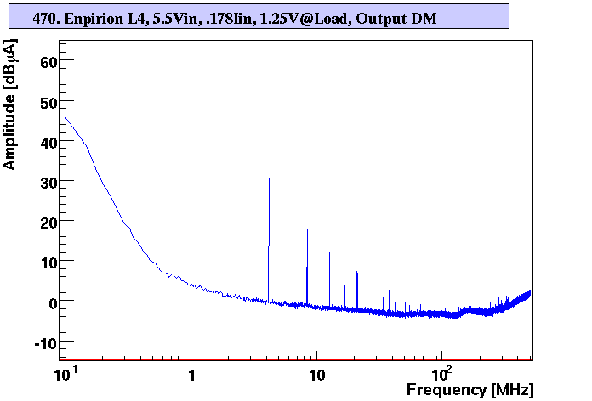
Converter Noise Spectra
Standardized EMC set-up to measure
Differential & Common Mode noise
spectra (similar to set-up at CERN)
PS
Line impedance
stabilization
network
Load
Load
Spectrum
analyzer
Spectrum
Analyzer
Copper ground
plane
Current probe
Enpirion
1.25V at load
Common mode
Enpirion
1.25V at load
Differential Mode
f_{s}

Slide 16
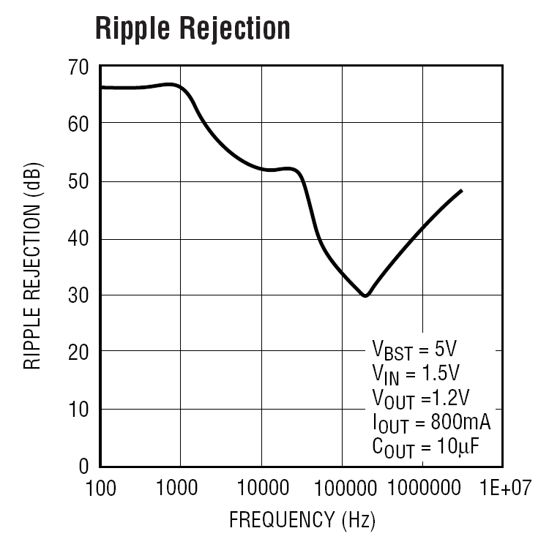
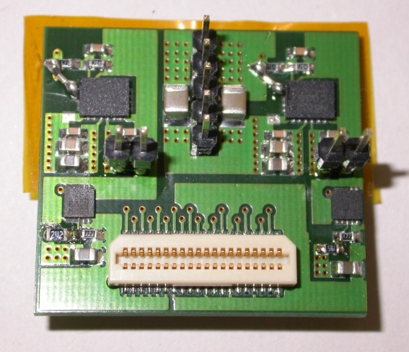
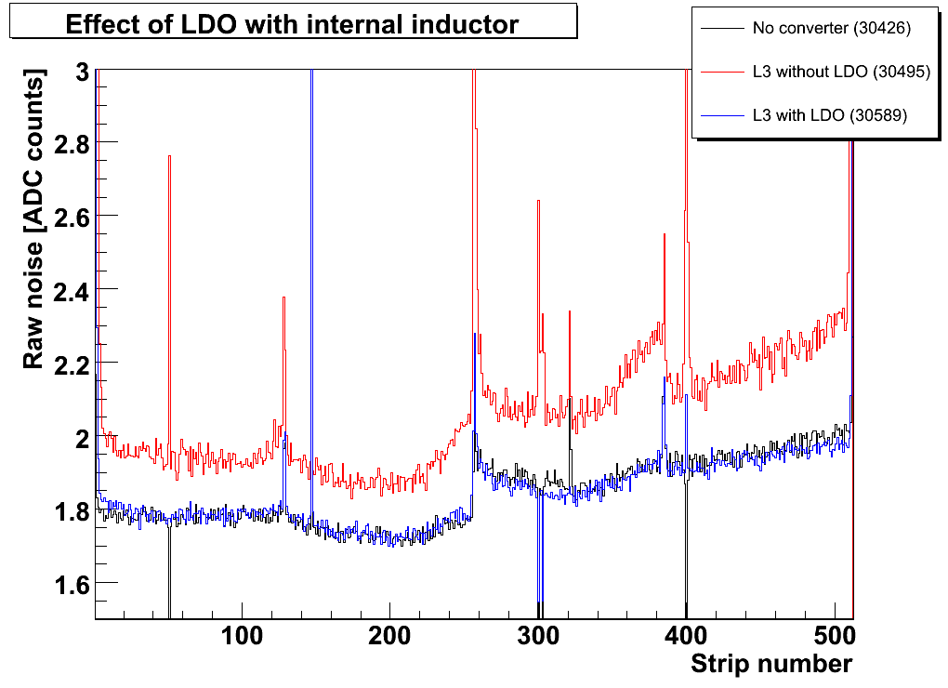
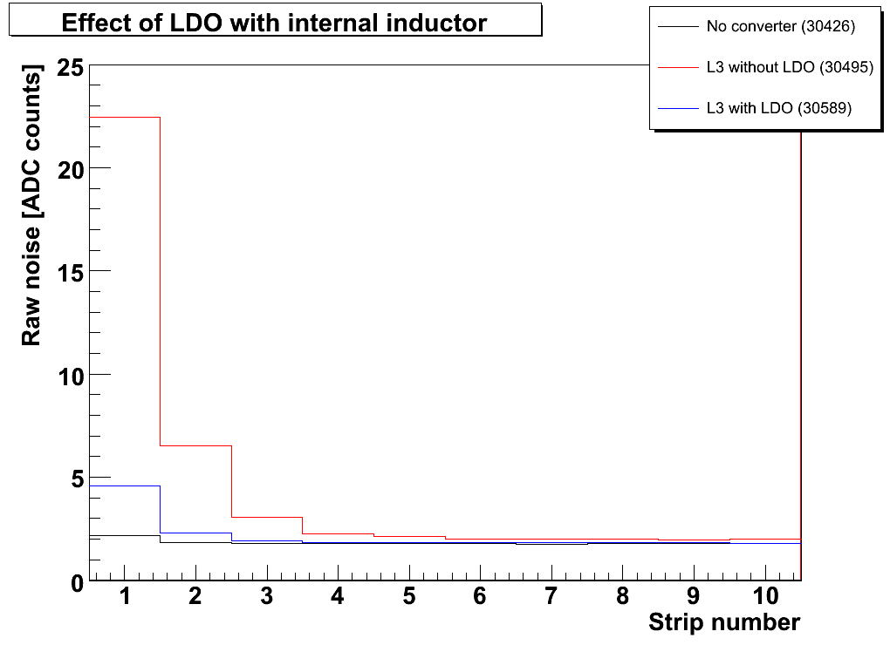
Combination with Low DropOut Regulator
Low DropOut Regulator (LDO) connected to output of
EN5312QI DC-DC converter
Linear technology VLDO regulator LTC3026
LDO reduces voltage ripple and thus noise significantly
⇒ Noise is mainly conductive and differential mode
Would require a rad.-hard LDO with very low dropout
⎯ No converter
⎯ Type L without LDO
⎯ Type L with LDO,
dropout = 50mV
⎯ No converter
⎯ Type L without LDO
⎯ Type L with LDO,
dropout = 50mV

Slide 17
System Test with DC-DC Converters
Measurements with
commercial buck converters
with external air-core inductor

Slide 18
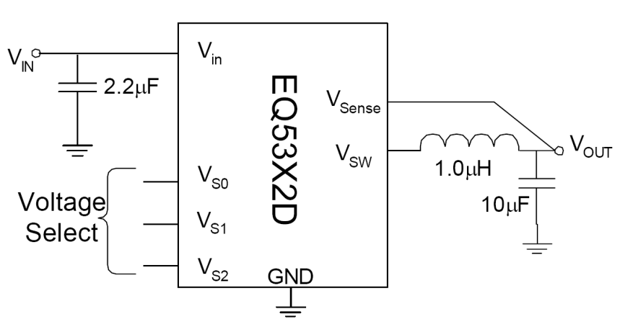
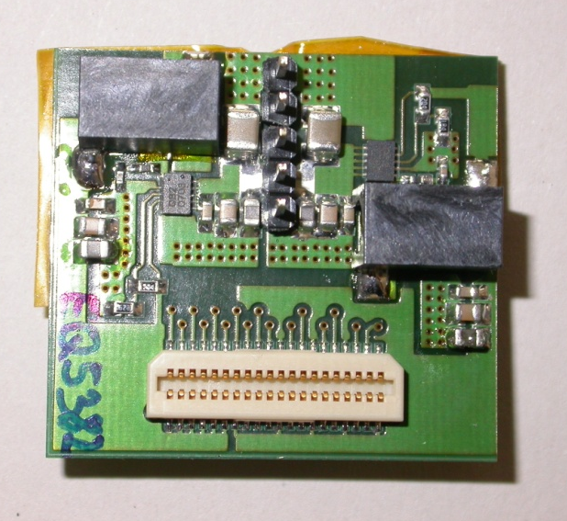
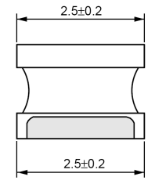
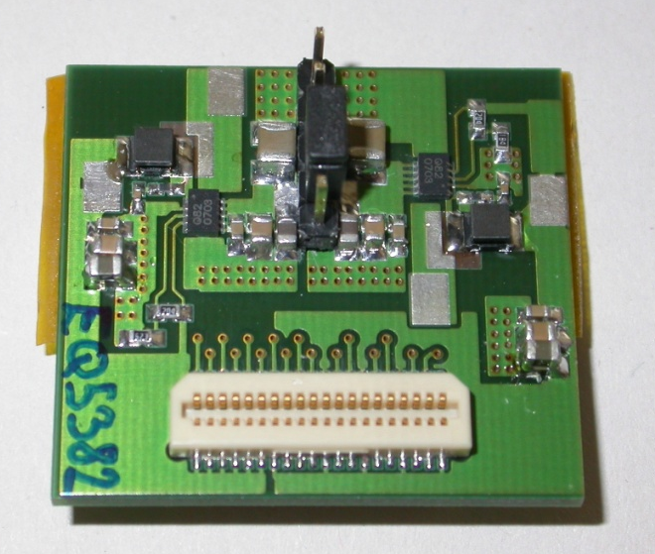
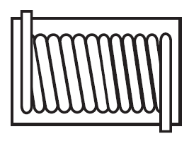
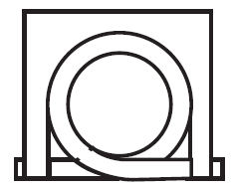
External Air-Core Inductor
Enpirion EN5382D (similar to EN5312QI)
operated with external inductor:
Air-core inductor Coilcraft 132-20SMJLB;
L = 538nH
Ferrite-core inductor Murata LQH32CN1R0M23;
L = 1μH
From data sheet
Air-core inductor
Ferrite-core inductor
10.55mm
6.60mm
5.97mm

Slide 19
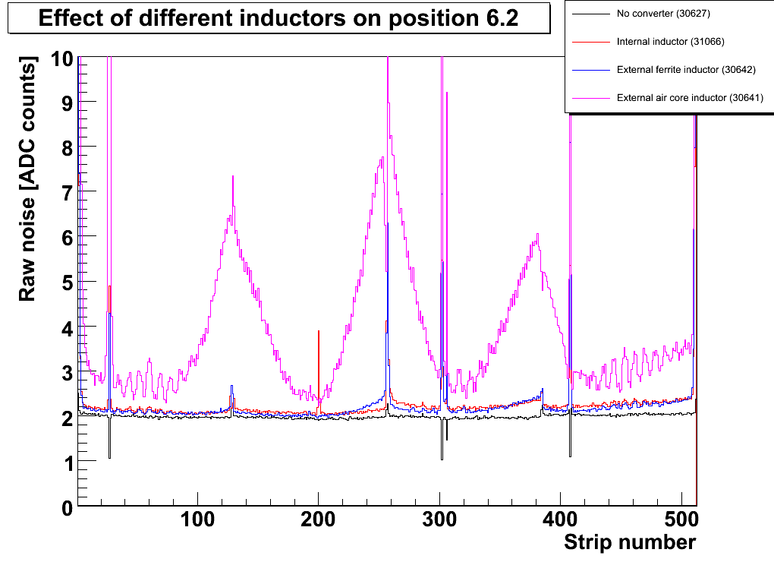
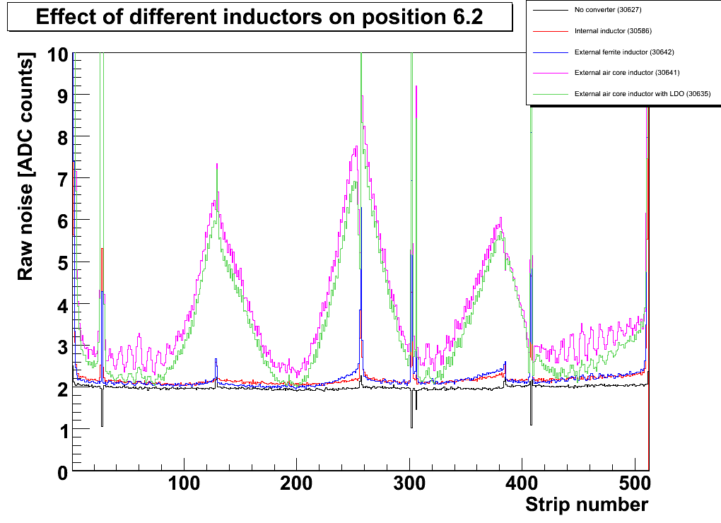
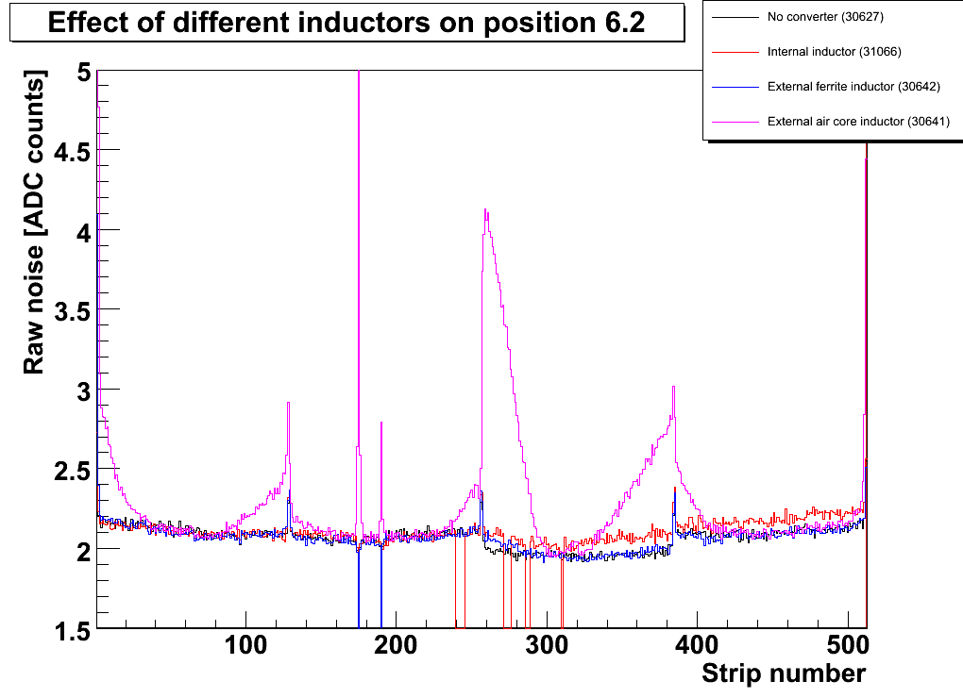
External Air-Core Inductor
⎯ No converter
⎯ Internal inductor
⎯ External ferrite inductor
⎯ External air-core inductor
⎯ No converter
⎯ Internal inductor
⎯ External ferrite inductor
External air-core inductor
Ext. air-core inductor + LDO
Pos. 6.2
radiative part
conductive part
⎯ No converter
⎯ Internal ind.
⎯ Ext. ferrite ind.
⎯ Ext. air-core ind.
Pos. 6.3
(Converter is on 6.2)
Huge wing-shaped noise induced by
air-core inductor, even on neighbour-module
Conductive part increases as well
Both shapes not yet fully understood
LDO leads only to marginal improvement
Slight improvement with toroids (see back-up)

Slide 20
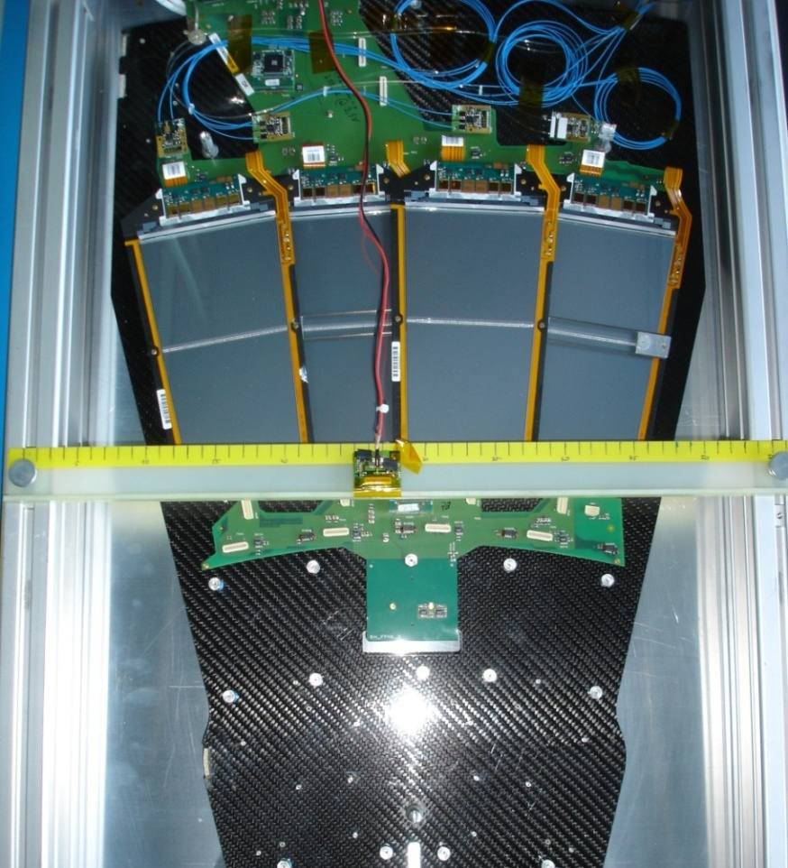
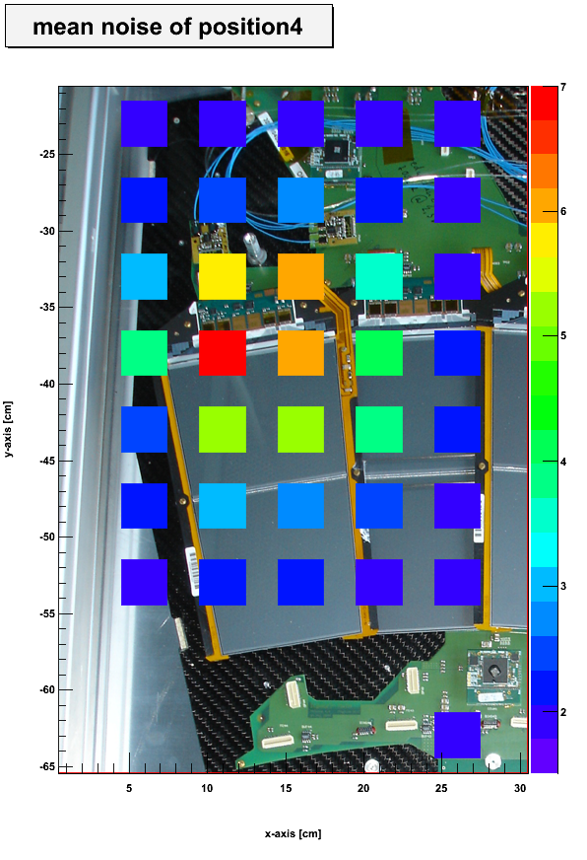
Radiative Noise from Air-Core Coil
Module “irradiated“ with detached converter board
Mean noise
of 6.4
[ADC counts]
Reference
without
converter
Increase of mean noise even if converter is not plugged  noise is radiated
Noise pick-up not in sensor but close to APVs

Slide 21
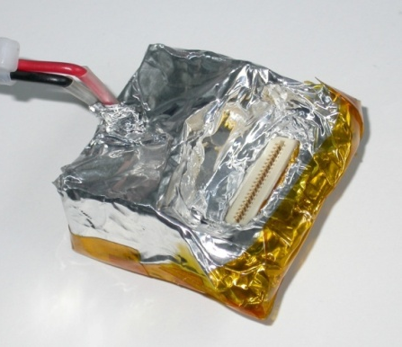
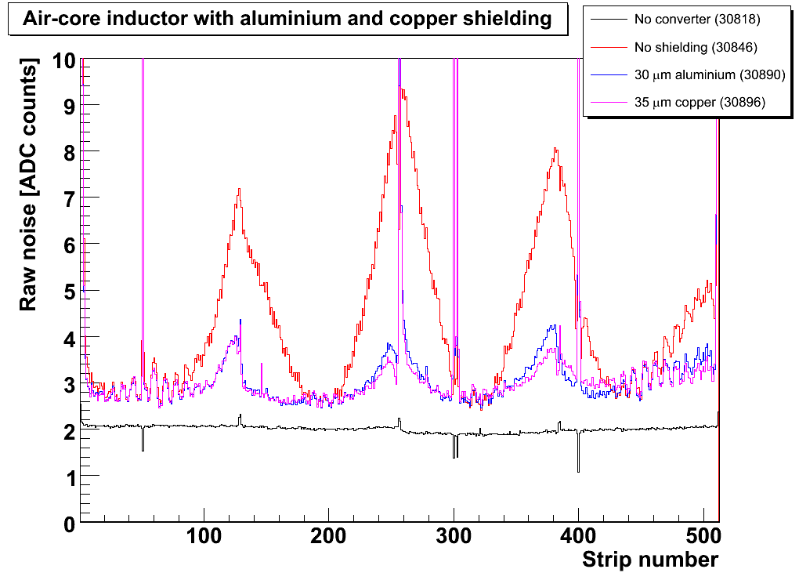
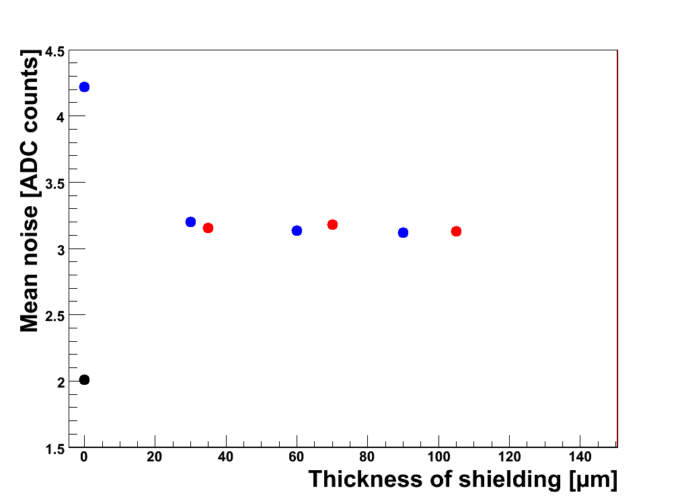
Shielding the DC-DC Converter
Enpirion with air-core solenoid wrapped in copper or aluminium foil
  Floating shield helps ⇒ magnetic coupling
  Aluminium shields as good as copper
  No further improvement for thickness > 30μm
Shielding increases the material budget
  Contribution of 3x3x3cm³ box of 30μm alum. for one TEC: 1.5kg
  (= 2 per mille of a TEC)
⎯ No converter
⎯ No shielding
⎯ 30 μm aluminium
⎯ 35 μm copper
No converter
• Copper shield
• Aluminium shield

Slide 22
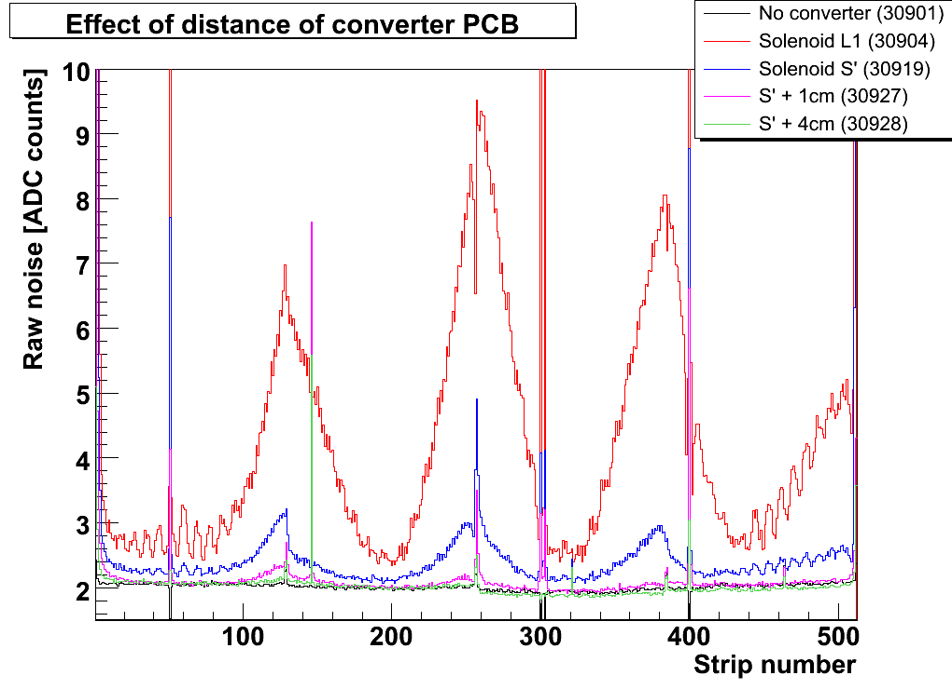
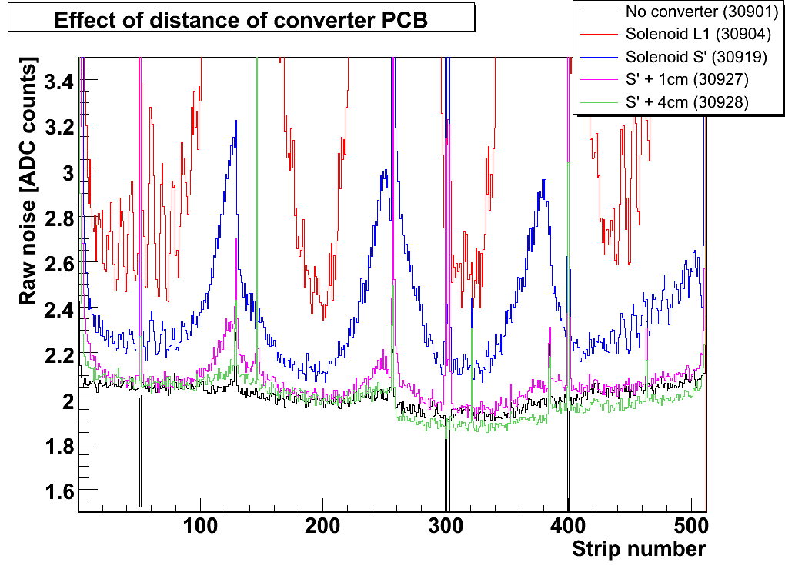
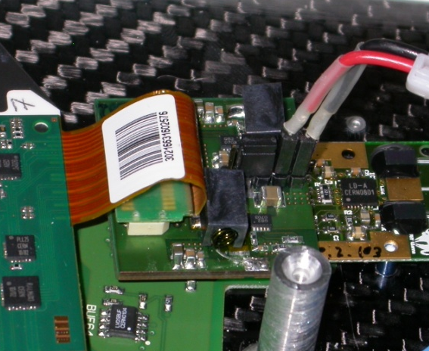
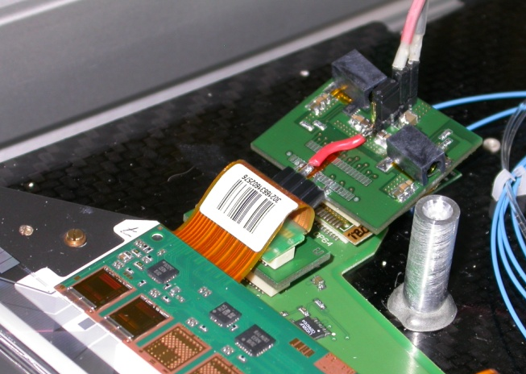
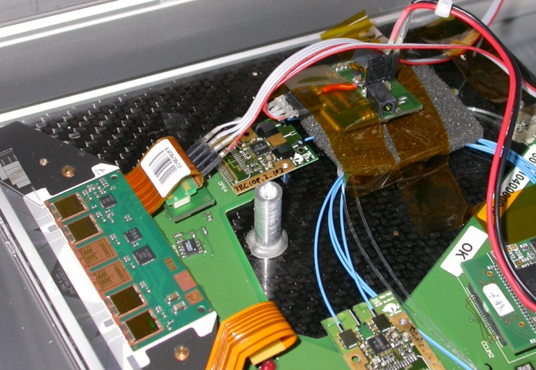
Distance betw. Converter and FE-Hybrid
⎯ No converter
⎯ Type L
⎯ Type S‘
Type S‘ + 1cm
Type S‘ + 4cm
The distance between converter and
FE-hybrid has been varied using a cable
between board and connector
Sensitivity to distance is very high!
Effect is a combination of distance and
additional filtering
Placing the buck converter at edge of
substructure is an option
Pos. 6.4
Type L with Solenoid
Type S‘ with Solenoid
Type S‘ 4cm further away

Slide 23
System Test with DC-DC Converters
Measurements with
custom DC-DC converters

Slide 24
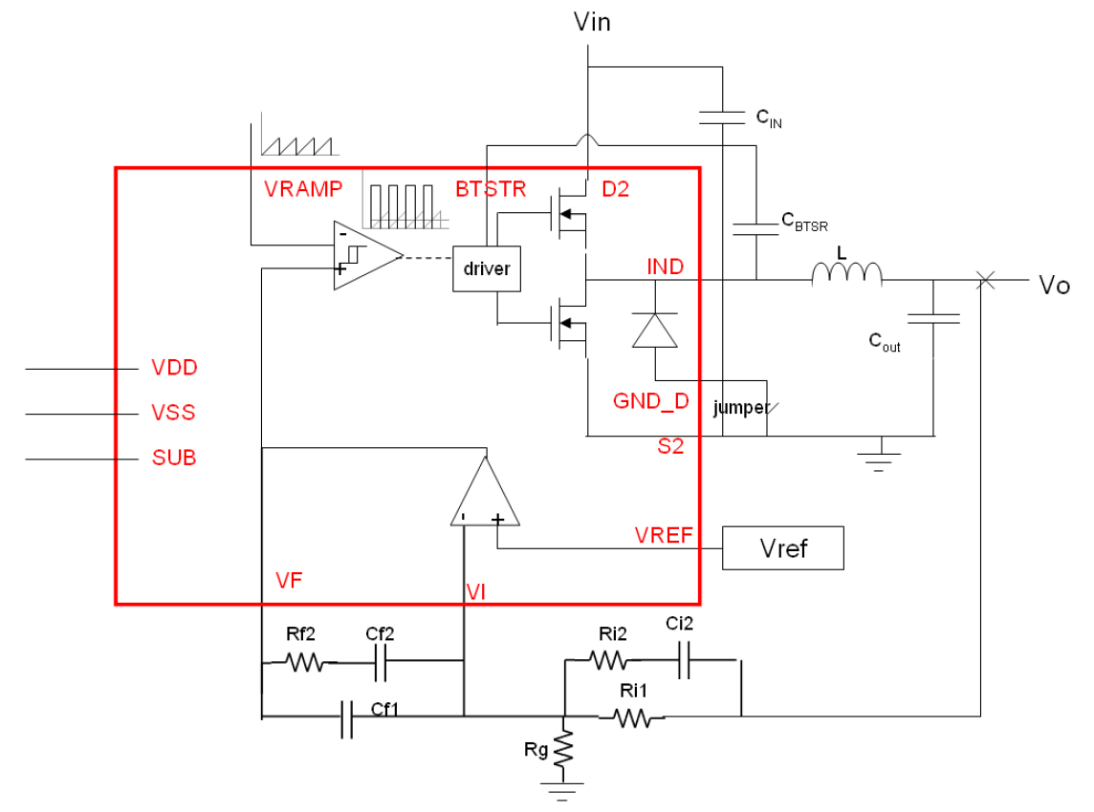

The CERN SWREG2 Buck Converter
Single-phase buck PWM Controller with Int. MOSFET dev. by CERN (F. Faccio et al.)
HV compatible AMI Semiconductor I3T80 technology based on 0.35 μm CMOS
Many external components for flexibility
PCB designed by RWTH Aachen University
V_{in} = 3.3 – 20V
V_{out} = 1.5 – 3.0V
I_{out} = 1 – 2A
f_{s} = 250kHz – 3MHz
S. Michelis (CERN) et al., Inductor based switching DC-DC converter for low voltage power distribution
in SLHC, TWEPP 2007; and poster 24 at TWEPP 08.

Slide 25



The CERN SWREG2 Buck Converter
PCB located far away from module
⇒ conductive noise measured
SWREG2 provides only 2.5V to FE-hybrid
Noise increases by about 20%
8-strip ripple structure understood to be
artefact of strip order during multiplexing;
converters affects readout stages of APV
No converter
2.5V via S type
0.60 MHz
0.75 MHz
1.00 MHz
1.25 MHz
V_{in} = 5.5V
Output DM
f_{s} = 1MHz

Slide 26

The LBNL Charge Pump
Simple capacitor-based step-down converter: capacitors charged in series and
discharged in parallel → I_{out} = n⋅I_{in}, with n = number of parallel capacitors
At LBNL (M. Garcia-Sciveres et al.) a n = 4 prototype IC in 0.35 μm CMOS process (H35) with external 1μF flying capacitors has been developed (0.5A, 0.5MHz)
Pros:
No air-core coil → less noise, less material
Cons:
Switches must be rad.-hard and HV safe
Many switches → mat. budget, switching losses
Switching noise
Restricted to low power applications
No feedback control
P. Denes, R. Ely and M. Garcia-Sciveres (LBNL), A Capacitor Charge Pump DC-DC Converter for Physics Instrumentation, submitted to IEEE Transactions on Nuclear Science, 2008.

Slide 27


The LBNL Charge Pump
Two converters connected in parallel: tandem-converter
  f_{s} = 0.5MHz (per converter)
  In-phase and alternating-phase versions
Tandem-converter connected either to 2.5V or 1.25V
Noise increases by about 20% for alternating phase
Next step: combination with LDO
⎯ No converter
⎯ In-phase on 2.5V
⎯ Alt-phase on 2.5V

Slide 28
Summary & Outlook
Using commercial buck converters, we have gained first experience with
DC-DC conversion and the associated problems
Measures to minimize conductive and radiative noise have been studied
Radiated noise appears to be biggest draw-back of ind.-based topologies;
but operation at the edge of the substructure seems feasible
Tests of first prototypes of custom converters has started & will continue
  Buck converter from CERN, charge pump from LBNL group
A radiation-hard LDO would be beneficial
Noise susceptibility studies are planned to understand better the effects
A realistic powering scheme, including also power for optical components,
bias voltage and controls, has to be worked out
Thanks to F. Faccio et al. (CERN) and M. Garcia-Sciveres et al. (LBNL)
for providing the converter protoypes!

Slide 29
Back-up Slides

Slide 30


Raw Noise on Different Positions
⎯ No converter
⎯ Type L
⎯ Type S
Pos. 6.2
On position 6.1 type L does not fit
Preliminary
⎯ No converter
⎯ Type L
⎯ Type S
⎯ No converter
⎯ Type L
⎯ Type S
Pos. 6.3
Pos. 6.4
Preliminary
Preliminary

Slide 31

Noise versus Conversion Ratio (V_{out}/V_{in})
V_{out} fixed to 1.25V & 2.5V ⇒ change of V_{in} leads to change of conv. ratio r = V_{out} / V_{in}
Output ripple V_{out} depends on duty cycle D (D = r for buck converter):
Mean noise per module
Pos. 6.4
Type L
Typical V_{in}
for system test
Mean noise increases for lower conversion ratio

Slide 32

Other Commercial Converters: MIC3385
Are we looking at a particularly noisy commercial device? ⇒ Micrel MIC3385
- f_{s} = 8 MHz
- V_{in} = 2.7–5.5 V
- footprint 3 x 3.5 mm²
⎯ No converter
⎯ Enpirion
⎯ Micrel
⇒ No evidence that EN5312QI is exceptionally noisy

Slide 33


Converter Noise Spectra
Standardized EMC set-up to measure
Differential & Common Mode noise
spectra (similar to set-up at CERN)
PS
Line impedance
stabilization
network
Load
Load
Spectrum
analyzer
Spectrum
Analyzer
Copper ground
plane
Current probe
Enpirion
1.25V at load
Common mode
Micrel
1.25V at load
Common mode
Enpirion
1.25V at load
Differential Mode
Micrel
1.25V at load
Differential Mode
f_{s}
f_{s}

Slide 34

Correlations with External Air-Core Inductor
corr_{ij} = (<r_{i}r_{j}> - <r_{i}><r_{j}>) / (_{i}_{j})
APV 4
Per APV:
- two halfs of 64 strips
- strips within each half are
highly correlated (90%),
but two halfs are strongly
anti-correlated (-80%)
- 50% correlations also on
module 6.3 (no converter)
Pos. 6.4 (with conv.)
Pos. 6.3 (no conv.)

Slide 35



External Air-Core Toroids
As expected, toroid coils radiate less than solenoids
Significant improvement already observed with simple self-made toroid coil
Coil design being systematically studied by D. Cussans et al. (Bristol) (Poster 107)
Toroid wiggled from copper wire
⎯ No converter
⎯ Solenoid
⎯ Wire toroid
⎯ Strip toroid
Pos. 6.4
Toroid wiggled from copper strip
Preliminary
Preliminary

