Slide 1

The HEPiX IPv6 working group
David Kelsey (STFC-RAL)
HEPiX meeting, Bologna
17 Apr 2013

Slide 2
Outline
Update since Beijing HEPiX (Oct 2012)
IPv4 address exhaustion – current status
What is new?
HEPiX IPv6 testbed
  File transfer tests
Software and tools survey
Testing plans for 2013

Slide 3
IPv4 address exhaustion …

Slide 4
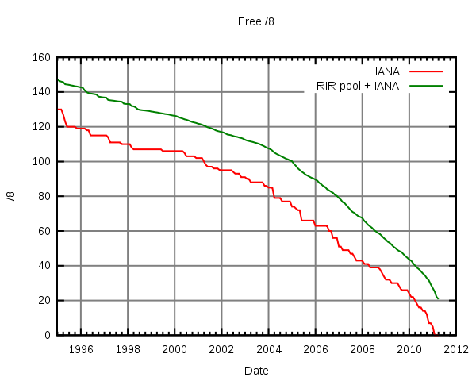
IPv4 Free Addresses
(/8 blocks) – one year ago
http://en.wikipedia.org/wiki/File:Ipv4-exhaust.svg

Slide 5
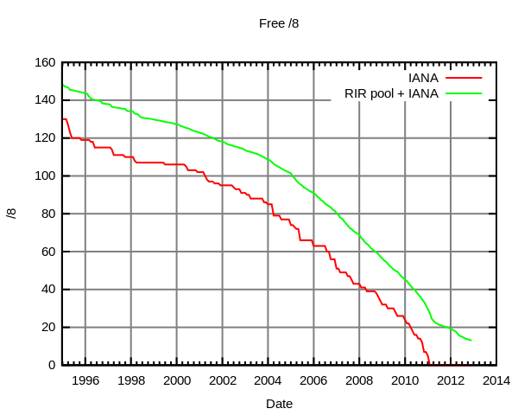
IPv4 free addresses - now

Slide 6
IPv4 Addresses
From Geoff Huston (http://ipv4.potaroo.net)
IANA Unallocated Address Pool (Global)
Exhaustion happened: 03-Feb-2011
Projected Regional (RIR) Address Pool Exhaustion Dates:
  APNIC: 19-Apr-2011 (Asia Pacific - happened)
  RIPENCC: 14-Sep-2012 (Europe - happened)
  ARIN: 02-Apr-2014 (North America)
  LACNIC: 26-Aug-2014 (South America)
  AFRINIC: 24-Jul-2020 (Africa)

Slide 7
HEPiX IPv6 WG
– what is new? …

Slide 10
Timetable for HEP IPv6 transition
Last year we said
  Support for IPv6-only clients *not before* Jan 2014
Now turning into
  Support for IPv6-only WNs is required *by* 2014
    Or soon after
This will be a challenge!
  We need to focus carefully
  And we will need more resources
    People and equipment

Slide 11
What else is new?
We had two F2F meetings plus video calls
New testbed sites
  IHEP (CN), Glasgow, Imperial London, PIC, USLHCNet Caltech (Chicago)
  Others in process of joining
LHC Experiments
  CMS (in from the start)
  LHCb was next
  ATLAS and ALICE now also on board

Slide 12
What is new? (2)
New group members
  ATLAS (+2), CMS (+1), PIC (+2), IHEP/CN (+2), CERN/IT/DM (+1), Imperial (+2)
  More GridPP (UK) sites planning to join soon
During 2013, we need to include more sites
  All Tier 1s
  But more Tier 2s too
lxplus at CERN is deploying some IPv6 nodes

Slide 13
The IPv6 testbed …

Slide 14
The HEPiX IPv6 Testbed
We have deployed a distributed testbed
Connected to IPv6 and IPv4 networks
  IPv6-only/IPv4-only names also registered in DNS
  e.g. hepix-v6.desy.de & hepix-v4.desy.de
https://w3.hepix.org/ipv6-bis/doku.php?id=ipv6:testbed
A perl script (on wiki) validates configuration
  Checks all DNS entries
  runs ping and ping6 to all nodes

Slide 15
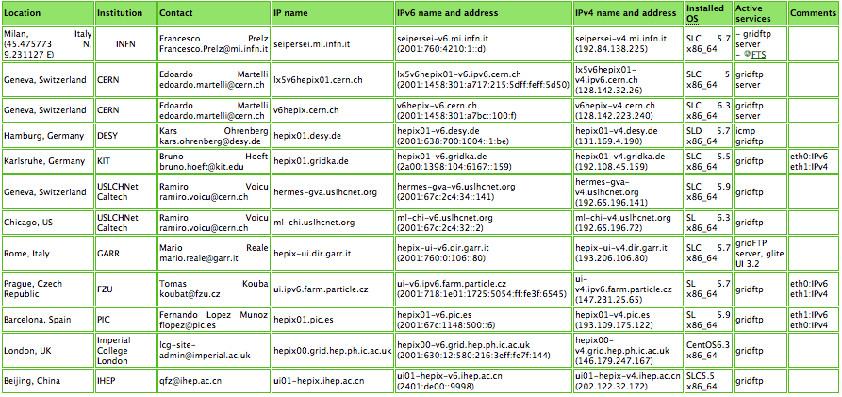
IPv6 Testbed

Slide 16
IPv6 file transfer tests
Tony Wildish (CMS)
Simple data transfers between all nodes in the testbed (over IPv6 channels) - simultaneously
Transfers a 1 GB file using GridFTP
  Measures time to transfer
  Records any errors
Uses UberFTP to confirm arrival and then delete
Then starts again
Very useful for checking ongoing status
Also for spotting and debugging problems

Slide 17
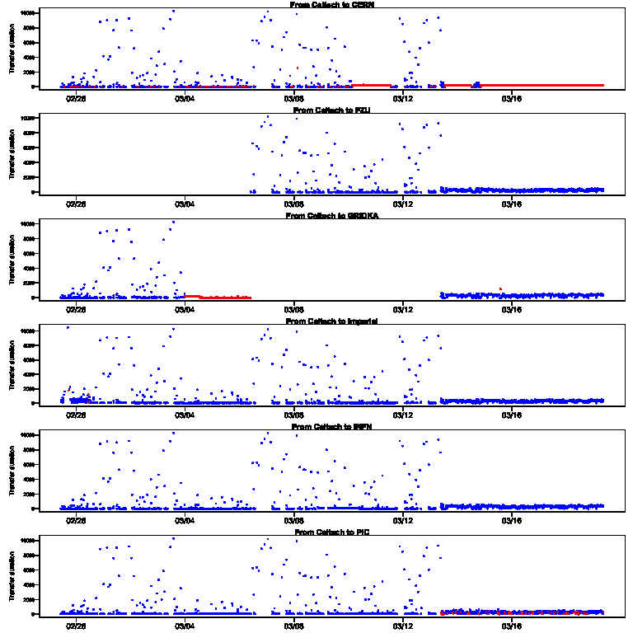
File transfers – Caltech to other sites
Time to transfer (secs)
Success
Error
Date/Time

Slide 18
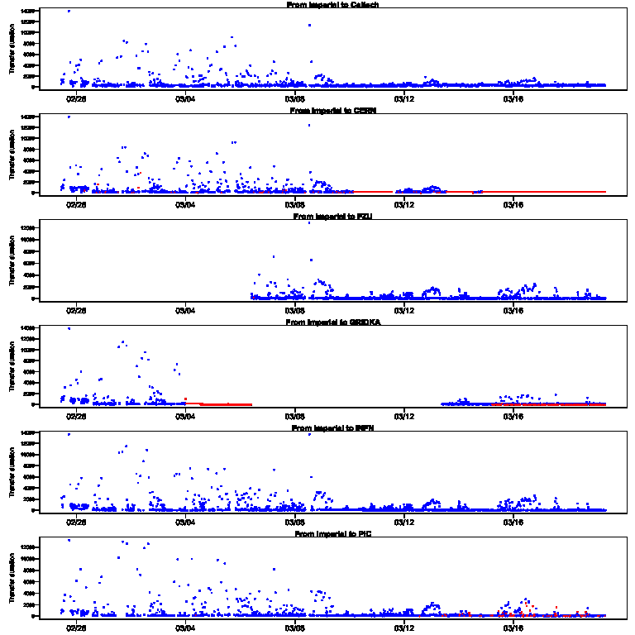
File transfers – Imperial to other sites

Slide 19
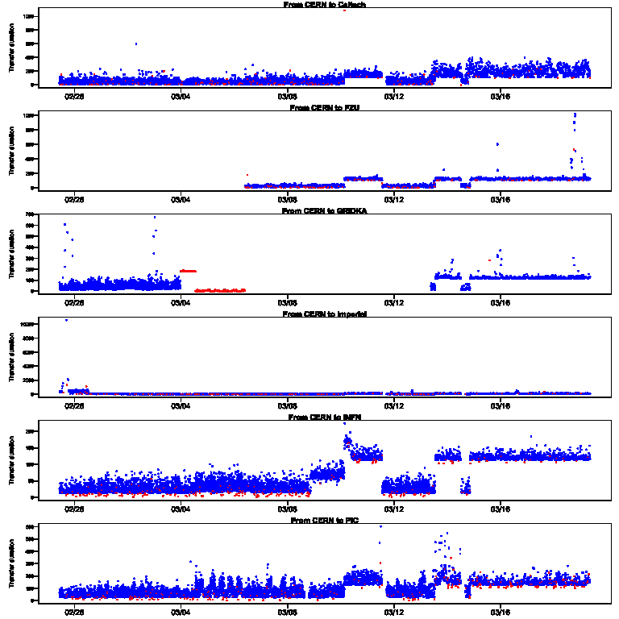
File transfers – CERN to other sites

Slide 20
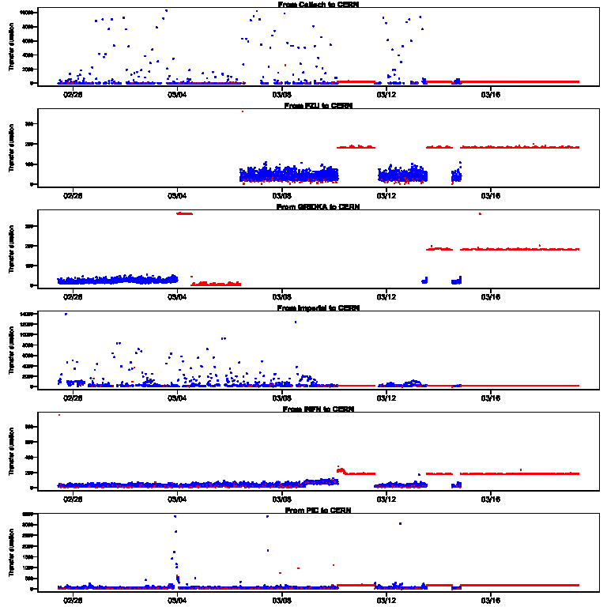
File transfers – sites to CERN

Slide 21
Software & Tools IPv6 Survey
An “Asset” survey is still underway
  Spreadsheet to all sites and the LHC experiments
  Includes all applications, middleware and tools
If IPv6-readiness is known, can be recorded
Otherwise we will need to investigate further
  Ask developer and/or supplier
  Scan source code or look for network calls while running
  Test the running application under dual stack conditions

Slide 22
IPv6 problems
See talk by Francesco Prelz – following this
Batch systems
OpenAFS (see talk by Arne Wiebalck)
activemq (used in FTS3)
dCache is being worked on
This is not a complete list
up to date information will be on our wiki site
  One of our objectives for next 3 months

Slide 23
Batch systems
News from EGI IPv6 testing
  Barbara Krasovec (Arnes, Slovenia)
Tested SGE, Slurm and Torque
SGE had no support, current status unknown
Slurm had no support for IPv6 and the status remains the same
PBS had support for the server side
  none for the client
  EGI has tested versions 2.5.7 and 4.x

Slide 24
Future plans and next steps …

Slide 25
CMS data transfer tests
Small-scale testbed – one machine per site
Agreed that this is still very useful
  To show that data transfers can be sustained
  Useful for debugging site issues
Small scale is good to involve many sites
  Helps learn about IPv6 and check site network
Not only the current GridFTP mesh
Add PhEDEx, FTS and Storage elements
  Starting with DPM

Slide 26
IPv6 on SL5 or SL6?
Most testing should continue on SL5
  use same software as current production
  If you want to use SL6 that is fine – your choice
Let others debug general SL6 issues
  When used in production we will move to it

Slide 27
Larger scale testing 2013
Some sites report they have tried dual-stack and it works
The group is reluctant to use the WLCG production infrastructure until fully convinced it will not break things
To do this we need more extensive testing
Glasgow has a larger IPv6 mini-cluster ready for use
KIT has plans to install one in the coming months
We will need some more sites
  CERN – yes (but need effort from WLCG)
  “Across the ocean” sites good to test long distance behaviour
    IHEP (Beijing)?, FNAL and/or BNL?
Others will also want to join
  DESY for one

Slide 28
Testing: use cases
Simplest in terms of needs
  Production Monte Carlo
  Use case could be IPv6-only machines in opportunistic Cloud resources
  Or IPv60only worker nodes at CERN
Next is Production Reconstruction
  What services does that need?
Most complex in terms of requirements is general user analysis
  E.g. requirement (?) to connect to OpenAFS

Slide 29
Production Monte Carlo
Start with real Worker Nodes (IPv6 only)
  rather than VMs
Required network access
  Some form of workload management
    To get the work into the WN
  Output from the job
    Presumably needs to write to an SE?
Experiments to specify the details

Slide 30
Other testing plans – next quarter
CMS - DPM endpoints at Glasgow and FZU
LHCb (ScotGrid, Imperial, RAL)
  Workload management and CVMFS
ALICE – waiting for release of IPv6 in xrootd (V4 soon)
ATLAS – plans not clear yet
  Glasgow and CERN to look at production monte-carlo use case
dCache on IPv6 testing
  DESY (testbed and dCache team), PIC, KIT, NDGF
USLHCnet – testing MonALISA
INFN will work on IPv6 and CREAM CE
CNAF Tier 1 joining – (STORM?)
Then decide when we can plan test on production infrastructure

Slide 31
Further info
HEPiX IPv6 wiki
https://w3.hepix.org/ipv6-bis/
Working group meetings
http://indico.cern.ch/categoryDisplay.py?categId=3538

Slide 32
Summary
During 2013, we must
  Increase participation in the working group
    Include all Tier 1s
    When do we need all Tier 2s to be IPv6 capable?
  Agree on what services need to be dual stack
    For access from IPv6-only WN at CERN
  Test these services
    First on the testbed
    Then on production infrastructure
Next face to face IPv6 meeting is at CERN
  Probably 4/5 July 2013 (to be confirmed)
VOLUNTEERS always welcome (please contact me)!

Slide 33
Questions?

