Slide 1
LHCb Readiness for LS1
  LHCb VSC Technical Responsible:
  Cédric Garion

Slide 2
Introduction
  ‘Assumption is working on two experiments in parallel. Any new requests to be discussed with Mark Gallilee for compatibility with manpower’.
  Procedures
  LS1 Interventions and Dates
  Conclusions

Slide 3
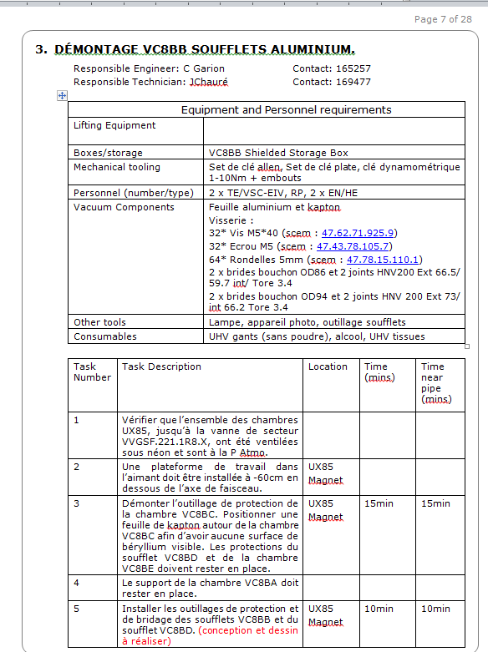
Procedures
Procedures have been written and all components have been purchased on the basis of each intervention to remove chambers

Slide 4
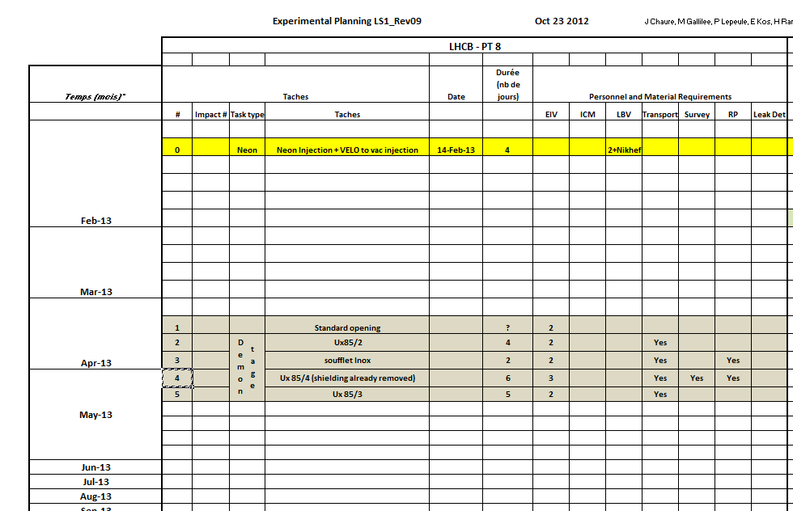
Interventions and Dates - Removal
LBV section will intervene on vacuum
Procedures established for removal
Support from LHCb is required for platform/scaffolding and detector opening.
Vacuum chambers are stored by LHCb at point 8.

Slide 5
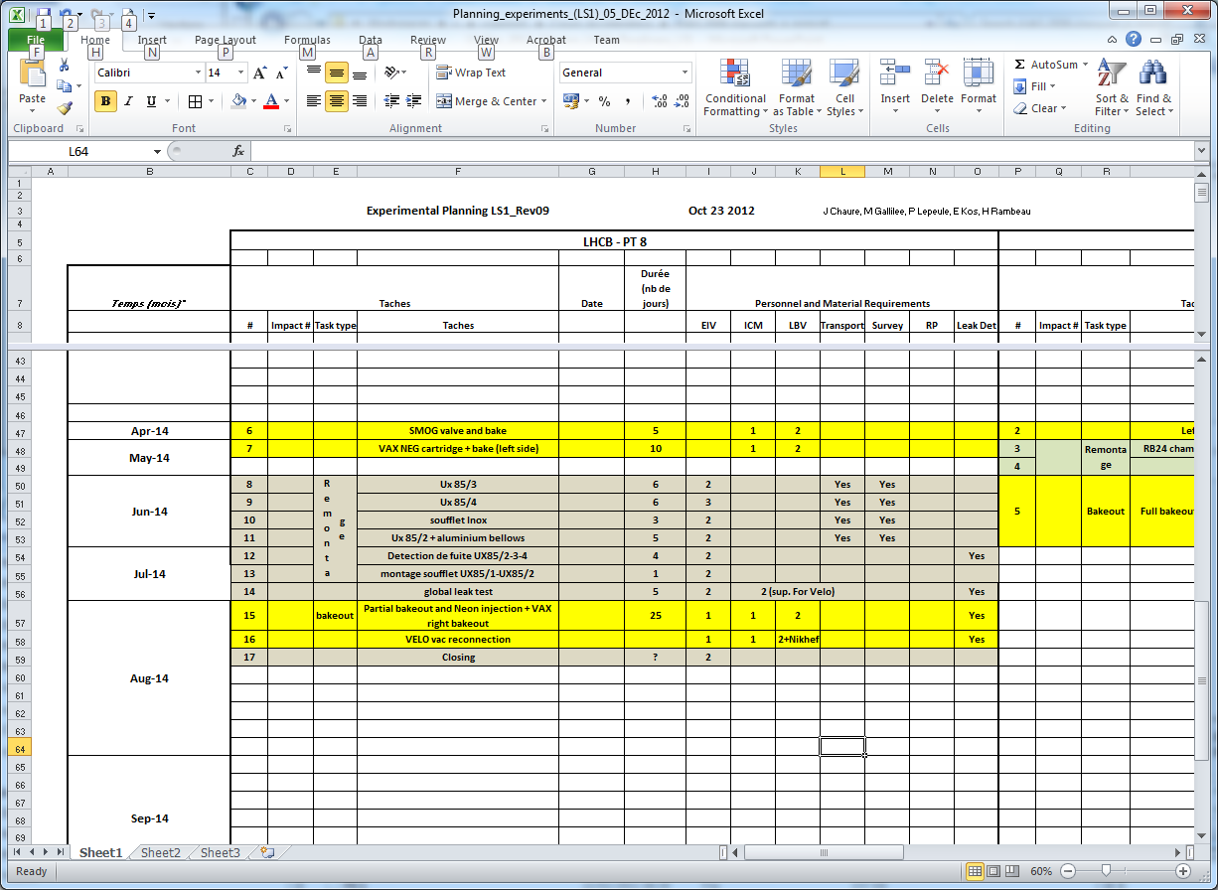
Interventions and Dates - VAX
LBV section will intervene on vacuum

Slide 6
Interventions and Dates - Installation
Support from LBV for the pumping through the VELO
Design of the supports almost frozen (and significantly improved since the EDR).
Beryllium parts already received.
Aluminum bellows manufacturing ongoing.
Installation procedures – to be done.

Slide 7
Interventions and Dates - Installation
Vacuum system commisionning

Slide 8
Conclusions
Schedule written outlined;
Removal procedures established and procurement of critical items ongoing or completed;
Storage foreseen at point 8;
Any outstanding items or interventions missing?.

