Slide 1
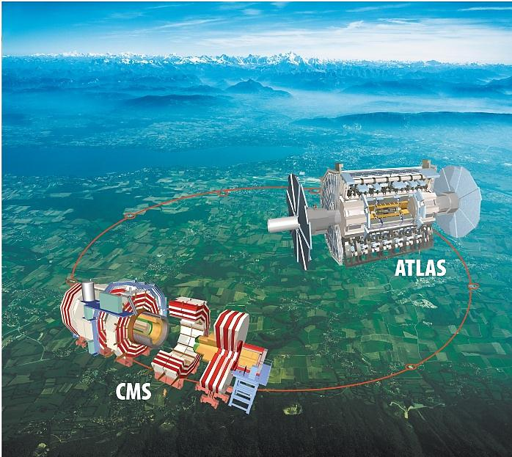
Report on Japanese Situation
Atsuto Suzuki
(KEK)

Slide 2

Japanese Roadmap for High Energy Physics
2008 - 2012
Roadmap
:
FY 2007
Beyond 2012
Roadmap
:
up to the end of
FY 2012

Slide 3
Summary of KEK Roadmap
2007
2008
2009
2010
2011
2012
operation & completion of 1st goal
J-PARC
power upgrade
upgrading to Super-KEKB
KEKB
operation
& upgrade
Photon Factory
continue R&D and compact ERL
ERL R&D
construction
operation
1st results
LHC
LHC upgrade
ILC R&D
TDP1
lots and lots of R&D’s
TDP2
Notes:
3

Slide 4
Summary of KEK Roadmap
2007
2008
2009
2010
2011
2012
operation & completion of 1st goal
J-PARC
power upgrade
upgrading to Super-KEKB
KEKB
operation
& upgrade
Photon Factory
continue R&D and compact ERL
ERL R&D
construction
operation
1st results
LHC
LHC upgrade
ILC R&D
TDP1
lots and lots of R&D’s
TDP2
Notes:
4

Slide 5
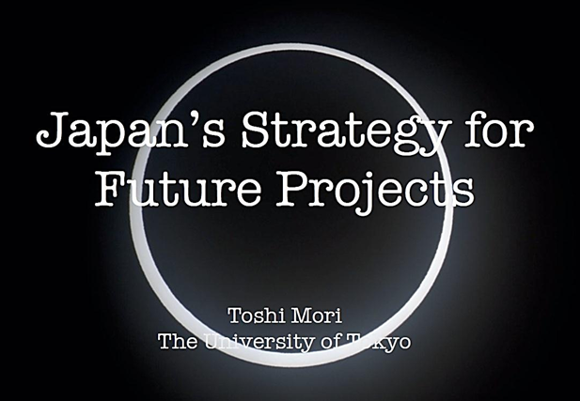
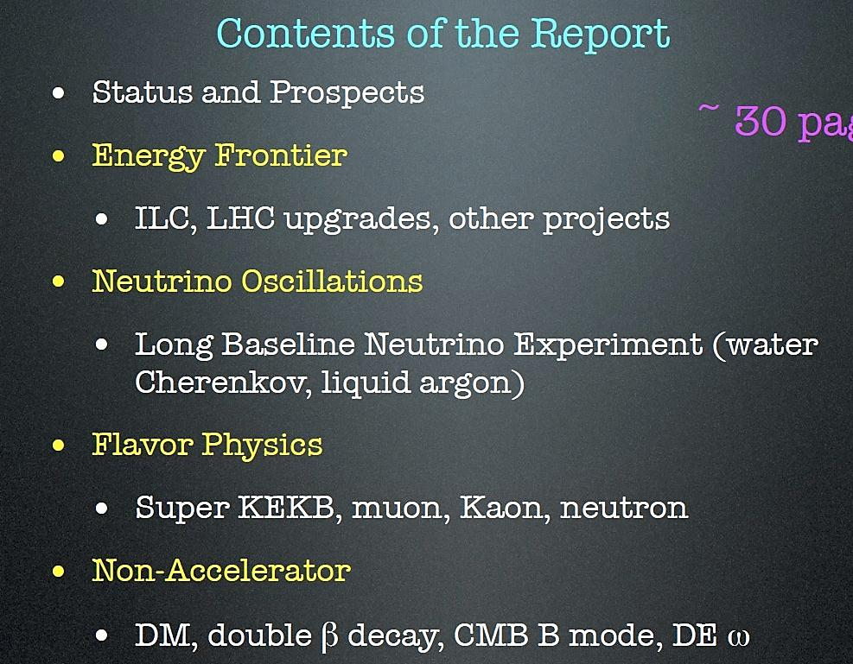


Slide 6
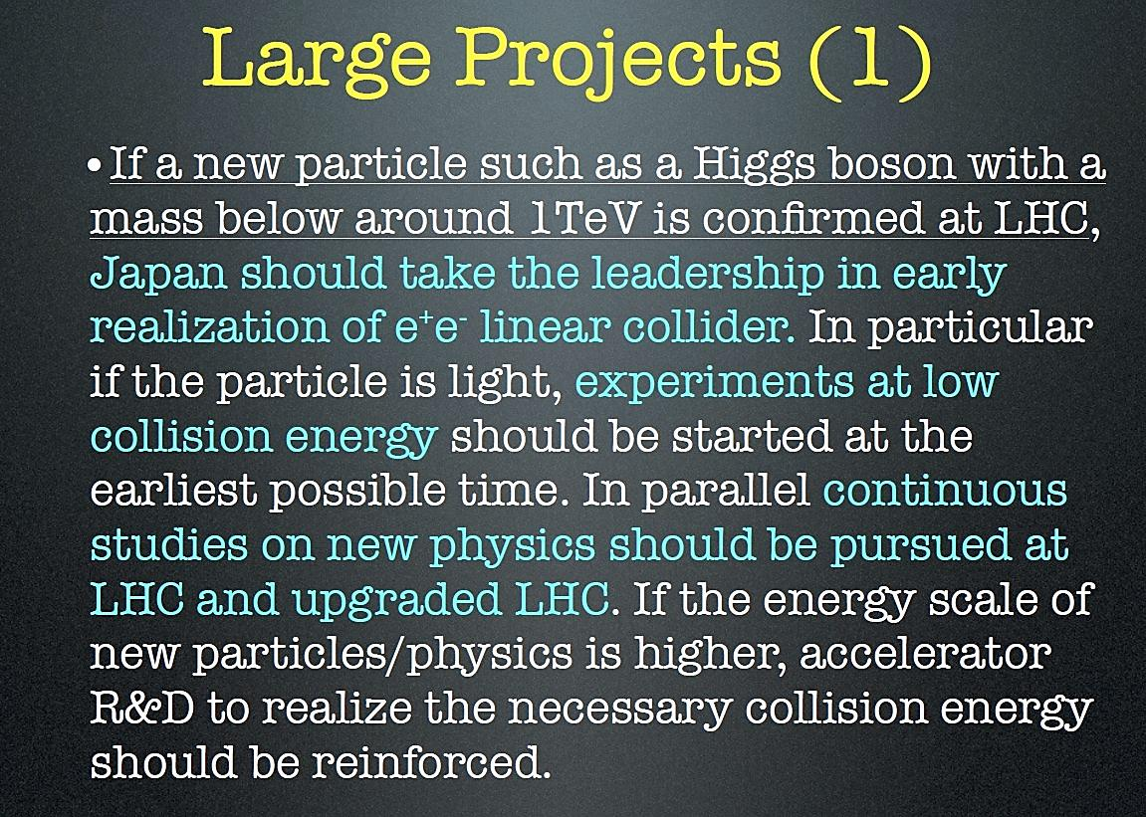

Slide 7
1. Quark Flavor Project

Slide 8
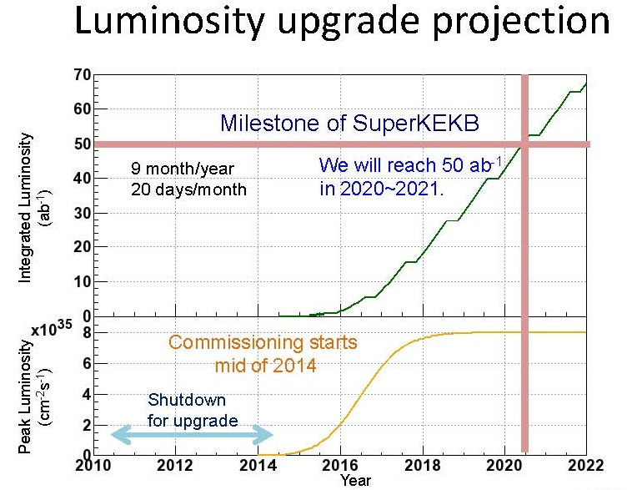

KEKB upgrade to SuperKEKB

Slide 9
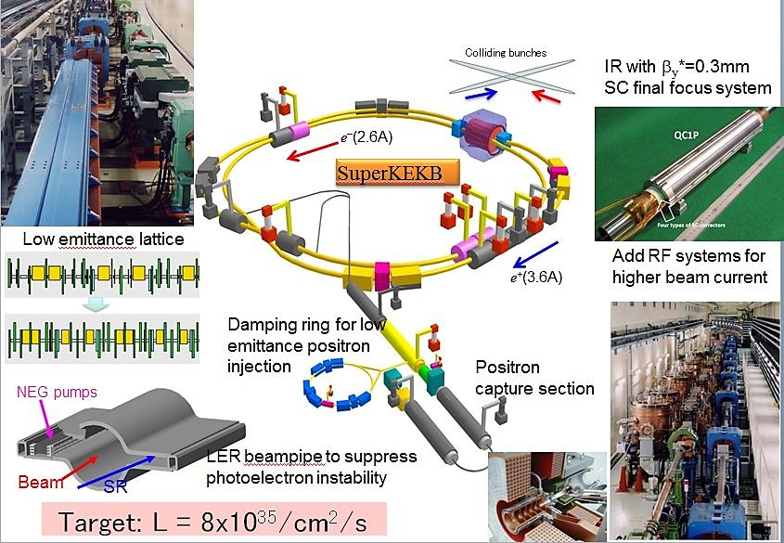
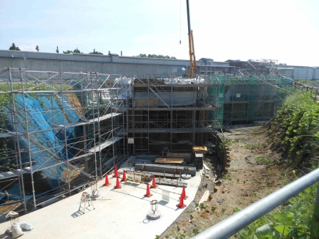
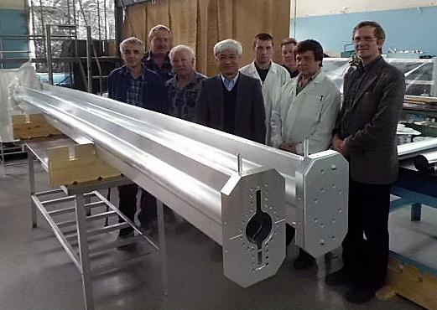
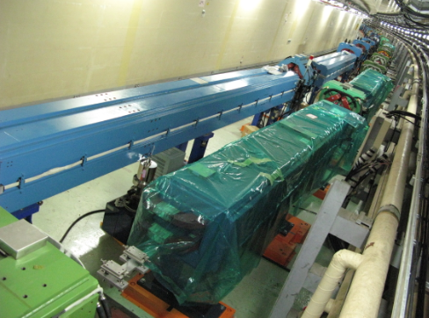
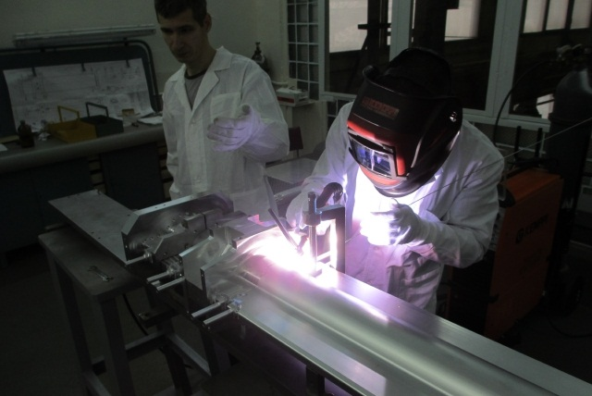
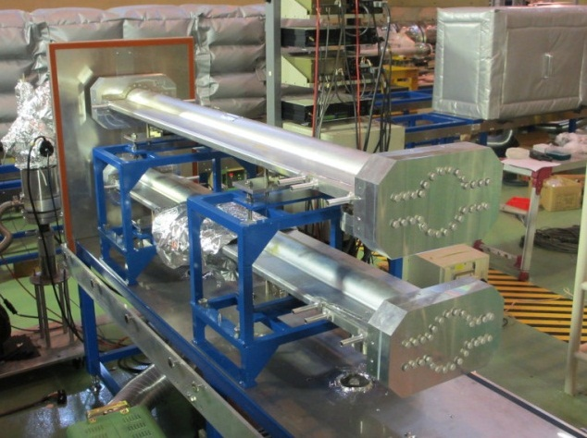

Slide 10
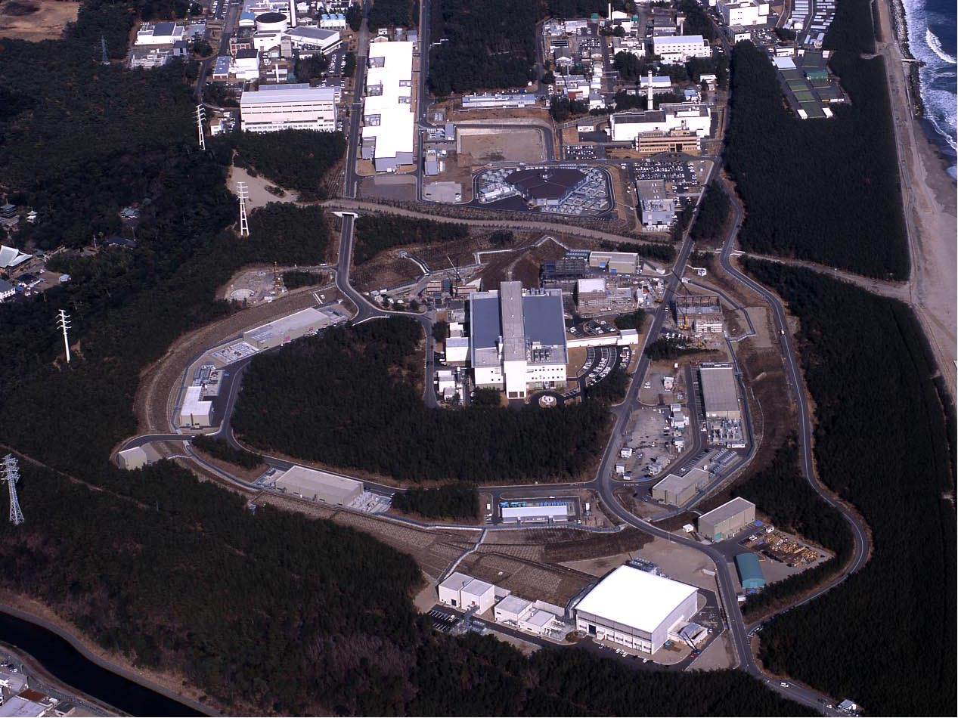
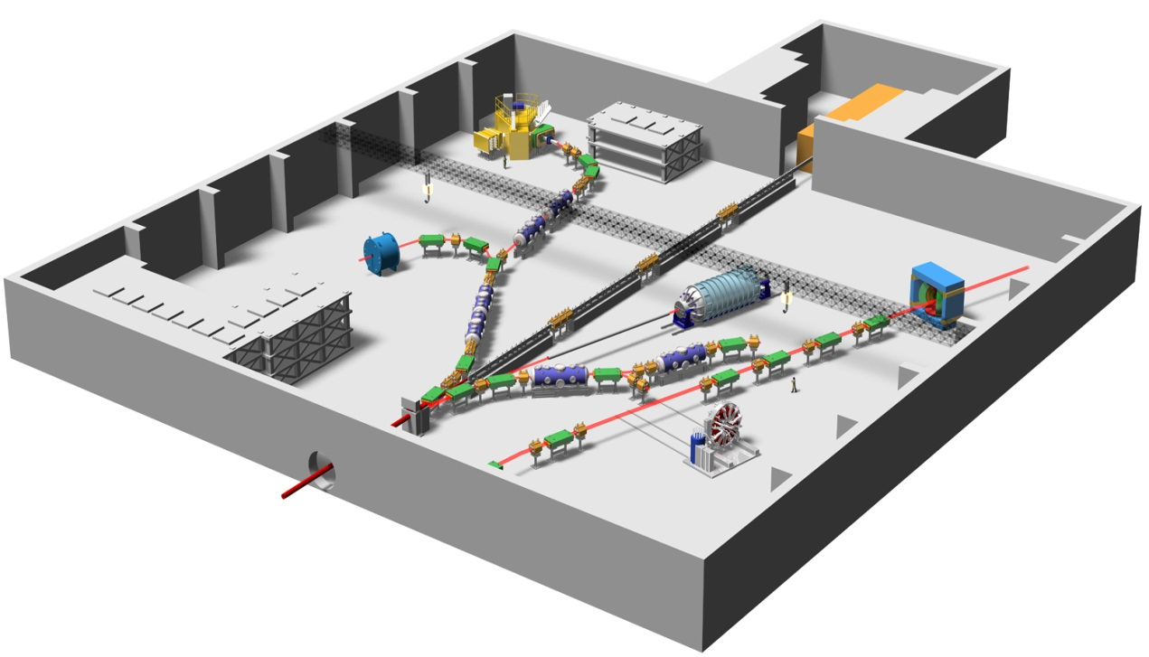
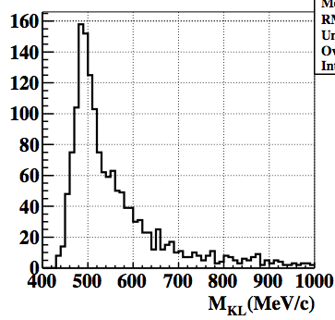
J-PARC Facility
(KEK/JAEA）
Linac
3 GeV RCS
KL Rare Decay
K⁰_{Ｌ}→ π⁰ ν ν
30 GeV Synchrotron
K⁰_{L}→π⁺π⁻π⁰
Hadron Exp. Facility (K)
Notes:
The J-PARC consists of three accelerators and three experimental facilities.
●In calendar year of 2007 the linac and 3 GeV synchrotron were completed. ● Then, in fiscal year of 2008 the 50 GeV synchrotron and two experimental facilities, the materials and life experimental facility with neutron and muon beams, and the hadron experimental facility with primarily kaon beams were completed. ● Finally, in fiscal year of 2009, which is the last year, the neutrino facility to send the neutrino beams to Superkamiokande was completed.

Slide 11

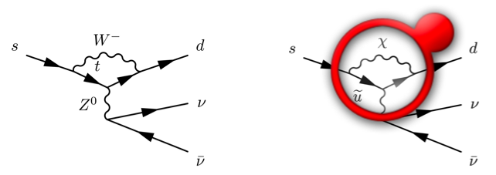

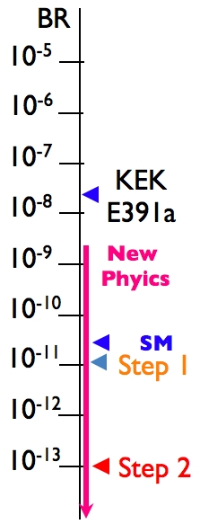

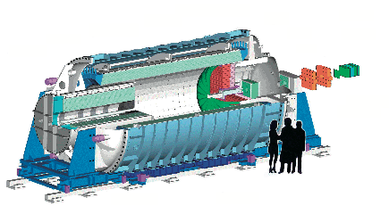
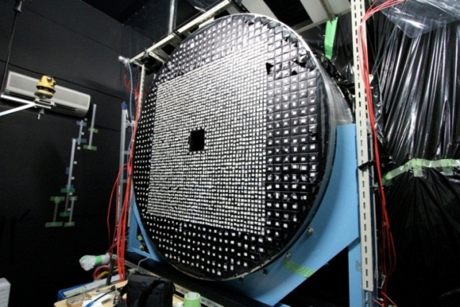
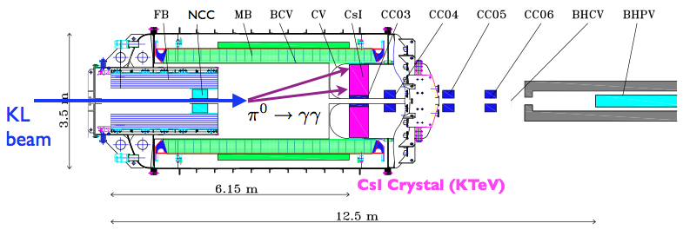

Rare Kaon Decay

Slide 12
2. Lepton Flavor Project

Slide 13
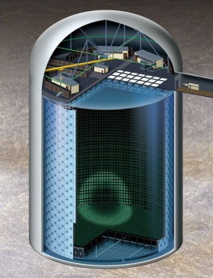
J-PARC Facility
(KEK/JAEA）
Linac
3 GeV RCS
Neutrino Beams (to Kamioka)
Materials and Life Experimental Facility (n, μ)
30 GeV Synchrotron
Hadron Exp. Facility (K)
Notes:
The J-PARC consists of three accelerators and three experimental facilities.
●In calendar year of 2007 the linac and 3 GeV synchrotron were completed. ● Then, in fiscal year of 2008 the 50 GeV synchrotron and two experimental facilities, the materials and life experimental facility with neutron and muon beams, and the hadron experimental facility with primarily kaon beams were completed. ● Finally, in fiscal year of 2009, which is the last year, the neutrino facility to send the neutrino beams to Superkamiokande was completed.

Slide 14
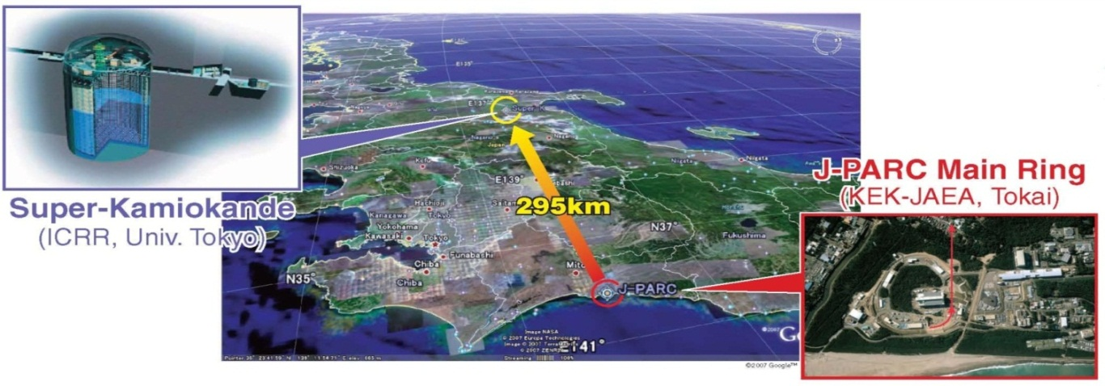
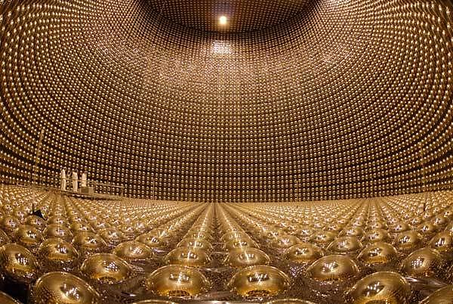
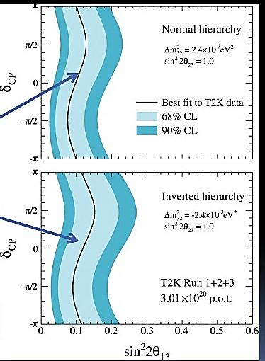
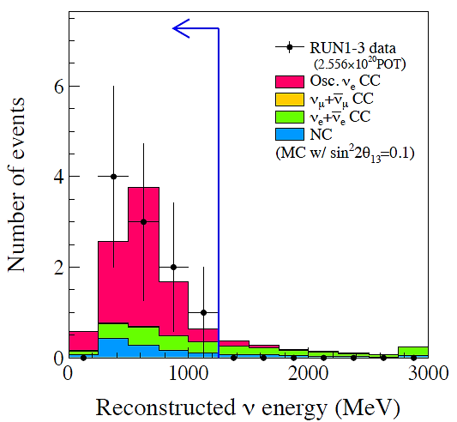
T2K Experiment
Long-Baseline Neutrino Experiment
ν_{μ} → ν_{e} Result from T2K
10 electron neutrino candidates are detected
Expected BG (θ₁₃=0) is estimated to be 2.73±0.37 evts
Probability to observe >=10 evts w/ θ₁₃=0 is 0.08% (3.2σ)
  C.f. 0.7% (2.5σ) in 2011

Slide 15
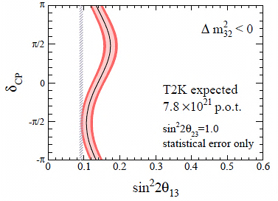
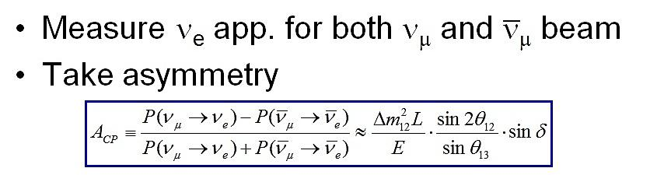
Latest Result of ν_{μ} →ν_{e} from T2K
Improvement of both reactor and accelerator
experiments will provide first handle on the CP
violating complex phase δ_{CP}.
Expectation with ~50 times more data
(750kWx 5x10⁷s)
Expected
beam power
Stat err only!
May 2012 | 2014 | 2018
190kW | 300kW | 750kW

Slide 16
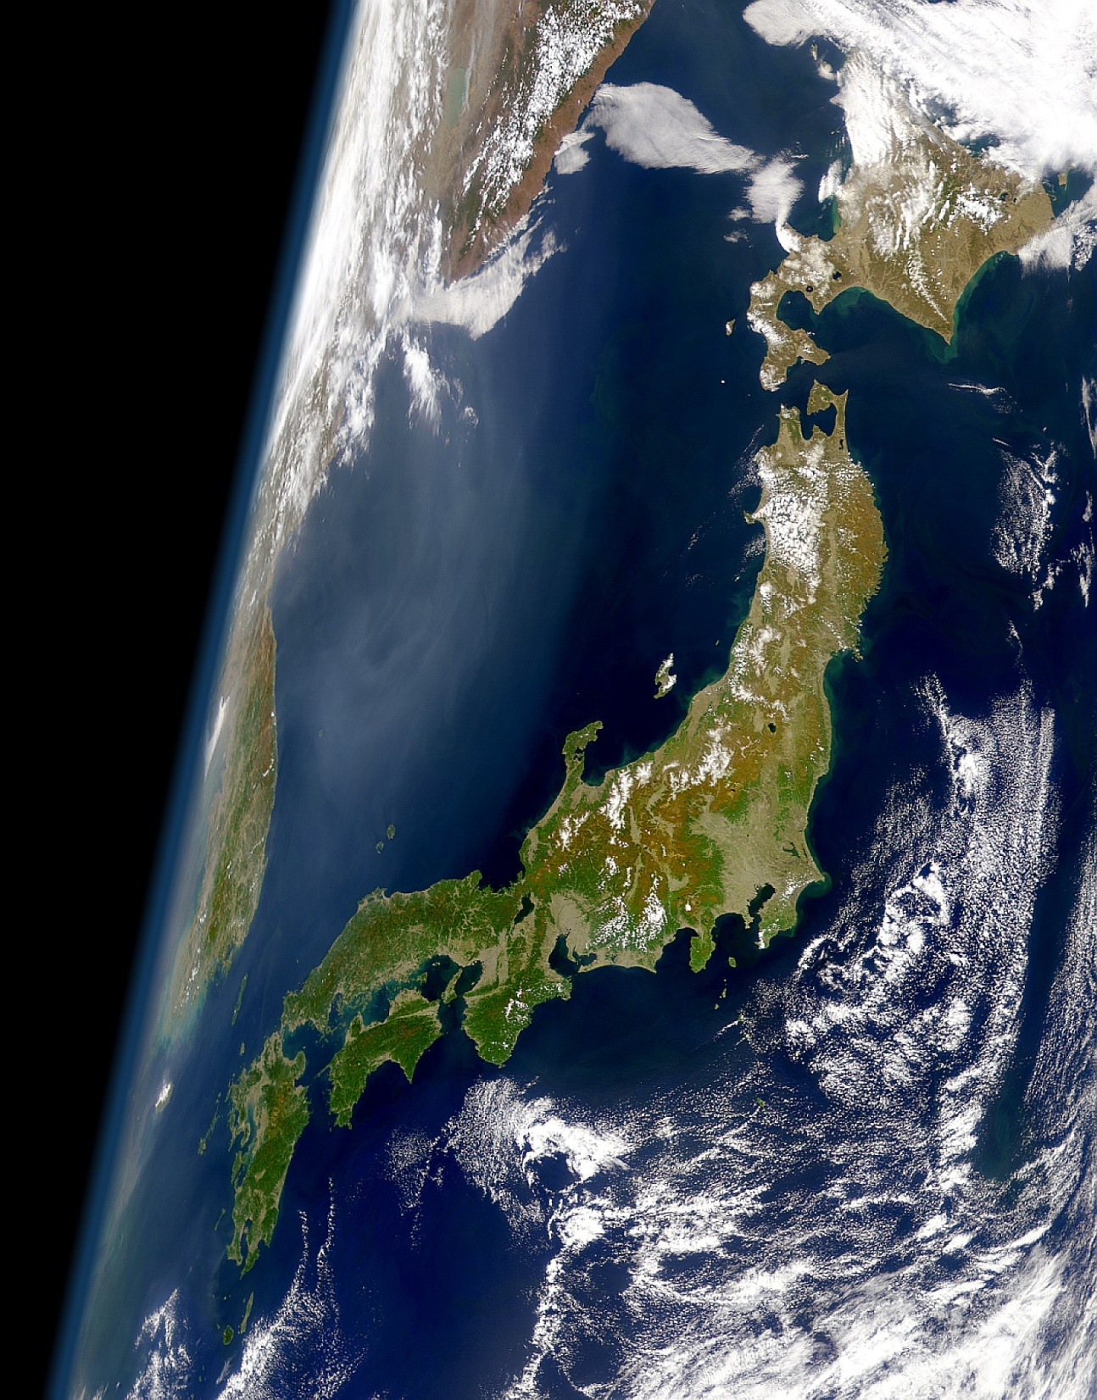
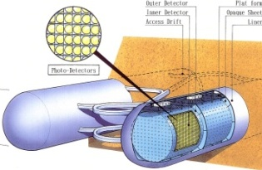
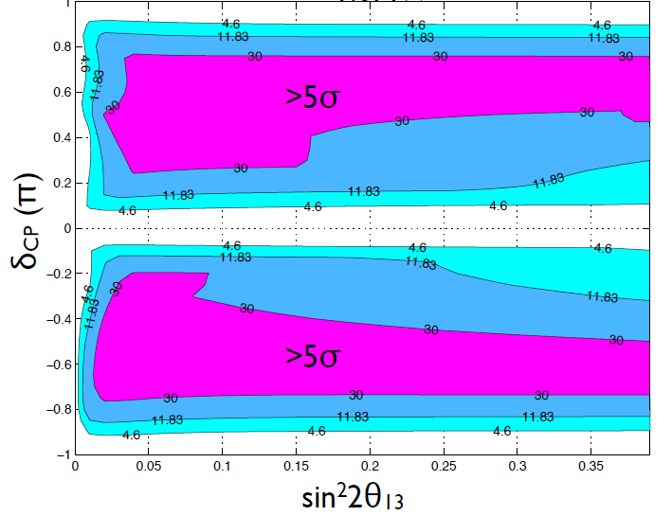
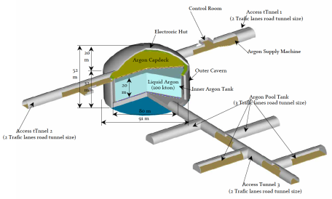

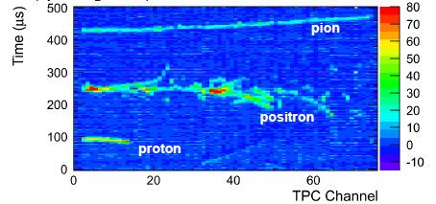
Next ν program at J-PARC
Kamioka L=295km OA=2.5deg
Okinoshima L=658km OA=0.78deg
J-PARC
→1.7MW
100kt Liq. Ar TPC
P32 proposal (Lar TPC R&D)
Recommended by J-PARC PAC
(Jan 2010), arXiv:0804.2111

Slide 17
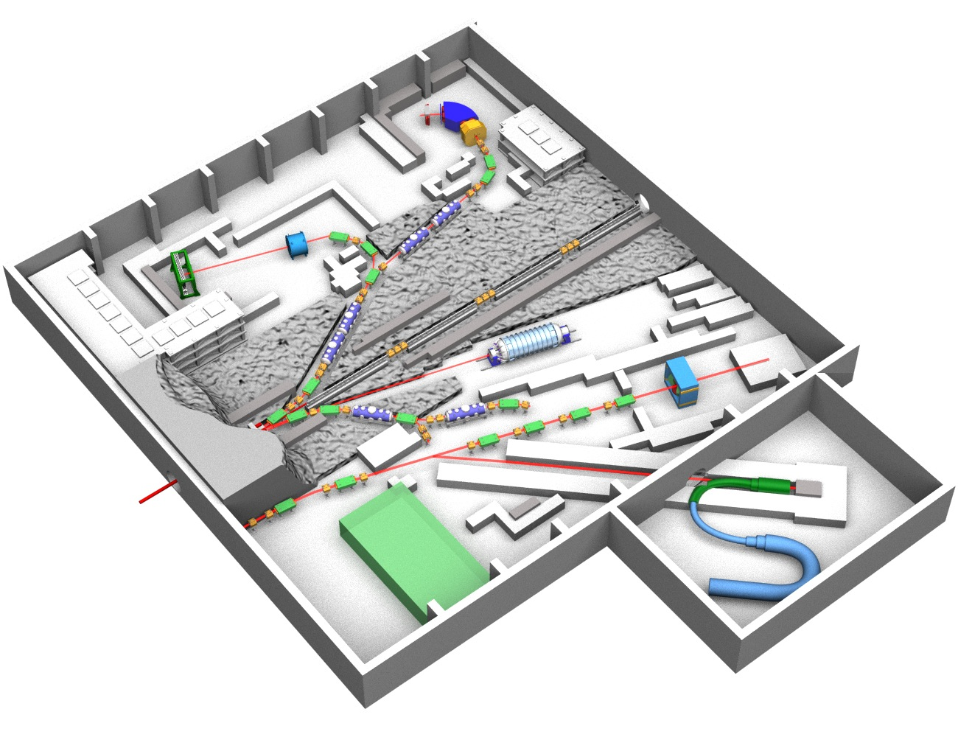
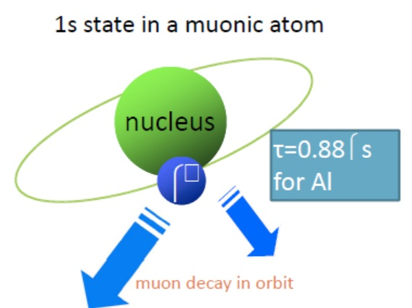

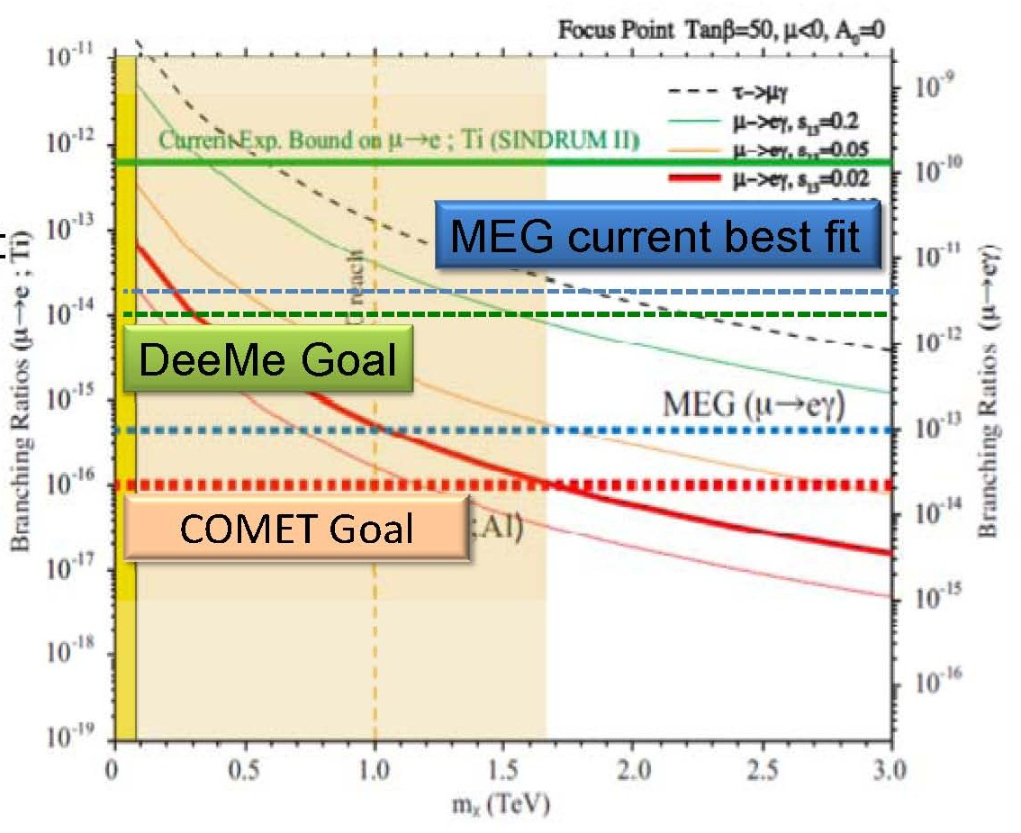
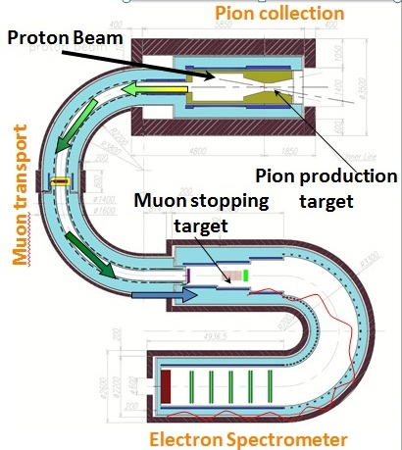
μ → e Conversion
Signal : μ- + (A,Z) → e- + (A,Z)
Search for cLFV mu-e conv.
  10⁻¹⁶ sensitivity (Target S.E.S. 2.6×10⁻¹⁷)
  Improve O(10⁴) than present upper bound such as SINDRUM-II BR[μ⁻ + Au → e⁻ + Au] < 7 × 10⁻¹³

Slide 18


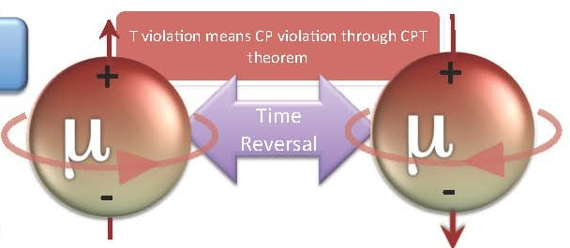

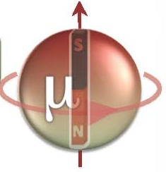
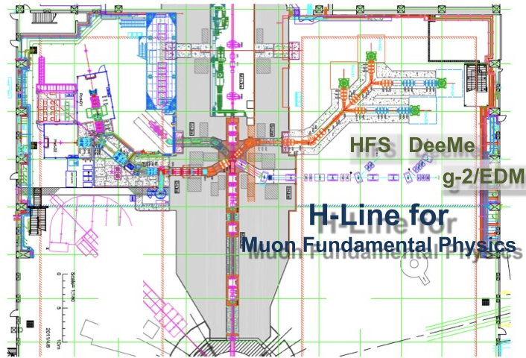

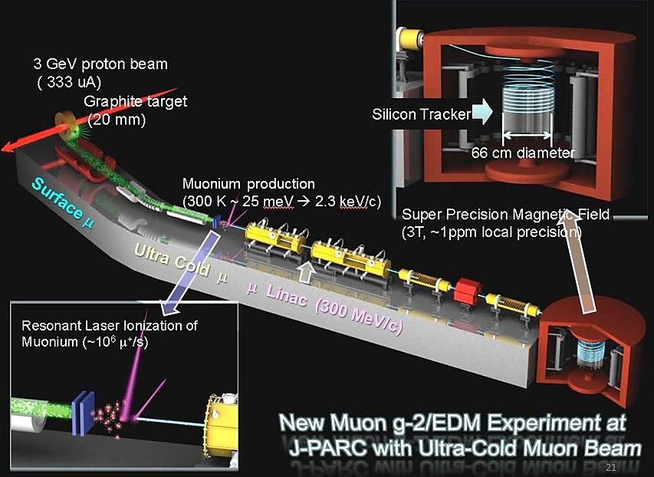
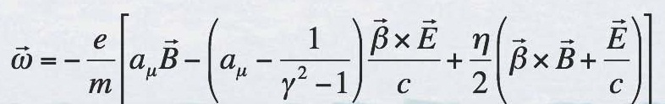


Improve Precision
by 100
Improve Precision
by 5 (0.1 ppm)
Bird’s eye photo in Feb. 2008

Slide 19
3. Energy Frontier Project

Slide 20
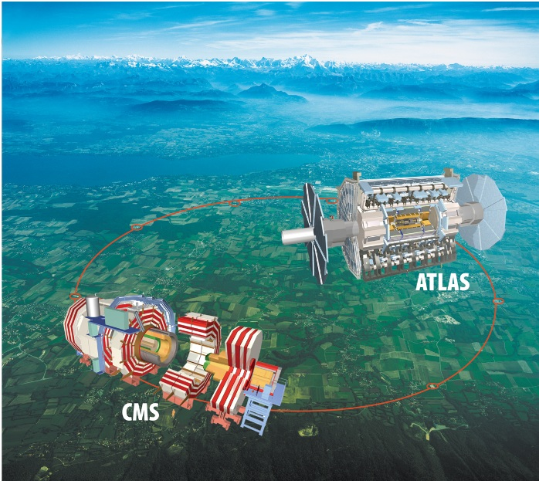
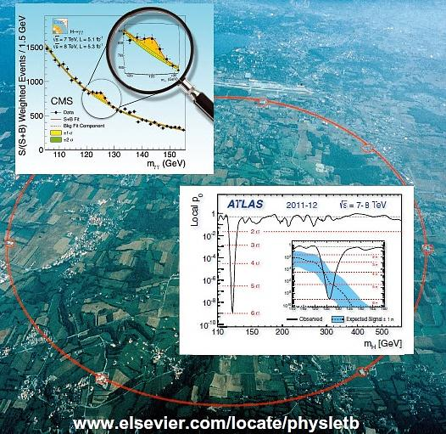
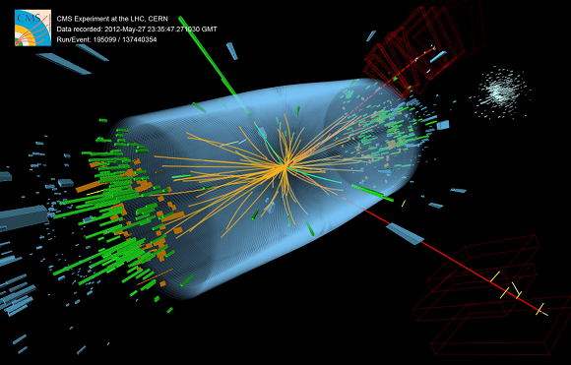
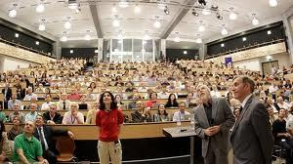
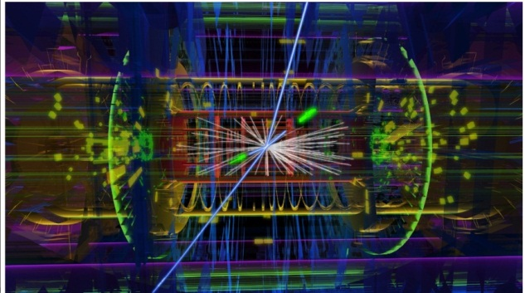
July 4 2012

Slide 21
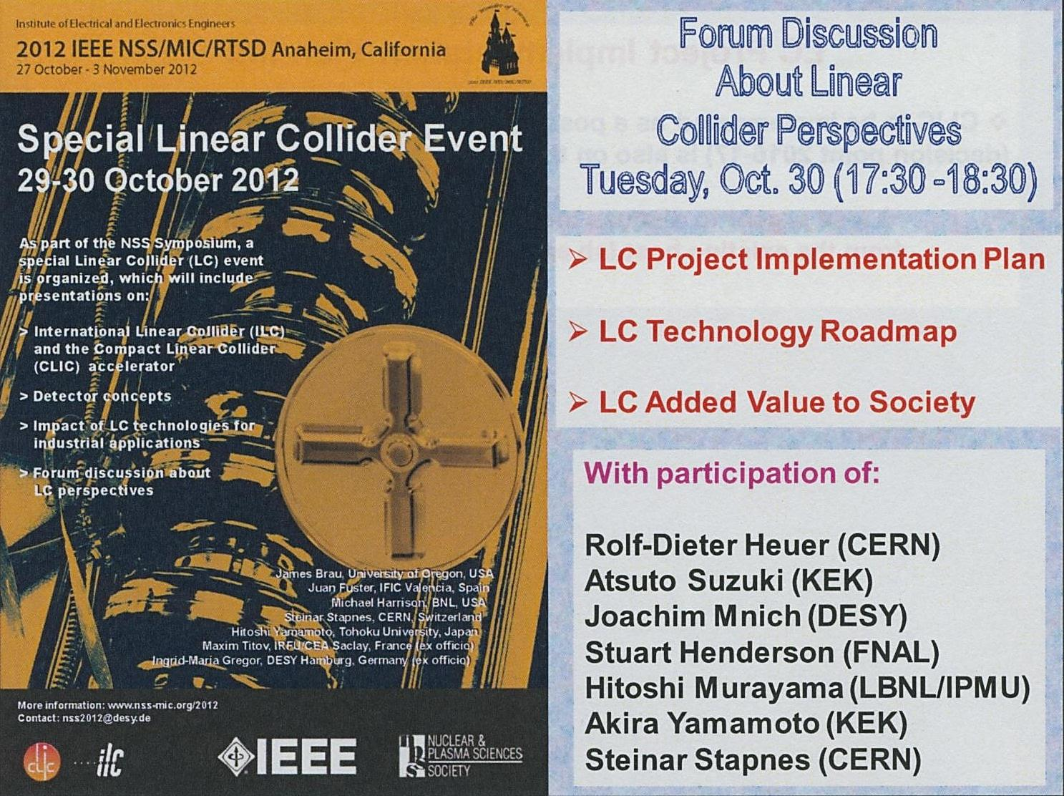

Slide 22
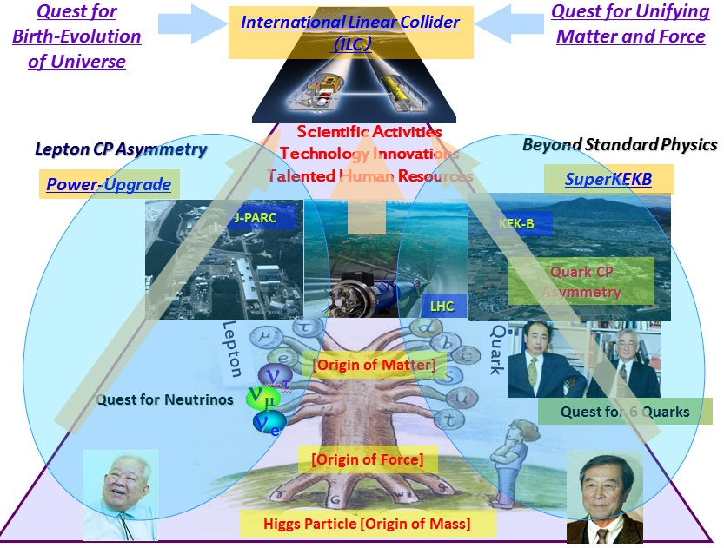
ILC Proposal from Japan
In 2008
1. Why ILC in Japan ? : 1

Slide 23
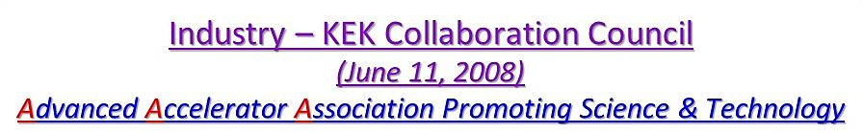
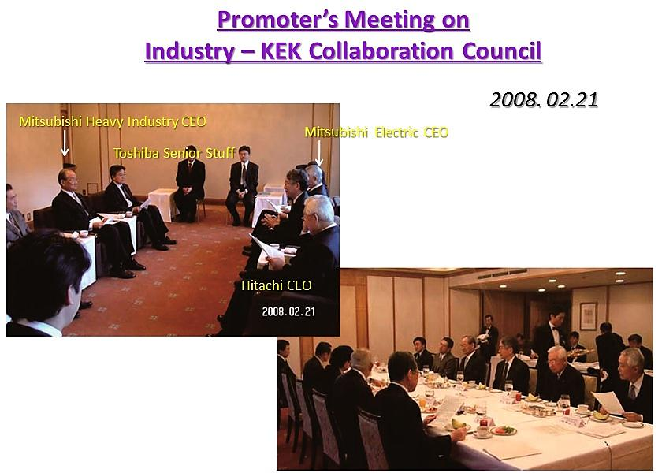
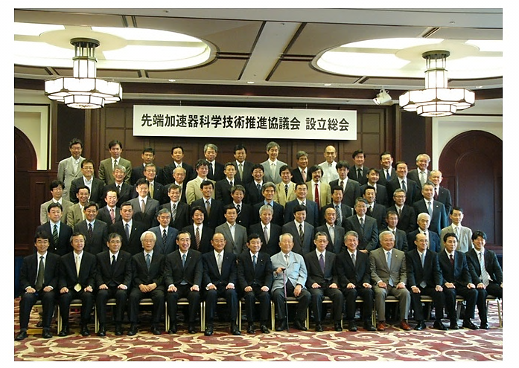

A bid-to host activity in Japan
~90 industries & ~30 universities

Slide 24











Prime Minister Noda
15/Dec./2011
positive reference to the ILC

Slide 25

Why ILC in Japan ? : 2
July 12, 2012
Japan Policy Council
Second Recommendations:
Regional Development through Creation of Global Country inside Japan
Realizing a global city that can attract human and financial resources from around the world: Regional development triggered by the International Linear Collider (ILC)
Realizing an international organization for the International Linear Collider (ILC), to push towards reforming regional cities as a role model for the creation of a global country.

Slide 26





Slide 27
Toward ILC Construction : International Activities
2012
2013
2014
2015~6
Linear Collider Directorate (LCD）
Accelerator/Detector R&D
Cite Recommendation
Detailed Design for Construction
Project Proposal
GDE
RD
Cite/Host
Establish
Linear Collider Board（LCB）
Detailed Design for ILC Lab.
Chart-out of Approval Process
for instance, ICFA→IUPAP→ OECD
→ Governmental Board
ILCSC
Project Proposal to
  ICFA → IUPAP → OECD
  → Governmental Board
ICFA

Slide 28
Toward ILC Construction in Japan
2012
2013
2014
2015~6
Positive Reference
from New Prime Minister
Establish ILC Pre-
J-Lab.
Set-up JLCB and JLCD
HEP
Researchers
Cite Decision
Design ILC Lab.
サイト/ホスト
国際決定
Fomal Message
On Hosting ILC in Japan
Project Proposal to Japan Academy Council
ILC Host Recommendation to Government
Detailed Design of International Country
Japan Policy Council

Slide 29

5. Summary

Slide 30


Summary of KEK Roadmap
2007
2008
2009
2010
2011
2012
J-PARC
construction
operation & completion of 1st goal
power upgrade
upgrading to Super-KEKB
KEKB : 1 (ab)⁻¹
operation
& upgrade
Photon Factory
continue R&D and compact ERL
ERL R&D
construction
operation
1st results
LHC
LHC upgrade
ILC R&D
TDP1
lots and lots of R&D’s
TDP2
Notes:
30

Slide 31

Next Prime Minister ??

Slide 32
Budget support from the government
In principal (researcher’s proposal)
50% of the total ⬅ host country
the other ⬅ non-host countries
Extra support
Given the special aims in Japan (Creation of Global Country inside Japan), the extra support from the government is feasible.
Multi-body promotion :
MEXT (Ministry of Education, Culture, Sports, Science &
Technology )
+ METI (Ministry of Economy, Trade and Industry)
+ MLIT (Ministry of Land, Infrastructure, Transport and Tourism)
+ ………..

Slide 33
Notes:
33

