Slide 1
CERN Plans for LHC upgrades
Lucio Rossi
CERN, HL-LHC project coordinator
CERN-KEK committee,
7th Meeting , 10 December 2012

Slide 2
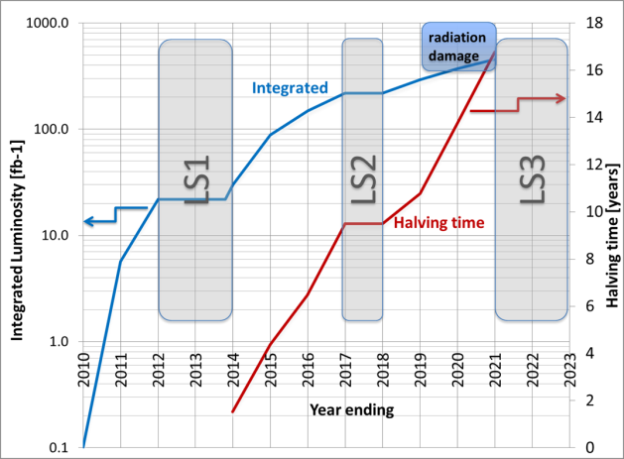
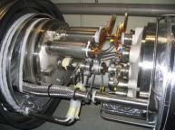
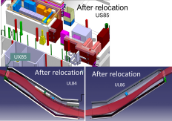
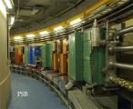
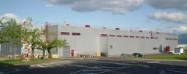
2 Reasons for upgrade:
Performance & Technical (Consolidation)
Shut down to fix interconnects and overcome energy limitation (LHC incident of Sept 2008) and R2E
Full upgrade
Shut down to overcome beam intensity limitation (Injectors, collimation and more…)

Slide 3
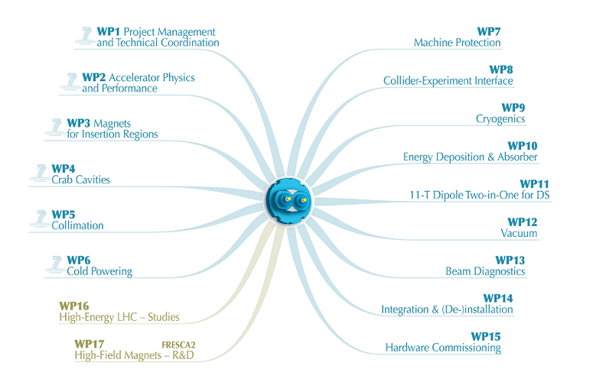
1 project – 1 structure: HL-LHC
FP7 HiLumi Design Study just covers part of it

Slide 4
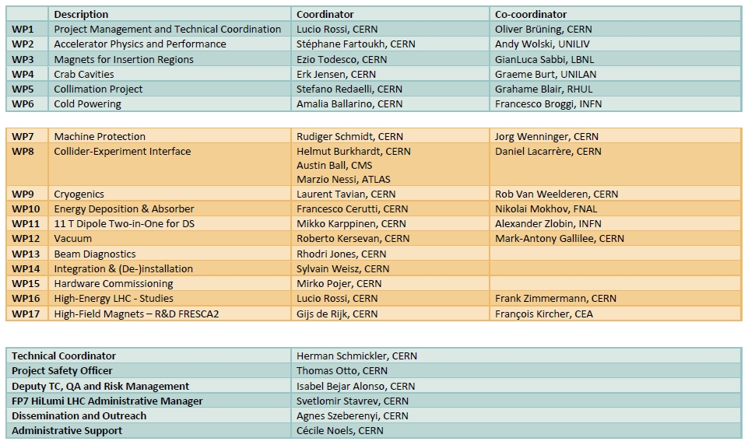
Structure and Management

Slide 5
HiLumi: Two branches (with overlap)
Performance Improving Consolidation upgrade (1000-1200 fb⁻¹)
  Magnet rad. damage and enhanced cooling
  Cryogenics (P4, IP4,IP5) with separation Arc form RF and from IR
  Collimation
  SC links (in part)
  QPS and Machine Prot.
    Kickers
    Interlock system
Full Performance upgrade (3000 fb⁻¹)
  Maximum low-β Quads aperture
  Crab Cavities
  HB feedback system (SPS)
  Advanced collimation systems
  E-lens (?)
  SC links (all)
  R2E and remote handling for 3000 fb⁻¹

Slide 6
Official Beam Parameters
(see PLC by O.Bruning)
Parameter | nominal | 25ns | 50ns
N | 1.15E+11 | 2.2E+11 | 3.5E+11
n_{b} | 2808 | 2808 | 1404
beam current [A] | 0.58 | 1.12 | 0.89
x-ing angle [μrad] | 300 | 590 | 590
beam separation [σ] | 10 | 12.5 | 11.4
β* [m] | 0.55 | 0.15 | 0.15
ε_{n} [μm] | 3.75 | 2.5 | 3.0
ε_{L} [eVs] | 2.51 | 2.5 | 2.5
energy spread | 1.20E-04 | 1.20E-04 | 1.20E-04
bunch length [m] | 7.50E-02 | 7.50E-02 | 7.50E-02
IBS horizontal [h] | 80 -> 106 | 20.0 | 20.7
IBS longitudinal [h] | 61 -> 60 | 15.8 | 13.2
Piwinski parameter | 0.68 | 3.1 | 2.9
geom. reduction | 0.83 | 0.35 | 0.33
beam-beam / IP | 3.10E-03 | 3.9E-03 | 5.0E-03
Peak Luminosity | 1 10³⁴ | 7.4 10³⁴ | 8.5 10³⁴
Virtual Luminosity | 1.2 10³⁴ | 21 10³⁴ | 26 10³⁴
6.2 10¹⁴ and 4.9 10¹⁴
p/beam
sufficient room for leveling
(with Crab Cavities)
Virtual luminosity (25ns) of
L = 7.4 / 0.35 10³⁴ cm⁻² s⁻¹
= 21 10³⁴ cm⁻² s⁻¹ (‘k’ = 5)
Virtual luminosity (50ns) of
L = 8.5 / 0.33 10³⁴ cm⁻² s⁻¹
= 26 10³⁴ cm⁻² s⁻¹ (‘k’ = 10)
(Leveled to 5 10³⁴ cm⁻² s⁻¹
and 2.5 10³⁴ cm⁻² s⁻¹)
28
Events / crossing (peak & leveled L) | 19 | 210 | 475 | 140 | 140

Slide 7
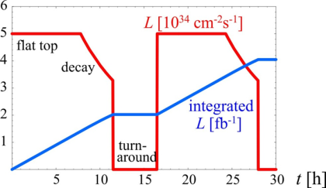
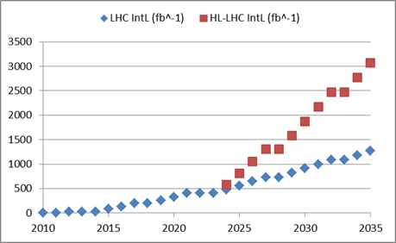
Final goal : 3000 fb⁻¹ by 2030’s…
3 fb-1 per day
60% of efficiency
250 fb-1 /year
300 fb-1/year as «ultimate»
Full Performance upgrade
Performance Improving Consolidation upgrade

Slide 8
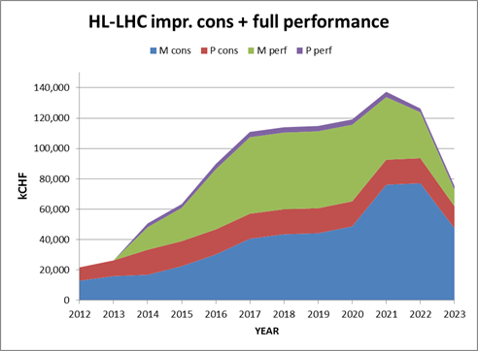
Preliminary budget estimate
 | Improving Consolidation | Full performance | Total HL-LHC
Mat. (MCHF) | 476 | 360 | 836
Pers. (MCHF) | 182 | 31 | 213
Pers. (FTE-y) | 910 | 160 | 1070
TOT (MCHF) | 658 | 391 | 1,049

Slide 9
European Strategy Update
Documents for open symposium, Cracow 10-12 Sept
    CERN-ATS-2012-236
    High Luminosity Large Hadron Collider - A description for the European Strategy Preparatory Group
    CERN-ATS-2012-237
    High Energy LHC - Document prepared for the European HEP strategy update
We work hard to make HL-LHC “unavoidable”: much return in Physics and Accelerator Technology for little (extra)money
HL-LHC is the test bed (on real scale) of new advanced technology:
  11T and 13 T Magnets,
  CCs at 10 fs accuracy
  new collimation concepts, new diagnostics, SC Links, advanced modelling at the highest energy, all working on a ∼ 1 GJ beam… (vacuum, cryogenics, kickers, protections…)

Slide 10
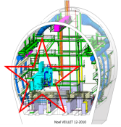
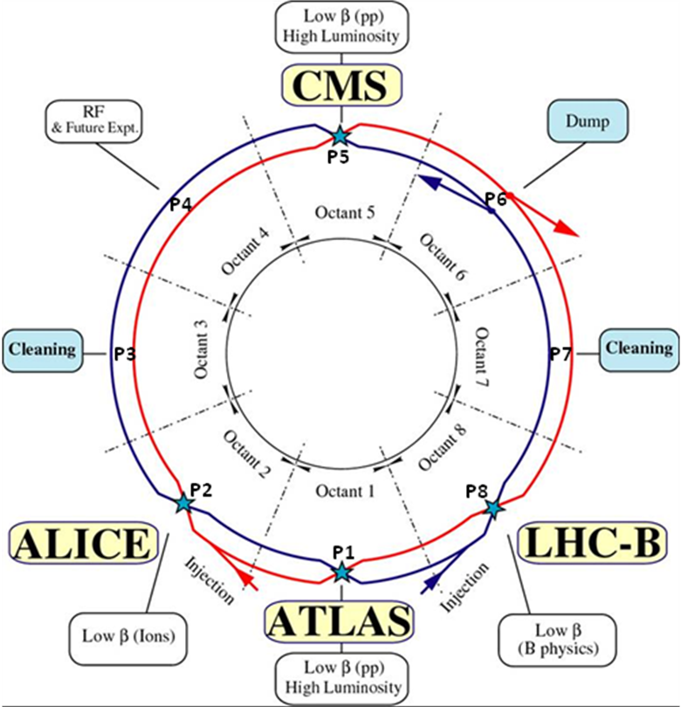
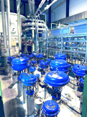
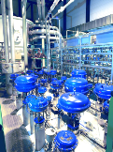
1.5 km of new equipment in the LHC…
6.5 kW@4.5K cryoplant
2 x 18 kW @4.5K cryoplants for IRs

Slide 11

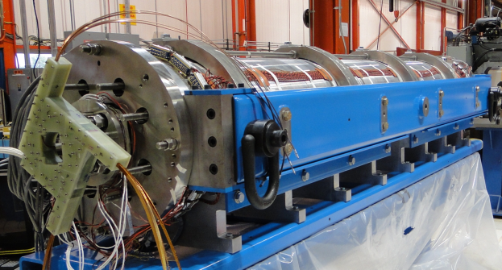
Technical Progress (incomplete …) - 2
WP3
LARP: HQ (1m-120 mm) and LQ3 (3.6 m -90 mm), very positive.
Aperture 150 mm, 4.5+4.5 m long, W-shielded, more rad-dam limited than heat depo limited, new plan for LARP+CERN
EU (CEA, INFN)+ JP
LQS03: 208 T/m at 4.6 K
210 T/m at 1.9 K
1st quench: 86% s.s. limit
3.3 m coils
90 mm aperture
Target:
200 T/m gradient at 1.9 K

Slide 12
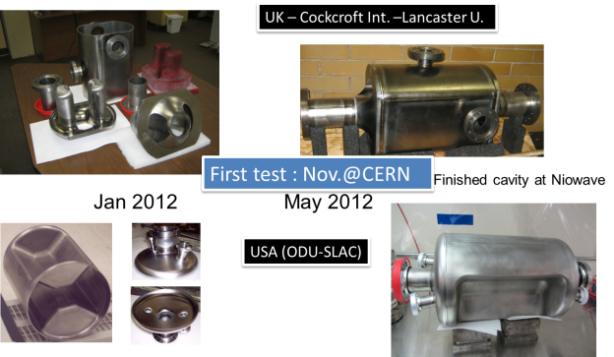
Technical Progress (incomplete …) - 3
WP4
First CC (from UK) arrived at CERN, near under test!
ODU-SLAC CC also very near, BNL under way
Interest from Fermilab for cryomodulization
From virtual to actual reality!

Slide 13
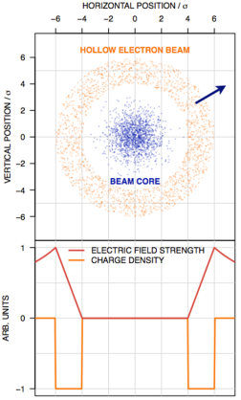
Technical Progress (incomplete …) - 4
WP5
Assessment of collimation needs in LHC after LS1 (Cryocollimators…): review in April 2013
New Material test (HiRadMat)
New concepts : Crystals, e-Lens
Hollow e-lens
Primary collimator

Slide 14
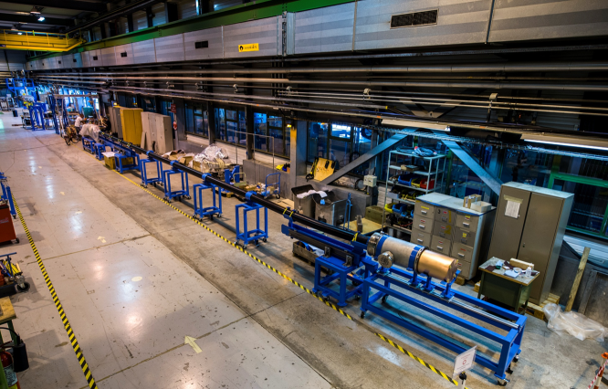
Technical Progress (incomplete …) - 5
WP6
    first proto 20 m – 20 kA under test at CERN!

Slide 15
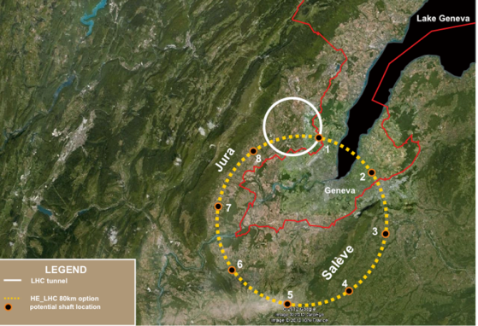
Study for the HE-LHC smoothly starting
HE-LHC in the LHC tunnel:
27-33 TeV c.o.m. energy
16-20 tesla dipole field
A new 80 km tunnel: for TLEP, then for a VHE-LHC
Optimitation could be at 16 T field level: collision
energy 80 TeV c.o.m.
Or 100 TeV for 20 T dipoles
Much better new infrastructure.
However many costs go linearly, or more, with length. Magnet stored energy, beam energy also a concern
Whatever solution, only a vigorous Magnet R&D will enable to go beyond LHC energy

Slide 16
Discussing in-kind contribution
(secure Full Performance Upgrade)
DOE: extremely positive: on 10 July 2012 first public sentence to prepare plan for 200 M$ contribution (project in addition to LARP R&D)
Japan: progressing for D1 design, discussion jsut started with aim at proposing 20-50 MCHF with also infrastructure renewal in KEK…
CERN-KEK Magnet R&D: preparatory meeting on 20 November 2012 https://indico.cern.ch/conferenceDisplay.py?confId=218192#
Other contributions: Russia…

