Slide 1
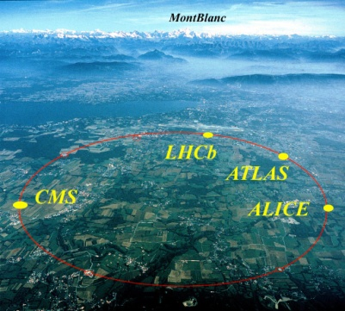
ATLAS and its upgrade
Katsuo Tokushuku
KEK

Slide 2
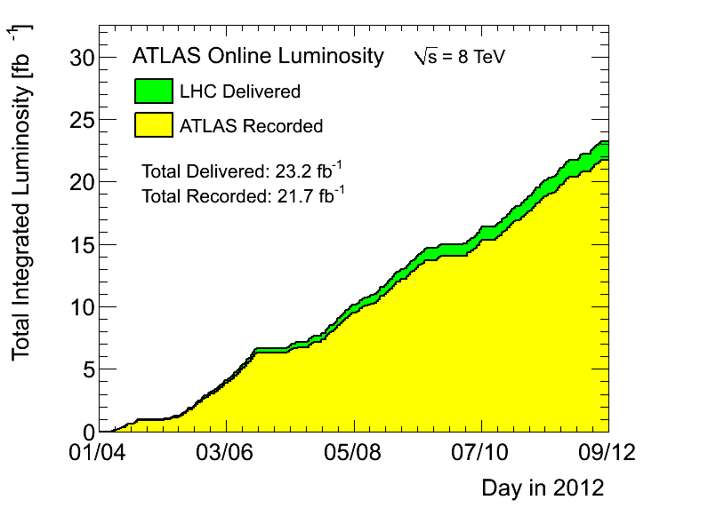

Another very successful year for LHC and ATLAS !
Integrated Luminosity: 21.7 fb⁻¹
Many thanks to the
LHC team for such a
superb performance !
© fabiola

Slide 3
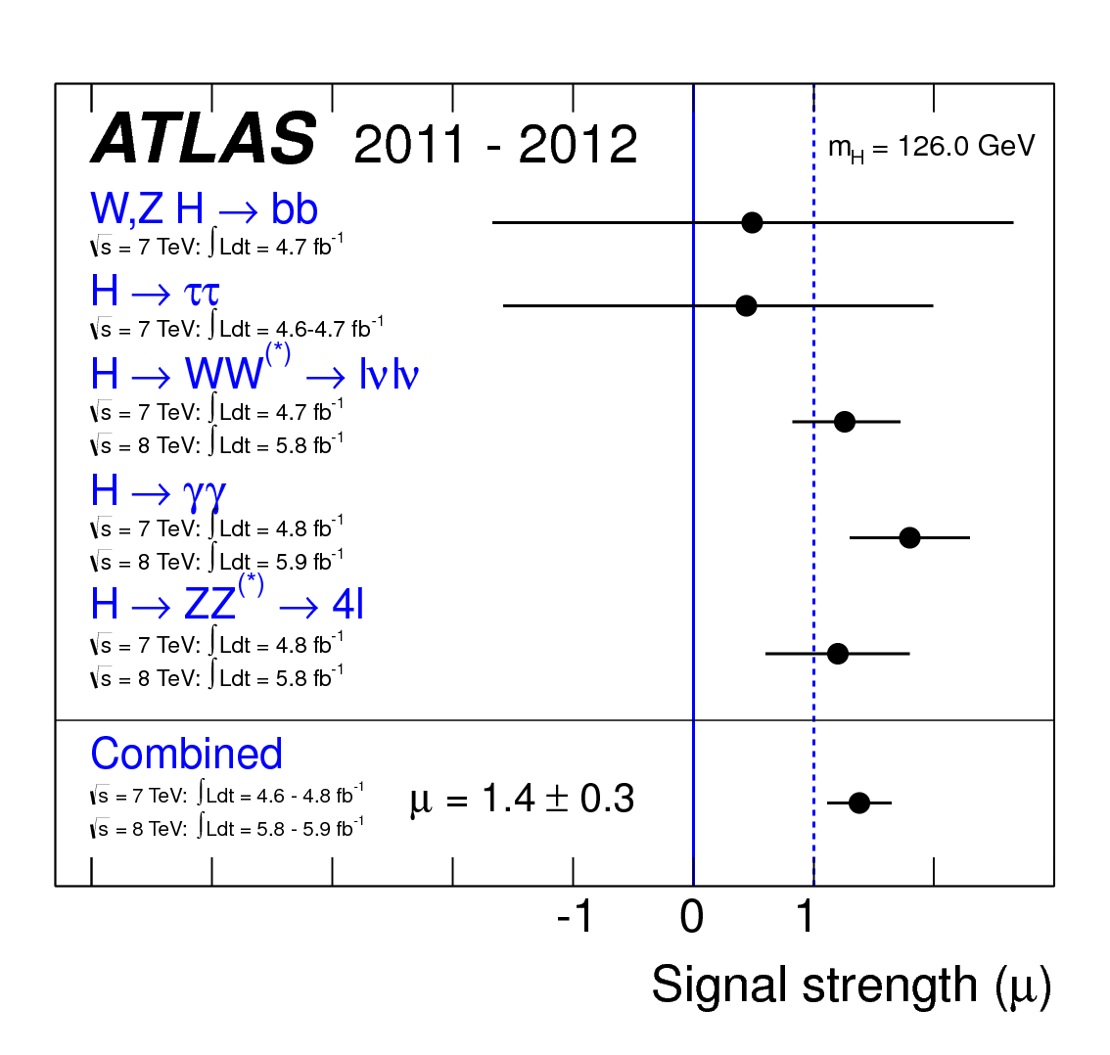
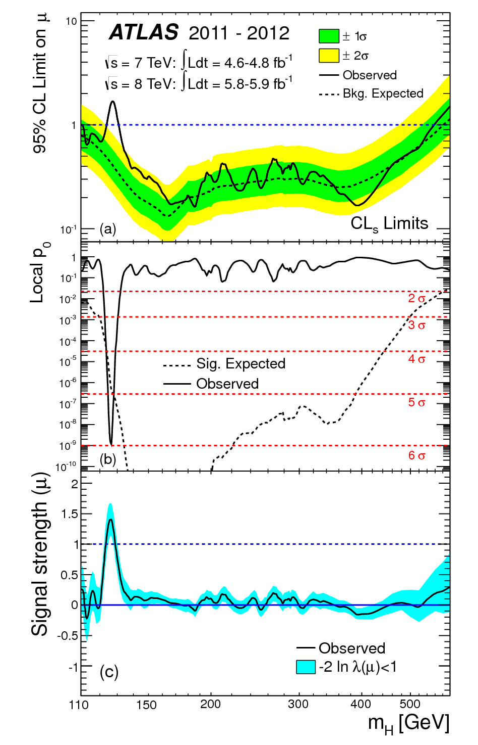
Discovery of a Higgs-like particle!
July

Slide 4
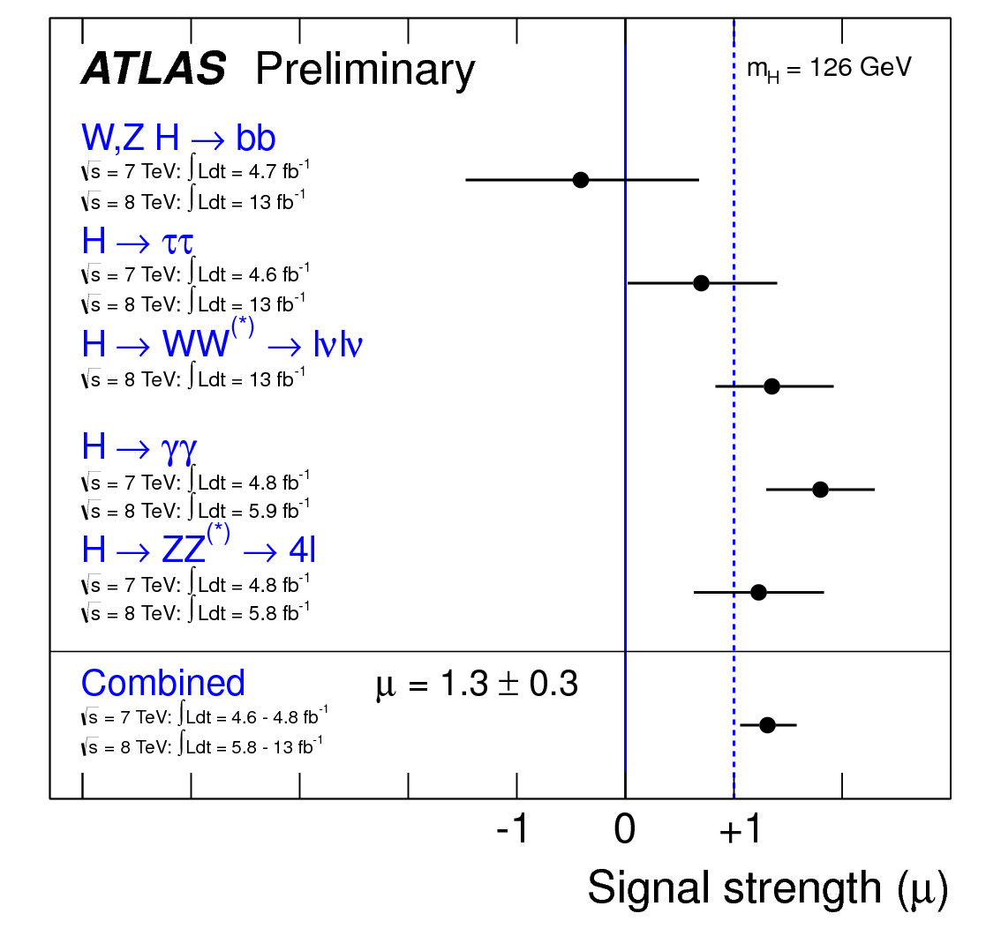
Discovery of a Higgs-like particle!
November
HCP
in Kyoto
(So far) the particle is consistent with the SM Higgs.
Direct coupling to fermions to be confirmed.
Spin/Parity to be determined (0⁺ 0⁻ 2⁺ 2⁻…..)

Slide 5

ATLAS Detector: construction and commissioning
Superconducting Central Solenoid (Japanese contribution:100%)
Time-to-digital conversion chips for muon drift tubes (100%)
End-cap muon triggering system (TGC) (~50%)
Silicon microstrip tracking system (SCT) (~20%)
Lvl-2 muon trigger (Software)
Tracking (|η|<2.5, B(solenoid)=2T) :
-- Si pixels and strips
-- Transition Radiation Detector (e/π separation)
Calorimetry (|η|<5) :
-- EM : Pb-LAr
-- HAD: Fe/scintillator (central), Cu/W-LAr (fwd)
Muon Spectrometer (|η|<2.7) :
air-core toroids with muon chambers
Length : ~ 46 m
Radius : ~ 12 m
Weight : ~ 7000 tons
~ 10⁸ electronic channels
~ 3000 km of cables

Slide 6
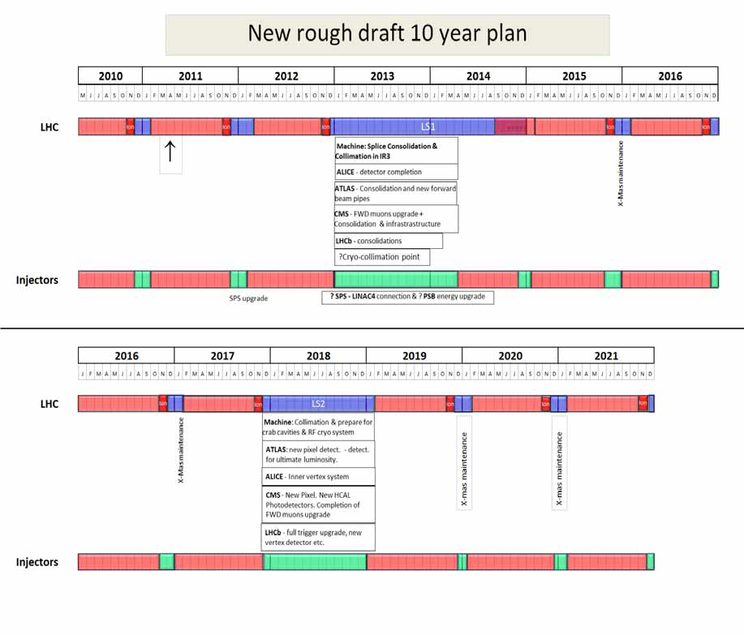

Phase 0 upgrade
IBL
Not yet official
^{8TeV}
Phase 1 LOI
Phase 2 LOI
Phase 1 upgrade
Muon
Phase 2 upgrade
Inner Tracker
13-14 TeV ~ 100fb⁻¹
14 TeV ~ 300fb⁻¹
HL-
LHC
L~ 1x 10³⁴ cm⁻²s⁻¹
L~ 2x 10³⁴ cm⁻²s⁻¹
3000fb⁻¹ by 2030

Slide 7
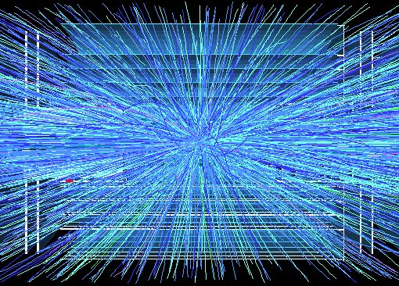
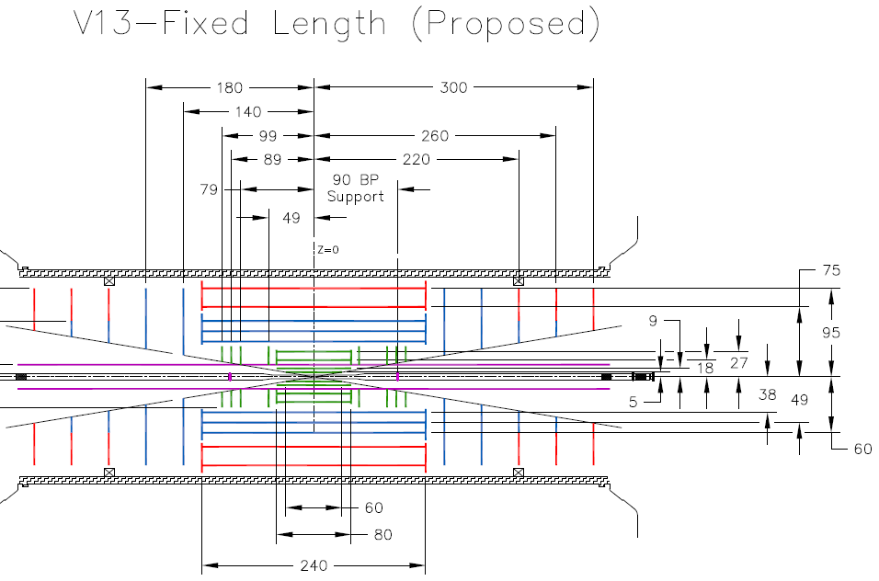
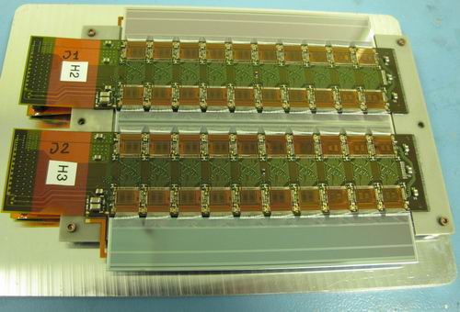
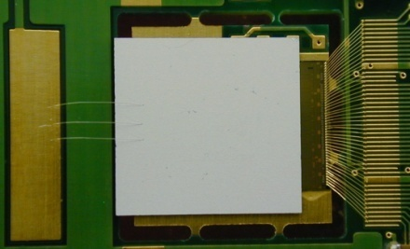
ATLAS detector upgrade plan
Phase 2: Major upgrade:
Complete replacement
of the inner trackers
(All-silicon tracker)
R&D activities in Japan
R&D of radiation- tolerant sensors
Development of short strip detector module
R&D of pixel sensors
development of muon and combined triggers.

Slide 8
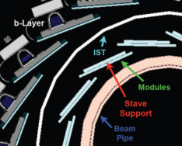
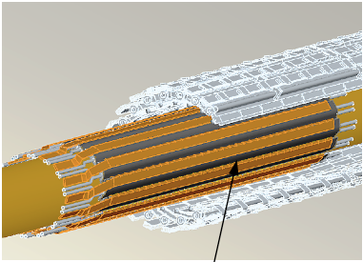
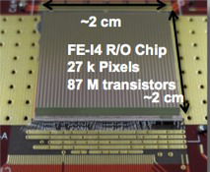
IBL: innermost pixel layer
IBL mounted on new beam pipe
Length: ~64cm
Envelope: R_{in} = 31mm, R_{out}=40mm
14 staves, 32 pixel sensors / stave.
Front-end chip:
        FE-I4 (IBM 130 nm CMOS tech.)
        50μm x 250μm
        80(col) x 336 (rows) = 26880 cells.
        2cm x 2cm!
Pixel
IBL

Slide 9
ATLAS upgrade and Japanese contributions
Phase 0: IBL + FTK (by Waseda univ.)
  The MEXT is informed. No extra money is needed
Phase 1: ATLAS (~33MCHF : Project)
  muon trigger upgrade
  Probably we can handle with current level of ATLAS budget
Phase 2: ATLAS (200~300MCHF : Project)
  Contributions to inner trackers (strips/pixels)
  Further muon trigger upgrade
  => Definitely need a new funding. : Not easy!
We are requesting for the R&D money for the upgrade. We have partly succeeded to get JSPS funds (2011-16).
We need to agree on the governance model of HL-LHC before we request the construction money to the MEXT!
Although we don’t know the governance model of HL-LHC, We start requestiong the construction money for ATLAS and LHC upgrades.

Slide 10
Preparation for LHC Upgrade
Making visible to the outside community/government.
  “Master Plan of big science project” will be updated in 2013/14 and proposals will be sent to Japan Academy of Science by March/2013.
    It becoumes more clear that the budget of a big project will not allocated unless it is listed in the master plan (and unless it gains high score.
In HEP society (and KEK), it is decided to submit HL-LHC as one of the big projects.
  Other project to be sent are; (not with priority (at moment))
  ILC
  Neutrino program (mainly for hyper-Kamiokande + moderate J-PARC power upgrade?)
  Extention of J-PARC facilities’
Now we need a cost estimation of the project. Basic idea so far is,
‘We request money for the parts where we contribute in kind.
i.e. Mostly for Inner trackers/Muon for ATLAS
and for D1 magnets for LHC upgrade

Slide 11
年度 | 2013 | 2014 | 2015 | 2016 | 2017 | 2018 | 2019 | 2020 | 2021 | 2022 | 10年積算
（千円）
LHC Magnet | 82,800 | 69,600 | 18,000 | 526,080 | 376,720 | 706,960 | 646,960 | 347,960 | 297,640 | 259,480 | 3,332,200
PSB electronics | 0 | 0 | 6,000 | 48,000 | 48,000 | 24,000 | 0 | 0 | 0 | 0 | 126,000
Crab | 12,000 | 12,000 | 12,000 | 12,000 | 12,000 | 12,000 | 12,000 | 12,000 | 12,000 | 12,000 | 120,000
Tracker | 62,000 | 83,000 | 62,000 | 329,000 | 329,000 | 493,000 | 329,000 | 165,000 | 10,000 | 20,000 | 1,882,000
Muon | 5,000 | 10,000 | 15,000 | 21,000 | 38,000 | 288,000 | 196,000 | 705,000 | 213,000 | 13,000 | 1,504,000
Trigger | 0 | 0 | 10,000 | 10,000 | 70,000 | 50,000 | 10,000 | 10,000 | 200,000 | 200,000 | 560,000
Total | 161,800 | 174,600 | 123,000 | 946,080 | 873,720 | 1,573,960 | 1,193,960 | 1,239,960 | 732,640 | 504,480 | 7,524,200
ATLAS operation | 200,000 | 200,000 | 200,000 | 200,000 | 200,000 | 200,000 | 200,000 | 200,000 | 200,000 | 200,000 | 2,000,000
LHC Total | 361,800 | 374,600 | 323,000 | 1,146,080 | 1,073,720 | 1,773,960 | 1,393,960 | 1,439,960 | 932,640 | 704,480 | 9,524,200
I.e. LHC: ~ 3.5billion yen - 35MCHF
ATLAS: ~ 4billion yen - 40MCHF
(Including R&D/Labour : i.e. not ‘TDR’ figures.)
not including personal cost (i.e. salary of us)

