Slide 1
Progress Report on Magnet R&D and Further Plans for CERN-KEK Collaboration
T. Nakamoto
KEK
CERN-KEK Committee, CERN Dec. 10, 2012.

Slide 2
R&D Items
R&D for beam separation dipole D1
  Conceptual design of the D1
  Radiation resistant materials development
  Neutron irradiation of stabilizer at cold
  Feasibility study, availability survey
Fundamental R&D
  Nb₃Al subscale magnet
  Nb₃Sn-Bronze cable development
  RHQ-Nb₃Al
    Stress/strain behavior
    Support to wire development

Slide 3
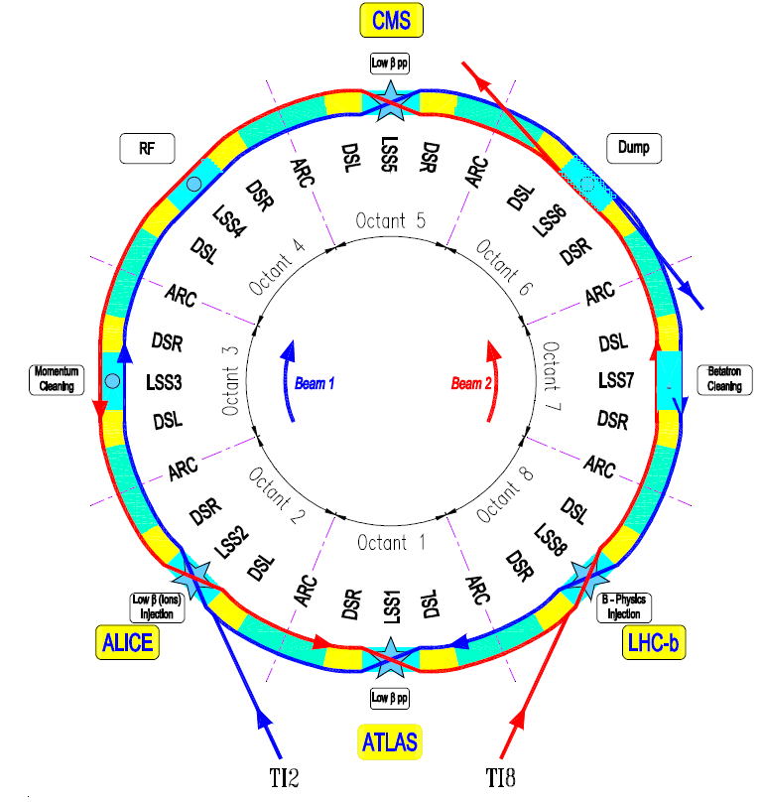
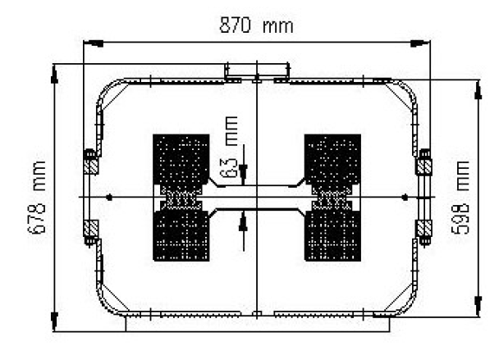
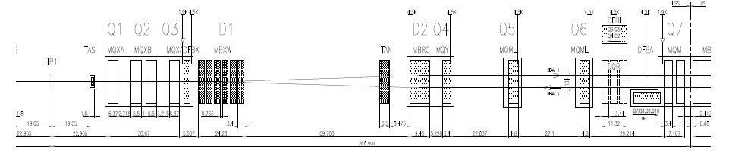
Objective of the development
For HL-LHC upgrade, needs for new Inner Triplet system at IR1 & IR5.
  Large aperture HF Quadrupoles (150 mm), corrector package.
New beam separation dipole (D1) should be accommodated with large aperture IT Quads; which will have a even larger aperture than IT Quads and 50% increase in original integrated field (26 T m 40 T m).
Schematic layout of the LHC
Schematic layout of the right side of IR1 (ATLAS)
Current D1 (MBXW) at IR1 & IR5
2012.8.10 The 9th Annual Meeting of Particle Accelerator Society of Japan

Slide 4


Latest design guidelines
(May 2012 - Now)
Coil ID: 160 mm for the 150 mm triplet
Integrated field: 40 T m, 50% larger than today
Operational margin: 70 % of the load line (possible to 80% ?)
T_{op}: 1.9 K
Coil lay out: One layer of 15 mm cable
Conductor: Nb-Ti LHC dipole cable (outer) is the baseline
Support structure: Collaring yoke structure (RHIC dipole, MQXA, J-PARC)
Field homogeneity: < 10⁻⁴ at 2/3 bore radius
Cold mass OD: 570 mm ~ 630 mm
Radiation, energy deposition not clear now, estimate to be done

Slide 5
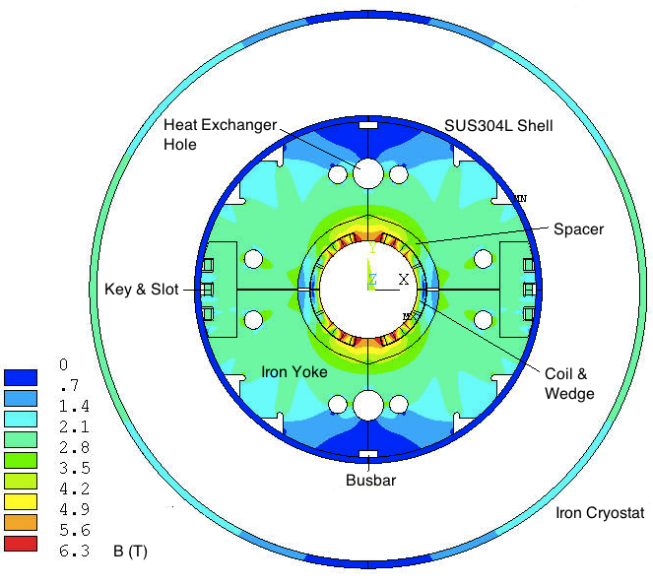
Main design parameters
Magnetic field distribution at nominal current
Item | Value
Bore diameter | 160 mm
Nominal field (dipole) | 5.23 T
Magnetic length | 7.65 m
Operating current | 11 kA
Injection current | ~ 0.7 kA
Field homogeneity | <0.01% (R_{ref}=50 mm)
Peak field in the coil | 6.1 T
Load line ratio | 70% @ 1.9 K / 91% @ 4.2 K
Inductance (low / nominal field ) | 6.58 / 5.91 mH/m
Stored energy | 331 kJ/m
Peak field/central field | 1.17
Lorenz force X/Y (1st quadrant) | 1.4/0.6 MN/m
Outer dia. of iron yoke | 550 mm
Inner dia. of iron yoke | 232 mm
Strand diameter | 0.825
Cu/Non-Cu ratio | 1.95
Cable dimension / insulation | 15.1* 1.48mm² / 0.16 mm (radial) 0.145 (azimuthal)
No. of strands | 36
Keystone angle | 0.9 °
Superconductor current density | 1710 A/mm²
Total length of the cable | 752 m (Coil length ~8 m)
4
9
14
20
Coil layout in the 1st quadrant

Slide 6
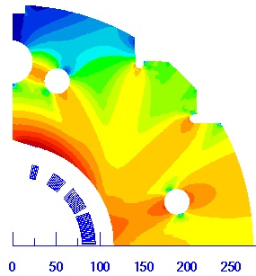
Field quality optimization
(at injection & nominal current)
Injection
Nominal current

Slide 7
Field quality optimization
– The other high order multiples for the best case in last page
Injection
Nominal current

Slide 8
Random geometric field errors
Estimation of random field errors induced by cable mispositioning during magnet fabrication
A simple case to illustrate the problem:
Block 1 moves in one direction with dipole symmetry condition (radial, azimuthal and rotational), simulation done by using ROXIE, with the reference radius of 50 mm; at nominal current 11 kA; iron yoke and cryostat is included in the ROXIE model.
4
3
2
1
Displacement direction | b3 | b5 | b7 | b9 | b11 | b13
Original optimized position | 0.06 | -0.02 | 0.16 | -0.66 | 0.48 | 0.17
+0.05 mm disp. in radial direction | -1.13 | -0.28 | 0.22 | -0.59 | 0.51 | 0.18
+0.05 mm disp. in azimuthal direction | -1.2 | -0.91 | -0.23 | -0.78 | 0.46 | 0.17
0.05 mm disp. Induced by rotation | -0.84 | -0.64 | -0.11 | -0.74 | 0.46 | 0.17
Integrated displacements in 3 directions | -3.3 | -1.77 | -0.43 | -0.8 | 0.46 | 0.17

Slide 9
Random geometric field errors
Random component dominated by coil geometry (position of the cables)
  Based on the experience of the previous projects: split the random displacement by family giving a s of displacement in each family
  We use the LHC MB case (same cable – but two layers and 2-in-1)
  RHIC (one layer) gives similar values
Amplitude of displacement corresponding to measured random components
[B. Bellesia et al., Tenth European Particle Accelerator Conference (2006) 2601-3)]

Slide 10
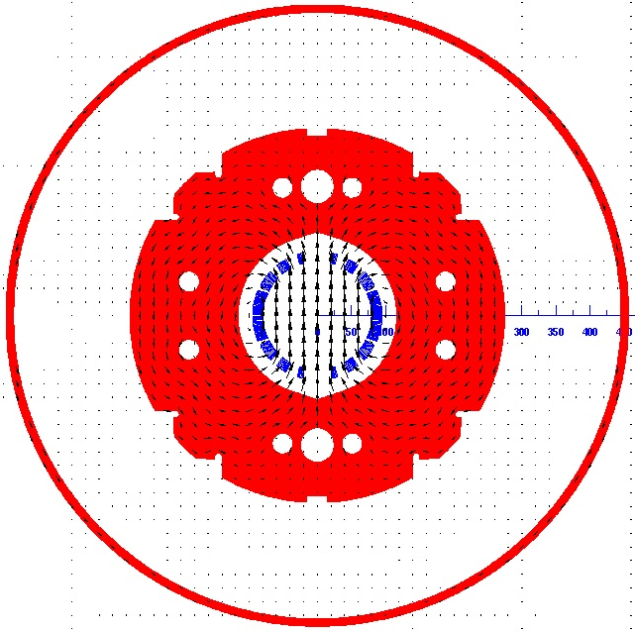
Influence of iron packing factor on field quality
Collaring - yoke assembly
Considering the packing factor variation of the iron yoke during fabrication.
Simulation with ROXIE; 11 kA, R_{ref} = 50 mm
Different packing factor at slot regions
PF (body) | PF (slot) | b3 | b5 | b7 | B (T)
1 | 1 | 0.21 | -0.18 | 0.16 | 5.25
 | 0.95 | -2.1 | -0.53 | 0.12 | 5.2443
 | 0.9 | -4.48 | -0.89 | 0.08 | 5.2384
0.98 | 0.98 | -0.1 | -0.05 | 0.16 | 5.2261
 | 0.94 | -1.94 | -0.33 | 0.13 | 5.2216
 | 0.9 | -3.83 | -0.62 | 0.09 | 5.2169
Importance of control of packing factor in highly saturated iron to maintain good field quality.

Slide 11
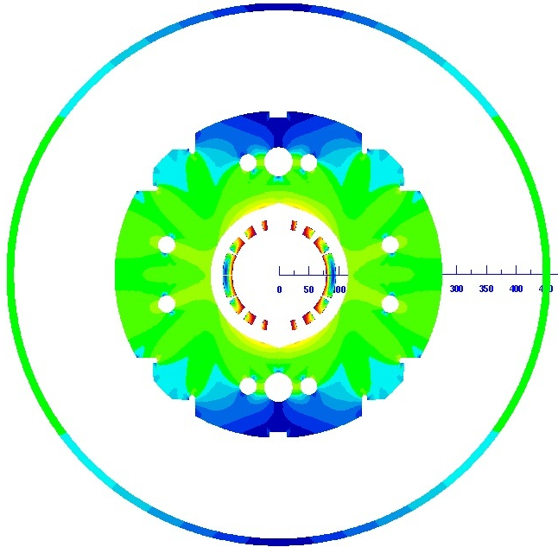
Stray field of the magnet
stray field at the outer surface of the iron cryostat with different outer diameters of the iron yoke;
At nominal current of 11 kA.
90 º
Iron cryostat
Iron yoke
180 º
Coil
0 º
270 º

Slide 12
Stray field of the magnet
stray field at the outer surface of the iron cryostat with different thicknesses of the iron cryostat;
At nominal current of 11 kA.
90 º
Iron cryostat
Iron yoke
180 º
Coil
0 º
270 º

Slide 13
Collaring-yoke support structure
(RHIC main dipole, MQXA, J-PARC)
1.4 MN/m
Iron yoke
0.6 MN/m
Simulation steps of the ANSYS 2D 2-layer model
Collaring
< 10 MPa pre-stress generated in coil by applying force on the stainless steel spacer;
Yoking (2 steps)
1. load applied on the yoke shoulder to close the gap between the top and bottom yokes;
2. remove load, insert the lock-key;
Shell welding
Including stress from stainless steel shell;
Cool-down to 2K;
Excitation.
Boundary conditions
Symmetry condition: UX = 0 in line X = 0;
Friction coefficient of 0.2 for all internal interfaces;
Mechanical design for 110% of the nominal current;
Shear stress in the key is not included
Lorentz force
In coil at nominal current
Spacer
Key
Coil
Gap between top yoke and mid-plane:
1.2 mm (inner) / 1.3 mm (outer)
0.5 unit thickness
for each layer
SS304L Shell

Slide 14
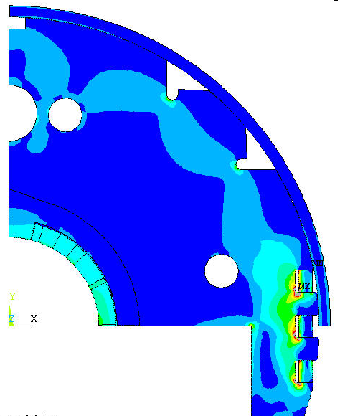
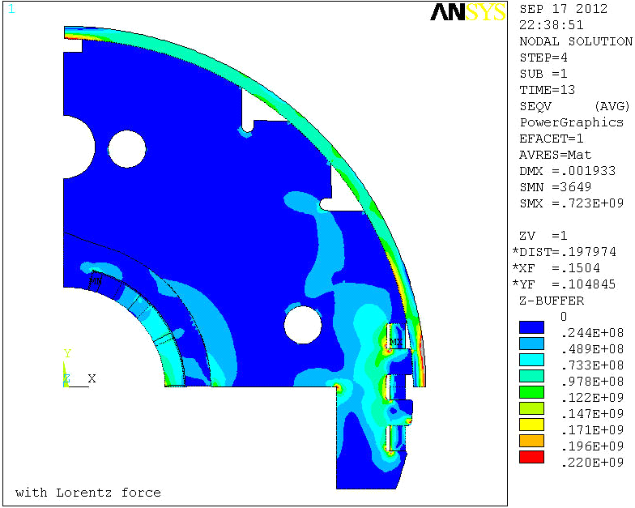
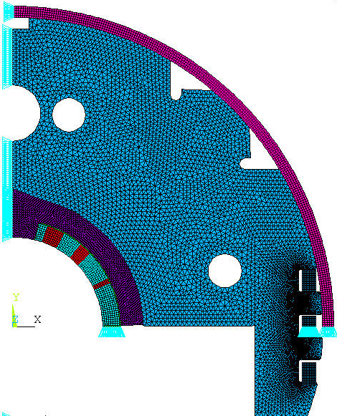
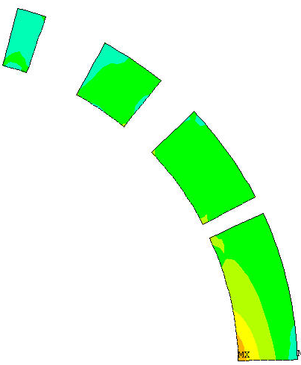
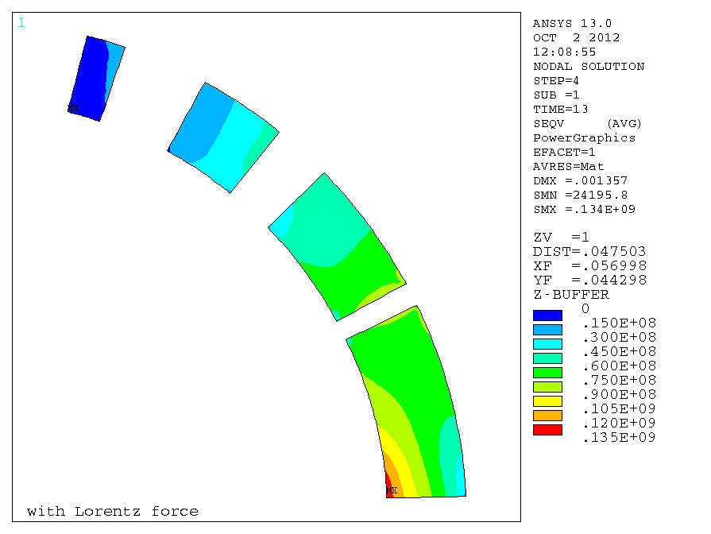
After shell welding
Magnet
Stress distribution
After assembly (Pa)
~1 mm displacement in x direction
UX = 0
With the fillet radius of 2 mm at the corner of key – slots
0.5 unit
thickness
Yoke
Spacer
Coil blocks
Coil
Stress distribution
after assembly (Pa)
UY = 0
Including the shell stress by making a ~1 mm displacement at one end of the shell;

Slide 15

After excitation
Stress distribution
after excitation (Pa)
Magnet
~1 mm displacement in x direction
Simulation model
(top half)
UX = 0
With the fillet radius of 2 mm at the corner of key – slots
0.5 unit
thickness
Yoke
Spacer
Coil blocks
Stress distribution
after excitation (Pa)
Coil
UY = 0
Applying Lorentz force transferred from the magnetic simulation results.

Slide 16
Coil stress at each step
160 mm aperture, with 110% of the nominal current
Lorentz force: 1.4 MN/m and 0.6 MN/m in X/Y direction at nominal current

Slide 17
R&D Items
R&D for beam separation dipole D1
  Conceptual design of the D1
  Radiation resistant materials development
  Neutron irradiation of stabilizer at cold
  Feasibility study, availability survey
Fundamental R&D
  Nb₃Al subscale magnet
  Nb₃Sn-Bronze cable development
  RHQ-Nb₃Al
    Stress/strain behavior
    Support to wire development

Slide 18
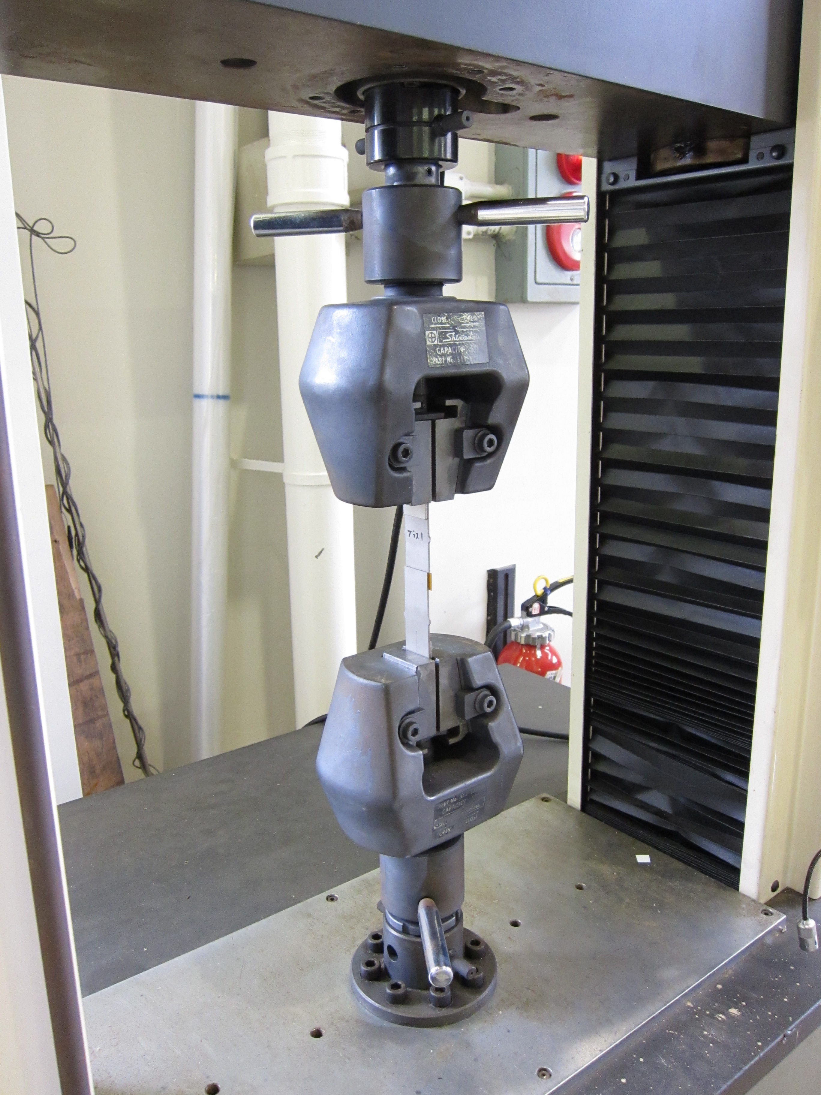
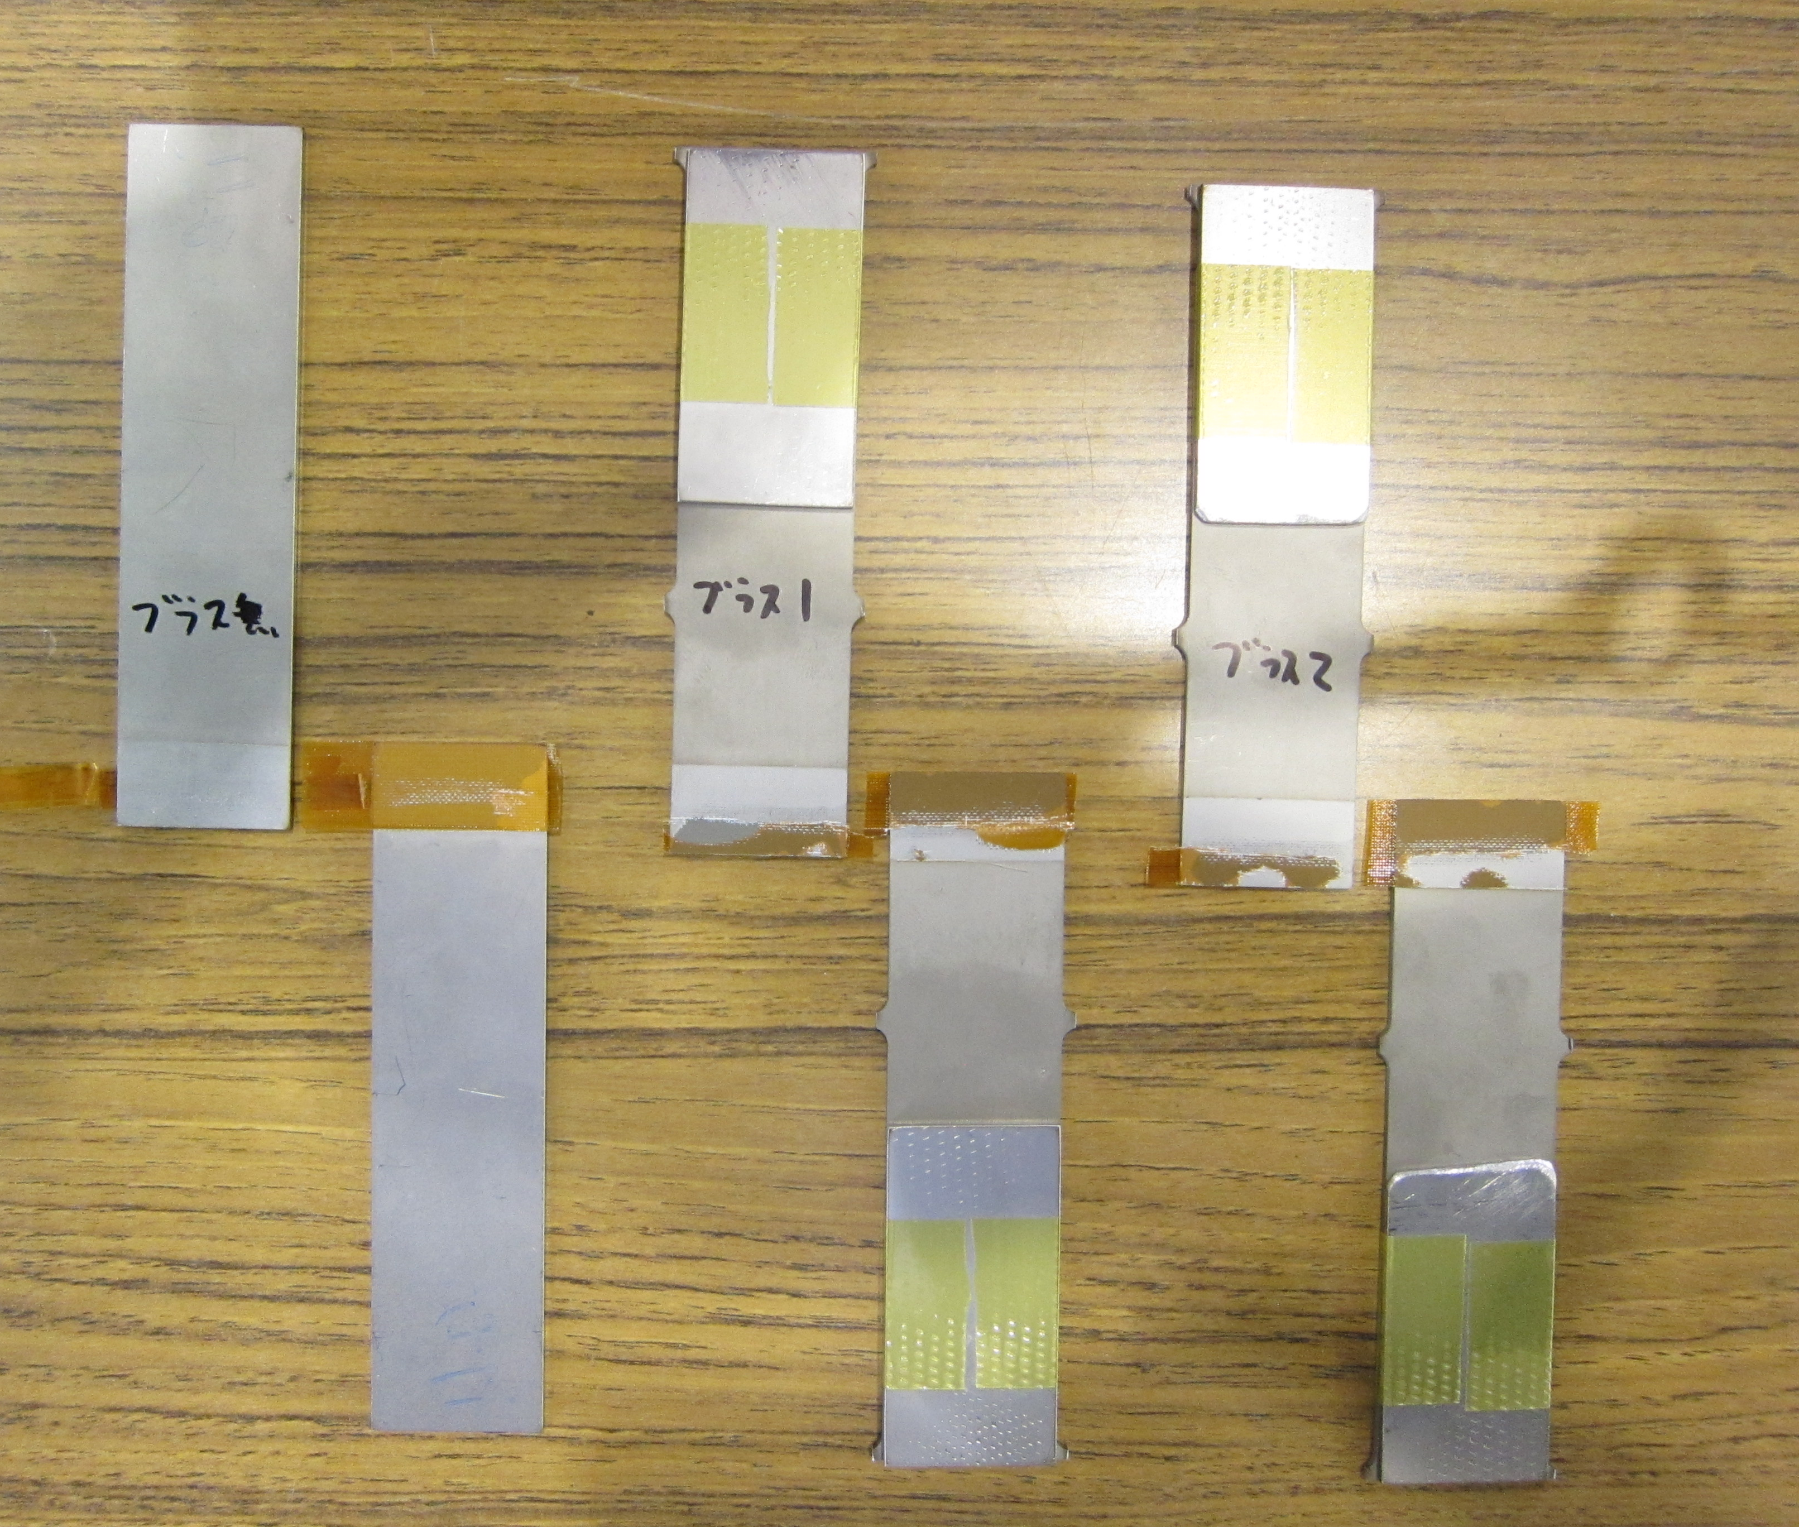
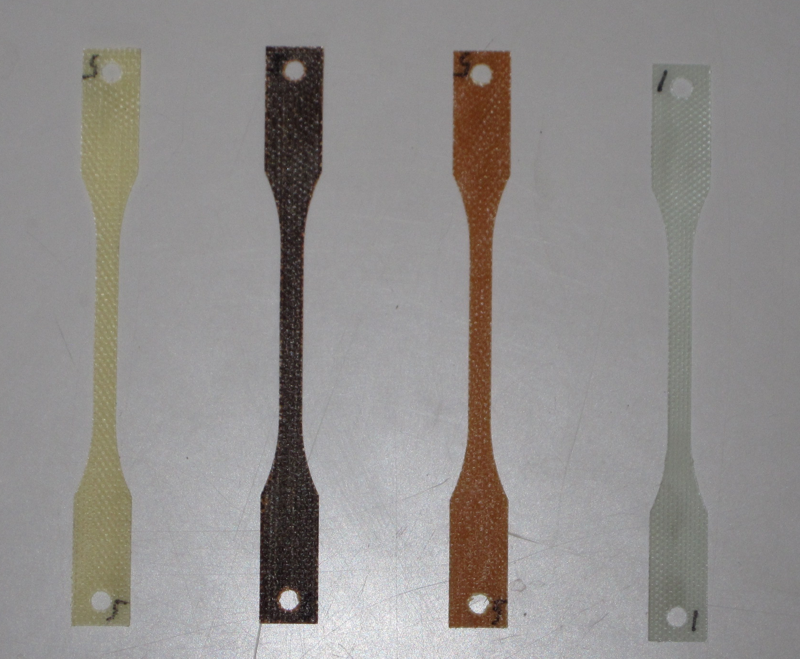
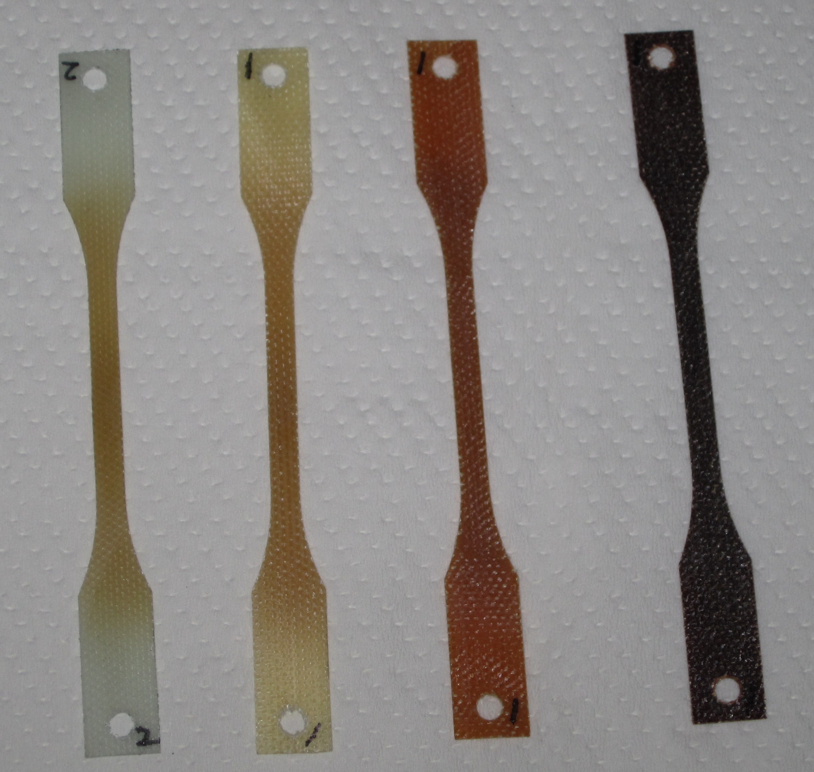
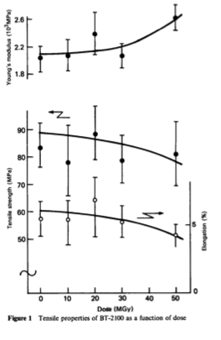
Radiation Resistant Materials R&D (1/2)
Radiation resistant organic insulation beyond Epoxy:
New Resins: BT(Bismaleimide Triazine), BM(Bismaleimide), Cyanate Ester.
  3 types of GFRP developed.
  CE based Prepreg tape (curing at 150 °C) developed.
Irradiation tests underway at RT, up to 100MGy
  Gamma rays (⁶⁰Co ), 2 MeV electron at JAEA Takasaki
  30 MeV electron at KUR
  Irradiation at cold (LN2) ??
After 1.9K
(SUS plates)
Polyimide coating
Alumina plasma spray
GKG type tape with CE prepreg
30MeV electron beam
(some 10 MGy)
CE
BMI
BT
Epoxy
(G10)
Epoxy
(G10)
CE
BT
BMI
BT resin: e irradiation
(T. Sasuga, Polymer Vol. 27, 1986, 681)

Slide 19
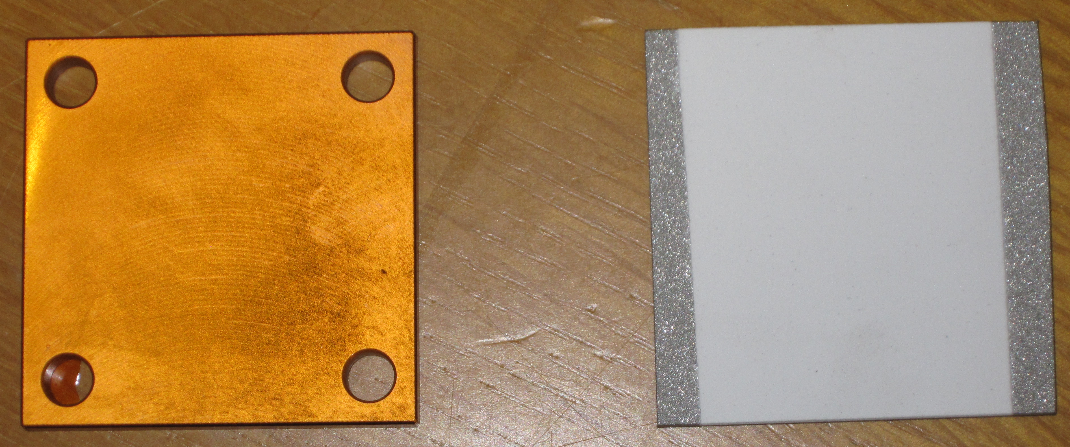
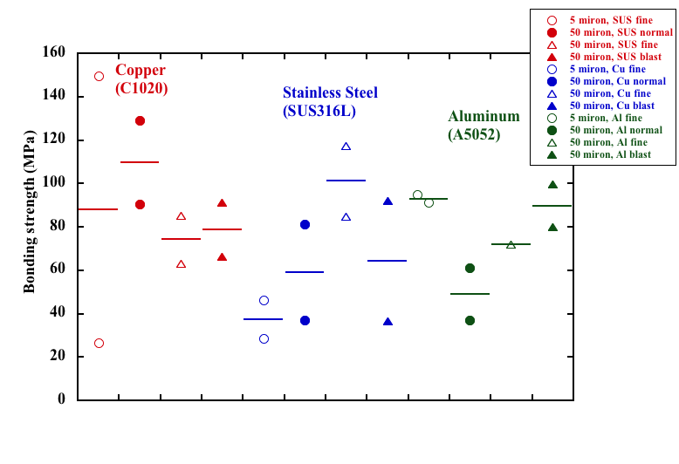
Radiation Resistant Materials R&D (2/2)
Insulation coating technologies on metal parts (i.e. end spacers, wedges)
  Ceramic spray
  Polyimide coating by Vapor Deposition Polymerization technology.
Difficulty in evaluation of bonding strength.
Irradiation test up to 100MGy is ongoing.
After 1.9K
(SUS plates)
Polyimide coating
Alumina plasma spray
*Before Irradiation

Slide 20
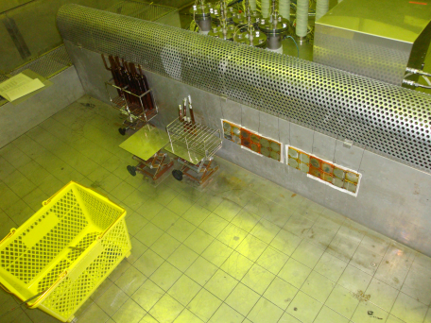
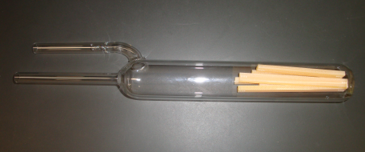
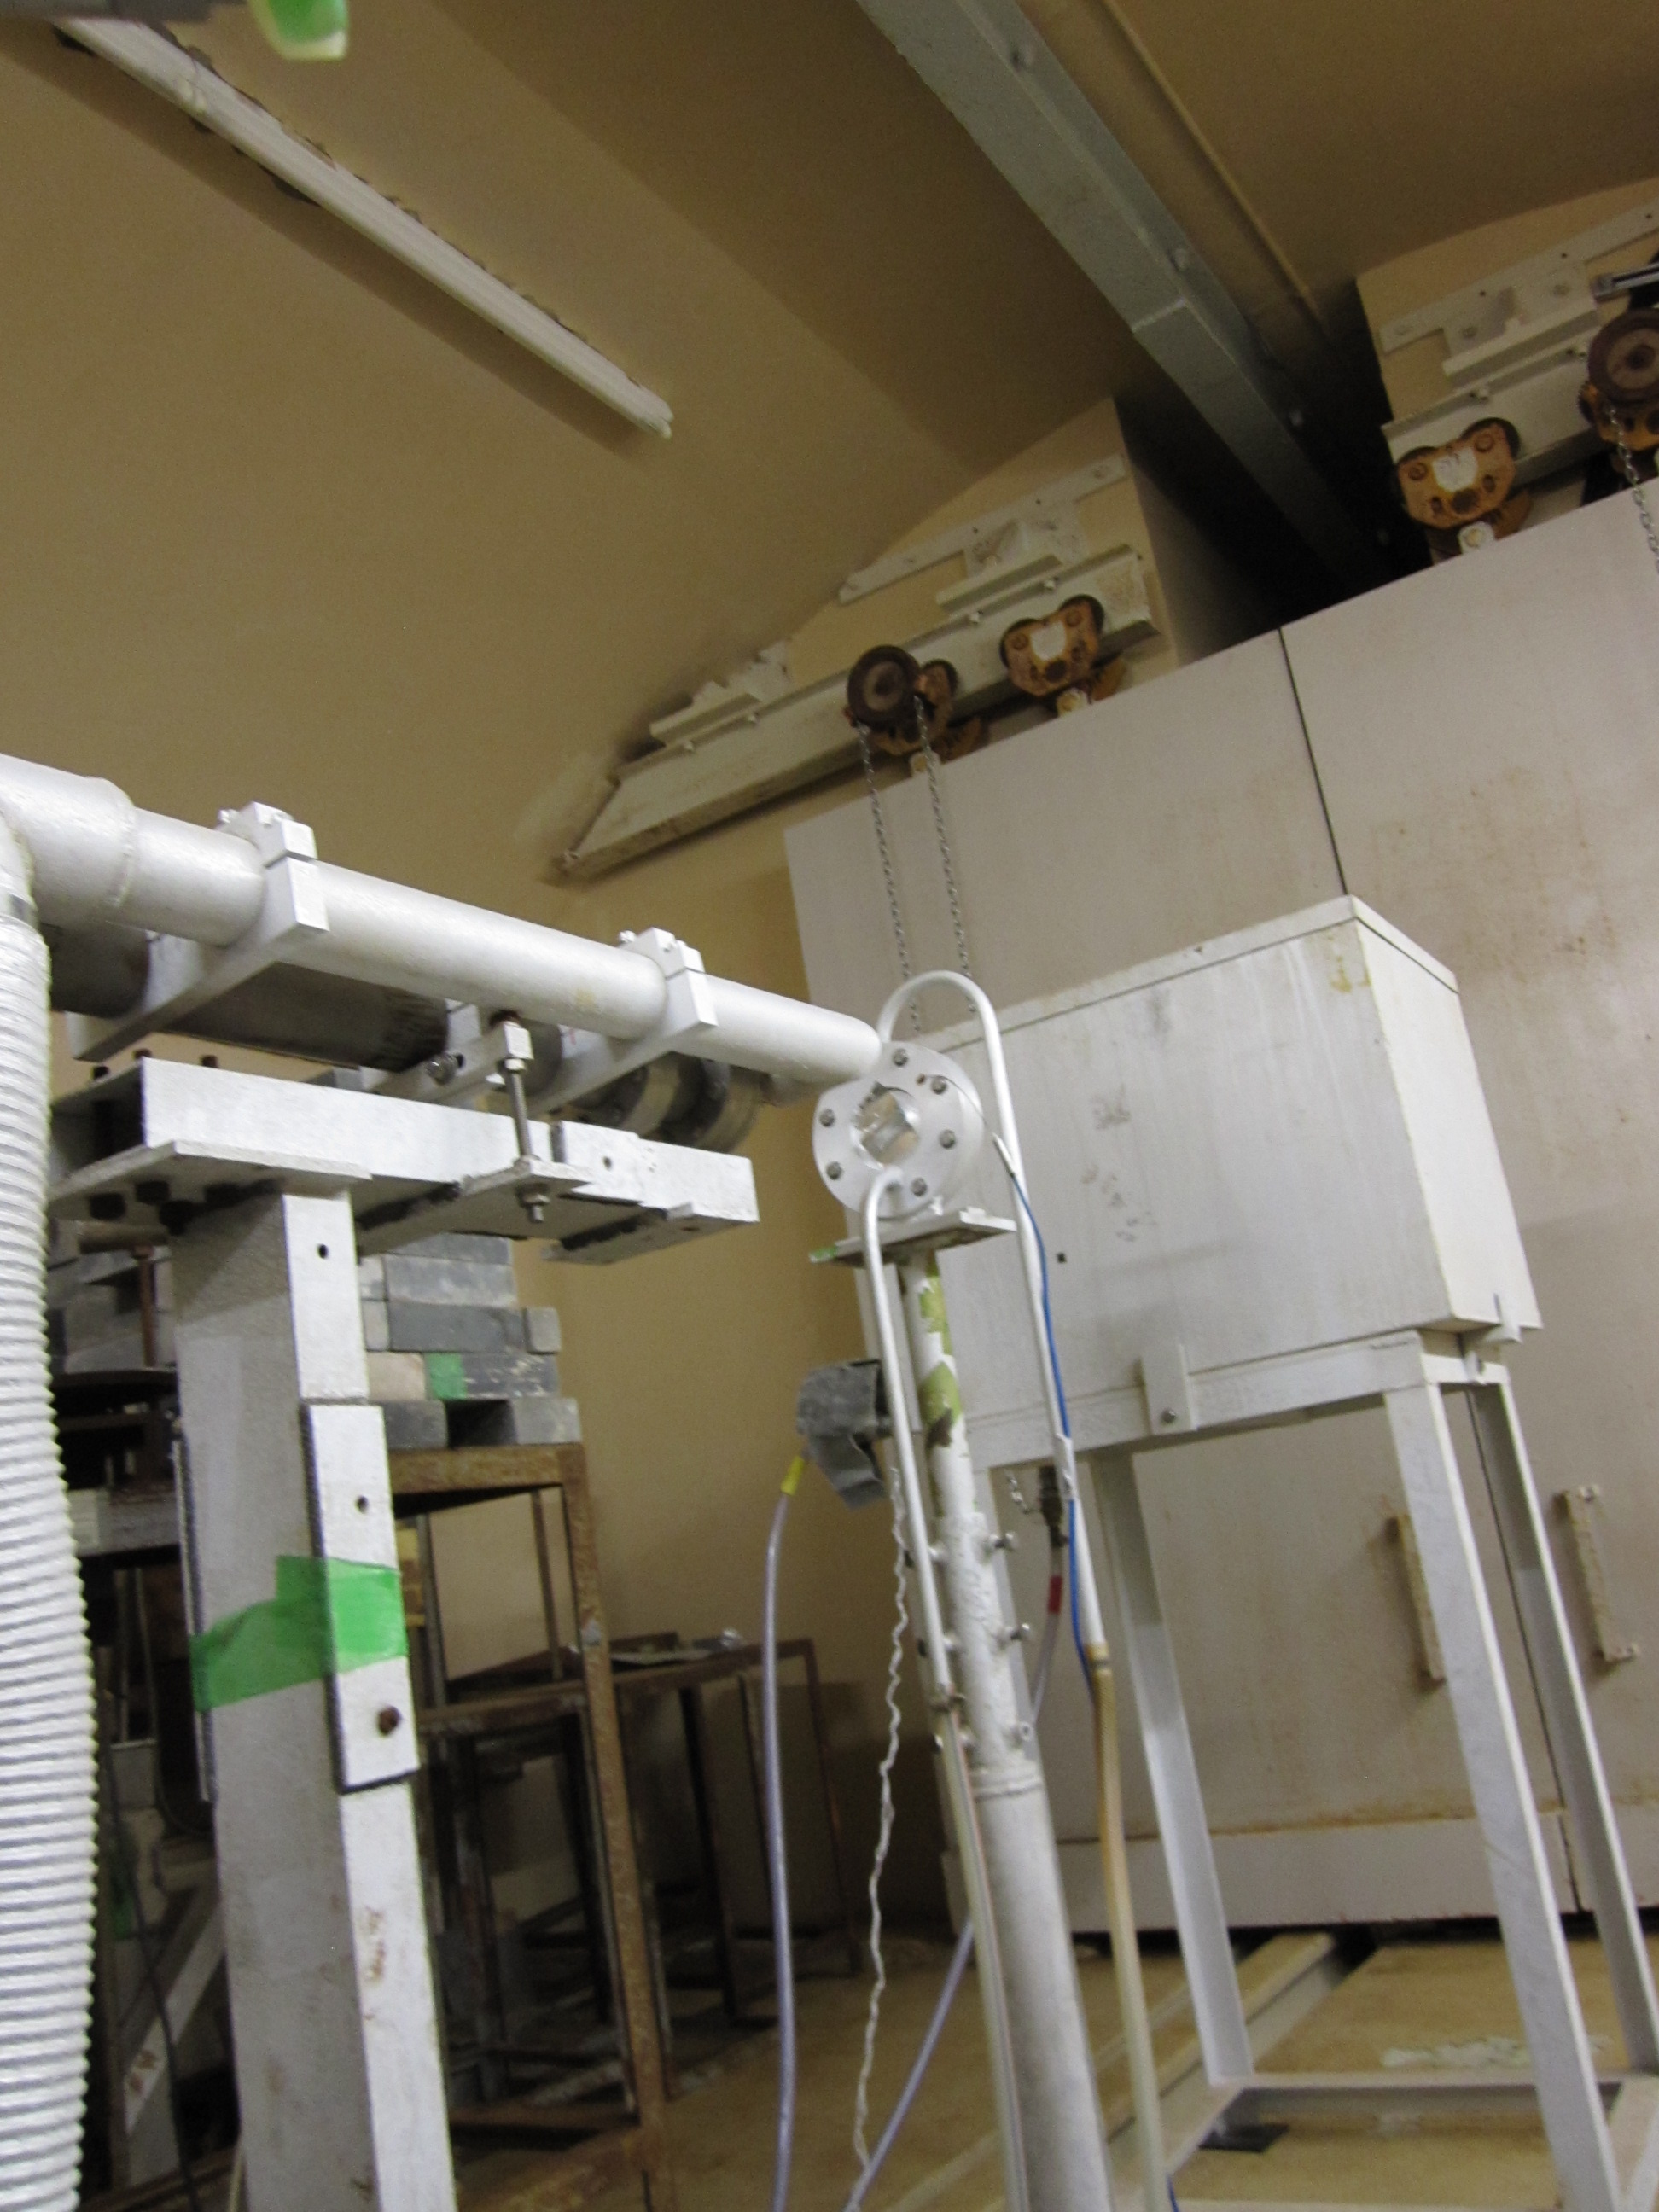
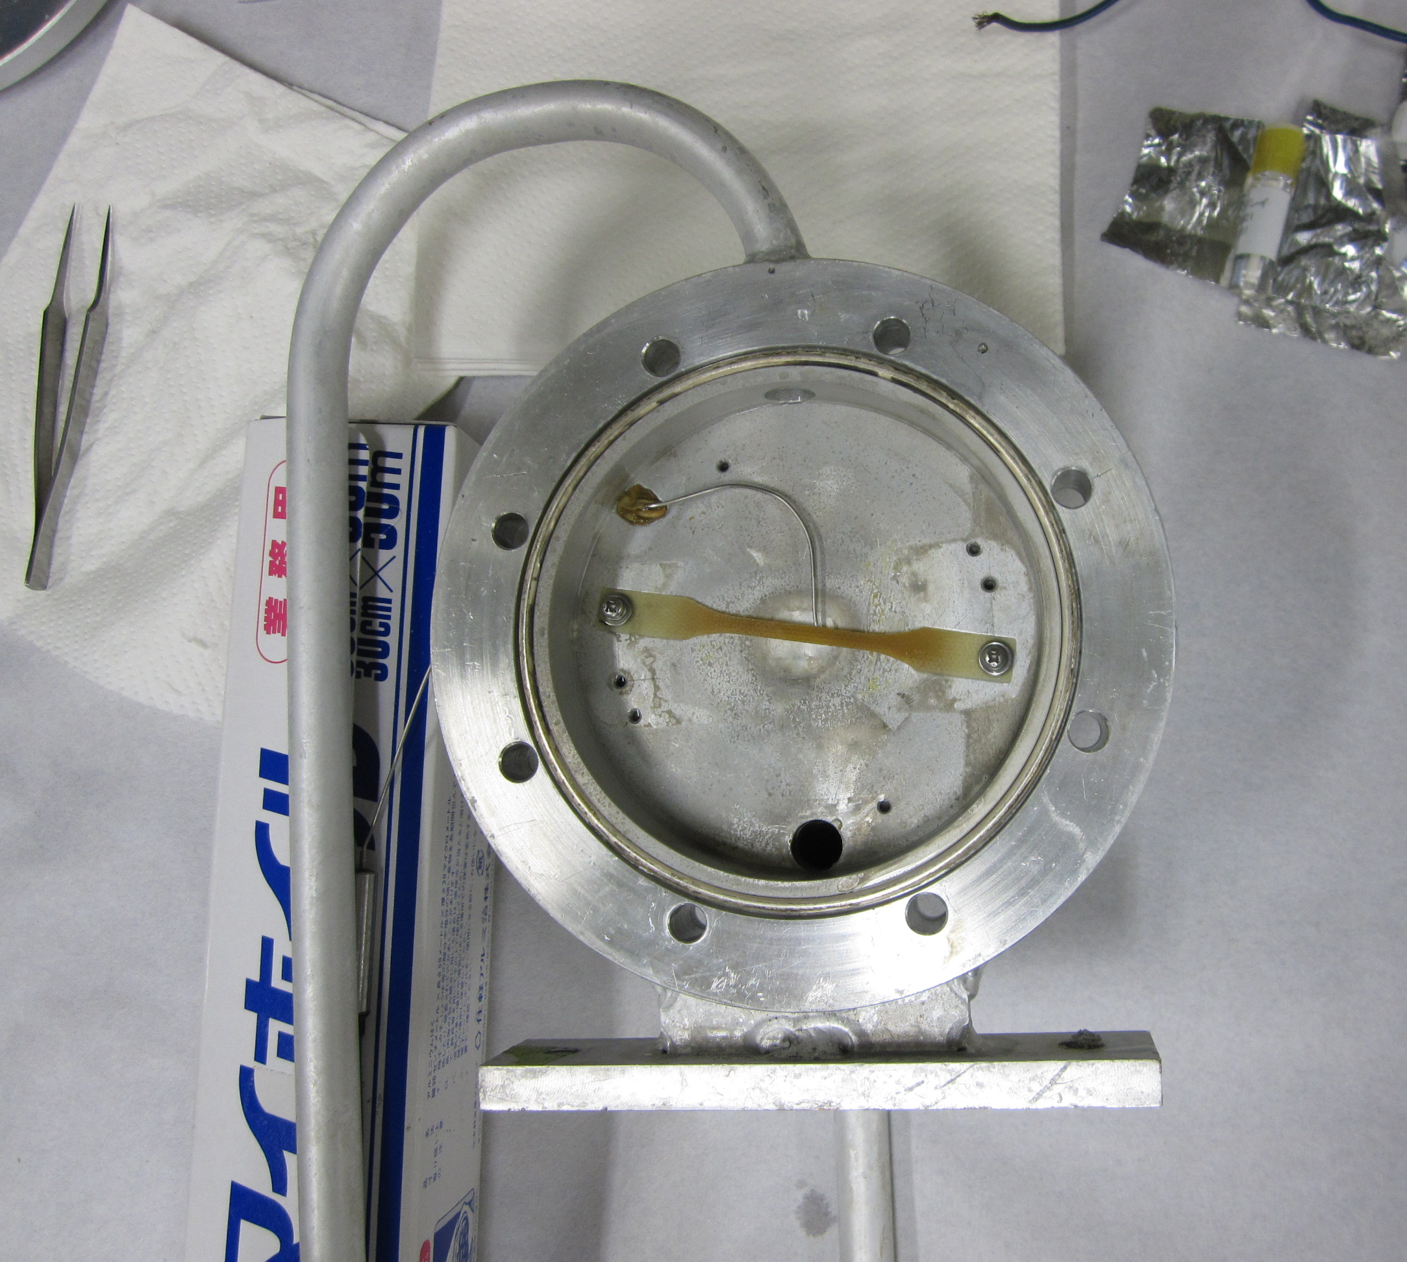
Irradiation Facilities
⁶⁰Co gamma ray source at JAEA Takasaki
  14.9 kGy/h
  Target: 100 MGy (7200hrs)
  RT irradiation started at this Sept.
KUR electron linac: ~30 MeV, 1 μA
  bremsstrahlung, neutron
  Water cooled sample.
  Target: 100 MGy (several hrs)
  Preliminary irradiation in this Sept.
  A series of irradiation tests will be started at next February.
Both facilities are capable of cold (LN₂) irradiation. In consideration…
Gamma ray facility at JAEA Takasaki
Samples
Inside: ⁶⁰Co gamma ray source
Electron Beam Line at KUR

Slide 21
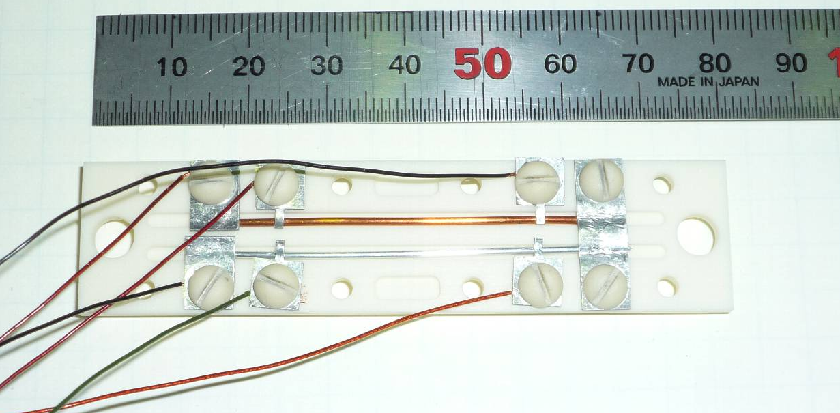
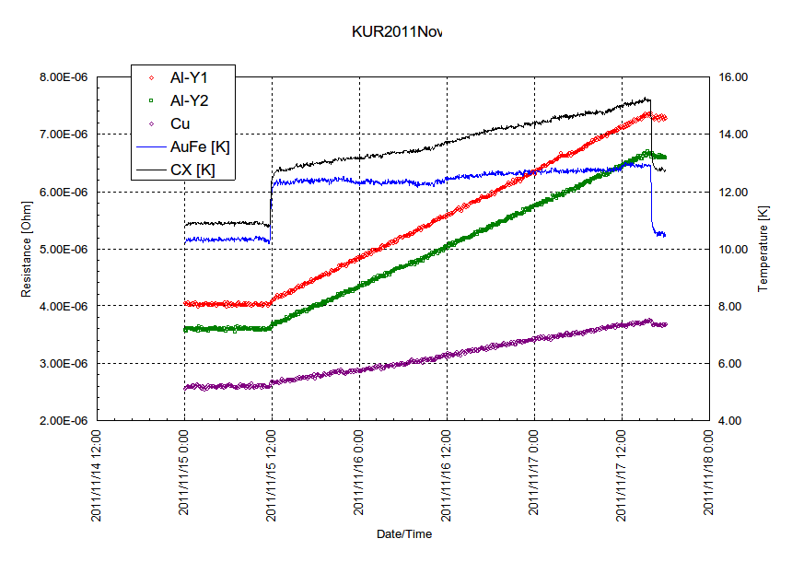
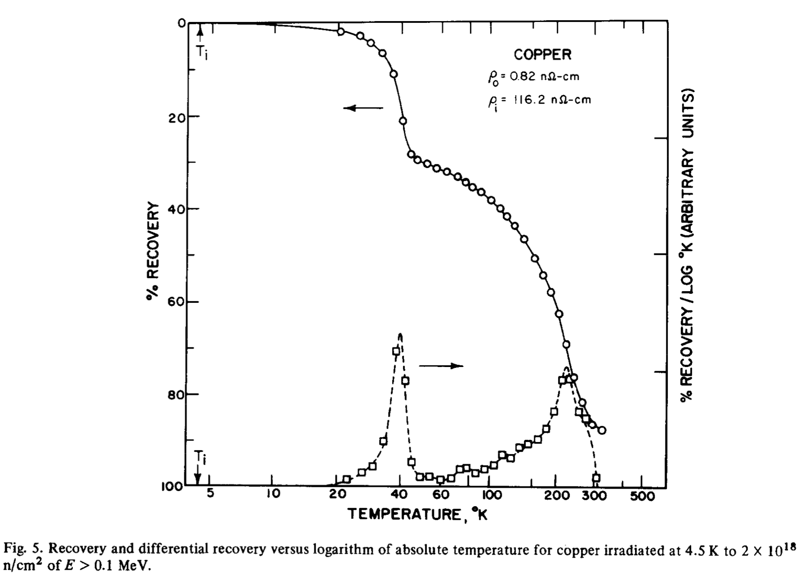
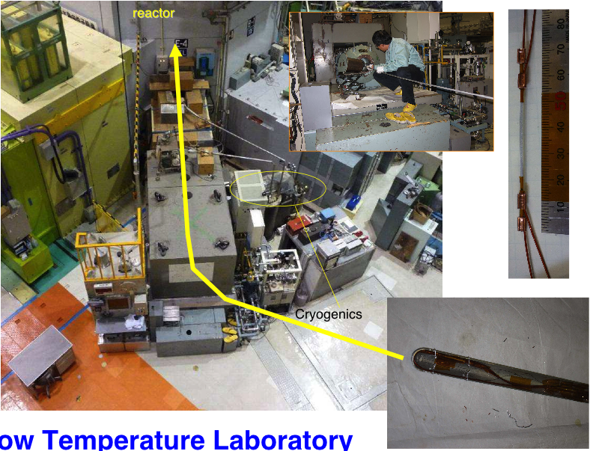
Neutron Irradiation for Copper
Stabilizer (copper) is most sensitive to neutron irradiation. Degradation only appears at low temperature and starts even at or below 10²⁰ n/m².
  >> degrading RRR
  >> compromising quench protection, stability
KUR(Kyoto Univ. Reactor): < 20 K
Collaboration with COMET-Mu2e experiments.
2.6 x10²⁰ n/m²
at 12 K
Copper and 5N-Aluminum samples
2x10²² n/m²
at 4.5 K by Horak

Slide 22
Prompt Report: Recovery by anneal
Nov. 13, 2012
For Copper
Before 1st irradiation: 2.61E-6 Ω @ 13.2K
After 1st irradiation: 2.78E-6 Ω @ 13K >> increased by 0.17E-6 Ω
ΔR by 1st irradiation: 1.07E-6 Ω Increase
Recovery: (1.07-0.17)/1.07= 84%. Need to keep watching.
Al-Y1
Al-Y2
2nd cooling after irradiation
1st cooling before irradiation
Cu
Further multiple irradiation tests at cold planned in next years.

Slide 23
Discussion
Materials | Aluminum |  |  |  |  | Copper
 | Horak | Guinan | Al+CuMg | Al+Y | Al-5N | Horak | Guinan | OFHC 1st | OFHC 2nd
RRR | 2286 | 74 | 450 | 334,361 | ~3000 | 2280 | 172 | 306(10K) | 288(13K)
T_{irr} (K) | 4.5 | 4.2 | 12 | 12 | 15 | 4.5 | 4.2 | 12 | 15
Netutron Source | Reactor | 14 MeV | Reactor | Reactor | Reactor | Reactor | 14 MeV | Reactor
Φ_{tot} (n/m²) (>0.1MeV) | 2 x 10²² | 1-2 x 10²¹ | 2.3 x 10²⁰ | 2.6 x 10²⁰ | 2.6 x 10²⁰ | 2 x 10²² | 1-2 x 10²¹ | 2.6 x 10²⁰ | 2.63 x 10²⁰
Δρ_{irr}/ Φ_{tot} x10⁻³¹(Ωm³) | 1.9 | 4.09 | 2.4 | 2.7 | 2.5 | 0.58 | 2.29 | 0.9 | 1.0
Recovery by thermal cycle | 100% | 100% | 100% | 100% | 100% | 90% | 80% | 84% | TBD in 2013
2011
2012
Degradation rate (Δρ_{irr}/ Φ_{tot} ) seems to be higher in 14 MeV neutron irradiation. Evaluation using a common index such as DPA would be necessary.
Present work shows that difference in RRR of Al doesn't influence the degradation rate.
For copper, degradation rates (Δρ_{irr}/ Φ_{tot} ) are ranged from 0.58 to 2.29 10⁻³¹ Ωm³. What if SC cables with the initial RRR of 200 are irradiated to 10²⁰ or 10²¹ n/m²?
  10²⁰ n/m² : RRR of 160 – 190
  10²¹ n/m² : RRR of 50 – 120 Estimation by DPA would be more fair…
Observation of recovery by thermal cycle and multiple irradiation are carried out for next years.

Slide 24
Feasibility study, Availability Survey for D1
Contract given to TOSHIBA. (Nov. 2012)
Feasibility study and availability survey in market regarding (for example):
  Workability of magnet centered in cryostat, alignment …
  Thicker cryostat for stray field.
  Special steel plate for yoke, stainless steel collar
  (high strength, electromagnetic property)
  Cost increase for subdivided cold mass: 1 or 2
Another contract in preparation for engineering of model magnet.

Slide 25
R&D Items
R&D for beam separation dipole D1
  Conceptual design (Presented by Xu)
  Radiation resistant materials development
  Neutron irradiation of stabilizer at cold
  Feasibility study, availability survey
Fundamental R&D
  Nb₃Al subscale magnet
  Nb₃Sn-Bronze cable development
  RHQ-Nb₃Al
    Stress/strain behavior
    Support to wire development

Slide 26
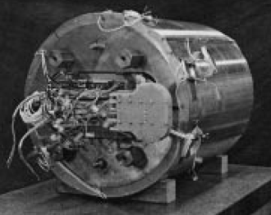
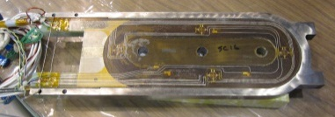
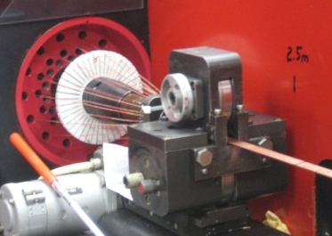
Nb3Al/Nb3Sn Hybrid Sub-scale Magnet
Goals of sub-scale magnet development
1. Performance evaluation of RHQ-Nb₃Al cable with the magnet construction.
2. Feasibility check of Nb₃Al for accelerator application.
3. The acquisition of the fabrication technology (wind & react, shell-based…)
LBNL
Al-shell
2x Nb₃Sn coil
8x keys
Yoke
φ680 mm
Magnet Technology
Y
3x Nb₃Al coil
2x Nb₃Sn coil
Z
X
KEK
- Magnet design
- Fabrication of Nb₃Al coil
- Magnet assembly
- Excitation test
KEK & NIMS & FNAL
Ta
Nb
Strand & Cable development

Slide 27
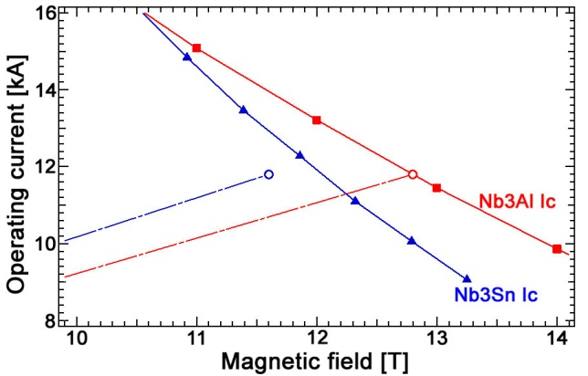
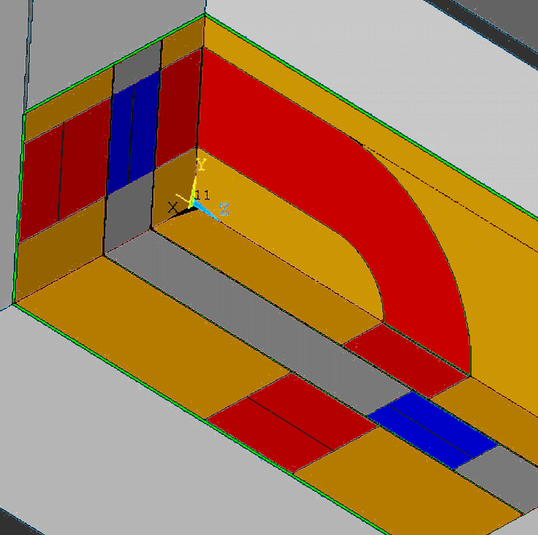
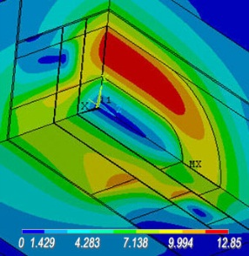


Sub-scale Magnet: Design
Magnetic field design
Mechanical design
Common- coil configuration
Common- coil configuration
Load line
Most of the preload
is intercepted
by hard coil parts
4.2K
Nb₃Al
operating point
Nb₃Sn
operating
point
-
+
Island & horseshoe
(Al-bronze)
Nb₃Al (half)
Field distribution
Nb₃Sn
+
-
Nb₃Al
$$E_{Al−bronze}>E_{coil pack}$$
Main Lorentz force
Pre-stress
Small Gap
This subscale magnet has a very thick Al-shell
12.8 T @ 11.8 kA

Slide 28
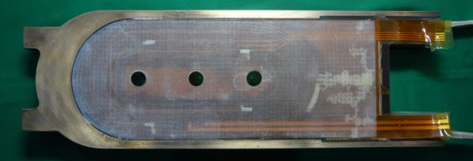
Sub-scale Magnet: Nb₃Al coil fabrication
Parameter | K1 | K3 | K4
Number of stands | 28 | 28 | 28
Cable width | 13.96 mm | 13.93 mm | 13.96 mm
Cable thickness | 1.84 mm | 1.84 mm | 1.84 mm
Cable insulation | CF-100 | TP-14S | CF-100
Coil type | 11 turns, 2 layers | 13 turns, 2 layers | 13 turns, 2 layers
Resin for impregnation | CTD-101K | CTD-101K | CTD-101K
Resistance: cable-horseshoe | >2000 MΩ | >2000 MΩ | >2000 MΩ
Resistance: cable-island | >2000 MΩ | ~20 MΩ | ~5 MΩ
Turn-turn insulation | Contact (3-5 turns) | OK | OK
K3-coil
K3 and K4 coils with 13 turns use for the excitation tests.

Slide 29

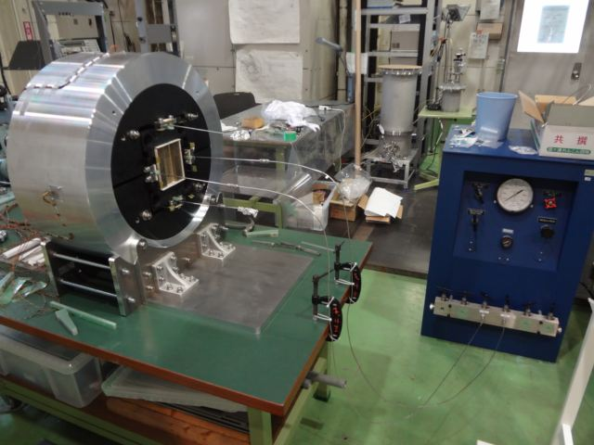
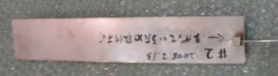
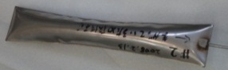
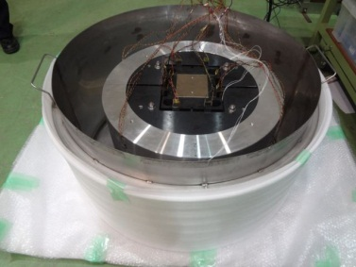
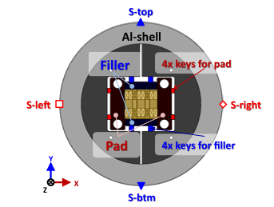
Sub-scale Magnet: Dummy Assembly
Assembling demonstration with dummy coil
Understanding the principle of the Al-shell structure and bladder technique
Performance check of strain monitoring system
Bladder
Pressurized
Setup for bladder operation
The behavior of stress and strain is good agreement with simulation.
Real coil assembling with 2 Nb₃Al and 2 Nb₃Sn coils configuration has been started.
Dummy coil in the LN₂ bath

Slide 30
R&D Items
R&D for beam separation dipole D1
  Conceptual design (Presented by Xu)
  Radiation resistant materials development
  Neutron irradiation of stabilizer at cold
  Feasibility study, availability survey
Fundamental R&D
  Nb₃Al subscale magnet
  Nb₃Sn-Bronze cable development
  RHQ-Nb₃Al
    Stress/strain behavior
    Support to wire development

Slide 31
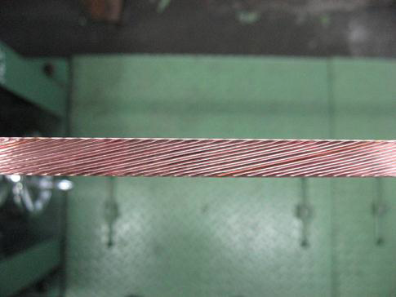
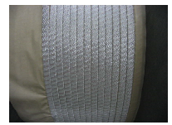
Development of Nb₃Sn Bronze Cable
2 main reasons:
  Backup plan for NbTi based D1 magnet.
  Materials used for lessons to make A15 SC coils.
ITER spec. wire (w/o Cr plating) manufactured and cabled by Hitachi Cable.
  24 strands (φ 0.82mm), t1.56mm, w9.42mm, 440 m
  Insulation by ALF tape (alumina fiber).
To be delivered in Nov. 2012.
But, proactive coil development is not planned in the meantime.

Slide 32
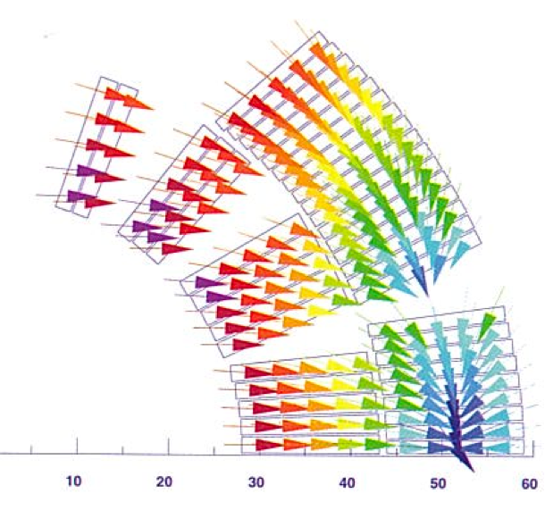
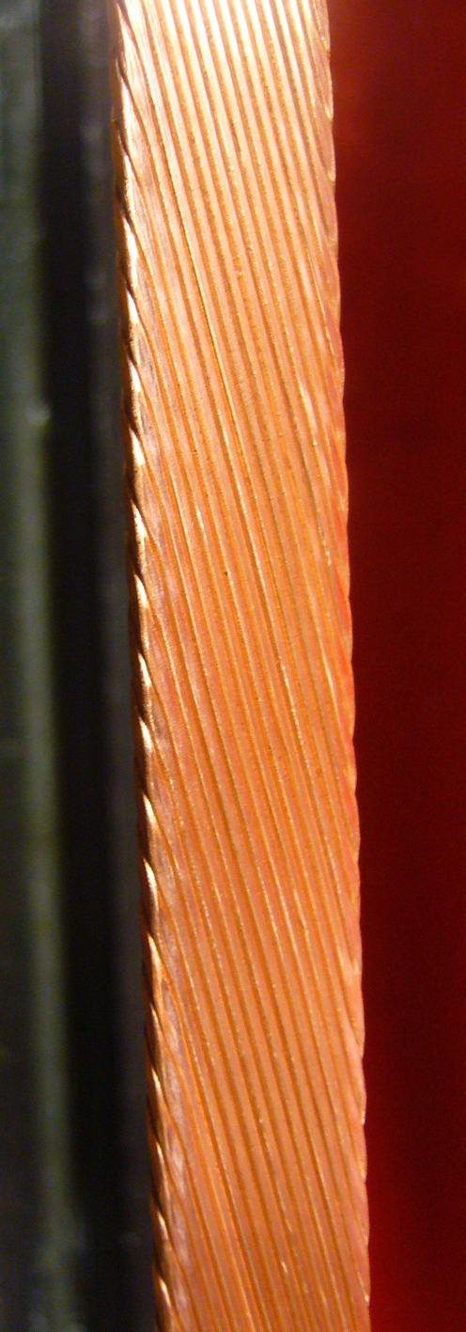
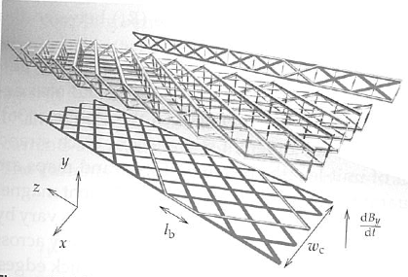

Motivation: Stress/Strain Behavior Study
Intrinsic strain= Residual Strain + Applied Strain
Local strain at cross over of Rutherford-type A15 SC cable in the magnet?
Effect of mechanical reinforcement by resin impregnation?
Target: Nb₃Al. >> then Nb₃Sn and HTS
Neutron diffractometer at J-PARC with 10-stack cable sample under various loads is a nice tooling to study …
Complementary to measurement using SR at ESRF, SPring-8.
Collaboration with C. Scheuerlein (presented at ASC2012).

Slide 33
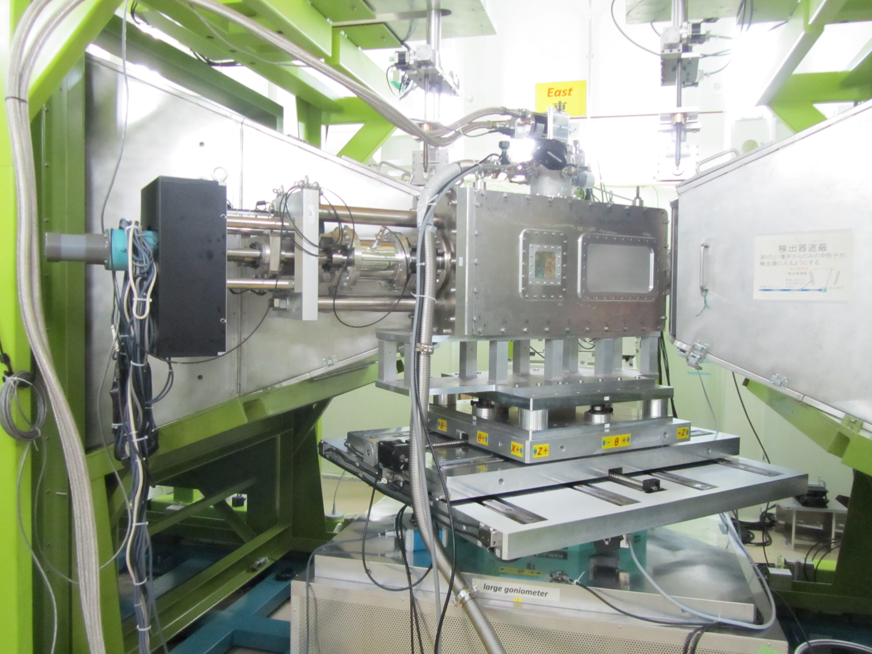
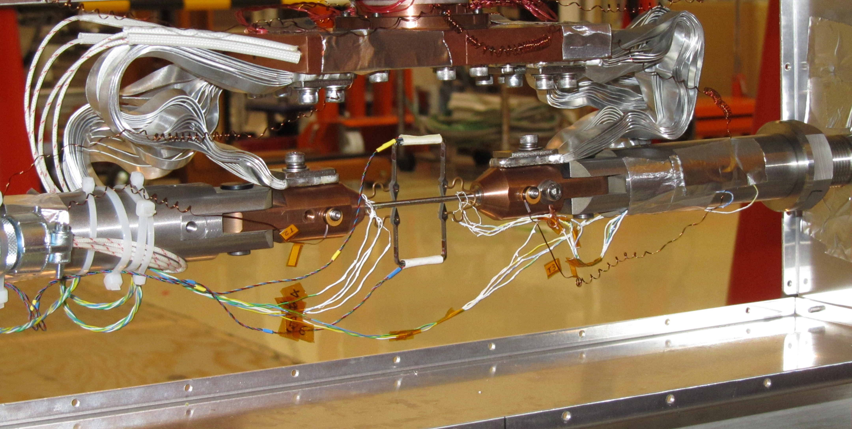
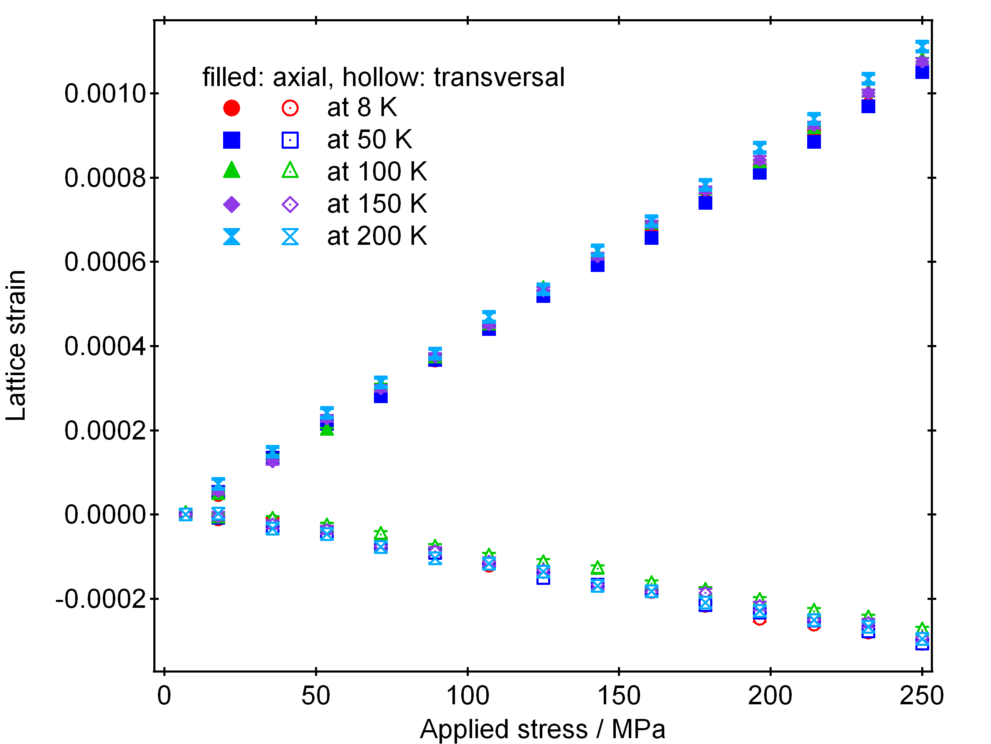
Commissioning of Cryogenic Load-Frame
Resume of neutron beam line after earthquake: March 2012.
First beam commissioning of the load frame at cold w/ SUS304 sample w/ load: June 2012.
1st measurement of Nb₃Al: Oct. 2012 >> failed (wire breaking during cool-down)
2nd measurement plan: Jan. 2013
Beam commissioning of "compresion jig": March 2013.
transversal
axial
For 5 min. at 8 K.
-> Good S/N ratio.

Slide 34
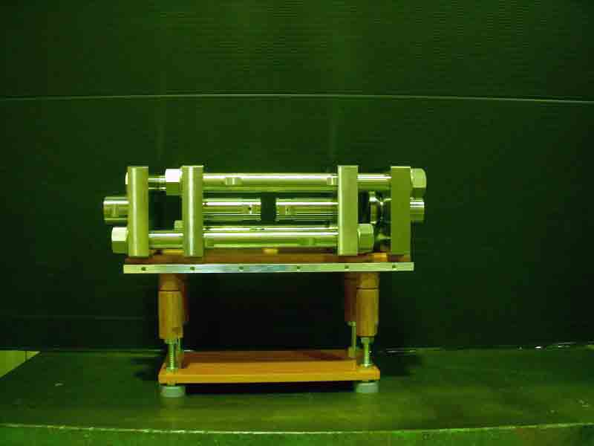
Progress and Plan: Stress/Strain Behavior Study
Study on RHQ-Nb3Al wire: 3 papers published, 1 paper presented at ASC2012, and 1 paper to be submitted to journal.
  Residual strain induced by different types of matrix (all Ta, Ta+Nb, all Nb) observed and discussed. [Supercond. Sci. Technol., 25 (2012) 065016]
  Observation of A15 phase transformation in RHQ-Nb3Al wire by neutron diffraction up to 800 K. [Journal of Alloys and Compounds, 535 (2012) pp124-128]
  Tensile strain dependence of critical current of RHQ-Nb3Al wires and influence by residual strain determined by neutron diffraction measurement discussed. [Cryogenics 2012, in press.]
Experiment plan with J-PARC MLF neutron beam line TAKUMI in next years:
  Fundamental measurements of RHQ-Nb3Al wire under loading at LT and of its powder for stress-free need to be carried out.
  Measurement of 10 stack cable samples up to 200 MPa >> spatial distribution of strains in the cable.
Compression jig for cable stack meas.

Slide 35
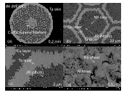
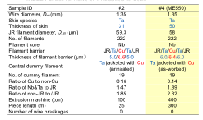



Support: RHQ-Nb3Al w/ Copper Matrix
Pursued by NIMS & HItachi Cable
No wire breaking in 300 m.
A continuous reel-to-reel RHQ process succeeded for a 50-m-piece of Ta/Cu/Ta barrier precursor.
The filament Jc (18 T, 4.2 K) almost the same as that of Ta filament barrier precursor.

Slide 36


Support: RHQ-Nb3Al w/ Tantalum Matrix
Pursued by NIMS, KEK, Fermilab.
Preparing 3 km long Ta matrix wire to make Rutherford cable for mirror Quadrupole magnet.
Original diameter of 1 mm needs to be reduced to 0.7 mm. >> Present feasibility study.
Results with re-drawn K3 wire doesn't show significant degradation of performance.
New Ta matrix wires (φ0.7mm) were fabricated and first cabling is planned in Dec. 2012.

Slide 37
Summary of R&D in 2012
R&D for new D1 magnet for HL-LHC upgrade
  Conceptual design: NbTi, 5.2 T@70%, 7.7m, control of iron saturation, collaring yoke structure.
    To be addressed: 3D modeling, quench protection, analysis of operation at 80% to shorten the length.
    Feasibility studies by a company.
  Radiation resistant materials development (GFRPs, special polyimide coating) and evaluation by irradiation tests.
  Neutron irradiation of copper at cold.
Fundamental R&D also pursued:
  Assembly of Nb3Al sub-scale magnet underway.
  Neutron diffraction measurement resumed and preparing cable stack meas. under compression.
  Continuous supports/efforts for RHQ-Nb3Al wire development.

Slide 38
R&D Proposal and Budget Plan in 2013

Slide 39
Accounting
2012
 |  | Budget |  | Accounting
 |  | 2011 | 2012 | 2012 so far | 2012 prediction
D1 model development | conceptual design | 1.2 FTE Grant | 1.2 FTE Grant | 1.2 FTE Grant | 1.2 FTE Grant
 | engineering by company |  | 11000 | 0 | 3000
 | fellow/CAD engineer/support |  | 7009 | 3789 | 4809
 | hardware (2013-) | - | - | - | -
 | insulated NbTi cable (2013-) | - | - | - | -
 | Cold Test (2013-) | - | - | - | -
 | Travel |  | 1000 | 1100 | 1200
 | sub-total (money transfer from CERN) |  | 19009 | 4889 | 9009
Fundamental R&D | radiation resistant materials | 3000+1000 |  | 4193 | 4200
 | irradiation test (gamma rays, neutron, LN2) | 0 + (4000) |  | - | -
 | stress/strain study for A15, HTS | 1000 + 1000 |  | 3030 | 3030
 | thermal cond. study | 0 + 500 |  | 0 | 0
 | RHQ-Nb3Al Sub-scale magnet | 0 + 7500 |  | 6318 | 7290
 | Nb3Sn Sub-scale magnet | 6000 + 1000 |  | 5880 | 5880
 | RHQ-Nb3Al SC | 0 + 500 |  | 0 | 0
 | Travel | 0 + 1700 |  | 2611 | 2800
25000 | sub-total | 23200 |  | 22032 | 23200
Total |  | 42209 |  | 26921 | 32209
Unit: kJYen
Covered by CERN-KEK budget
To be provided by CERN
Carry over to 2013:
10000 kJYen
Covered by Jap. Grants
*Note: Due to the delay of money transfer of Jap. grant in 2011, it was difficult to handle budget (and accounting) for 2011 and 2012 separately.

Slide 40
R&D Proposal (1/2)
R&D baseline items will be continued.
  R&D for beam separation dipole D1
    Conceptual design
    Radiation resistant materials development
    Neutron irradiation of stabilizer at cold
  Fundamental R&D
    Subscale magnet development: Nb₃Al, Nb₃Sn
    RHQ-Nb₃Al
      Stress/strain behavior
      Support to wire development
Covered by CERN-KEK budget
Covered by Jap. Grants

Slide 41
R&D Proposal (2/2)
Start of engineering for 1.5-2 m long model in 2013.
*Assuming production of 5 sets of cold mass with cryostat + spare coils after 2015
**Work by a company under supervision of KEK.
  Engineering design
  Preparatory Study for Cryostat
  Practice coil, Mechanical short model.
    (Budget NOT approved yet.)
Covered by CERN-KEK budget
Budget request to DG. Or sliced from other budget.

Slide 42



Development Plans
  Target: "Build and test a 2-m model magnet by 2015"
  Full funding is NOT approved yet.
  NbTi SC cable (LHC MB outer). Some options for insulation.
  Upilex + CE prepreg, Apical (MB), Apical (MQXC)
  Choice made by heat load, workability
  Collaring yoke structure (RHIC, MQXA,J-PARC SCFM)
  Reuse of tooling, jigs, and facilities for SCFM
  Yoke OD < 550 mm (LHC MB)
  Cooperation with industry
JFY2012 Conceptual design.
JFY2013 Engineering design.
Practice winding. Mechanical short model.
JFY2014 Coil winding. Magnet Assembly.
Testing at cold.
JFY2015 TDR

Slide 43
Grants, Human Resources
"Strategic Young Researcher Overseas Visit Program for Accelerating Brain Circulation" (Prof. K. Tokushuku, KEK) for JFY 2010-2012 will end March 2013.
  Covering travel expenses to/at CERN for Q. Xu as well as relevant supervisors (A. Yamamoto, T. Nakamoto, others) so far.
  Replaced by CERN-KEK budget or other KEK budget.
The KAKENHI grant related to the LHC experiment until 2016 still continues.
  Resource for magnet R&D other than D1 model development. ~10 MJYen per year will be provided until JFY2015 (totally 50 MJYen for 5 years).
Dr. M. Iio who was a fellow employed by CERN-KEK budget became an assistant professor in Nov. 2012. He will be mainly engaged in the new D1 magnet development (in particular cryostat related matters).
Dr. X. Jin, a post-doc fellow working for study on stress/strain behavior of Nb₃Al conductor will leave KEK in March 2013.

Slide 44
2013 R&D Plan and Budget Proposal
Unit: kJYen
 |  | 2011 | 2012 | 2013 | 2014 | 2015 | item total
D1 model development | conceptual design/R&D | 1.2 FTE Grant | 1.2 FTE Grant | 1.6 FTE Grant | 1.8 FTE | 1.8 FTE | 7.6 FTE
 | engineering by company |  | 3000 | 20000 | 10000 | 9000 | 42000
 | fellow/CAD engineer/support |  | 4809 | 7000 | 7000 | 7000 | 25809
 | Components, Construction of model magnet | - |  | 73800 | 55600 | 13000 | 142400
 | insulated NbTi cable |  |  |  |  |  | (5000)
 | Cold Test |  |  | 5000 | 10000 | 5000 | 20000
 | Travel |  | 1200 | 1000 | 1000 | 1000 | 4200
 | sub-total (money transfer from CERN) |  | 9009 | 10000* 18000 | 18000 | 17000 | 72009
Fundamental R&D | radiation resistant materials | 3000+1000 |  | 1000 | 2000 | 2000 | 9000
 | irradiation test (gamma rays, neutron, LN2) | - |  | 4000 | 4000 | 0 | 8000
 | stress/strain study for A15, HTS | 1000 + 1000 |  | 1500 | 1500 | 1000 | 6000
 | thermal cond. study | 0 + 500 |  | 500 | 500 | 500 | 2000
 | RHQ-Nb3Al Sub-scale magnet | 0 + 7500 |  | 4000 | 500 | 500 | 12500
 | Nb3Sn Sub-scale magnet | 6000 + 1000 |  | 2000 | 1500 | 1000 | 11500
 | RHQ-Nb3Al SC | 0 + 500 |  | 4000 | 0 | 0 | 4500
 | Travel | 0 + 1700 |  | 1000 | 1000 | 1000 | 4700
 | sub-total | 23200 |  | 14000 | 7000 | 6000 | 50200
Total | Approved | 32209 |  | 42000 | 25000 | 23000 | 122209
 | Not approved | - |  | 82800 | 69600 | 18000 | 170400
Budget not approved!!
To be requested to KEK DG or sliced from other KEK budget.
KEK internal budget(Nov. –Dec.)
11000
(ATLAS)
10000
(KEK DG)
To be provided by CERN
*Carry over
10000 kJYen
Covered by CERN-KEK budget
Covered by Jap. grants.

Slide 45
2013 "Plan B"
Unit: kJYen
 |  | 2011 | 2012 | 2013 | 2014 |  | 2015 |  | item total
D1 model development | conceptual design/R&D | 1.2 FTE Grant | 1.2 FTE Grant | 1.6 FTE Grant | 1.8 FTE |  | 1.8 FTE |  | 7.6 FTE
 | engineering by company |  | 3000 | 20000 | 10000 |  | 9000 |  | 23000 | 19000
 | fellow/CAD engineer/support |  | 4809 | 7000 | 1000 | 6000 | 1000 | 6000 | 13809 | 12000
 | Components, Construction of model magnet | - |  | 31000 | 98400 |  | 13000 |  | 31000 | 111400
 | insulated NbTi cable |  |  |  |  |  |  |  | (5000)
 | Cold Test |  |  | 0 | 15000 |  | 5000 |  | 20000
 | Travel |  | 1200 | 1000 | 1000 |  | 1000 |  | 4200
 | sub-total (money transfer from CERN) |  | 9009 | 10000* 49000 | 2000 |  | 2000 |  | 72009
Fundamental R&D | radiation resistant materials | 3000+1000 |  | 1000 | 2000 |  | 2000 |  | 9000
 | irradiation test (gamma rays, neutron, LN2) | - |  | 0 | 8000 |  | 0 |  | 8000
 | stress/strain study for A15, HTS | 1000 + 1000 |  | 1500 | 1500 |  | 1000 |  | 6000
 | thermal cond. study | 0 + 500 |  | 500 | 500 |  | 500 |  | 2000
 | RHQ-Nb3Al Sub-scale magnet | 0 + 7500 |  | 4000 | 500 |  | 500 |  | 12500
 | Nb3Sn Sub-scale magnet | 6000 + 1000 |  | 2000 | 1500 |  | 1000 |  | 11500
 | RHQ-Nb3Al SC | 0 + 500 |  | 4000 | 0 |  | 0 |  | 4500
 | Travel | 0 + 1700 |  | 1000 | 1000 |  | 1000 |  | 4700
 | sub-total | 23200 |  | 14000 | 7000 |  | 6000 |  | 50200
Total | Approved | 32209 |  | 73000 | 9000 |  | 8000 |  | 122209
 | Not approved | - |  | 0 | 137400 |  | 33000 |  | 170400
*Carry over
10000 kJYen
If the main part of KEK funding is unclear until June 2013, most of the remaining CERN-KEK budget should be transferred to keep the model magnet construction schedule.
11000
(ATLAS)
10000
(KEK DG)
To be provided by CERN
Covered by CERN-KEK budget
Covered by Jap. grants.

Slide 46
Summary
Several lines of magnet R&D have been pursued under the framework of CERN-KEK collaboration.
  In particular, conceptual design of the new beam separation dipole D1 for the HL-LHC upgrade has shown remarkable progress in JFY2012.
In JFY2013, engineering design study of the new D1 should be started and followed by construction of the 2-m long model magnet.
  A new funding in KEK will be necessary in JFY2013 to deliver the test results of the model magnet by 2015.
  Endorsement of this committee is asked so that the money transfer of remaining CERN-KEK budget can be made in case the funding approval is unclear until June 2013: "Plan B"

Slide 47

Proposal at the last review (2011) for reference.

