Slide 1




DDS design status
Task 9.2-Sub-task 2
Alessandro D’Elia on behalf of Roger M. Jones

Slide 2
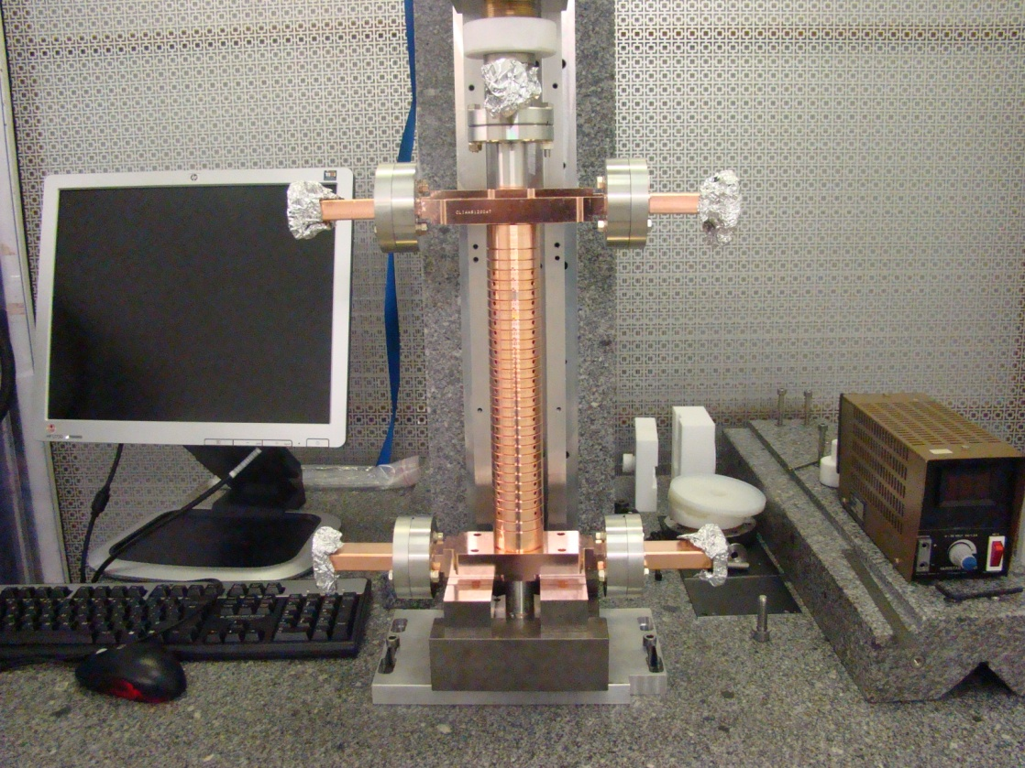
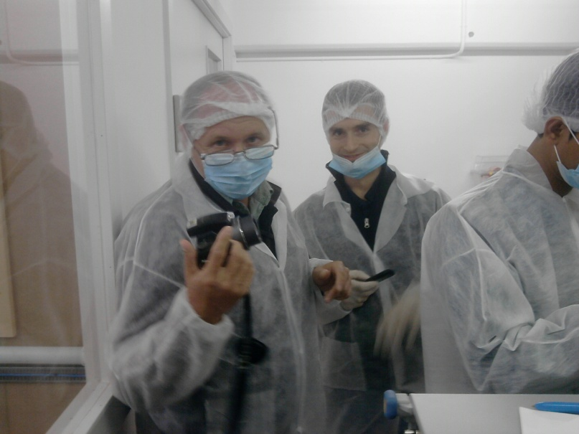
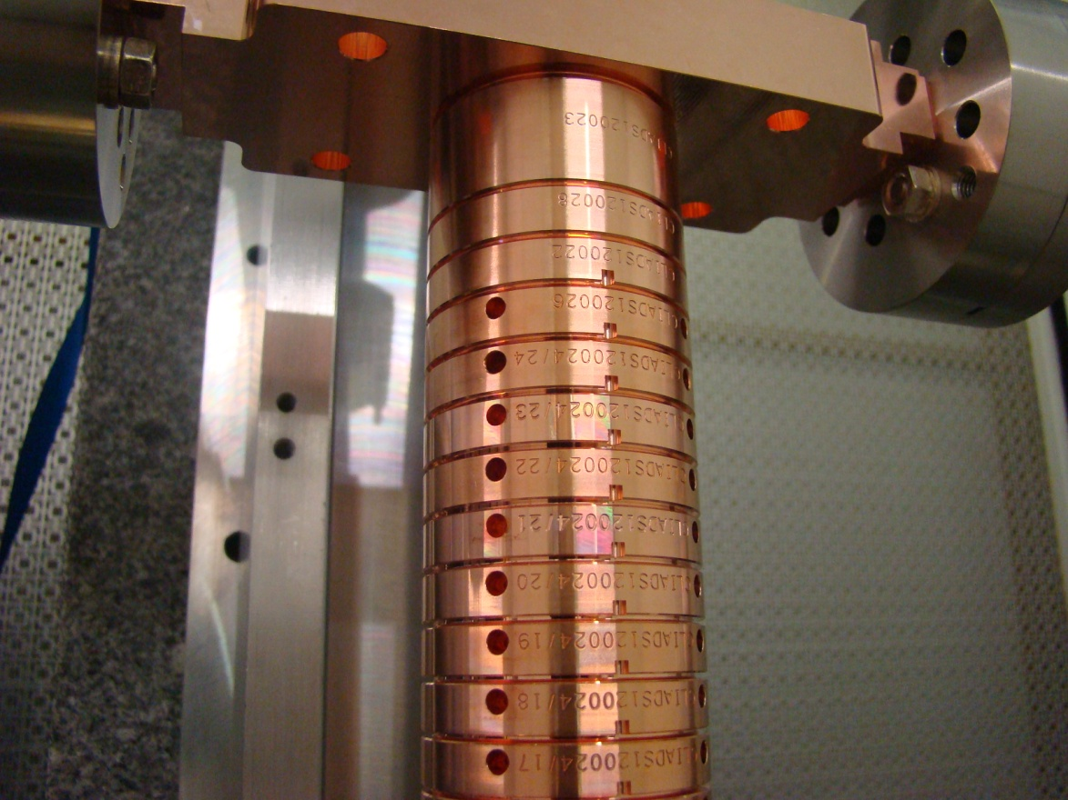
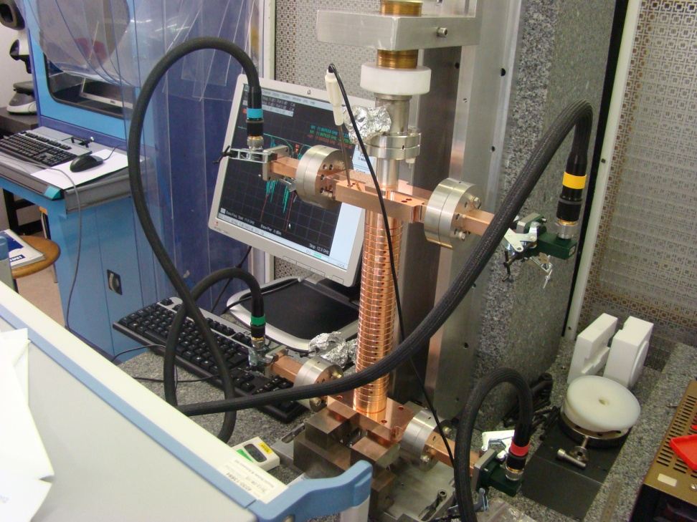
CLIC_DDS_A First Prototype before bonding
Thanks to Rolf, Vasim and Andrey!!!
October 2012
Thanks to the whole CLIC RF Structure Development Group!!!

Slide 3
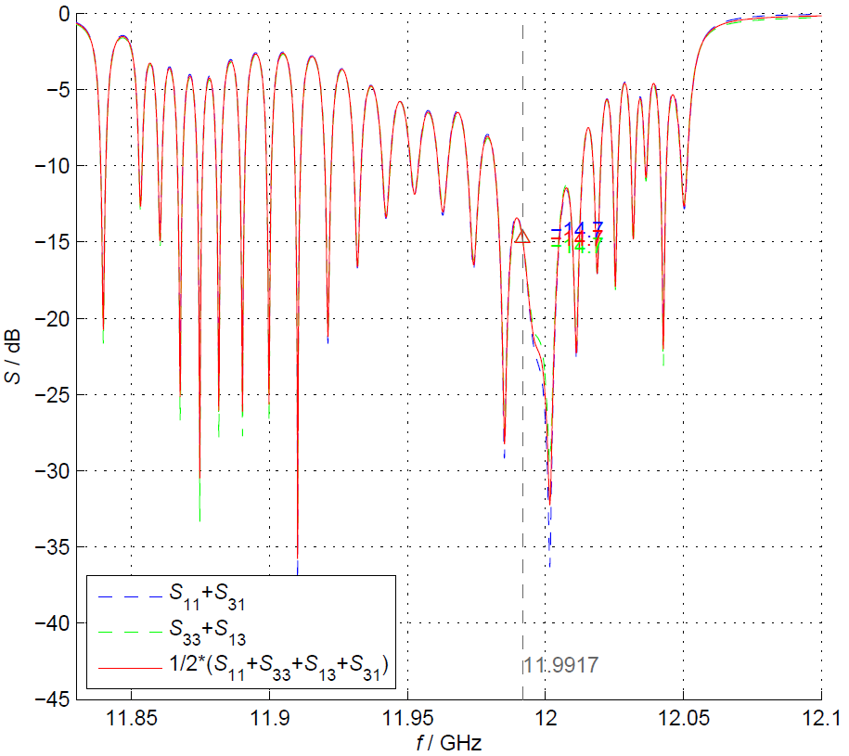
CLIC_DDS_A RF Check before bonding
https://edms.cern.ch/document/1243888/1
From these measurements it seems that we are ~ 10MHz off (higher). Not really consistent with the RF check of the single cells done last year. Anyway we are in the tuning range➔OK from the RF point of view
October 2012

Slide 4
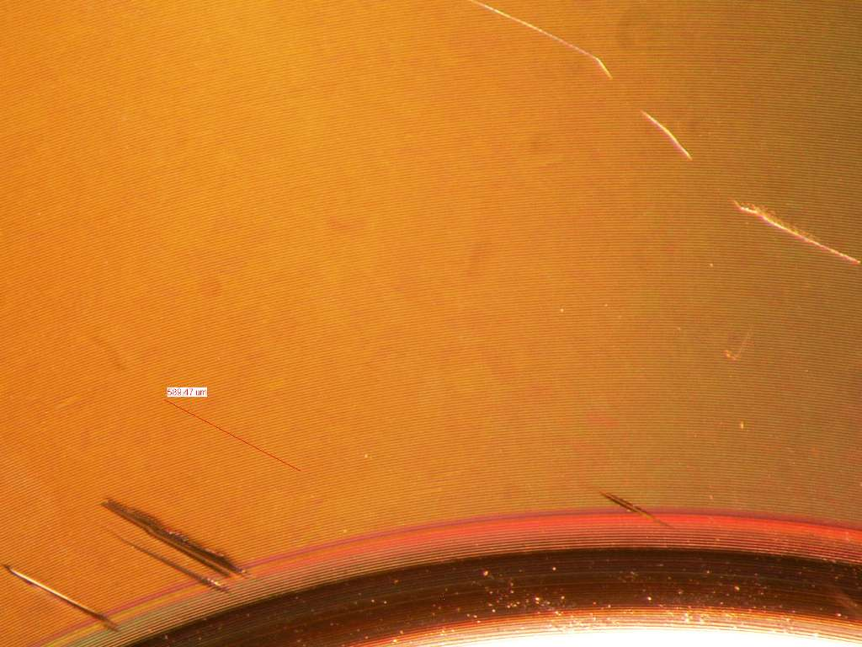

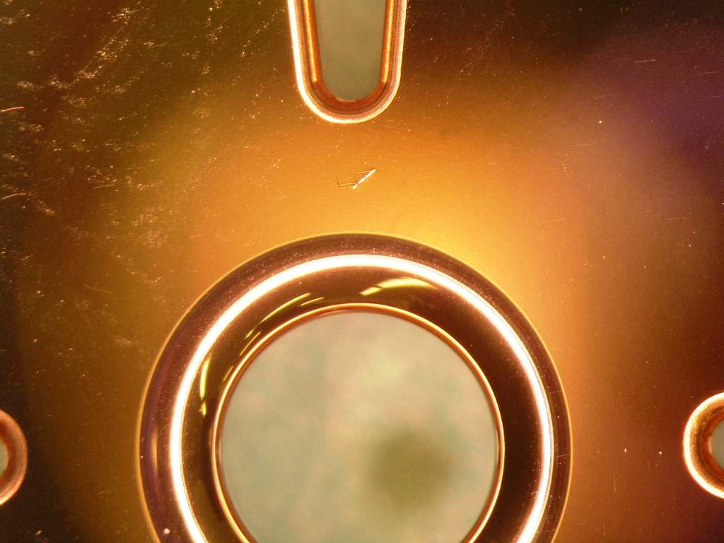
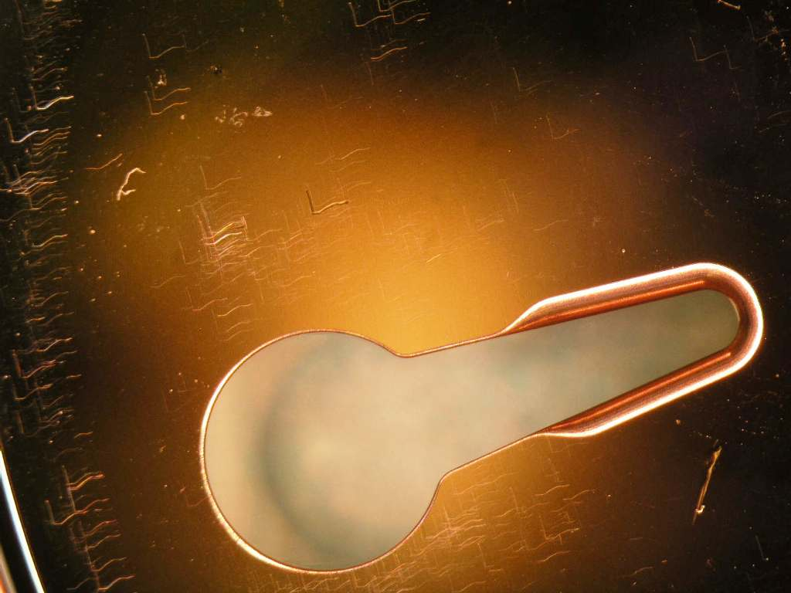
CLIC_DDS_A Inlet inspection
Disk 10a
Disk 22a
October 2012
Mag=32
Disk 24 a Mag=7
Mag=7
Disk inspection showed some marks/scratches on the disks. In particular, we decided, as suggested by Toshi, to re-machine disks N10, N22 and N24.
Courtesy of Andrey

Slide 5
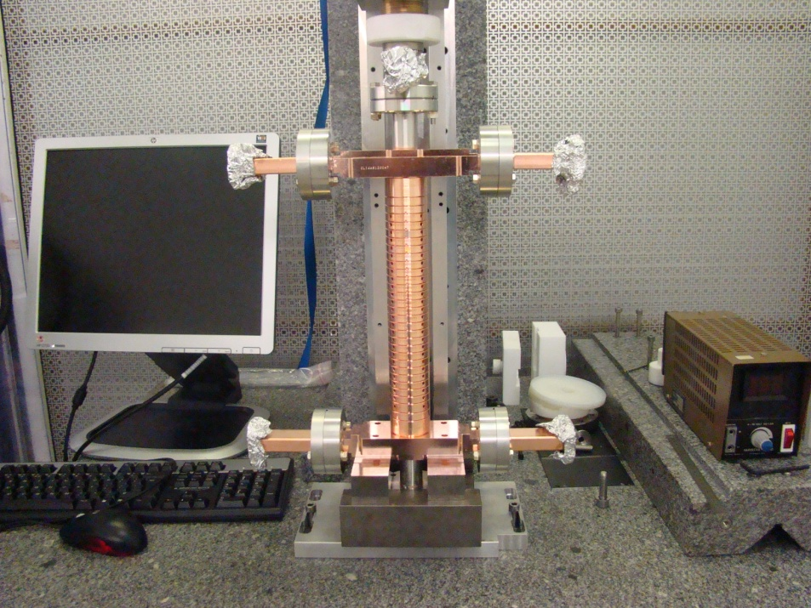
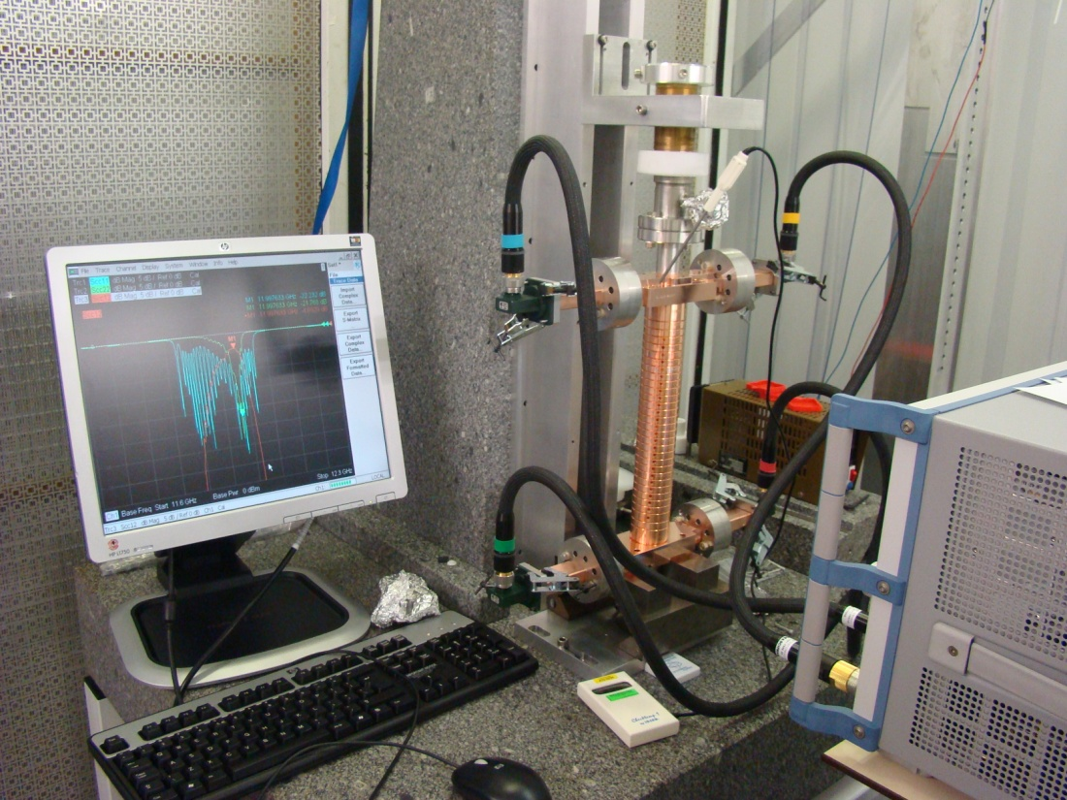
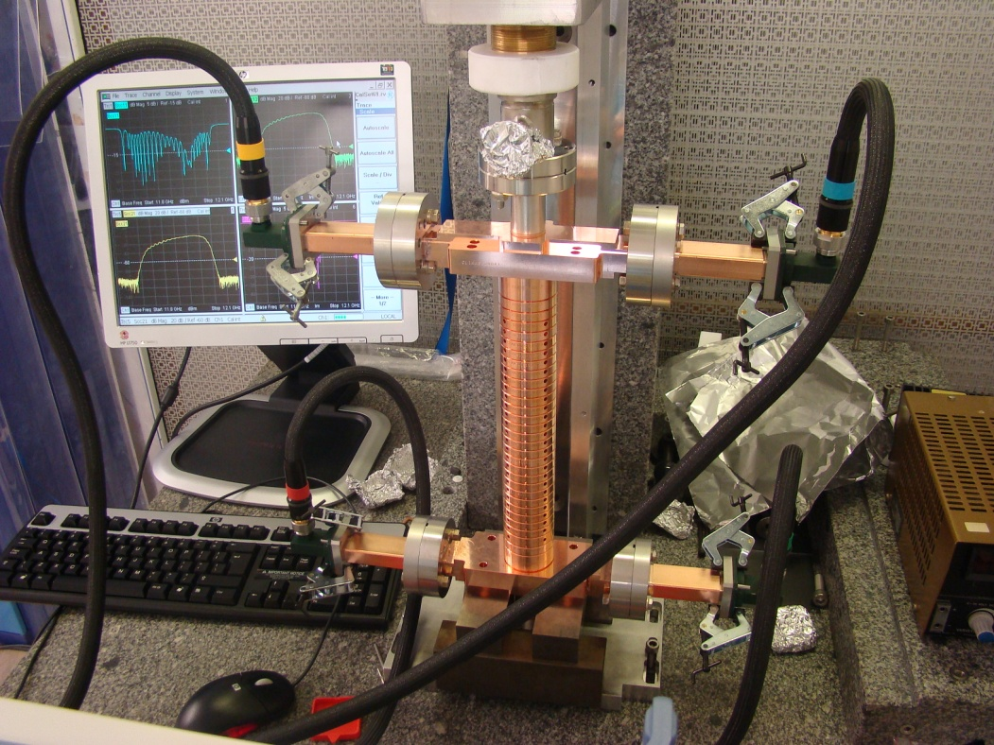

New RF Check before bonding
November 2012

Slide 6
https://edms.cern.ch/document/1252807/1
This peak was hidden in the old measurements
Comparison of old (2/10/2012) and new (13/11/2012) measurements

Slide 7
https://edms.cern.ch/document/1252807/1
~5MHz off

Slide 8
Comments and Status of CLIC_DDS_A
The actual 2π/3 peak was hidden in the previous measurement
The actual peak is only ~5MHz off from the target frequency (11.9918GHz in Air, 22.9°C, humidity 50%)
The actual frequency is now pretty consistent with single cell measurements done last year (<2MHz off with respect to HFSS simulations)
We are fully within the tuning range of 20MHz
Disks will be cleaned (etching) until 14/12/2012
CW2 2013 – the bonding of the disk stack

Slide 9
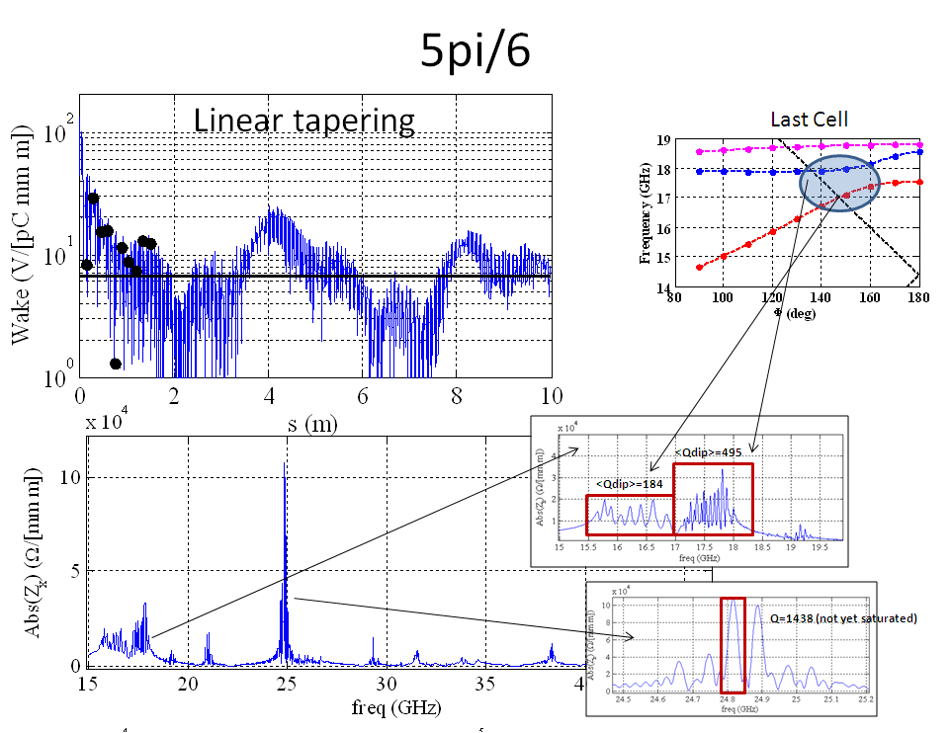
Other studies
We explored structures with phase advance different than 120°. In particular higher phases should result in a reduction of the kicks because of the larger iris apertures. What we have learnt is that for first dipole band this is surely valid but for higher bands (in particular band from 5th to 7th) we experience an enhancement of the kicks.
From Last Meeting

Slide 10
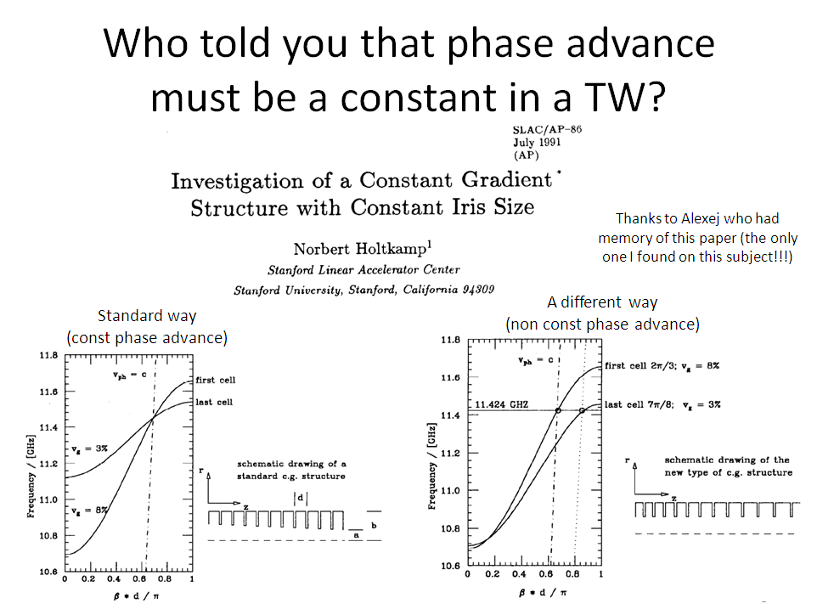
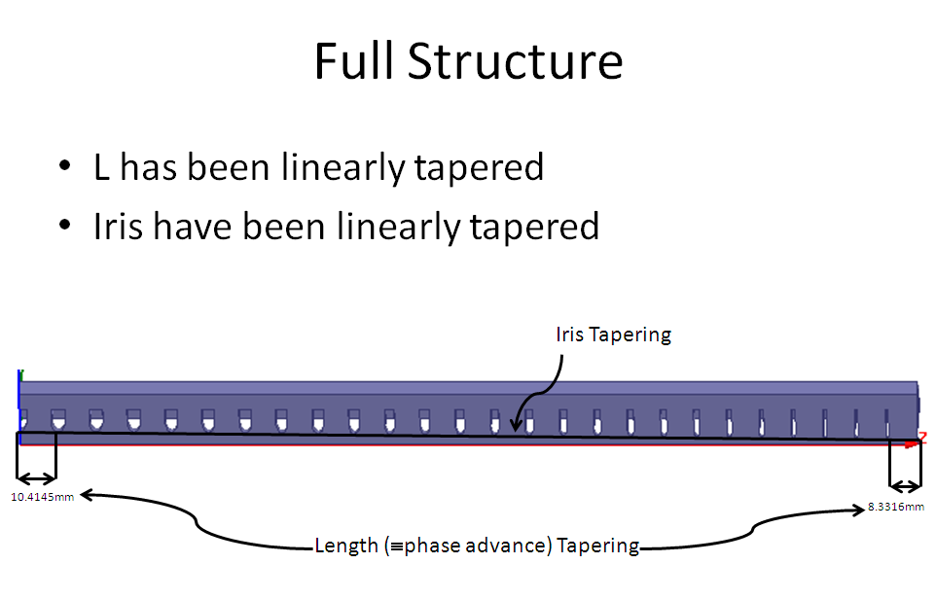
Thanks to Igor for the idea
150°
120°

Slide 11
Conclusions
CLIC_DDS_A first prototype is almost ready to be tuned (bonding is foreseen for the 2nd week of January) and then RF tested in power
The results of these tests will lead the further steps on DDS activity for CLIC
Nevertheless studies on an improved DDS design are still continuing

