Slide 1




Uppsala Progress Report
10/12/2012
Tomoko Muranaka

Slide 2
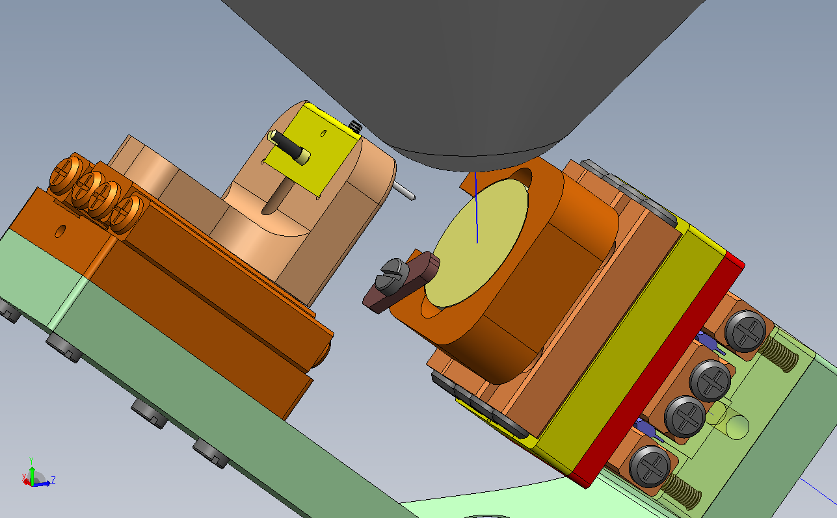
3D piezo positioner installation
Purpose:
  2D scan with controlled gap distance at targeted spot.
  Measurement and observations in one instrument.
  Compact & transportable experimental setup.
Schematic drawing of the new setup

Slide 3
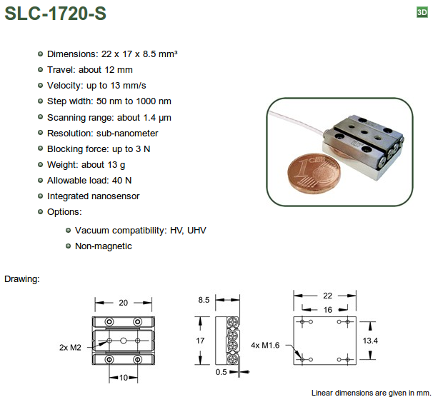
SmarAct Piezo positionner http://www.smaract.de/

Slide 4
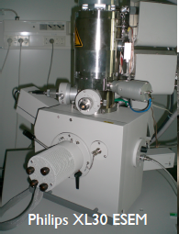
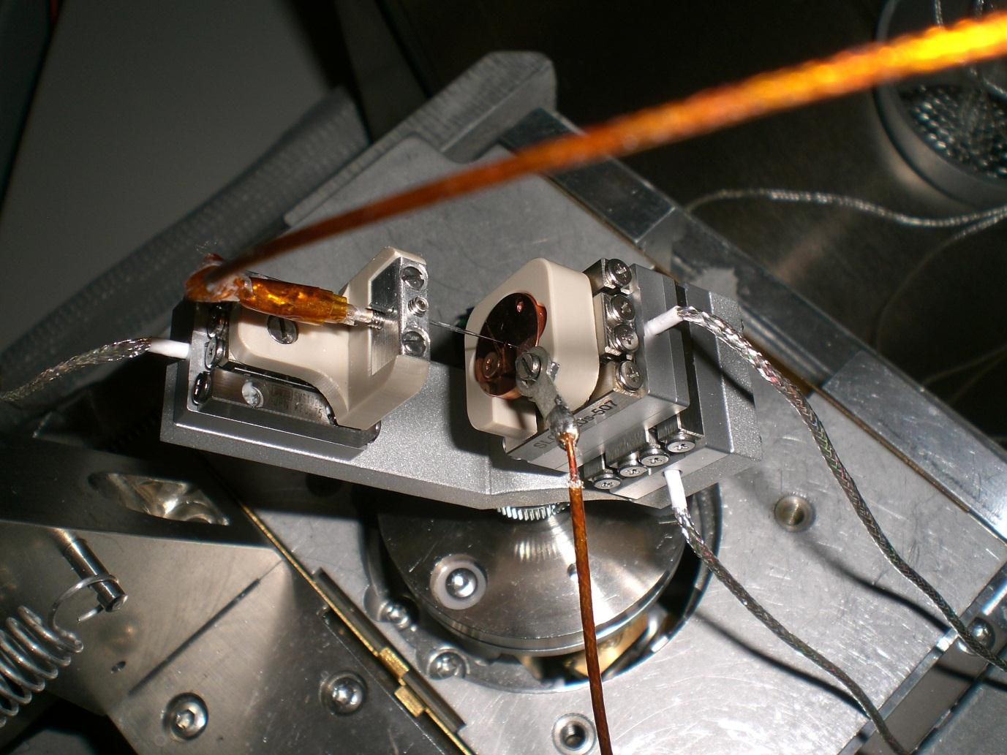
Experiment
W tip
Cu sample
Piezo Z-stage
Piezo XY-stage
Built-in SEM sample stage

Slide 5
Parallelism check
The parallelism was checked by positioning the anode tip at several sites on a sample. By comparing the anode injection required to be a certain gap, one could calculate the slope of the cathode sample with respect to the injection axis (Z direction).
Position | X [um] | Y [um] | Z [um]
1 | 6000.0 | -4000.0 | 1934.0
2 | -2000.0 | -4000.0 | 2003.0
3 | -2000.0 | 0.0 | 2021.0
4 | 6000.0 | 0.0 | 1951.7
5 | 6000.0 | 2000.0 | 1959.7
3
2
1
4
Position | X [um] | Y [um] | Z [um]
1 | 0.0 | 1000.0 | 831.3
2 | 5000.0 | 1000.0 | 792.2
3 | 5000.0 | -3000.0 | 764.7
4 | -2000.0 | 1000.0 | 847.2
1
2
4
3
5
Hysteresis check
Hysteresis of the positioners X and Y have been checked by traveling 1.5mm. Since there are sensors installed to each positioners, coming back to the reference position was well done. However, due to the beam shift of the SEM, the accuracy couldn't be determined. Next time one has to put the tip in the SEM display as a reference. The Z positioner has also be checked A bump of 0.5um width on the surface was used as a reference. After 1mm of round traveling, the tip came back at the place where it had been at SEM pictures with 8000x magnification.

Slide 6
Test measurements
I have done some IV measurements at targeted positions and 1D scan over some scratches. The purpose of those measurements was for checking the sensitivity of the system to the field emission current enhanced by geometry.
Measurement at Scratch1:
- Five IV measurements have been done at positions indicated in the following SEM image. The step size is 1V from 0 to 1kV.
- The gap distance between the anode and the cathode flat area was 2.3μm that was measured after scanning by soft-touching.
- Scan over the scratch in the x-direction has been done with same gap distance as IV measurements with fixed bias voltage 350V. The travelling distance was 20μm over the Scratch one as seen in Fig.2 along the blue line with 1μm step. Currents have been measured 10 times at one position and averaged as plotted in Fig.3. The forward and backward scans have been done.

Slide 7
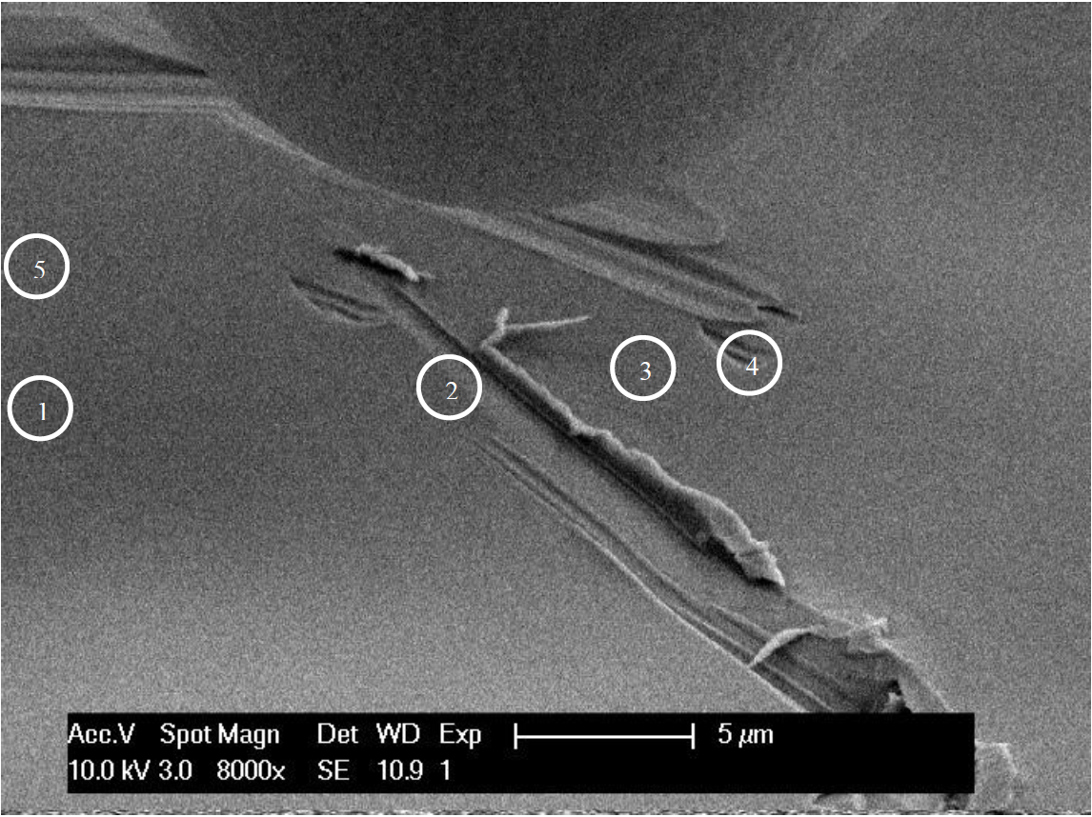
First 1D-scan site. Numbers in circles correspond to the positions of IV measurement run number.
Position | 1 | 2 | 3 | 4 | 5
Onset Voltage | - | 337V | 372V | 599V | -
Table of voltage where the measured current exceeded 100nA at each position. Measured current at position 1 and 5 were always below 100nA until the maximum bias voltage (1kV).

Slide 8
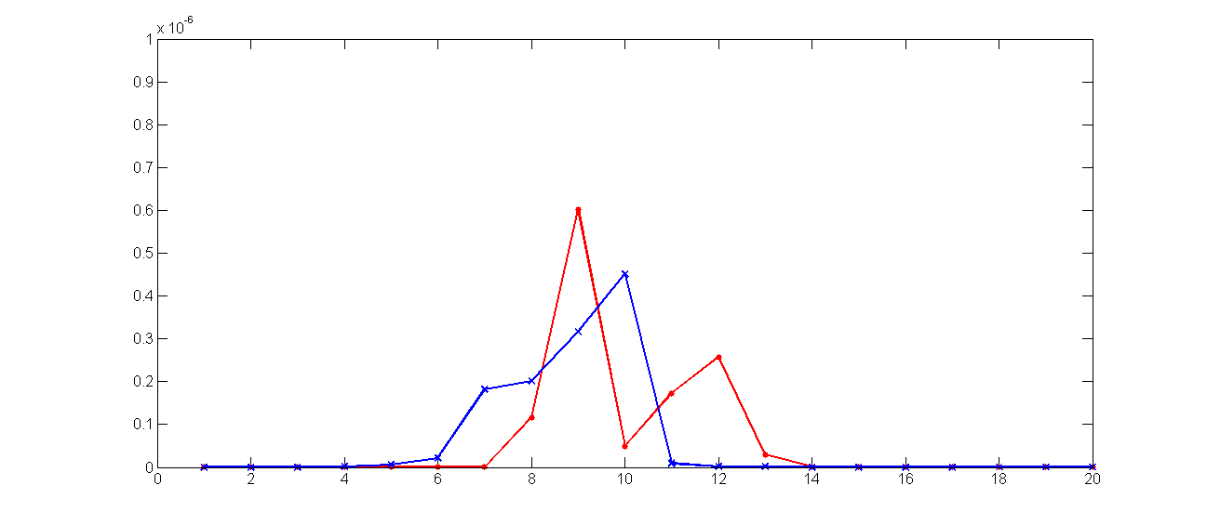
Result of the 1D scan over the Scratch1. The peak of both forward run (red, scanned from left to right at Fig.2) and backward run (blue, from right to left) was around the center of the scanning area where the edge of the scratch existed.

Slide 9
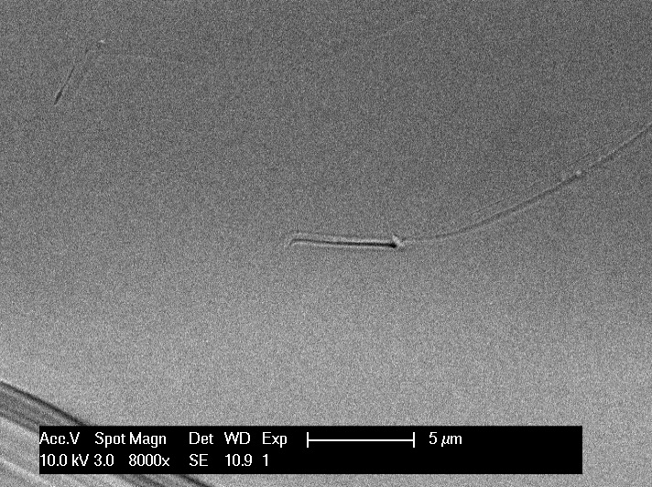
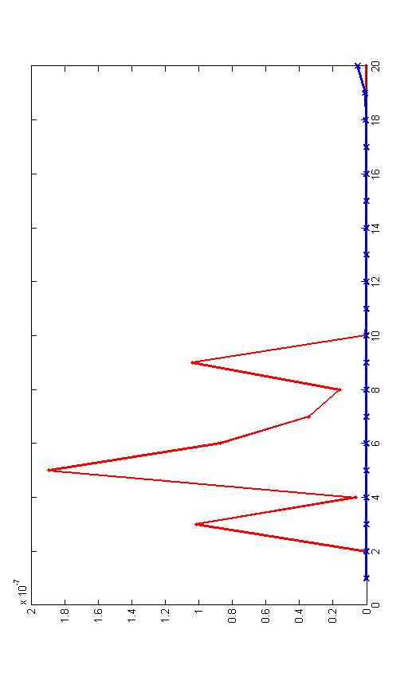
Measurement at Scratch2:
Result of the 1D scan over the Scratch2. The peak of both forward run (red, scanned from bottom to top at Fig.5) and backward run (blue, from top to bottom) was around the center of the scanning area where the edge of the scratch existed.

Slide 10
Summary and Outlook
3D piezo positioner for scanning field emission/breakdown measurement has been successfully installed.
One can find a targeted spot by SEM image and fix a measurement position by the positioner.
Test scanning showed that μm range of defects on sample surfaces can be detected with current setup.
Sensitivity for geometric surface condition should be checked.
Automation of scanning measurement should be constructed.

