Slide 1
EAST AREA NEWS
Lau Gatignon, EATM 11 December 2012

Slide 2
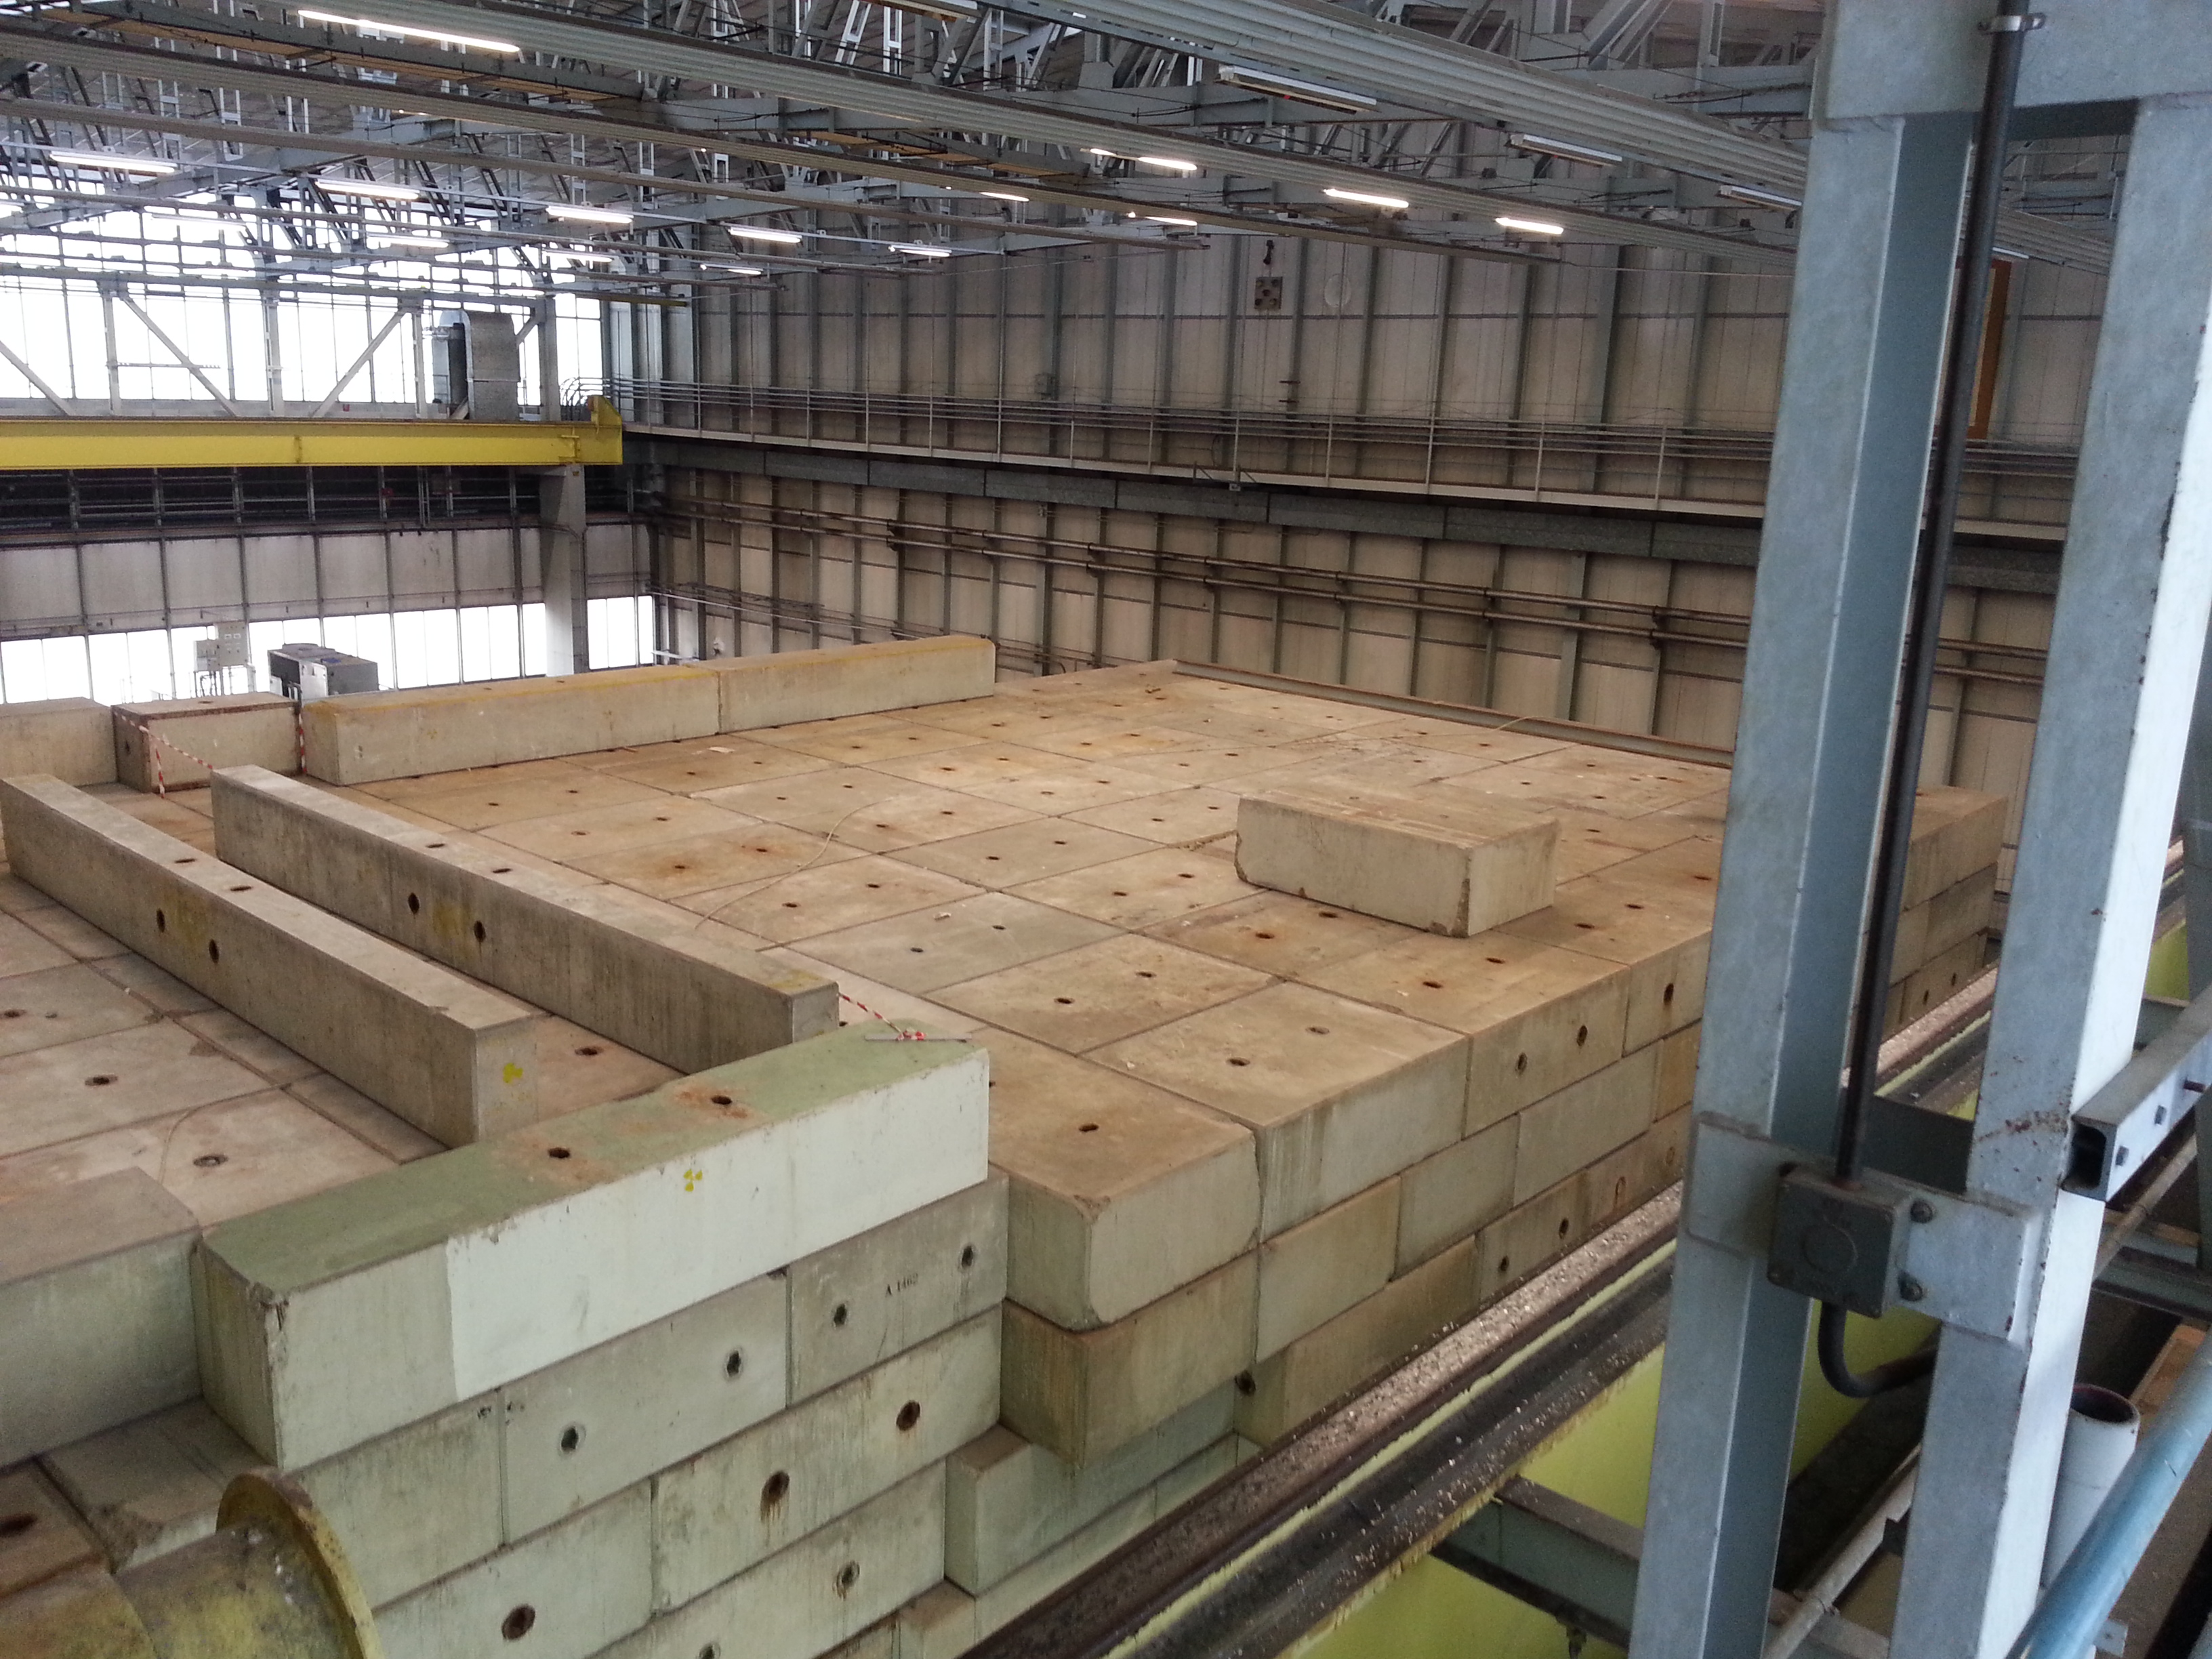
EAST AREA PREPARATIONS FOR LS1
The DIRAC roof has been cleaned up
in preparation of the shielding
dismantling.
The crane renovation is well under way and the 45 tons crane is already available for loads up to 7.5 tons, while waiting for the test with full load.

Slide 3
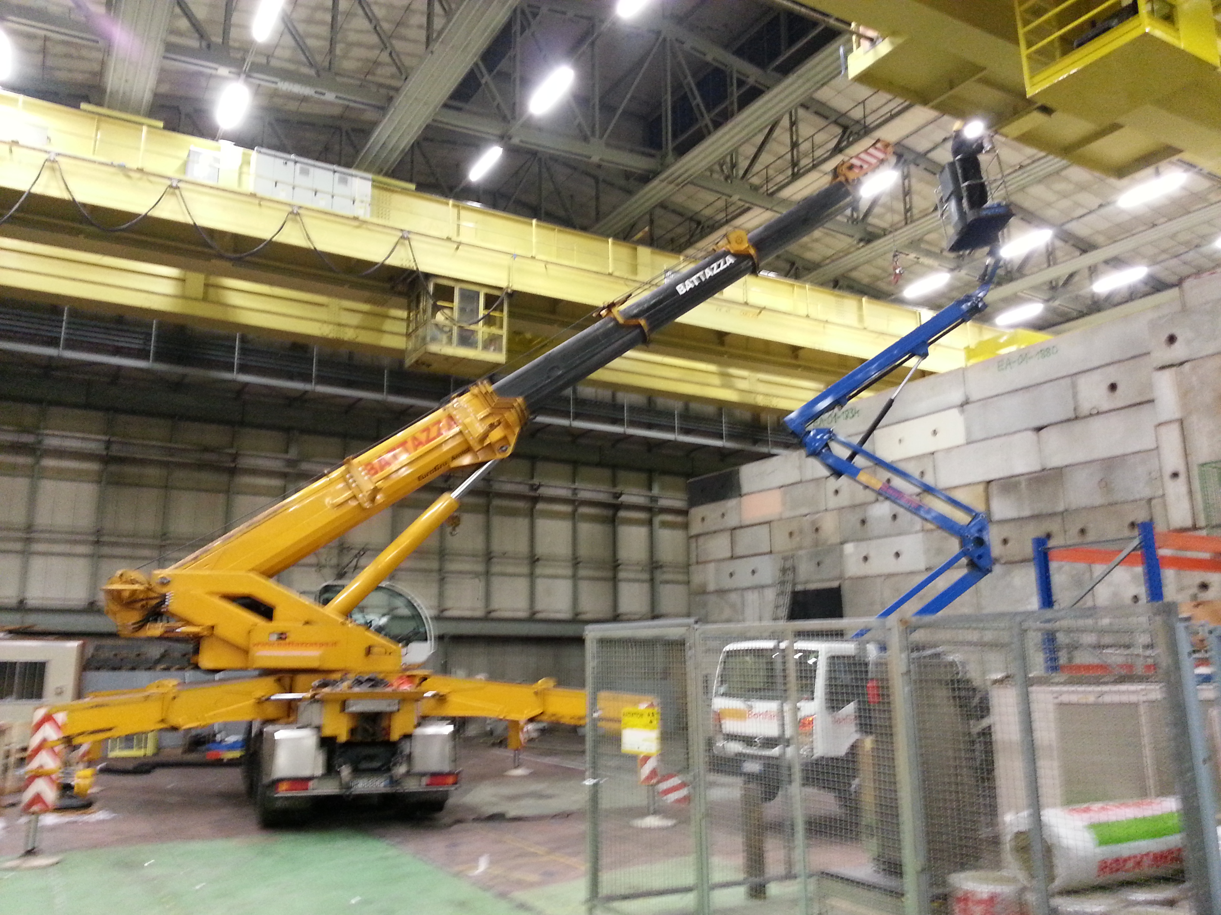
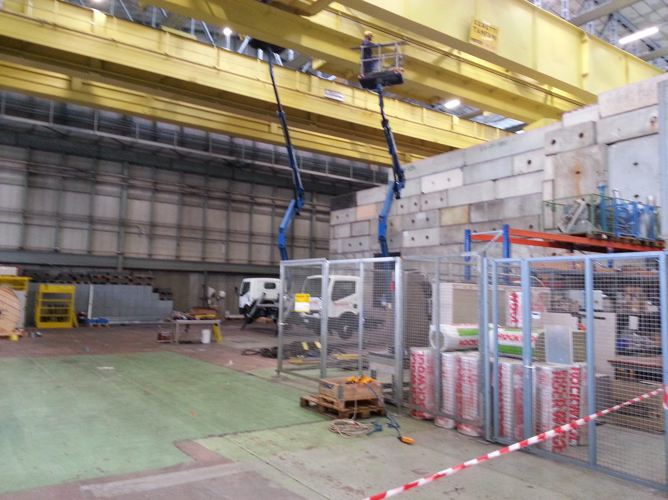
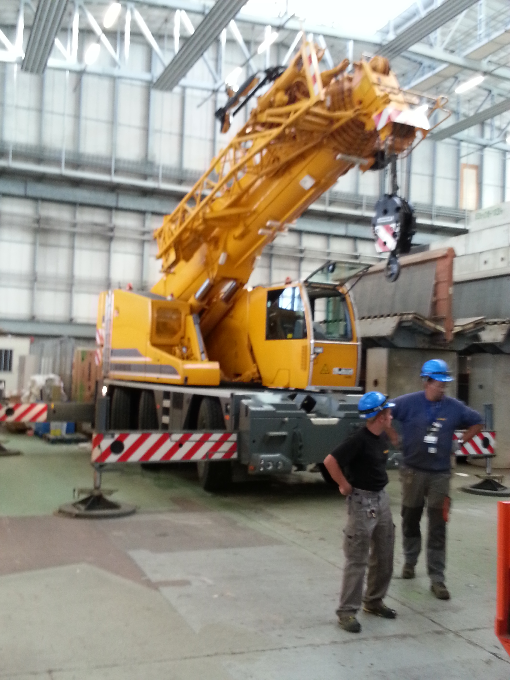
Crane renovation in preparation of DIRAC dismantling

