Slide 1
EIS-BEAM & EIS-MACHINE IN OPERATION
QUALITY ASSURANCE MANAGEMENT FOR
Safety Unit
BE-ASR-SU
EDMS 1255482

Slide 2
Contents
Introduction
Quality assurance principles for the EIS in operation
Actions to be taken by the EIS group owners & schedule

Slide 3
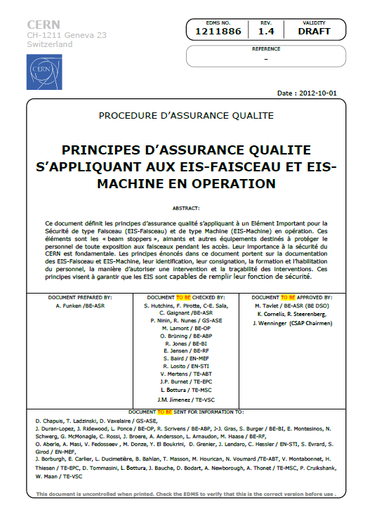
Introduction (1/3)
To ensure and demonstrate that the safety elements are able to fulfill their safety function (i.e. protection of the personnel against beams hazards and hazards due to the operation of the machines), a set of quality assurance principles have been defined.
The principles are detailed in a document which aims at compiling and standardizing the best practices already used in groups:
EDMS 1211886
These principles were presented to the Joint-CSAP on 4th October 2012.

Slide 4
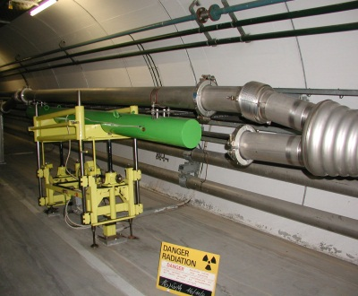
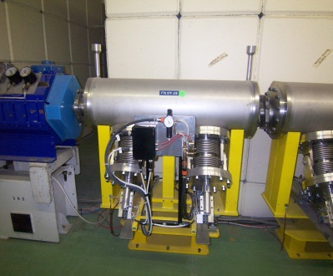
Introduction (2/3)
Equipment concerned:
FTN.STP428 (TT2A)
TBSE 2106 (TT20)
EIS-Beam and EIS-Machine
(register available on EDMS 1182293)
Ex.: beam stoppers, beam dumps, magnets,
MTV screens, vacuum valves, power converters, …
Equipment interlocked with the access safety system
Ex.: low voltage and high voltage circuit-breakers, …

Slide 5
Introduction (3/3)
Equipment concerned:
Associated equipment in case of an EIS not fail safe (essential services required to ensure its safety function)
Ex.: compressed air, electrical supply, water supply, control system (PLC)…
In case of an EIS fail safe: associated equipment having an impact on the availability of the access safety system (operational purposes)
Ex.: electrical supply…
An intervention on the circuit-breaker supplying the control unit of an EIS power converter will block the access to the area concerned.

Slide 6
What are the principles ? (1/4)
Written operational documentation and procedures for the personnel who have
to intervene on an EIS :
Electronic form, easily accessible (EDMS, CDD)
At least, a small description of the equipment with focus on the
EIS functions, of the types of controls and checks to carry out with
the precautions to take regarding the EIS functions,…
Training and habilitation of the personnel who will be authorized to intervene.
To be done by the group in charge of the equipment.
Identification on site of the EIS with reference to the procedure to follow.

Slide 7
Identification on site (1/3)
EIS-Beam and EIS-Machine
120 mm
Ex.: beam stoppers, beam dumps, magnets,
MTV screens, vacuum valves, power converters, …
XXXXXXX
40
mm
Associated equipment
Ex.: compressed air, electrical supply,
water supply, control system (PLC)…
90 mm
The interlocked cables with the
access safety system
(on the EIS-Beam and EIS-Machine side)
20 mm
Labels supplied by the BE Safety Unit and put in place by the equipment owner

Slide 8
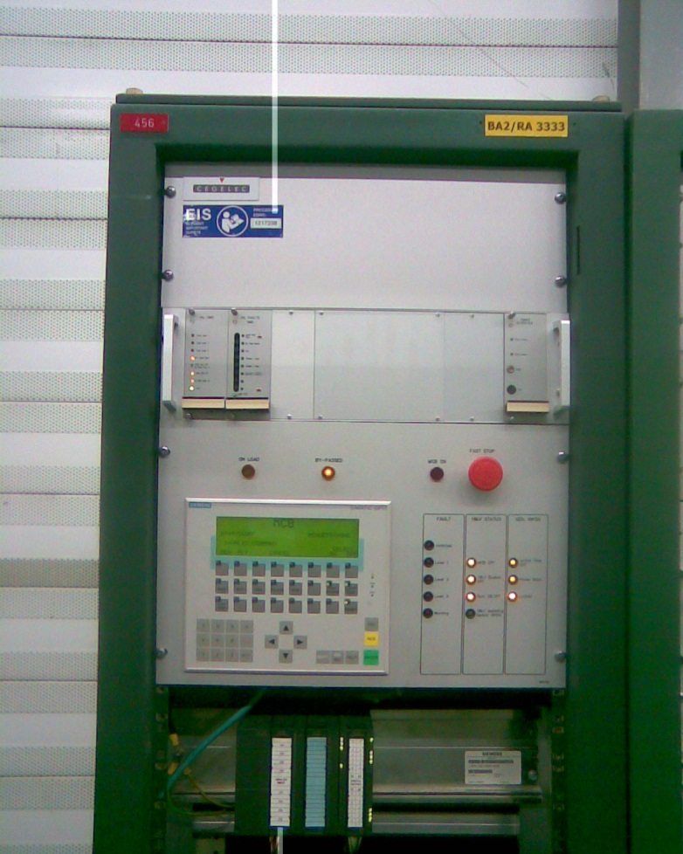
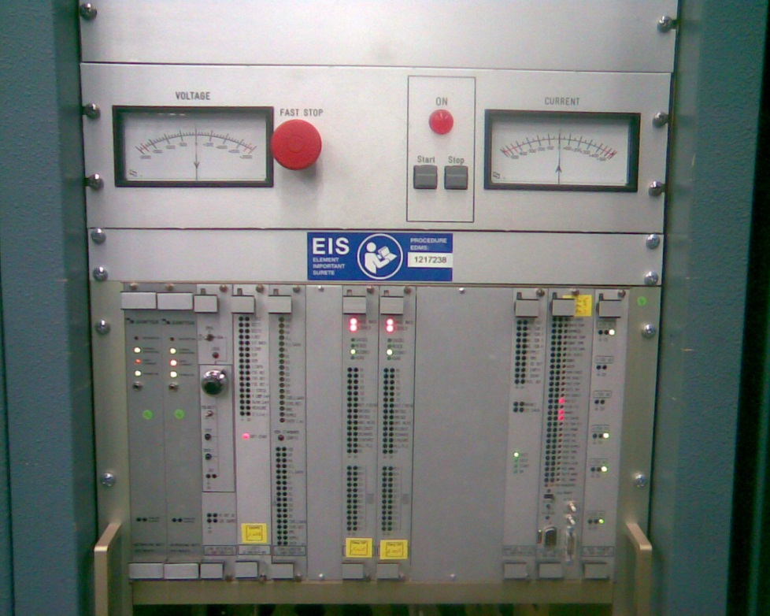
Identification on site (2/3)
BA2, PLC for the power converter
of the Main Dipoles (SMD2)
“Note d’opération: SPS et Lignes de
transfert - EIS équipments”, EDMS 1217238
BB3
Controls rack for the power converter of the Main Sextupoles LSFA

Slide 9
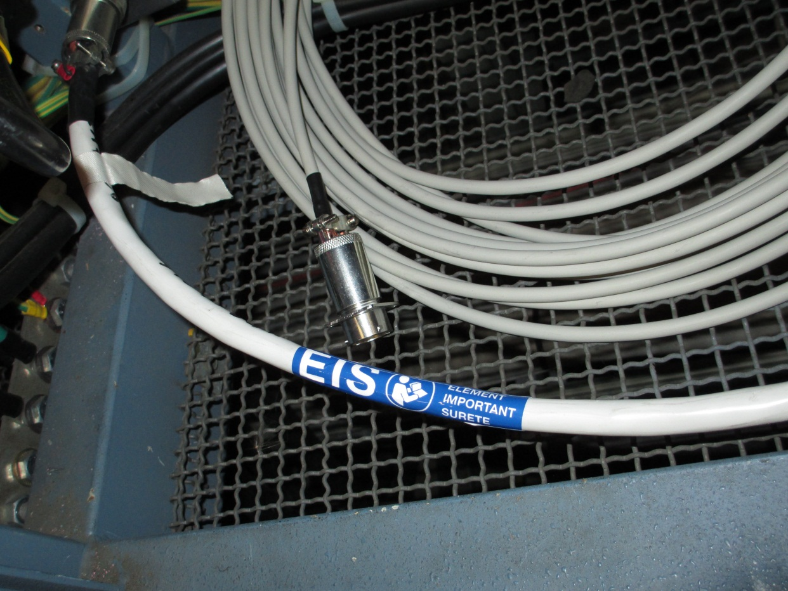
Identification on site (3/3)
BA1, interlocked cable with the access safety system for the power converter MBIV1003M (TT10)

Slide 10
What are the principles? (2/4)
Written reports of interventions (electronic logbook) and functional tests of the EIS (EDMS, …). Electronic form, easily accessible. To be done by the group responsible for the EIS.
Tests of the safety chains:
  After a LS or Xmas break: “DSO tests” are carried out. Reports are prepared by the DSO and stored in EDMS,
  After a TS or during beam operation: validation test of a specific chain could be required by the DSO depending on the type of intervention carried out.
Always inform the BE DSO that an intervention on an EIS is needed.
No more intervention shall take place once the “DSO tests” start.
The EIS shall be fully operational.

Slide 11
What are the principles? (3/4)
Authorization from DSO of BE is required for interventions on EIS:
During the operation of the accelerator complexes.
During shutdown, if an EIS needs to be put in/out of chain.
The DSO of BE :
Defines (with BE-OP) the compensatory measures needed to guarantee
safety of the personnel during access, and when these measures can be removed.
Requests the in/out of chain to GS/ASE via the “CERN Service
Portal” for traceability purpose. The status of the EIS-Beam and EIS-Machine
per complex is stored in EDMS.

Slide 12
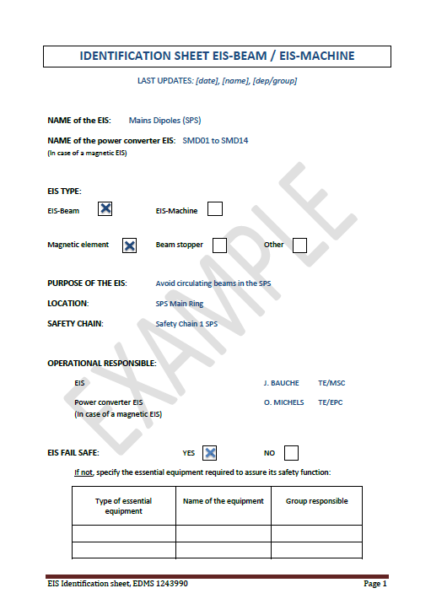
What are the principles? (4/4)
Identification sheets grouping all the relevant information of an EIS (or a set of EIS if applicable).
To be created and maintained by the EIS
responsible or power converter responsible
in case of a magnetic EIS.
Example for a magnetic EIS : EDMS 1243990
Discussions are ongoing to record this information directly in a database (Layout database, InforEAM).

Slide 13
What needs to be done by EIS responsible?
As presented to the Joint-CSAP on the 4th of October 2012:
The objective is to have the quality assurance principles for the EIS in place by the end of LS1, for the restart of the accelerators.
Group owners are asked:
To write the operational documentation and procedures + identify the EIS on site,
To complete the identification sheets of the EIS.
For the written reports of interventions (electronic logbook) and functional tests of the EIS, group owners are encouraged to contact the “Maintenance Framework Implementation Office” to use the CERN standard methods and tools.

Slide 14
Thank you for your attention !

