Slide 1



Search for New Physics in Events with Jets and Missing Transverse Momentum Using LHC Data
Samantha Hewamanage
On Behalf of the CMS Collaboration
Pheno
May 6, 2013

Slide 2
Outline
Introduction
Analysis Strategy
  Jets +MHT analysis (7 TeV, 4.9 fb⁻¹)
  analysis (8 TeV , 11.7 fb⁻¹)
  New results from 8 TeV data is coming out very soon and can be found at:
  https://twiki.cern.ch/twiki/bin/view/CMSPublic/PhysicsResultsSUS
Dataset and Event Selection
Backgrounds Estimation
Results
Summary
Notes:
Analysis strategy:
We have many complementary analysis
Showing only two here.

Slide 3
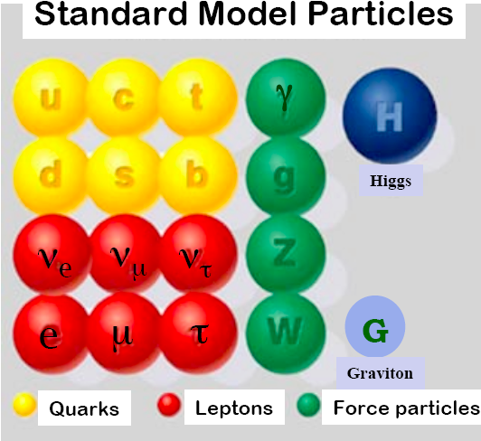
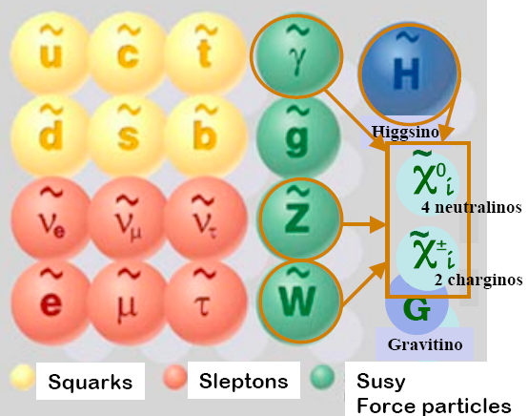
Introduction to Supersymmetry
Supersymmetry introduces super-partner for every SM particle that differs by half-a-spin.
Standard Model Particles
Supersymmetry Particles
Four neutralinos
Two Charginos
SUSY is a broken symmetry : Expect new particles in ~TeV range !
In R-Parity conserving models, lightest supersymmetry particle (LSP) is stable.
Notes:
Doubles partners
Avoids a large corrections to Higgs mass.
Natural dark matter candidate
LSP is stable a escapes detection creating MET.
----- Meeting Notes (5/3/13 09:48) -----
SUSY is introduced to overcome the short comings of the SM.
1. large corrections to H mass
2. Hierarchy problems

Slide 4
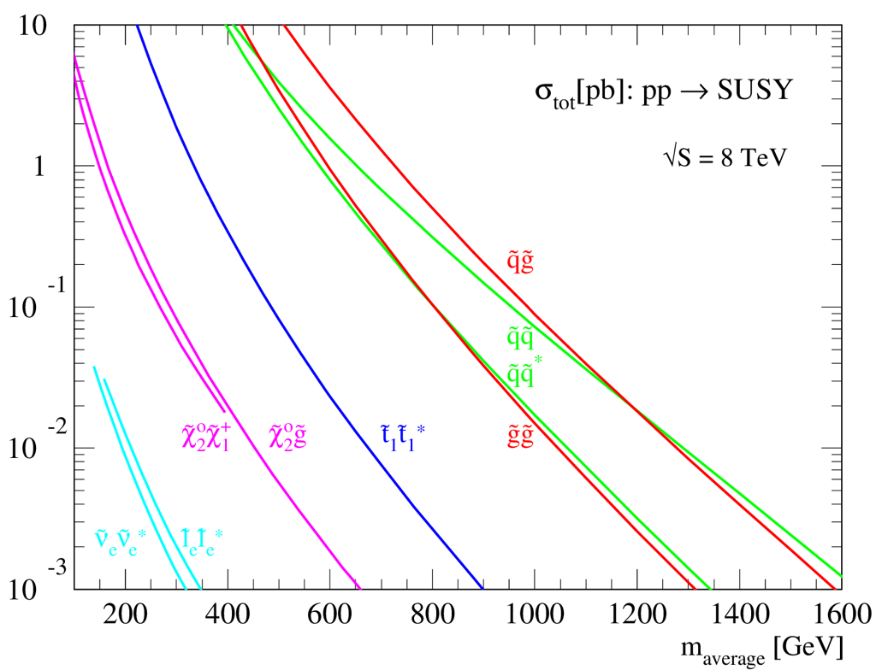
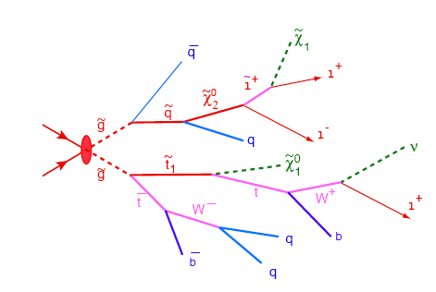
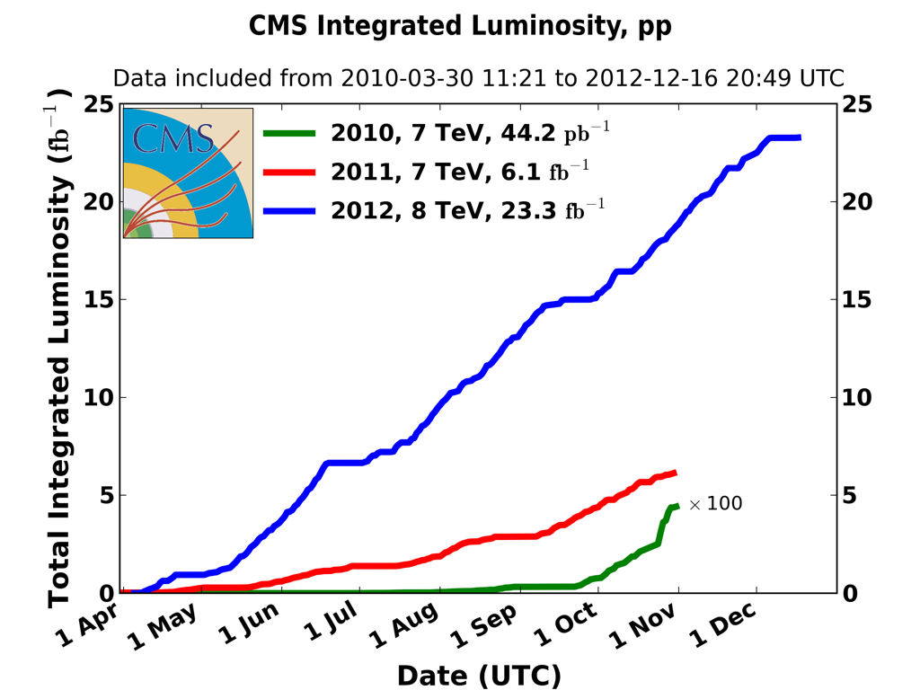
SUSY Production at LHC
An example decay chain of a SUSY event
Two LSPs ( ) : Large MET
Strong production
squarks and gluino pairs, large cross-section at hadron colliders
Typically Jets & MET based searches categorized in numbers of leptons (and photons)
Notes:
Point out cascade decay with multiple LSPs.
Do not mention photon/leptons.

Slide 5
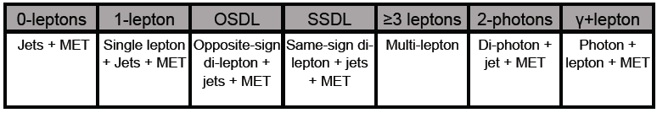
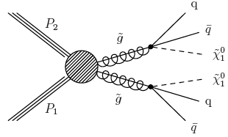
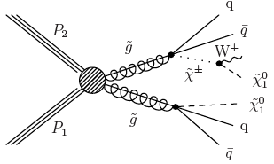
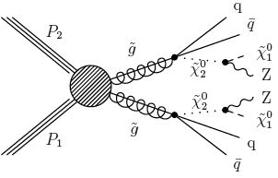


Generic Searches for Strong Production
Two LSPs ( ) : Large MET
Mostly involves Jets
Categorize further in number of leptons and photons.

Slide 6
Analysis Strategy (Jets +MHT: 4.9 fb⁻¹ @ 7 TeV)
Require >= 3 Jets (p_{T}>50 GeV & |η|<2.5)
Veto events with isolated leptons (e/μ)
Veto multi-jet background (QCD)
  Δϕ (MHT, Jets 1 & 2) >0 .5 and Δϕ (MHT, Jet-3)>0.3)
Divide data into exclusive HT and MHT bins.
  Baseline selection is HT>500 GeV & MHT>200 GeV.
Search Variables
HT from jets with pT>50 GeV, |η|<2.5
MHT from jets pT>30 GeV, |η|<5.0
Search Bins
Notes:
Minimal use of information from simulated data (MC) in estimating backgrounds.Used to develop and validate the estimates.
Each background is estimated using two different methods and one is used as a cross check. Only the primary method is described in this talk.

Slide 7
Backgrounds
There are SM processes with similar decay signatures.
  Invisible Z decays (Z->νν + Jets)
  W/tt-bar + Jets (W(e/μ/τν))
    Lepton (e/μ) is not reconstructed
    A Tau decaying hadronically reconstructed as a jet.
  QCD multi-jets
    Jets that are mismeasured.
All backgrounds are estimated from collision data. Minimal use of simulated data (Monte Carlo)

Slide 8
Invisible Z Background Estimation
Z decaying to pair of neutrinos giving rise to real missing energy
Estimated using ϒ + Jets events
Largest uncertainty comes from theory uncertainty on Z + jets to ϒ+Jets ratio (from BlackHat collaboration).
MHT spectrum
Z. Bern et.al. (arXiv:1206.6064v1)
Notes:
Di-lepton method is limited in statistics. Used as cross check.
MHT spectrum shows the fraction of photons in out data sample? Does this include prompt and fragmented????
Point out the ration stays flat which gives us confident that our method safe
Hadronic part is same

Slide 9
W/Top Background – “Lost Lepton”
These are events from tt-bar and W+jets decaying leptonically (e/μ) and the lepton is not reconstructed.
  Out of acceptance region, reconstruction failure, or fails isolation requirement.
Select a control sample with exactly one muon
Measure the identification and isolation (in) efficiencies with the data.
Then scale the control sample according to the measured (in)efficiencies.
Notes:
Why no electron?

Slide 10
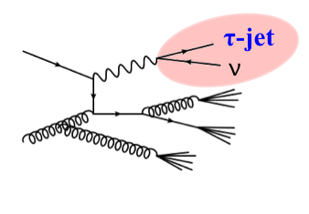
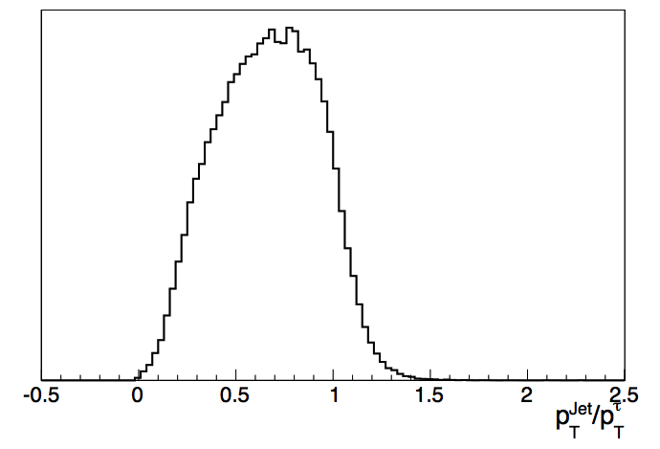
W/Top Background – “Hadronic Tau”
W decays to Tau(τ) (+ν) where Tau decays hadronically.
Use a control sample with one isolated muon + >= 2 jets.
Smear the muon-p_{T} using Tau response function derived from Monte Carlo and recalculate all search variables
  Energy of Tau-jet is included in the calculation.
Largest systematic uncertainties comes from Tau energy scale and acceptance.
Sample Tau
Response
Template

Slide 11
QCD Multijet Background
These are events from semi-leptonic decays of heavy-flavor (b, c) quarks and events where energies of the jet/s are mismeasured giving rise to “fake” missing energy (MHT).
Use a QCD rich control sample from data.
Rebalance events using a kinematic fit constraining MHT=0.
  This restores the reconstructed jets to particle level jets
Smear the rebalanced event using the jet resolution function and reevaluate all kinematics variables.
The largest uncertainty comes from the difference in the width of Gaussian core of resolution function between Data and Monte Carlo.
Notes:
There is no energy imbalance in QCD events at particle level

Slide 12
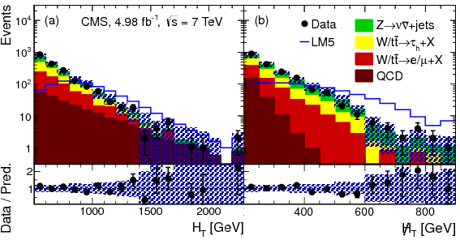
Data vs SM Expectation
No significant access of data over the expected total background is observed.
Uncertainties on the background prediction are shown by the hatched region.
We set limits on CMSSM and Simplified Models (SMS)

Slide 13
Limits on CMSSM
Parameters are m₀, m_{1/2}, tan β, Trilinear coupling A, and sign (μ).
m₀ and m_{1/2} parameter space is scanned for tan β = 10, A₀, μ>0
Excludes squark masses below 1.2 TeV and gluion masses below 0.72 TeV @ 95% CL.
The observed and expected 95% CL limits in the CMSSM (m₀, m_{1/2}) plane.
Uncertainties on signal includes: Jet Energy Scale, Jet Energy Resolution, Theoretical Uncertainty, Signal Contamination, Statistical Uncertainty, Luminosity, Trigger inefficiency, and event cleaning.
Notes:
Constrained Minimal SUSY Model (CMSSM)
m₀, m_{1/2}, tan β, Trilinear coupling A, sign (μ)
m₀ and m_{1/2} parameter space is scanned for tan β = 10, A₀, μ>0
The yellow-shaded region shows the ±1σ variation in the expected limit, while the dot-dashed curves show the variation in the observed limit when the signal cross section is varied by its theoretical uncertainties. The remaining CMSSM parameters are tan β = 10, μ > 0, and A0 = 0. The limits from an earlier CMS search and from other experiments are also shown.

Slide 14
Limits on Simplified Models
2 energetic jets + a third from radiated parton
3 or more jets
We exclude and for
Notes:
Also shows the ±1σ variation in the expected limit and the variation in the observed limit when the signal cross section is varied by its theoretical uncertainties.
The observed and expected 95% CL upper limits on the (a) gluino-gluino and (b) squark-squark cross sections in the nutralino vs gluion and squark mass planes obtained with the simplified model.

Slide 15
8 TeV Results from Luminosity of 11.7 fb⁻¹
Missing transverse momentum + 0, 1, 2, 3, or ≥ 4 b
effectively removes QCD where as in Jets+MHT, we really need to understand QCD!
T1tttt
T1bbbb
We are excluding gluino masses ~ 1 TeV @ 95% CL
Notes:
Explain how alpha_t kills qcd (met is not in the direction of jet)
Point our alpha_t distribution and different background
Explain the limitsand point out Extending to 3G sq generation
Point out the main difference between MHT+jets and apla_t where we have to really understand the QCD background.

Slide 16
Summary
We have searched for physics beyond SM in multi-jet events with large missing energy using 4.9 fb⁻¹ and 11.7 fb⁻¹ of LHC data.
Our data measurements agree with expected SM prediction and no significant access is observed.
Results are interpreted in:
  CMSSM: we exclude squark masses below 1.2 TeV and gluino masses below 0.72 TeV
  Simplified models: we excludes gluino masses <1 TeV and squark masses < 0.7 TeV for neutralino masses of <200 GeV.
Thank you.

Slide 17
Backup Slides
Reference
  Search for new physics in the multijet and missing transverse momentum final state in proton-proton collisions at √s=7 TeV (Phys.Rev.Lett. 109 (2012) 171803 , http://inspirehep.net/record/1121703/)
  Search for supersymmetry in final states with missing transverse momentum and 0, 1, 2, 3, or ≥ 4 b jets in 8 TeV pp collisions (arXiv:1303.2985, submitted to EPJC)
Notes:
Add ref to Simplified Models

Slide 18
Data vs Backgrounds: Jets+MHT (7 TeV)
Event yields for different backgrounds for the 14 search selections together with the total backgrounds, as determined from the collision data, and number of events observed in data. The quoted uncertainties are the combinations of the statistical and systematic uncertainties.

Slide 19


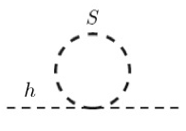

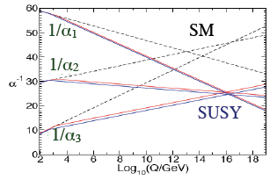
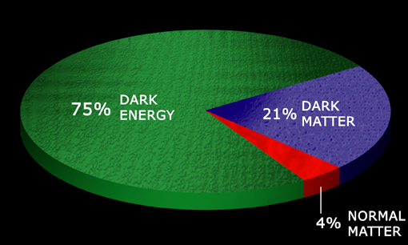
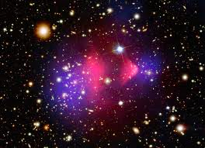
Why is Supersymmetry Attractive ?
Naturalness or Hierarchy problem :
fermion and boson loops contribute to higgs mass loop with opposite signs, hence avoid quadratic divergences
Unification of couplings of three interactions
SM predicts “running” of coupling constants as a function of energy but without making these cross at the same energy
Dark matter candidate
If the LSP is neutral and weakly interacting, it is a potential dark matter candidate
A SUSY extension is a small perturbation consistent with the electroweak precision data

Slide 20
α_{T} : 8 TeV Results from Luminosity of 11.7 fb⁻¹
α_{T} very effective in reducing multi-jet background.
For eg: N_{jets}=2, E_{T}^{j2} is the transverse momentum of the least energetic jet of the two and M_{T} is the transverse mass of the di-jet system.
T1
T2
Notes:
Extending to 3G sq generation

