Slide 1
A New Higher Brightness Option – continued
(see LMC 156 - 158)
S. Cettour Cave, H. Damerau, A. Findlay,
S. Gilardoni, S. Hancock, G. Metral
Thanks to: Gianluigi, Hannes, Jorg, Jan, Laurette, Eric, Alick, Lasse , …

Slide 2
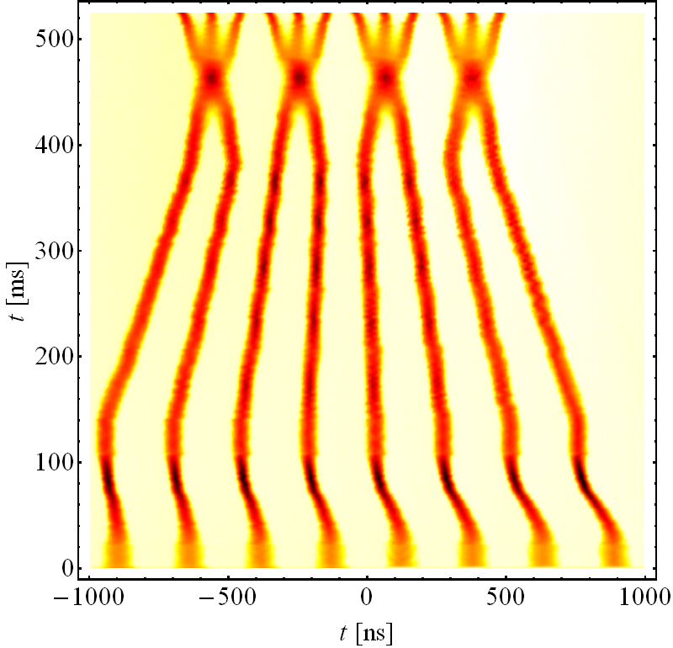
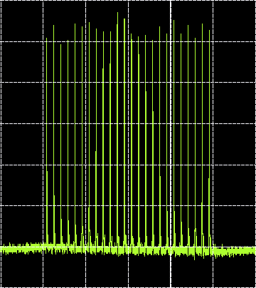
Higher brightness beams for LHC
  Most ‘simple’ scheme to increase brillance:
  batch compression + bunch merging before usual RF gymnastics
  8 PSB bunches merged in 4, triple split and then double split: 8/2*3*2=24
  h = 9 → 10 → 11 → 12 → 13 → 14 → 7 → 21 → 42 → 84 (+168)
Pure h = 21
24 b, 50 ns at PS ej., up to 2.0 · 10¹¹ p/bunch
Last turn PS
E_{kin} = 1.4 → 2.5 GeV
  Measurement
24 bunches spaced 50 ns
48 bunches spaced 25 ns (in the SPS)
Emittance of order of ~1-1.2 μm (1 σ*)
very well preserved from PSB to SPS
for 1.7-1.9 10¹¹ ppb
Pure h = 9

Slide 3
Emittance evolution (preliminary)** for ~1.7-1.8 10¹¹ ppb
Machine | BCMS 50 ns** (εh +εv)/2 (1 σ*) | Nominal 50 ns** (εh +εv)/2 (1 σ*) | Measured at
PSB | 0.7-0.8 μm | 1.3-1.4 μm | Extraction
PS | ~ 0.8 μm | ~ 1.2 μm | Before bunch rotation
SPS | ~ 1.0 μm | ~1.5 μm | end FB
LHC | ~1-1.3 μm | 1.6-1.7 μm | At injection
** Not to be used yet for future luminosity extrapolation. Only indicative values not based on large statistics, no analysis done yet

Slide 4
BS vs. BCMS beam @ SPS extraction
Nominal
BCMS

Slide 5
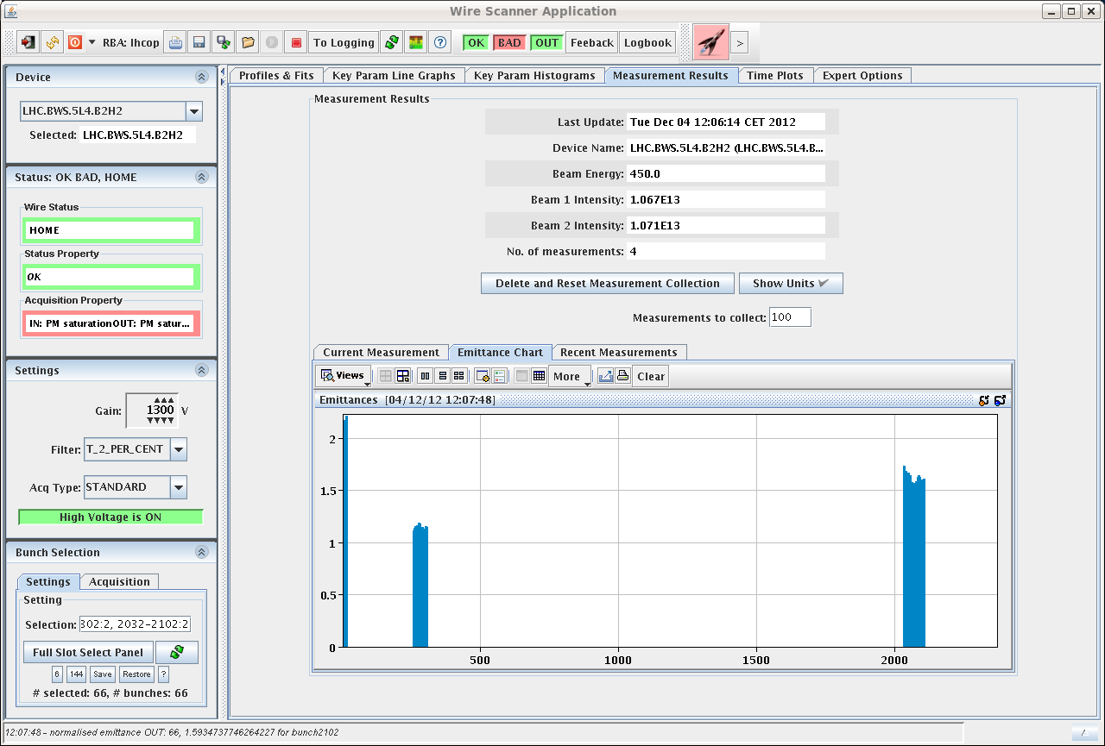
LHC @ Injection, emittances: B2 - H
BCMS
Nominal

Slide 6
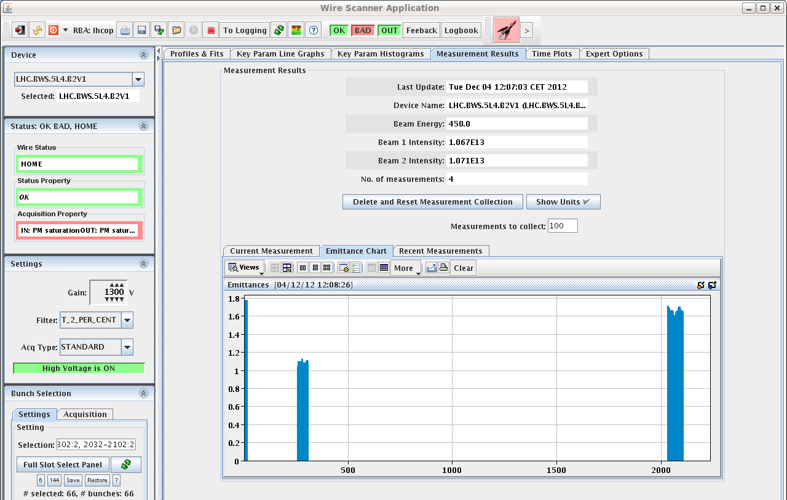
LHC @ Injection, emittances: B2 - V
BCMS
Nominal

Slide 7
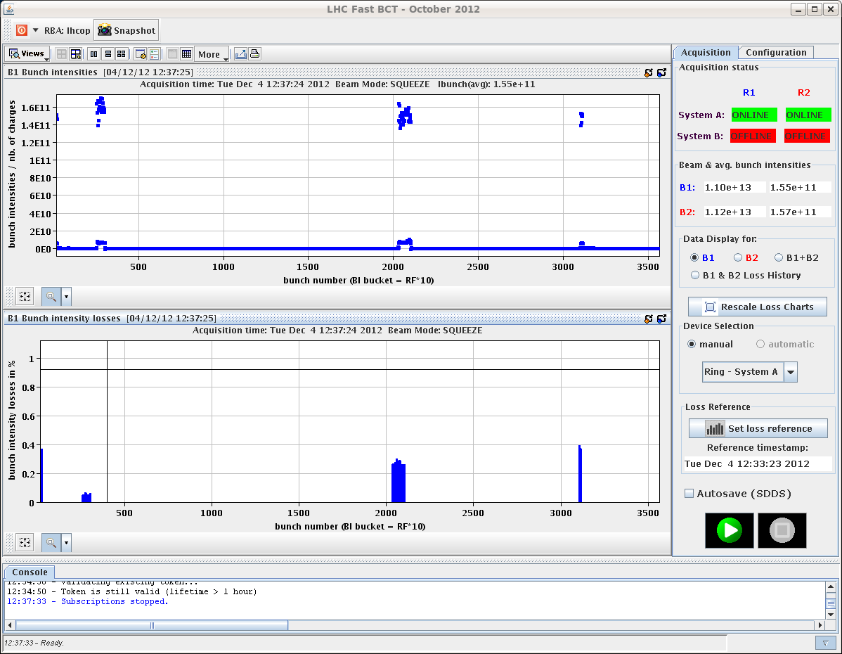
Losses during squeeze – B1
Nominal
BCMS

Slide 8
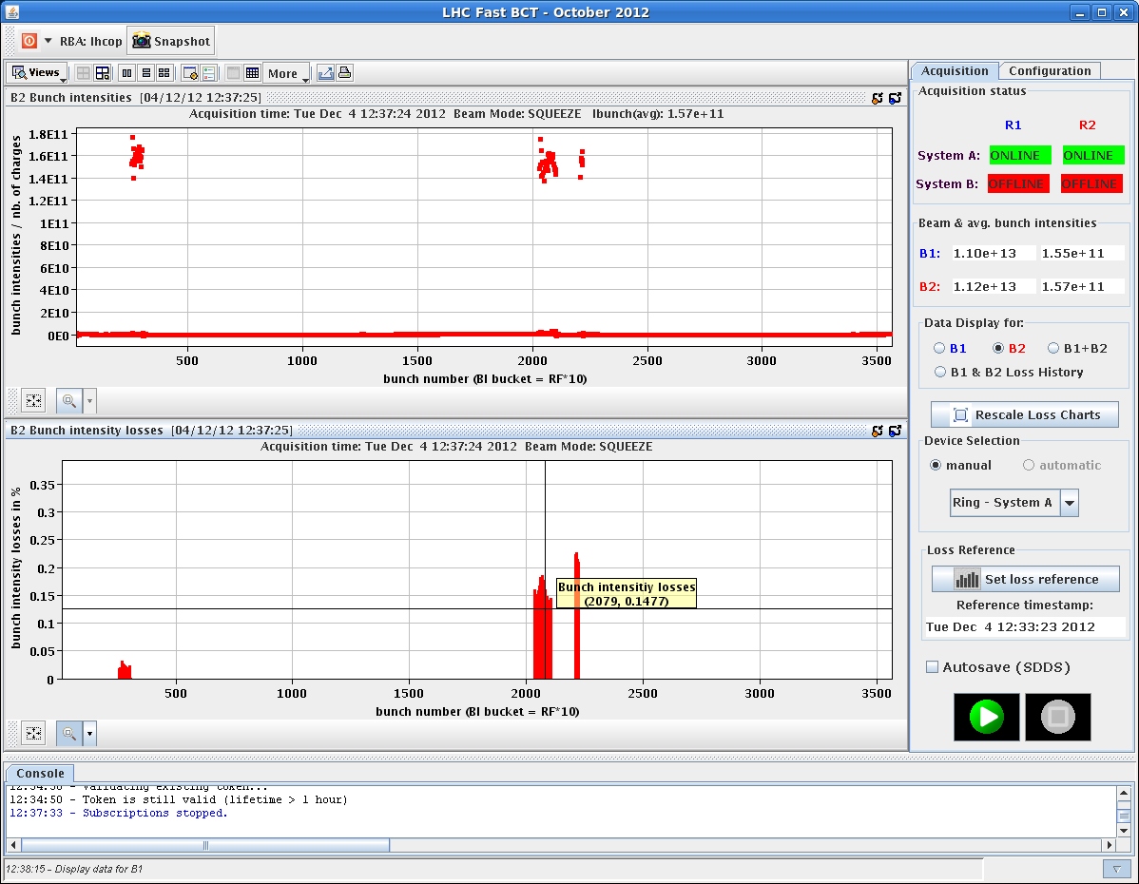
Losses during squeeze – B2
Nominal
BCMS

Slide 9
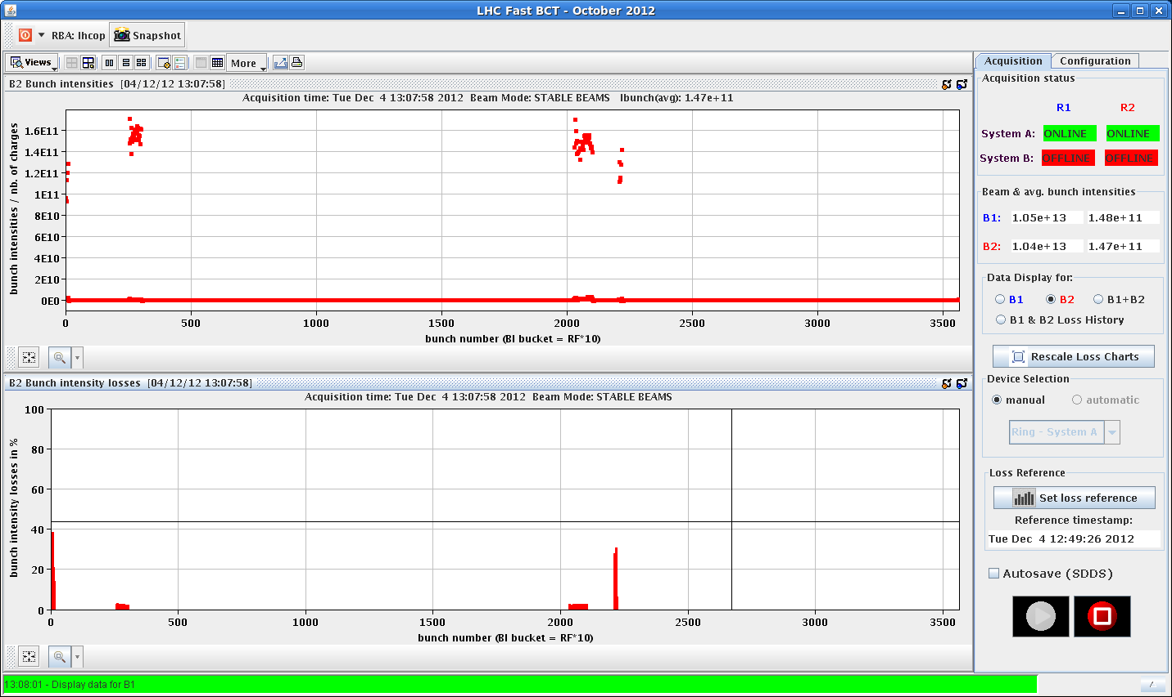
Stable beam losses: B2
BCMS
Nominal

Slide 10
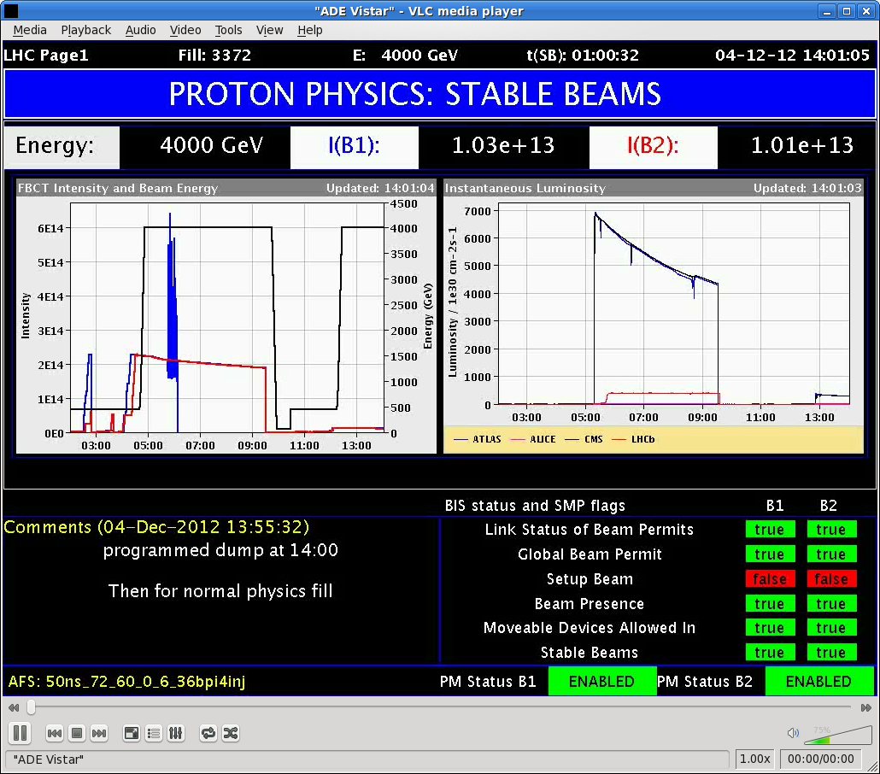
Lumi @ end-of-the fill

Slide 11
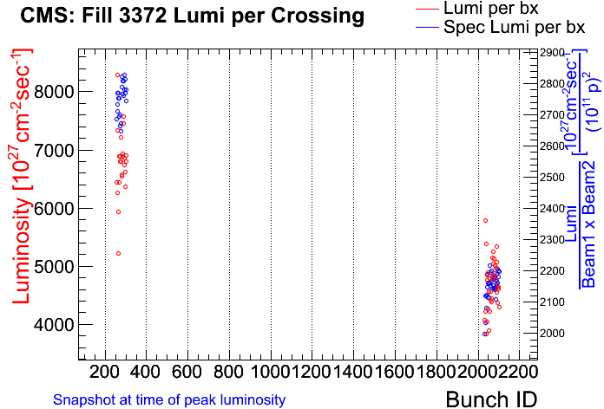
Preliminary results from CMS (same ppb)
From Greg Rakness
Larger spread from PS-RF gymns
Not yet fully optimized
36 bunches
24 bunches

