Slide 1
What do we learn from the recent cosmic-ray positron measurements?
K. Blum*, B. Katz*, E. Waxman
Weizmann Institute
*currently at IAS, Princeton
arXiv:0907.1686 [MNRAS 405, 1458]
arXiv:1305.1324

Slide 2
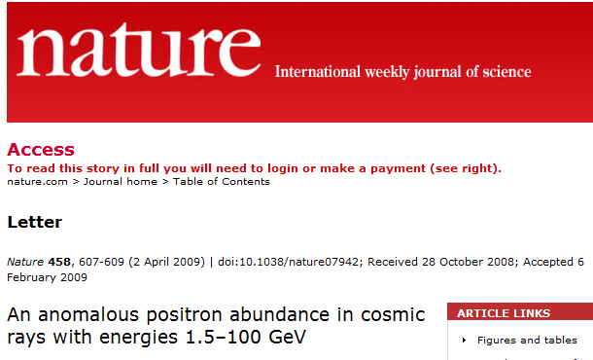
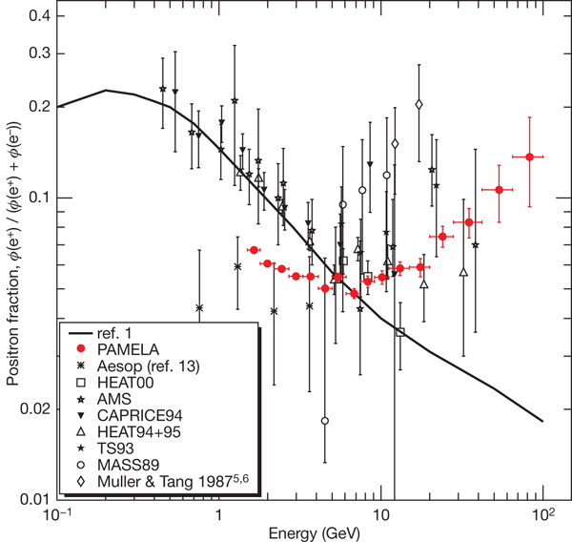
PAMELA 09
…Our results clearly show an increase in the positron abundance at high energy that cannot be understood by standard models describing the secondary production of cosmic-rays.

Slide 3
The positron “anomaly”
A common argument:
Unsubstantiated assumptions:
The “anomaly” implies that (some of) these assumptions, which are not based on theory or observations, are not valid.

Slide 4
What is the e⁺ excess claim based on?
On assumptions not supported by data/theory
* primary e⁻ & p produced with the same spectrum,
and e⁻ and e⁺ suffer same f_{rad}
→ e⁺/e⁻~Σ_{sec}~ε^{-0.5}
Or
* detailed assumptions RE CR propagation,
e.g. isotropic diffusion, D~ε^{δ},
within an ε-independent box
→ f_{rad} ~ε^{(δ-1)/2}
If PAMELA/AMS correct, these assumptions are wrong

Slide 5
What we really know
For all secondary nuclei (e.g. C → B, Be; …):

Slide 6
Why does it work?
We have no basic principles model for CR propagation.
In general
If: The CR composition (n_{j}/n_{p}) is independent of x,
The CR spectrum is independent of x
(or: E/Z the same for prim. & sec.),
Then:

Slide 7
What we really know: application to e⁺
Positron secondaries:
A robust, model independent, upper limit:
Estimate f_{rad} at 20GeV from ¹⁰Be (10⁷yr): ~0.3
(CMB and starlight ~1eV/cm³, e⁺ lifetime ~10⁷yr).
Known from Lab
Suppression due to synchrotron
And inverse Compton energy loss
Measured from CR sec.

Slide 8
Some cautionary notes
t_{sec} is not the residence time
If G(x,x’) is independent of x’ then
For particles with life time τ,
f_{sec} depends on model assumptions. It may, e.g.,
attain the values τ/t_{res} or V(t_{prop}<τ)/V_{G} under
different model assumptions.

Slide 9
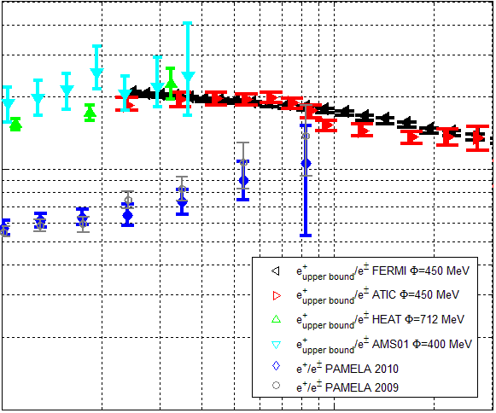
PAMELA 09-10
For all secondaries (e.g. anti-p)
Radiative e⁺ losses- depend on propagation in Galaxy (poorly understood)
* At ~20GeV: f_{rad}~0.3~f_{10Be}
→ e⁺ consistent with 2ndary origin
* Above 20GeV:
If PAMELA correct
→ energy independent f_{rad}(ε)
[Katz, Blum, Morag & EW 10]

Slide 10
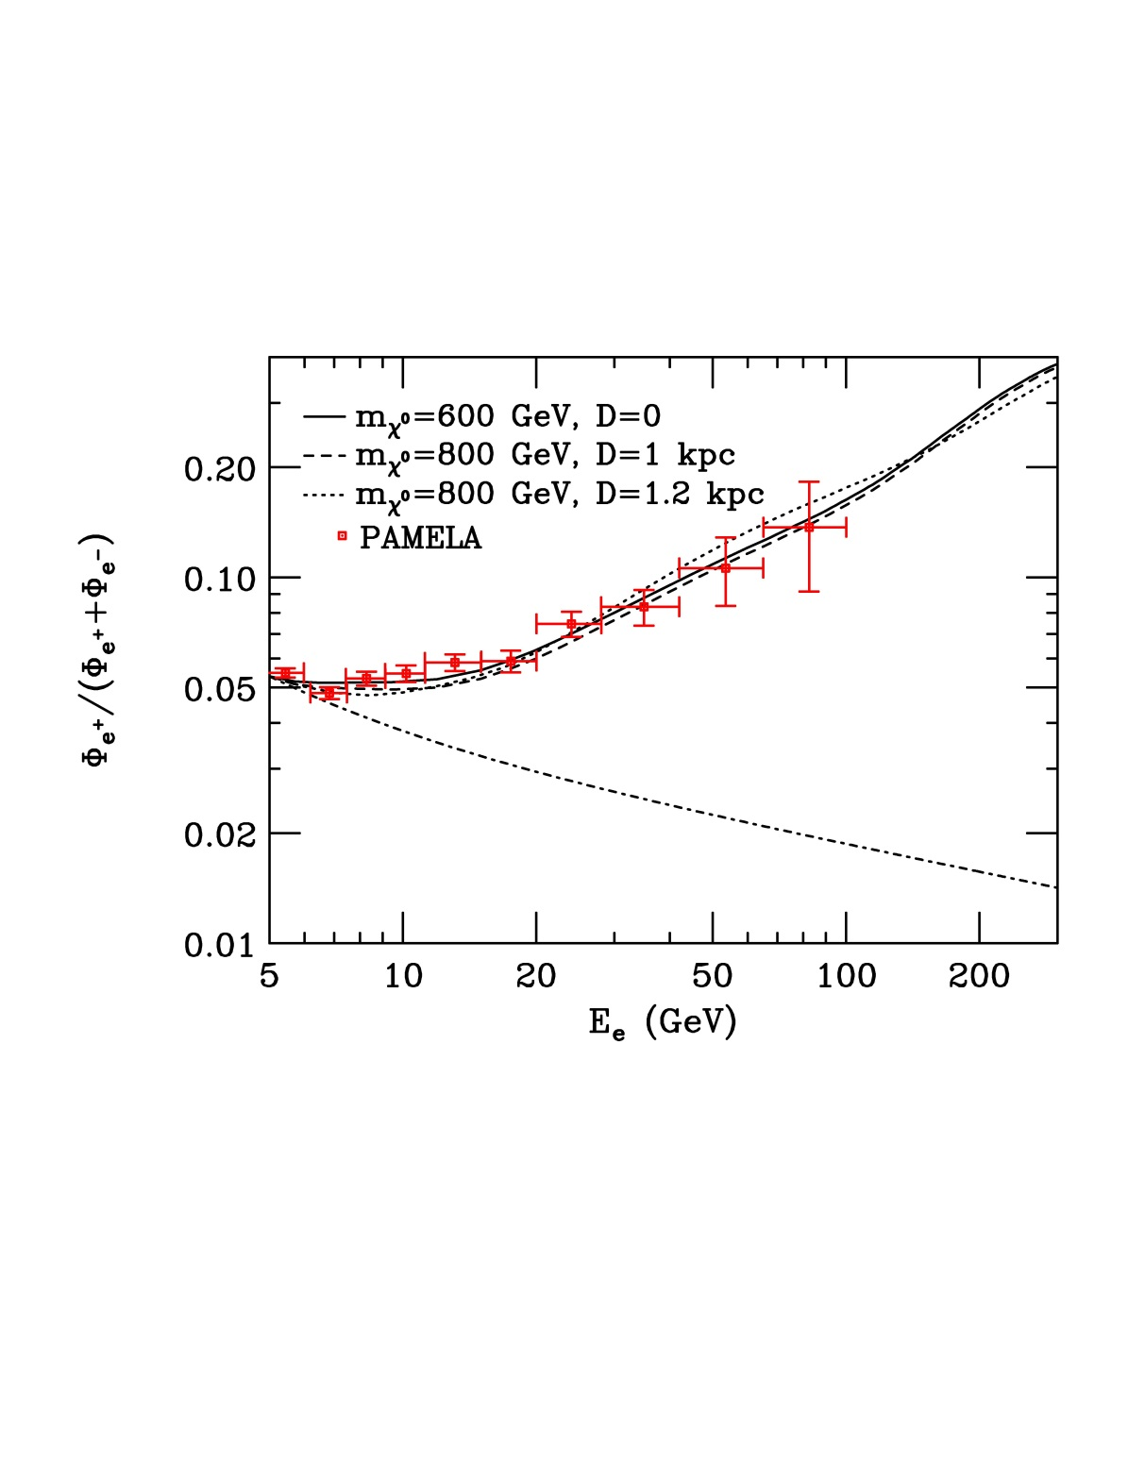
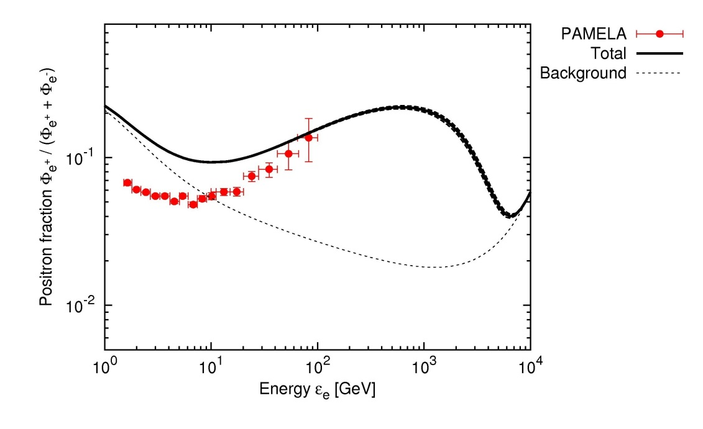
Primary e+ sources
DM annihilation [Hooper et al. 09]
Pulsars [Kashiyama et al. 11]

Slide 11
New primary sources
?
Secondary origin

Slide 12
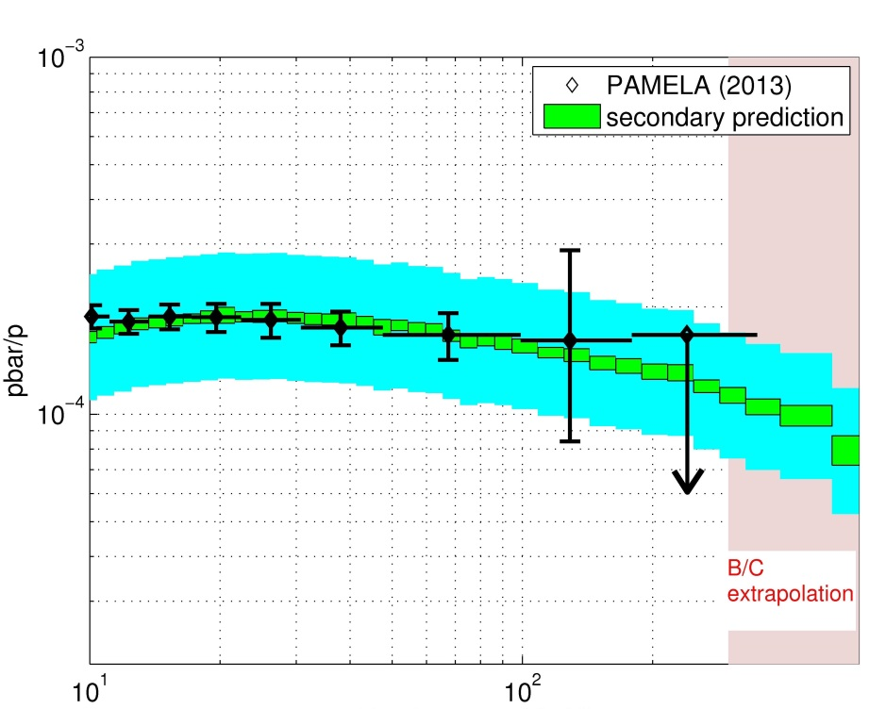
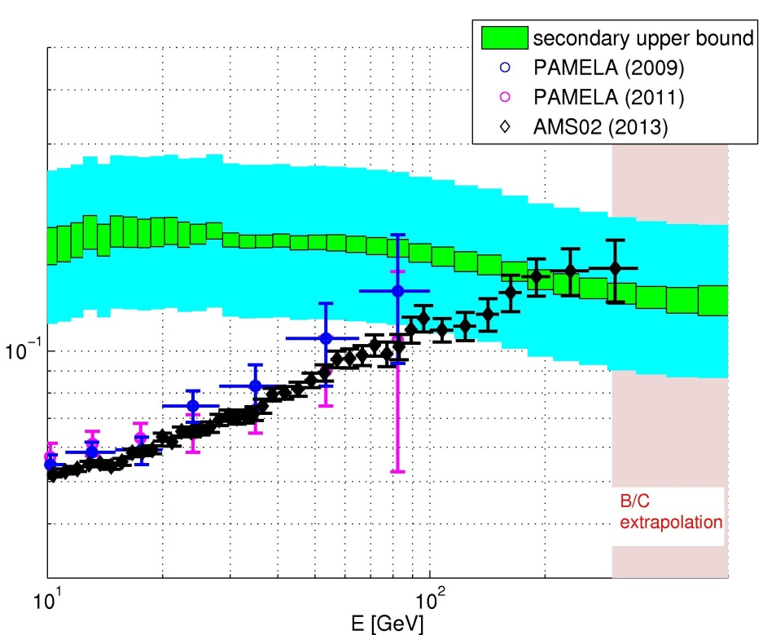
PAMELA & AMS 2013
Anti-p consistent with prediction.
e⁺ flux saturates at the secondary upper bound.
The ABSOLUTE e⁺ flux matches the secondary bound.
In all primary e+ models (DM, pulsars…) there is no intrinsic scale that would explain why the ABSOLUTE observed flux lies near the data-driven secondary bound.
[Blum Katz & EW 13]

Slide 13
Conclusions
Anti-p and e⁺ measurements are in excellent agreement with secondary production model predictions.
The saturation of the ABSOLUTE e⁺ flux at the predicted secondary upper bound is a strong indication for a secondary origin, and is not expected in primary production models.
Upcoming measurements at yet higher energy will further test the validity of the model.
The main constraints that may be derived from the e⁺ measurements are on models of Galactic CR propagation.
In particular, the measurements constrain f_{rad}(e⁺).

Slide 14
Implications of f_{sec}(e⁺)~0.3- an example
Under some model assumptions
f_{sec}(e⁺)~ t_{cool}/t_{res}
which would imply
t_{res}(E/Z=10GeV)>30Myr, t_{res}(E/Z=200GeV)<1Myr
and using Σ_{sec}
<n_{ISM}>(E/Z=10GeV) < 0.2g/cc,
<n_{ISM}>(E/Z=200GeV)> 0.6g/cc,
which in turn implies that the CR halo scale height
decreases with E.

Slide 15
A note on the IceCube detection

Slide 16
UHE: Flux & Generation Spectrum
ε²(dN/dε)_{Observed}=ε²(dQ/dε) t_{eff.} (t_{eff.} : p + γ_{CMB} → N + π)
Assume: p, dQ/dε~(1+z)^{m}ε^{-α}
ct_{eff} [Mpc]
log(ε²dQ/dε) [erg/Mpc² yr]
GZK (CMB)
suppression
[Katz & EW 09]
>10^{19.3}eV: consistent with
protons, ε²(dQ/dε) =0.5(+-0.2) x 10⁴⁴ erg/Mpc³ yr + GZK
[EW 1995; Bahcall & EW 03]

Slide 17
HE ν: UHECR bound
p + γ → N + π
π⁰ → 2γ ; π⁺ → e⁺ + ν_{e} + ν_{μ} + ν_{μ}
→ Identify UHECR sources
Study BH accretion/acceleration physics
For all known sources, τ_{γp}<=1:
If X-G p’s:
→ Identify primaries, determine f(z)
[EW & Bahcall 99;
Bahcall & EW 01]
[Berezinsky & Zatsepin 69]

Slide 18
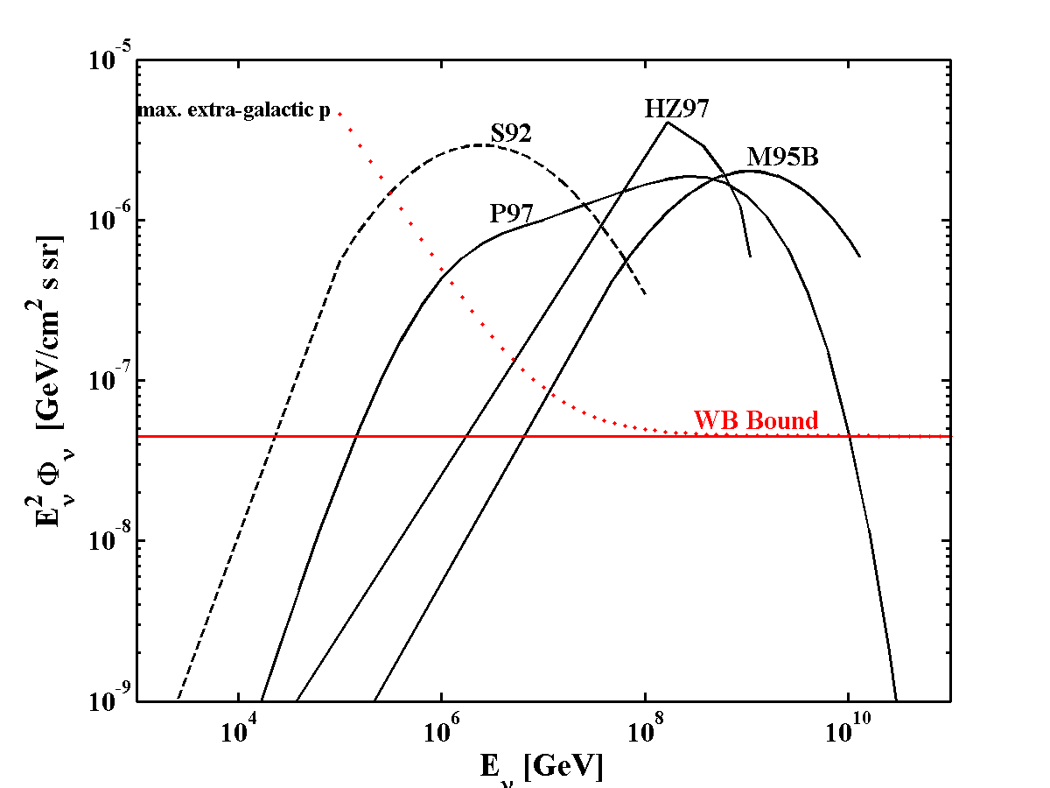
Bound implications: I. AGN ν models
“Hidden” (ν only)
sources
Violating UHECR
bound
BBR05

Slide 19
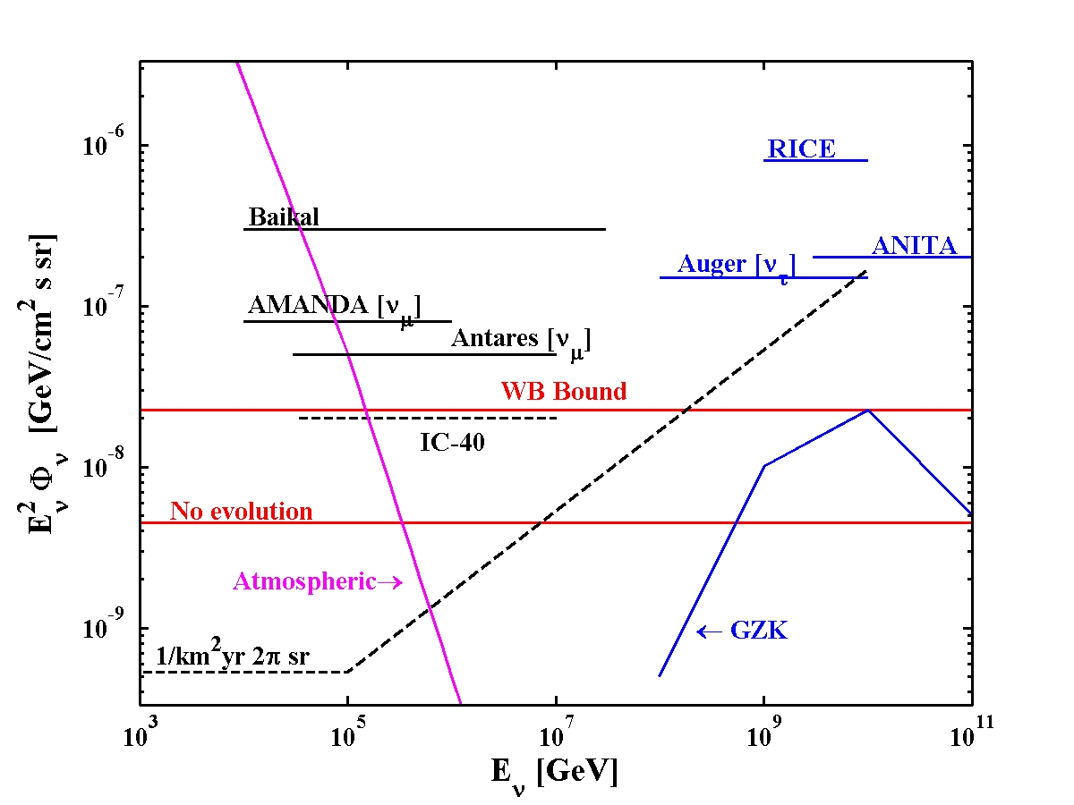
Bound implications: ν experiments
Fermi
2 flavors,

Slide 20
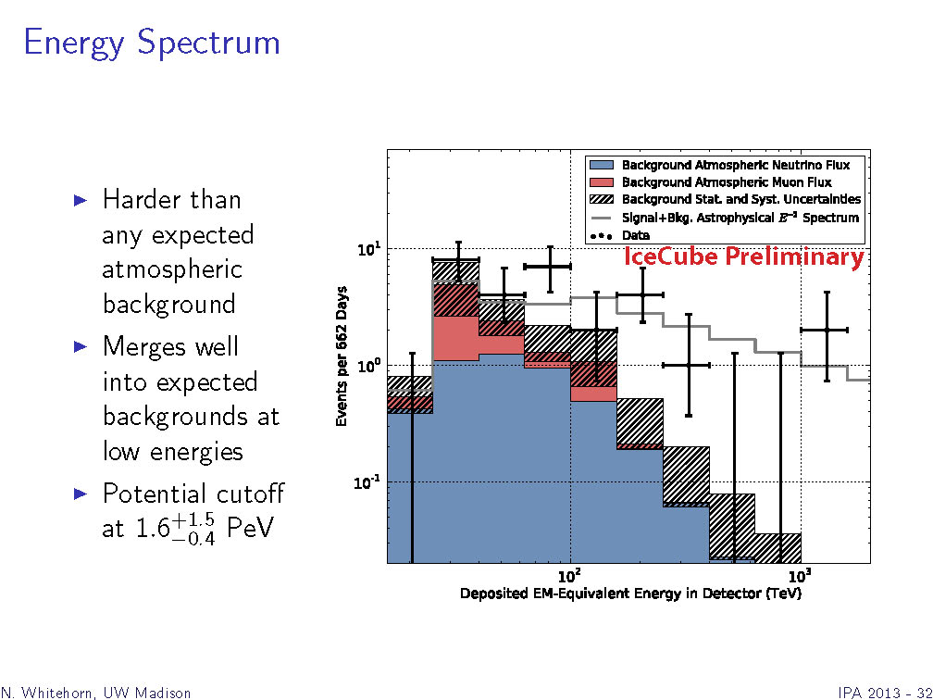
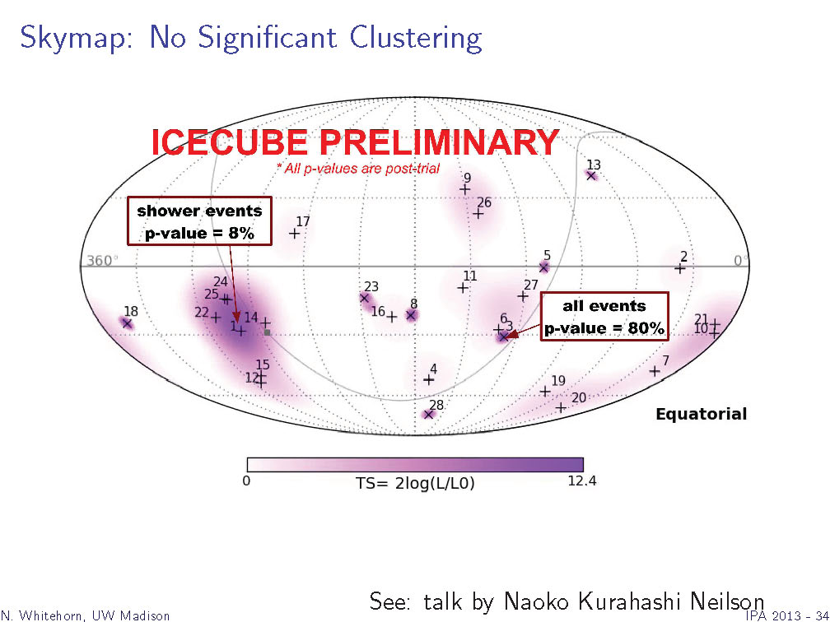
IceCube (preliminary) detection
28 events, compared to 12 expected, above 50TeV; ~4σ
(cutoff at 2PeV?)
1/E² spectrum, 4x10⁻⁸GeV/cm²s sr
Consistent with ν_{e}:ν_{μ}:ν_{τ}=1:1:1
Consistent with isotropy
New era in ν astronomy
[N. Whitehorn, IC collaboration, IPA 2013]

Slide 21
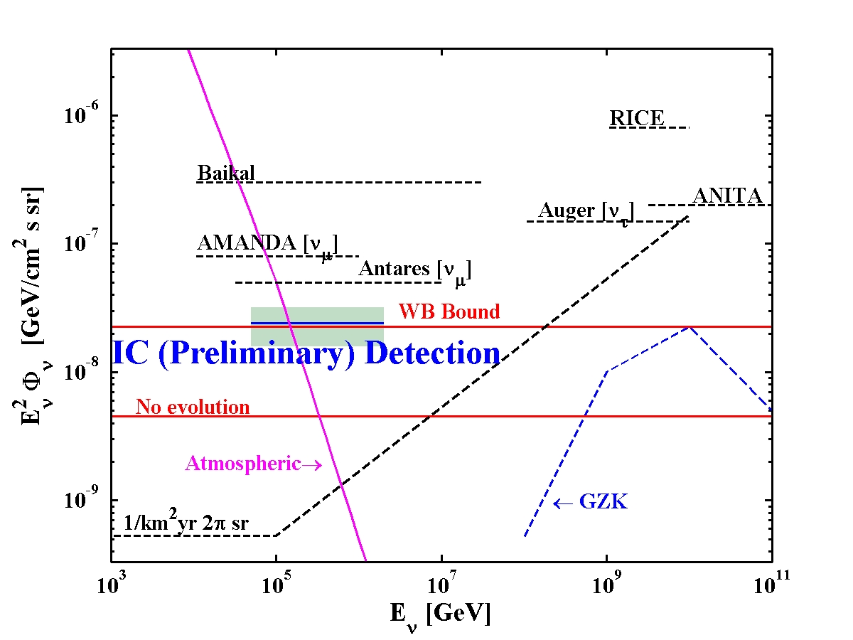
IceCube (preliminary) detection
2 flavors,

Slide 22
IceCube’s detection: Some implications
The coincidence of 50TeV<E<2PeV ν flux, spectrum (& flavor) with the WB bound is unlikely a chance coincidence.
Unlikely Galactic: ε²Φ_{γ}~10⁻⁷(E_{0.1TeV})^{-0.7}GeV/cm²s sr [Fermi]
→ ~10⁻⁹(E_{0.1PeV})^{-0.7}GeV/cm²s sr
XG distribution of sources,
p, ε²(dQ/dε)_{PeV-EeV}~ ε²(dQ/dε) _{>10EeV}, τ_{γp(pp)}>~1
Or:
ε²(dQ/dε)_{PeV-EeV}>> ε²(dQ/dε) _{>10EeV}, τ_{γp(pp)}<<1
& Coincidence (over a wide energy range)

Slide 23
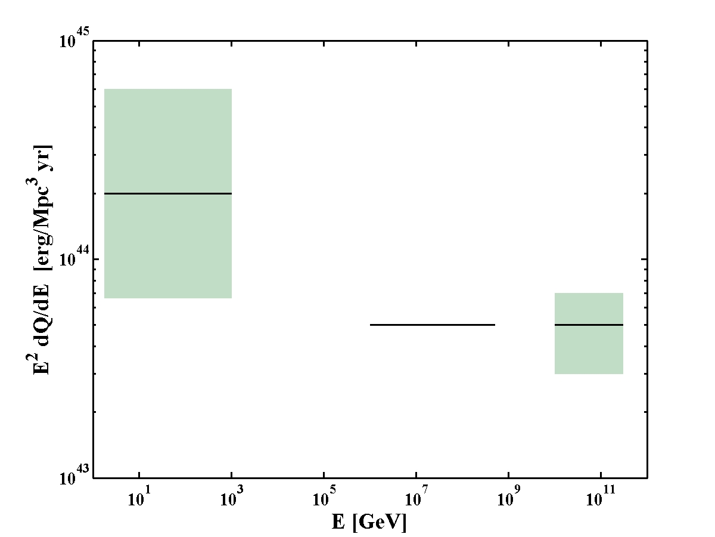
The cosmic ray generation spectrum
Galactic CRs
(+ CRs~SFR)
XG ν’s
XG CRs

Slide 24
ν’s from Star Bursts
Starburst galaxies
  {Star formation rate, density, B} ~ 10³x Milky way.
  Most stars formed in z>1.5 star bursts.
CR e’s lose all energy to synchrotron radiation,
ε<10PeV p’s likely lose all energy to π production,
at higher e may escape.
ε²(dQ/dε) ~10⁴⁴ erg/Mpc³ yr → Φ_{ν} ~Φ_{WB}
[Quataert et al. 06]
[Loeb & EW 06]

Slide 25
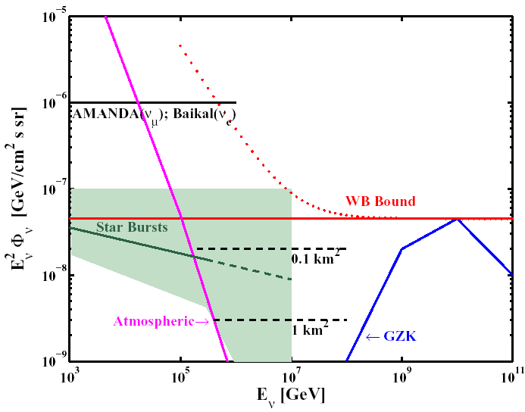
Starburst galaxies: predicted ν emission
[Loeb & EW 06]

Slide 26
IceCube’s detection: Some implications
The identity of the CR source(s) is still debated.
Open Q’s RE candidate source(s) physics [accreting BHs].
ε²(dQ/dε) ~ 10⁴⁴erg/Mpc³yr at all energies (10—10¹⁰ GeV).
Suggests: CRs of all E produced in galaxies @ a rate ~ SFR,
by transients releasing ~10^{50.5+-1.5}erg.
IceCube’s detection: new era in ν astro.
Next: spectrum, flavor, >1PeV, GZK,
EM association- Bright transients are the prime targets.
Coordinated wide field EM transient monitoring- crucial.
EM Association may resolve outstanding puzzles:
- Identify CR (UHE & G-CR) sources,
- Resolve open “cosmic-accelerator” physics Q’s
(related to BH-jet systems, particle acc., rad. mechanisms),
- Constrain ν physics, LI, WEP.

