Slide 1
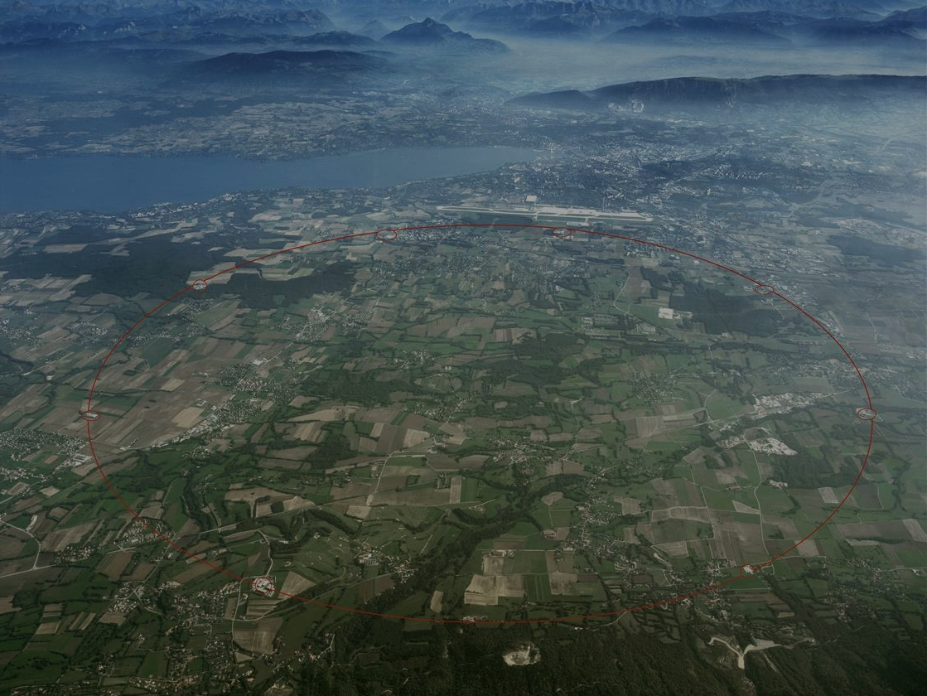
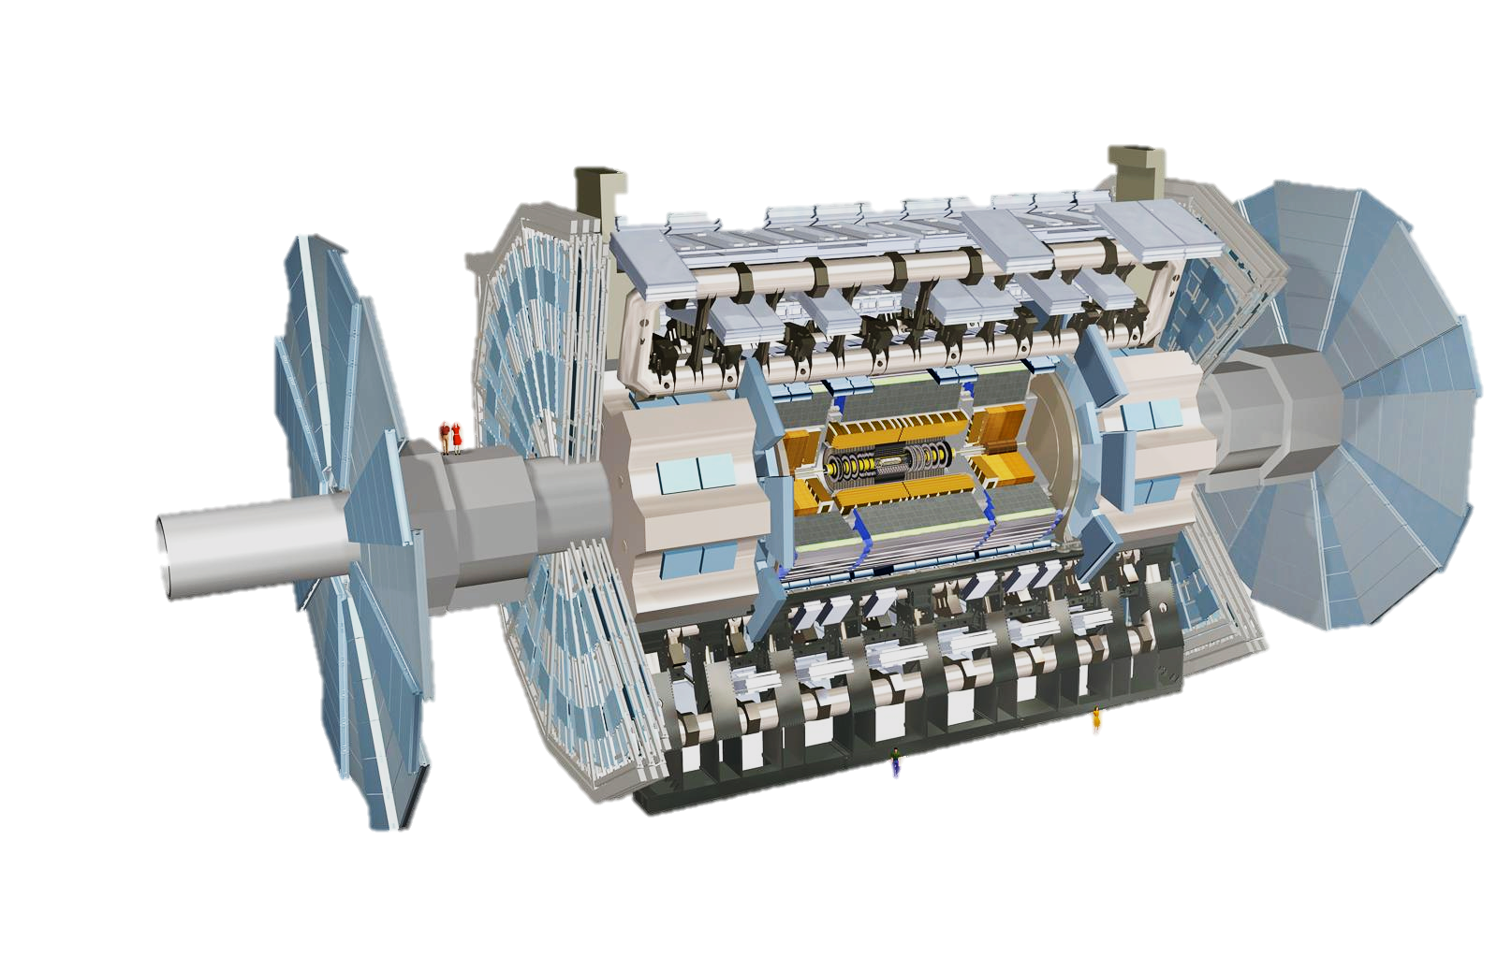
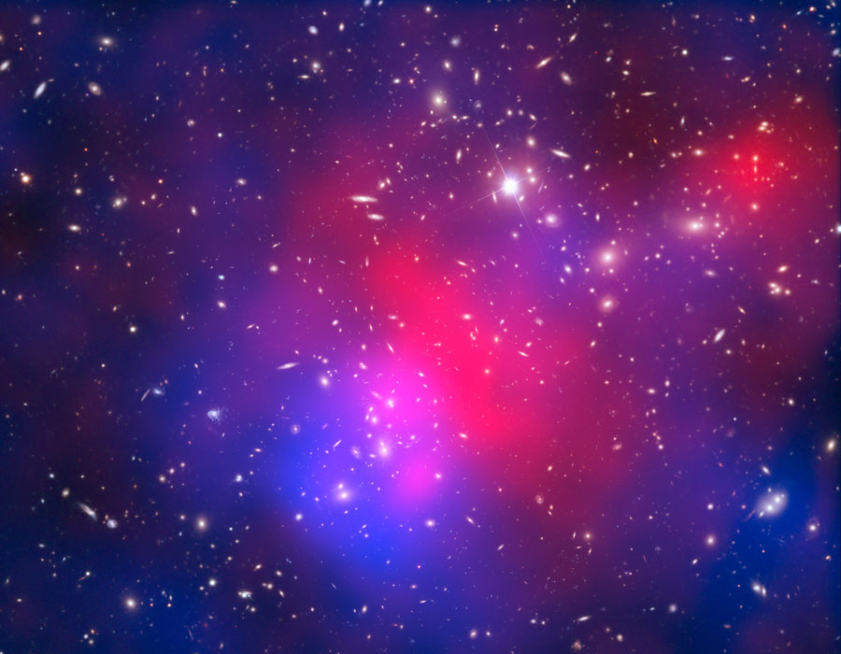
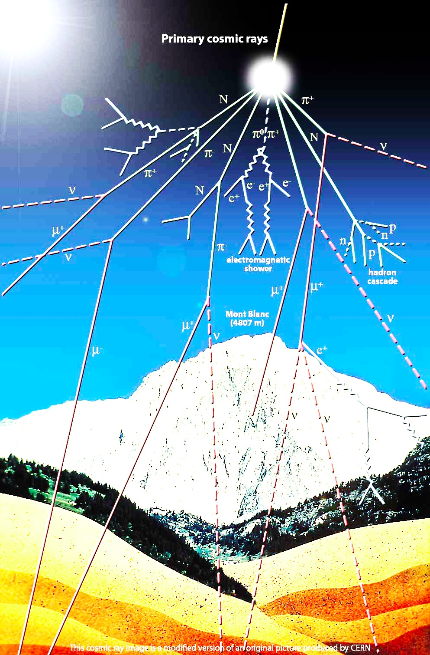
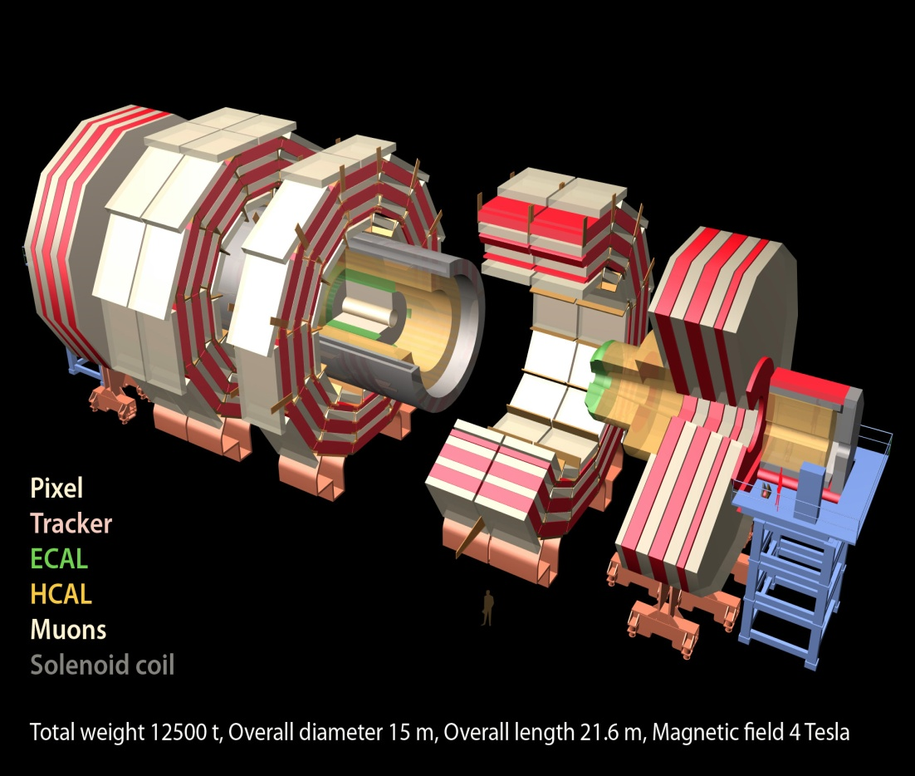
News from the LHC
“Astroparticle Physics at the LHC”
David Berge (GRAPPA, Amsterdam)
ATLAS
CMS

Slide 2
ATLAS and CMS public results
Journal publications:
  ATLAS: https://twiki.cern.ch/twiki/bin/view/AtlasPublic/Publications
  CMS:
    https://twiki.cern.ch/twiki/bin/view/CMSPublic/PhysicsResults
    http://cern.ch/go/8rH8
Conference notes with preliminary results, internally reviewed:
  ATLAS: https://twiki.cern.ch/twiki/bin/view/AtlasPublic/CONFnotes
  CMS: http://cern.ch/go/V9wC

Slide 3
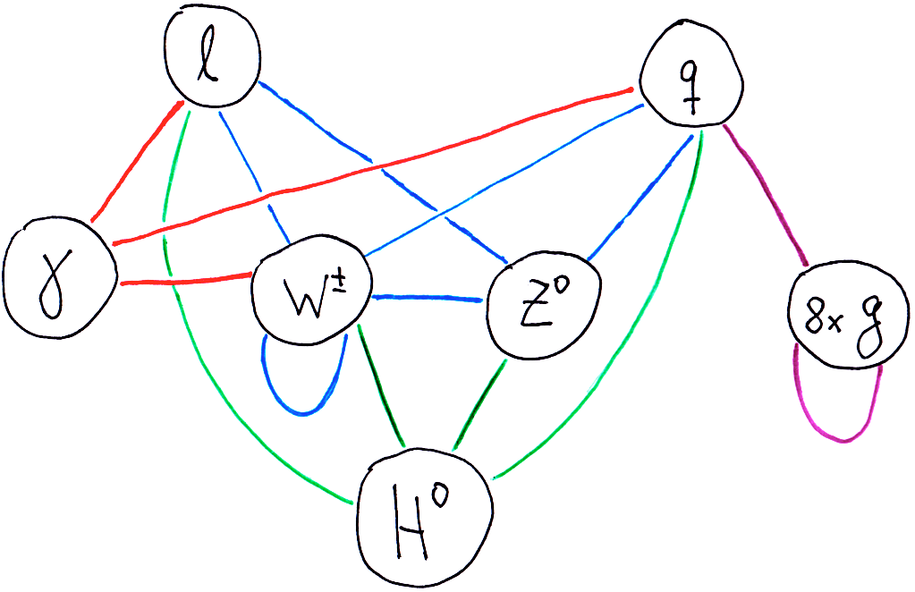
LHC Mission: Complete the Standard Model
Notes:
Particle physics is about understanding the fundamental constituents of matter, and the forces that act between them
Six quarks, six leptons, and their anti-particles
Forces are modeled by exchange of massless spin-1 bosons, which are generated by gauge symmetries
Photon is exchange particle mediating elm force
W/Z boson are mediating weak force
Gluons are strong force
W/Z ARE massive, and the idea is that they obtain mass via a vacuum field, the Higgs field, which breaks the original symmetry which generated the weak bosons, thereby giving them mass
Quarks and leptons are also obtaining mass via this SM vacuum field
Higgs particle is force carrier of this field, it has to be spin-0 and its mass is not specified by the theory

Slide 4
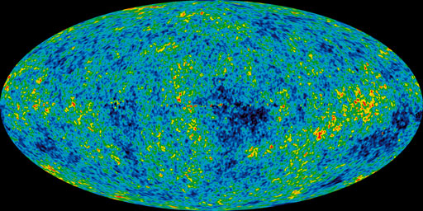
LHC Mission: Discover the Dark Sector (and more…)
χ
1
:
5

Slide 5
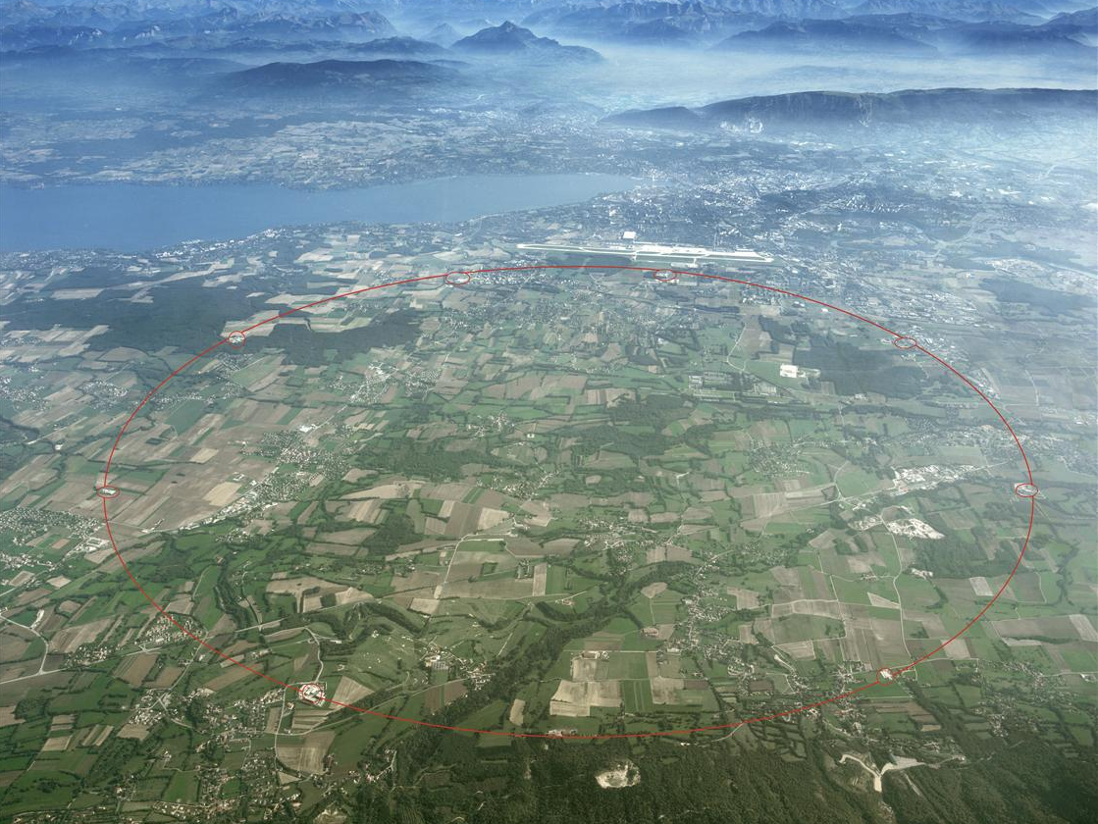
Two general-purpose experiments: ATLAS & CMS
ATLAS
CMS

Slide 6
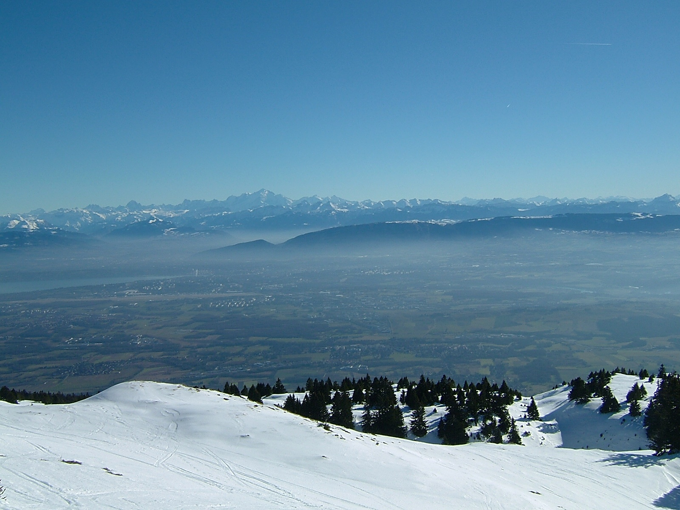

The Large Hadron Collider
 | 2012 performance | Design performance
Colliding bunches | 1331 | 2808
Energy | 4 TeV x 4 TeV | 7 TeV x 7 TeV
Bunch spacing | 50 ns | 25 ns
Luminosity | 7.7 x 10³³ cm⁻² s⁻¹ | 10³⁴ cm⁻² s⁻¹
Pile-up interactions | ~35 | ~25
LHC
PS
SPS

Slide 7
The Large Hadron Collider
 | 2012 performance | 2015 likely performance
Colliding bunches | 1331 | 2520
Energy | 4 TeV x 4 TeV | 6.5 TeV x 6.5 TeV
Bunch spacing | 50 ns | 25 ns
Luminosity | 7.7 x 10³³ cm⁻² s⁻¹ | 1.5 x 10³⁴ cm⁻² s⁻¹
Pile-up interactions | ~35 | ~40
LHC
PS
SPS

Slide 8
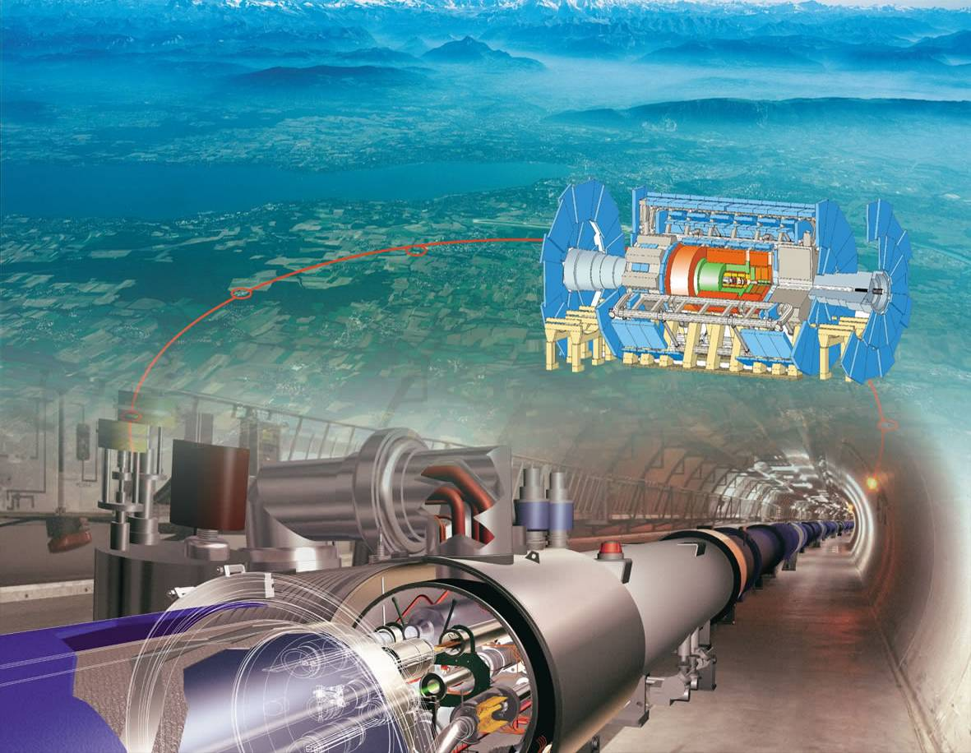
Searches for weakly interacting particles
p
Q ² = M_{X}
X = jets, W, Z, top, Higgs, SUSY, …
p
Underlying event
Notes:
Make it simple and short!

Slide 9
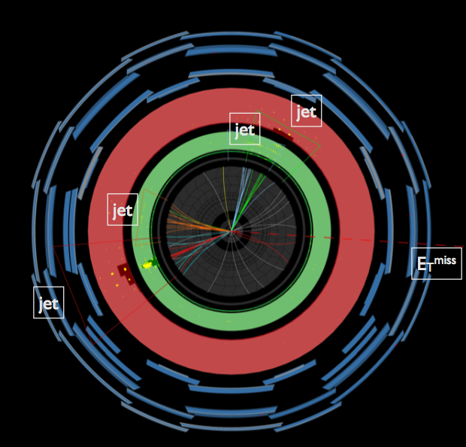
Task: measure transverse energy

Slide 10
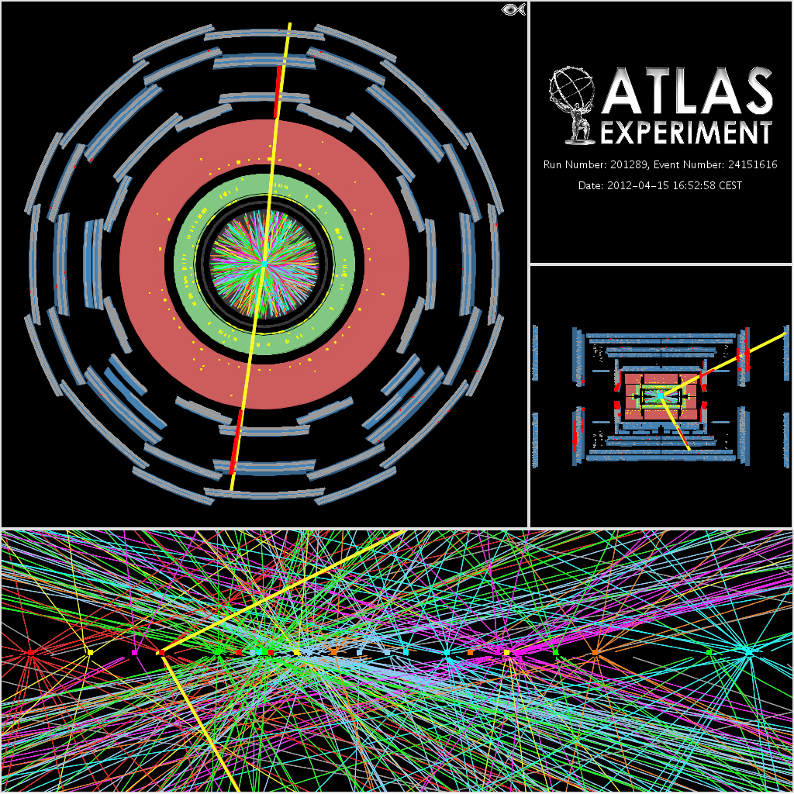
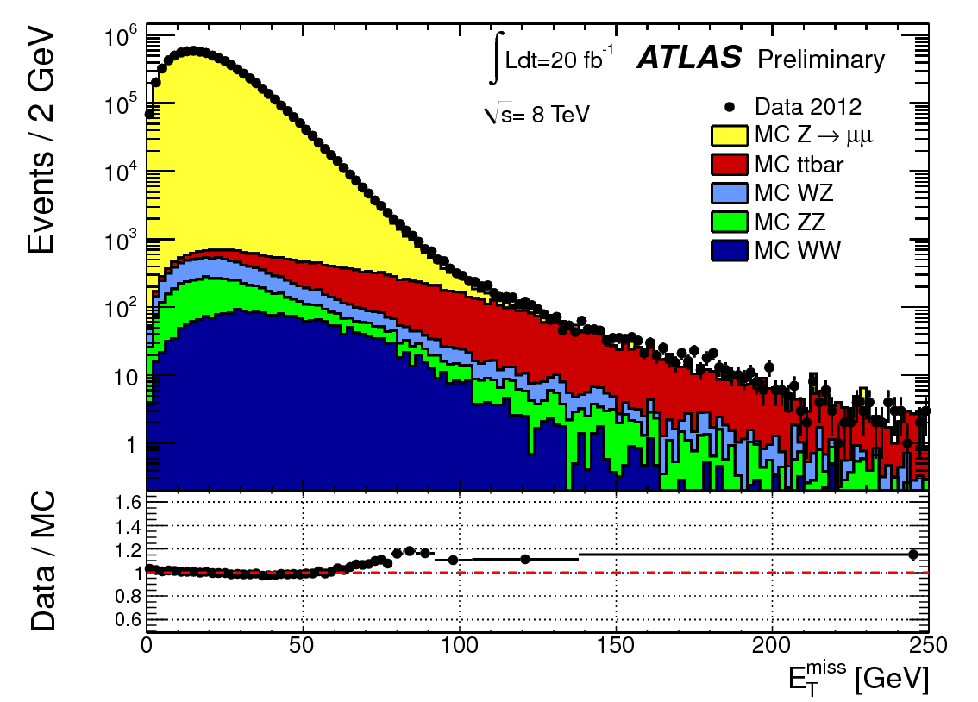
Difficulty: event pile-up
ATLAS-CONF-2013-082
Z → μμ event in ATLAS with 25 reconstructed vertices
Notes:
----- Meeting Notes (2/14/12 10:17) -----
High lumi comes at a price: pile-up
additional energy shot constantly and at random into the detector
Here a picture that proves we are doing well

Slide 11
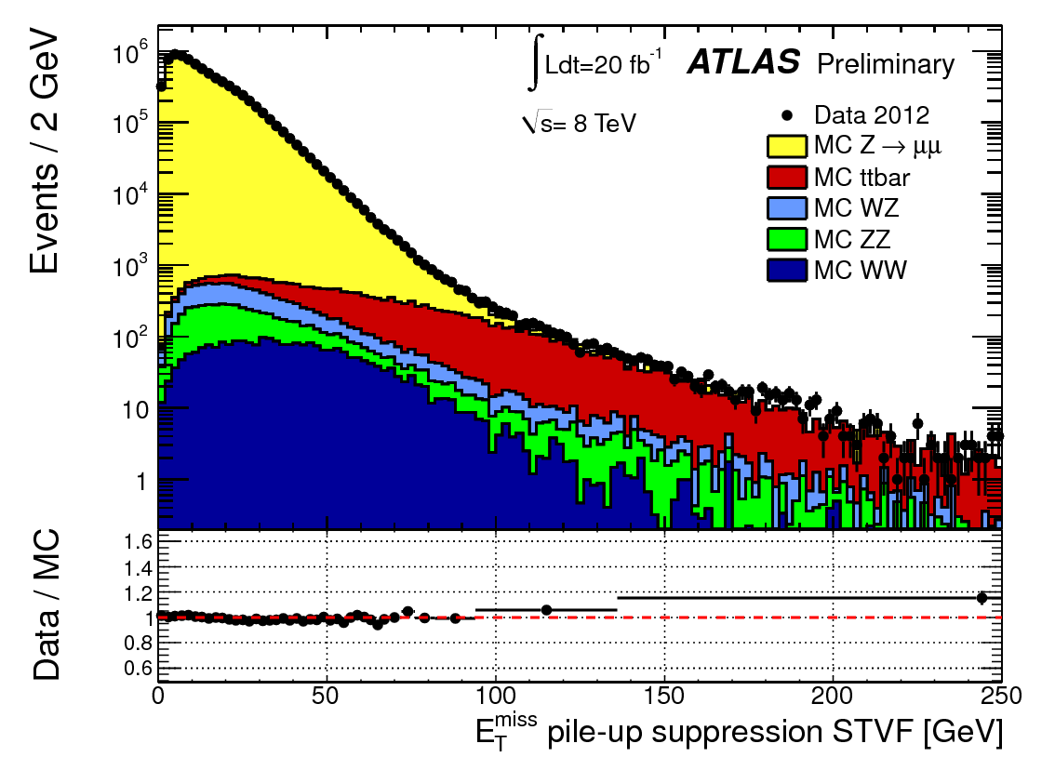
Difficulty: event pile-up
ATLAS-CONF-2013-082
With pile-up suppression algorithms
Z → μμ event in ATLAS with 25 reconstructed vertices
Notes:
----- Meeting Notes (2/14/12 10:17) -----
High lumi comes at a price: pile-up
additional energy shot constantly and at random into the detector
Here a picture that proves we are doing well

Slide 12
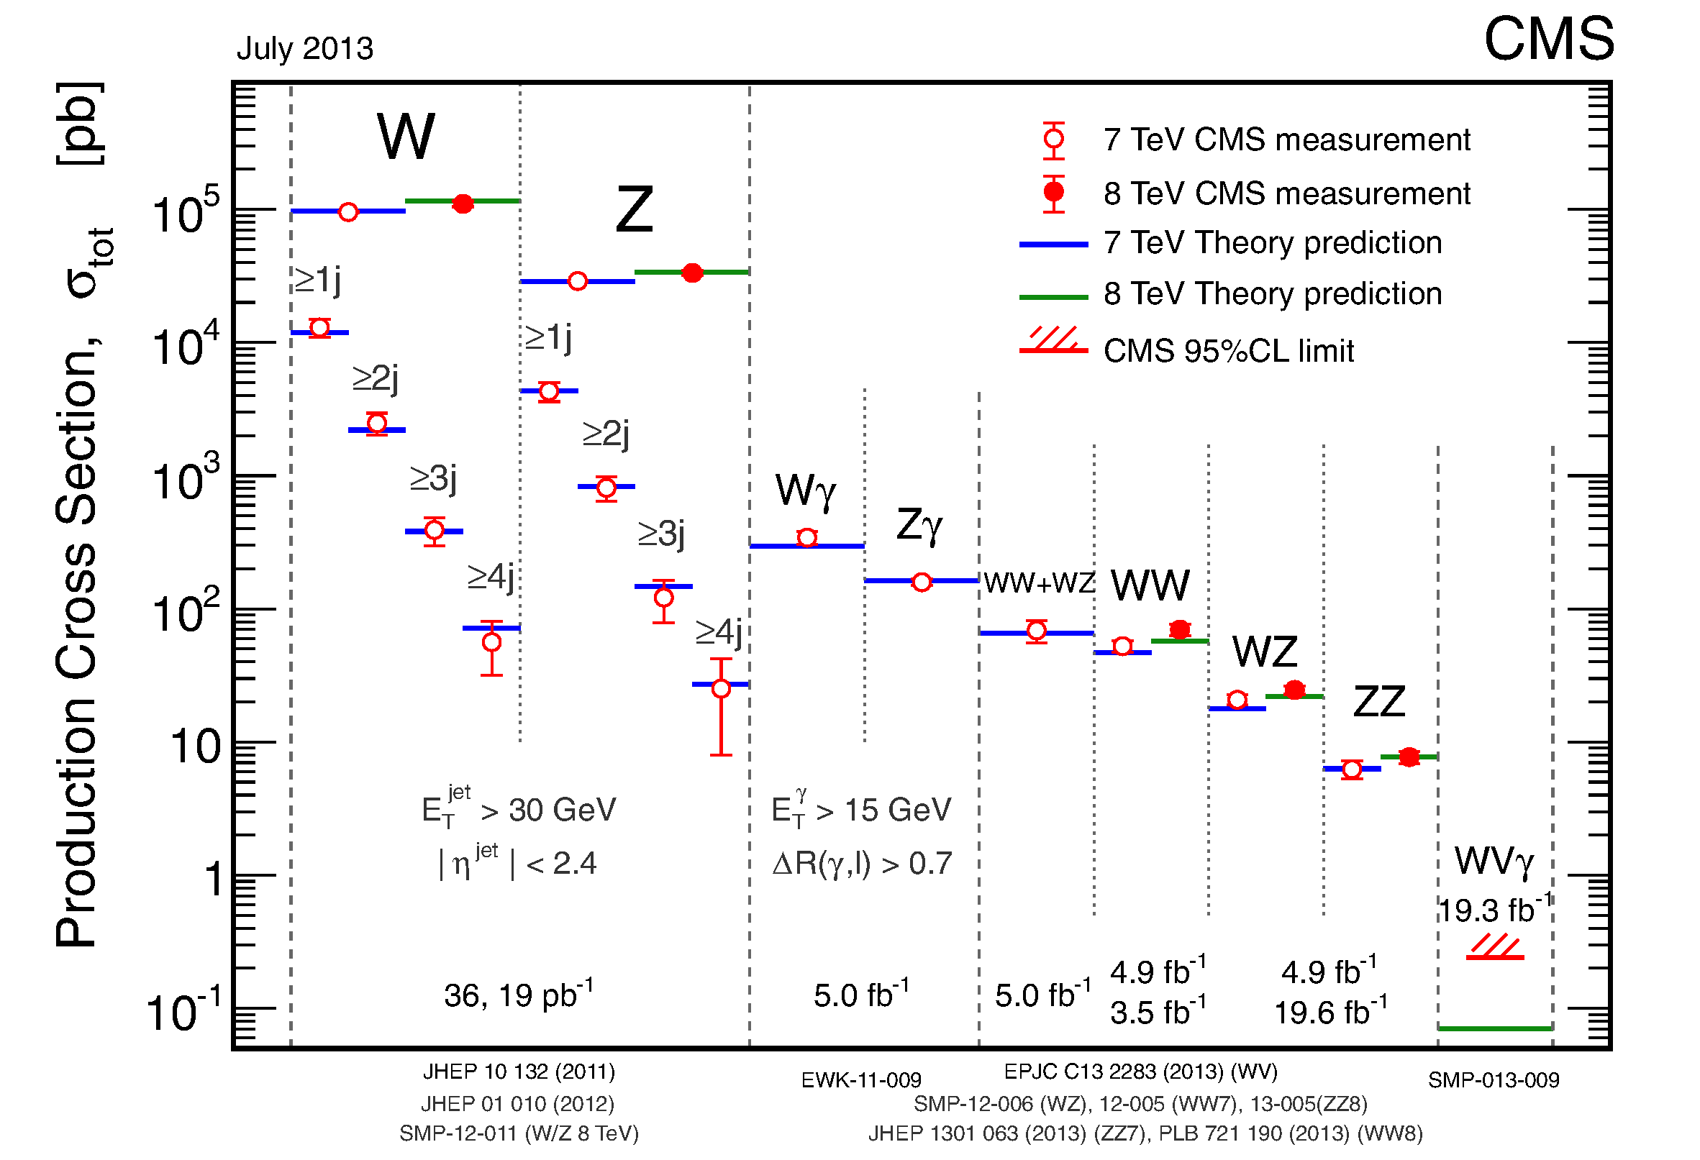
Up to now, we found everything we knew about…
https://twiki.cern.ch/twiki/bin/view/CMSPublic/PhysicsResultsSMP

Slide 13
… and nothing we didn’t know about!
https://twiki.cern.ch/twiki/bin/view/AtlasPublic/CombinedSummaryPlots, or next slide…

Slide 14
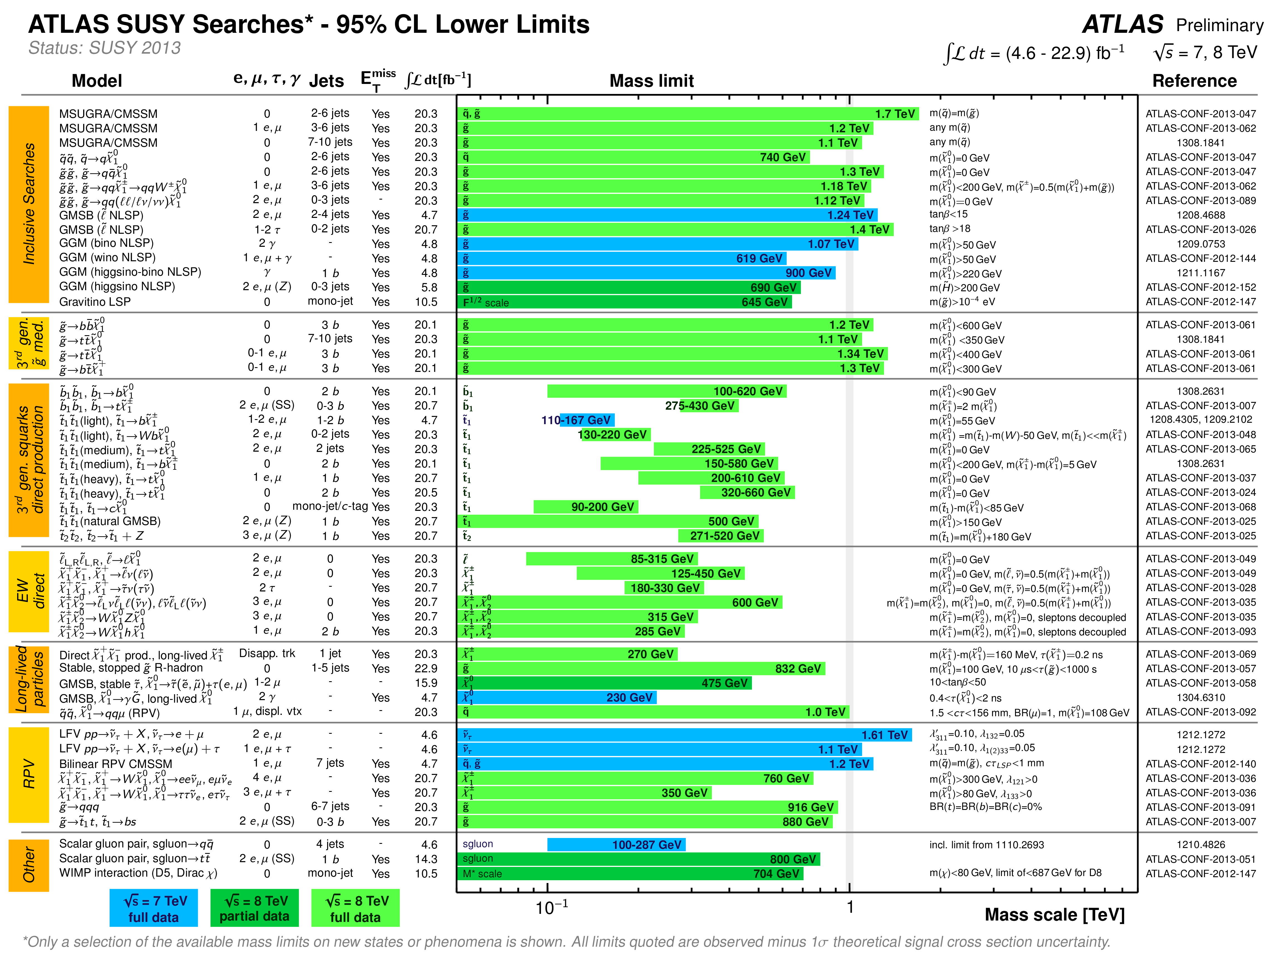
… and nothing we didn’t know about!
Strong push on naturalness dedicated searches, but also long-lived particles and RPV

Slide 15
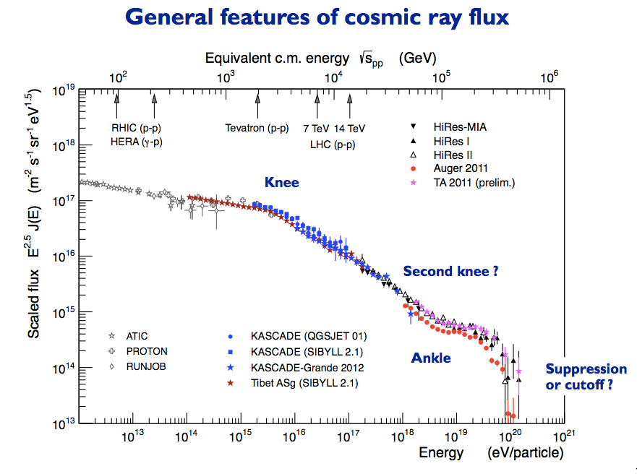
CERN / LHC Interactions with Astroparticle Physics
ATLAS ApP Forum newly founded
CERN-wide workshop “Results and prospects of forward physics at the LHC: Implications for the study of diffraction and cosmic ray interactions”: indico.cern.ch/conferenceDisplay.py?confId=223562
Now regular CERN-wide meetings in forward physics working group: http://lpcc.web.cern.ch/LPCC/index.php?page=fwd_wg
R.Engel

Slide 16
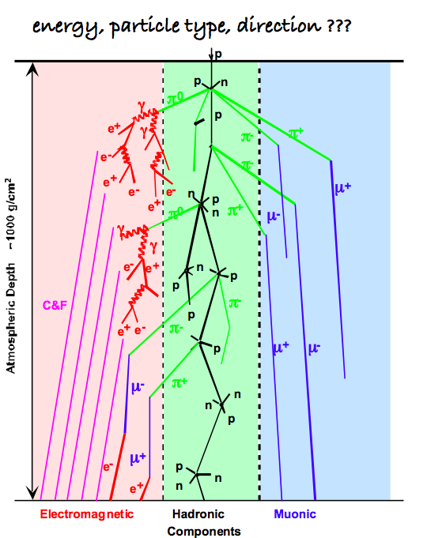
CERN / LHC Interactions with Astroparticle Physics
ATLAS ApP Forum newly founded
CERN-wide workshop “Results and prospects of forward physics at the LHC: Implications for the study of diffraction and cosmic ray interactions”: indico.cern.ch/conferenceDisplay.py?confId=223562
Now regular CERN-wide meetings in forward physics working group: http://lpcc.web.cern.ch/LPCC/index.php?page=fwd_wg

Slide 17
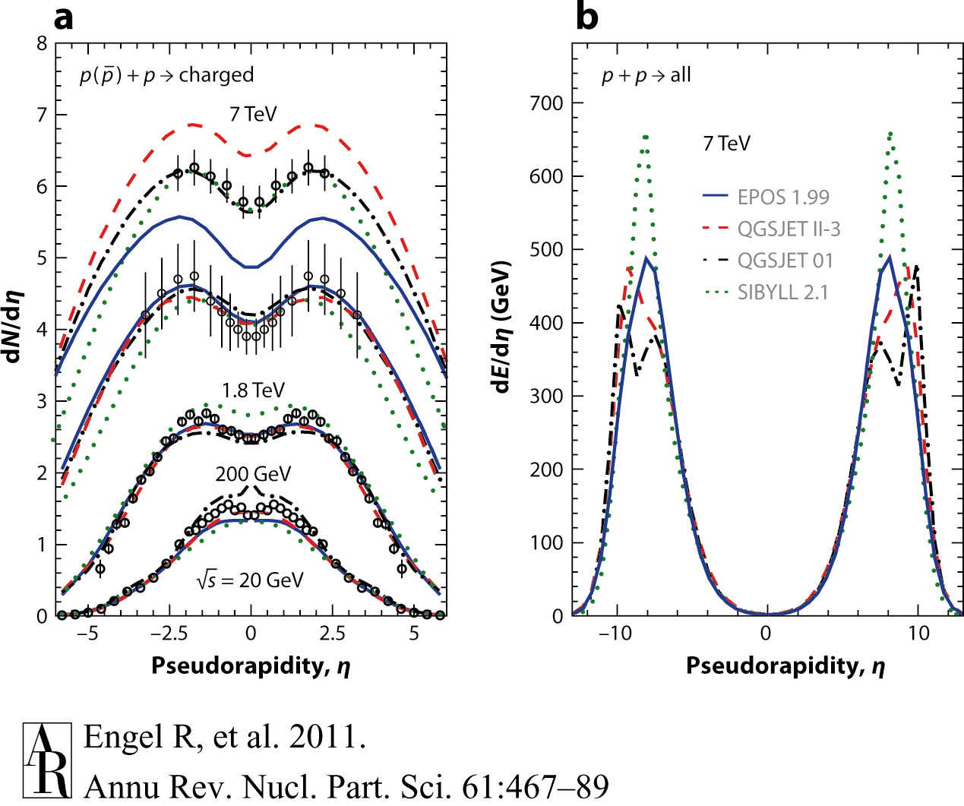
CERN / LHC Interactions with Astroparticle Physics
ATLAS ApP Forum newly founded
CERN-wide workshop “Results and prospects of forward physics at the LHC: Implications for the study of diffraction and cosmic ray interactions”: indico.cern.ch/conferenceDisplay.py?confId=223562
Now regular CERN-wide meetings in forward physics working group: http://lpcc.web.cern.ch/LPCC/index.php?page=fwd_wg
Extrapolations needed:
Energy
Central to very forward particle production
proton-proton to proton-Air

Slide 18
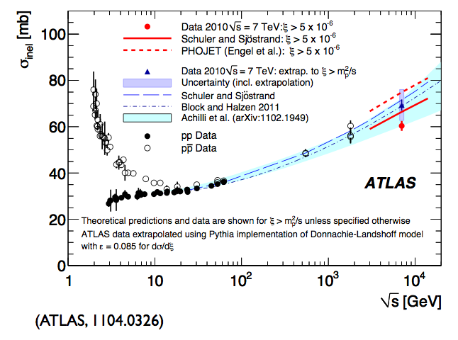
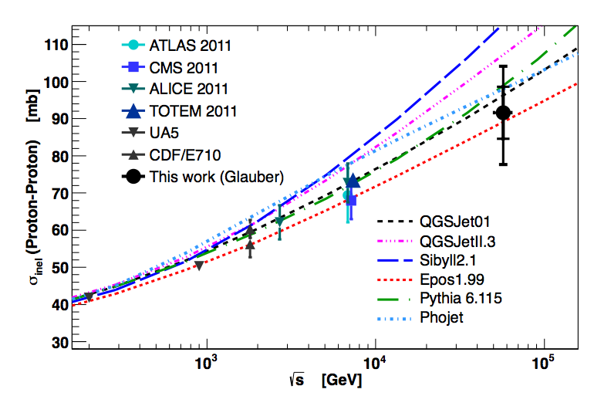
Extrapolations to the highest CR energies
Total pp cross section in ATLAS:
arXiv:1104.0326
Auger, arXiv:1208.1520
p
p
p
p
Cross-section measured within detector volume
Cross-section extrapolated to full phase space

Slide 19
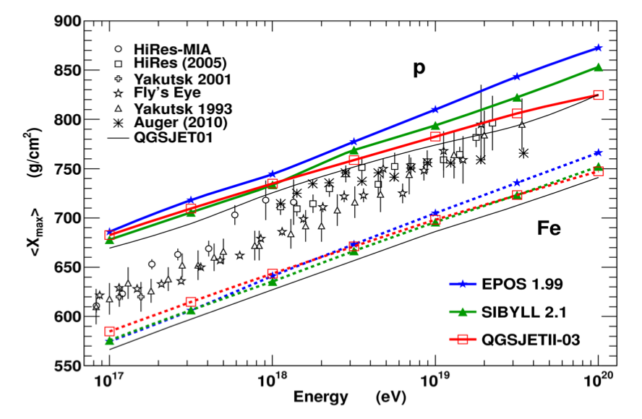
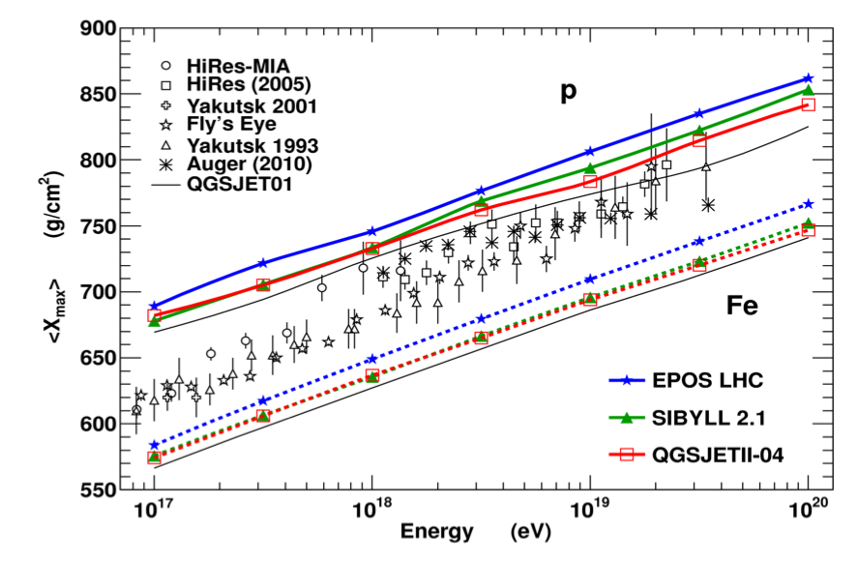
CERN / LHC Interactions with Astroparticle Physics
ATLAS ApP Forum newly founded
CERN-wide workshop “Results and prospects of forward physics at the LHC: Implications for the study of diffraction and cosmic ray interactions”: indico.cern.ch/conferenceDisplay.py?confId=223562
Now regular CERN-wide meetings in forward physics working group: http://lpcc.web.cern.ch/LPCC/index.php?page=fwd_wg
Pre-LHC
Post-LHC
T.Pierog

Slide 20
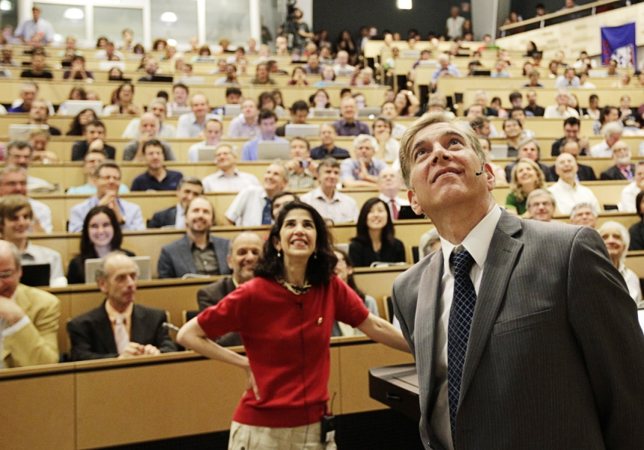
Back to the mainstream
H⁰…!
Fabiola Gianotti, ATLAS
Joe Incendela, CMS
4th of July, 2012 — Higgs-day at CERN

Slide 21
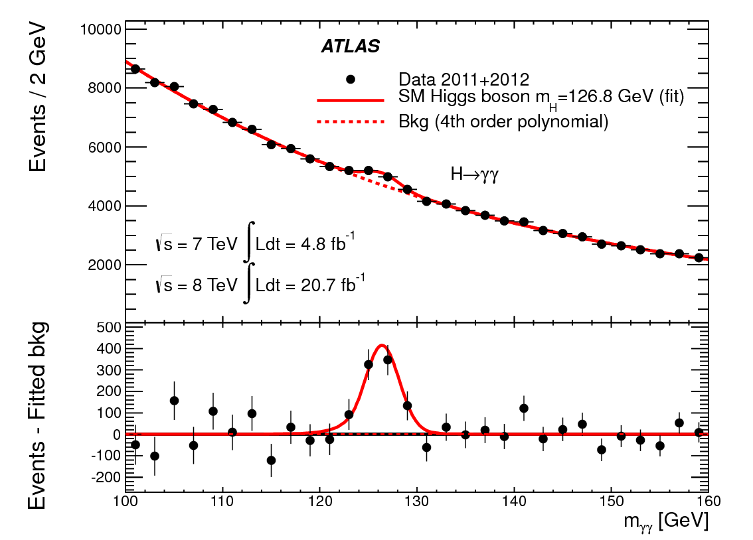
Back to the mainstream
arXiv:1307.1427

Slide 22
Expectations for the Standard Model Higgs at the LHC
Production cross sections
Quantum numbers:
spin-parity 0+
gluon fusion
vector boson fusion
associated production
The LHC Higgs cross section working group:
https://twiki.cern.ch/twiki/bin/view/LHCPhysics/CrossSections

Slide 23
Expectations for the Standard Model Higgs at the LHC
Decay branching fractions
Quantum numbers:
spin-parity 0+
The LHC Higgs cross section working group:
https://twiki.cern.ch/twiki/bin/view/LHCPhysics/CrossSections

Slide 24
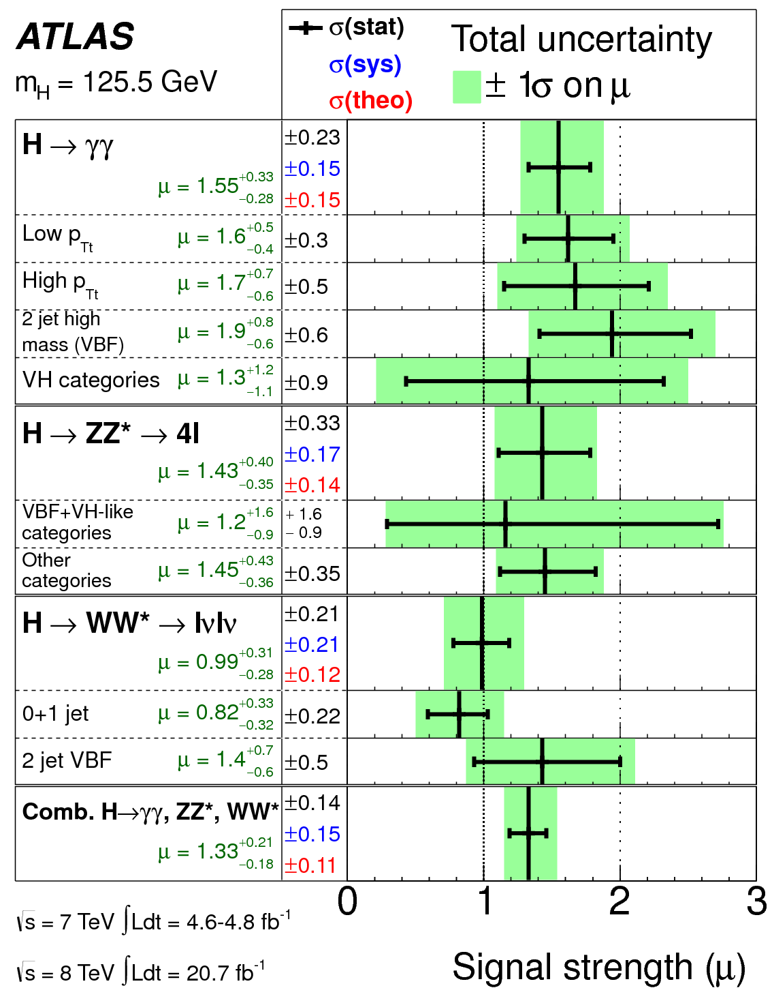
Higgs coupling to bosons
arXiv:1307.1427
γγ, ZZ, WW seen at 7.4, 6.6, 3.8σ
Leptonic decays of Z’s and W’s
Grand combination, including VBF or VH enhanced categories, yields for overall signal strength:
where μ=1 is the SM expectation

Slide 25
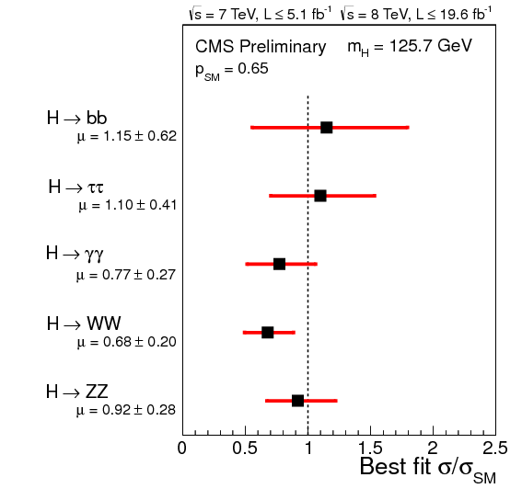
Higgs coupling to fermions
ττ and bb at 3σ and 2σ at the moment
as expected, wait for Run 2
CMS HIG-13-005
https://twiki.cern.ch/twiki/bin/view/CMSPublic/PhysicsResultsHIG

Slide 26
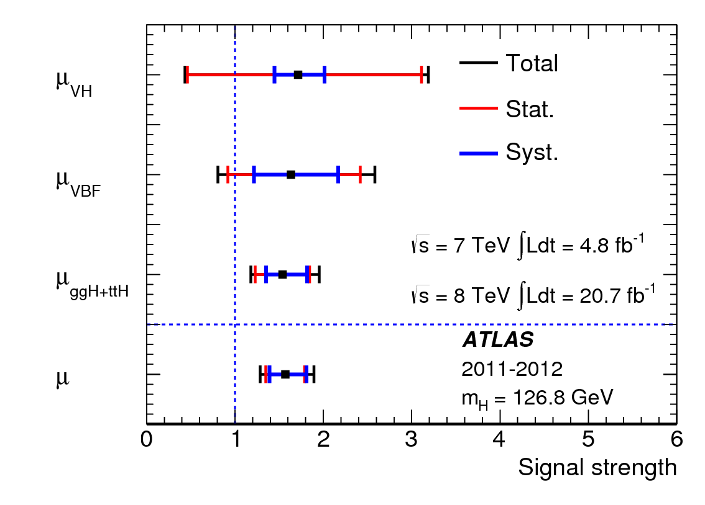
Higgs properties
mass
spin-parity
CMS HIG-13-002
‘0⁺’ clearly favored, other combinations disfavored by at least 97% in both ATLAS and CMS!
Angular analysis of H ➔ZZ➔4l
production modes
3.3σ evidence that fraction of VBF Higgs events is not zero.
arXiv:1307.1427

Slide 27
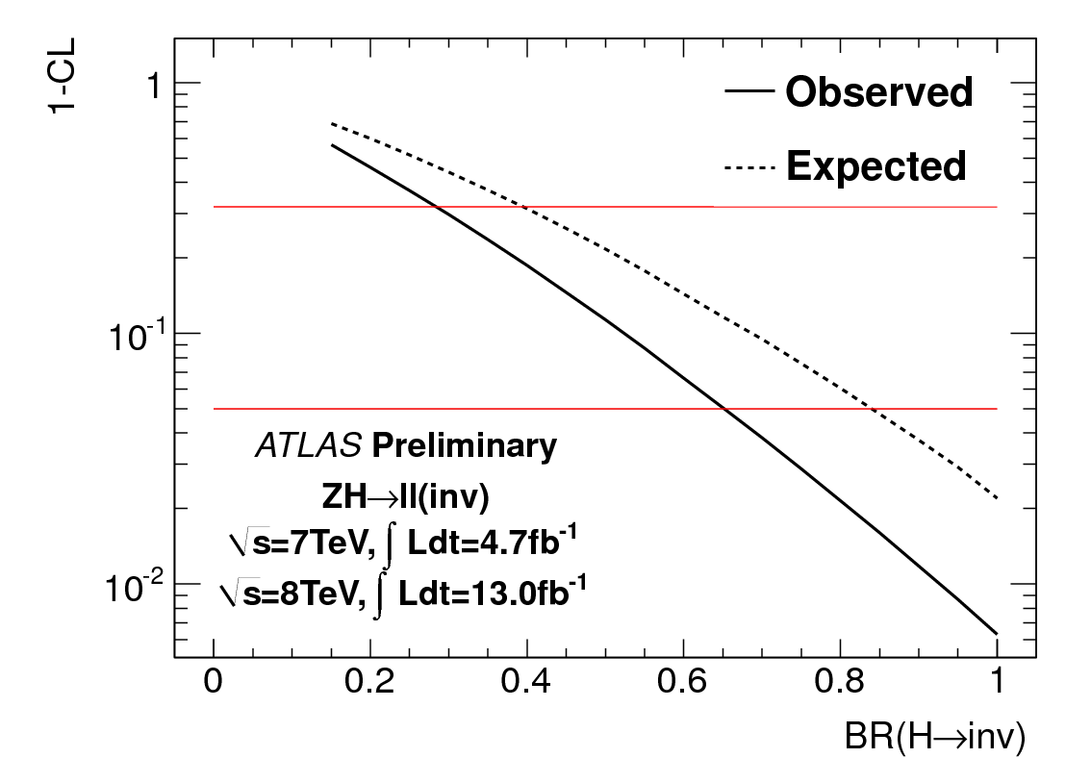
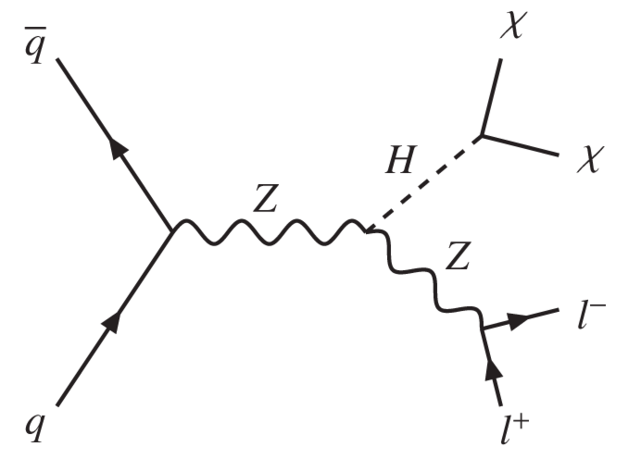
Higgs coupling to dark matter
Direct search in ZH
2 leptons plus missing transverse energy
ATLAS-CONF-2013-011
BR invisible < 65% at 95% CL
Plus brand-new CMS VBF result shown at SUSY13:
BR invisible 69% at 95% CL (CMS HIG-13-013)

Slide 28
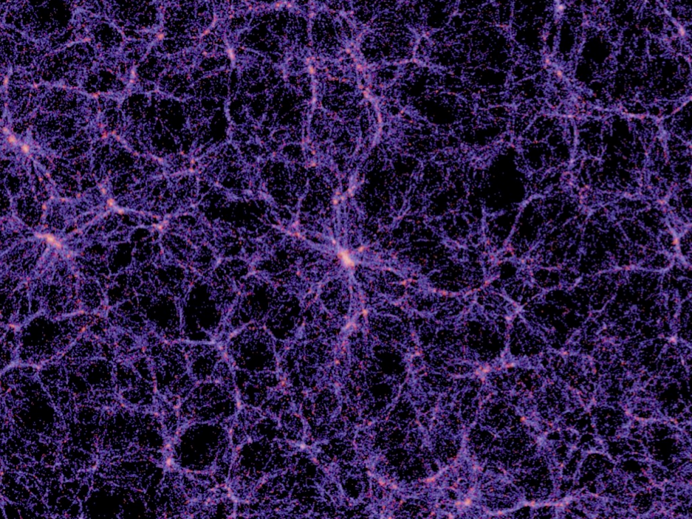
Going after the Dark at the LHC

Slide 29
Going after the Dark at the LHC
Data combinations and interpretations require assumptions about the red bubble!
Galaxy cluster Abell 2744
Particle Dark Matter Searches based on:
χ
SM
χ
χ
SM
χ
χ
SM
SM
SM
SM
χ
Indirect
Direct
Colliders

Slide 30
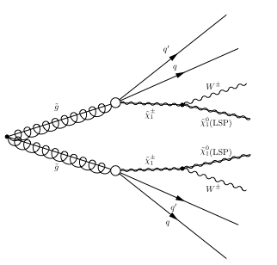
1: “Standard” Dark Matter Searches at Colliders
SM
χ
SUSY:
High-p_{T} jets from squark & gluino decays
Leptons from gaugino & slepton decays
Missing transverse energy from LSPs
SM
χ
jet
jet
jets/lepton
X
ET^{miss}
p
p
... + χ⁰1

Slide 31
Where do we start?
Huge parameter space, but guiding principles
Strong SUSY production
Electroweak SUSY production
SUSY searches strategy driven by cross section and luminosity
Strong production
(1+2 gen. squarks, and gluinos)
Strong production
(3rd gen. squarks)
EW production
31

Slide 32
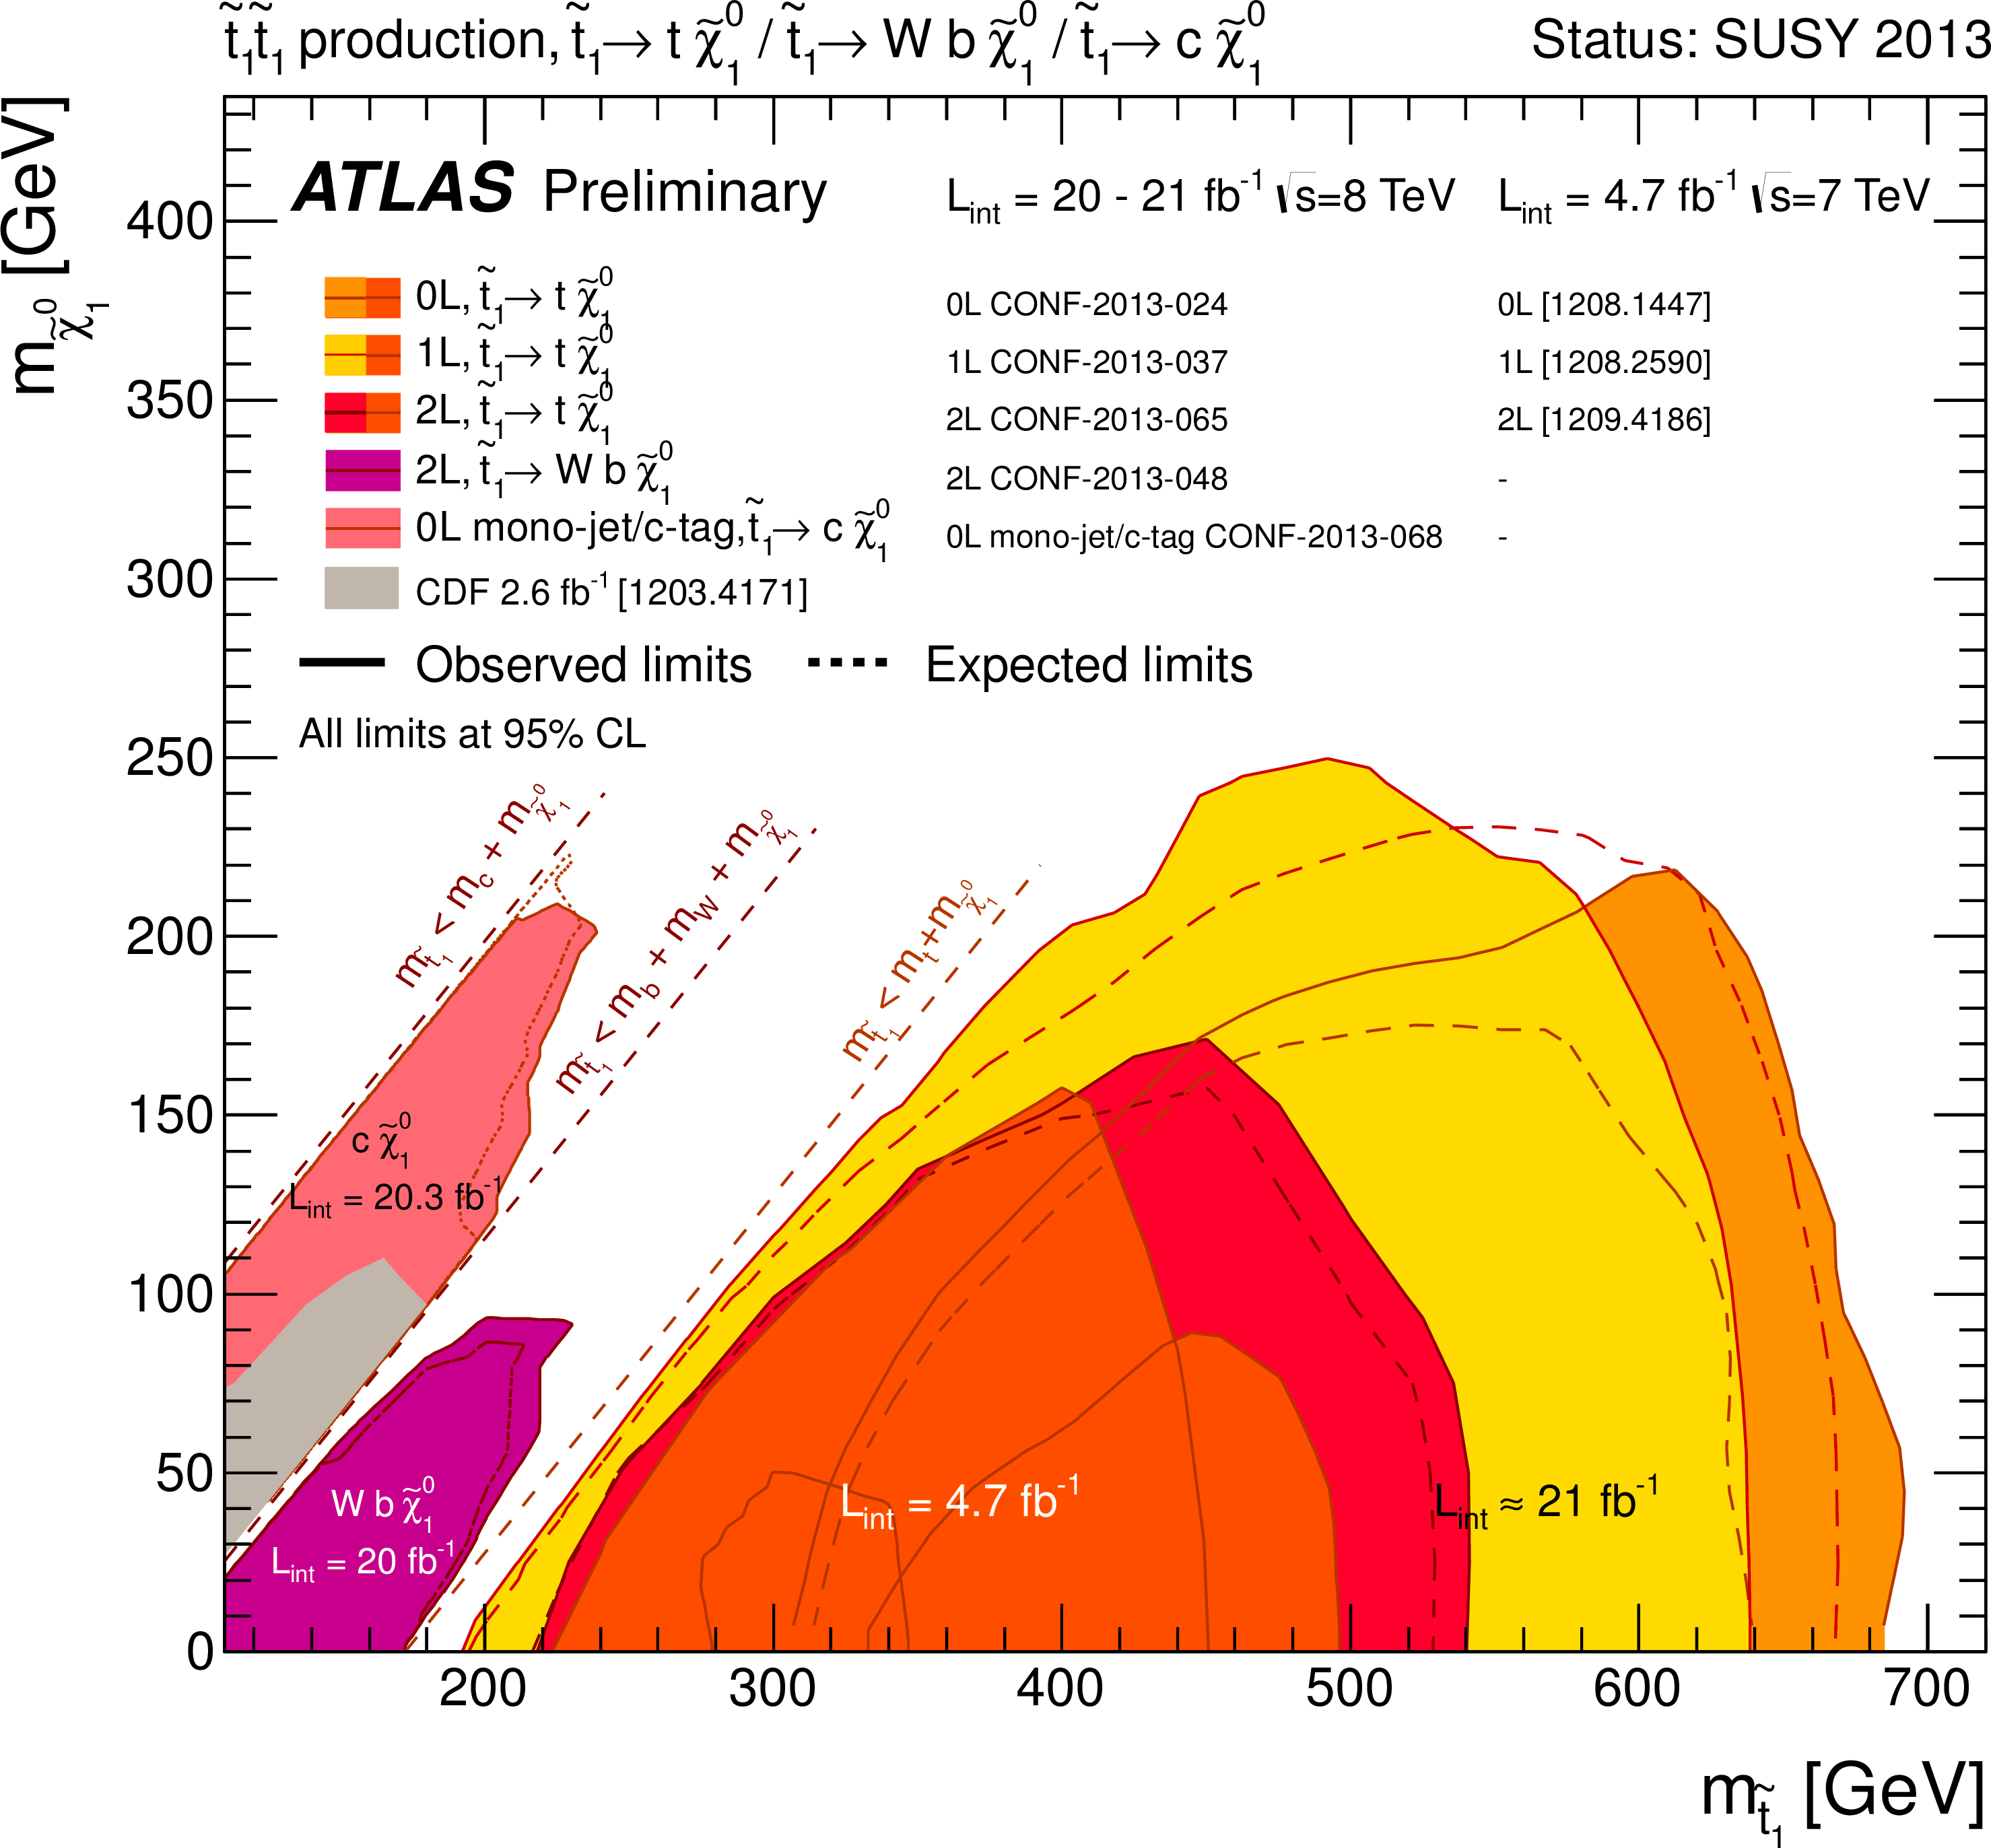
Natural SUSY searches
Search for 3rd generation squarks, leptons, b-jets, jets, missing Et
Probe SUSY as solution to the hierarchy problem
https://twiki.cern.ch/twiki/bin/view/AtlasPublic/CombinedSummaryPlots
https://twiki.cern.ch/twiki/bin/view/CMSPublic/PhysicsResultsSUS

Slide 33
Incl. searches
Natural SUSY
LLP + RPV
Extended
MSSM
David Berge (GRAPPA) / TeVPA 2013

Slide 34
So what?
Can still search for pairs of “ISR-tagged” dark-matter particles, not particular SUSY signatures
squark, gluino
mass
Δm ≈ missing E_{T}!
LSP / Neutralino
Amount of missing E_{T} depends on mass difference!

Slide 35

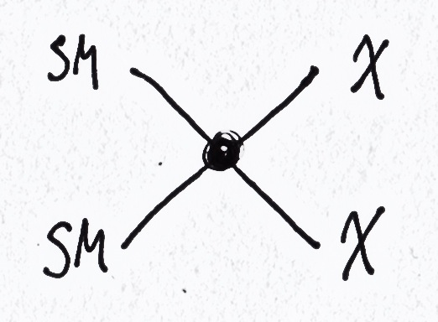
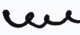
2: Dark Matter Pair Searches at Colliders
“ISR tag”
Everything else
mass
Δm very large
Dark matter

Slide 36
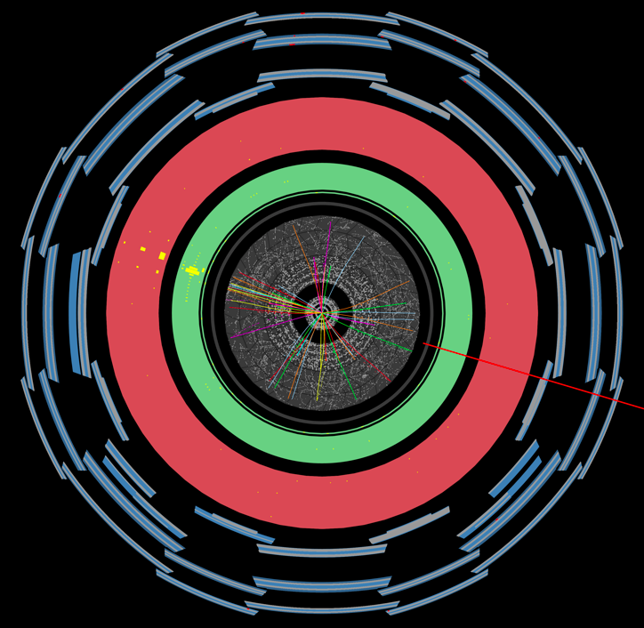

Slide 37
MET
y
Signal
x
Jet
Jet/γ
Backgrounds: Z / W
ν/l
ν
Z / W
Jet
Jet/γ

Slide 38
Nada! Set limits…
CMS EXO-12-048
CMS mono-jet, 20 fb⁻¹ at 8 TeV

Slide 39
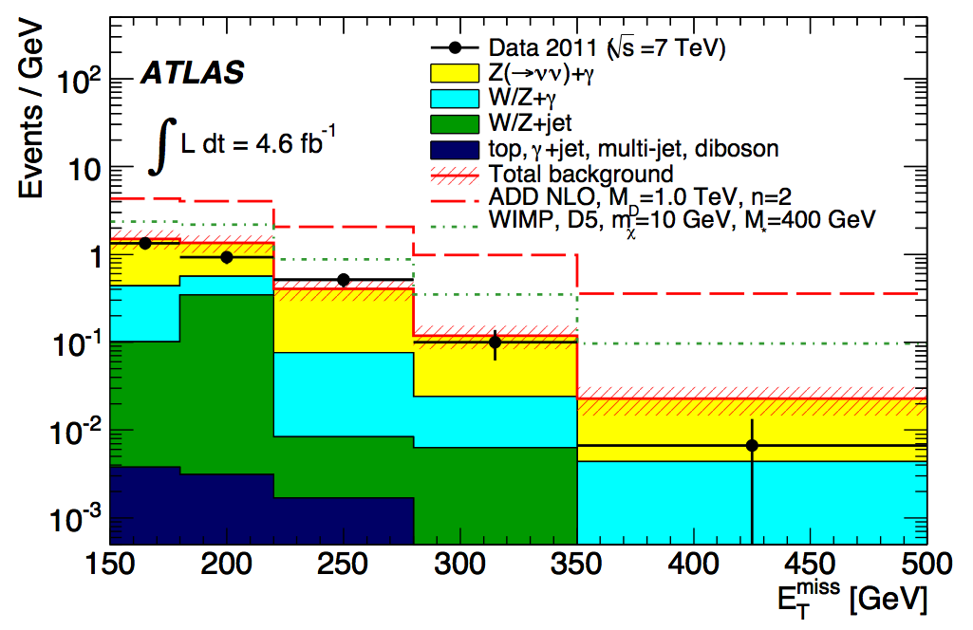
Nada! Set limits…
arxiv:1209.4625
ATLAS mono-γ, 4.6 fb⁻¹ at 7 TeV

Slide 40
Dark matter contact interactions
Galaxy cluster Abell 2744
M* and m_{χ} fix dark-matter nucleon scattering and annihilation cross sections (for given interaction type)!
Particle Dark Matter Searches based on:
χ
SM
χ
χ
SM
χ
χ
M*
SM
SM
M*
SM
SM
M*
χ
Indirect
Direct
Colliders

Slide 41
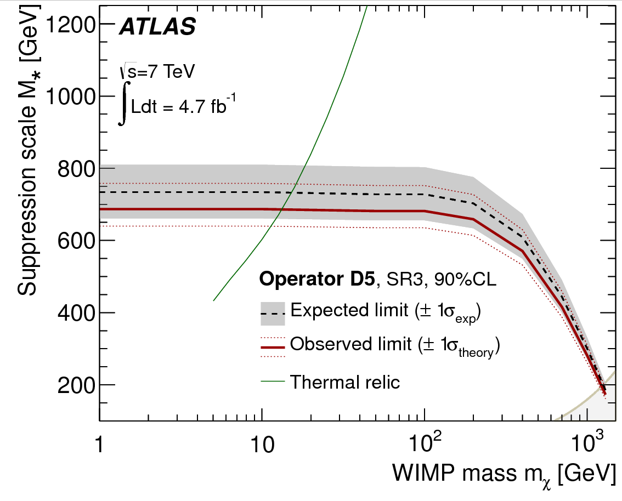
Nada! Set limits…
Suppression scale M* lower limits
arXiv:1210.4491
M* fixes coupling SM-χ
Coupling fixes annihilation cross section χ to SM
Relic density (WMAP) corresponds to cross section
Probe thermal relic dark matter particle at LHC!
Red above green line: conflict!
  Exclusion for this operator, or
  Additional annihilation channels (leptons!), or
  Wrong assumptions
χ
SM
χ
SM

Slide 42
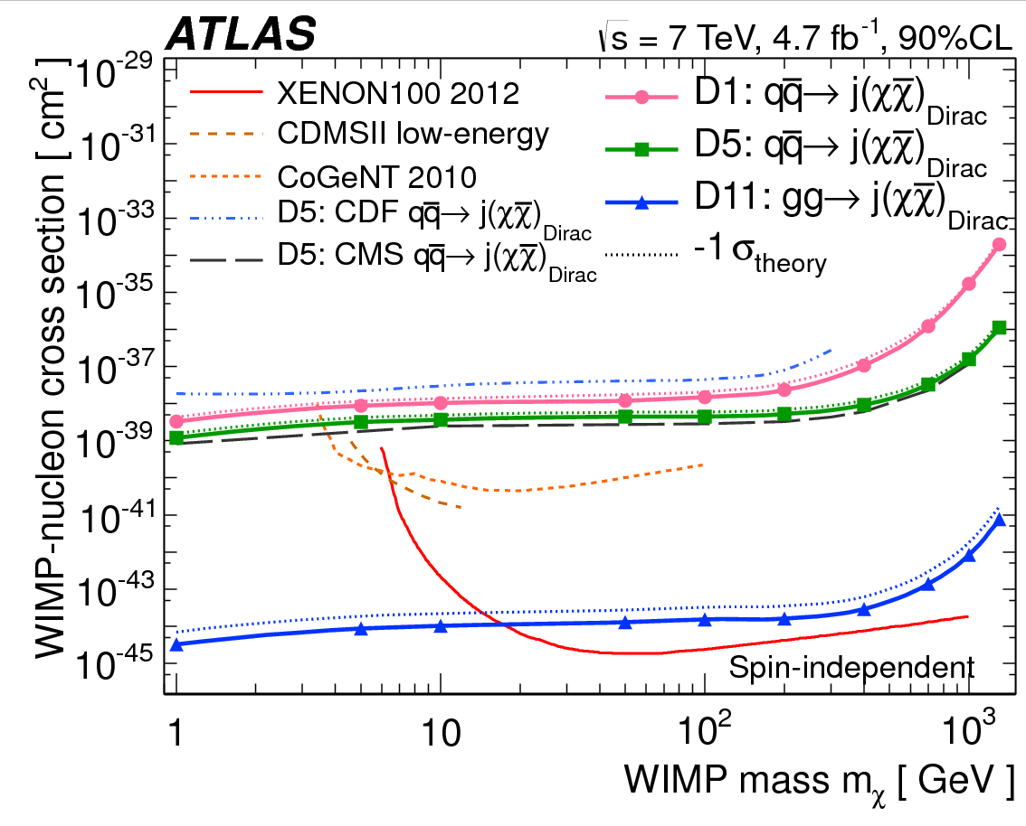
Dark matter contact interactions
See also future sensitivity study for Snowmass:
arXiv:1307.5327
arXiv:1210.4491
LHC 14 TeV 2021 (300 fb⁻¹):
× 20 to 100
× 300 to 1000

Slide 43
Dark matter contact interactions
CMS comparison of 5/fb at 7 TeV to 20/fb at 8 TeV
CMS EXO-12-048

Slide 44
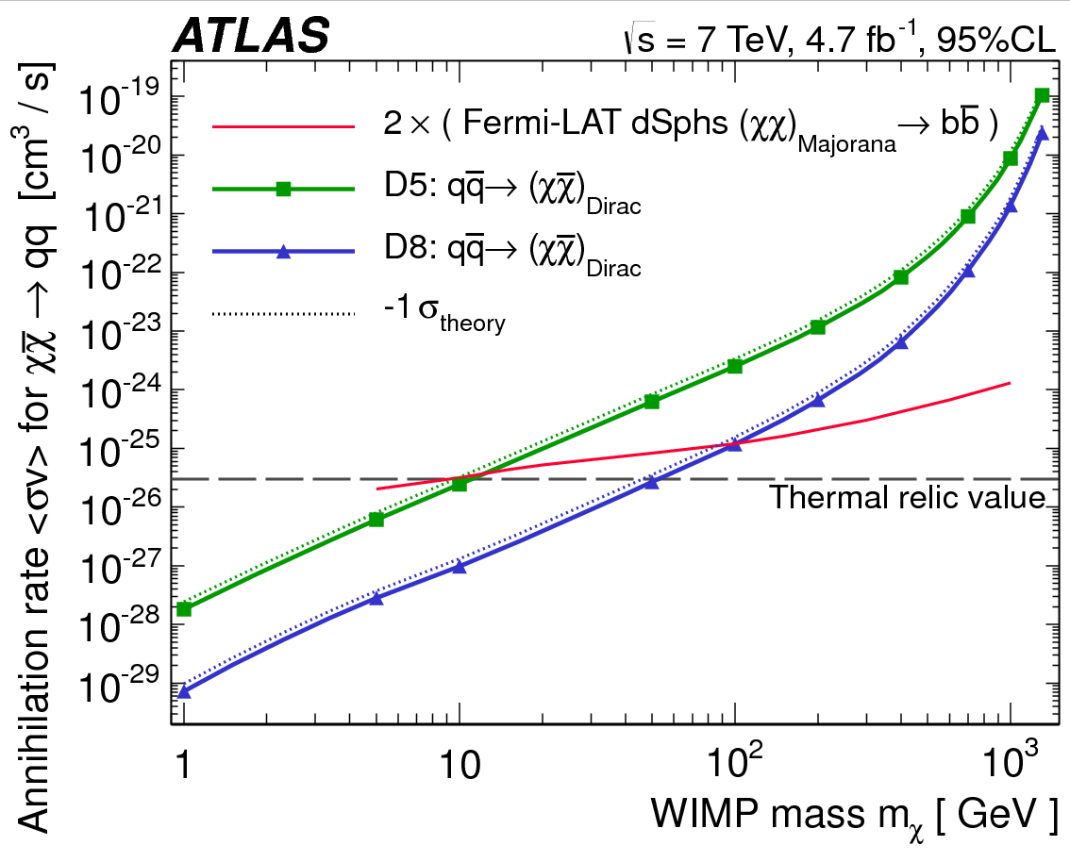
Dark matter contact interactions
See also future sensitivity study for Snowmass:
arXiv:1307.5327
arXiv:1210.4491
LHC 14 TeV 2021 (300 fb⁻¹):
× 20
× 300

Slide 45
News from the LHC
“Astroparticle Physics at the LHC”
David Berge (GRAPPA, Amsterdam)
ATLAS
CMS

Slide 46
News from the LHC
“Astroparticle Physics at the LHC”
Summary
LHC in shutdown, preparing for 13-14 TeV in 2015
Establishing contact with Astroparticle Physics community
New boson for now very similar to SM Higgs
  Run 2 will tell us about the other couplings (fermions!)
  Measuring all Higgs properties will take long, potentially a new machine (self coupling!)
We are going after the dark, so far without success
David Berge (GRAPPA, Amsterdam)
ATLAS
CMS

