Slide 1
LAGUNA-LBNO HP-PS
Rende Steerenberg, Javier Alabao, Javier Alabao, Androula Alekou, Fanouria Antoniou, Michael Benedikt, Roland Garoby, Frank Gerigk, Brennan Goddard, Christos Lazaridis, Yannis Papaphilippou, Angelina Parfenova,

Slide 2
The HP-PS basics
High Power Protons Synchrotron:
  2 MW beam power (@ 30 – 50 GeV)
  Dedicated to neutrinos for LAGUNA-LBNO
  Keep in mind possible use for LHC in future
3-fold symmetric machine is considered:
  About 1 km in circumference
  Imaginary gamma transition
  Injection/Extraction straight section
  Collimation straight section
  RF straight section

Slide 3
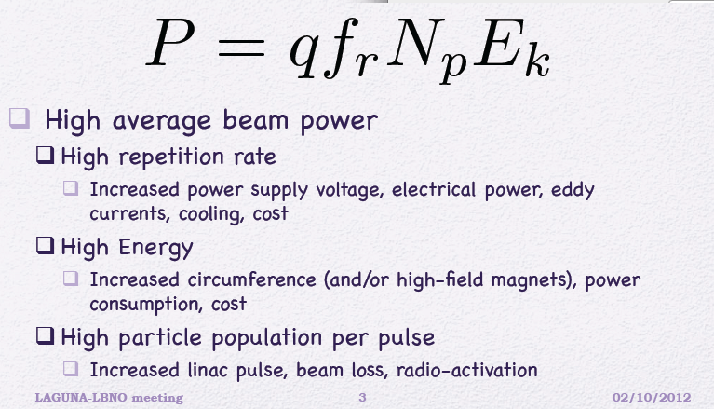
Beam Power

Slide 4
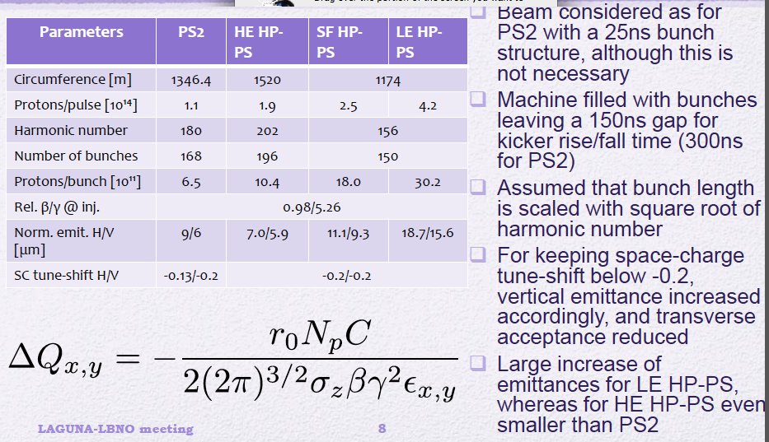
Different Options explored
50 GeV
65 GeV
50 GeV
30 GeV

Slide 5
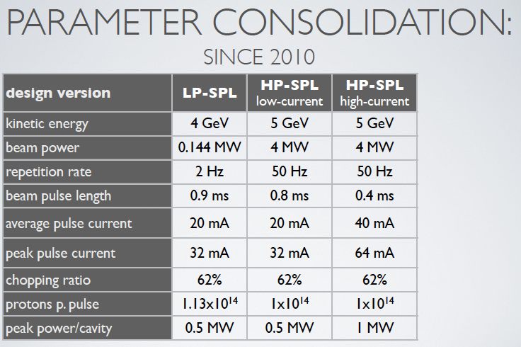
SPL options/parameters

Slide 6
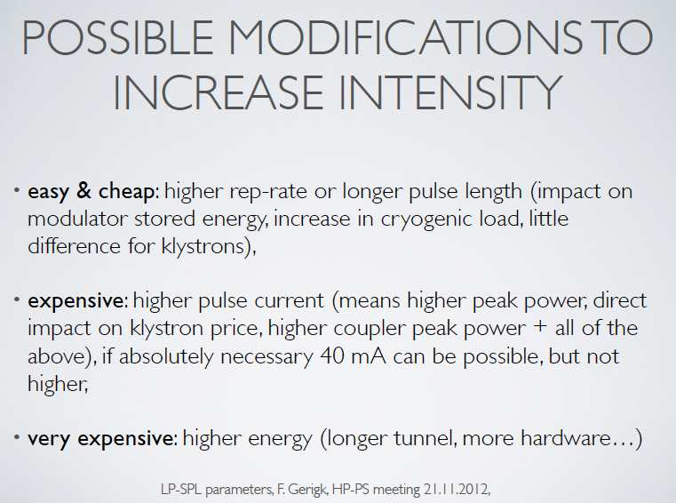
LP-SPL intensity

Slide 7
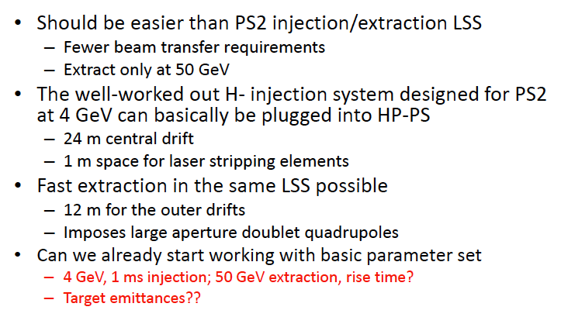
Injection / Extraction

Slide 8
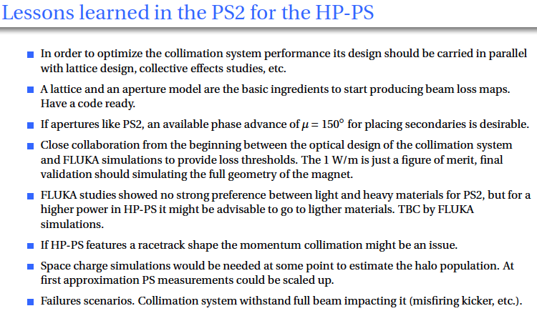
Collimation

Slide 9
Next Steps
Consolidate the basic options and optics (Fannouria & Andoula).
Investigate further the Super Ferric options
  Support form L. Bottura and his team (Javier)
Injection/Extraction (Angelina & Brennan)
Collimation (Christos, ..)
RF cavities etc (BE/OP PJAS + Elena, …).

