Slide 1
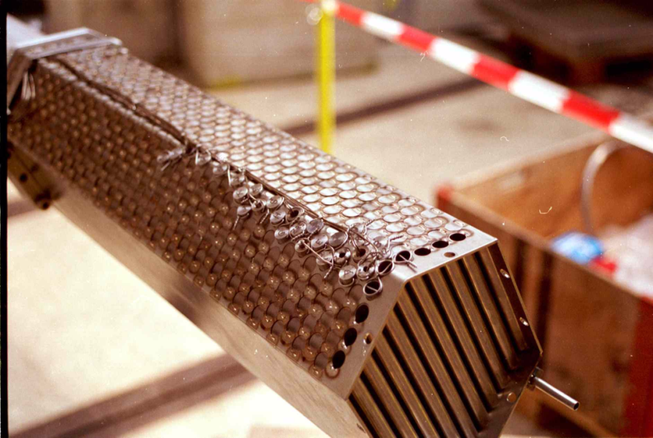
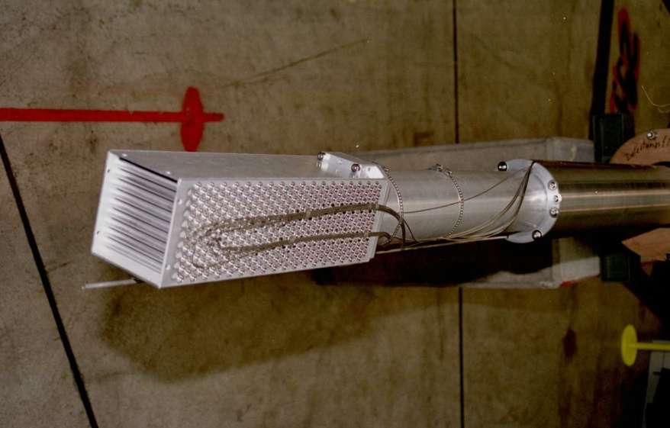
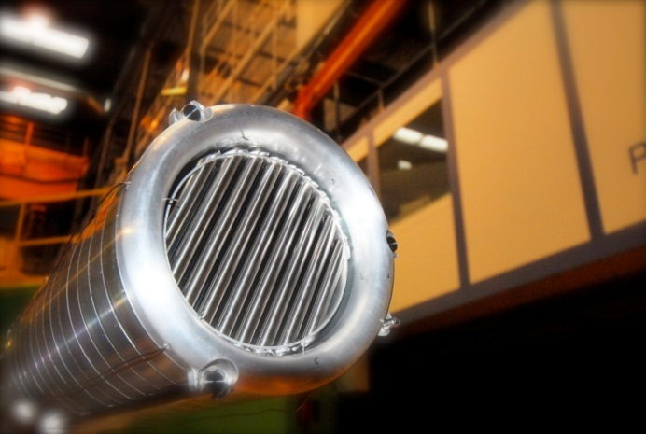
Target Evolution at SINQ
2000 - 2003:Target Mark II:
Lead rods, steel clad
42% increase in neutron yield
1997-1999: Target Mark I
Water-cooled Zircaloy rods
2004 – 2008:Target Mark III
hybrid Pb SS & Pb Zr-clad
Aug - Dec 2006: MEGAwatt Pilot Experiment:
Joint international initiative to design,
build, licence, operate and explore
a liquid metal spallation target
for 1 MW beam power (Details next talk)
2009 – present: Target Mark IV
Lead rods, with Zr clad, blanket

Slide 2
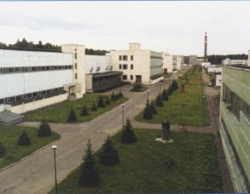
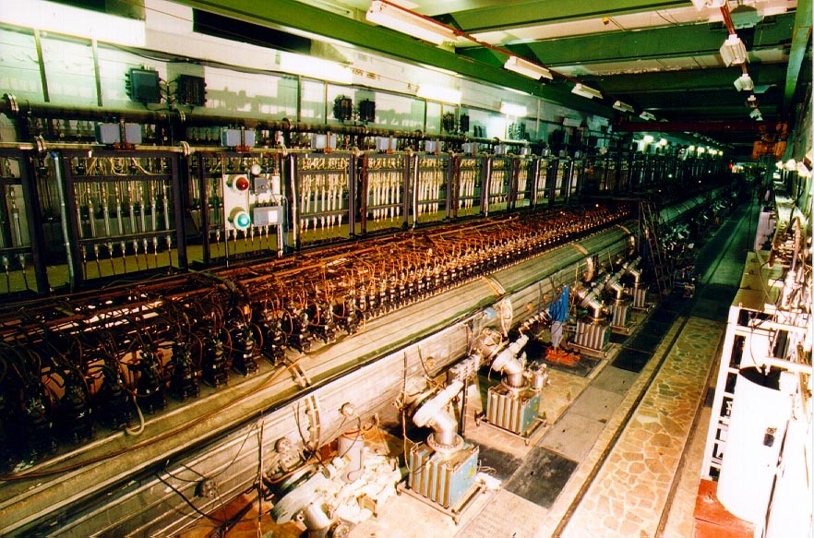
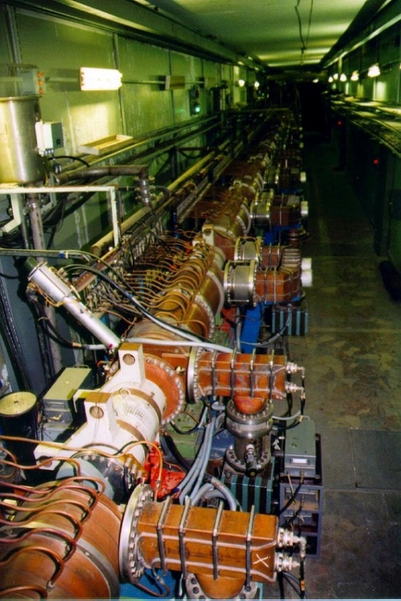
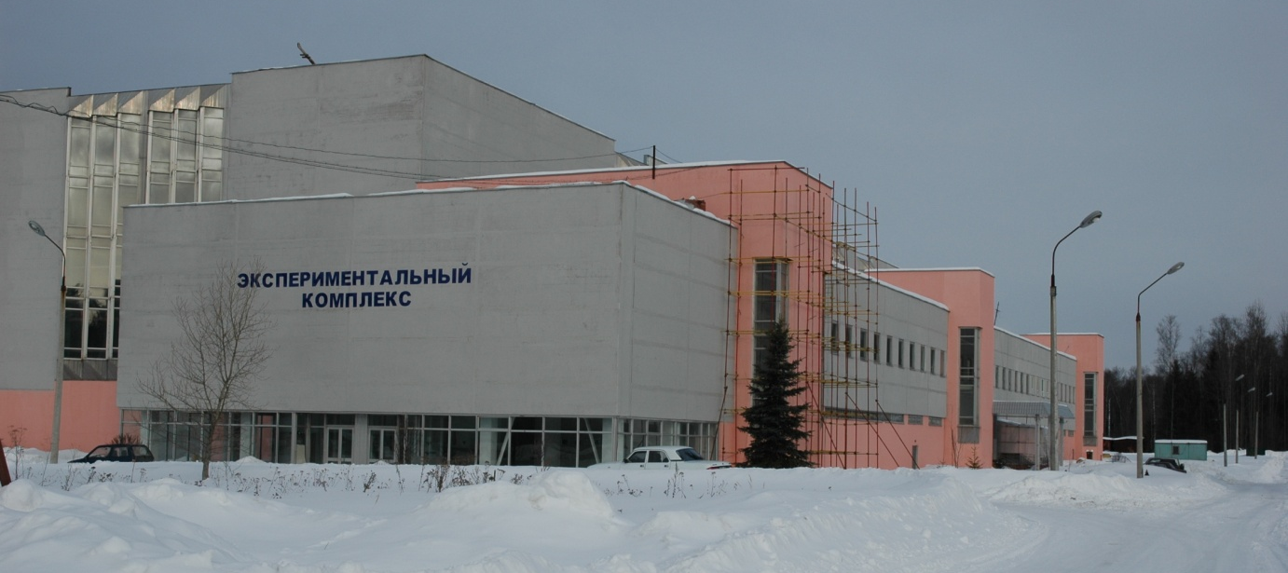
Initial and main parts of linac
Linac
Experimental Complex

