Slide 1
A future for Thorium Power ?
Carlo Rubbia
IASS (Institute for Advanced Sustainability Studies), Potsdam, Germany
GSSI (Gran Sasso Science Institute), L’Aquila, Italy

Slide 2
Introduction
The recent Fukujima accident, after the previous warning signs of Three Miles Island accident, has brought to sudden rest one of the most advanced and heavily Nuclear Energy exploited countries, creating a strong movement against a continuation of the Nuclear Power.
This has proven the inadequacy of the present “probabilistic” concept vastly used by the Nuclear Community and the necessity of an entirely new, alternative, “deterministic” approach. In order to be vigorously continued, Nuclear Power must be profoundly modified.
New breeding reactions based on Tritium, natural Uranium or Thorium and which may last for many thousand years, far beyond fossils, must be pursued but with much stricter safety and deterministic levels. The long-lived waste problem has to be solved. For such new processes a distinction between renewable and not renewable energies is academic.
Amongst the various breeding alternatives the use of Thorium represents an unique opportunity. This is a very old idea. Strongly supported by the main of fathers of Nuclear Energy, like Alvin Weinberg, Eugene Wigner and Ed Teller, but perhaps then also ultimately neglected because its intrinsic absence of military fall-outs, the use of Thorium deserves nowadays a considerable attention.

Slide 3
Today’s nuclear energy
Today’s commercial nuclear fission is based on the highly fissile U-235, present at the level of 0.71 % in the natural Uranium.
Nuclear reactors may operate either directly from natural U (CANDU), or more often with the help of U-235 enrichment leaving behind depleted U tails typically at ≈ 0.25%.
In both alternatives a substantial fraction of the U-235 remains unused and in practice less than one part in a few hundred of the natural U is actually burnt.
The burning is somewhat extended with the help of producing Pu-239 from the U-238, in particular with the introduction of the so-called MOX fuel, in which the Plutonium is extracted, reprocessed and mixed again with the (enriched) Uranium.
These procedures reduce significantly — typically by some 30% — the consumption of Uranium, but increase several times the amount of the Minor Actinides in the spent fuel and the residual long lived radio-toxicity of the waste.

Slide 4
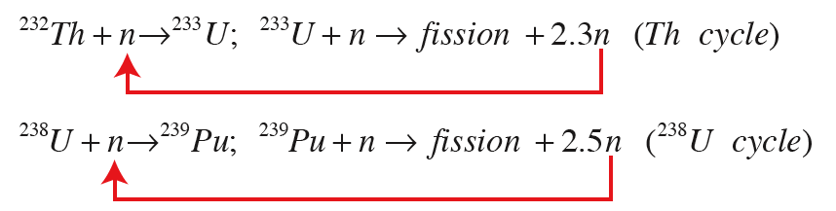
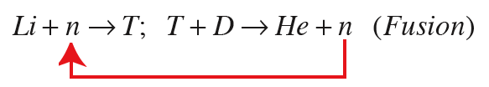
New, virtually unlimited forms of nuclear energy
Although the exact amount of exploitable ores are not exactly determined and depend on the lowest levels of the recoverable Uranium, as long as used in this way and at the present level of consumption (6.5 % of primary energy), there are probably no more reserves of Uranium than of Oil and Gas.
Particularly interesting and so far largely unexploited are other fission reactions in which a natural element is first bred into a fissionable one:
These sources of energy available from exploitable ores are comparable to the one for the D-T fusion reaction (ITER)

Slide 5
How much Thorium is available?
Thorium, (Th-232), an unexploited energy resource, is about four times more abundant than Uranium on the Earth crust. While most of U is dissolved in the seas, Th is present as mineral deposits. The total abundance is estimated 1.2 x 10¹⁴ tons. Soil commonly contains an average of around 6 parts per million (ppm) of Thorium.
The Monazite black sand deposits are composed from 2 to 22 percent of Thorium. Th can be extracted from granite rocks and from phosphate rock deposit, rare earths (REE), Tin ores, coal and Uranium mines tailings.
Estimates of available Th resources wary widely. The 2007 IAEA-NEA publication Uranium 2007: Resources, Production and Demand gives 4.4 x 10⁶ tons of known and estimated Th resources, but this still excludes data from much of the world.
For instance with well designed Th burners, the whole 2007 electricity production of China (3.2 Trillion kWh) could be produced by 443 ton/year of Th/U233, a few % of REE domestic production.

Slide 6
Many different sources of Thorium
It has even been suggested that Thorium could be extracted from ashes of coal plants.
A 1000 MWe coal plant generates about 13 tons of Th per year in its ash. One ton of Th can generate in turn 1000 MWe in a well optimized Th reactor. Thus the ashes of a single coal power plant can conceptually fuel 13 Thorium plants of its own power.
Soil commonly contains an average of around 6 parts per million (ppm) of Thorium, with an energetic yield about 3 x 10⁶ times the one of coal.
If burnt in a reactor, Th in soils would generate (6 x 10⁻⁶) x (3 x 10⁶) = 18 times the energy of the same amount if coal.
Recovering 1/1000 of all Th on crust (1.2 x 10¹⁴ tons) is equivalent to producing the today’s primary world’s power (15 TW, i.e. 6 kton/y of Th) during about 20 thousand years.

Slide 7
Global energy resources in ZetaJoules

Slide 8
CONCLUSION
Reserves of Thorium, may represent an attractive potential energy supply for many millenia to come, with little or no CO2 emissions.
For instance the whole today electricity (3.2 Trillion kWh/year) of China could be produced during ≈20’000 years by well optimized Th reactors with 8,9 million ton of Th.

Slide 9
Main properties of fissionable nuclei
Fission
Capture
Capt/`Fiss
Neut/fiss
Neut/event
²³³U is rather insensitive to neutron energy (α and η)
²³³U is the best fissile isotope in thermal range
The Th/ ²³³U has practical potentials for breeding over the whole neutron spectrum.Three different spectra have been considered:
  Thermal or epi-thermal (≈0.1 ÷1 eV)
  Over the “resonances” region (10³÷10⁴ eV)
  Fast (10⁵÷10⁶ eV)
Instead U/²³⁹Pu breeding is operable only with fast neutrons.

Slide 10
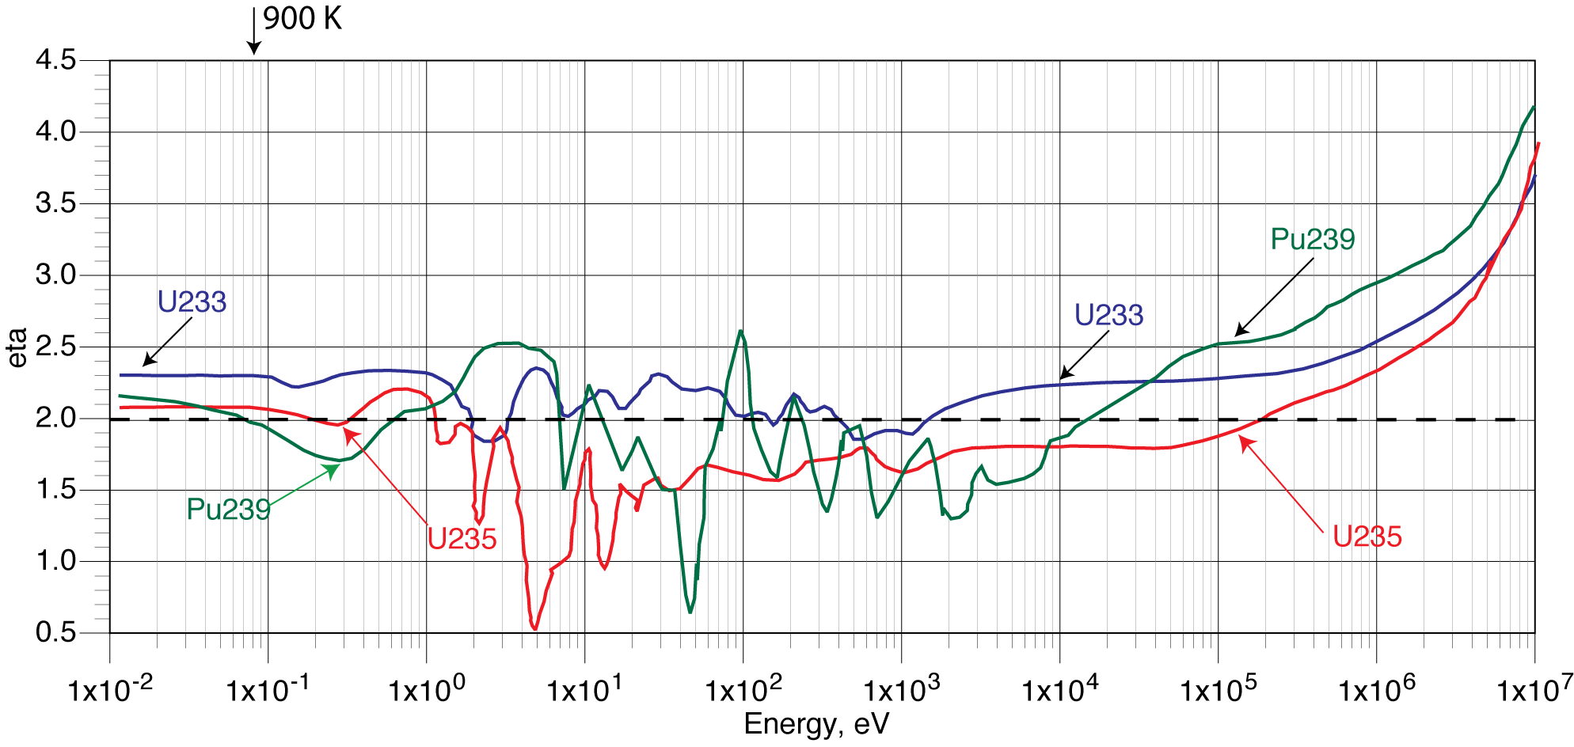
Energy dependence of U and Th breeders
Breeding reactions besides being an almost unlimited source of energy, require major new developments since :
  two neutrons are necessary to close the main cycle, η>2
  Enrichment is no longer necessary, since they consume entirely the natural material, either Thorium or Uranium.
  They generate an energy ≈200 times larger than the one currently available from using only the U-235 isotope.
Molten salts
L-Na
L-Pb
Several alternatives
for Th232/U233
Thermal
Resonance region
Fast
η = 2
Only Fast n
for U238/Pu239

Slide 11
Early attempts: blending a U-235 reactor with Thorium
In these programmes, Th is a secondary U-233 producer, with the (repeated) addition of external fissile materials using U-235.
Source: C.Renault. CEA

Slide 12
Thorium blending with an ordinary Uranium driven reactor
A practical way would consist of mixing a U-235 reactor with additional blending with Thorium in the form of a “blanket” which breeds U-233.
Several alternatives of such a scenario has been discussed,
  The Radkowsky reactor in which uranium "seeds" enriched to about 20 percent U-235 are kept separate from a surrounding thorium-uranium "blanket." U-235 produces the neutrons that sustain the chain reaction while slowly creating uranium 233 in the blanket.
  The CANDU heavy water reactor with a Thorium blanket associated to an enriched Uranium or maybe Plutonium core. The technology is similar to the one of Radkowsky.
As burnup continues, the newly created U-233 picks up an increasingly greater share of the fission load. In practice somewhere between 30% and 50% of energy comes from Th.

Slide 13
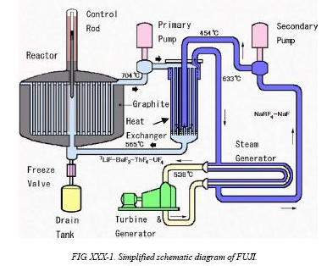
A pure Thorium thermal breeder ? (A. Weinberg, Ed Teller)
Liquid Fuel: LiF, (NN)F₄, BeF:
NN from 6,5% to 20 %.(U,Th..+)
Volume : 20 m³, Temp.: 630°C,
Power : 2.5 GW_{th} = 1 GW_{ele}
The molten salt reactor's fuel is continuously reprocessed by an adjacent chemical plant on line.
All the salt has to be reprocessed every <10 days to ensure criticality.
  Fluorine removes U233 from the salt.
  A molten bismuth column separates Pa-233 from the salt before decay.
  A fluoride-salt system distills the salts.
  The Thorium salts must be separated from the Fission Fragments which are the “waste”

Slide 14
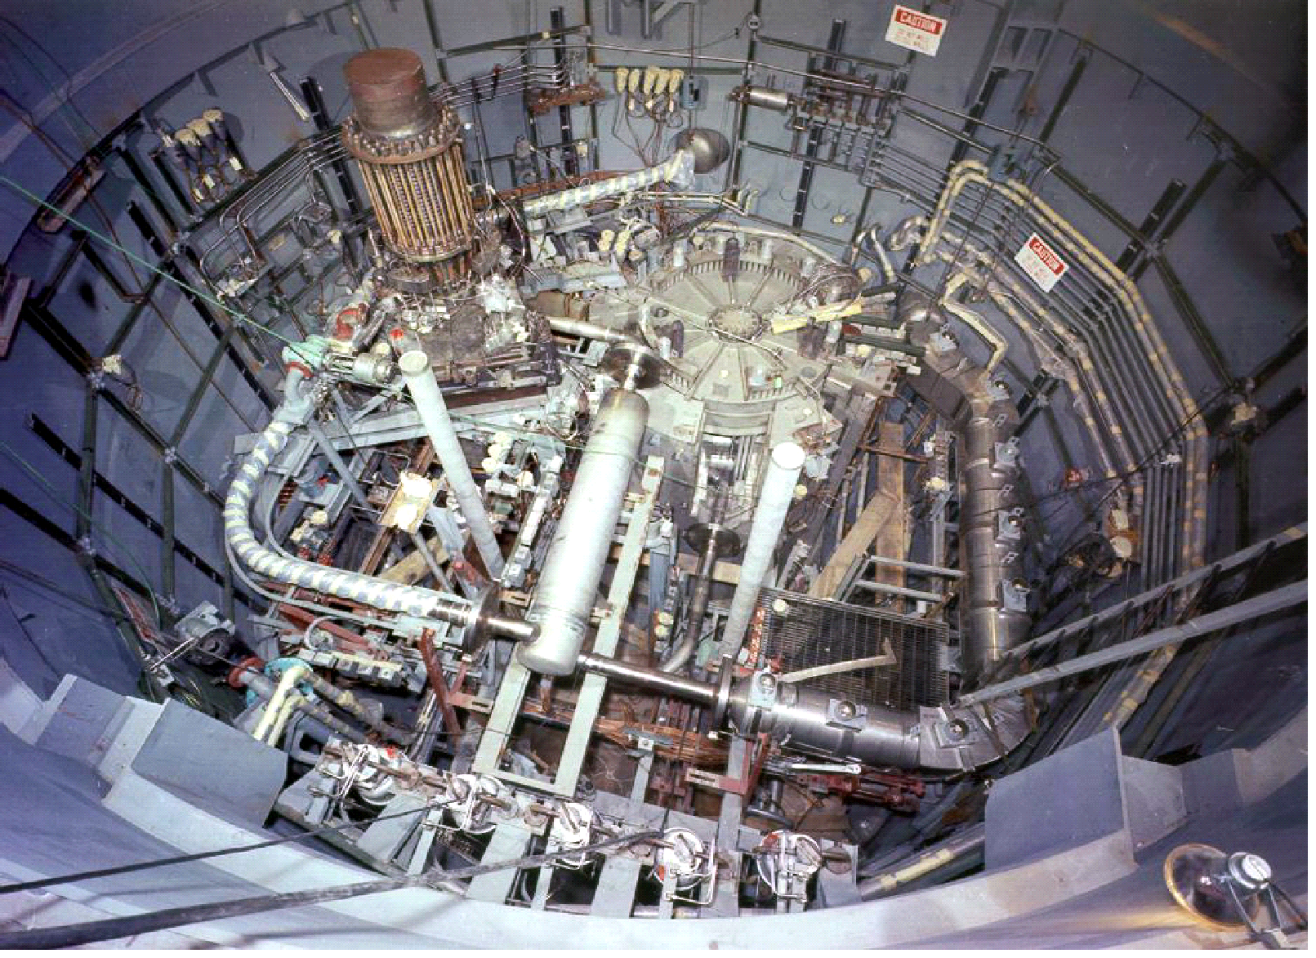
MSR programme in ORNL
MSRE (MOLTEN SALT REACTOR
EXPERIMENT)
THE MSBR PROJECT
2250 MWth – 1000 MWe
FUEL SALT
66%LiF-29%BeF2-5%ZrF4-0,2%UF4
PROJECT STOPPED
IN 1976
OPERATED 5 YEARS
(LOAD FACTOR 85%)
WITHOUT ANY INCIDENT

Slide 15
MSBR FUEL PROCESSING FLOWSHEET
Processed
Processed
salt
Salt
salt
Salt
UF
UF
6
purification
6
Ln extraction (metal transfer)
purification
reduction
reduction
Th
Th
-
-
Li
Li
-
-
Bi
Bi
3
2.85 m
3
2.85 m
/h
(
/h
(
)
UF
)
UF
H
H
Extractor
6
Extractor
6
2
2
3
0.2 m
3
0.2 m
/h
Salt
/h
Salt
containing
containing
rare
rare
earths
earths
(
(
)
)
Li
Li
-
-
Bi
Uresidual+ Pa + TRU extraction
Bi
Extractor
Extractor
Pa
Pa
+TRU+
+TRU+
Zr
Zr
LiCl
Extractor
LiCl
Extractor
Li
Li
-
-
Bi
extraction
Bi
extraction
3
(7.5 m
3
(7.5 m
/h)
/h)
Reactor
Extractor
Extractor
Li
Li
-
-
Bi
Pa
Bi
Pa
Decay
Fluorination
Decay
Fluorination
Hydrofluor
Hydrofluor
.
.
Fluorination
Fluorination
Divalent
+
Divalent
+
rare
rare
earths
U recovery
F
earths
F
F
F
HF
HF
2
2
Li
Li
-
-
Bi
2
Bi
2
F
F
Fluorination
Bi
Fluorination
Bi
2
2
Extractor
Extractor
Reductant
Salt
Reductant
Salt
Salt to
addition
Salt to
addition
Li
Li
-
-
Bi
waste
Bi
Metal
waste
Metal
Trivalents
+
Trivalents
Pa decay for residual U recovery
TRU to waste
+
TRU+
TRU+
Zr
Zr
rare
rare
earths
(
earths
(
)
)
UF
Li
UF
Li
6
6
Source: C.Renault. CEA

Slide 16
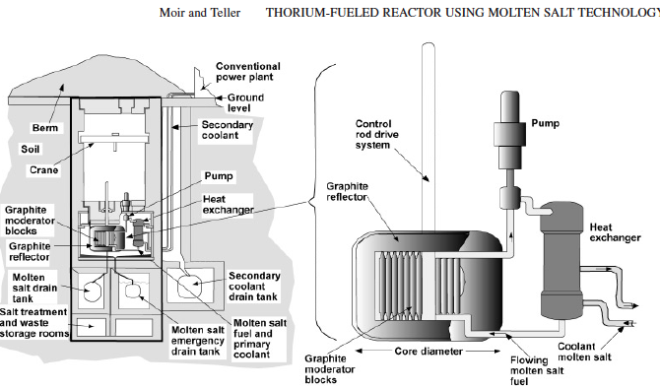
NUCLEAR TECHNOLOGY VOL. 151 SEP. 2005
Written by Ed Teller one month before his death
“The power plant could operate for up to 200 yr with no transport of fissile material to the reactor or of wastes from the reactor during this period. Advantages that include utilization of an abundant fuel, inaccessibility of that fuel to terrorists or for diversion to weapons use, together with good economics and safety features such as an underground location will diminish public concerns. We call for the construction of a small prototype thorium-burning reactor.”
Not all his assumptions are actually true, but the idea is tantalizing !

Slide 17
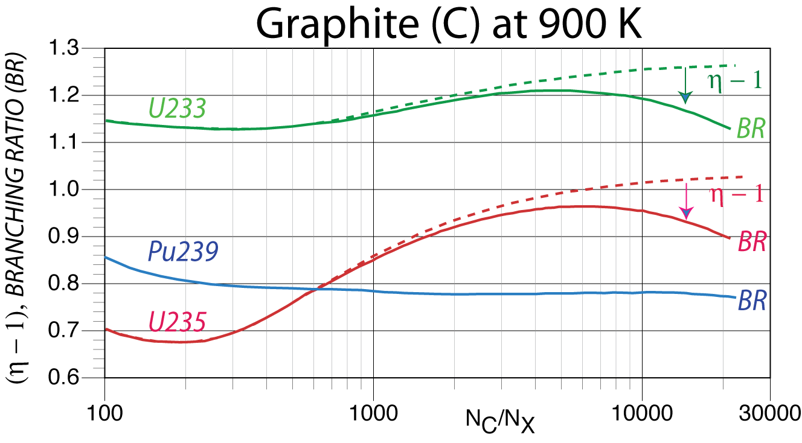
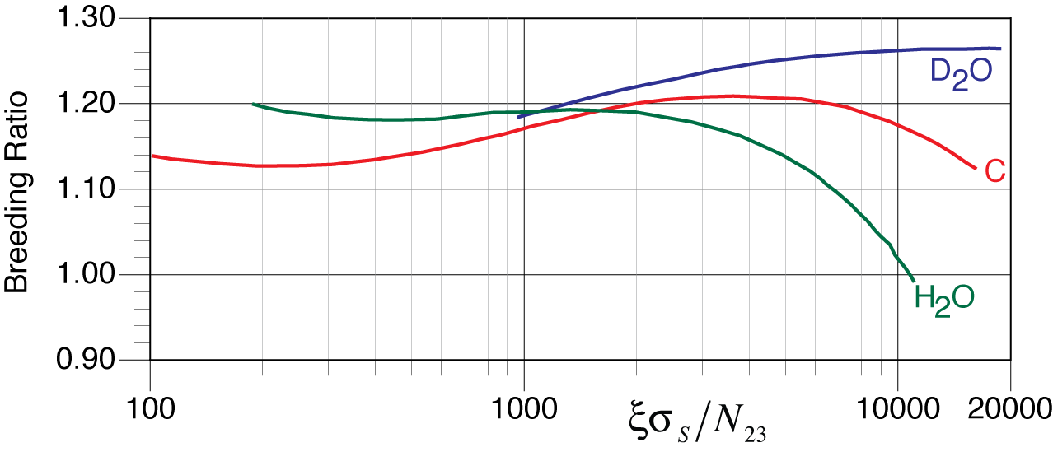
Thermal breeders
The main advantage of is that the technology is well known.
The theoretical breeding ratio (η-2)/2 is given as the function of the slowing down power per fuel atom assuming a infinitely size reactor for a variety of coolants and no fission products.
BR ≈ 1.2 for
optimum
conditions
But other effects reduce the breeding ratio by factors ΔL
  Xenon poison fraction, ΔL = 0.047 at S = 3 MW(t)/kg
  Losses due to intermediate Pa-233 captures, suppressing the U-233 breeding reaction, ΔL = 0.1 at S = 3 MW(t)/kg.
  A reasonable ΔL due to fission product build-up
  The build-up of less readily fissionable U-234 isotopes

Slide 18
Conclusions for pure thermal Th operation
A thermal neutron reactor with H₂0, D₂0 or Carbon coolant requires inevitably a delicate on-line fuel reprocessing in order to operate satisfactorily :
In a critical reactor, without such chemistry, the small excess k > 1 will be quickly wiped out by the presence of the fission products, fuel cladding and so on. In comparison an ordinary CANDU with natural U has k₀ = 1.47, far larger than the one for Th breeding.
If operated as a proton driven subcritical ADS and k₀ < 1, the active size of the fuel around the beam is proportional to the inverse of the neutron cross-section times 1/(1-k) :
  For thermal neutrons the cross section is large and hence the beam fission activity is narrowly concentrated (exponentially) around the location of target.
Therefore the beam activated volume for the fission energy production in a thermal ADS and for any reasonable value of k₀ is strongly localized and not very uniform.

Slide 19
CONCLUSION
The thermal Thorium configuration demands a complex, flawless and risky on-line reprocessing of fuel in order to remove the fission products and Pa²³³ captures prior to the U²³³ formation.
This local reprocessing produces an additional strong radioactive background due to delayed neutron and gamma emissions generated outside the reactor core.
It is unlikely that such a technology may become widely acceptable in view of the presently very sensitive critical public concerns.

Slide 20
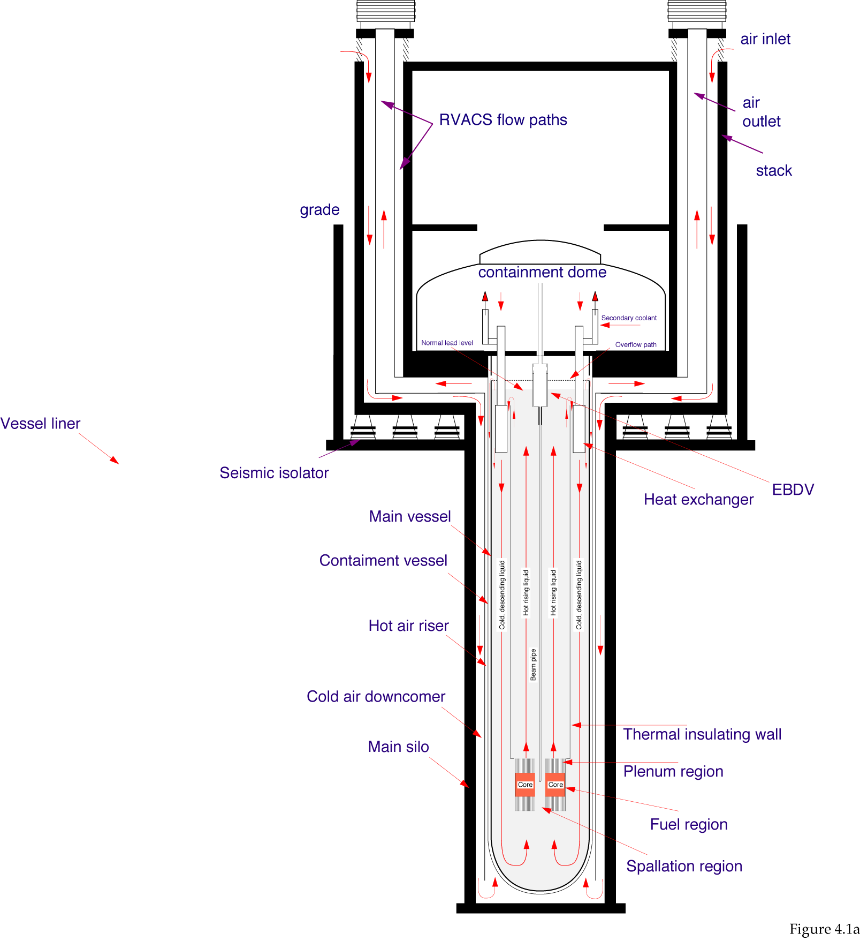
The Thorium driven fast EA (CERN/AT/95-44)
Subcritical system driven by a proton accelerator.
Fast neutrons and fuel cycle based on natural Thorium
Closed cycle: all actinides are recycled indefinitely. The “waste” are fission fragments and structural materials which are relatively short-lived
Lead as target both as neutron moderator and as heat carrier
Deterministic safety with passive elements to eliminate
  Criticality
  Meltdown
  Decay heat
  Seismic protection
600 MWattele

Slide 21
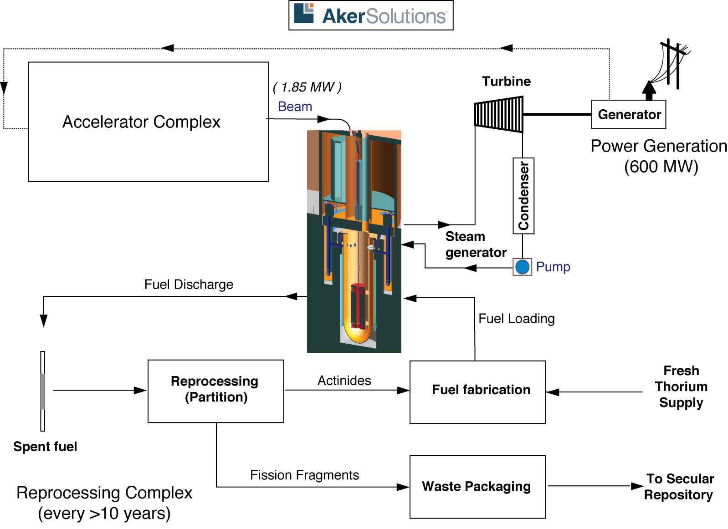
The Thorium driven fast EA (CERN/AT/95-44)

Slide 22
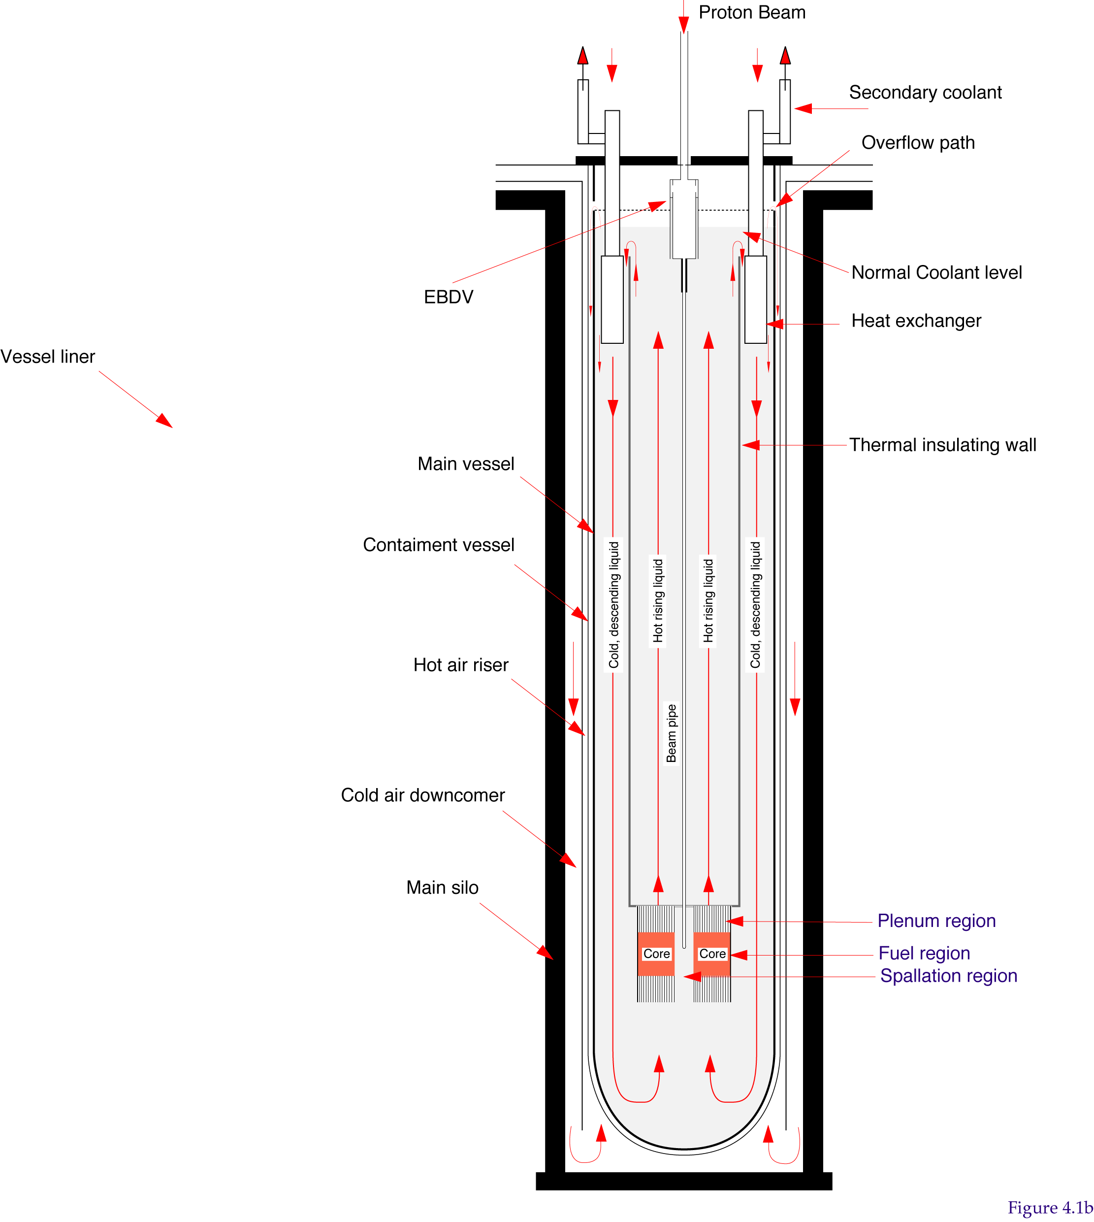
Main parameters of the EA according to CERN/AT/95-44

Slide 23

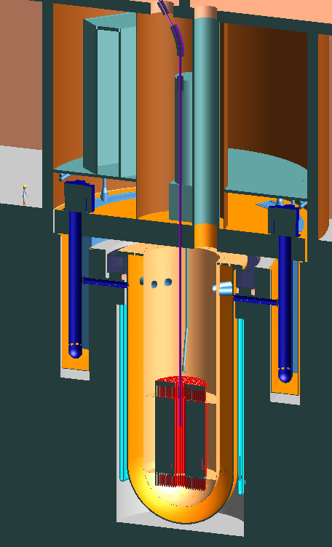
EA Feasibility Study: Aker ASA and Aker Solutions ASA (2010)
1500MWTh/600MWe
Sub-critical core
Thorium oxide fuel
Accelerator driven via central beam tube
Molten lead coolant
Coolant temp 400-540ºC
2 Axial flow pumps
4 Annular heat exchangers
Direct lead/water heat exchange
It may be modified to
a Minor Actinide burner (ADS)
A Thorium fuelled reactor for power generation

Slide 24

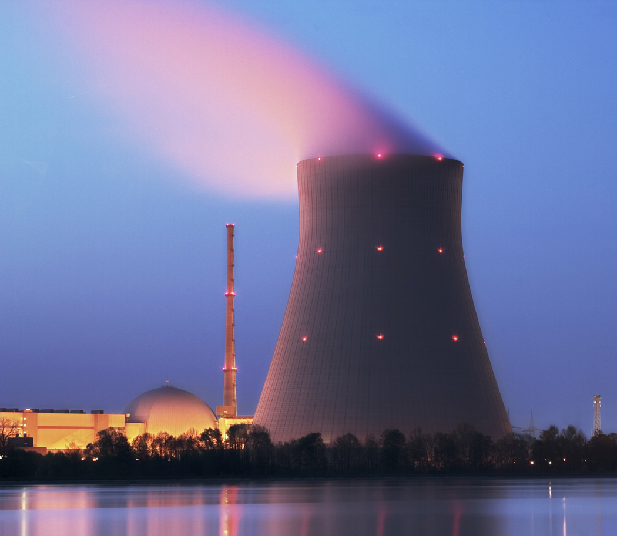
Comparing alternatives
To continuously generate a power output of 1GW_{electric} for a year requires:
PWR
3,500,000 tonnes of coal
Significant impact upon the Environment
especially CO2 emissions
200 tonnes of Uranium
Low CO2 impact
but challenges with reprocessing
very long-term storage of hazardous wastes
Proliferation
Enrichment
1 tonne of Thorium
Low CO2 impact
Can eliminate Plutonium and radioactive waste
Reduced quantity and much shorter duration for storage of hazardous wastes
No enrichment
No proliferation

Slide 25
Typical operation of the CERN/AT/95-44 Energy Amplifier
A particle accelerator is supplying the missing neutron fraction and it controls the energy produced in the reaction.
For a proton beam energy of 1 GeV and 1.5 GW thermal power
  2.7 10²⁰ fission/s (Keff = 0.997, G = 700 )
  3.8 10¹⁷ spallation neutrons/s (30 n/p)
  1.3 10¹⁶ protons/s
  Current: 2.12 mA
For a F-EA and the total ΔL = 0.11 is subdivided as follows :
  Lead coolant: L = 0.0626
  Cladding: L = 0.0378
  Beam window L = 0.0004
  Main Vessel L = 0.0071
  Leakage L = 0.0012
2.2 MWatt, feasible within the state of the art
L due to Fission Products linearly growing with burnup to ΔL ≈ 0.06 including buckling changes due to the reduction of fuel mass .
Notes:
25

Slide 26
General considerations
Thorium driven fission has very different requirements than the ones envisaged for Uranium driven cycles, both thermal and/or fast.
We consider either a sub-critical or a critical Thorium driven breeding nuclear reactor as the indefinite repetition of very long lasting and nearly identical breeding nuclear fuel cycles, progressively approaching to an equilibrium concentration configuration of the fission generating Thorium-Uranium mixture.
Such specific configuration, called “secular configuration”, is characterized by an extreme fuel stability during a very long duration of the cycle and in particular an extremely constant spontaneous neutron multiplication coefficient k.
Each cycle is lasting from 10 to 15 years, determined by the integrity of the fuel materials due to radiation damage (dpa, displacements per atom)

Slide 27
Basic features of the breeding process
Assume for simplicity the main iterative breeding process of a simple binary mixture Th-232/U-233, in which neutrons from U-233 fissions are transforming Th-232 into fresh U-233, in an indefinitely continuing process.
In steady neutron flux conditions, the chain will tend to an equilibrium, namely to a condition in which each fissioned nucleus is replaced by a newly bred fuel nucleus. To a first approximation, the spectrum averaged equilibrium is
[Flux] x [cross sect.] x [Number atoms]
The breeding equilibrium is then a pure function of the averaged cross sections
For thermal neutrons: ξ = 0.0135, fast neutrons: ξ = 0.125

Slide 28
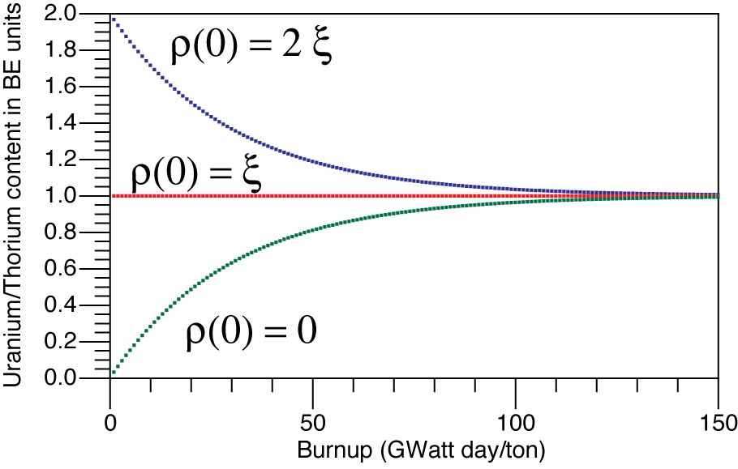
The emergence of a breeding equilibrium
Ratio ρ = N(U233)/N(Th232) as a function of burn up for 3 typical initial U-233 configurations:
  At the breeding equilibrium, ρ(0) = ξ
  For an initial excess of U-233, ρ (0) = 2ξ
  For an initially pure Th-232, ρ (0) = 0
All configurations tend to approach progressively to the breeding equilibrium, for which the ratio is ρ = ξ
Breeding
Equilibrium
ρ = ξ

Slide 29
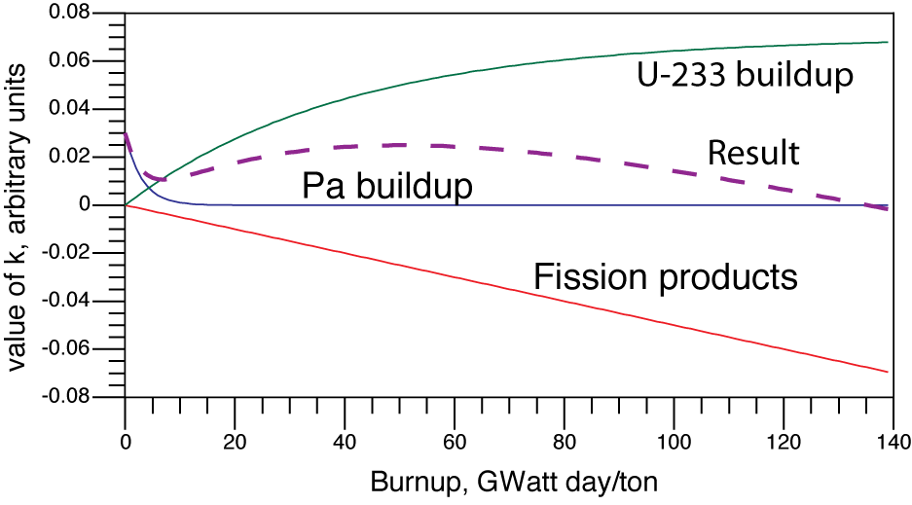
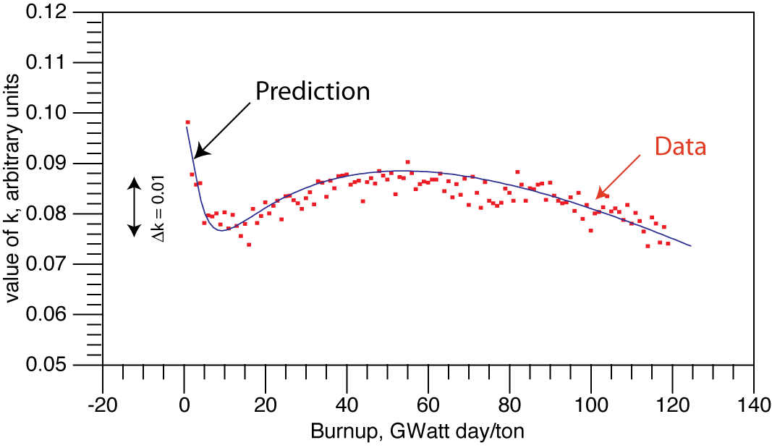
“Magic” equilibrium for breeding (CERN/AT/95-44)
Assume that the breeding equilibrium has been nearly reached at the end of the previous cycle
The addition of fresh Thorium to the recovered Uranium shifts the effective k below the breeding equilibrium. Hence k will be progressivley growing.
However the buildup of the fragment captures will reduce the value of k.
The “magic cancellation” may be optimized, leading to a nearly constant value of k.

Slide 30
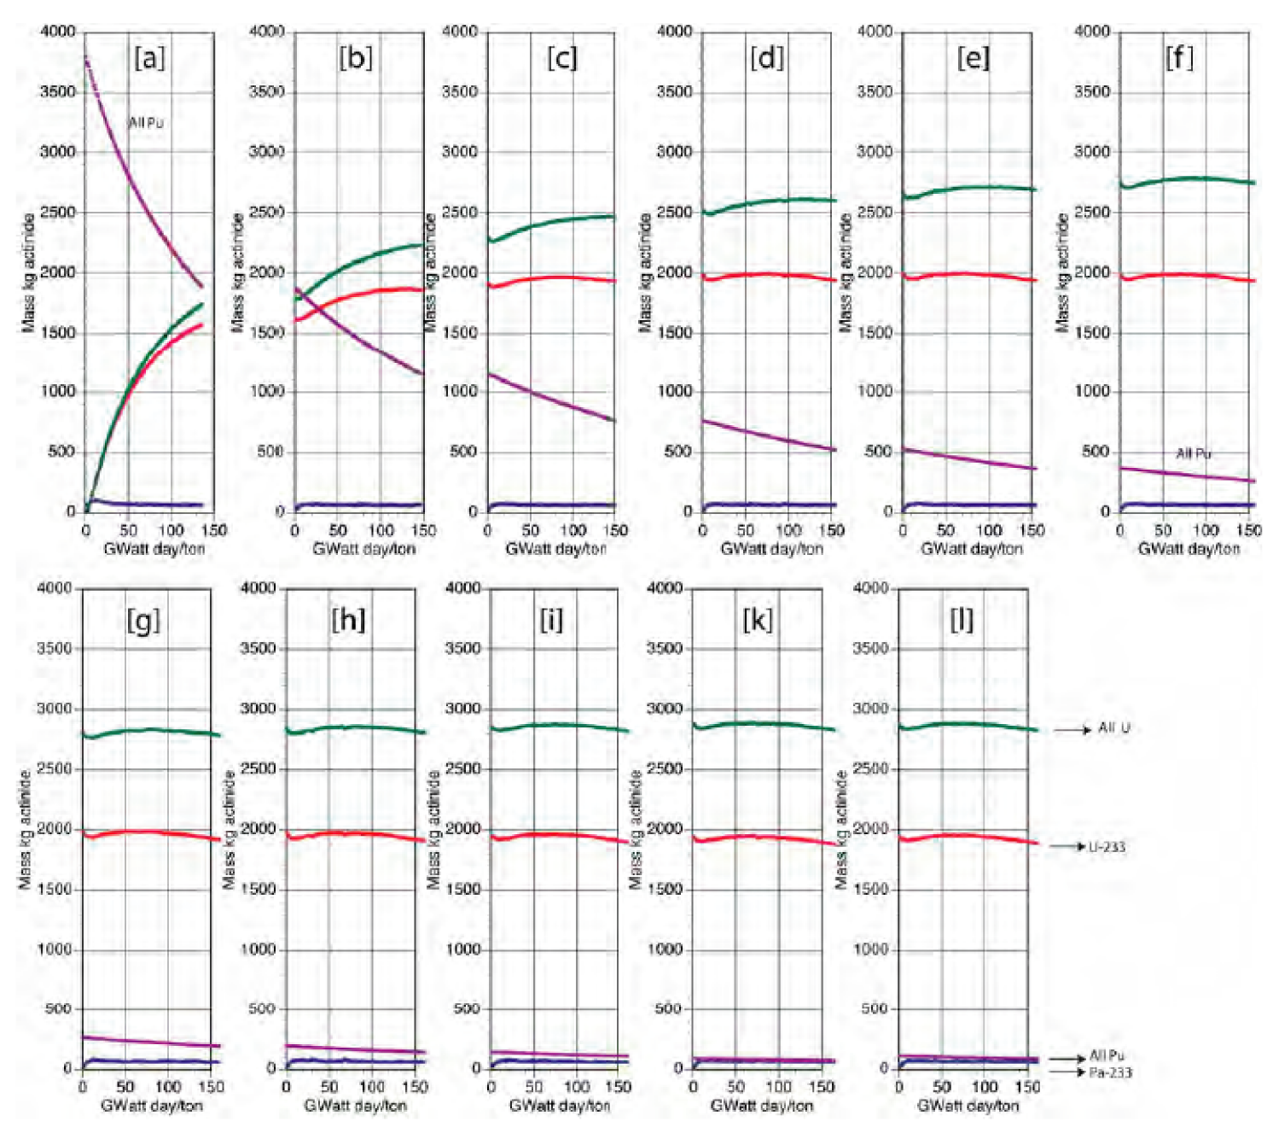
Plutonium elimination and Uranium Fissile buildup
Metal content of Plutonium, U-233, all Uranium isotopes and Pa-233 as a function of the burn-up for 11 successive cycles.
The initial fuel is a MOX mixture with of 84.5 % of ThO2 and 15.5% of PuO2 .
At the end of each cycle, all Actinides are reprocessed and burnt Th-232 is refilled with fresh Th-232 .
All U’s
U-233
All Pu’s
Pa-233

Slide 31
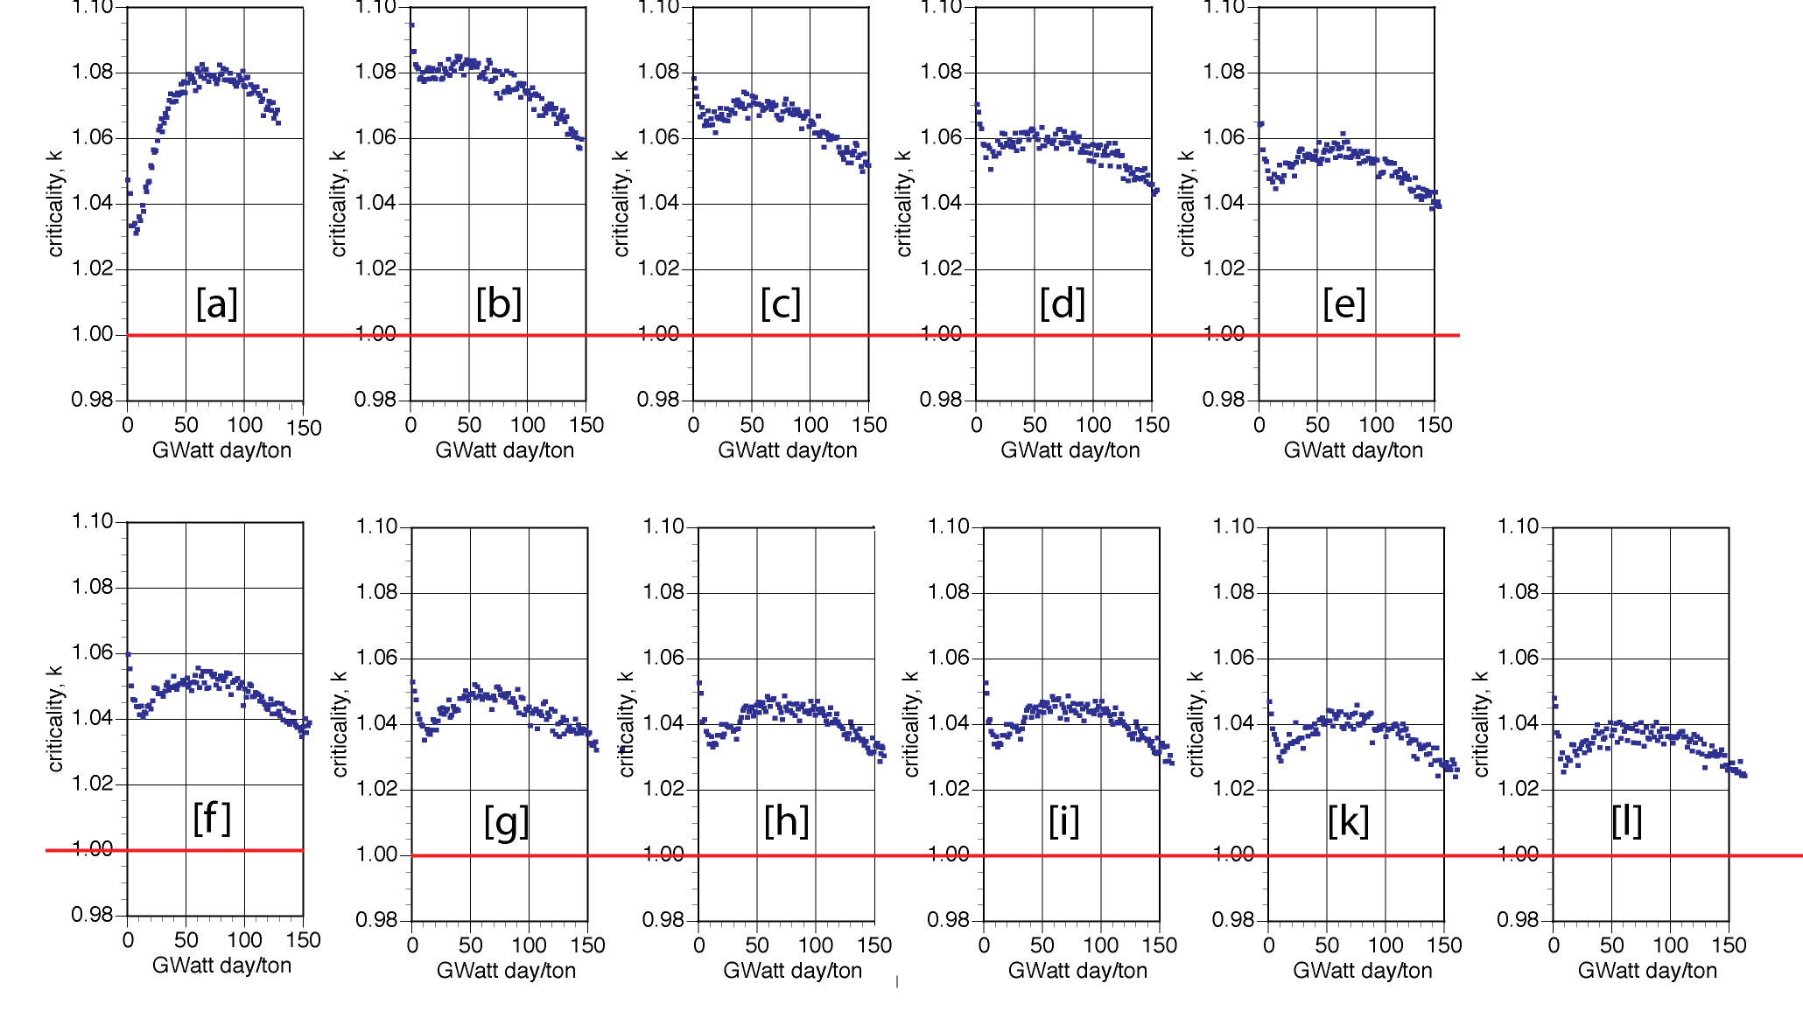
From Pu to asymptotic Th-U mixture
K-eff excess
Burn-up (Y)
The appropriate k < 1 value is adjusted with the help of control bars

Slide 32
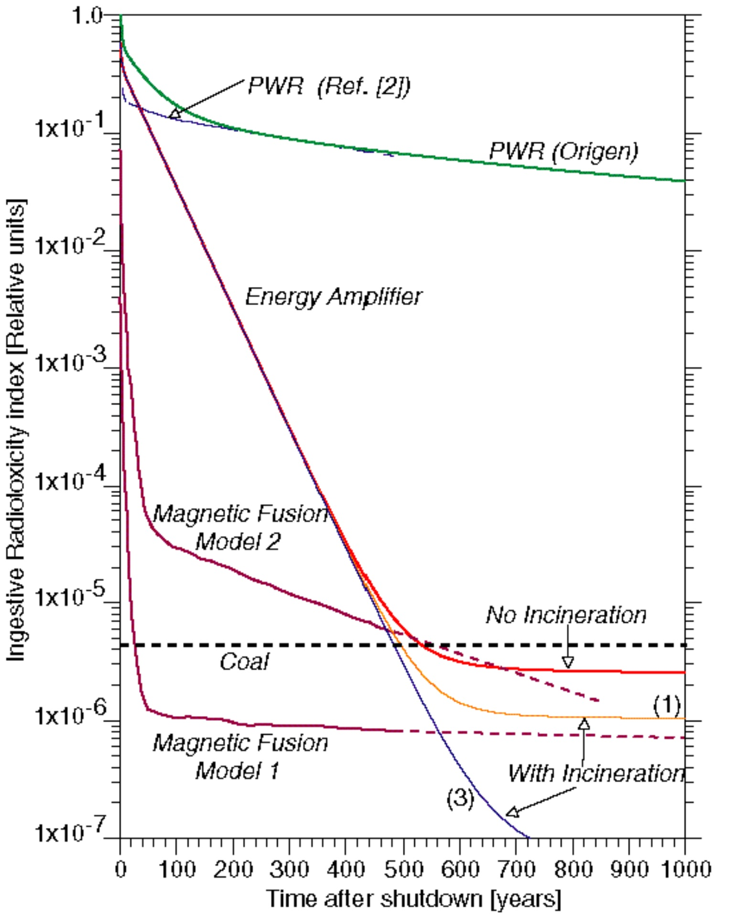
Short duration of nuclear waste and Fuel reprocessing
An uninterrupted operation of about 10 years, in which
  the only waste are Fission fragments Their radio-activity of the material is intense, but limited to some hundreds of years.
  Actinides are recovered without separation and are the “seeds” of the next load, after being topped with about 10 ÷ 15 % of fresh breeding element (Th or U-238) in order to compensate for the losses of element.
  A small fraction of Actinides is not recovered and ends with the “waste”
The cycle is “closed” in the sense that the only material inflow is the natural element and the only “outflow” are fission fragments.

Slide 33
CONCLUSION
The pureTh breeder may operate in a variety of configurations, namely epithermal, resonance or fast neutrons, all with rather similar nuclear performances (i.e. values of η).
The basic reaction chain Th²³²→Pa²³³→U²³³ will converge to a “breeding equilibrium”, namely to a steady condition in which each fissioned nucleus is replaced by a newly bred U²³³ fuel nucleus.
New Th supply is added periodically. Ideally the process is closed, i.e. Th²³²→Fission products

Slide 34
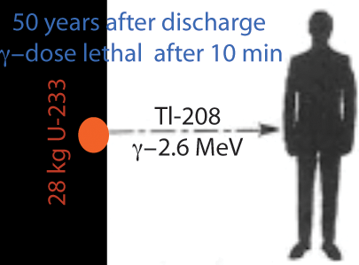
Proliferation issues
The breeding reaction on natural Uranium is badly proliferating, since it implies the vast production of Plutonium;
Instead the breeding reaction on Thorium is robustly immune from proliferation risks;
  the three main elements of the discharge, if chemically separated, namely U, Np and Pu (Pu-238) exclude the feasibility of an explosive device (CM= critical mass)
Lethal after 10min
28 kg U-233
  The long duration of the fuel cycle (10 y) permits to keep it sealed under international control, avoiding an illegal insertion of any other possible bomb-like materials

Slide 35
Comparing Pb, Pb/Bi eutectic and Na coolant’s
The eutectic Pb-Bi is dominated by the Po-210 activity, resultant of a direct n-γ process on main Bi. The equilibrium amount for the EA1600 is 1.89 kg and 260 kWatt of decay power.
The pure Pb has still a dominant activity due to Po-210 , but with only 0.534 grams.
Sodium has a simpler spectrum characterized by Na-22 (β⁺-γ, with a γ-line at 1.27 MeV, half-life 2.6 y) and Na-24 (β⁻-γ, with 2 γ-lines at 1.38 MeV and at 2.75 MeV, half-life 14.6 h).
The early time radio-toxicity of Na is substantially higher than the one of pure Pb.They become equal after about 2.5 days.
Total ingestive radio-toxicities after delay time in days

Slide 36
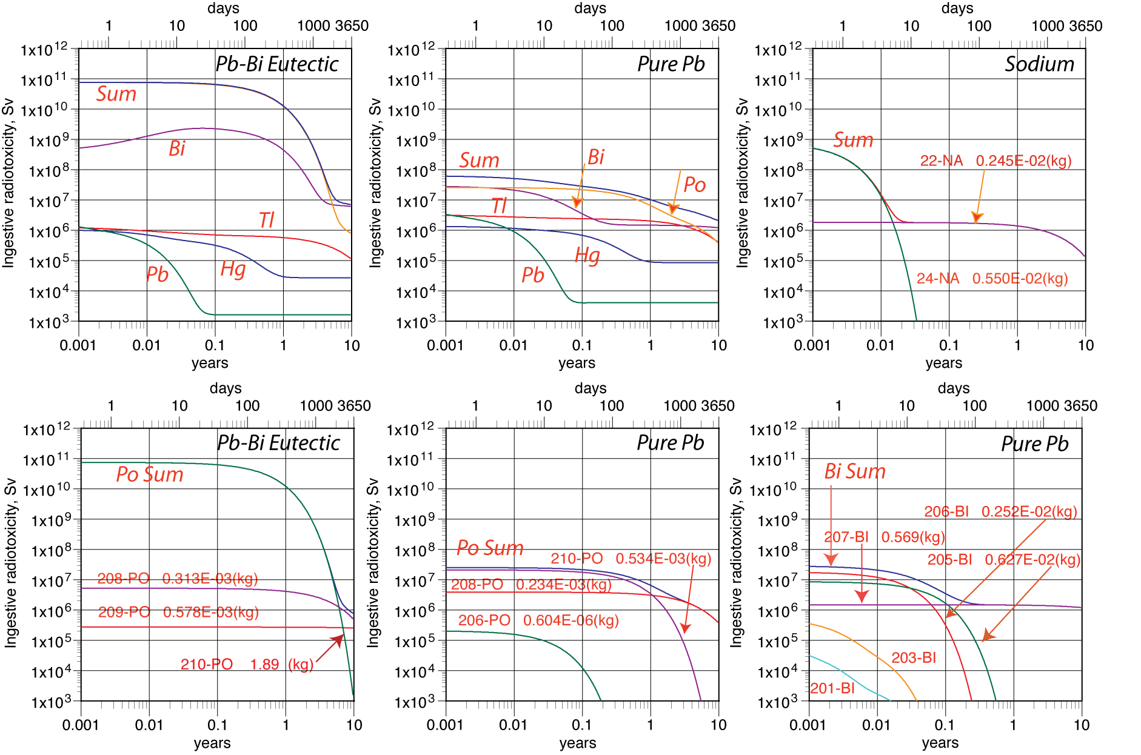
Comparison between Pb-Bi eutectic, pure Pb and Sodium

Slide 37
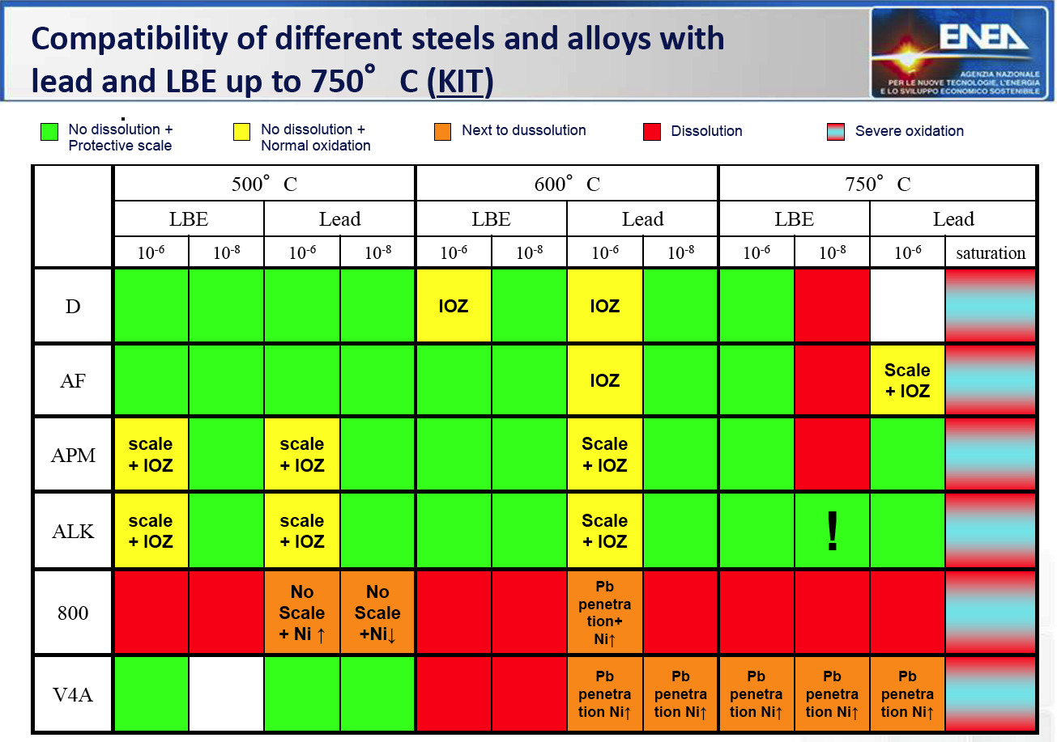
Corrosion studies

Slide 38
Choosing the coolant
The ex-USSR military programme has produced extensive information on the use of the eutectic Pb/Bi molten mixture as a reactor coolant.
While with the help of controlled Oxygen the corrosion of stainless steel cladding is well manageable, the residual problem is associated to the large amount of Polonium produced by the neutron capture of Bi.
The Russians claim that the majority of Po remains in the eutectic mixture and it does not volatize within the molten metal, but this has to be better verified.
But in spite of this, the presence of industrial quantities of Polonium is to be excluded for a civil, international programme. Note that in presence of air at 55 °C about 50% of Po-210 is volatized in 24 hours !
It is concluded that the pure Pb is highly preferable; Pb-Bi should be excluded for any wide commercial deployement.

Slide 39
CONCLUSION
A fast metal cooled ADS may represent a practical solution to the exploitation of pureTh breeder.
A detailed design based on CERN/AT/95-44 has been completed by Acker Solutions
A metal coolant may be apriori either Na, LBE or Pb.
However some problems persist since 1) Na is highly flammable. 2) LBE is plagued by a very large amounts of Po²¹⁰ activity. 3) Pb is far less radioactive, but it needs higher temperatures and may be plagued by corrosion.

Slide 40
Working in the neutron resonance region
Neutrons from a fluoride salt with Graphite coolant are thermal and, as already pointed out, they require on line reprocessing. But it is possible to harden considerably the spectrum with an appropriate choice of the actinide loaded fluorides and a high density ≈ 20% of (Th+U)F₄.
The energy spectrum is characterized by several resonances above 3 10⁴ eV and a negligible thermal contribution
FF captures limited to 10% after 150 GW/d/t
≈8-10 years
of operation

Slide 41
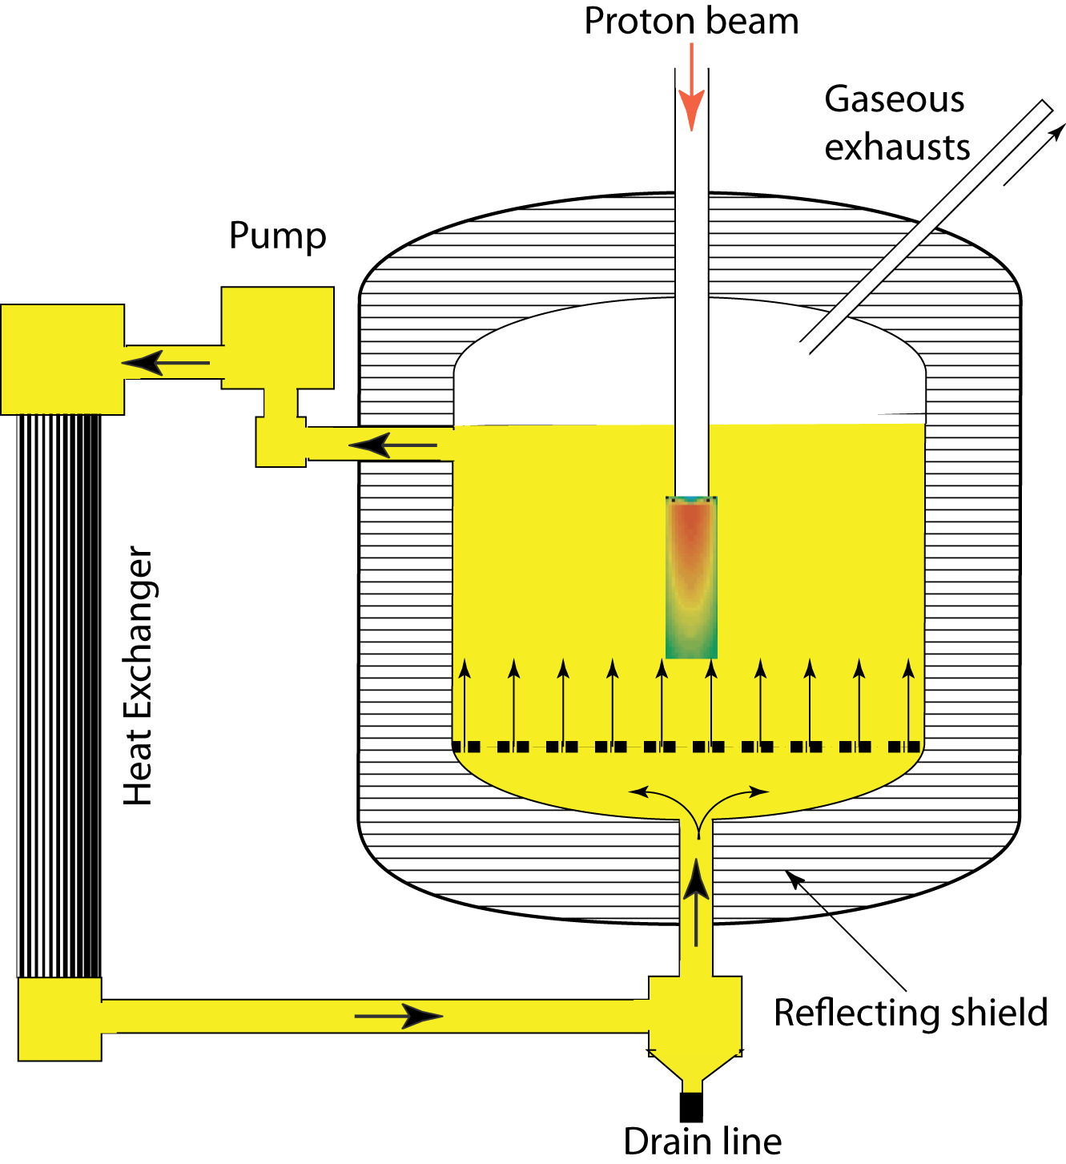
Accelerator driven pure Th without on-line reprocessing
The sub-critical operation of a MSR with an high energy proton accelerator can be an alternative far simpler than a thermal critical reactor with fast, integral on-line reprocessing.
Spread out beam is hitting directly the molten salt (n/p ≈ 15 at 1 GeV).
Operating T is about 640 °C. All metal parts contacting the salt are made with Hastelloy-N —proven well compatible with fluoride salts.
The heat exchanger may be using as secondary salt LiF-BeF₂ (66/34 mole %).
Simple and cheap to build. Multiple containments against MS leaks.
MS_ADS
ADMS ?
The molten salt is drained and reprocessed maybe every 150 GW/d/t

Slide 42
Some considerations for the optimal arrangement
Although apriori attractive for its simplicity and cost the solution of a molten salt has some draw-backs:
  The value of the criticality coefficient k depends from the actual location of the liquid salt inside the reactor. Can one insure absolute stability of k to the required level <<10⁻⁴ ?
  The radio-toxicity of the molten fuel in its liquid form is huge. The classic alternative with many separate solid fuel rods may represent a better protection against accidents.
We however believe that the molten salt per se has many interesting properties, like the higher operating temperature (640 C) and the widely proven compatibility to appropriate steel cladding and so on.
An arrangement which may be worth considering is a Acker Solutions like configuration but with the Molten salt coolant replacing the Pb in a fast neutron configuration and conventional fuel pins.

Slide 43
New Reprocessing methods
The end of cycle process in the case of Thorium needs major new developments and it deserves new methods.
It would not be appropriate to throw away each time the seeds, since we shall miss the indefinite repetition of several very long lasting breeding Thorium fed nuclear fuel cycles.
The standard aqueous processes THOREX, PUREX and so on applied to the Thorium fuel above, in which actinides are separated and later recovered by a centralized reprocessing facility is presumably possible but it will be certainly both very complicated and costly.
Aqueous solution systems use an organic solvent which is easily decomposed and deteriorated in the case of the closed Th-U cycle by the substantial effects of radiation damage.
The creation of a new, appropriate end of the cycle procedure has been a so far undisclosed necessity for the practical realization of any closed Thorium cycle.

Slide 44
A new, very simple dry reprocessing of U+Pu seeds.
Volatility of fluorides has been widely used to extract Actinides with a valence of 5 or greater: Uranium, Neptunium, Plutonium. Fluoridation is one of the universally used systems.
It is a fortunate circumstance that U and Pu are the main “seeds” in the case of Fast EA Thorium nuclear fuel.
The initial UO₂ is converted with hydrofluoric acid (HF) to Uranium tetra-fluoride, UF₄. Oxidation with fluorine finally yields UF₆ with the following process
Spent Thorium, the Fission products and the minor Actinides, Protactinium, Americium, Curium are “waste”. Uranium and Plutonium are “seeds”.
New Thorium may be injected at each cycle: Th is cheap.
The final transformation from fluoride to oxide is currently performed with the help of hydrogen and steam/ hydrogen flowing at appropriate temperatures.

Slide 45
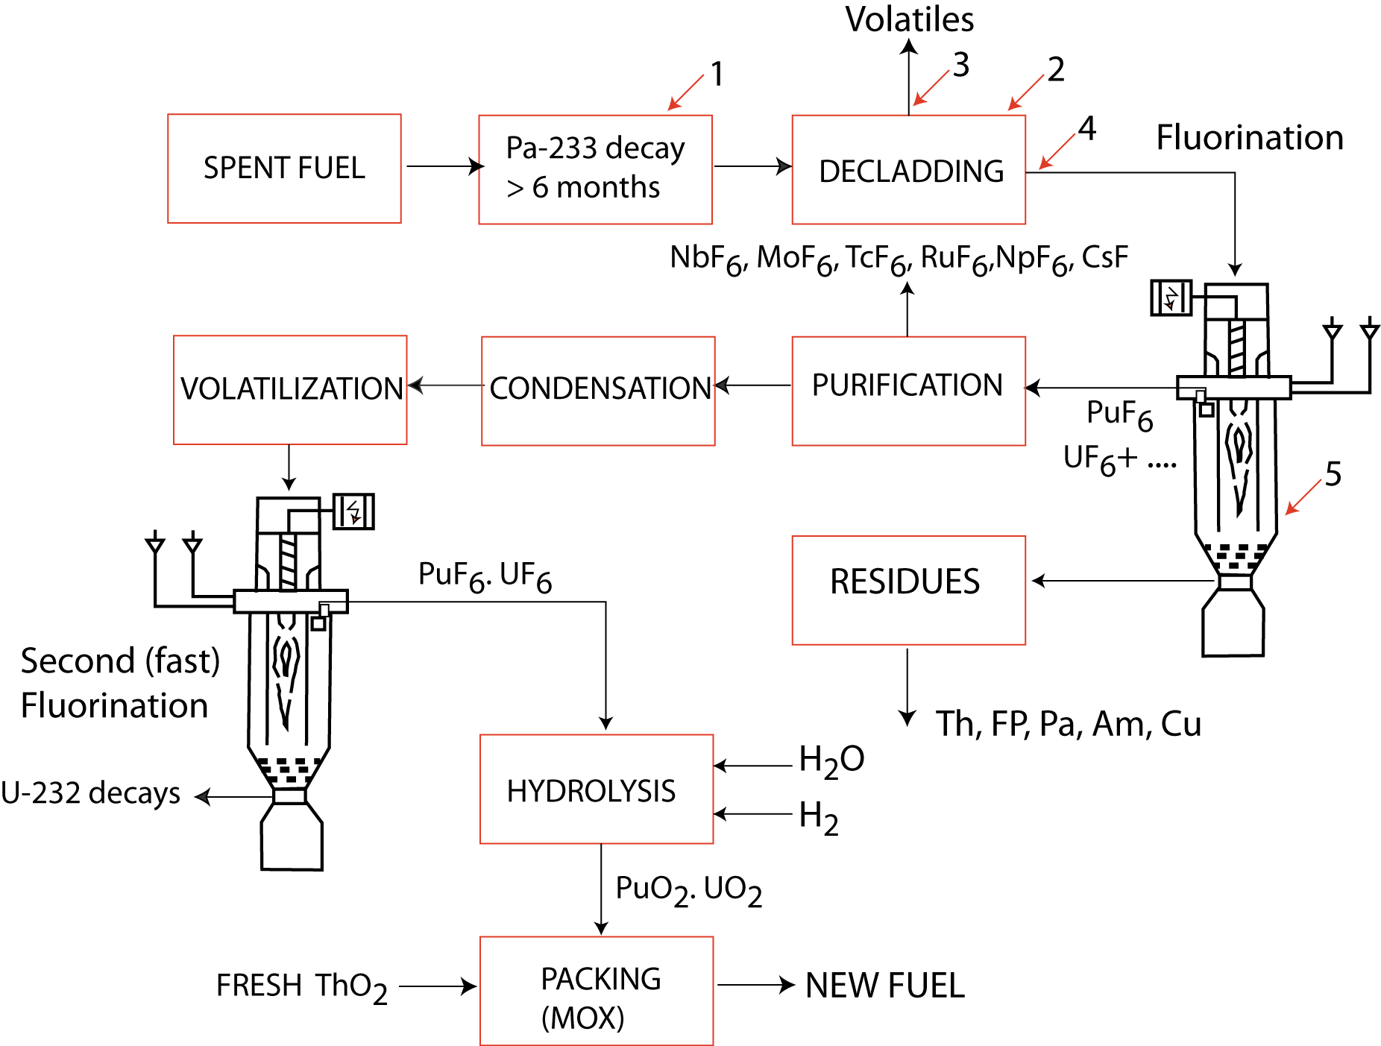
Simple Oxide fuel regeneration with Fluorination
About 95% of the depleted uranium produced to date
is stored as uranium hexafluoride, UF6, in steel
cylinders in open air yards close to enrichment plants.

Slide 46
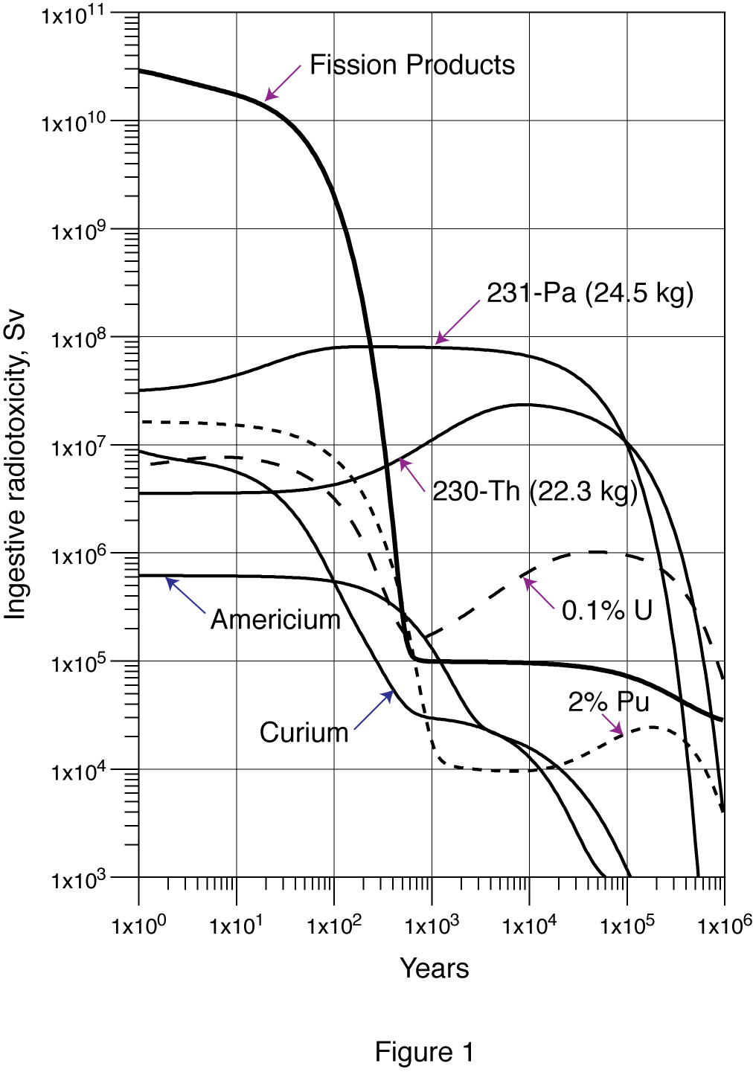
Long lasting toxicities for the simple fluorination method
The radio-toxicity of the resulting waste are due to two main contaminants:
  long lived Pa²³¹ which may be recovered with the help of Bismuth.
  The discharged Thorium is radioactive since it contains Th²³⁰. Thorium may be further recycled as “seeds” with an appropriate chemical extraction.
The remaining “waste”, namely the U and Pu leaks, Cm and Am have a radio toxicity that is negligible with respect to FP.
EA1600 asymptotic load after 120 Gwatt/d/t

Slide 47
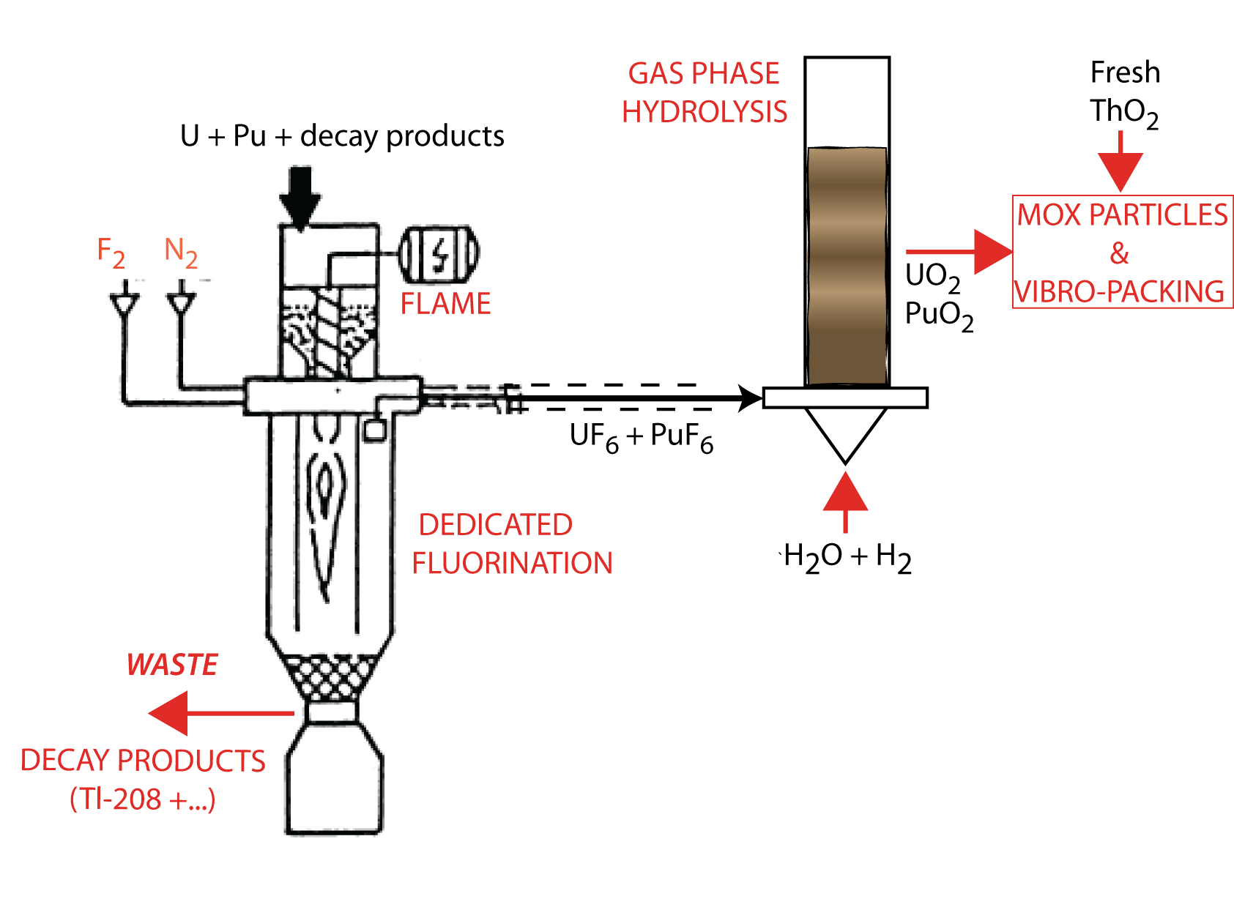
Removing the Tl-208 radioactivity making new MOX fuel
Fluorination offers an attractive and simple method to separate the production of the U seeds from the γ-active equilibrium contaminants.
Assume a second (quick) batch fluorination: U and Pu hexa-fluorides are separated out from the other locally produced products, which include the whole decay chain from U-232 and Pu-236, progressively building up the strong γ-lines.(Tl-208)
During the manufacturing phases, a few MOX pins at the time are quickly assembled while the newly built up γ-ray background is still small.
The final conversion onto oxides is performed with the help of hydrogen and hot steam.
Oxides are reduced to a MOX type powder and mechanically mixed with fresh ThO2 oxide.

Slide 48
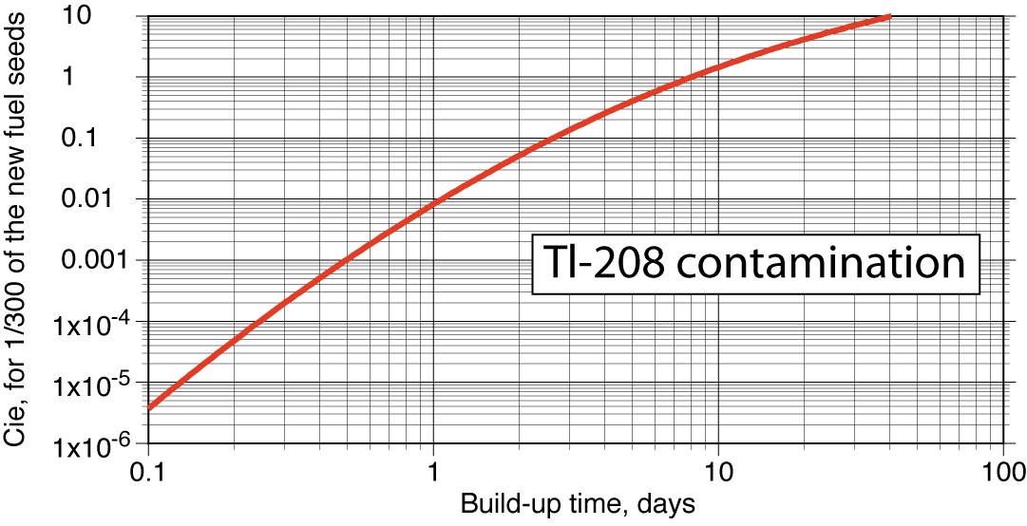
New fuel batches: a tentative example
The new fuel consists typically of 19 ton of new metal Th, 3.4 tons of metal U and a residue of 130 kg of metal Pu, from the seeds of the previous batch. Individual fuel pins, consist of ≈ 6 kg of MOX each.
total Tl-208 equilibrium contamination in the spent fuel is huge
8.1 x 10⁵ Ci
Each cycle is expected to manufacture about 15 new pins
i.e ≈ 90 kg
The regenerated γ-contamination is growing progressively with time. For 90 kg of new MOX fuel, it is about 1 milliCurie after 5 h but 0.1 Curie after 2.5 day.
The manufacturing process must then be performed as quickly as possible to minimize emitted radioactivity.

Slide 49
CONCLUSION
Fuel “reprocessing” or better “regeneration” is an essential part of the Thorium process.
It is a fortunate circumstance that most of the seeds are Uranium. UF6 is the most volatile U compound known to exist. (PuF6 is also volatile). Uranium and Plutonium are therefore the ideal “seeds” for a breeding process.
A simplified reprocessing may then consist in keeping the spentThorium, FP’s and Minor Actinides (Pa, Np, Am and Cm) as “waste” and Uranium + Plutonium as “seeds”.

Slide 50
My own recommendations
A 600 MWe prototype sub critical, beam driven reactor along the lines of (CERN/AT/95-44) and the design of the EA Feasibility Study by Aker Solutions ASA, but with a salt instead of a metal.
The fuel is a conventional structure of stainless rods and metal oxides operating at about 640 °C. All parts contacting the LiF-BeF₂ cooling fluoride coolant are Hastelloy-N —proven compatible with LiF-BeF₂.
The start-up fuel is conventional Thorium-MOX progressively bred into fissile U-233 and beyond. The duration of each cycle is about 10 years and the reactor lifetime is > 200 years .
A simple in situ fuel reprocessing/regeneration is performed, based on the transformation of the U and Pu into hexa-fluorides
Spent Thorium, the Fission products and the minor Actinides, Americium, Curium are “waste”. U and Pu are “seeds”. Long lived Pa²³¹ from Pa may be recovered as “seed” with the help of Bismuth.
The discharged Thorium is radioactive since it contains some Th²³⁰. New Thorium may be injected at each cycle or recovered as “seed”

Slide 51
Summary

Slide 52
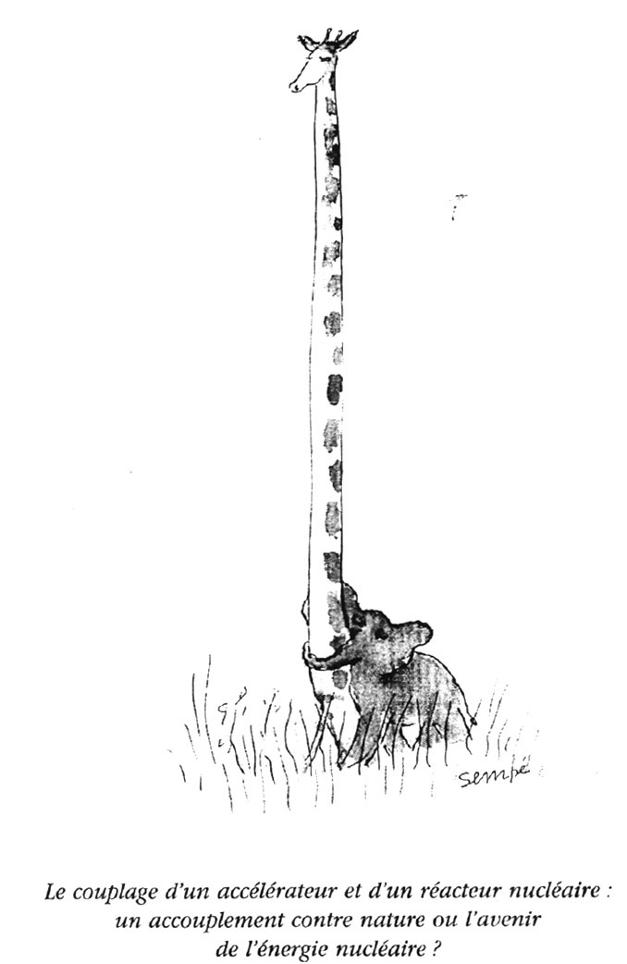
The coupling of an accelerator and of a nuclear reactor:
a mating against nature or the future of the nuclear energy ?

Slide 53
Thank you !

