Slide 1

Overview of the Thorium Programme in India
P.K. Vijayan, I.V. Dulera, P.D. Krishnani, K.K. Vaze, S. Basu and R.K. Sinha*,
Bhabha Atomic Research Centre, Mumbai India
Department of Atomic Energy, Mumbai, India*
vijayanp@barc.gov.in
iThEC13-International Thorium Energy Conference,
Geneva, Switzerland, October 27-31, 2013

Slide 2
CONTENTS
Introduction
Relevance of thorium to long term Indian nuclear power programme
Advantages and challenges of thorium fuel cycle
Indian experience with thorium fuel cycle
  Mining, thorium fuel fabrication,
  Thorium bundle irradiation, reprocessing and
  Built research reactors based on U²³³ fuel
Indian programme on thorium based reactors
  AHWR and
  Indian HTR Programme
Concluding remarks

Slide 3

Introduction
Thorium is three to four times more abundant than uranium in the earth’s crust
Relatively easy to mine
India has large reserves in the form of monazite sands along its southern and eastern coastal areas

Slide 4
Relevance of thorium to long term Indian nuclear power programme

Slide 5
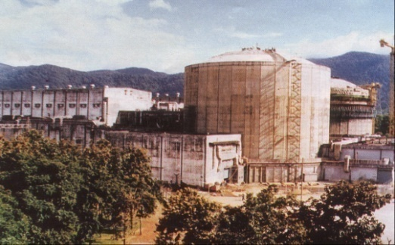
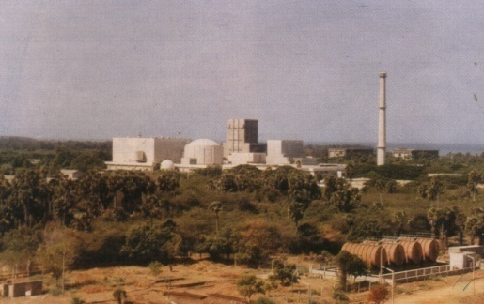
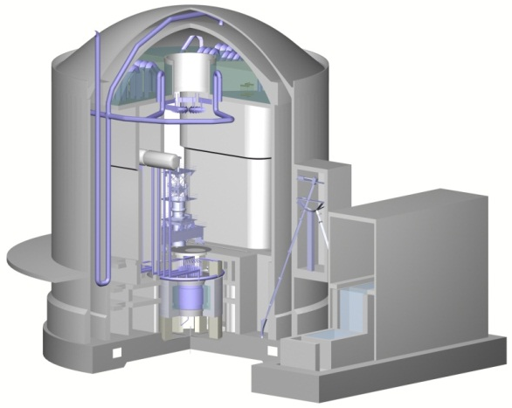
The goal of three stage Indian nuclear power programme is resource sustainability- Accordingly power generation in 3rd stage is predominantly dependent on thorium based fuel
PHWR
FBTR
AHWR
300 GWe-Year
Th
About 42000 GWe-Year
Nat. U
U fueled
PHWRs
Electricity
Th
Dep. U
>155000
GWe-Year
Pu Fueled
Fast Breeders
Electricity
Pu
U²³³
Electricity
U²³³ Fueled
Reactors
H₂/ Transport
fuel
Pu
U²³³
Power generation primarily by PHWR
Building fissile inventory for stage 2
Expanding power programme
Building U²³³ inventory
Thorium utilisation for
Sustainable power programme
Stage 1
Stage 2
Stage 3
5

Slide 6
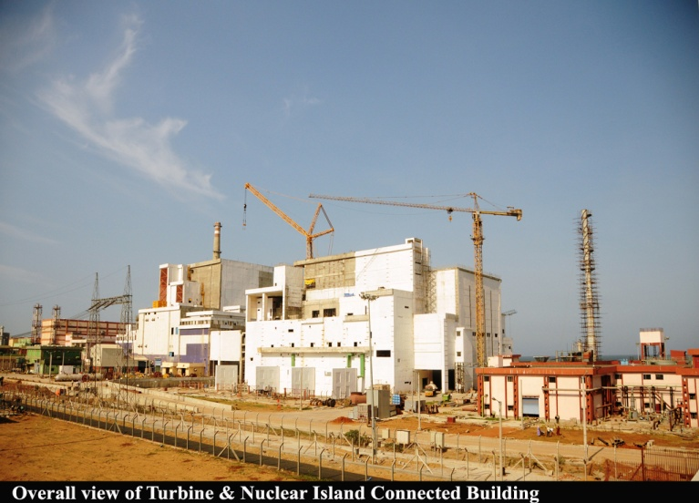
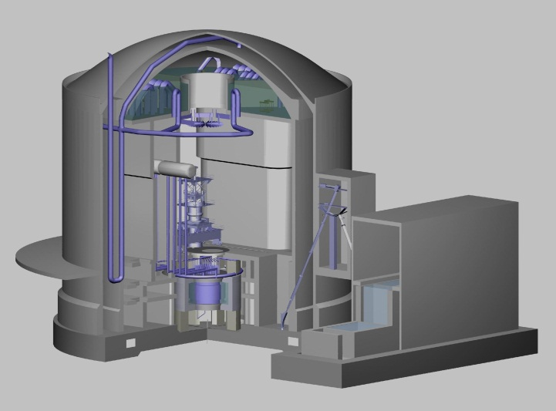
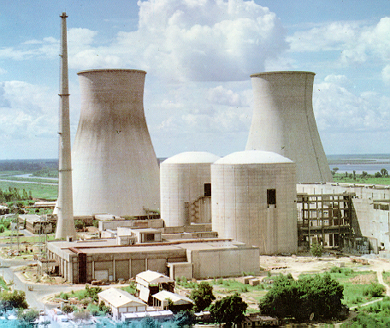
Current Status of Indian Three Stage Nuclear Power Programme
Globally Advanced Technology
Globally Unique
World class performance
Stage – I PHWRs
18 – Operating
4x700 MWe - Under construction
Several others planned
Gestation period has been reduced
POWER POTENTIAL ≅ 10 GWe
LWRs
2 BWRs Operating
1 VVER– Achieved criticality (July, 2013) & commercial operation (Oct. 2013)
1 VVER- under construction (~96%)
Stage - II
Fast Breeder Reactors
40 MWth FBTR - Operating since 1985
Technology Objectives realised
500 MWe PFBR-
Under Construction >95% complete
TOTAL POWER POTENTIAL ≅ 42,000 GWe-year
Stage - III
Thorium Based Reactors
30 kWth KAMINI- Operating
300 MWe AHWR: Pre-licensing safety appraisal by AERB completed, Site selection in progress
POWER POTENTIAL IS VERY LARGE
MSBRs – Being evaluated as an option for large scale deployment
6

Slide 7
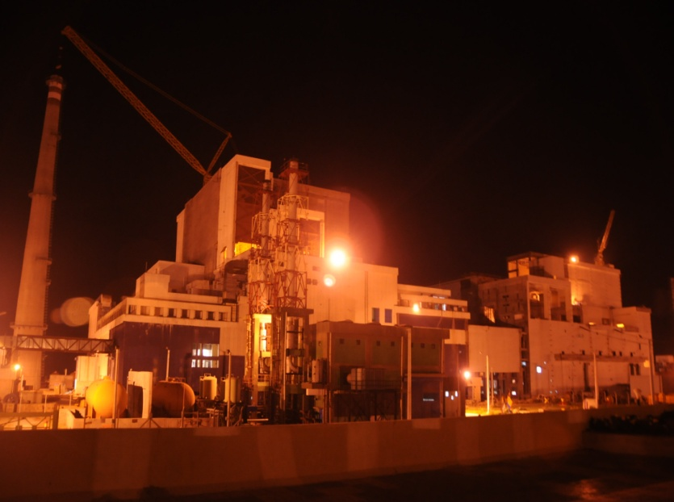
Optimising the use of Domestic Nuclear Resources
PFBR (500 MWe)
Project sanctioned in 2003
Further development being pursued to reduce doubling time and UEC
Russia is the only other country with a larger FBR under construction /operation
Reactor building
Capital cost (Rs/kWe) | 69840
UEC (Rs/kWh) | 3.22
Construction period | 7 years
Power profile of PHWR programme
Growth with Pu-U FBRs
Results of a case study; assumptions 60000 te Uranium and short doubling time FBRs beyond 2021

Slide 8
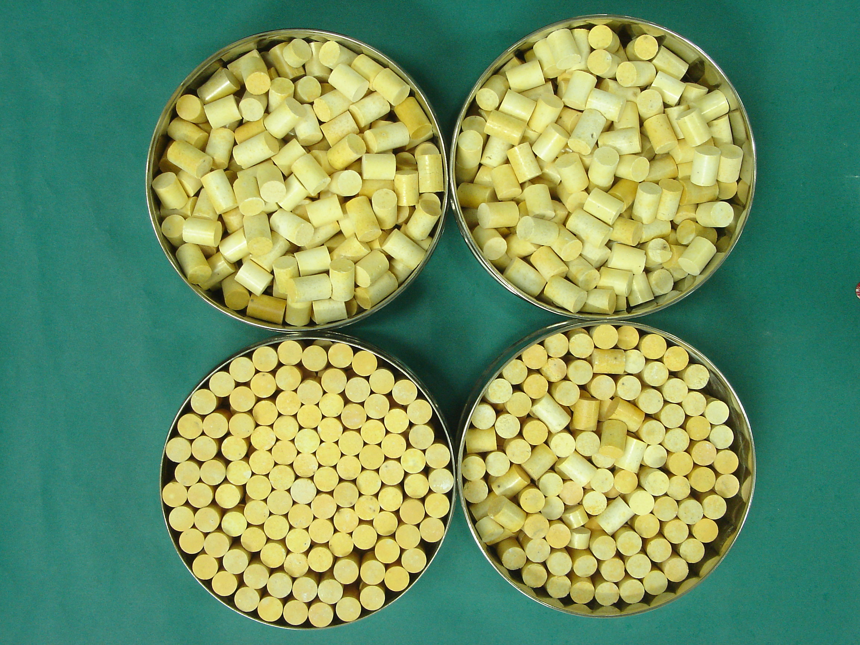
Optimising the use of Domestic Nuclear Resources
Further growth with thorium
Power profile of PHWR programme
Growth with Pu-U FBRs
Results of a case study; assumptions 60000 te Uranium and short doubling time FBRs beyond 2021

Slide 9
Optimising the use of Domestic Nuclear Resources
Premature introduction of thorium hampers the growth
Detailed calculations have shown that thorium can be deployed on a large scale about 3 decades after introduction of FBRs with short doubling time
Growth with Pu-U FBRs
Peaks at 36 GWe only
Further growth with thorium
Best effort use of Pu with Th in PHWRs and MSRs
PHWR(Nat U)
Power profile of PHWR programme
Growth with Pu-U FBRs
Results of a case study; assumptions 60000 te Uranium and short doubling time FBRs beyond 2021

Slide 10
A Road Map for Deployment of Thorium Based Reactors
Premature deployment of thorium leads to sub-optimal use of indigenous energy resource.
Necessary to build-up a significant level of fissile material before launching thorium cycle in a big way for the third stage
Incorporation of thorium in the blankets of metallic fuelled fast breeder reactors – after significant FBR capacity built-up
  Full core and blanket thorium FBRs only after U-shortage felt
  Thorium based reactors expected to be deployed beyond 2070
AHWR – Thorium fuel cycle demonstrator by 2022
Surplus ²³³U formed in these FBRs could drive HTRs including MSBRs

Slide 11
Important attributes and advantages of thorium fuel cycle

Slide 12
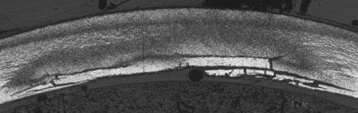
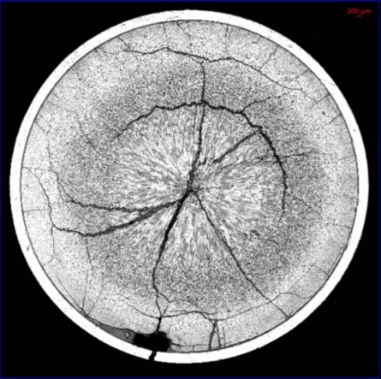
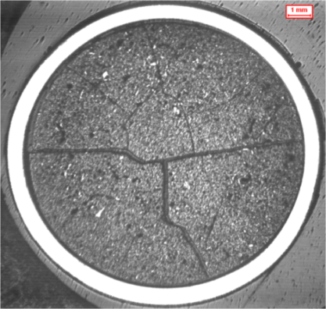
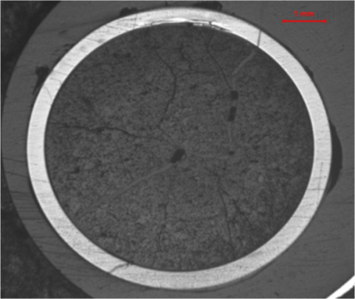
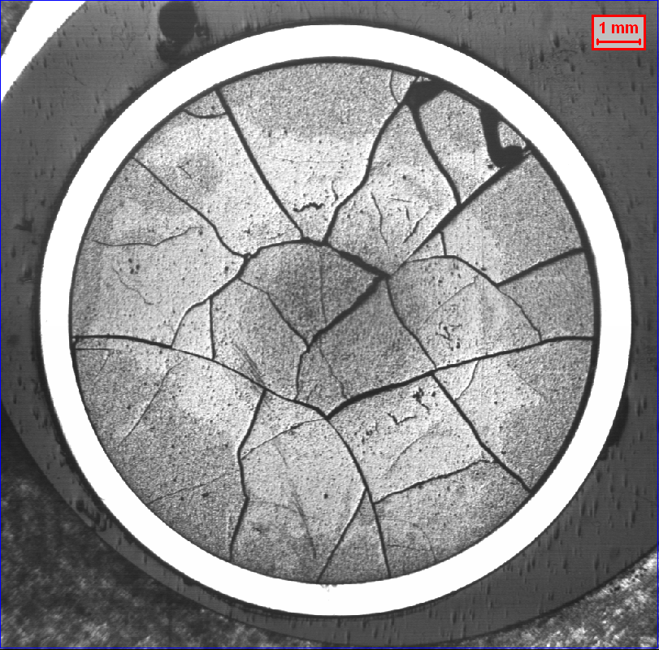
ThO₂ - Physical and Chemical properties
Relatively inert. Does not oxidise unlike UO₂, which oxidizes easily to U₃O₈ and UO₃. Does not react with water.
Higher thermal conductivity and lower co-efficient of thermal expansion compared to UO₂. Melting point 3350 °C as against 2800 °C for UO₂.
Fission gas release rate one order of magnitude lower than that of UO₂.
Good radiation resistance and dimensional stability
ThO₂-4%PuO₂
Failed ThO₂-4%PuO₂
Failed UO₂
UO₂-4%PuO₂

Slide 13
Advantages of ²³³U-Thorium: Important Neutronic Characteristics
²³³U has an η value (greater than 2.0) that remains nearly constant over a wide energy range, in thermal as well as epithermal regions, unlike ²³⁵U and ²³⁹Pu. This facilitates achievement of high conversion ratios with thorium utilisation in reactors operating in the thermal/epithermal spectrum.
²³⁹Pu
²³³U
Number of neutrons per neutron absorbed, η
²³⁵U
²³⁸U
²³²Th
η: Number of neutrons released per thermal neutron absorbed
Thermal Neutrons
Incident neutron energy
Fast
Neutrons
Cross section for capture of thermal neutrons in ²³²Th is typically 2.47 times that in ²³⁸U. Thus thorium offers greater competition to capture of the neutrons and lower losses to structural and other parasitic materials leading to an improvement in conversion of ²³²Th to ²³³U.
Capture cross section of ²³³U is much smaller than ²³⁵U and ²³⁹Pu, the fission cross section being of the same order implying lower non-fissile absorption leading to higher isotopes. This favours the feasibility of multiple recycling of ²³³U, as compared to plutonium.
Ratio of fission and capture cross sections (σ_{f}/ σ_{c})
Thermal Capture cross section (barn)
²³³U
²³⁵U
²³⁹Pu
The neutronic characteristics of ²³³U-Th lead to:
  High potential for achieving near-breeding condition in thermal reactors
  High potential for tolerating higher parasitic absorption (e.g. in light water and structural materials)

Slide 14
Advantages of Thorium : Presence of ²³²U offers an Intrinsic Barrier to Proliferation
²³²U is formed via (n, 2n) reactions, from ²³²Th, ²³³Pa and ²³³U. The half-life of ²³²U is about 69 years. The daughter products (²⁰⁸Tl and ²¹²Bi) of ²³²U are high energy gamma emitting isotopes.
Due to presence of ²³²U in separated ²³³U, thorium offers good proliferation-resistant characteristics.
Notes:
14

Slide 15
Advantage of thorium over uranium becomes evident if thorium based fuels are used at high burnups
There is a growing global interest in thorium for various reasons such as
  Energy advantage
  Relatively stable core reactivity
  Low minor actinide generation
  Proliferation resistance
  Performance potential of homogeneous mixture of fertile materials with ²³⁵U in a PHWR
  By virtue of being lower in the periodic table than uranium, the long-lived minor actinides resulting from burnup are in much lower quantity with the thorium cycle

Slide 16
Challenges of thorium fuel cycle

Slide 17
Challenges of thorium fuel cycle
Melting point of ThO₂ (3350 °C) is much higher than that of UO₂ (2800°C).
  Much higher sintering temperature (>1700°C) is required to produce high density ThO₂ and ThO₂–based mixed oxide fuels.
    Admixing of ‘sintering aid’ (CaO, MgO, Nb₂O₅, etc) is required for achieving the desired pellet density at lower temperature.
ThO₂ and ThO₂ based mixed oxide fuels are relatively inert and do not dissolve easily in concentrated nitric acid.
  Addition of small quantities of HF in conc. HNO₃ is essential which cause corrosion of stainless steel equipment and piping in reprocessing plants.
  The corrosion problem is mitigated with addition of aluminium nitrate.
  Requires long dissolution time in boiling THOREX solution [13M HNO₃+0.05M HF+0.1M Al(NO₃)₃] for ThO₂ based fuel
The irradiated Th or Th–based fuels contain significant amount of ²³²U, having a half-life of 68.9 years and is associated with strong gamma emitting daughter products, ²¹²Bi and ²⁰⁸Tl with very short half-life.
  There is significant build-up of radiation dose with storage of spent Th–based fuel or separated ²³³U,
  This necessitates remote and automated reprocessing and re-fabrication in heavily shielded hot cells, increasing the cost of fuel cycle activities.

Slide 18
Challenges of thorium fuel cycle
In the conversion chain of ²³²Th to ²³³U, ²³³Pa is formed as an intermediate, which has a relatively longer half-life (~27 days) as compared to ²³⁹Np (2.35 days) in the uranium fuel cycle thereby requiring longer cooling time of at least one year for completing the decay of ²³³Pa to ²³³U.
Normally, Pa is passed into the fission product waste in the THOREX process, which could have long term radiological impact.
  It is essential to separate Pa from the spent fuel solution prior to solvent extraction process for separation of ²³³U and thorium.
The database and experience of thorium fuels and thorium fuel cycles are very limited, as compared to UO₂ and (U, Pu)O₂ fuels, and need to be augmented before large investments are made for commercial utilization of thorium fuels and fuel cycles.

Slide 19
Indian experiences with thorium fuel cycle R&D

Slide 20





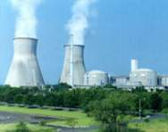


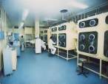


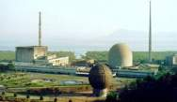
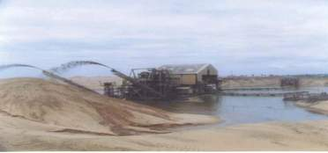
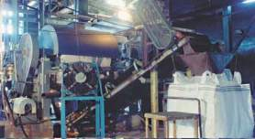
Evolution of thorium fuel cycle development in India
KAMINI research reactor:
²³³U-Al Fuel
Use of thoria bundle in PHWR
AHWR critical facility
Irradiated fuel reprocessing and fabrication
Dismantling of irradiated bundle and Post-irradiation examination
Thoria pellets/pins irradiation in research reactor
Thorium extraction
Notes:
20

Slide 21
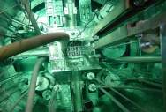
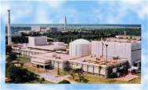
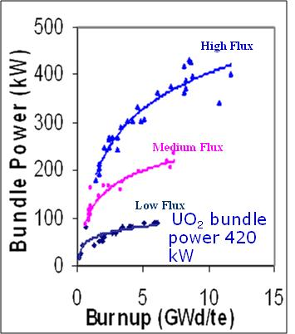
Thoria Irradiation in Indian reactors
CIRUS:
  Thoria rods irradiated in the reflector region for ²³³U production
  Irradiations of (Th, Pu) MOX fuels in Pressurised Water Loop to burnup of 18 GWd/te.
Dhruva: Thoria based MOX fuel pins of AHWR are under irradiation
PURNIMA-II (1984 -1986): First research reactor using ²³³U fuel.
PURNIMA-III (1990-93): ²³³U-Al dispersion plate type fuel experiments.
KAMINI: Research reactor operating at 30 kW power, commissioned at Kalpakkam in 1996. Reactor based on ²³³U fuel in the form of U-Al alloy, for neutron radiography
Thoria bundles irradiated in the blanket zone of Fast Breeder Test Reactor (FBTR)
²³³U-MOX fuel being irradiated in FBTR
Three PHWR stations at Kakrapar, Kaiga and Rajasthan (units 3&4) have irradiated a total of 232 thorium bundles, to maximum discharge burnup of 14 GWd/te. The power produced by the bundle just before discharge (600 FPD) was about 400 kW.
Notes:
21

Slide 22
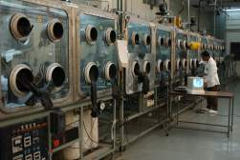

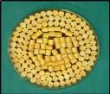

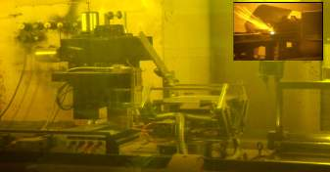
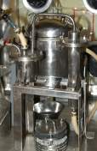
Fuel fabrication and reprocessing facility
Experience with fabrication of thoria-based fuel
  Thoria bundles for PHWRs.
  Thoria assemblies for research reactor irradiation.
  (Th-Pu) MOX pins for test irradiations.
Fabrication was similar to that of UO₂ & (U-Pu) MOX
MOX Powder Processing
Thoria microspheres and ThO₂ Pellets
fabricated for AHWR Critical Facility
Glove box and cask handling
Thoria dissolution studies
Thorium fuel cycle technologies is relatively complex because of
  inert nature of thoria
  radiological aspects
Bundle dismantling
Impregnation setup
Notes:
22
22

Slide 23
Indian Programme on thorium based reactors:
● Advanced Heavy Water Reactor (AHWR)
● Indian HTR programme
- Compact High Temperature Reactor (CHTR)
- Innovative High Temperature Reactor (IHTR)
- Molten salt Breeder reactor (MSBR)

Slide 24
AHWR General Introduction
AHWR is a 300 MWe, vertical, pressure tube type, boiling light water cooled, and heavy water moderated reactor.
AHWR is a technology demonstration reactor designed to achieve large-scale use of thorium for power generation.
Provides transition to 3rd stage of the Indian Nuclear Power Programme.
AHWR Schematic
Addresses most issues relevant to advanced reactor designs like sustainability, enhanced safety, proliferation resistance and economic competitiveness.
The reactor incorporates a number of passive safety features to reduce environmental impact.
Fuel cycle flexibility
  AHWR-LEU using (LEU-Th) MOX
  AHWR–Pu using (Pu-Th) MOX and (Th-U²³³) MOX

Slide 25
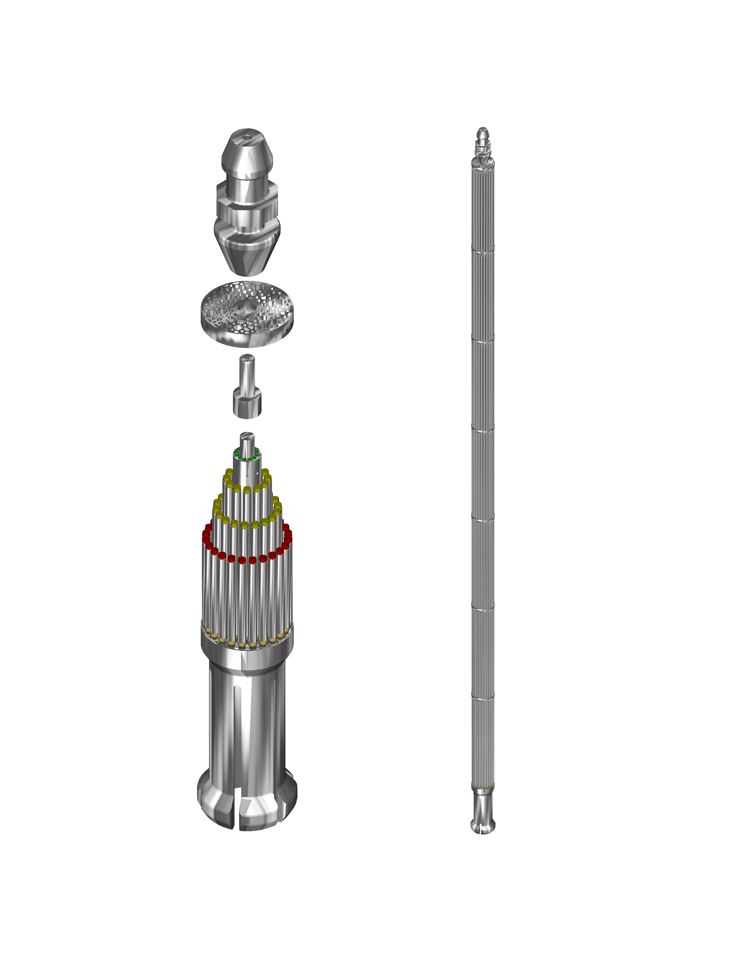
AHWR-LEU: Advanced Heavy Water Reactor with LEU-Th MOX Fuel
Solid Rod
Solid Rod
Central Structural Tube
Central Structural Tube
Inner ring fuel pins with Th-²³³U MOX ( 3%)
Inner ring fuel pins with 30% of LEUO₂, balance ThO₂
Central ring fuel pins with Th-²³³U MOX (3.75%)
Central ring fuel pins with 24% of LEUO₂, balance ThO₂
Outer ring fuel pins with Th-Pu MOX ( 2.5/4%)
Outer ring fuel pins with avg.16% of LEUO₂, balance ThO₂
Discharge burnup: 38 GWd/te
Discharge burnup: 61 GWd/te
Fuel cluster of AHWR-Pu
Fuel cluster of AHWR-LEU

Slide 26
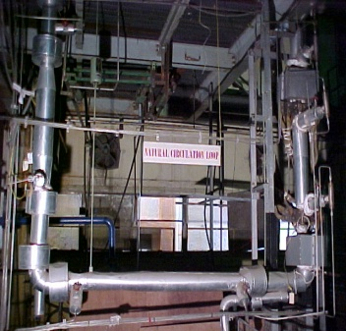
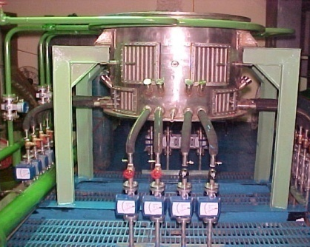
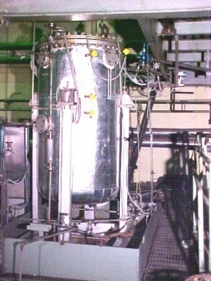
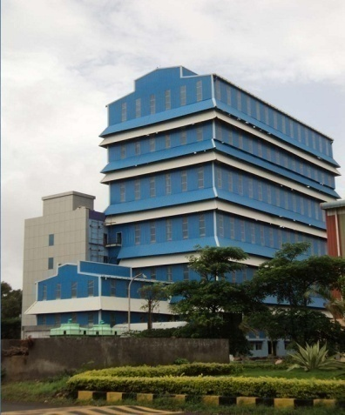
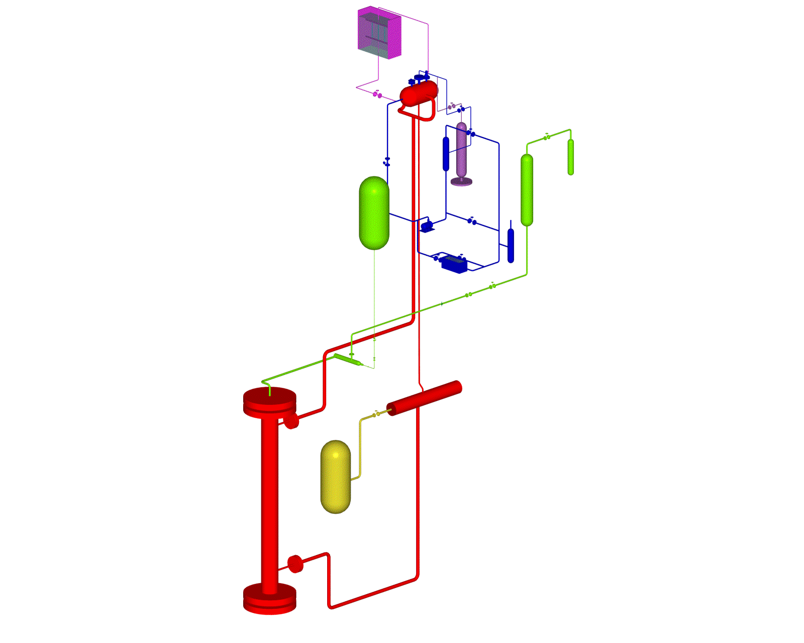
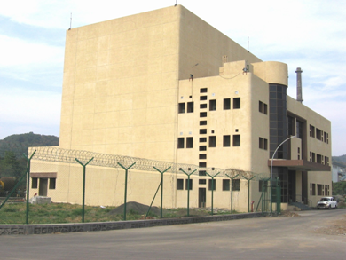
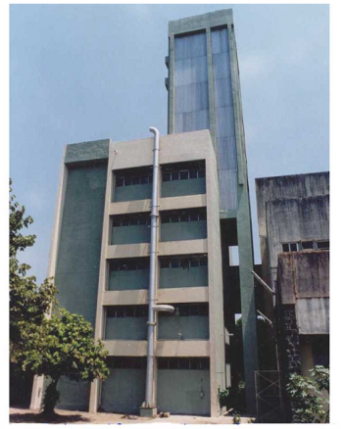
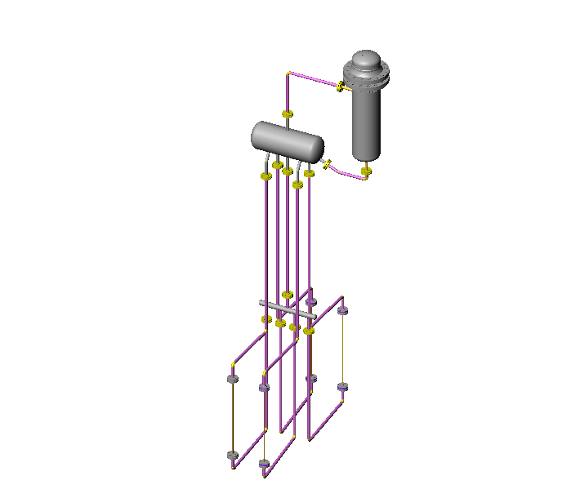

Test Facilities for AHWR Design Validation
PCITF
HPNCL
Moderator & liquid poison distribution
PCCTF
SDTF
IC
SD
JC
SB
AA
SFP
PBC
AHWR Critical Facility
QOV
HEADER
Building housing ITL
FCS
ATTF, Tarapur
BFST
ITL
FPTIL/CHIL
PCL
Several test facilities have been setup for AHWR design validation. Some of these are devoted to the study of specific phenomena. Major test facilities include 3 MW BWL, ITL and AHWR critical facility. The ATTF at R&D Centre Tarapur is the latest of these.

Slide 27
Indian High Temperature Reactor Programme

Slide 28
Indian High Temperature Reactor Programme
Compact High Temperature Reactor (CHTR)- Technology Demonstrator
100 kWth, 1000 °C, TRISO coated particle fuel
Several passive systems for reactor heat removal
Prolonged operation without refuelling
Status: Design of most of the systems worked out. Fuel and materials under development. Experimental facilities for thermal hydraulics setup. Facilities for design validation are under design.
Innovative High Temperature Reactor for Hydrogen Production (IHTR)
600 MWth , 1000 °C, TRISO coated particle fuel
  Small power version for demonstration of technologies
Active & passive systems for control & cooling
On-line refuelling
Status: Optimisation of reactor physics and thermal hydraulics design, selection of salt and structural materials in progress. Experimental facilities for molten salt based thermal hydraulics and material compatibility studies set-up.
Indian Molten Salt Breeder Reactor (MSBR)
Medium power, moderate temperature, demonstration reactor based on ²³³U-Th fuel cycle
  Small power version for demonstration of technologies
Emphasis on passive systems for reactor heat removal under all scenarios and reactor conditions
Status: Initial studies being carried out for conceptual design
28

Slide 29
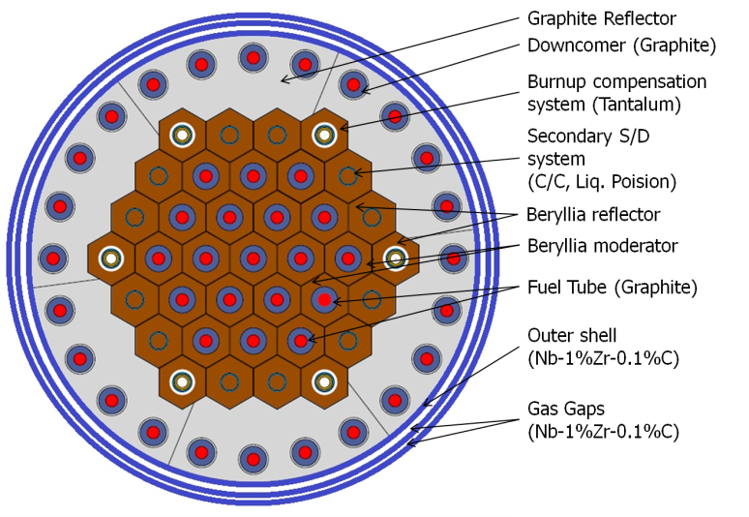
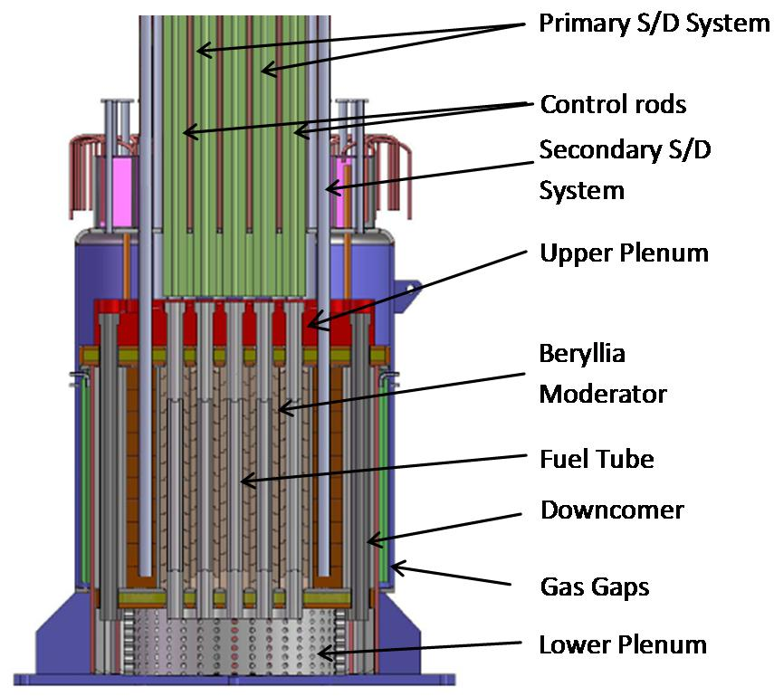
Advanced Reactors – Indian Initiatives
Compact High Temperature Reactor (CHTR)
CHTR is a technology demonstrator with the following features:
  Coolant exit temperature of 1000°C -Facilitate hydrogen production.
  Compact: For use as nuclear battery in remote areas with no grid connection.
  Fuel using ²³³U-Th based on TRISO coated particle fuel with 15 years refuelling frequency and high burnup.
  Ceramic core: BeO moderator, and graphite for fuel tube, downcomer tube and reflector
  Coolant: Lead-Bismuth eutectic with 1670 °C as the boiling point.
  Emphasis on reactor heat removal by passive systems e.g. natural circulation of coolant and high temperature heat pipes
(Tantalum alloy)
(Tantalum alloy)
(B₄C)
(Graphite)
(Graphite)
(Graphite)

Slide 30
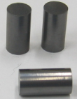
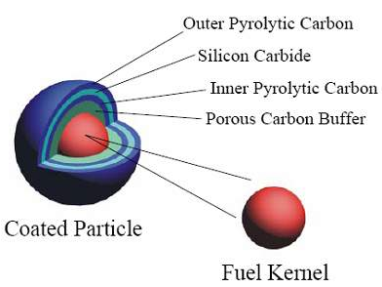
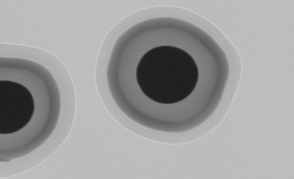
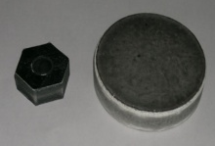
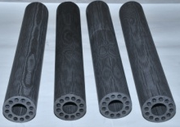
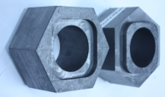
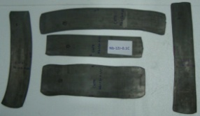
Major Research & Development Areas in Progress
Area of development | Status of development
High packing density fuel compacts based on TRISO coated particle fuel | Technology for TRISO coated particles & fuel compacts developed with surrogate material
Materials for fuel tube, moderator and reflector Carbon based materials (graphite and carbon carbon composite) Beryllia Graphite Oxidation & corrosion resistant coating | Fuel tubes made using various techniques & materials including carbon-carbon composites Beryllia blocks manufacturing technology established Techniques for SiC coating on graphite & silicide coating on Nb developed
Metallic structural materials Nb-1%Zr-0.1%C alloy, Ta alloy | Indigenous development of alloy and manufacture of components for a lead- bismuth thermal hydraulic loop
Thermal hydraulics of LBE coolant Code development & validation High temperature instrumentation | LBE test loop operated to validate design codes. Loop for studies at 1000 °C established. Level probes, oxygen sensor, etc. developed for LBE coolant
OPyC
SiC
IPyC
Fuel compacts
High density beryllia blocks
Fuel tubes
Graphite blocks
Nb-1%Zr-0.1%C alloy

Slide 31
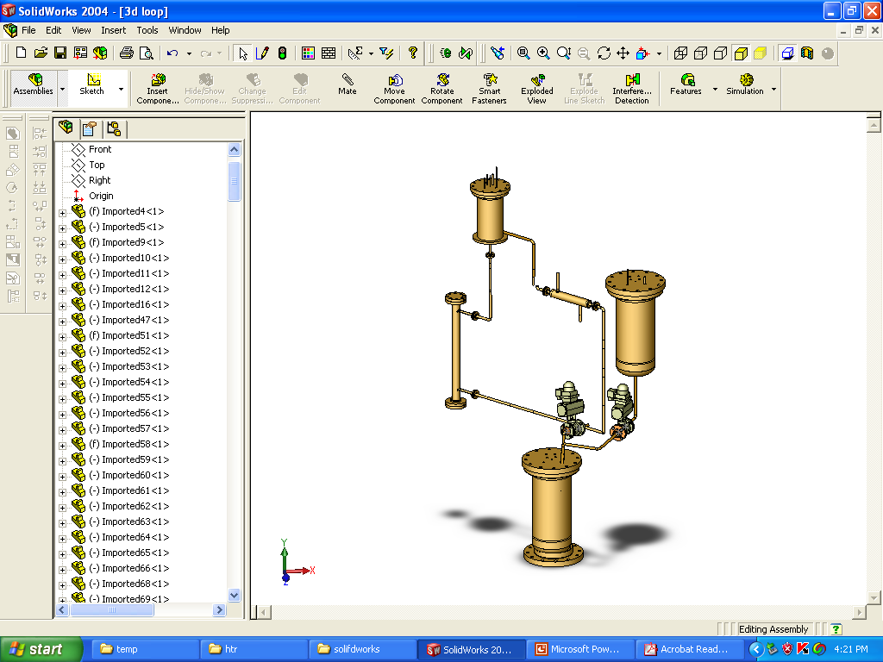
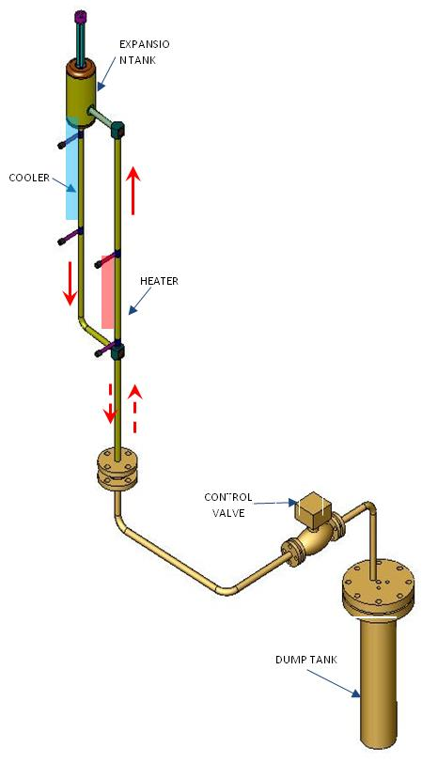
Thermalhydraulic Studies for LBE Coolant
Major areas of development
Analytical studies and development of computer codes
Liquid metal loop for experimental studies
  Loop at 550 °C operating since 2009
  Loop at 1000 °C established
Steady state and transient experiments carried out
In-house developed code validated
Experimental and analytical studies for freezing and de-freezing of coolant
Test bed for instrumentation development-level probes, oxygen sensor, EM pump & flowmeters
EXPANSION
TANK
MELT
TANK
HEAT
EXCHANGER
HEATER
YSZ based oxygen sensor
SUMP
Liquid Metal Loop (2009)
Comparison of steady state correlation [Vijayan, 2002] with experimental data
Isometric of Kilo temperature Loop
31

Slide 32
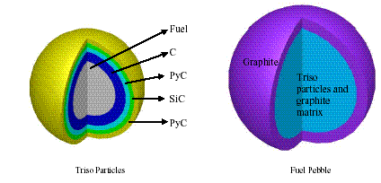
Innovative High Temperature Reactor (IHTR) for commercial hydrogen production
600 MWth, 1000 °C, TRISO coated particle fuel
Pebble bed reactor concept with molten salt coolant
Natural circulation of coolant for reactor heat removal under normal operation
Current focus on development:
  Reactor physics and thermal hydraulic design – Optimisation
  Thermal and stress analysis
  Code development for simulating pebble motion
  Experimental set-up for tracing path of pebbles using radio-tracer technology
  Pebble feeding and removal systems
Pebble
TRISO coated particle fuel
Hydrogen: 80,000 Nm³ /hr
Electricity: 18 MWe, Water: 375 m³/hr
No. of pebbles in the annular core ~150000
Packing fraction of pebbles ~60%
Packing fraction of TRISO particles ~ 8.6 %
²³³U Requirement 7.3 %

Slide 33
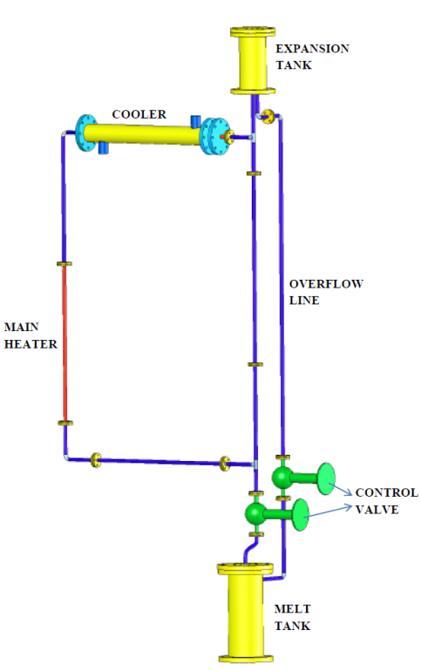
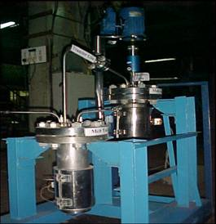
Thermal hydraulic studies and material compatibility studies for molten salt coolant
Molten salt loop
Major areas of development
Analytical studies and development of computer codes
Molten salt natural circulation loop for experimental studies
Molten fluoride salt corrosion facility using FLiNaK
  Experiments carried out up to 750 °C mainly on Inconel materials
Steady state NC flow
Molten salt NCL
Molten salt corrosion test facility
Predicted and measured temperatures
33

Slide 34
Utilisation of ²³³U in a Th matrix in metallic fuelled FBRs and MSBRs - a comparison
 | Metallic ²³³U/Th fuelled FBR with Th blanket ^{[1]} | Molten Salt Breeder Reactor^{[2]}
Reactor Power | 1000 MWe | 1000 MWe
Cycle fissile inventory | 6 tonnes* | <1 tonnes **
Breeding ratio | 1.115 | 1.14
* Assuming out of core time (cooling + reprocessing + refabrication) to be 3 years ** Assumes online reprocessing
Cycle fissile inventory for metallic fuelled FBRs are very high (~6 t) compared to MSBRs operating in thermal or epithermal spectrum
Breeding ratio of 1.06 to 1.14 is possible in MSBRs operating in thermal and epithermal zone. FBRs will have BRs ~1.115
Reprocessing in FBRs requires extensive clad removal and fuel refabrication – avoided in MSBR
MSBR provides significant advantages over metallic fuelled FBRs and hence is an attractive option for the 3rd stage and conceptual design of IMSBR in progress.
Ref.: [1] Alternate Fuel Cycles for Fast Breeder Reactors, INFCE/DEP/WG.5/78, International Nuclear Fuel Cycle Evaluation, 1978
Ref. : [2] ORNL-4528

Slide 35
Concluding Remarks
Thorium offers a sustainable and proliferation resistant fuel option with lower minor actinides burden
Over a period of time, indigenous technologies developed for all the aspects of thorium fuel cycle
AHWR is being developed as a technology demonstrator for industrial scale thorium fuel cycle
India is developing thorium based high temperature reactor concepts dedicated for hydrogen production
Large scale deployment of molten salt breeder reactors is envisaged during the third stage of Indian nuclear power programme

Slide 36
Thank you

Slide 37
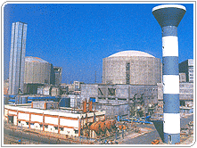
Optimising the use of Domestic Nuclear Resources
NPCIL is a AAA (CRISIL) rated company for ten years in a row.
 | Indian PWHRs (700 MWe) | Global range
Capital Cost $/kWe | 1700 | 2000-2500
Construction period | 5-6 years | 5-6 years
UEC $/MWh | 60 | 60 - 70
TAPS 3 – 4
(540 MWe each)
* Completion cost ⁺ 2008 Prices
KAPS – 1 adjudged the best performing PHWR in the world for the period October 2001 to September 2002.
In 2003, 2007 and 2010, three senior Indian operators of Nuclear Power Stations, received the WANO excellence award.
Power profile of PHWR programme
Results of a case study; assumptions 60000 te Uranium and short doubling time FBRs beyond 2021
Notes:
UEC: Unit Energy Cost; GCF: Gross Capacity Factor

Slide 38
Challenges of thorium fuel cycle
Melting point of ThO₂ (3350 °C) is much higher than that of UO₂ (2800°C).
  Much higher sintering temperature (>1700°C) is required to produce high density ThO₂ and ThO₂–based mixed oxide fuels.
    Admixing of ‘sintering aid’ (CaO, MgO, Nb₂O₅, etc) is required for achieving the desired pellet density at lower temperature.
ThO₂ and ThO₂ based mixed oxide fuels are relatively inert and do not dissolve easily in concentrated nitric acid.
  Addition of small quantities of HF in conc. HNO₃ is essential which cause corrosion of stainless steel equipment and piping in reprocessing plants.
  The corrosion problem is mitigated with addition of aluminium nitrate.
  Requires long dissolution time in boiling THOREX solution [13M HNO₃+0.05M HF+0.1M Al(NO₃)₃] for ThO₂ based fuel
The irradiated Th or Th–based fuels contain significant amount of ²³²U, having a half-life of 68.9 years and is associated with strong gamma emitting daughter products, ²¹²Bi and ²⁰⁸Tl with very short half-life.
  There is significant build-up of radiation dose with storage of spent Th–based fuel or separated ²³³U,
  This necessitates remote and automated reprocessing and re-fabrication in heavily shielded hot cells, increasing the cost of fuel cycle activities.

Slide 39

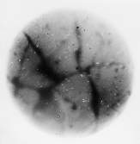


Post Irradiation Examination (PIE) of thoria fuel
The PIE was carried out for one of the discharged bundles from Kakrapar unit-2, which had seen 508 full power days.
  Dissolution tests done for uranium isotope composition and fission products and compared with theoretical evaluations.
  Power distribution shows peaking at the outer pins for UO₂ bundle and at intermediate pins for thoria bundle.
  Fission products (¹³⁷Cs) migrate to thoria pellet cracks unlike upto periphery in UO₂ fuel.
Isotopic Composition of Discharged Uranium (%)
 | ²³²U | ²³³U | ²³⁴U | ²³⁵U | ²³⁶U | ²³⁸U
Mass Spectrometric Analysis | 0.0459 | 88.78 | 9.95 | 1.0 | 0.085 | 0.14
Theoretical Prediction * | 0.0491 | 90.556 | 10.945 | 1.07 | 0.0918 | -
Power peaking in the central elements
Atom % fission = 1.25%
Fission products measured were
¹²⁵Sb, ¹³⁴Cs, ¹³⁷Cs, ¹⁴⁴Ce-¹⁴⁴Pr, ¹⁵⁴Eu, ¹⁵⁵Eu, ⁹⁰Sr.
Gross activity of the bundle measured
α-Autoradiograph
β, γ - Autoradiograph
PIE hot cell facility
Fission gas analysis set up
Notes:
39

Slide 40
Brief history of thorium fuel based reactors

Slide 41


Experience with thorium based fuels in world -Thorium fuel experience of more than three decades old exists for test reactors & power reactors of different types
Name & country | Type | Power | Fuel | Operation
Lingen, Germany | BWR | 60 MWe | Test fuel (Th+Pu)O₂ pellets | Till 1973
MSRE, ORNL, USA | MSBR | 8 MWt | ²³³U molten fluorides | 1964-1969
Shippingport & Indian Point 1, USA | LWBR, PWR | 60 MWe 285 MWe | Th+²³³U driver fuel, Oxide Pellets | 1977-1982 1962-1980
SUSPOP/KSTR, KEMA, Netherlands | Aqueous homogeneous suspension | 1 MWt | Th+HEU, Oxide pellets | 1974-1977
NRU & NRX, Canada | MTR |  | Th+²³⁵U, Test fuel | Irradiation of few elements
Shipping port Reactor: A major experience in the use of thorium
First large-scale nuclear power reactor for electricity-60 MWe
  Test bench for thermal breeder using ²³³U fuel
Operated as LWBR during 1977-1982
  1.39% more fissile fuel at EOL
Breeding success achieved
  by high cost of sophisticated core
  by sacrificing reactor performance
1966: MSRE
Molten-Salt Reactor Experiment (MSRE)
Operated for 17,655 h

Slide 42
  Thorium based fuels have been loaded either partially or fully in High Temperature Gas cooled Reactor (HTGR) cores.
Name & country | Type | Power | Fuel | Operation
AVR, Germany | HTGR (Pebble bed) | 15 MWe | Th+²³⁵U driver fuel, Coated fuel particles of oxide & dicarbides | 1967-1988
THTR-300, Germany | HTGR (Pebble bed) | 300 MWe | Th+²³⁵U driver fuel, Coated fuel particles of oxide & dicarbides | 1985-1989
Dragon, UK, OECD | HTGR (Prismatic block) | 20 MWt | Th+²³⁵U driver fuel, Coated fuel particles of oxide & dicarbides | 1964-1976
Peach Bottom, USA | HTGR (Prismatic block) | 40 MWe | Th+²³⁵U driver fuel, Coated fuel particles of oxide & dicarbides | 1967-1974
Fort St. Vrain, USA | HTGR (Prismatic block) | 330 MWe | Th+²³⁵U driver fuel, Coated fuel particles, Dicarbides | 1976-1989

Slide 43

Indian Advanced Reactors Based on Thorium Fuel: AHWR & AHWR-LEU
AHWR is a technology demonstration reactor is designed to achieve large-scale use of thorium for power generation.
Addresses most issues required in advanced reactor designs
  Enhanced safety, Proliferation concern, Minimize waste burden
  Maximize resource utilisation (sustainability) and
  Economic competitiveness
AHWR-LEU
AHWR-LEU
AHWR-LEU

