Slide 1

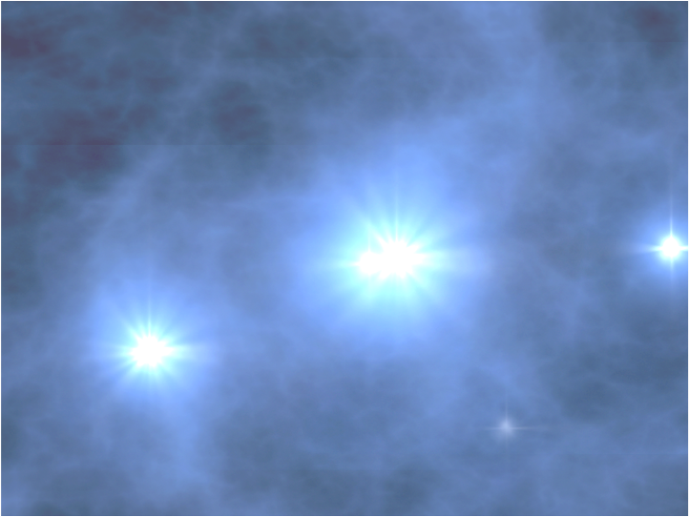
AMON
AMON
Astrophysical Multimessenger
Observatory Network
Under development at
The Pennsylvania State University
http://amon.gravity.psu.edu
Miles Smith
Penn State University
February 5, 2012

Slide 2
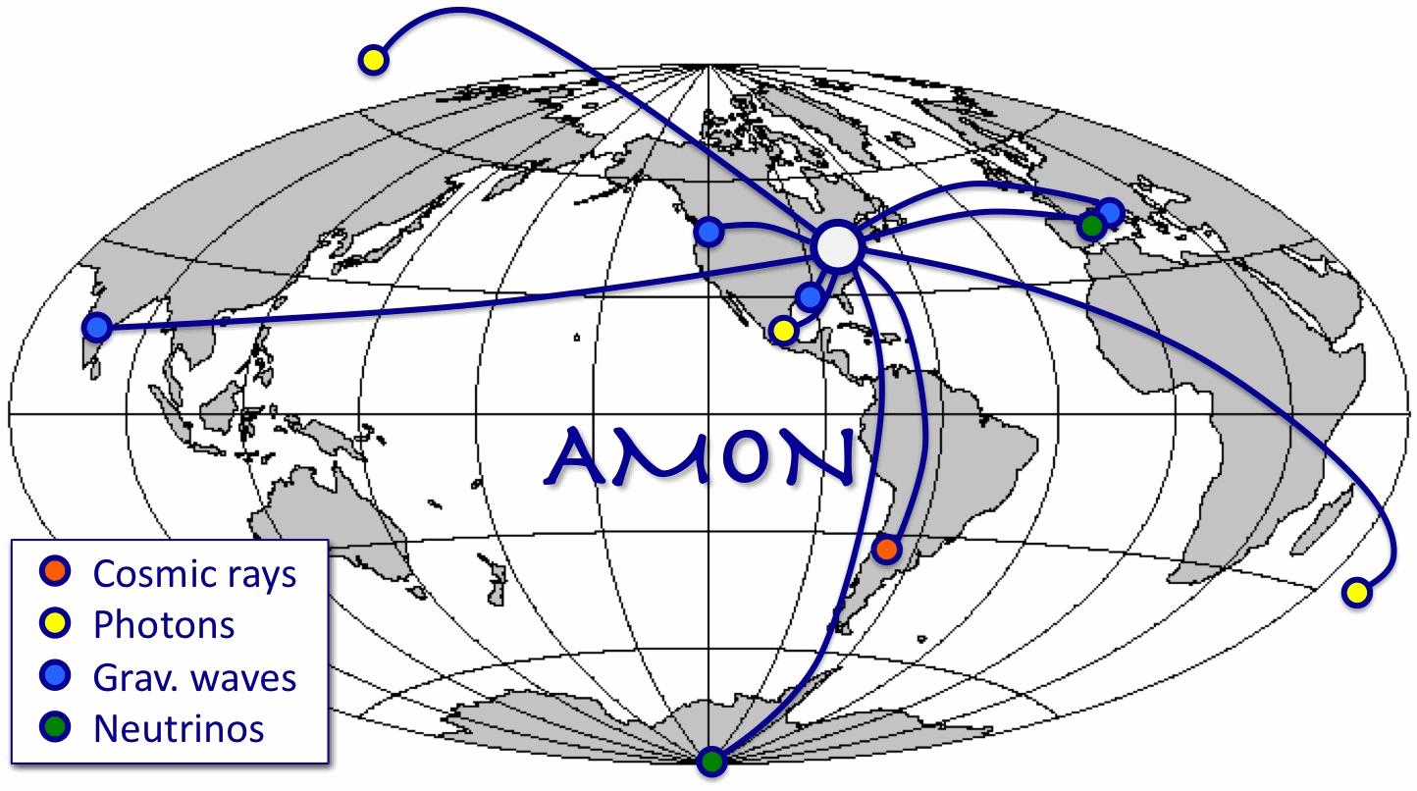
Overview
Introduction
Sci Motivation
AMON Systems
The AMON MoU
Development timeline
Data analysis and alerts
References:
http://arxiv.org/abs/1211.5602
http://amon.gravity.psu.edu

Slide 3

AMON
1. Introduction
Under development at
The Pennsylvania State University
http://amon.gravity.psu.edu

Slide 4
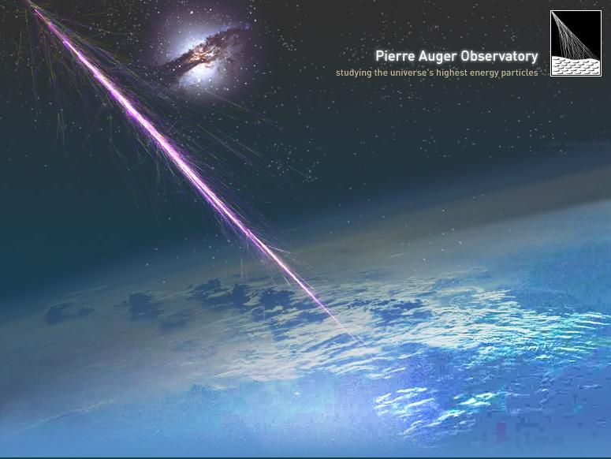
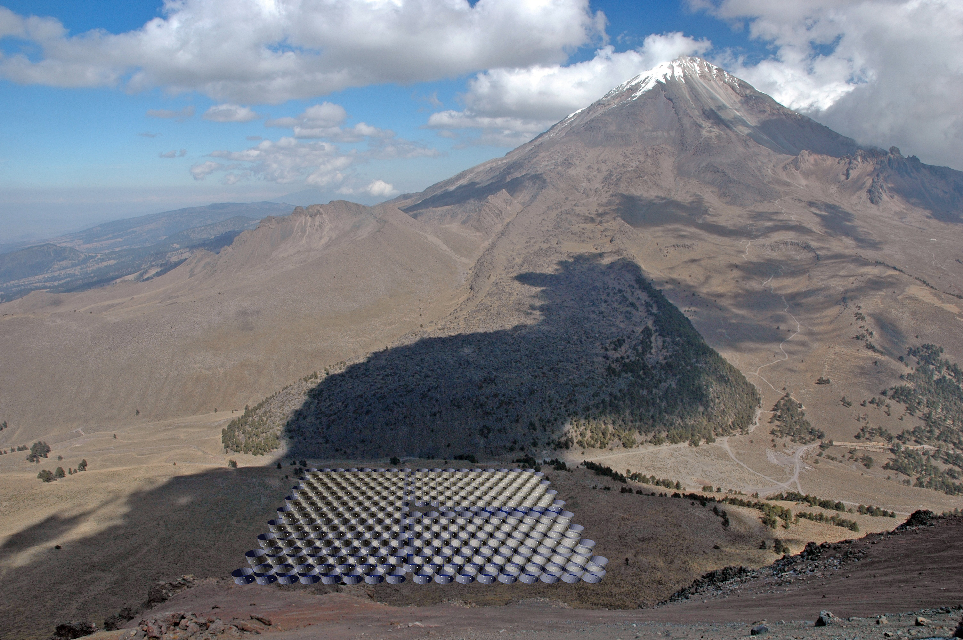
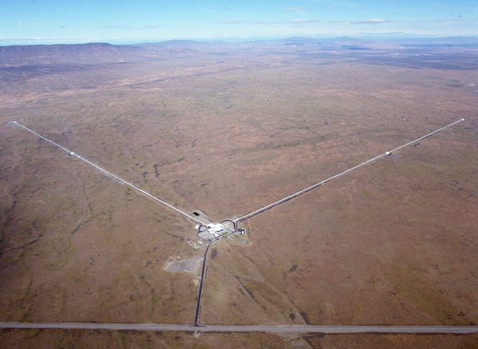
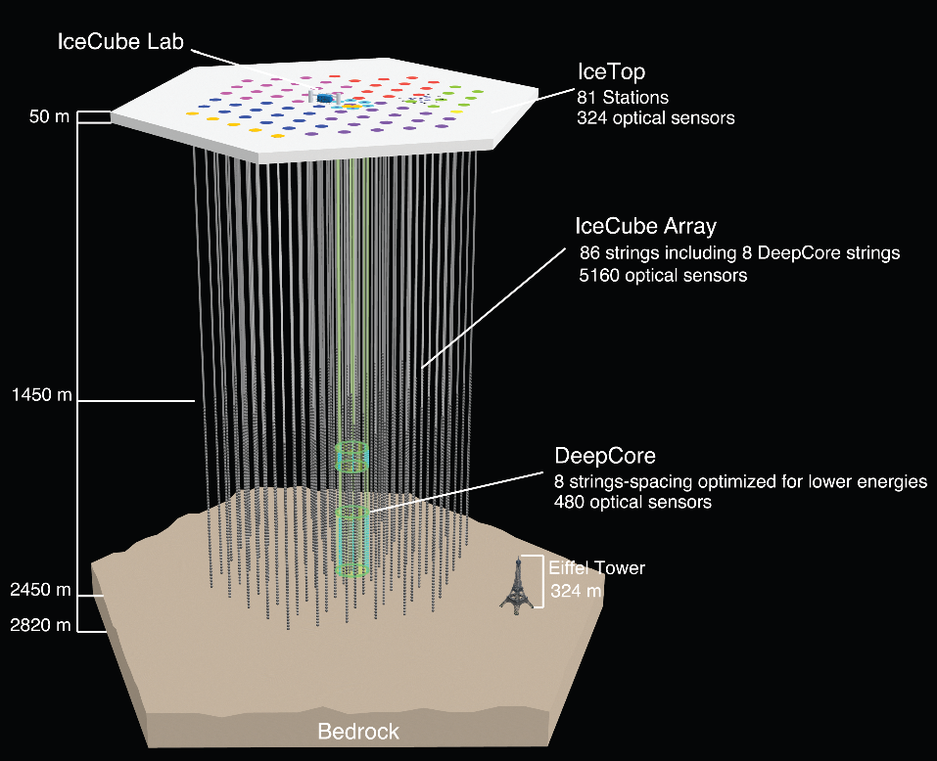
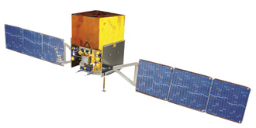
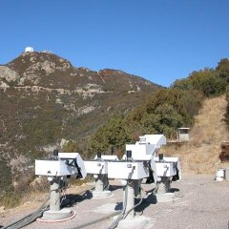
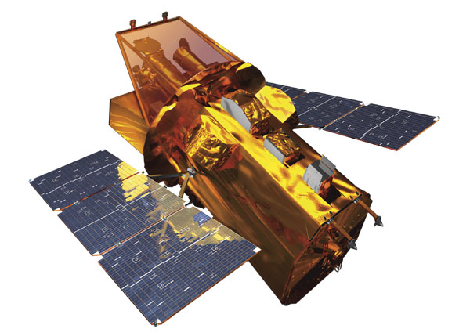
1.1 The Basic Idea
“Triggering” observatories representing all 4 forces
Provide sub-threshold candidate events to AMON in real time
Data stored as VOEvents
AMON: Actively aggregates events and seeks coincidences in (t,ψ)
  Archival searches also enabled
Generates, broadcasts Alerts
“Follow-up” observatories
  Respond in real time to alerts
  Will include numerous optical telescopes around the globe

Slide 5
1.2 Networking
Status quo
  Numerous bilateral, uni-directional arrangements
  N² pairings: lots of MoUs, wheel-reinvention, hard to maintain
  Misses many possible correlations
AMON is a qualitative improvement
  Unified, multilateral, omnidirectional
  Minimal latency, maximum uptime
  Increasing aggregate sensitivity at nominal added cost
  Permits previously ~impossible searches (for ≥ 3 observatories)
  Reduces anxiety: we’re more likely to be ready for “The Big One”
AMON

Slide 6
1.3 Participants (thus far)
Observatory | Messenger | Contact and/or Exec. Board Rep. | Letter of collaboration | MoU in review | MoU signed
Triggering Facilities
ANTARES | ν | Jürgen Brunner | ✔ | ✔ | ✔
Auger | n | Paul Sommers | ✔ | ✔
Fermi LAT And GBM | γ X | Julie McEnery | ✔ ✔
HAWC | γ | Ignacio Taboda | ✔ | ✔ | ✔
IceCube | ν | Doug Cowen | ✔ | ✔ | ✔
LIGO | GW | Gabriela Gonzelez | ✔
Swift BAT | X | Scott Barthelmy | ✔ | ✔ | ✔
VERITAS | γ | Abe Falcone | ✔ | ✔
Follow-up Facilities
LMT | Radio | Alberto Carramiñana | ✔ | ✔
PTF | Optical | Tom Prince | ✔
Swift XRT and UVOT | X-ray Opt/UV | Scott Barthelmy | ✔ ✔ | ✔ ✔ | ✔ ✔
VERITAS | γ | Abe Falcone | ✔ | ✔

Slide 7

1.4 The other AMON
The Egyptian god Ra represented the Sun, while Amon represented the silent and hidden elements of creation
ν
GW
n

Slide 8
AMON
2. Scientific Motivation
Under development at
The Pennsylvania State University
http://amon.gravity.psu.edu

Slide 9
2.1 Sources
Prompt
Delayed
Event class | Gamma | Neutrino | Neutron | Grav. wave | X-ray | IR/O/UV | Radio
Long GRB | ✔ | ✔ |  | ✔ | ✔ | ✔ | ✔
Short GRB | ✔ | ✔ |  | ✔ | ✔ | ✔ | ✔
Obscured GRB | ✔ | ✔ |  | ✔ |  |  | ✔
AGN Flare | ✔ | ✔ |  |  | ✔ | ✔ | ✔
“Quenched Jet” GRB/SN |  | ✔ |  | ✔ | ✔ | ✔ | ✔
Local Supernova |  | ✔ | ✔ |  | ✔ | ✔
Cataclysmic Variable |  |  | ✔ |  | ✔ | ✔
Pulsar Quake |  |  | ✔ | ✔ | ✔ | ✔ | ✔
Magnetar Flare | ✔ | ✔ | ✔ | ✔ | ✔ | ✔ | ✔
Exotic sources | ✔ | ✔ | ✔ | ✔
Notes:
Here is a partial list of candidate multimessenger source populations. We are erring on the side of inclusion, but nonetheless, a key take-away is that few, if any, of the anticipated multimessenger sources are expected to be single-channel emitters (perhaps if there are stellar mass BH-BH mergers). For the most part, bright multimessenger transients will be candidates for detection across channels. And the EM channel is especially useful in this context, because of our well-developed capabilities across the electromagnetic spectrum, which mean that sources may be detectable not only via their prompt emission, but via long-lived afterglow or supernova-like counterparts.

Slide 10
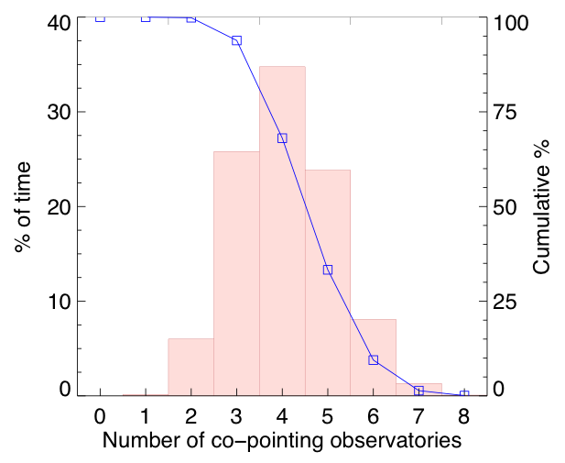
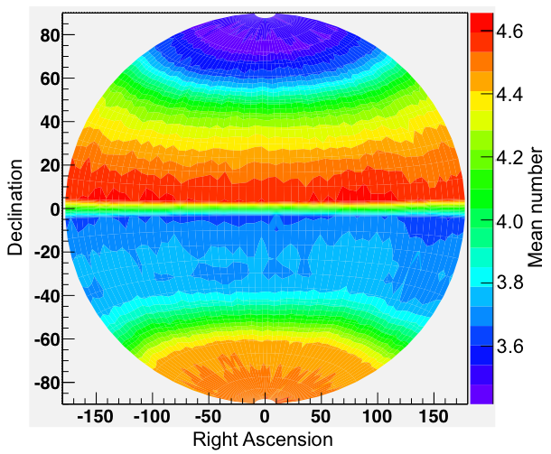
2.2 Co-Pointing
Considered 8 streams: ANTARES, Auger, BAT, GBM, LAT, HAWC, IC, LIGO-Virgo
  Did not consider downtime
Simulated 10⁷ sources
  2010 pointing for satellites
Results show % of 4π-yr that AMON is sensitive
Messenger pairs | percent
Multispectral | 49%
GW, n | 50%
GW, γ | 97%
n, γ | 28%
ν, GW | 87%
ν, n | 44%
ν, γ | 84%

Slide 11
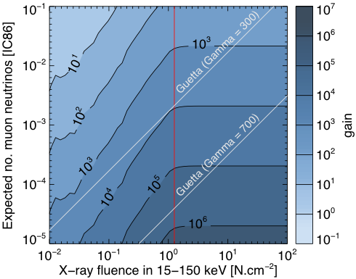
2.3 Example: ν-γ Sensitivity
Goal: Follow-up candidate astrophysical neutrinos
  Status quo: trigger follow-up with 2ν
  AMON: trigger follow-up with 1ν + Nγ

Slide 12
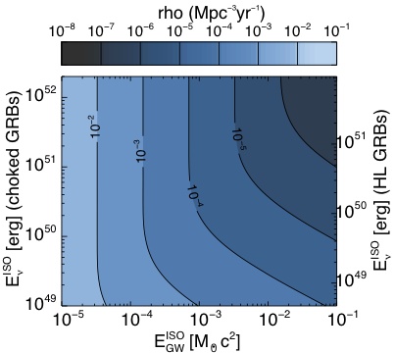
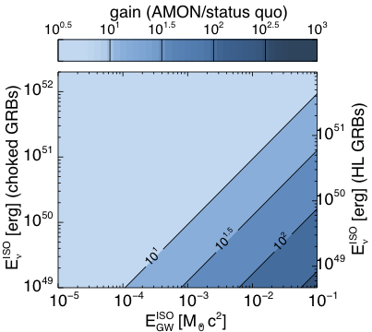
2.4 Example: ν-GW Sensitivity
Goal: Find joint GW-ν sources in realtime
  Status quo: above-thresh GW + above-thresh ν
  AMON: subthreshold GW + ν

Slide 13
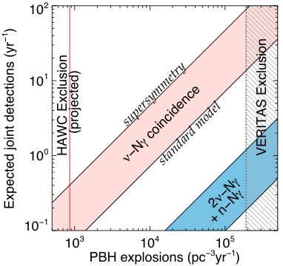
2.5 Example:
Primordial Black Holes
Goal: Search for exotic phenomena
  If PBH are observed by HAWC, then AMON will see multimessenger signal

Slide 14
AMON
3. AMON systems
Under development at
The Pennsylvania State University
http://amon.gravity.psu.edu

Slide 15
3.1 Top-level
AMON will leverage existing infrastructure
  Gamma-ray burst coordinates network (GCN)
  GW network (Advanced LIGO-Vrigo, etc)
High-energy ground ν & γ observatories
Gravitational wave observatories
AMON
GW Network
GW
Events
Events
Alerts
GCN
Events
Alerts
Orbital γ-ray telescopes
Follow-up telescopes

Slide 16
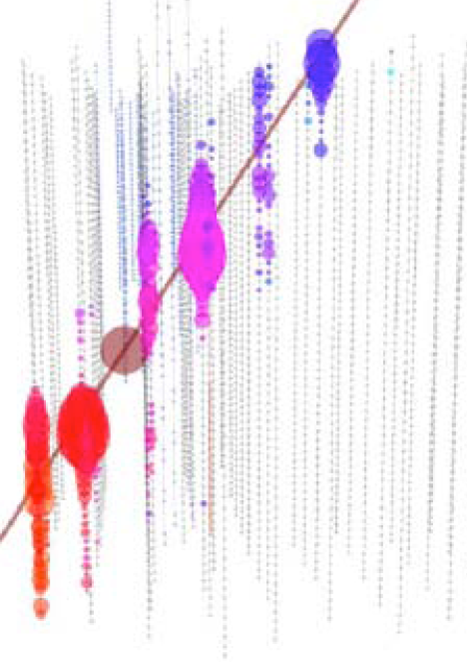
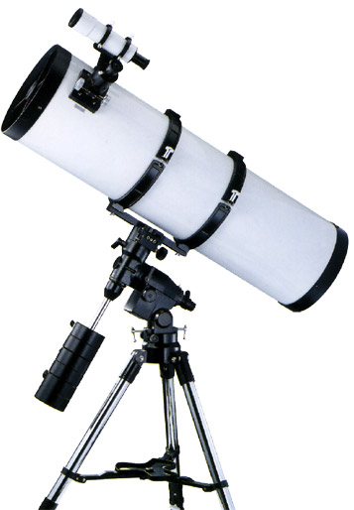
3.2 Internal infrastructure
Main systems housed at Penn State
  Designed for robustness and confidentiality
  Dual servers, “clustered” database for redundancy
  Systems physically and cyber-secure
  Very high level of uptime, modest data needs
Server B
Server A
Trigger event
Trigger events
Trigger
Event
Event handling
Clustered database
init
Analysis
AMON alerts
Alert generation
System monitoring/heartbeat
One server transmits
AMON Alert

Slide 17
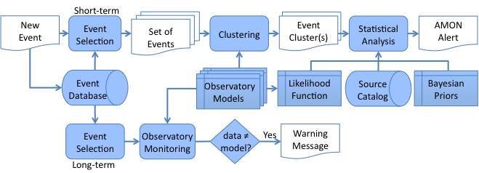
3.3. Data Flow
For speed, a realtime algorithm selects event clusters (top)
A more sophisticated statistical analysis will distinguish between clusters using likelihood function/prior information
Archival analysis is designed case-by-case, but could include a multimodal search of the database (e.g. with MultiNest)
A monitoring analysis will check for consistency of the observatory models used by the realtime system (bottom)

Slide 18
AMON
4. Memorandum of Understanding
Under development at
The Pennsylvania State University
http://amon.gravity.psu.edu

Slide 19
4.1 Background
As well as wires and bits, AMON is a consortium of observatories
AMON is intended as a service to the participating collaborations, but is not in of itself a scientific collaboration
  The AMON development team will never publish data, other than performance reports
Decisions about data sharing /analysis will be made by participating collaborations
  Collaborations are represented by working groups and the AMON Executive Board

Slide 20
4.2 MoU overview
http://amon.gravity.psu.edu/mou_aug2012.shtml
Currently signed by four observatories, with many currently reviewing it
Identifies that data is the intellectual property of each observatory
Maintains confidentiality of data
Identifies requirements made on each observatory
Establishes the AMON executive Board
Defines publications rules

Slide 21
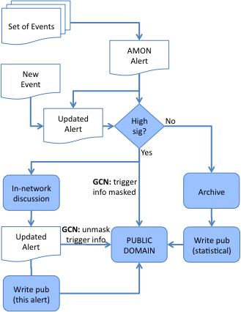
4.3 Publication rules
Proposed publication rules in MoU
  Anytime, an observatory may publish its own data
  Alphabetical author list for joint publications
  Alert authorship is established a priori
  4-6. Joint pubs are inclusive, with some exceptions:
    If an observatory has no sensitivity to alert
    Excessive latency
    If data already public
    Observatory opts out
Proposed paths for data release

Slide 22
AMON
5. Development
Timeline
Under development at
The Pennsylvania State University
http://amon.gravity.psu.edu

Slide 23
5.1 Timeline
Timeline, as identified in MoU

Slide 24
5.2 Progress report
MoU developed and under reviewed by charter member collaborations
Proposals submitted to NSF
  Data Infrastructure Building Blocks (fully developed AMON)
  Physics on the Information Frontier (prototype system with ν−γ triggers)
AMON science potential paper submitted to Astroparticle Physics
  http://arxiv.org/abs/1211.5602
Infrastructure development
  Database designed
  Communication protocols tested
  Analysis algorithms under development
  Hardware and IT support identified

Slide 25
AMON
6. Data Analysis
and Alerts
Under development at
The Pennsylvania State University
http://amon.gravity.psu.edu

Slide 26
6.1 Analysis Phases
Archival
  Initiated during phase 1 of AMON
  Typically involves statistical stacking
  Enabled by AMON infrastructure
    Access-controlled multimessenger database
    Trigger Events and AMON Alerts
    Observatory models and co-pointing calculations
  Carried out by AMON members via approval process
  Test bed for realtime algorithms
Realtime
  Initiated during phase 2 of AMON
  Automatic search for statistically significant individual source detections (FAR ≈< 1/10 yr⁻¹)
  Previously ~impossible 3-fold detections
Follow-up
  Initiated during phase 3 of AMON
  AMON-triggered follow-up obs (FAR = 10-100 yr⁻¹)
  Observation of an EM counterpart is near-definitive
  Final FAR ≈< 1/1000 yr⁻¹

Slide 27
6.2 Analysis Flow
new event
new event
Real-time events
rate
Monitor each observatory’s status, subthreshold event rate
Time filter: Events occur within Δt window
Position filter: Events occur in same part of sky
Calculate False Alarm Rate (FAR)
Calculate best-fit position, uncertainty
Distribute alert based on FAR
Database
?
Δt
t
t
time- correlated events
dec
RA
time + spatially correlated events
FAR
P
σ
x
AMON Alert

Slide 28
6.3 AMON Alerts
AMON Alert
Alert ID
Revision number
Mean time
Burst duration
Combined max LH position (RA, dec)
Position uncertainty (1-3 params)
Number of events
Which obs were sensitive
Multimessenger content (yes/no)
False alarm rate
    Single alert type (e.g. IC-BAT)
    All streams combined
Universal statistical measure(s)
  e.g. Bayesian probability under astrophysical model(s)
(masked) Which obs triggered

Slide 29
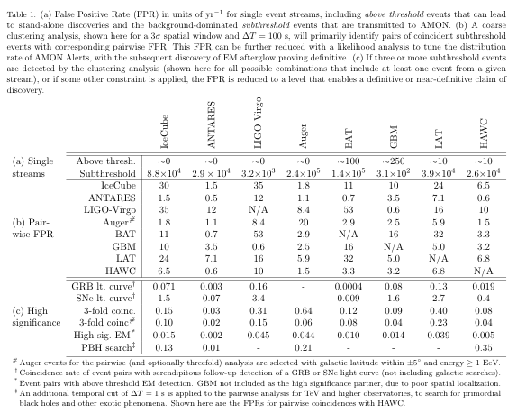
6.5 False Positive Rates
False Alarm Rates (per year) for clustering analysis
  Δt = 100 sec, ΔΩ = 2σ
Tune FAR up by relaxing cuts, down with likelihood refinement
Refinement may be needed prior to distribution of Alerts
Events per year

Slide 30
6.5 False Positive Rates
Single observatory event rates are too large for discovery
  Could raise threshold to give stand-alone discovery or reduce false positive rate
  But, this is the purview of the individual collaborations
“Triple” coincidences typically have discovery-level false positive rate
  3 events or 2 events plus additional significance
  All of these should be followed-up
Pairwise coincidences are marginal and require follow-up counterpart for discovery
  Need to prioritize these marginal alerts
  Difficult to do this in a model-independent way

Slide 31
6.6 Merging alert streams
AMON output streams (a = 1 - N)
  Threshold for each stream: d_{a}
  Event rates: R_{a}(d_{a})
  Sensitivity (model dependent): Se_{a}(d_{a})
If a follow-up program allows R_{alerts} then our goal is to maximize
  Vary {d_{a}} and Lagrange multiplier λ
  Optionally, include follow-up efficiency in Se calculations
  λ is equivalent to Bayesian probability for discovery, serving as a universal ranking
Result is highly model dependent

Slide 32
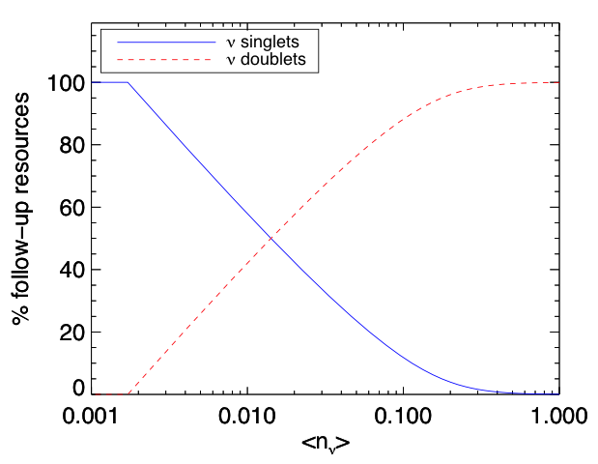
6.6 Merging alert streams
Example: IceCube singlet & doublet streams
  Adjust thresholds to maximize discovery potential
    1. Singlet energy threshold
    2. Opening angle between doublets
  Keeping follow-up budget fixed
Result depends on Bayesian prior P(n)

Slide 33
6.7 Data conflict
Prioritizing alerts requires optimizing discovery potential in the context of a specific model
Competing Needs:
  Requirement to keep data confidential, e.g.
    Which observatories triggered
    Event energy or significance
  Desire of follow-up facilities to prioritize sub-threshold alerts
A Solution?
  AMON can perform a standard set of model-dependent analyses, distributing the Bayesian probability with the alerts
  Each follow-up facility selects which model they will use to threshold their programs

Slide 34
AMON
Additional Material
Under development at
The Pennsylvania State University
http://amon.gravity.psu.edu

Slide 35
Menu of services
Realtime search for coincident subthreshold events from two or more observatories
Generation and distribution of these coincidences as “AMON Alerts” to the network of follow-up facilities that have signed the AMON MoU
Optional forwarding of single-observatory above-threshold events to a selected set of follow-up partners
Statistical ranking of multimessenger alerts, individualized to the capabilities and science goals of each follow-up partner
Transmission of all AMON Alerts back to originating observatories for e.g. triggered GW analysis
Subscription to single observatory event streams (e.g. neutrinos), where permitted by pair-wise MoUs
For the purpose of archival studies, access to events in the AMON multimessenger database (with read permission granted after approved by the AMON executive board)

Slide 36
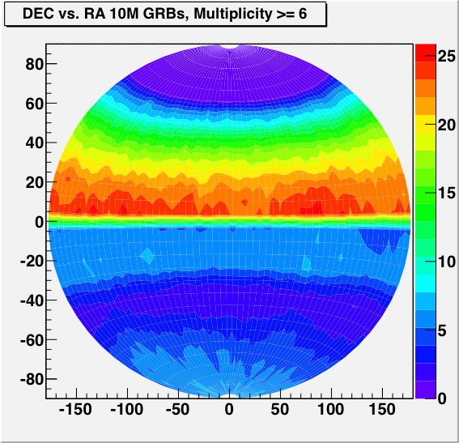
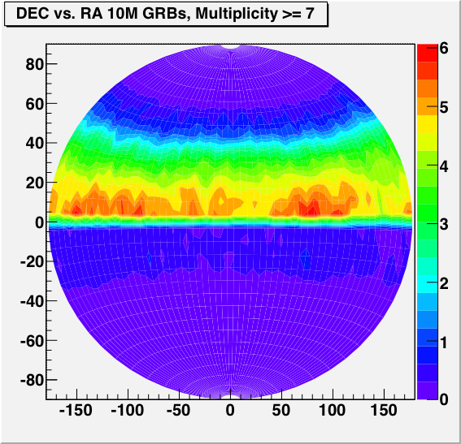
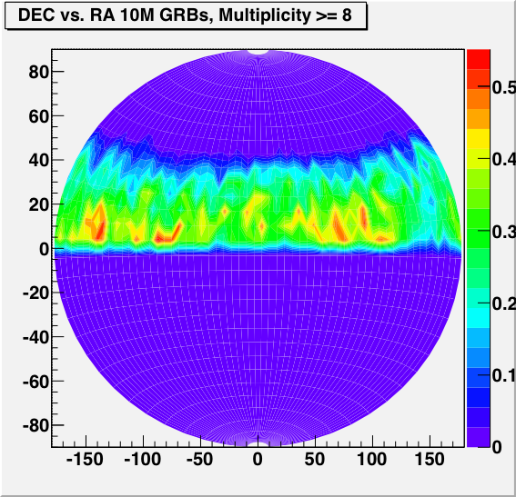
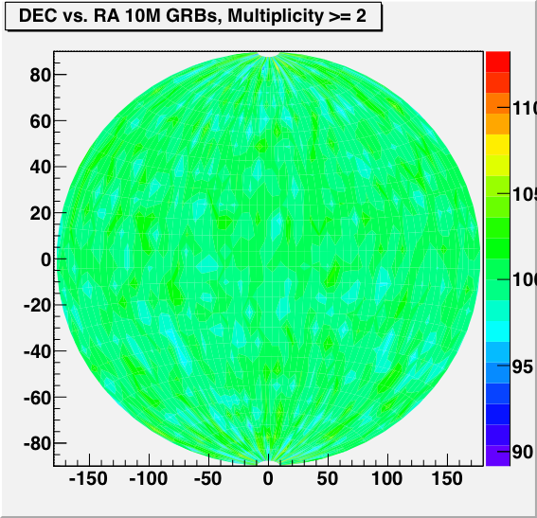
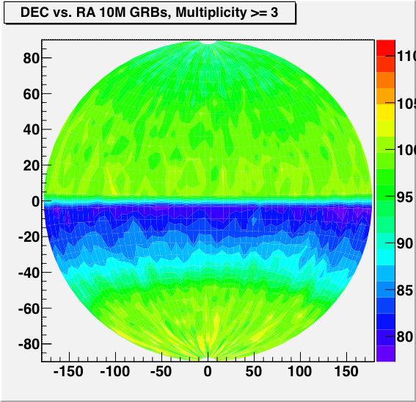
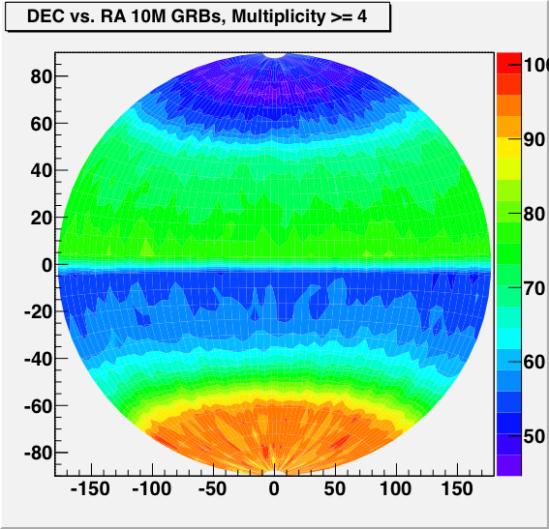
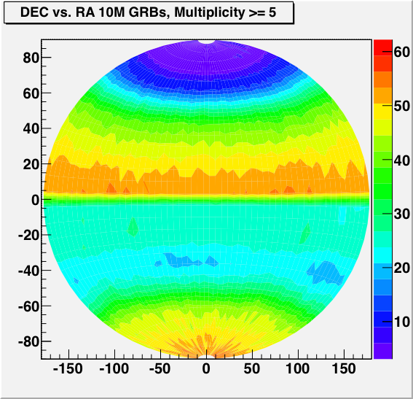
Co-Pointing

Slide 37
Data Analysis
Data Products
Triggering Events
  Transmitted in realtime from each observatory
  Stored in VOEvent format
  Treated highly confidential
Observatory models
  Housed in AMON system
  Updated occasionally
  Some parameters trans-mitted in event stream
AMON Alerts
  Cluster of events from multiple observatories
  Unique to AMON
  Stored in VOEvent format
Triggering Event
1. Observatory and event ID
2. Time stamp
3. Event Position
4. Position error or link to PDF(x)
5. Background rate near event
Observatory Model
1. Observatory pointing
2. Point-spread function
3. Event rate as a func of time
AMON Alert
1. Alert ID and revision number
2. Mean time and burst duration
3. Combined max LH position
4. Position error
5. Statistical ranking and/or FAR

Slide 38
6.4. Merging alert streams
Example: IceCube singlet & doublet streams
  Adjust thresholds to maximize discovery potential
    1. Singlet energy threshold
    2. Opening angle between doublets
  Keeping follow-up budget fixed
~ GRB-ν Exclusion
(IC40+59)
~ Triplet exclusion
Result depends on Bayesian prior P(n)

Slide 39
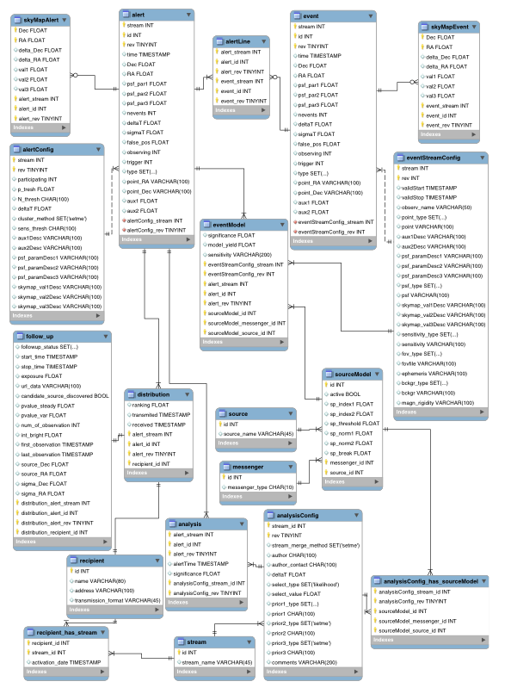
dtaabase

