Slide 1
MICE CM35
Schedule session introduction
Position at CM34
Agenda for this afternoon
Andy Nichols, STFC, 13/2/13

Slide 2
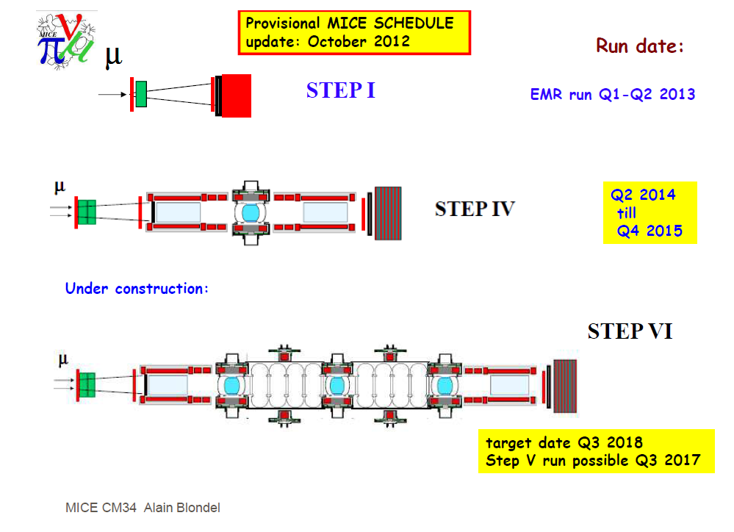

Slide 3

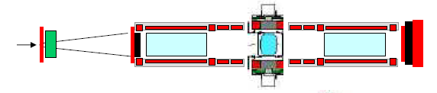
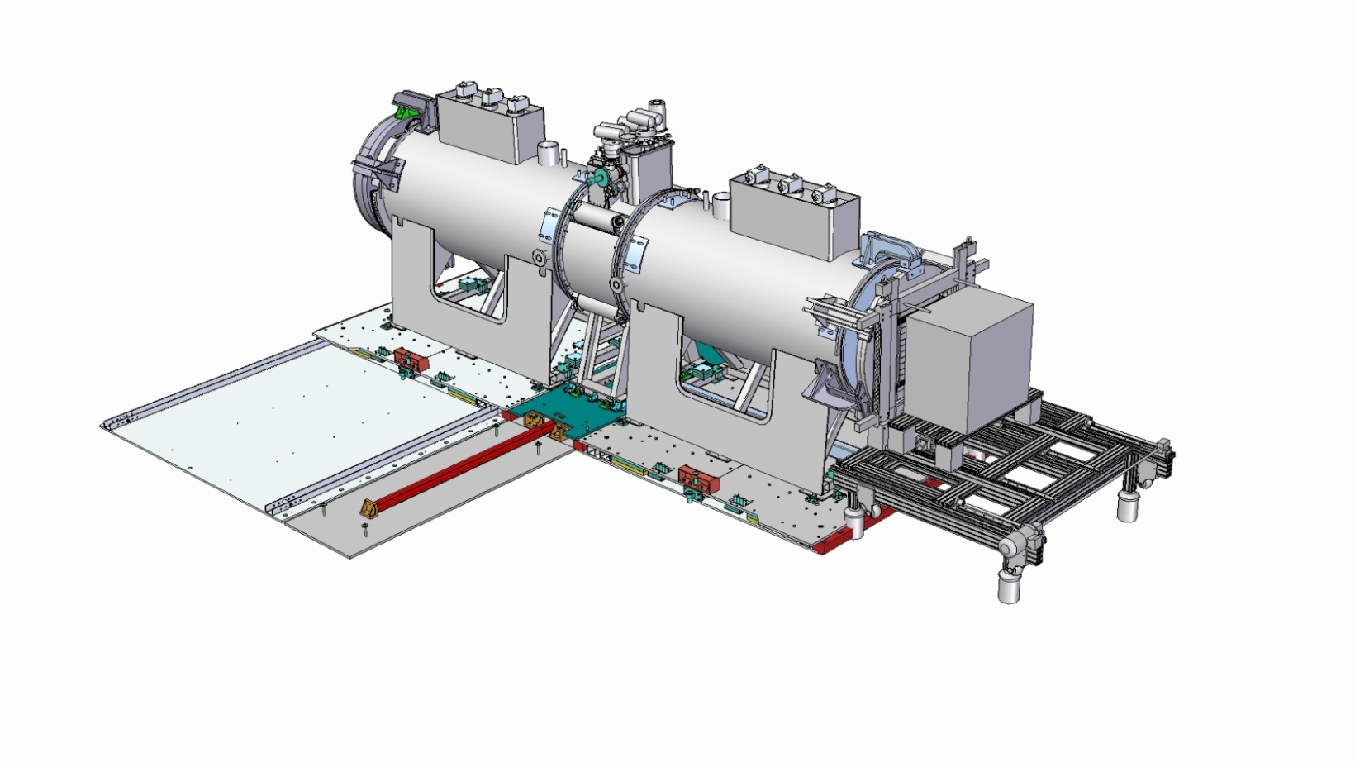
STEP IV
Subsystem | Date
Spectrometer solenoid #1 + #2 | Q3 2013
Fibre tracker #1 + #2 | Ready
Focus coil #1 | Nov ’12
LH₂ system A | TBC
Solid absorber(s) | TBC
Liquid absorber | Ready
Diffuser | Ready
Virostek plate & TOF cage assy | Ready
Substation upgrade | Ready
EMR installation | Feb’13
Radiation shutter | Ready
AFC Moving platform #1 | Ready
SS platforms Installation | Ready
Magnetic shielding plan | TBC
Step IV ready Q2, 2014

Slide 4
Agenda
Schedule report on each WP/subsystem – Level II Managers
Project Installation schedule - Alan
Definition of shielding mitigation project in the WBS
Step V & Step VI plans
Preparations for the MPB cost and schedule review
AOB and open issues

