Slide 1
Magnetic Modelling
CM 35
RAL 14th – 16th February 2013
P. J. Smith

Slide 2
Update to the Hall model
At the last CM we had a reasonably well developed model of the MICE hall but it was still missing some iron. The Hall model now contains all of the iron that we think is appropriate for this particular model. I have also included Holger’s return yoke (Step IV) but that is all I will say about the return yoke in this presentation.
I’ve resisted the urge to list every piece of iron in the model this talk, I don’t think that will accomplish anything other than boring you– there is plenty of documentation if you’re interested or you can talk to me.
There is a requirement for realistically representing the iron but we need a solvable model, and to do this the level of detail has to be constrained.
There is an element of judgement here, and it is understood that this judgement require some form of validation. Even now it’s not exactly clear where the balance lies, and opinions differ.
There is also the argument that if you want an understandable model that having too much iron in the model can become a hindrance – something that has become clearer over the last few months.

Slide 3
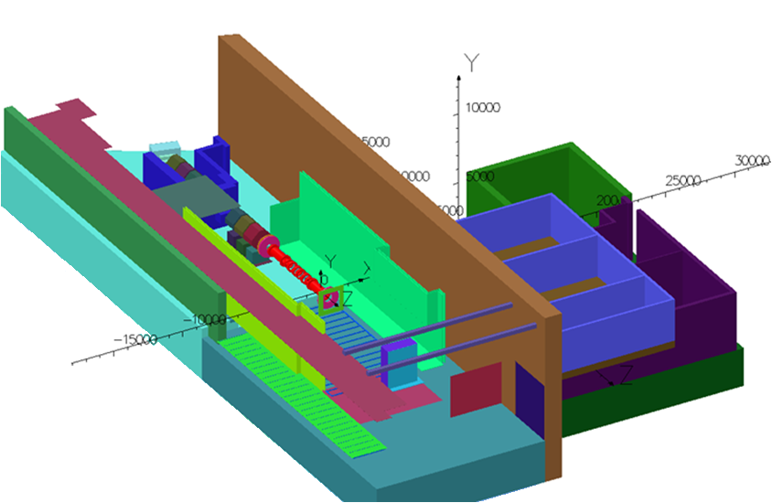
So what is in the model?

Slide 4
Modelling Website
We have been very careful to ensure that the modelling process has been fully documented. To this end we now have a website at:
http://www.hep.shef.ac.uk/research/mice/opera_models/
This contains links to:
Notes on individual models as they are generated.
Solution files that are generated.
Presentations to the modelling group.
Snapshots of the code that builds the hall model (.comi) and a link to a repository that stores this code.
Drawings/photographs/reference material used to generate the model.
I’ve recently started an auto-generated screenshot creator that generates field maps throughout the hall for specific models. Nice for quickly looking at the field in specific areas. All these screenshots are linked from the website. This is work in progress.

Slide 5
Modelling Website
There is still material to add to this website:
Results
Sub-modelling when we get started in earnest,
so this should become a valuable resource/record to those interested and involved in the modelling work.

Slide 6
Brief Overview of the Rack Studies
After adding the structural iron I started to try and increase the level of detail in the MICE hall by adding some racks and compressors in particular areas of interest, namely the West Wall and behind the North Shield Wall.
We knew that this increase in detail was risky as it was clear that we were pushing the resolution of the hall model and it wasn’t clear whether the results would be valid.
Why do it? At the time it was a question of why not (inexperience on my part) –we knew that we were going to get some validation data later on from the R9 AFC setup.
By a twist of fate the results from these models piqued Holger’s interest who did some studies of his own…this has proven to be very useful to us.

Slide 7
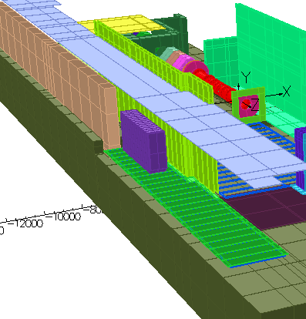
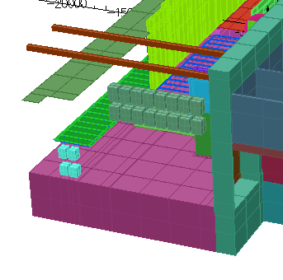
Brief Overview of the Rack Studies
I took the Hall model and added a series of racks behind the NSW and placed all of the compressors against the West wall.
The West wall is the default location for the compressors as it a low field region in the Hall (air field < 1 gauss –which I’ll show later)

Slide 8
Brief Overview of the Rack Studies
And we ran a number of models with different rack/compressor configurations…
I’ve deliberately not shown details of these configurations here as I’ll run out of time and it is tangential to the point of these slides but basically the racks were composed of an outer skin (iron) with some inner iron in different configurations. Details of the models run are on the website.
Concentrating on the West Wall the models showed:
Air field < 1 gauss at the West Wall
Magnetisation of steel skin on outside of racks typically 20 to 120 gauss
Small but non-zero field inside of the racks.
Considering the first point...

Slide 9
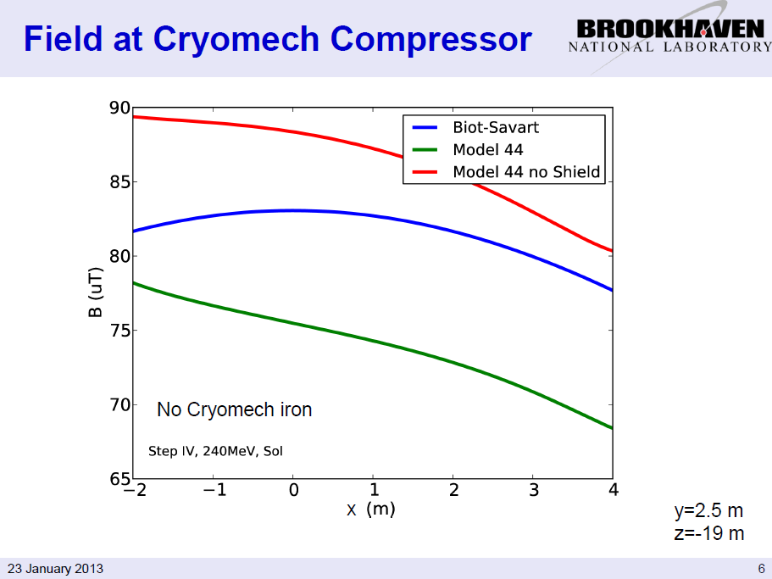
Brief Overview of the Rack Studies
Holger first looked at the field at the location of the Cryomech compressors
<- (No Return Yoke)
Red line is a little high but compares well with Biot Savart – Hall model Absolute value seems to be reasonable at the location of the West Wall – Reassuring.
Earth's magnetic field at the surface ranges from 25 to 65 µT (0.25 to 0.65 G).
Slide taken from Holger’s presentation 23/01/2013

Slide 10
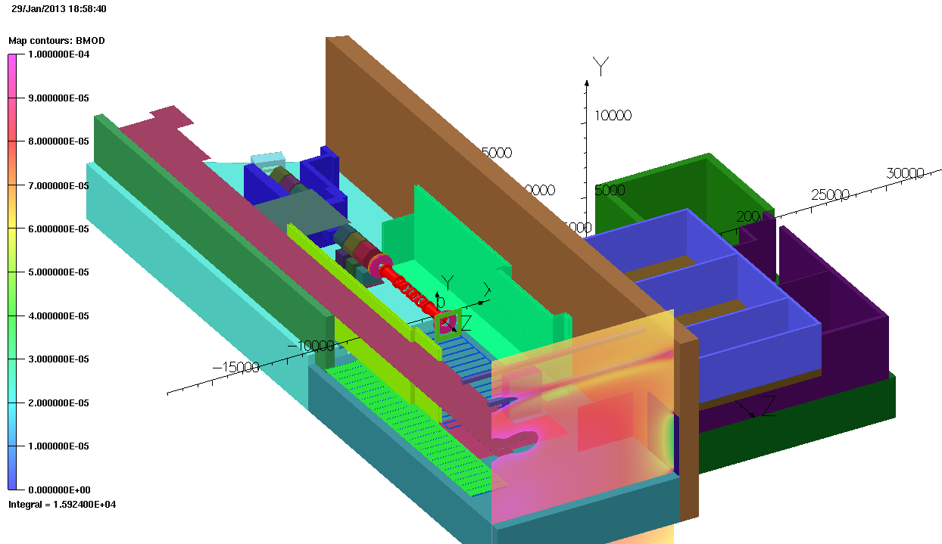
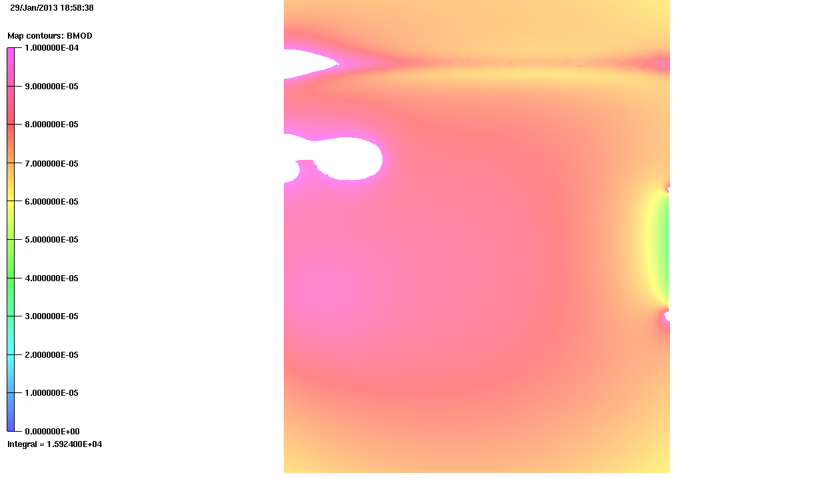
Model 51 – No Return Yoke
Z= 19000 XY Plane
Air Field at location of Cryomech Compressors (Compressors are not shown in this model)
~4m

Slide 11
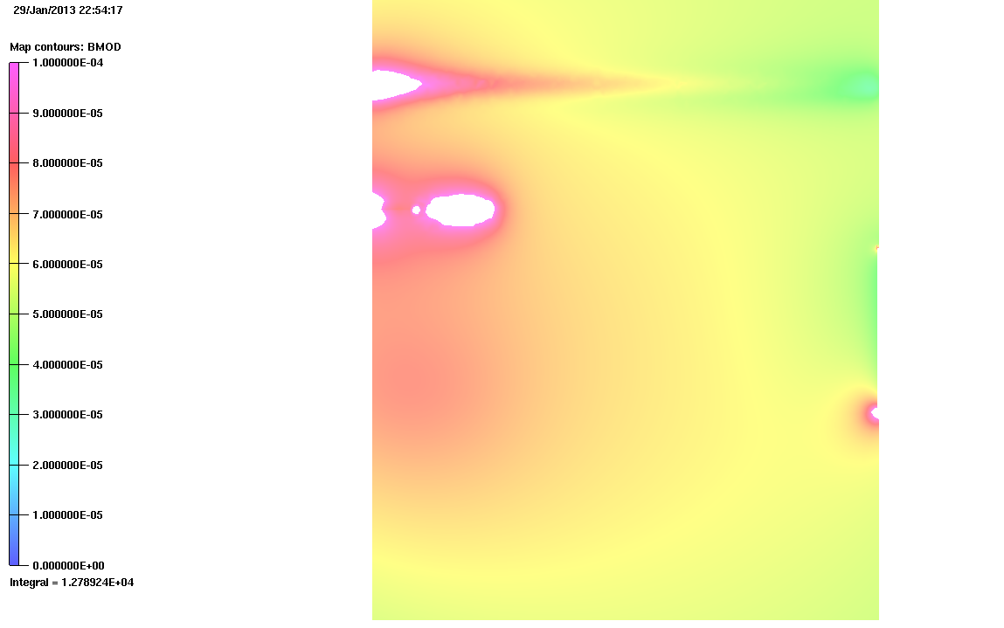
Model 52 –With Step IV Return Yoke
z=19000 XY Plane
~4m

Slide 12
Brief Overview of the Rack Studies
Holger then did a high resolution rack model in a background field of 60uT
Field in iron was about 1.5 -3 times as much as in air…
  Much closer to what would be expected theoretically.
Hall model was predicting order(s) of magnitude higher
There is a tendency in models that don’t have good enough resolution to overestimate the fields in the iron.
The problem is much more difficult with the racks behind the North Shield Wall – I may not be able to bench mark this model accurately by replicating what Holger did with Biot-Savart.

Slide 13
Brief Overview of the Rack Studies
Conclusions
Air field far from magnets at the West Wall shown to be reasonable in the Hall model.
Hall model shown to be unreliable at estimating magnetisation in fine iron structures due to meshing resolution limitations.
Where does this lead us?
Clear need for validation of results.
Clear need for sub-modelling of areas where high resolution is required.
Questions
What structure/mesh size gives a valid field in the Hall model?

Slide 14
Validation
Holger has highlighted one method of benchmarking FEA when considering a volume that is not close to iron structures. – Biot Savart
What about in areas where there are lots of iron? – This is less clear and requires a bit more thought and maybe some simpler models? I need to sit down and give this some thought. Reverse engineer the Hall model…?
We are currently using the AFC setup in R9 to take some measurements. This will provide a useful feedback loop on the validity of models, particularly sub-models – Craig will discuss this in his talk.
Are the Spectrometer people also using their system as a test bed to take field measurements with?
Also looks like there are some plans to do some testing in the hall – could provide some useful information.

Slide 15
Field Maps of the Hall
As I’ve stated there is now a library of images on-line that you can browse at your leisure so I won’t show many images here.
http://www.hep.shef.ac.uk/research/mice/opera_models/atlas/
However with consideration to what I have said on the previous slides the images should only be taken as an indication of what the field level qualitatively is in a given area, and most of these images are not validated.
Still it’s a useful starting point when combined with a knowledge of what field you know you need to attain - and this isn’t known well yet for all equipment - in a given area.
We have a tool and we are starting to learn how to use it.

Slide 16
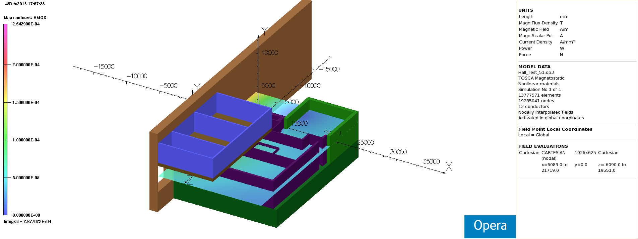
Field Maps of the Hall
Model 51 – 240 MeV/c Solenoid Step IV – No Return Yoke y=0 (i.e. Height of beam axis)

Slide 17
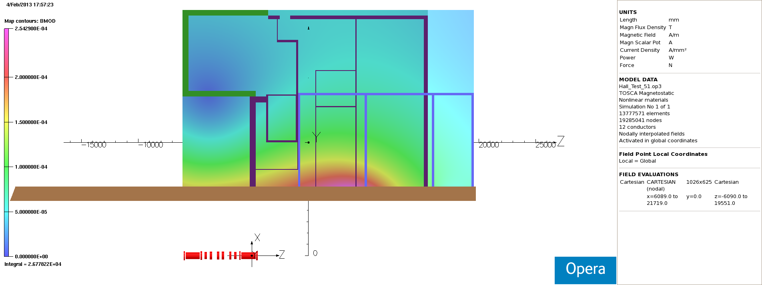
Field Maps of the Hall
Not correct shape for Rack Room 2
-
~5m
Model 51 – 240 MeV/c Solenoid Step IV – No Return Yoke y=0

Slide 18
Sub Modelling
A sub-model is a region of the hall that we wish to model in much finer detail.
Sub-modelling allows us to parallelise the problem of looking at different areas of the MICE hall.
There are many areas that need to be looked at. There is a list of potentially affected equipment and this can be correlated with the Hall field map to ascertain whether something needs to be looked at more closely. This task still needs to be done rigorously but there are plenty of obvious candidates.
Tracker – Cryostats and Electronics
Quads
Sub Station
Control Racks behind North Shield Wall
Quad Power Supplies
Transformer in Trench

Slide 19
Sub Modelling
We’ve have recently acquired some additional help with this problem:
Melissa George (Imperial) -> R9 Sub-model & Racks
Our rack model placed in the MICE hall gave poor results. Can we improve upon this? Can we get agreement with experimental results from R9.
Kiril Marinov (Daresbury) -> Tracker
The tracker is a high risk item as it will see some of the highest fields of any of the sensitive equipment. There is a clear need to have a shielding solution for this equipment.
I shall also pick up a sub-model soon but I want to do some more work on validating the results on the Hall model first with Biot-Savart where that is possible.

Slide 20
Conclusions
We have made good progress with the Modelling effort – we now have a reasonable representation of the iron in the MICE hall on a course scale.
We are confident that the West Wall looks like a safe location for equipment during Step IV operation.
I am trying to validate other areas that are clearly in relatively low fields.
We have put in a lot of effort just trying to understand the problem that we have.
We’re starting to understand what the problems with the problem are…
We have that understanding in some very specific areas.
In a lot of other areas we have field plots but there is some question on what the errors on those results are – particularly areas with lots of iron.
I have concerns about how we validate the model in these areas.
We haven’t yet tried to solve a specific problem by shielding.
We are now at a good point to parallelise the problem and start to try and close in on this a little.

