Slide 1

WLCG – Overview
LCG
LHCC Comprehensive Review
19-20 November, 2007

Slide 2

LCG Organisation – Phase 2
No changes
LHC Committee - LHCC
Scientific Review
Computing Resources Review Board - C-RRB
Funding Agencies
Collaboration Board – CB
Experiments and Regional Centres
Overview Board - OB
Management Board - MB
Management of the Project
Architects Forum
Coordination of
Common Applications
Grid Deployment Board
Coordination of
Grid Operation
Physics
Applications
Software
Distributed
Analysis &
Grid Support
Grid
Deployment
Computing
Fabric
Activity Areas

Slide 3
Applications Area Progress Summary
The organization of the Applications Area is mature and works reasonable well
The main emphasis for the area has been consolidation and getting as stable as possible for the startup of LHC
Regular production releases – ROOT, Geant4, CORAL, POOL, Cool - each with many improvements including performance and some new functionality
The new organization of the MC Generator services has been put in place and a new repository structure has been introduced, as agreed with the community
Introduced the Applications Area nightly build system to help in the integration and validation of new releases – and several complete configurations have been released with strong emphasis on consolidation and stability
Improving coordination of software releases with other areas (middleware, fabric), and adding support for other significant platforms such as 64-bit Scientific Linux and MacOSX/Intel

Slide 4
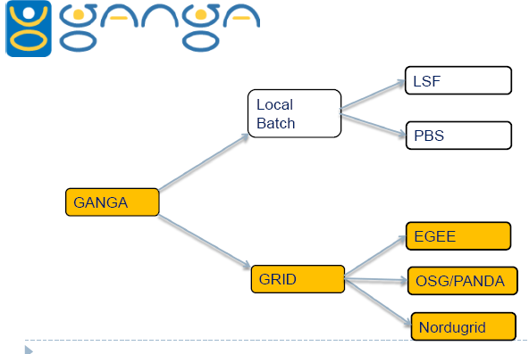
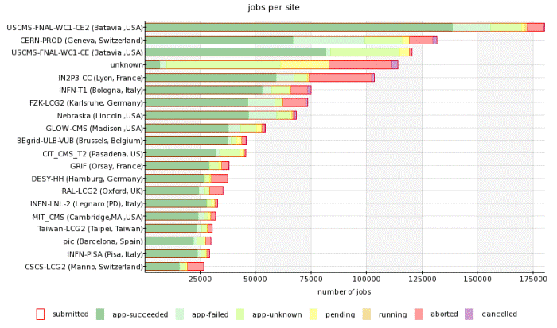
ARDA
Ganga – ATLAS and LHCb
exposed to users
Lot of effort in training and support
Good feedback and a lot of users!
Dashboards & monitoring
In production for all 4 experiments
General core
Specialised plug-in (CMS and ATLAS)‏
VO information (global figures)‏
User info (tracking of individual users jobs)‏
Site info (breakdown of errors and efficiency figures)‏
Experiment-specific support
Participation in xrootd support for ALICE
Distributed analysis coordination for ATLAS

Slide 5
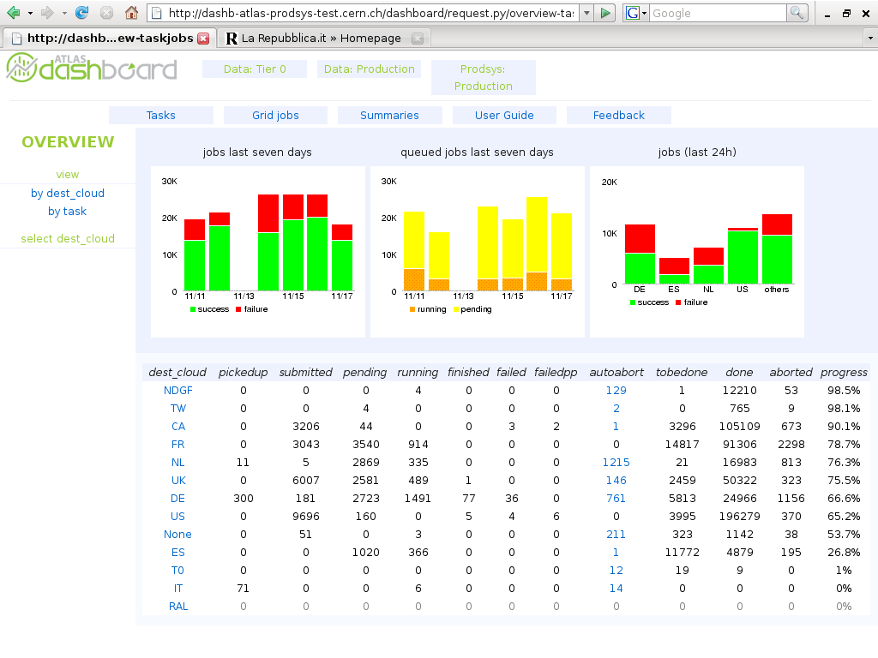
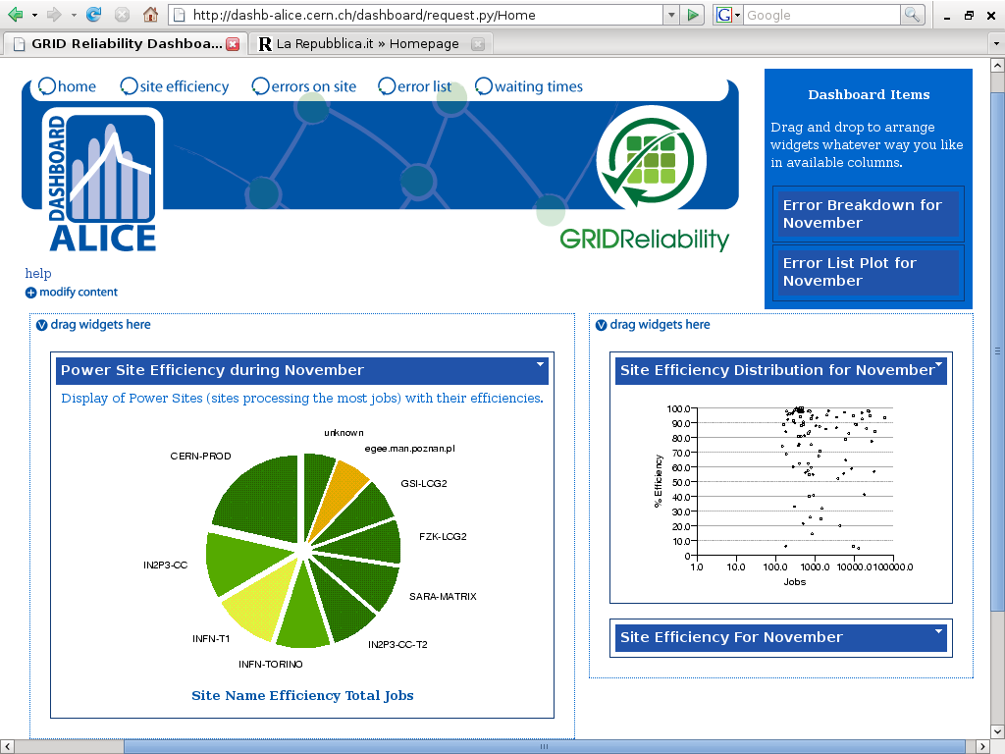

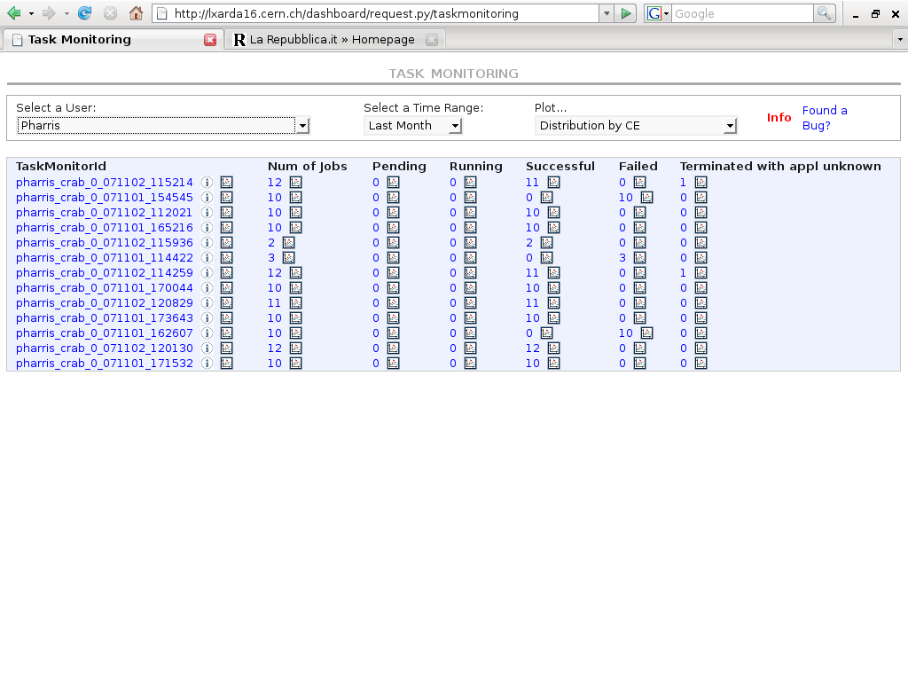
Monitor of the
production system
Site info per VO
Tracking of users' jobs

Slide 6
Baseline Services
The Basic Baseline Services – from the TDR (2005)
Storage Element
Castor, dCache, DPM (with SRM 1.1)
Storm added in 2007
SRM 2.2 – long delays incurred - being deployed in production
Basic transfer tools – Gridftp, ..
File Transfer Service (FTS)
LCG File Catalog (LFC)
LCG data mgt tools - lcg-utils
Posix I/O –
Grid File Access Library (GFAL)
Synchronised databases T0←→T1s
3D project
Information System
Compute Elements
Globus/Condor-C
web services (CREAM)
gLite Workload Management
in production at CERN
VO Management System (VOMS)
VO Boxes
Application software installation
Job Monitoring Tools
... continuing evolution
reliability, performance, functionality, requirements

Slide 7
Data & Storage Services
At the time of the last review there was concern over the storage management services, in particular:
Implementation of the new version of the Storage Resource Manager (SRM 2.2)
SRM is a standard interface to the storage management systems
WLCG spec/usage agreed May 2006, but details finally agreed only in November 2006
The performance and stability of CASTOR2 needs to be improved for both the Tier-0 and Tier-1 sites

Slide 8
Data & Storage Services
dCache (DESY, FNAL)
New version being deployed now with all functionality needed for start-up (including SRM 2.2)
In production at NDGF (end October) and FZK (second week of November)
CASTOR (CERN)
Performance problems at CERN resolved; full performance demonstrated with ATLAS
New version (SRM 2.2-ready) deployed at all Castor sites over past few months
Upgrades with all the functionality needed for start-up is being deployed now
DPM (CERN), STORM (INFN)
“simpler” disk-only systems for Tier-2s
Being introduced in production

Slide 9
SRM 2.2 Deployment
First implementations available around the end of 2006
GSSD – working group of sites and developers formed to guide deployment
Many problems encountered – but basic tests finally passed and test instances installed at several sites in July
Priority/availability problems at developer sites → test programme stalled during the summer → more realistic schedule agreed at WLCG workshop early September
SRM 2.2 now in production:
dCache - 2nd week of November at FZK
Castor – end October at CERN, 3rd week of November at CNAF (SRM 1.1 and SRM 2.2 can co-exist at CASTOR sites)
Comprehensive testing using packaged tests – but only LHCb has tested SRM 2.2 functionality with experiment applications
Target is to have SRM 2.2 in production (dCache. Castor) at all Tier-1s by end of year, key Tier-2 sites by February 2008
DPM, STORM already available for production use

Slide 10
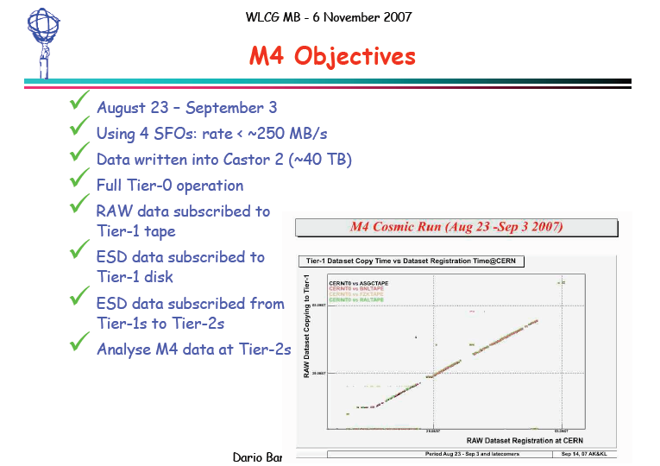

Slide 11
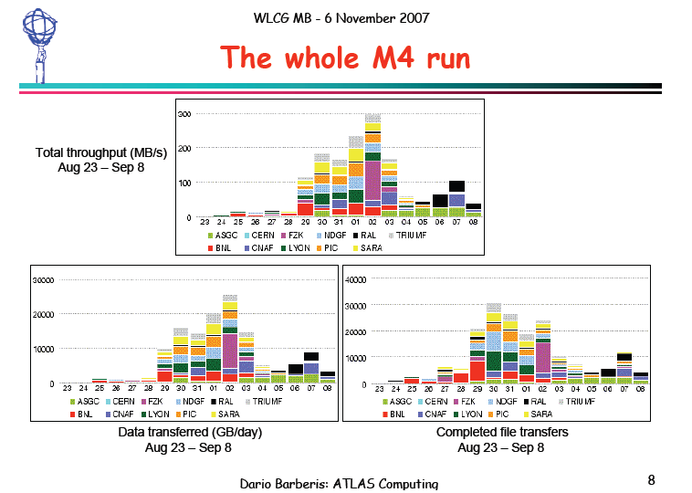

Slide 12
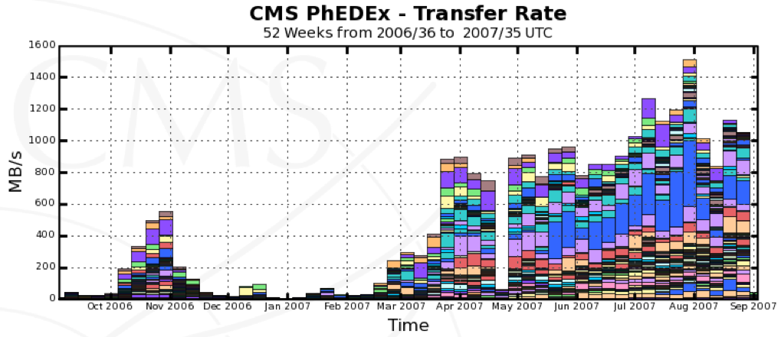
Load Tests for CMS
We have designed a LoadTest infrastructure to execute 24/7 transfer tests between sites. The test have been running continuously for some months. Rates have increased since CSA06 last fall and more sites are participating. T0 --> T1 and many regional T1 <--> T2 transfers are reliable.
Issues with non-regional T1<--> T2 which are not easy to debug and there are many combinations to test. A program has started to address this issue. May require additional manpower.
CSA06
Sep.07

Slide 13
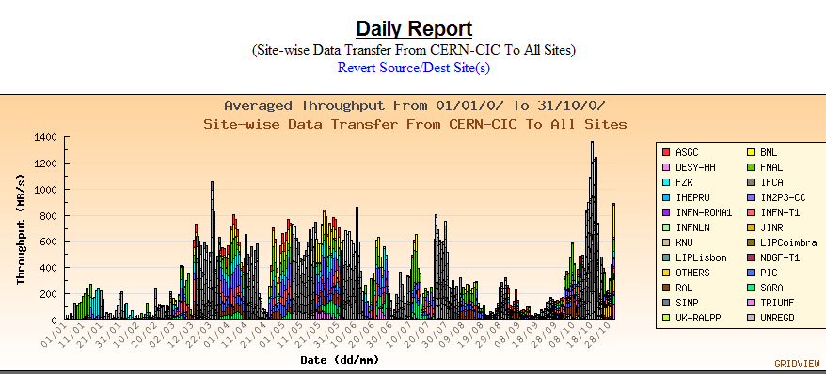
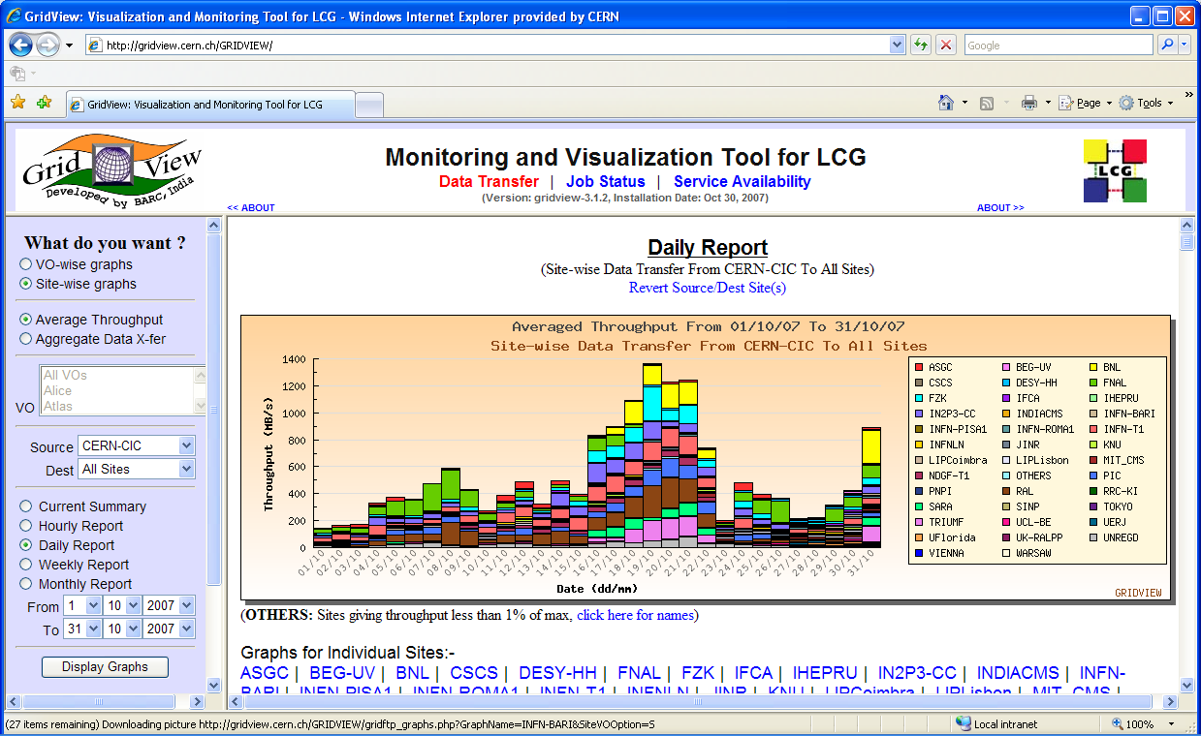
Data Distribution from CERN
Target 2008
jan feb mar apr may jun jul aug sep oct
Data distribution from CERN to Tier-1 sites
The target rate was achieved last year under test conditions
This year under more realistic experiment testing, reaching target peak rate with ATLAS and CMS active

Slide 14
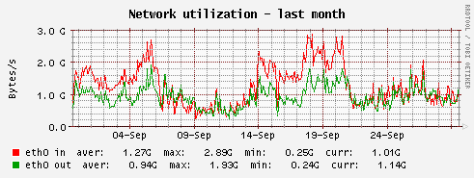
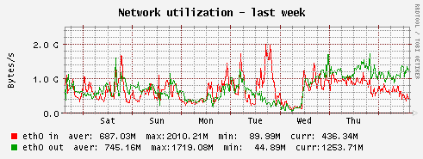
Castor during CMS Export Tests
CMS t0 export pool (330TB across 60 servers)
Red: Data into the pool
~100MB/s from tape
up to 100MB/s data import
rest is data written by CSA07- preparation application.
Green: Data out of the pool
~280MB/s to tape
up to 100MB/s data export
rest is data read by CSA07- preparation application.
CSA 07 starts
Several concurrent activities with aggregate I/O corresponding to nominal CMS speed at 100% accelerator efficiency.
Up to 900,000 file operations/day (10/s)
Good stability
Tony Cass cern/it – 5 october 07

Slide 15
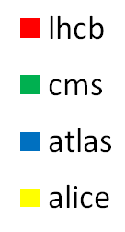
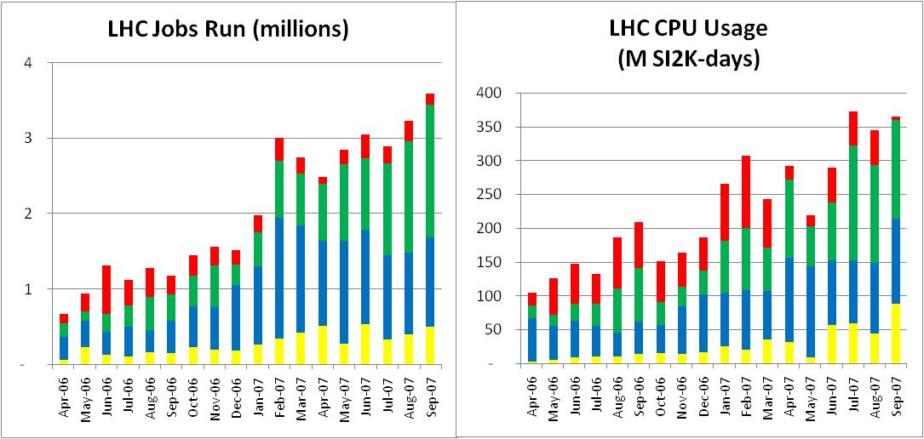


Grid Activity
Continuing increase in usage of the EGEE and OSG grids
All sites reporting accounting data (CERN, Tier-1, -2, -3)
Increase in past 17 months – 5 X number of jobs - 3.5 X cpu usage
100K jobs/day

Slide 16
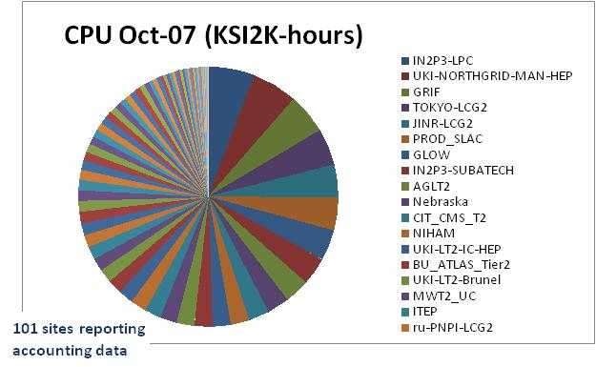
Tier-2 Sites – October 2007
30 sites deliver 75% of the cpu
30 sites deliver 1%

Slide 17
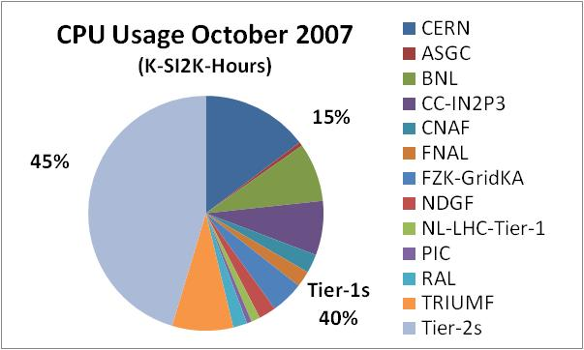
October 2007 - CPU Usage CERN, Tier-1s, Tier-2s
*
* NDGF usage for September 2007
> 85% of CPU Usage is external to CERN

Slide 18
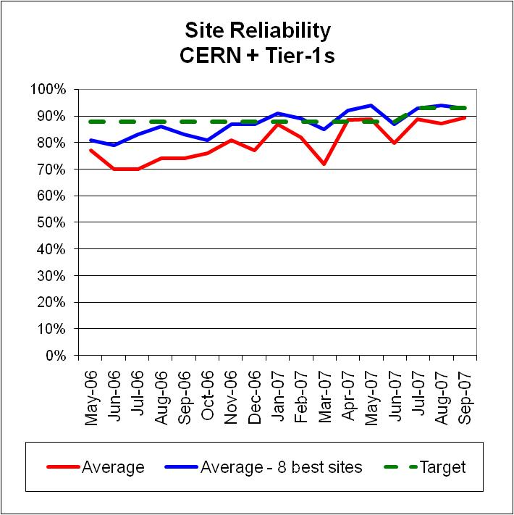
Site Reliability – CERN + Tier-1s
“Site Reliability” a function of
grid services
middleware
site operations
storage management systems
networks
........
Targets – CERN + Tier-1s
 | Before July | July 07 | Dec 07 | Avg.last 3 months
Each site | 88% | 91% | 93% | 89%
8 best sites | 88% | 93% | 95% | 93%

Slide 19
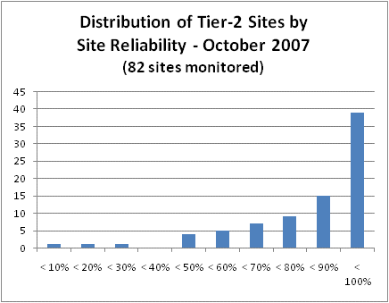
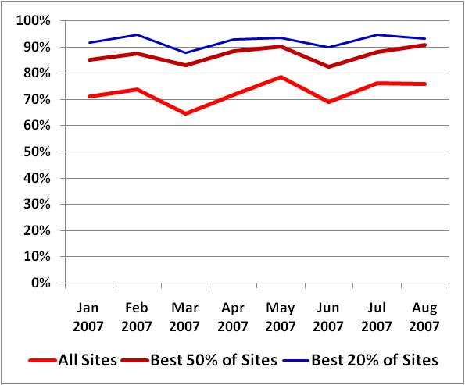
Tier-2 Site Reliability
Site Reliability
Tier-2 Sites
83 Tier-2 sites being monitored

Slide 20
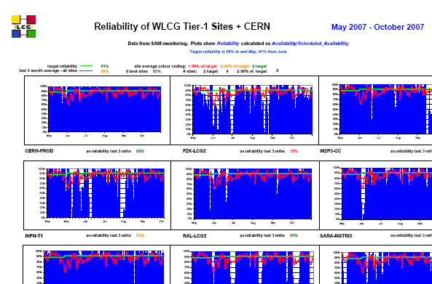
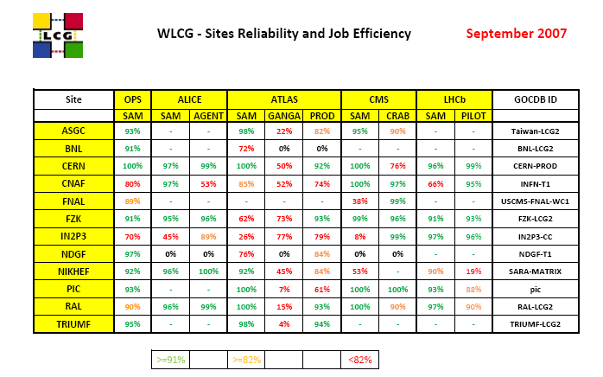
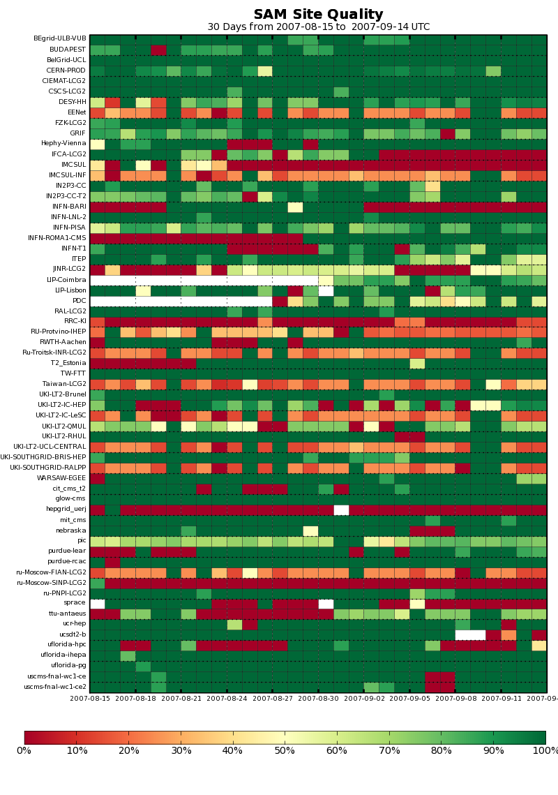
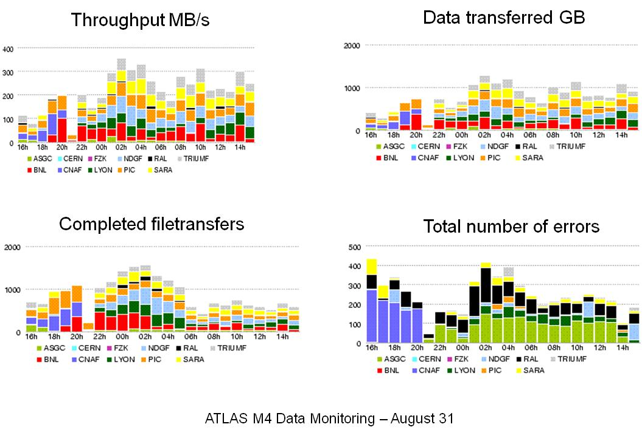
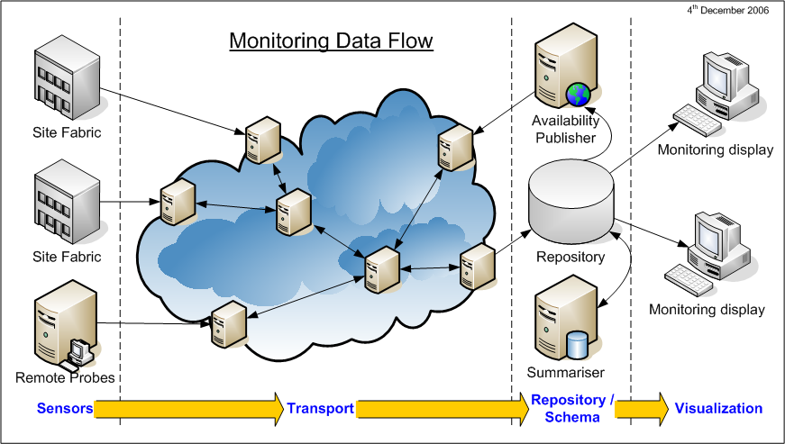

Improving Reliability
Monitoring
Metrics
Workshops
Data challenges
Experience
Systematic problem analysis
Priority from software developers

Slide 21
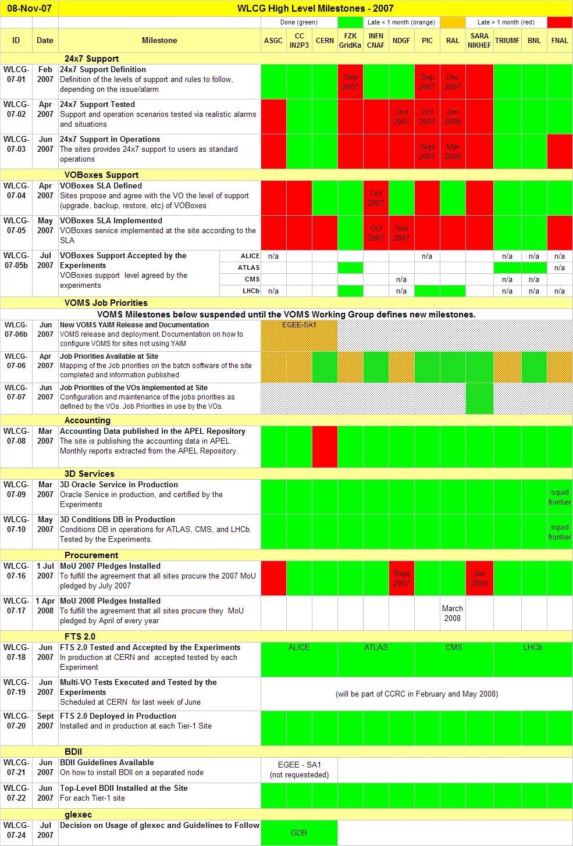
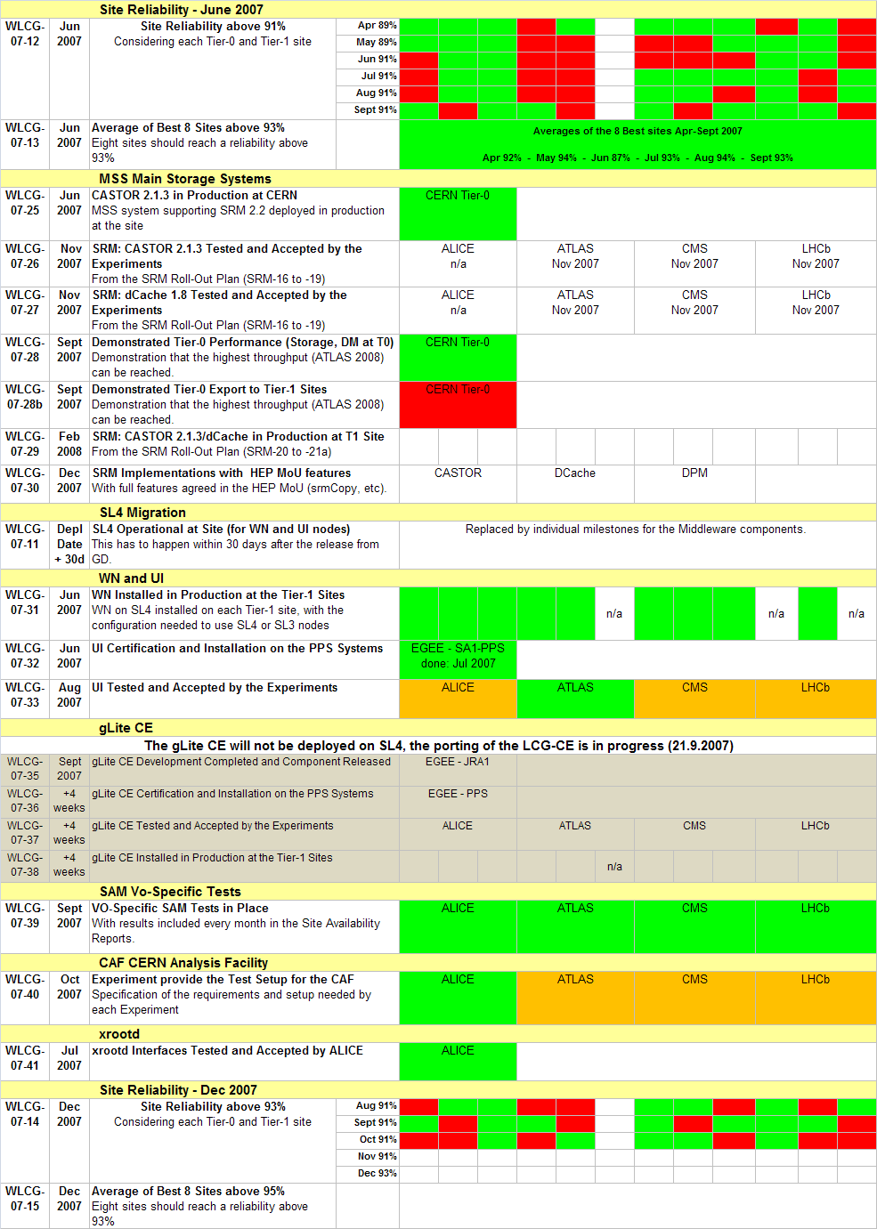
Suspended – re-design and new deployment plan
Fallback strategy implemented

Slide 22
Level 1 Milestones
Done
Late
<1 mon
Late
>1 mon
colour coding
Only 5 sites have tested their 24 X 7 support, and only 4 have put the support into operation
Only 3sites have completed the
set of VO BOX milestones

Slide 23
Testing Integration with DAQ
ALICE
Major test programme over several years
Full data rate demonstrated
LHCb
On-going tests, full data rate demonstrated
ATLAS
Exercised during Muons tests (M4, M5)
~50% of full data rate
CMS
First tests scheduled January 2008

Slide 24
Combined Computing Readiness Challenge - CCRC
A combined challenge by all Experiments & Sites
validate the readiness of the WLCG computing infrastructure
before start of data taking
at a scale comparable to that need for data taking in 2008
Should be done well in advance of the start of data taking
to identify flaws, bottlenecks
and allow time to fix them
Wide battery of tests – simultaneously – all experiments
Driven from DAQ with full Tier-0 processing
Site-site data transfers, storage system to storage system
Required functionality and performance
Data access patterns similar to 2008 processing
CPU and data loads simulated as required to reach 2008 scale
Coordination team in place
Two test periods – February, May

Slide 25
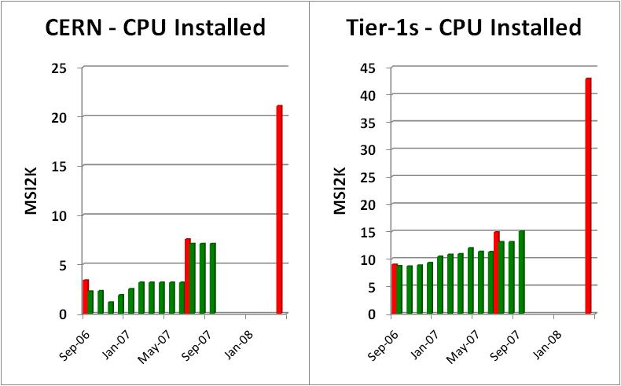
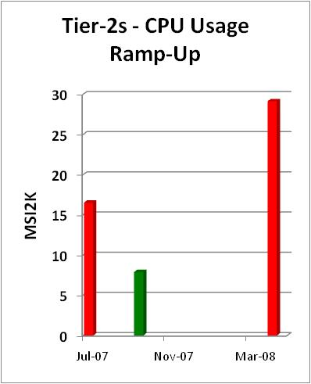
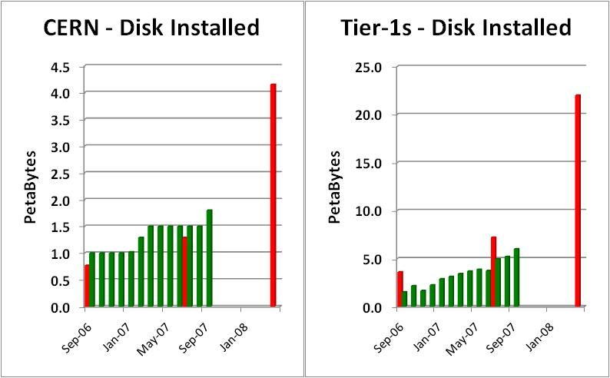
Ramp-up Needed for Startup
3 X
2.9 X
3.7 X
Sep Jul Apr
-06 -07 -08
Sep Jul Apr
-06 -07 -08
Jul Sep Apr
-07 -07 -08
2.3 X
3.7 X
target usage
usage
Sep Jul Apr
-06 -07 -08
Sep Jul Apr
-06 -07 -08
pledge
installed

Slide 26
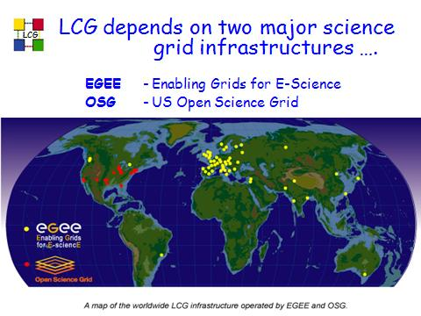
Grid Infrastructure Outlook
WLCG uses two major science grid infrastructures:
OSG – current funding cycle goes to the end of 2010
EGEE – current funding stops April 2008
proposal to extend to March 2010 – expect acceptance, but possibly with major cut in software support
EGI-DS - Design project under way since September to propose a long-term follow-on infrastructure
This would be based on formal National Grid Infrastructures, many of which have not yet been formed
Too early to guess what will be proposed, whether it will provide the underlying operational support needed for WLCG
But time is short to formulate a project that could be operational by April 2010
Time now to look at fall-back strategies

Slide 27
Summary
Applications support in good shape
WLCG service
Baseline services in production with the exception of SRM 2.2
Continuously increasing capacity and workload
General site reliability is improving – but still a concern
Data and storage remain the weak points
Experiment testing progressing –
involving now most sites, approaching full dress rehearsals
Sites & experiments working well together to tackle the problems
Major Combined Computing Readiness Challenge next year before the machine starts, -- essential to provide experience for site operations and storage systems – stressed simultaneously by all four experiments
Steep ramp-up ahead to deliver the capacity needed for 2008 run

