Slide 1
TLEP3
How radiation issues could be studied
through FLUKA simulations.
Possible approaches/mitigation schemes
Alberto Fassò

Slide 2
Compared with present (and future!) times, computing resources for shielding design of LEP 1 and 2 were poor.
But radiation studies were successful.
I will show:
what the most important radiation problems were 30 years ago
how they were solved
which issues will become more important at TLEP3
which of these will need improvements, not always easy to figure out yet

Slide 3
Three main classes of problems:
Protection of the machine (including electronics) ← the most critical!
Protection of people ← easy, not worse than for any other large accelerator
Protection of the environment ← technically not too difficult to calculate with modern tools. Very important politically and in order to avoid too conservative and costly solutions
Mitigation of 1. is problematic.
Mitigation easy for 2., provided deep underground
Mitigation of 3. needs dedicated studies

Slide 4
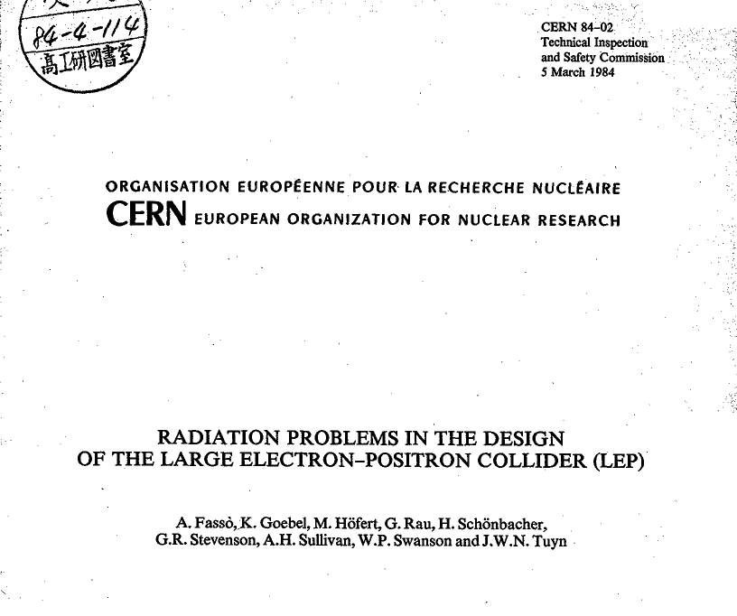

Slide 5
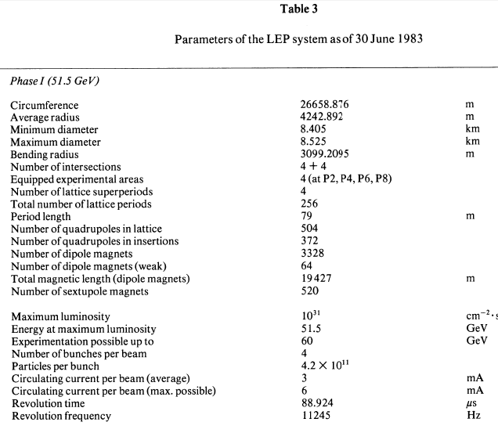

Slide 6
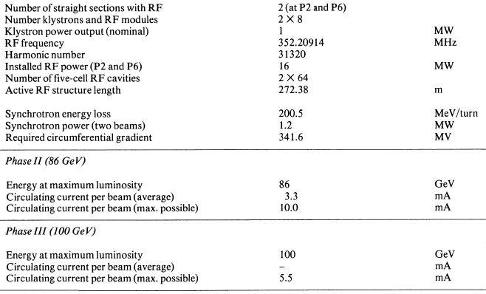

Slide 7
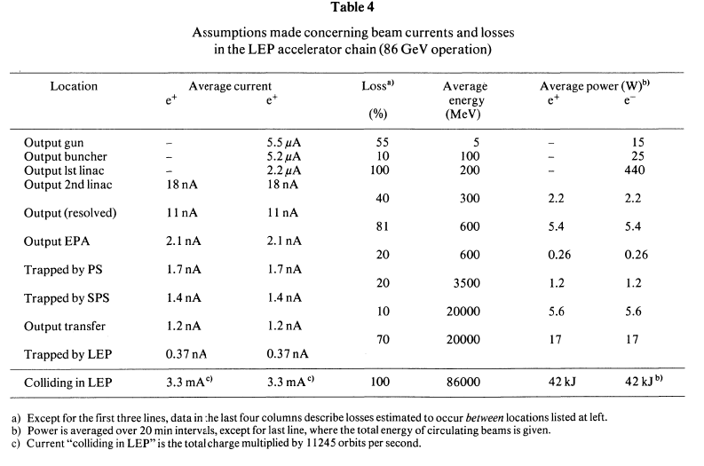

Slide 8
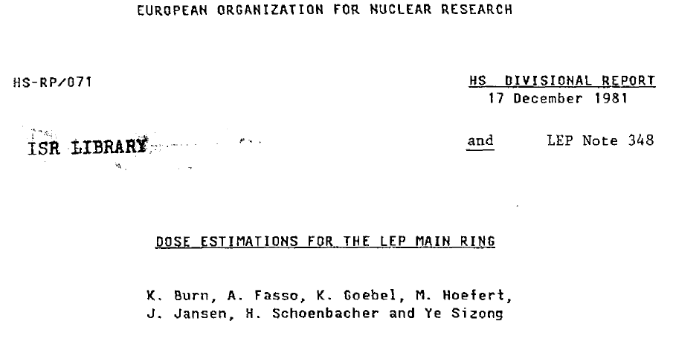

Slide 9
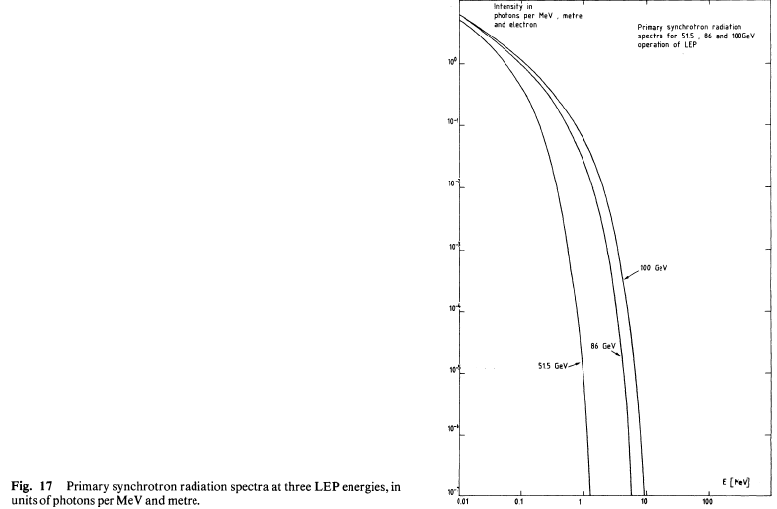
Synchrotron Radiation
Critical energy:
Half power below it, half above
Proportional to E³ / ρ
(E=electron energy, ρ = bending radius)
SR power: proportional to E⁴ / ρ

Slide 10
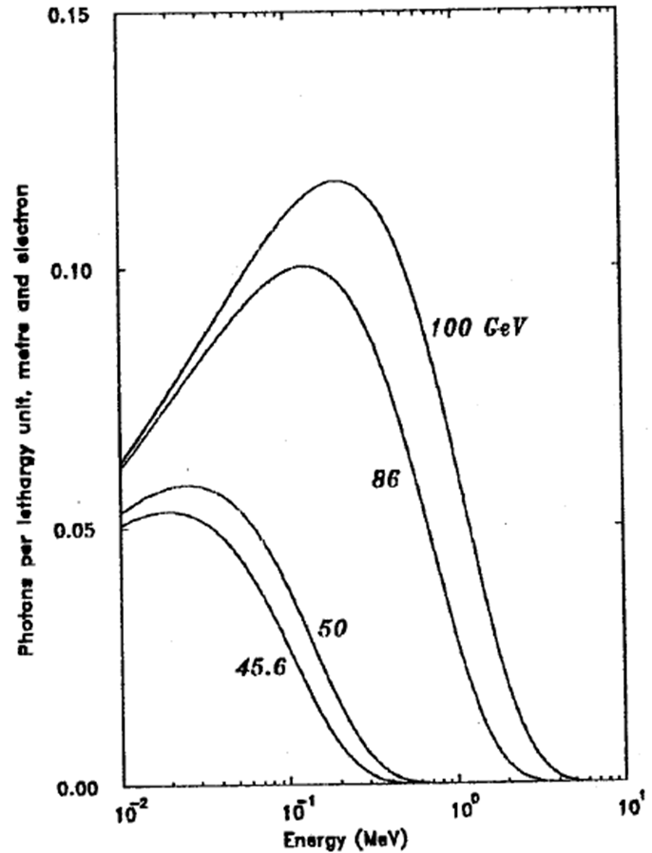
The same SR spectra in lethargy units
Critical energy:
51.5 GeV: 97.8 keV
86 GeV: 455.2 keV
100 GeV: 715.7 keV
120 GeV: 1400. keV
1400
716
455
98

Slide 11
Calculations for LEP 1 and 2
SR doses to coils, cables in ring →damage
SR doses to electronics in alcoves →damage
(would we now need also hadron fluence for SEU?)
SR streaming through ducts and mazes → dose to people
O₃, NO_{x} production → damage, impact on environment
Dose rate effects (transients) on pick-ups, sparking in high-tension cables (10⁸ Gy/s!) → damage
Calculations 2., 3. and 4. were made with MORSE
Calculations 1. and 5. with MORSE and EGS3
All could be done now with FLUKA, with much better accuracy

Slide 12
Photon streaming
SR streaming in waveguide ducts, in long straight sections to the klystron galleries (ducts: 8m long, 80 cm diameter)
Superconducting cavity radiation streaming in waveguide ducts (high-energy photons)
These calculations were made with MORSE.
FLUKA of course can do it much better

Slide 13
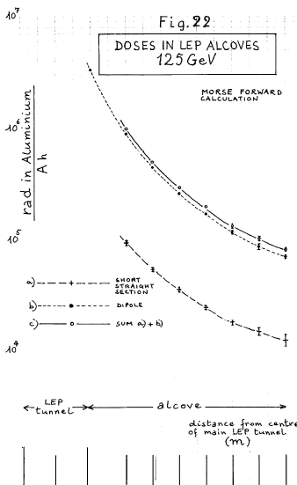
Example of SR streaming calculated with MORSE

Slide 14
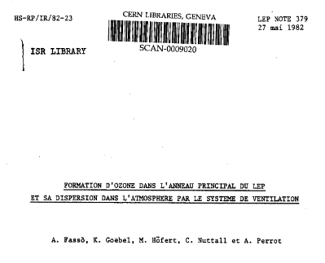
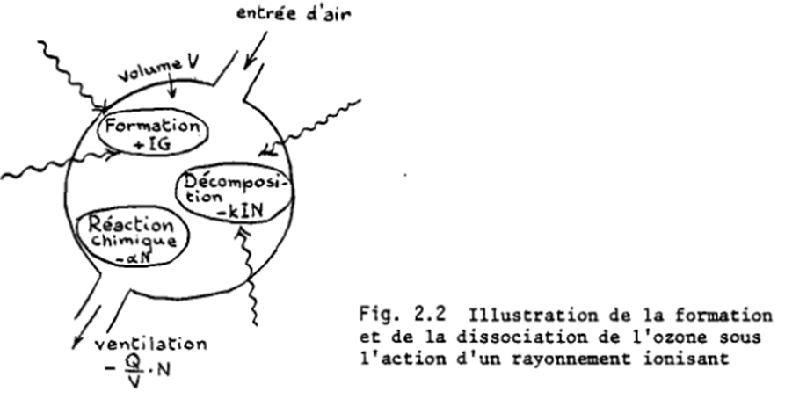
An educational report explaining the ozone impact on environment, used in the discussions with local populations
Production scaling with total escaping power

Slide 15
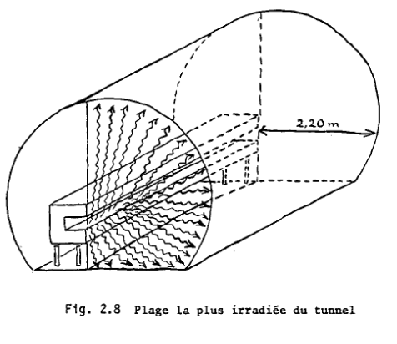
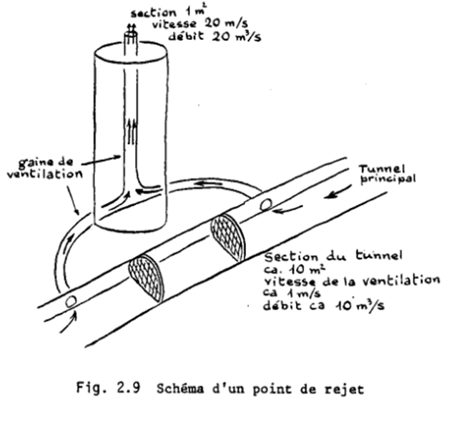
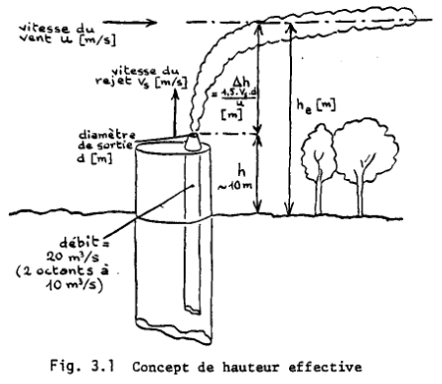
Ozone in the environment: calculated values much smaller than measured background, but fierce opposition by some local communes

Slide 16
Beam losses at LEP 1 and 2
Injection losses: assumed 1.55×10¹⁰ e±/s
→ 720 μSv/h at 4 m (can be much higher in top-off
mode)
Stored beam losses: assumed 1.1×10¹³ e±/s (2×10 mA) lost locally
→ 99 μSv integrated dose
→ in experiments, 1.20 m concrete equivalent
(280 g/cm²) required in all directions from loss point
Experiments: assumed to be self-shielded (needs active collaboration between RP and experiment designers)
Shielding high energy losses was calculated using Swanson’s book (now everything could be done with FLUKA)

Slide 17
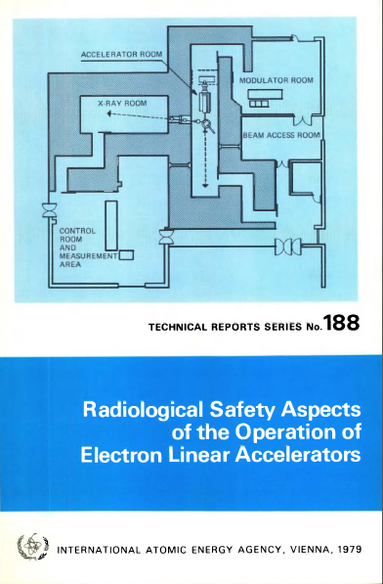
SWANSON’s BOOK

Slide 18
Calculations for LEP 1 and 2
Neutron production from SR and beam losses (from SR minimal at LEP, will increase with higher critical energies) ← dose to people near ducts and mazes
Neutron shielding in experimental areas (due to beam losses) ← dose to people
Muons in experimental areas (due to beam losses) ← dose to people
These calculations were done analytically by hand, using very crude assumptions. For calculation 8., a muon transport code TOMCAT was also used.
All could be done now with FLUKA, with much better accuracy

Slide 19
MORSE as used for LEP SR:
Multigroup photon transport: 21 γ-ray energy groups (max. energy 14 MeV)
P3 Legendre angular expansion → only 2 scattering angles at each collision )
No electron transport (pair production accounted for as scattering to 511 keV group!)
Special scoring and biasing prepared at CERN (later brought to FLUKA…)
FLUKA as can be used for LEP3 SR and beam losses:
Continuous transport of γ and electrons up to PeV energies.
Explicit effects: photoelectric, Compton, pair prod., e⁺ annihilation
Photon polarization (important for SR!)
Photonuclear reactions at all photon energies.
Photomuon production.

Slide 20
Induced activity
Low at LEP 1 and 2 (although important on dumps), but required a big effort at decommissioning time:
M. Silari and L. Ulrici,
Investigation of induced radioactivity in the CERN Large Electron Positron collider for its decommissioning
NIM A 526, 510-536 (2004)
From beam losses, calculated first using Swanson’s book, with FLUKA later.
From SR, negligible at LEP 1 and 2, will not be so at LEP3. Photonuclear reactions in FLUKA are OK, but cross-sections near threshold will be critical, and are not all well known yet. Photofission possible in Pb.

Slide 21
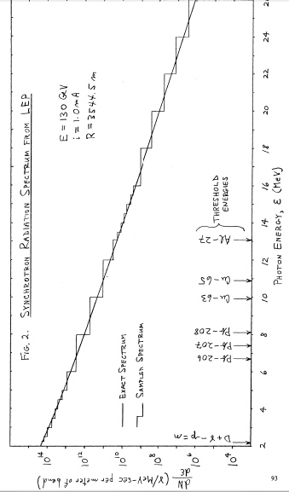
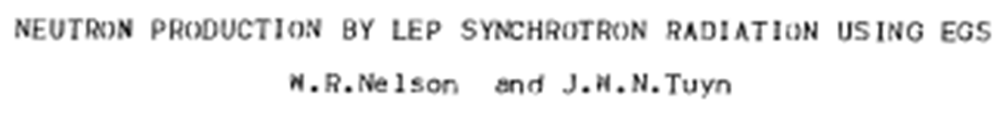

Also induced activity

Slide 22
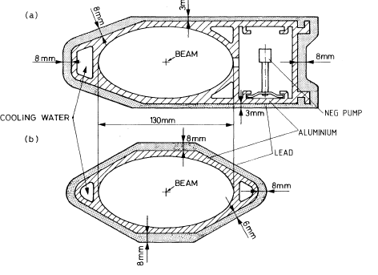
Pb thickness 3 or 8 mm, attenuates power by 98 to 99%
Would be very ineffective at higher SR energies!!!
How to mitigate? Don’t know: needs new ideas

Slide 23
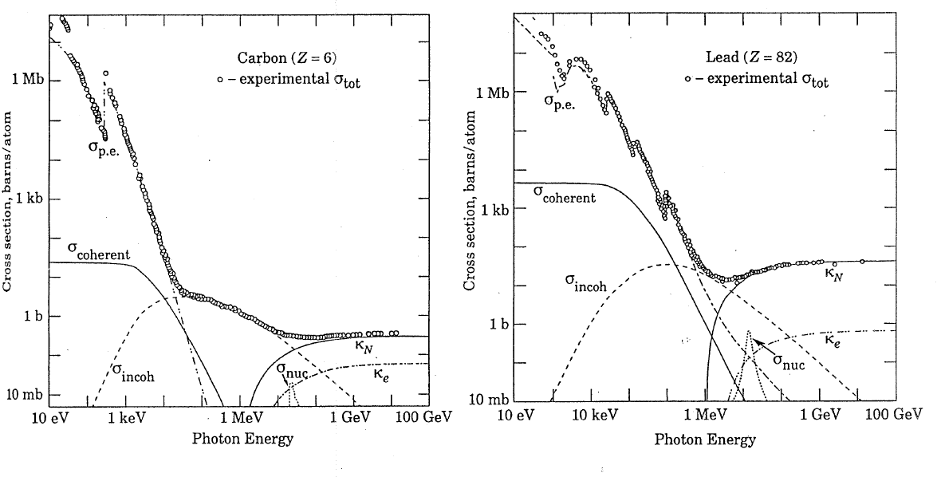
Photon cross sections
Photoelectric dominated
Compton dominated
Pair dominated
Photoelectric dominated
Compton dominated
Pair dominated
σ_{p.e.}=photoelectric cross section; σ_{incoh}=Compton cross section;
σ_{coherent}=Rayleigh cross section; σ_{nuc}=photonuclear cross section;
κ_{N}=pair production cross section, nuclear field;
κ_{e}=pair production cross section, electron field

Slide 24
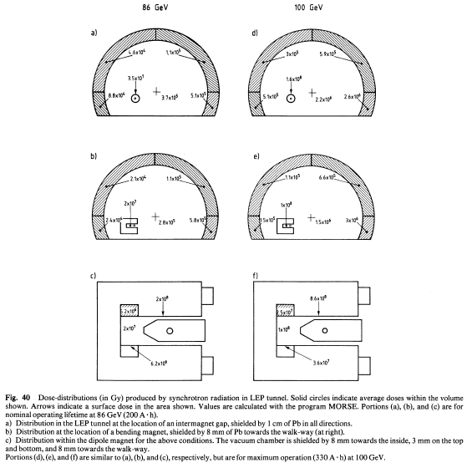

Slide 25
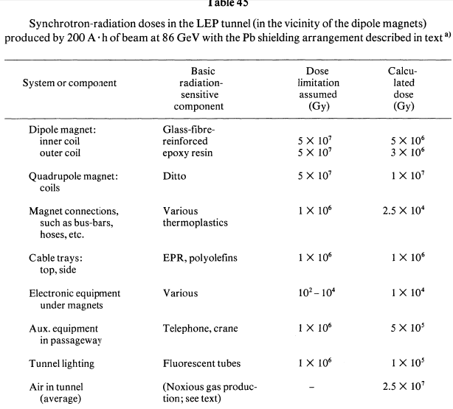

Slide 26
Radiation Damage
Assumed criterion for acceptability of materials: must survive after 200 Ah at 86 GeV
Coil insulation: glass-fiber reinforced epoxy resins
→ Survive at < 10⁸ Gy
Cable insulation: no PVC or other that can produce corrosive gases (EPR: ethylene-propylene rubber, polyethylene) → survive < 10⁶ Gy

Slide 27
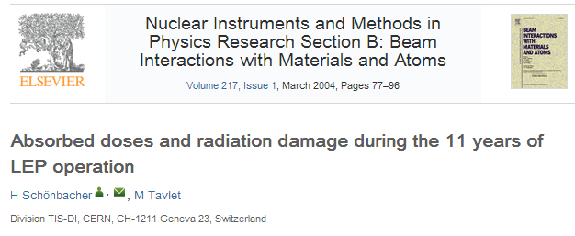
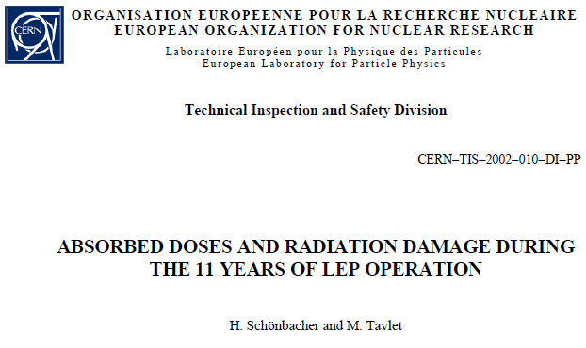

Slide 28
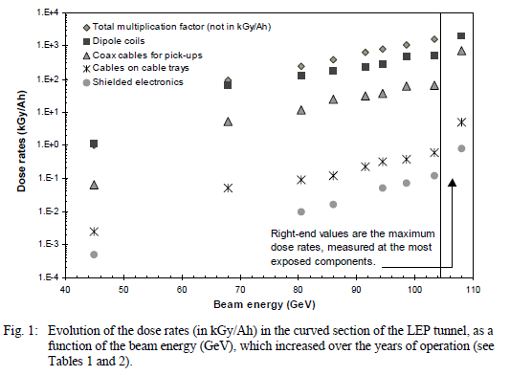
Measured!

Slide 29
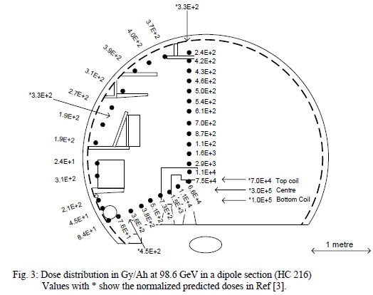
Too good to be true!

Slide 30
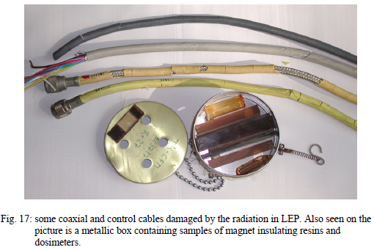

Slide 31
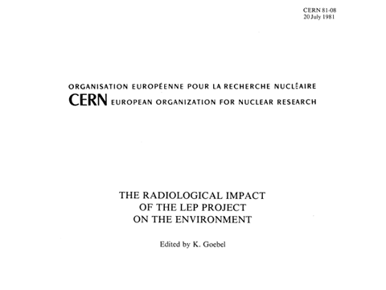

Slide 32
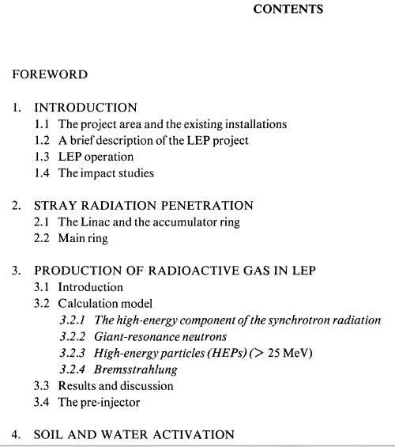
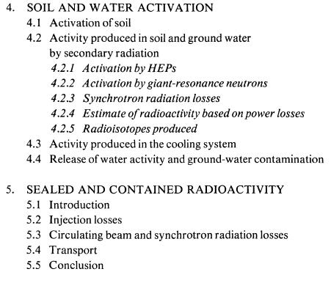

Slide 33
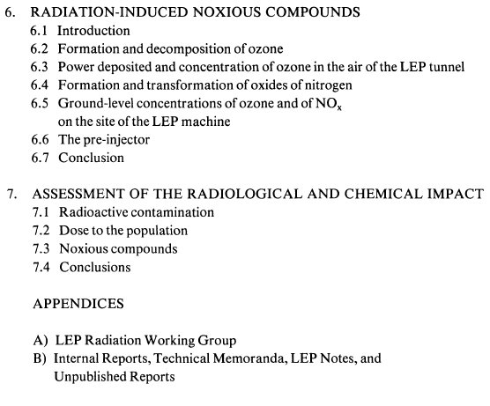
Effects on environment were minimal, but were calculated in a very crude way (e.g. induced activities calculated as integrated values over all soil thicknesses).
But politically VERY important!!!
Very accurate and detailed calculations are now possible with FLUKA, and needed due to the constraining evolution of legal limits and the excessive cost of a too conservative approach

Slide 34
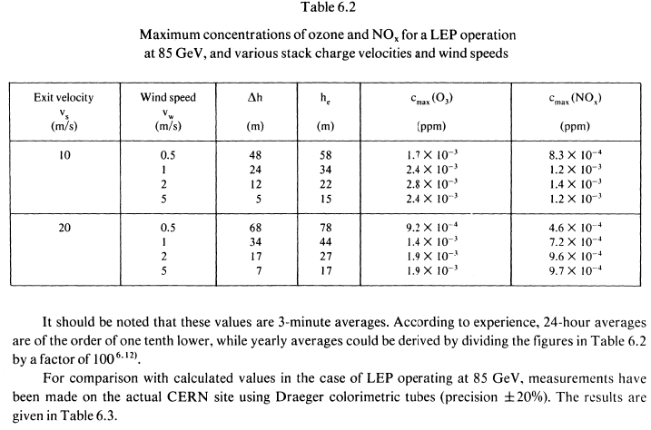
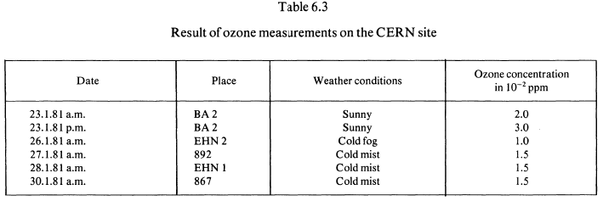

Slide 35
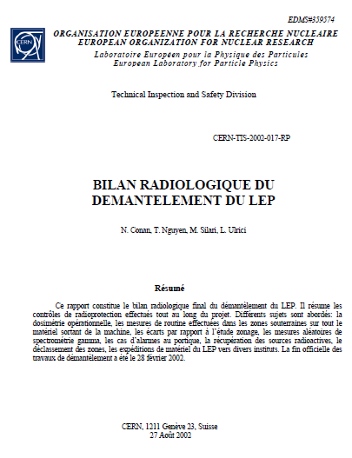
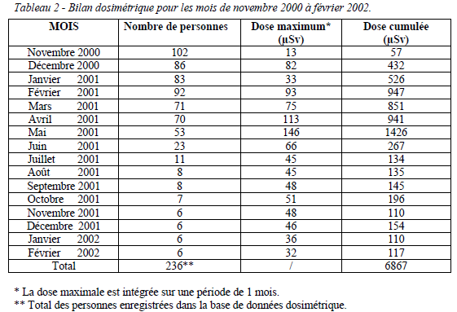

Slide 36
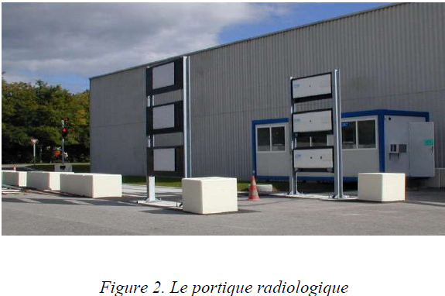

Slide 37
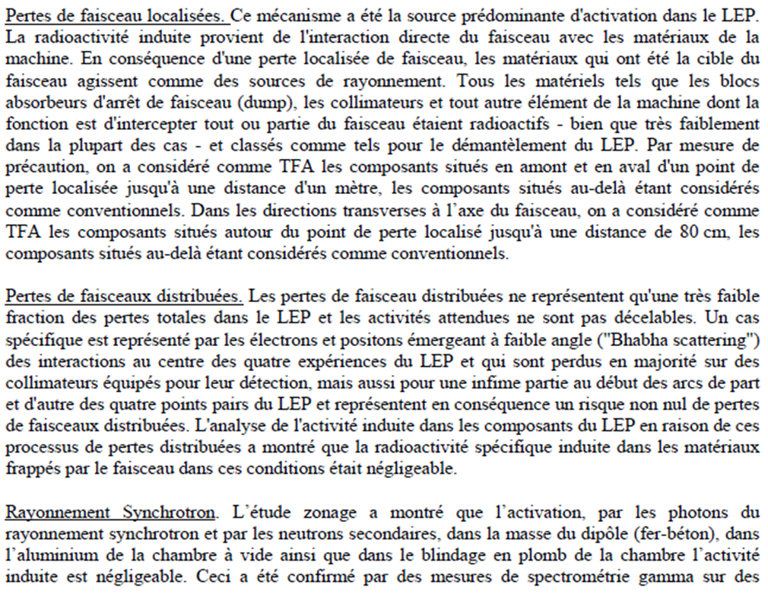

Slide 38
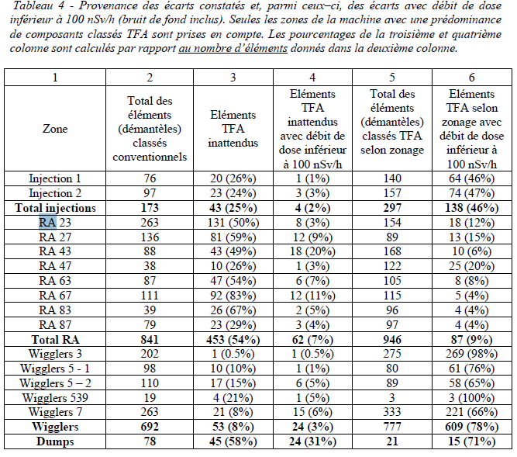

Slide 39
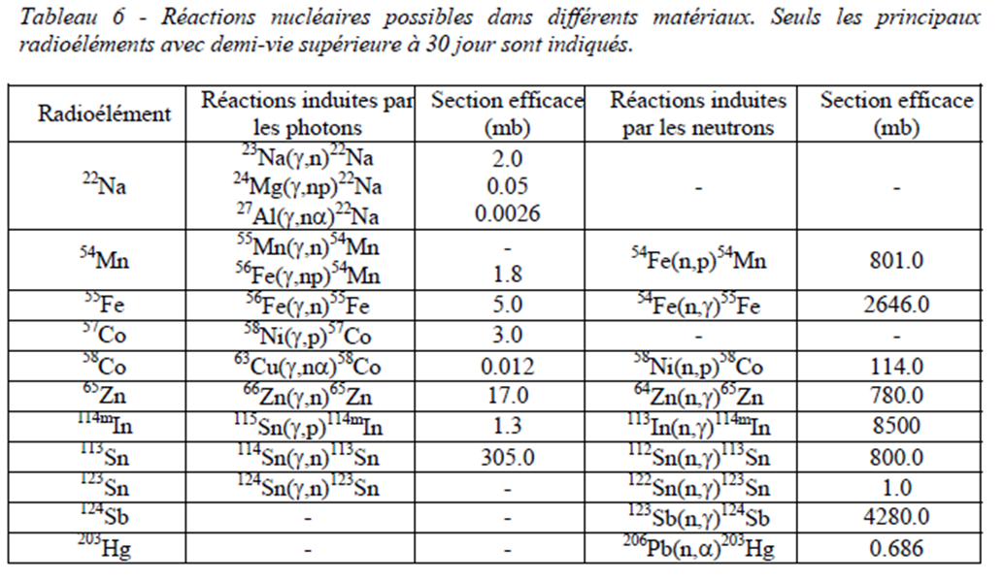

Slide 40
The RAWOG (RAdiation WOrking Group)
The LEP radiation studies were organized by the RAWOG, in a way that proved very successful.
Members of RAWOG were radiation physicists, LEP engineers and physicists, and experts from various European electron accelerators (DESY, Frascati, Orsay…)
The working group met once every month to present and discuss one or two radiation issues. During the coming month, radiation physicists made relevant calculations whose results were presented and discussed in the next monthly meeting.
Examples: mazes, klystron galleries, alcoves, vacuum chamber shielding…

Slide 41
