Slide 1

LHCb Status and Recent Highlights
Berkeley Workshop on
Heavy Flavor Production at Hadron Colliders
14 January 2013
Pascal Perret
LPC Clermont
On behalf of the LHCb Collaboration

Slide 2
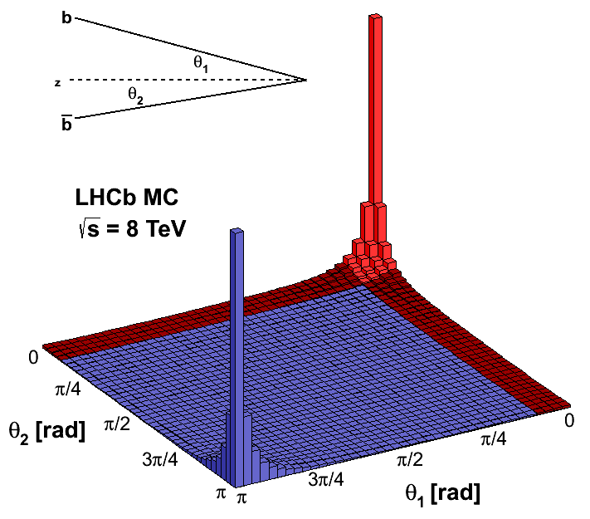
Heavy Flavours @ LHC
LHC is a B- and D-mesons super factory:
  Large bb cross section (~250 µb – 500 µb @ √s=7 – 14 TeV):
    LHCb measurement @ 7 TeV [PLB 694 (2010) 209]:
      ~ 280 μb (~75 ± 14 μb in LHCb acceptance)
    σ_{cc} is 20 times larger! [LHCb-CONF-2010-013] σ(pp → ccX) = ~6 mb
      LHCb acceptance / 1 fb⁻¹:
        ~10¹¹ b decays [all species produced, B⁰,B⁺,B_{S}, Λ_{b},..]
        ~10¹² c decays
    b-hadrons produced at low angle
      Spreading predominantly in the narrow cone
      around the beam
    High rate of background events:
      σ_{vis. Inel.} ~ 60 mb at √s =7 TeV
      1/200 event contains a b quark, typical interesting BR < 10⁻³
TRIGGER!

Slide 3
Outline
The LHCb detector
Selected physics highlights
  Parameters of the CKM matrix: γ measurements
  Studies of CPV in the B_{s} system
  CP violation in charm
  Rare B decays
Conclusion

Slide 4
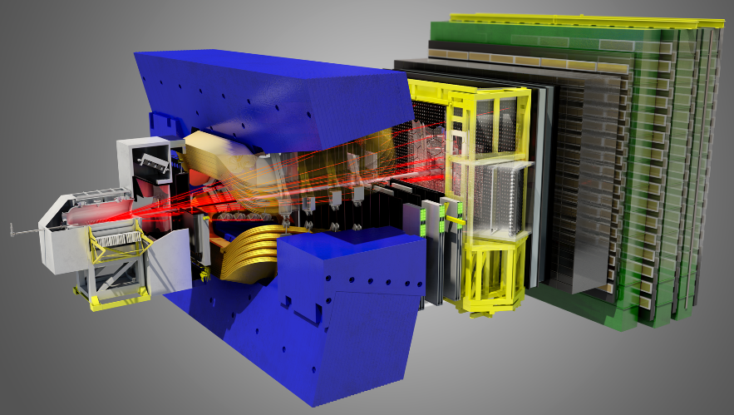
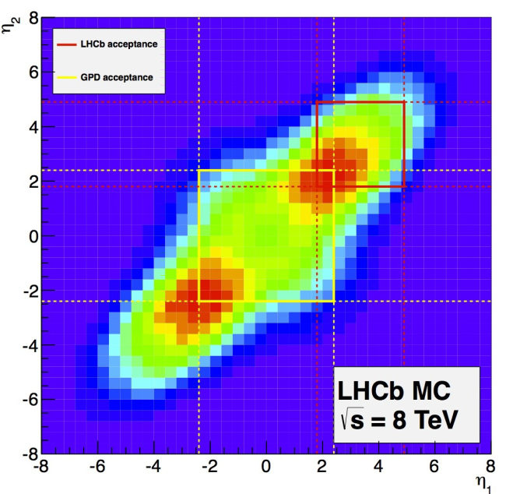
The LHCb detector
A single-arm forward spectrometer:
  Covers ~4% of the solid angle, but captures ~30% of the heavy quark production cross-section
ATLAS & CMS
region |η| < 2.5
LHCb region
2 < η < 5
~10m
10 – 250 mrad
10 – 300 mrad
~20m

Slide 5
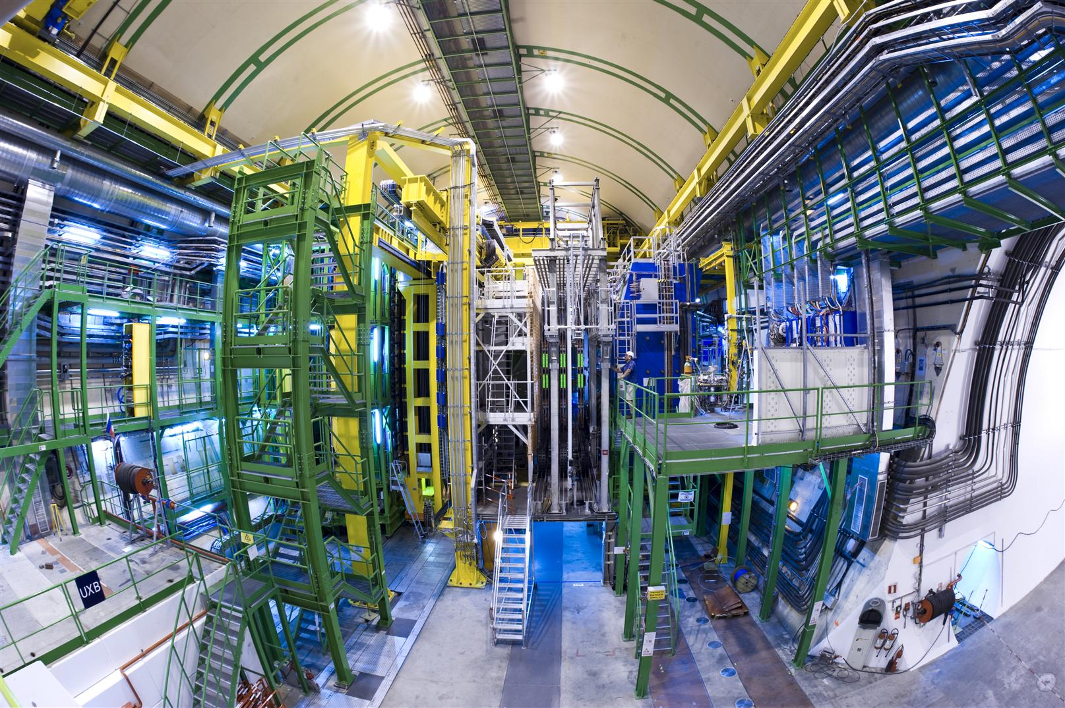
The LHCb detector

Slide 6
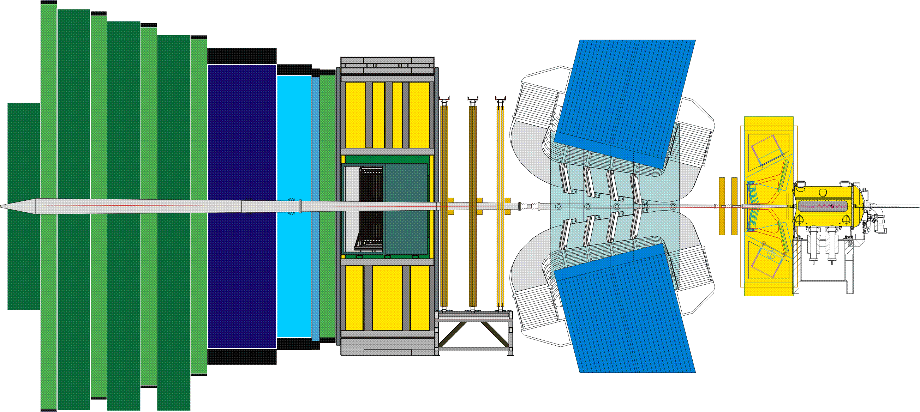
The LHCb detector
RICH2
Outer Tracker straw Tubes
TT
Si
HCAL
ECAL
Magnet
VELO&PU
Si
p
p
Muon
MWPCGEM
Inner Tracker
Si
RICH1
PS+SPD
[The LHCb Detector at the LHC, JINST 3 (2008) S08005]

Slide 7
The LHCb detector
σ(E)/E ~ 70%/√E ⊕ 10%
σ(E)/E ~ 10%/√E ⊕ 1% σ_{m}~90 MeV for B⁰→K*γ
σ_{m}~8 MeV for B⁺→J/ψK⁺, 25 MeV for B →µ⁺µ-
~20 µm IP resolution at P_{T} > 2 GeV
p
p
Excellent muon identication ε = 97%, misid 2%
ε(k → k) 90% for ε(k → π) <10%
Great Vertex Resolution! Primary/secondary separation, proper time resolution.
Excellent momentum and mass resolution.
Outstanding PID (K-π) and μ reconstruction.
Dedicated Trigger system for B and C!

Slide 8
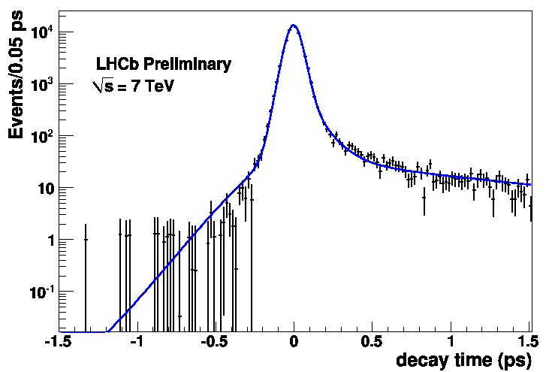
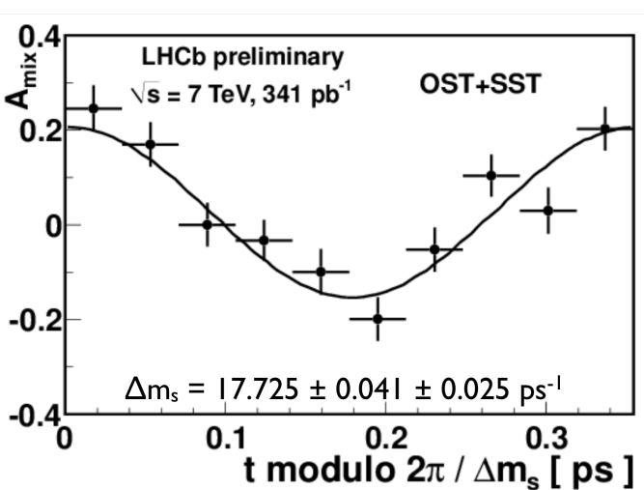
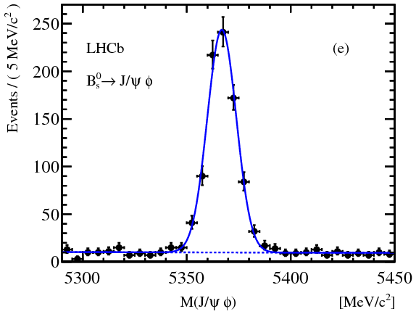
Some illustrations: Tracking
  VELO: IP resolution = 12 mm for high p_{T} tracks
Proper-time resolution: σ_{t} = 45 fs
B_{s}–B_{s} oscillations measured
cf CDF:
17.77 ± 0.10 ± 0.07 ps⁻¹
(σ_{t} = 87 fs)
[PRL 97 242003]
[LHCb-CONF-2012-02]
[LHCb-CONF-2011-50]
  Tracking: σ_{p}/p ~ 0.4 – 0.6 % (5-100 GeV/c) p scale ~ 2 10⁻⁴
    World best measurement of b-hadron masses [PLB 708 (2012) 241]
  B_{s} → J/ψ φ (σ= 7 MeV)
J/ψ mass constrained
cf. [CMS DPS-2010-040] ~ 16 MeV/c2
[ATLAS CONF-2011-050] ~ 22 MeV/c2

Slide 9
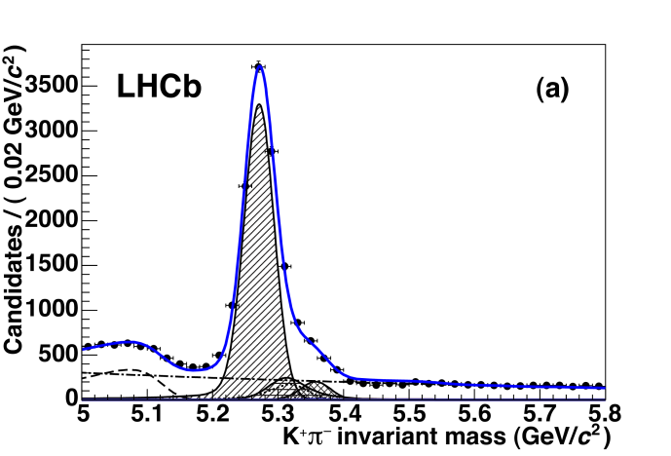
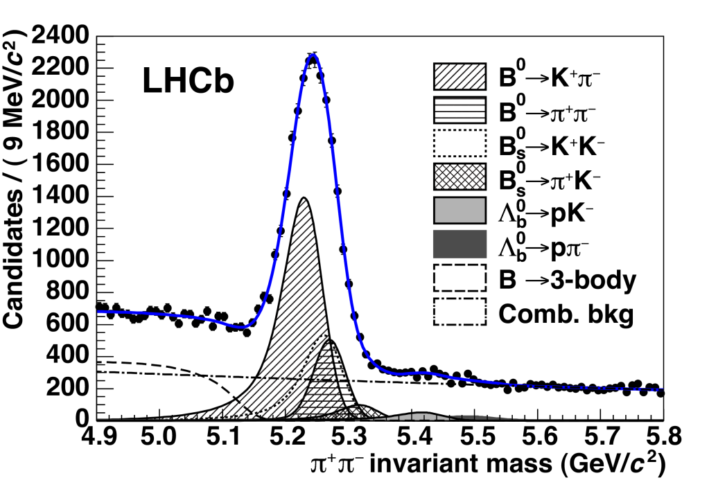
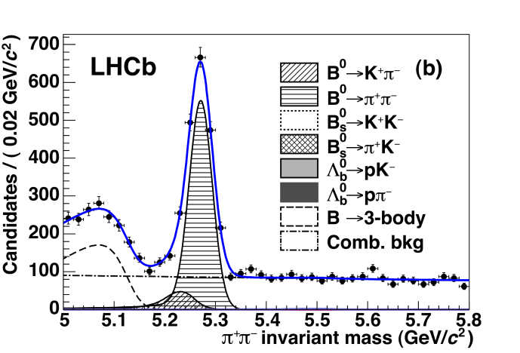
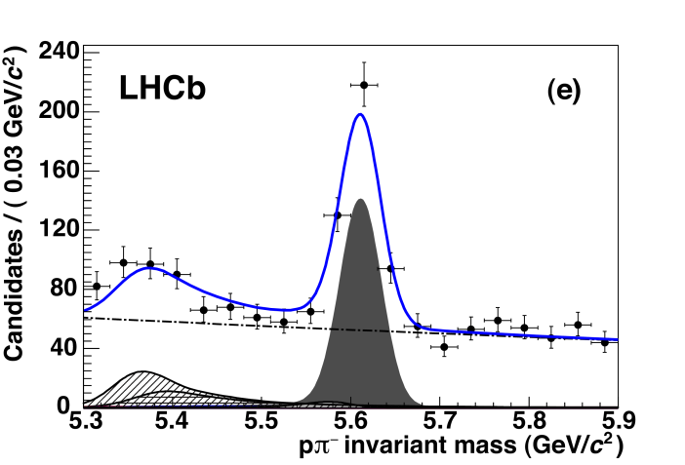
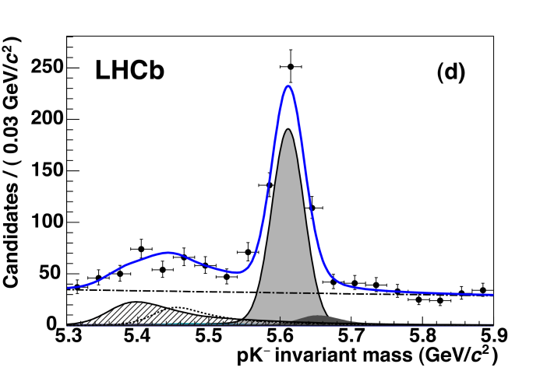
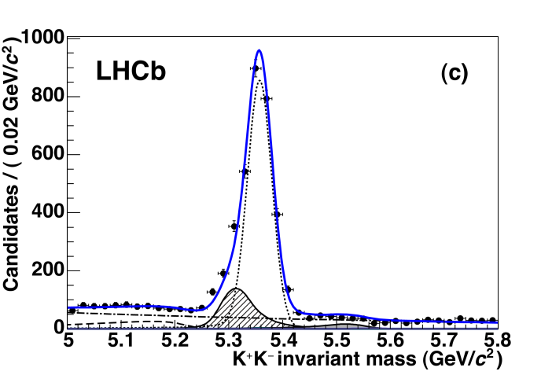
Some illustrations: PID performances
[JHEP 10 (2012) 037]
Plot with ππ hypothesis - No RICH
B⁰ → Kπ
B⁰ → ππ
Λ_{b}→ pπ
Λ_{b}→ pK
B_{s} → KK

Slide 10
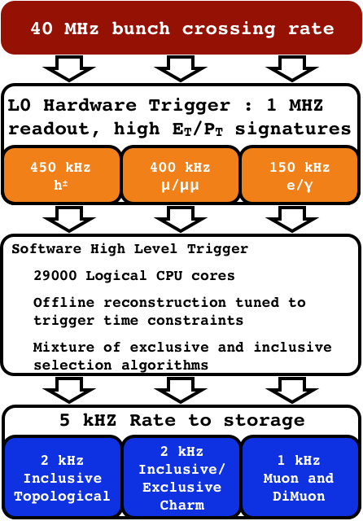
LHCb trigger
  Level-0 trigger: hardware
    4 μs latency @ 40MHz
    “Moderate” E_{T}/p_{T} threshold:
      Typically
        E_{T}(e/γ)>2.7 GeV; E_{T}(h)>3.6 GeV
        p_{T}(μ)>1.4 GeV/c
  HLT trigger: software
    ~30000 tasks in parallel on ~1500 nodes
  Storage rate: 5 kHz
  Combined efficiency (L0+HLT):
    ~90 % for di-muon channels
    ~30 % for multi-body hadronic final states

Slide 11
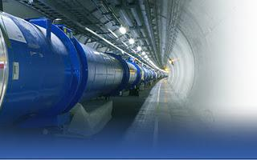
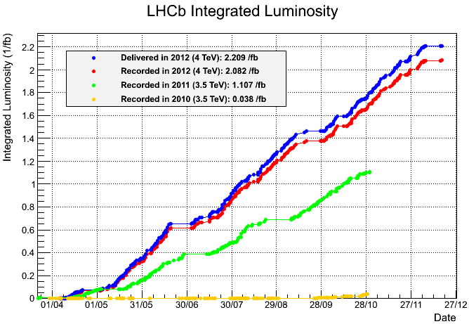
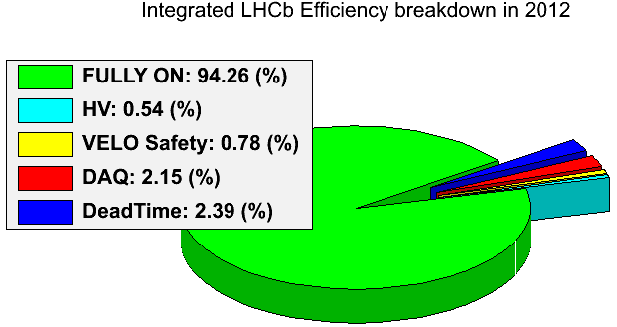
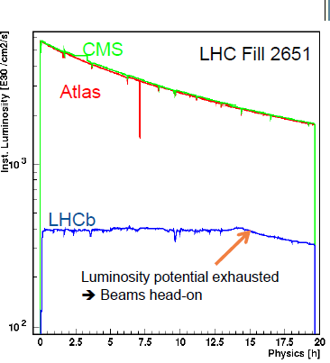
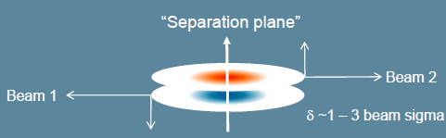
LHCb operation
LHC
2012 | 8 TeV | 2.1 fb⁻¹
2011 | 7 TeV | 1.1 fb⁻¹
2010 | 7 TeV | 0.038 fb⁻¹
High Efficiency!
ε(operation)>94%
~98% are good data!
2012
2011
Detectors all with >~99% active channels
2010
Semi-continuous (automatic) adjustment of offset of colliding beams allows luminosity to be levelled
15 h!
4x10³²cm⁻²s⁻¹
Design:
2x10³²cm⁻²s⁻¹
    4 times more collisions per crossing than in the design!!!

Slide 12
LHCb Physics program
B decays to charmonium
  Bs mixing parameters
  CP violation measurements
  B → J/ψ X and related decays
B decays to open charm
  CKM angle γ from B → D K family
  B decays to double charm
  Rare hadronic B decays
Charmless B decays
  Studies of B →h h^{(‘)} and B → h h^{(‘)}h^{(“)}
  B → V V decays
  Rare charmless B decays
Charm physics
  Mixing and CP violation
  Open charm prod. & spectroscopy
  Rare charm decays
Rare decays
  Leptonic, electroweak and radiative decays
  SM forbidden processes
Semileptonic B decays
  Search for CP violation in mixing
  Form factors
  Rare decays
B hadrons & quarkonia
  Production and spectroscopy of B hadrons and quarkonia
QCD, electroweak & exotica
  “Soft” & “hard” QCD
  Electroweak boson production, PDFs
  New long-lived particles
Etc …

Slide 13
LHCb Physics program
B decays to charmonium
  Bs mixing parameters
  CP violation measurements
  B → J/ψ X and related decays
B decays to open charm
  CKM angle γ from B → D K family
  B decays to double charm
  Rare hadronic B decays
Charmless B decays
  Studies of B →h h^{(‘)} and B → h h^{(‘)}h^{(“)}
  B → V V decays
  Rare charmless B decays
Charm physics
  Mixing and CP violation
  Open charm prod. & spectroscopy
  Rare charm decays
Rare decays
  Leptonic, electroweak and radiative decays
  SM forbidden processes
Semileptonic B decays
  Search for CP violation in mixing
  Form factors
  Rare decays
B hadrons & quarkonia
  Production and spectroscopy of B hadrons and quarkonia
QCD, electroweak & exotica
  “Soft” & “hard” QCD
  Electroweak boson production, PDFs
  New long-lived particles
Etc …
+ 2 additional LHCb talks:
  Andrew Cook:
    Quarkonium production in LHCb
  Jean Wicht:
    Open c and b meson production in LHCb

Slide 14
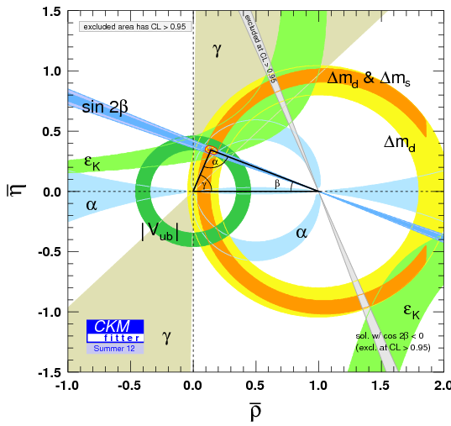
Measurements of the CKM angle γ
CKM fitter | 66±12°
UTFit | 72±9°
The least well-constrained angle of the CKM triangle
From Babar + Belle

Slide 15
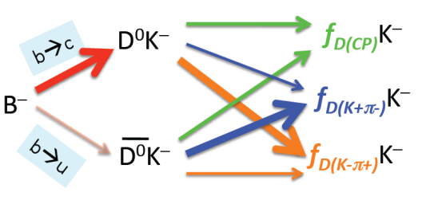
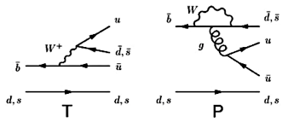
Measurements of γ
γ can be measured in tree and loop-level decays
  Tree-level decays: SM benchmark measurement of γ
    B → DK family provide a wide and clean lab to measure it
      Several different final states (and B flavour) give independent measurements
  2 amplitudes, b→c (dominant) & b→u (color suppressed), interfere in decays to a common D⁰ and D⁰ modes state.
  B_{s} → D_{s}± K⁺: Interference between 2 tree diagrams via B_{s} mixing
  Loop-level decays: Measurement of γ sensitive to NP
    B_{d,s} → hh or hhh (h = π, K) is the lab
    Large hadronic uncertainties: can be controlled employing U-Spin symmetry
    (invariance of strong interaction under exchange of d and s quarks)
Penguin amplitudes: Interference of b→u tree & b→d(s) penguin diagrams

Slide 16
Measurements of γ : Tree-level decays
Aside from γ, the ratio of favoured to suppressed B(D) decay amplitudes r_{B}e^{i(δ}B^{- γ)} (r_{D}e^{iδD}) depends on 2 hadronic unknowns:
r_{B(D)}, δ_{B(D)}
  Several methods to extract these hadronic unknowns (and γ) are used. They depend on the D final state:
    D in CP eigenstates (D⁰ → K⁺K⁻, π⁺ π⁻)
      GLW (Gronau-London-Wyler) [PLB 265, 172 (1991)]
    Cabibbo allowed (D⁰ → K⁻ π⁺) and double Cabibbo suppressed states (D⁰ → K⁺ π⁻ and D⁰ → K⁺ π⁻ π⁺ π⁻ )
      ADS (Atwood-Dunietz-Soni) [PRL 78, 3257 (1997)]
    D in 3-body decays (D⁰ → K_{s} π⁺π⁻)
      GGSZ, Dalitz (Giri-Grossmann-Soffer-Zupan) [ PRD 68, 054018 (2003]
  Combined analyses of all modes to extract all the unknowns

Slide 17
Measurements of γ : Tree-level decays
  Several kind of measurements have been published
    all using 1fb⁻¹ of 2011 data (√s = 7 TeV):
  Time-independent measurements:
    B⁺→D⁰K⁺ with D⁰ → K π, KK, ππ [PLB 712 (2012) 203]
    B⁺→D⁰K⁺ with D⁰ → K πππ : [LHCb-CONF-2012-030]
    B⁺→D⁰K⁺ with D⁰ → K_{S} ππ, K_{S}KK : [PLB 718 (2012) 43]
  Gamma combination from time-independent:
    Using B⁺→D⁰K⁺ and B⁺→D⁰ π⁺: [LHCb-CONF-2012-032]
  Time-independent with neutral B decays:
    B⁰→D⁰K^{*0} with D⁰ → KK: [LHCb-CONF-2012-024]
  Time-dependent measurements:
    B_{S}→D_{S}K decays (first!) [LHCb-CONF-2012-029]

Slide 18
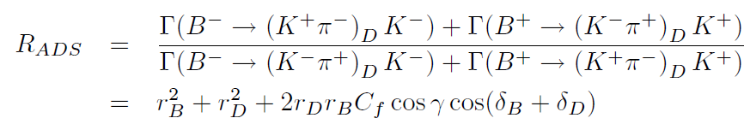
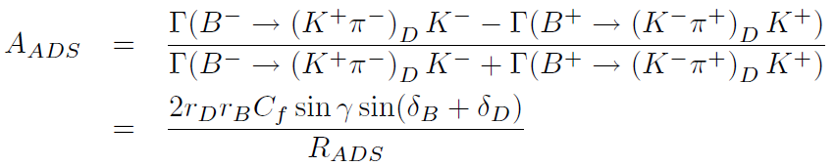
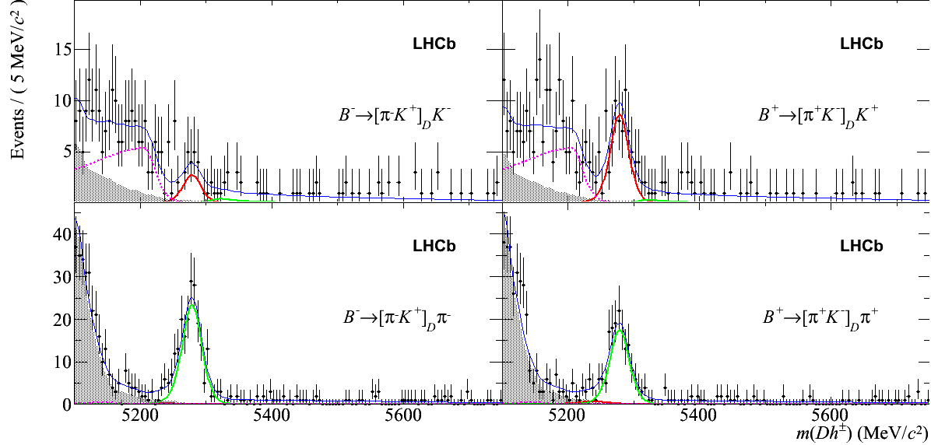
Measurements of γ : Tree-level decays
ADS modes: B⁺→D⁰K⁺ with D⁰ → Kπ, KK, ππ
C_{f} (or κ) is the coherence factor, with C_{f} =1 for two-body decay, and 0< C_{f} <1 for multi-body decay
[PLB 712 (2012) 203]
Evidence for asymmetry in
B ± →DK± (4 σ):
A_{ADS}(DK)= - 0.52 ± 0.15 ± 0.02
Hint for asymmetry in
B ± →Dπ± (2.4 σ):
A_{ADS}(D π)= - 0.143 ± 0.062 ± 0.011
B⁻
B⁺
B⁻
B⁺
  Considering KK, Kπ and ππ together, direct CPV is observed (5.8 σ) in B → DK decays for the first time!

Slide 19
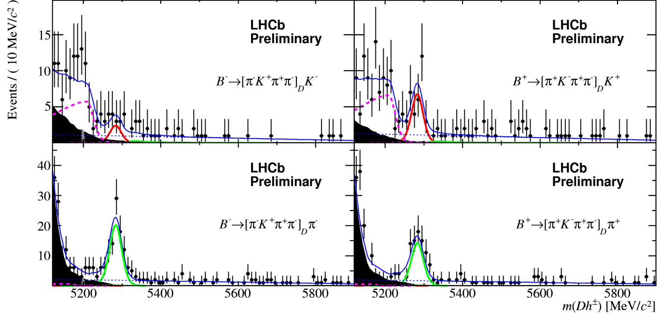
Measurements of γ : Tree-level decays
ADS modes: B⁺→D⁰K⁺ with D⁰ → Kπππ
  Similar to ADS but D decay parameters differ (r_{D}, δ_{D})
    Add statistics but also new information
    First observation of rare ADS decays:
[LHCb-CONF-2012-030]
5.1 σ in B ± →DK± :
A_{ADS}(DK)= - 0.42 ± 0.22
R_{ADS}(DK)= (1.24 ± 0.27)%
10 σ in B ± →Dπ± :
A_{ADS}(Dπ)= + 0.13 ± 0.10
R_{ADS}(D π)= (0.369 ± 0.036)%
B⁻
B⁺
B⁻
B⁺
    Systematics small, dominated by
      Particle identification (R)
      Production, interaction, detection asymmetries (A)

Slide 20
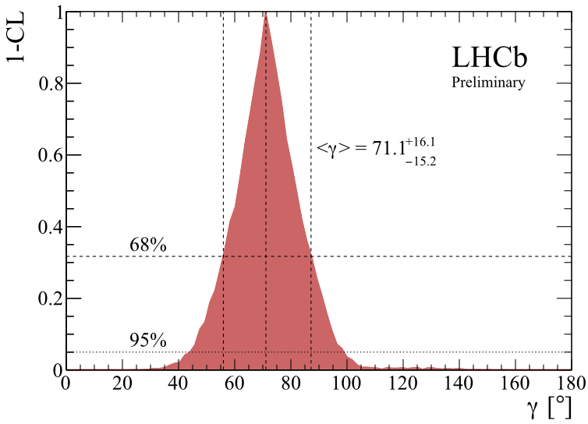
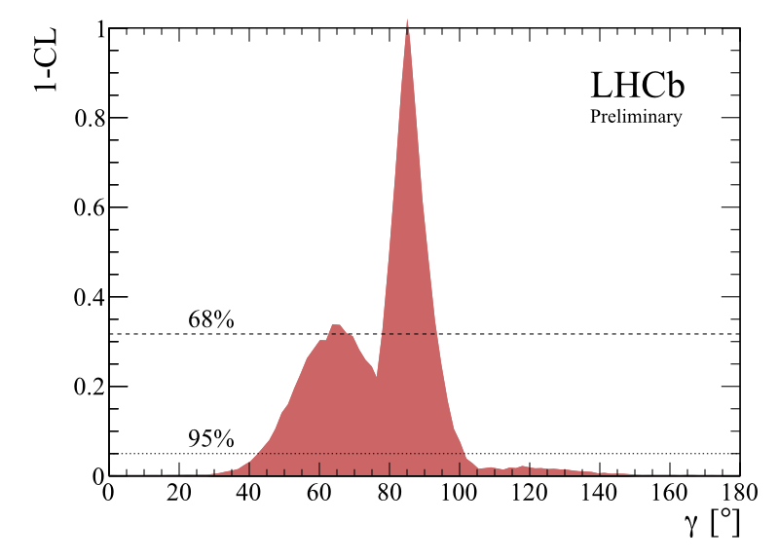
Measurements of γ : Tree-level decays
LHCb combination using B→Dh with D→hh, hhh, K_{s}hh (h=K,π)
  Use frequentist approach to combine the results from:
B→[hh]_{D} K | GLW/ADS | PLB 713 (2012) 351
B→[πKππ]_{D} K | GLW/ADS | LHCb-CONF-2012-030
B→[K⁰_{S} hh]_{D} K | GGSZ | PLB 718 (2012) 43
B → DK only
  γ = 71 ± 16°
    γ ∈ [43.8 – 101.5]° @ 95%
  Precision already comparable with γ averages from B factories
      Babar: γ = 69 ± 17°
      Belle: γ = 68 ± 15°
+ B → D π

Slide 21
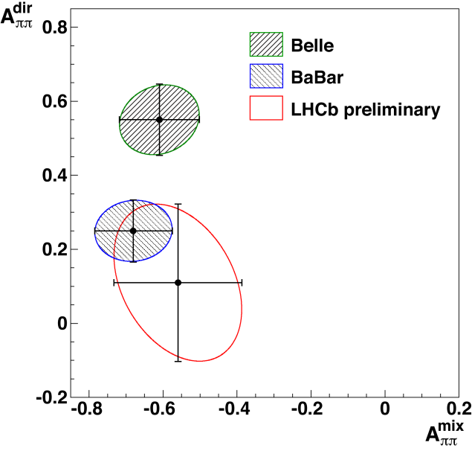
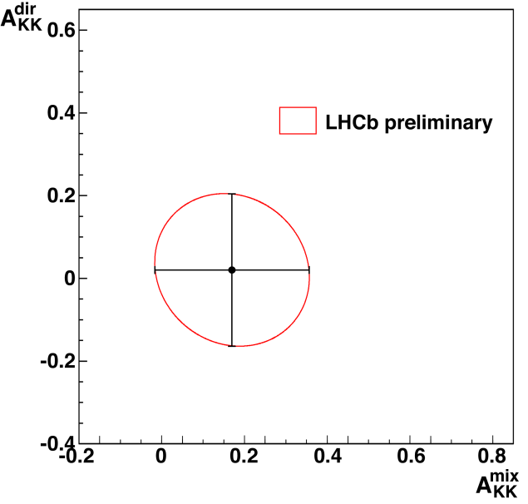
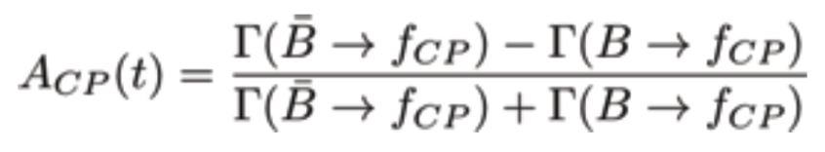
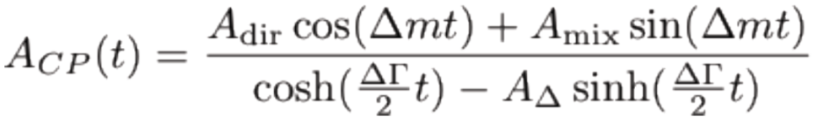
Measurements of γ : Loop-level decays
  LHCb has already provided several results in the field:
    Time-integrated CP asymmetries B → K π: [PRL 108 (2012)201601] 0.35fb⁻¹
      B_{d} → K π: world’s best (6σ) significance of the direct CP asymmetry.
      B_{s} → πK: first evidence of direct CP asymmetry (3 σ).
    Time-dependent CP asymmetries B → ππ/KK : 0.67 fb⁻¹
      B_{d} → ππ: measurement favors BaBar results.
      B_{s} → KK: first ever measurement in this channel
      [LHCb-CONF-2012-007]
A^{dir}_{ππ} = 0.11 ± 0.21 ± 0.03
A^{mix}_{ππ} = -0.56 ± 0.17 ± 0.03
A^{dir}_{KK} = 0.02 ± 0.18 ± 0.04
A^{mix}_{KK} = 0.17 ± 0.18 ± 0.05

Slide 22
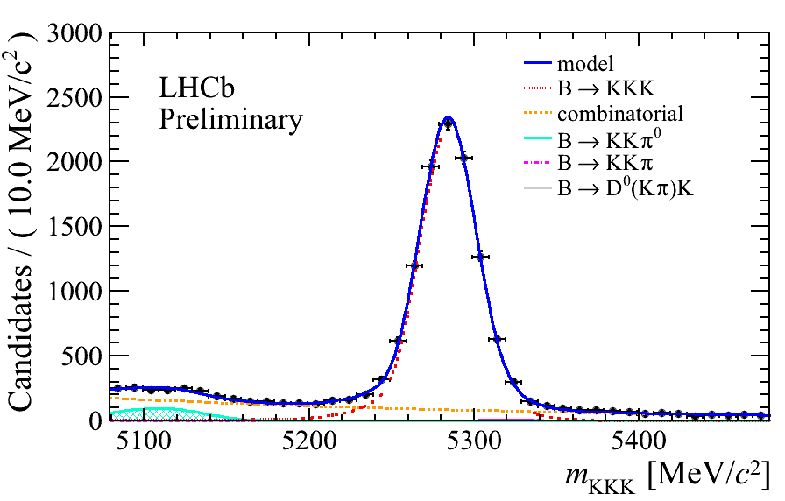
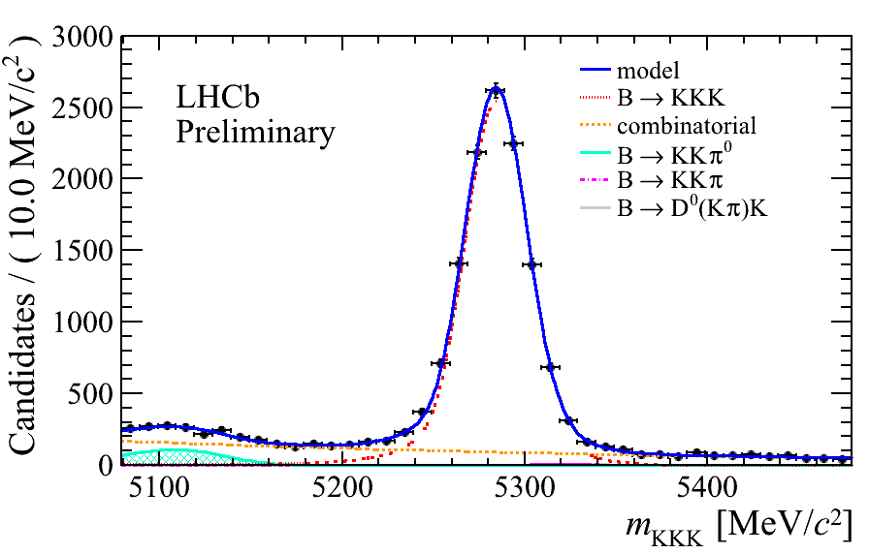
Measurements of γ : Loop-level decays
    Time-integrated CP asymmetries: B_{u} → hhh ( Kππ, KKK, πππ)
      [LHCb-CONF-2012-028, LHCb-CONF-2012-018] 1 fb⁻¹:
      Several first observations of CP violation.
      Study of asymmetries in localized regions.
B⁻
B⁺
      Asymmetries observed and well controlled using control channels (B → J/ψ K).
    A_{CP}(Kππ) = 0.034 ± 0.009(stat) ± 0.004(syst) ± 0.007
    Several first observations are made in B_{s} → K_{s}hh [LHCb-CONF-2012-23]
      Good prospects for future analyses
assumption of no CP violation in B → J/ψ K

Slide 23
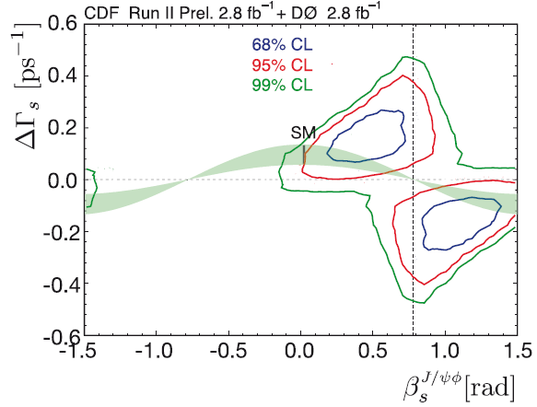

φ_{s} measurements
CDF: 2.8 fb⁻¹ + D0: 2.8 fb⁻¹
2.3 σ consistency with SM
*
V_{ts}V_{tb}
*
β_{s}
V_{us}V_{ub}
*
V_{cs}V_{cb}
B_{S}⁰ → J/ψ φ
B_{s}

Slide 24










CP violation in B_{s} → J/ψ X
The interference between B_{s} decay to J/ψX with or without mixing gives rise to a CP violating phase φ_{s}.
  It is a sensitive probe of New Physics:
    It is well calculated in the SM:
      φ_{s}SM= φ_{s}^{M} – 2φ_{s}^{D} ≈ -2β_{s}= -2arg(-V_{ts}V_{tb}*/V_{cs}V_{cb}*) = -0.037±0.002
    New particles can contribute to the B_{s}-B_{s} box diagrams and significantly modify the SM prediction adding large phases:
      φ_{s}= φ_{s}SM + φ_{s}^{NP}
φ_{D}≈0
B_{s}
J/ψX
φ_{M}
B_{s}
-φ_{D}≈0
$$\overline{b}$$
$\overline{u}$, $\overline{c}, \overline{t}$
$\overline{d}$, $\overline{s}$
$$B^{0}$$
$$W^{+}$$
$$W^{−}$$
$$\overline{B^{0}}$$
+NP?
$$d, s$$
$$u, c, t$$
$$b$$

Slide 25
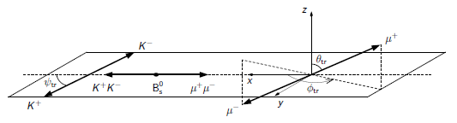
Golden channel: B_{s} → J/ψ(μ⁺μ⁻)φ(K⁺K⁻)
  Theoretically and experimentally clean
    Relatively large branching ratio and clean topology
  It is not a pure CP eigenstate (P→ VV decay)
    2 CP even, 1 CP odd amplitude
      Needs flavour-tagged, time-dependent angular analysis to disentangle CP-even and CP-odd components
        Initial states must be tagged
        Final states need to be statistically separated through angular analysis
      Mistag and proper time resolution are crucial…
        Use opposite side tag: Power=(2.35 ± 0.06 (stat))% [LHCb-CONF-2012-026]
      3 angles in the transversity rest frame:
cos ψ_{tr}: kaons
cos θ_{tr}, cos ϕ_{tr} : muons
φ rest frame
J/ψ rest frame

Slide 26
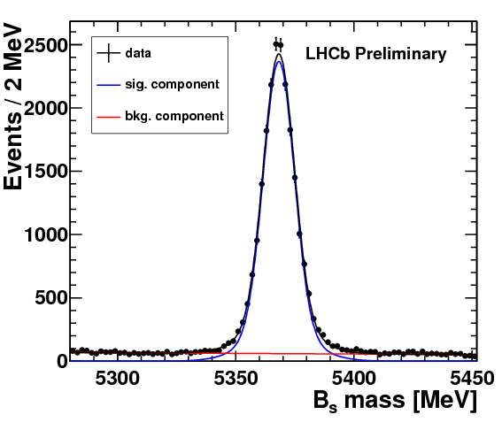
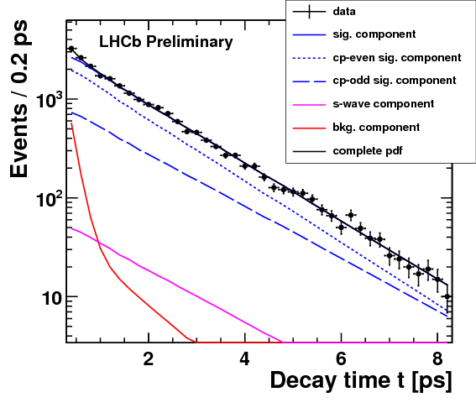
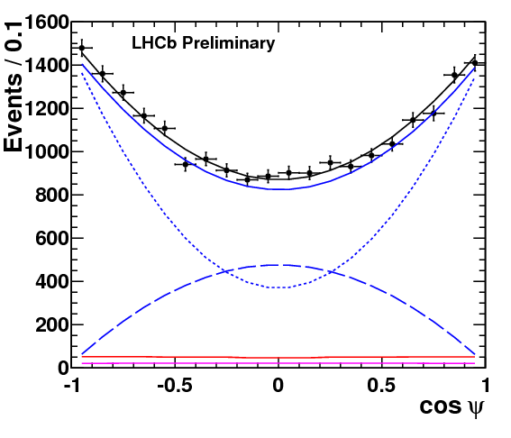
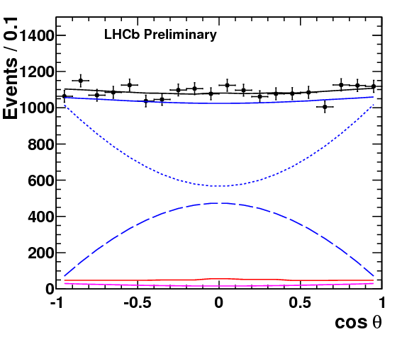
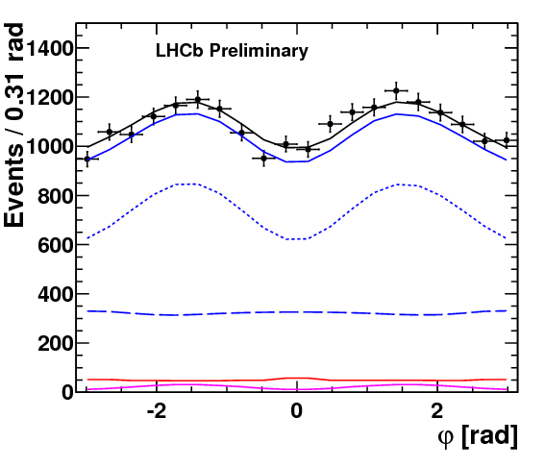
CP violation in B_{s} → J/ψ φ
  6 observables: 3 angles + invariant mass, B_{s} flavour, proper time
  Analysis based on 1.0 fb⁻¹ [LHCb-CONF-2012-002]
    21k signal events
      world's largest sample
    Only few % background
    Fit cleanly separates
    CP even/odd components
    Different lifetimes clearly
    visible in fit projection
CP-even
CP-odd
B
S-wave-odd
Invariant mass + B_{s} flavour
Proper time
CP-even
CP-even
CP-even
CP-odd
CP-odd
CP-odd
B
S-wave-odd
B
S-wave-odd
B
S-wave-odd
Angles of the decay products
S-wave-odd: Non-resonant Bs→ J/ψKK

Slide 27
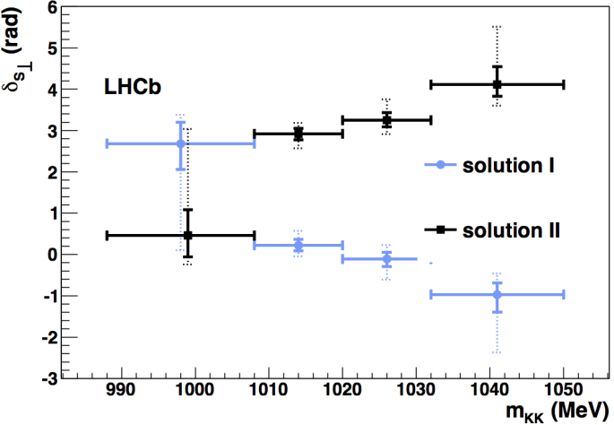
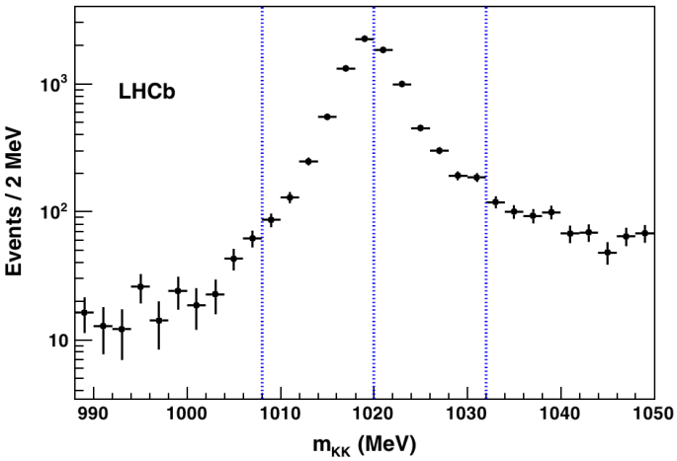
CP violation in B_{s} → J/ψ φ
  But: Two-fold intrinsic ambiguity
(φ_{s},ΔΓ_{s},δ//,δ⊥δ_{s}) ⇔ (π-φ_{s},-ΔΓ_{s},-δ//,π-δ⊥,-δ_{s}) δ_{s⊥} ⇔ -π -δ_{s⊥}
    Study strong phase difference δ_{s⊥}= δ_{s}- δ⊥ between K⁺K⁻ P-wave and S-wave amplitudes as a function of m(K⁺K⁻) around the φ(1020)
      S-wave: non-resonant + tail from f₀(980)
        Expect no significant variation of phase
      P-wave: φ(1020), going through resonance
        Expect rapid positive phase shift
  Analysis based on 0.37 fb⁻¹
    Determine δ_{s⊥} in four K⁺K⁻ mass bins
    [PRL 108 (2012) 241801]
  Solution corresponding to ΔΓ_{s} > 0
  preferred with 4.7 σ significance

Slide 28
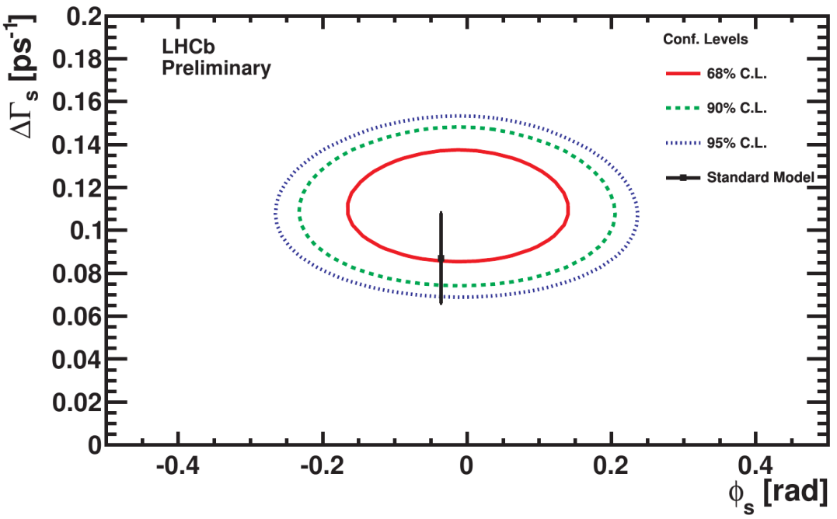
CP violation in B_{s} → J/ψ φ
Results [LHCb-CONF-2012-002]
  Simultaneous fit with ΔΓ_{s}=Г_{L} – Г_{H} lifetime difference between CP eigenstates
  ϕ_{s}= −0.001± 0.101(stat)± 0.027(syst) rad
  Result consistent with Standard Model prediction
  ΔΓ_{s}= 0.116 ± 0.018(stat)± 0.006(syst) ps⁻¹
  First observation (> 5 σ) of ΔΓ_{s} ≠ 0
  Both results dominated by statistical uncertainties

Slide 29
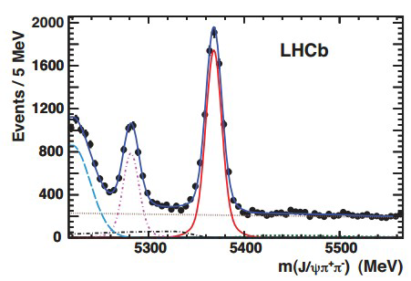
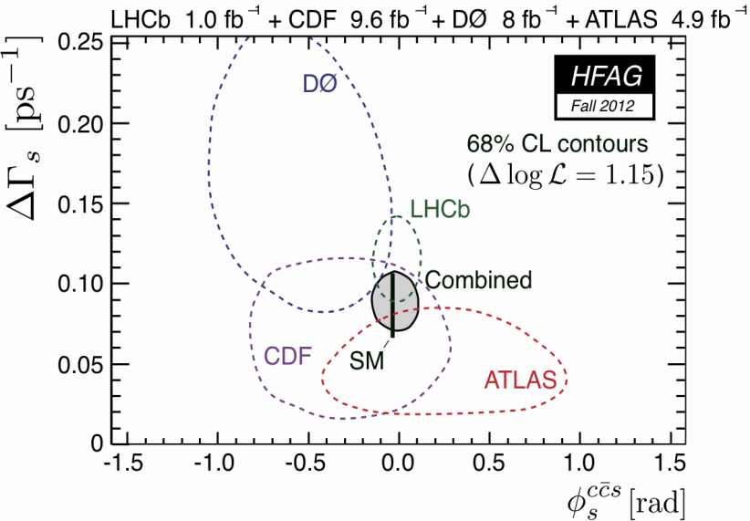
φ_{s} measurements
  φ_{s} measurement in B_{s} → J/ψ π⁺π⁻
    [PLB 713 (2012)378]
    Dominated by f₀(980) → π⁺π⁻
    Lower BR than B_{s} → J/ψ φ
    Purely CP-odd eigenstate
      No angular analysis needed!
    ϕ_{s}= −0.019± 0.17(stat)± 0.004(syst) rad
  Simultaneous fit of B_{s} → J/ψφ and B_{s} → J/ψ π⁺π⁻
    [LHCb-CONF-2012-002]
    ϕ_{s}= −0.002± 0.083(stat)± 0.027(syst) rad
    Most precise measurement
    In perfect agreement with the SM
B⁰
B_{s} → J/ψ π⁺π⁻
7421±105 events

Slide 30
CP Violation in charm
LHC is also a charm factory: σ_{cc} ~ 20 σ_{bb} !
Is charm a background or a physics signal for LHCb?
  Good efficiency due to moderate high-p_{T} trigger requirements
CPV in charm predicted to be O(10⁻³) in SM
  But long distance effects are difficult to estimate …

Slide 31
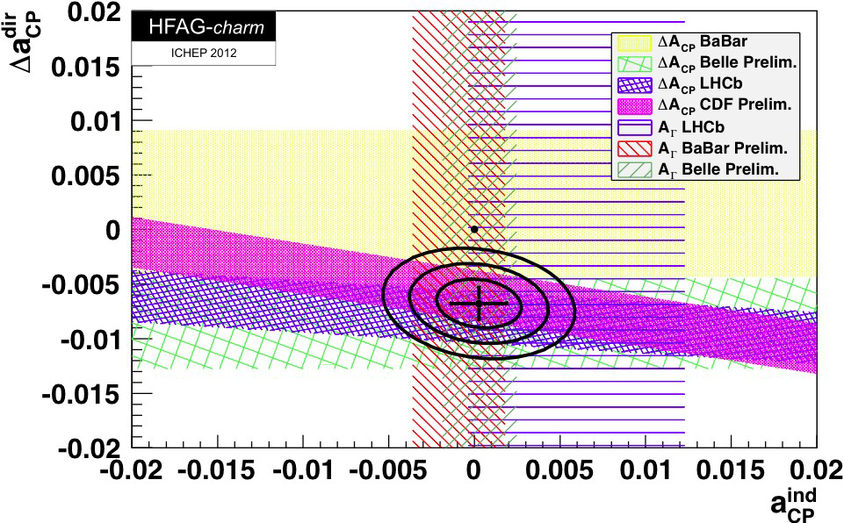
Time integrated A_{CP} in charm
    The charge of π±_{s} from D^{*+} → D⁰ π⁺_{s}, D^{*-} → D⁰ π⁻_{s} tags the D flavour
    But A_{raw}(f) depends about production and detection asymmetries
      This vanishes for the difference of a flavour symmetric final states:
      ΔA_{CP}= A_{CP}(π⁺π⁻) - A_{CP} (K⁺K⁻) ≈ A_{raw}(π⁺π⁻) - A_{raw} (K⁺K⁻)
  LHCb measurement (0.6 fb⁻¹):
    [PRL 108 (2012) 111602]
      1.4 M tagged D⁰ → K⁺K⁻
      0.4 M tagged D⁰ → π⁺π⁻
  ΔA_{CP}= (-0.82 ± 0.21(stat) ± 0.11(sys))%
    3.5 significance: first evidence!
    Non-zero ΔA_{CP} confirmed by:
      CDF (2.7 σ) [CDF note 10784]
      Belle (2.1 σ): [Byeong Rok Ko @ ICHEP 2012]
Signal window

Slide 32
Charm mixing measurement
Charm mixing:
  Should be very small in SM
  It has been confirmed by BaBar, Belle & CDF
    But no clear observation in a single experiment.
  The oscillation is very slow
  LHCb Measurement of the time-dependent ratio of D⁰ decays to Wrong Sign to Right Sign (1 fb⁻¹): [arXiv:1211.1230]
    The charge of π±_{s} from D^{*+} → D⁰ π⁺_{s}, D^{*-} → D⁰ π⁻_{s} tags the D flavour
    R(t) flat in decay time ⇒ no mixing
    R(t) not flat (parabolic shape) in decay time ⇒ mixing !

Slide 33
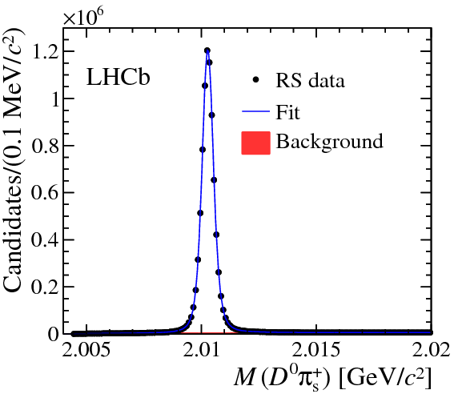
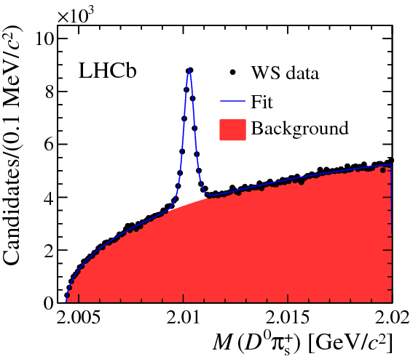


Charm mixing measurement with LHCb
D⁰ → K⁻ π⁺
D⁰ → K⁺ π⁻
R_{D}=
BR(D⁰ → K⁺ π⁻)
BR(D⁰ → K⁻ π⁺)
R_{D}= (3.52 ± 0.15)10⁻³
~8.4 M
~36 k
  The no mixing hypothesis is now excluded at the 9.1σ level in a single experiment
Ratio in all bins of decay time

Slide 34






(very) Rare decays

Slide 35



Radiative decays
  Theory
      Predictions for BR suffer from large uncertainties from hadronic form factors
        B⁰ → K* γ = (4.3±1.4)x10⁻⁵ ; B_{s} → ϕ γ = (4.3±1.4)x10⁻⁵
      Ratio of BR and direct CP asymmetries are better known
  LHCb measurements (1 fb⁻¹) [NP B 867 (2012) 1]
N _{B0 → K* γ} = 5279 ± 93
N _{Bs → ϕ γ} = 691 ± 36
B⁰ → K* γ
B_{s} → ϕ γ
  R_{BR} = 1.23 ± 0.06 ± 0.04 ± 0.10(f_{s}/f_{d})
    Th: 1.0 ± 0.2
  A_{CP}(B⁰ → K* γ) = (0.8 ± 1.7 ± 0.9)%
    Th: (-0.61 ± 0.43)%
  WB measurements
Invariant mass resolution: ~90 MeV/c²
BR(B_{s} → ϕ γ) = (3.5 ± 0.4)x10⁻⁵
    No sizeable deviation from SM

Slide 36



B_{d}→K^{*0}μ⁺μ⁻
Flavour Changing Neutral Current Decay
  In SM: b → s electroweak penguin
  NP diagrams could contribute at same level
    Sensitive to magnetic and vector and axial semi-leptonic penguin operators
gluino, chargino,
neutralino, ?
Higgs, ?
  Forward-backward asymmetry A_{FB}(q²)
    In the μμ rest-frame is sensitive NP probe
    Zero of A_{FB}(q²) is of particular interest
  LHCb has largest sample in world, as clean as the B Factories!
900 ± 34 events
[LHCb-CONF-2012-008]

Slide 37

B_{d}→K^{*0}μ⁺μ⁻
  Decay described by 3 angles θ_{l}, φ, θ_{K} and di-μ invariant mass q²
  In the Standard model, A_{FB} changes sign at a well defined q² point
    No hadronic uncertainties
    q²₀ = 4.36 GeV² [EPJ. C 41 (2005) 173]
  LHCb measures (1fb⁻¹): preliminary
    [LHCb-CONF-2012-008]
  q²₀ = 4.9 GeV²
+0.33
-0.31
+1.1
-1.3
68% c.l.

Slide 38



Isospin asymmetry in B → K^{(*)} μ⁺μ⁻
The isospin asymmetry is defined as:
  Predicted to be very small in SM
  LHCb measurement (1 fb⁻¹): [JHEP 7 (2012) 133]
A_{I}(B → K μ⁺μ⁻ ): 4.4 σ deviation from 0 (integrated over q²)!
No similar effect seen in
A_{I}(B → K* μ⁺μ⁻ ) ~0 …
More data to come!

Slide 39



Search for K⁰_{S} → μ⁺μ⁻
  FCNC decay not yet observed:
    SM: BR = (5.0 ± 1.5) x 10⁻¹²
    Best limit (1973): BR < 3.2 x 10⁻⁷ @ 90% c.l.
    LHCb analysis (1 fb⁻¹): [arxiv:1209.4029v2]
      The Peaking background from K⁰ → π⁺ π⁻ decays is shifted due to μ - π mass difference.
        Good mass resolution helps containing it.
      K⁰_{S} → π⁺ π⁻ is used for normalization
μμ
hypothesis
ππ
hypothesis
K⁰_{S} → µ⁺µ⁻
  Use CLs method to determine an upper limit on the BR:
  BR(K⁰_{S} → μ⁺ μ⁻) <
  11(9) x10⁻⁹ @ 95% (90%) c.l.
    Factor 30 improvments vs previous result!
Expected bgd-only
1 σ (2 σ) bands
observed
Signal window

Slide 40

B_{(s)}→μ⁺μ⁻
  Decay strongly suppressed (helicity) in SM
    Well predicted in the SM:
      BR(B_{s} → μ⁺μ⁻)=(3.5 ± 0.3) ×10⁻⁹
      BR(B⁰ → μ⁺μ⁻)=(0.11 ± 0.01) ×10⁻⁹
        [arXiv:1208:0934 & PRL 109 041801 (2012)]
    Sensitive to New Physics; could be strongly enhanced in SUSY
SM
?
SM
MSSM
?
~ tan⁶β/M_{H}²
    Experimentaly easy to reconstruct
      Fully reconstructable leptonic final state
      Searching it for a long time!

Slide 41

B_{(s)}→μ⁺μ⁻
  A long quest for B_{s}→μ⁺μ⁻
    First attempt by CLEO (1984)
      BR(B⁰→μ⁺μ⁻) < 2x10⁻⁴ (90%CL)
    And ARGUS (1987)
      BR(B⁰→μ⁺μ⁻) < 5x10⁻⁵(90%CL)
    Situation before October 2012 (95%CL):
      ATLAS: BR(B_{s}→μ⁺μ⁻) < 22x10⁻⁹
      CMS: BR(B_{s}→μ⁺μ⁻) < 7.7x10⁻⁹
      LHCb: BR(B_{s}→μ⁺μ⁻) < 4.5x10⁻⁹
        [PRL 108 (2012) 231801]
      LHC combination
      BR(B_{s}→μ⁺μ⁻) < 4.2x10⁻⁹
      BR(B_{d}→μ⁺μ⁻) < 8.1x10⁻¹⁰

Slide 42


First evidence of B_{s}→μ⁺μ⁻
  LHCb measurement (2.1 fb⁻¹) 2011 (7 TeV) + ½ 2012 (8 TeV) data: [arXiv:1211.2674]
    Selection based on multivariate estimator (BDT) combining vertex and geometrical information
    2-dimensional analysis with blinded signal mass region
      Boosted decision tree based on topological variables
      Dimuon invariant mass
    B_{(s)}→h⁺h⁻ are used as calibration
    B⁺ →J/ψ (μ⁺μ⁻)K⁺ and B⁰ → K⁺π⁻ as normalization
  3.5 σ observation of the signal!
Cut on BDT>0.7
B_{s} region
B_{d} region

Slide 43


First evidence of B_{s}→μ⁺μ⁻
  Branching fraction is measured
  BR(B_{s}→μ⁺μ⁻) = (3.2 (stat) (syst))x10⁻⁹
  Double sided limit (@95% CL)
    1.1x10⁻⁹ <BR(B_{s}→μ⁺μ⁻)< 6.4x10⁻⁹
  Tightest upper limit is set
  BR(B_{d}→μ⁺μ⁻) < 9.4x10⁻¹⁰ @95% c.l.
  Results compatible with SM
  Constraints on new physics models
+1.4
-1.2
+0.5
-0.3
Observed
Expected bkg
Expected SM + bkg
  A large part of the TeV-scale SUSY is excluded
    However there are still a number of models, which behave in the same way in this point
Based on arXiv:1205.6094v1 [hep-ph]

Slide 44


A B_{s}→μ⁺μ⁻ candidate event
μ⁺
μ⁻
μ⁺
B_{s}
PV
μ⁻
M_{μμ}=5.353 GeV/c², BDT =
Decay length = 20.51 mm
Tracks shown for p_{T}>0.5 GeV/c

Slide 45
conclusion

Slide 46
Conclusions
  Excellent LHC & LHCb performances: a huge success!
    They are working spectacularly well
  A lot of interesting LHCb results:
    In the B_{d} sector results (γ, etc.) are competitive with B factories
    Lots of “most precise“ measurements and “first observations“ with 1 year of data taking
    Interesting results in Charm physics:
      Is that the NP could be revealed here?
    First evidence of B_{s}→μ⁺μ⁻ after a quest of more than 25 years!
  We are almost everywhere limited by statistical error
    Many analyses have to still process x2 data compared to now
    Much more data to come after LS1 (till 2017), with increased cross section
      And specially after the upgrade!
  No Standard Model disagreement yet …
  We are poised for a long and exciting physics program !!!

Slide 47
Thank you!

Slide 48

Future:
LHCb upgrade
50 ns
LS1
25 ns
LS2
25 ns
Start-up 2010 2011 2012 2013 2014 2015 2016 2017 2018 2019 … 20xx
√s (TeV) = 0.9 - 7 - 8 - 13
L (cm⁻²s⁻¹) = 10³² 3-4x10³² 4x10³² 10 - 20 10³²
3 fb⁻¹
~3 fb⁻¹
> 50 fb⁻¹

Slide 49

LHCb upgrade
Why:
  No (not yet) deviation observed from The Standard Model …
    We need more statistics!
  LHCb has demonstrated its ability to perform precise measurements in an hadronic environment:
    Almost all LHCb results are completely dominated by statistical uncertainties
      Leading systematic uncertainties will also decrease with increasing statistics
    Current limitations are due to the 1 MHz L0 trigger/readout systems
      To keep output rate < 1 MHz requires raising thresholds
        Rate for hadrons saturate at 4x10³²
    Upgrade of LHCb detector planned for 2019 to take at least 10xmore data: 50 fb⁻¹ (over 10 years) running at L = 1-2x10³³ cm⁻²s⁻¹

Slide 50
LHCb upgrade
How: [CERN-LHCC-2011-001, CERN-LHCC-2012-007]
  Remove the hardware trigger
    Read out detector at 40 MHz (bunch crossing rate).
    Trigger fully in software in CPU farm.
    Requires replacing front-end electronics
  This will allow to operate the detector at x 5 higher luminosity
    Requires new main tracker to cope with particle densities
  Both together will give a factor > 10 increase in rate for hadronic channels
  Framework TDR submitted to the LHCC in May 2012:
    Physics case enthusiastically endorsed in September 2012
    Detector R&D underway

Slide 51

LHCb upgrade
    2013: R&D, technology choices, preparation of sub-system TDRs
    2014: funding, procurements
    2015-2019: construction and installation

Slide 52

LHCb upgrade
LHCb upgrade sensitivities for 50 fb⁻¹ [arXiv:1208.3355]
  From “exploration” to “precision” studied

Slide 53

The LHCb collaboration
17 countries
63 Institutes
~800 members
84 publications
102 Conference notes
  Most results based on 2011 data, many more results will come soon!

