Slide 1
Ultra-peripheral collisions with ALICE
Workshop on results and prospects of forward physics at the LHC
Evgeny Kryshen
on behalf of the ALICE collaboration
Petersburg Nuclear Physics Institute, Gatchina, Russia
12 February 2013

Slide 2
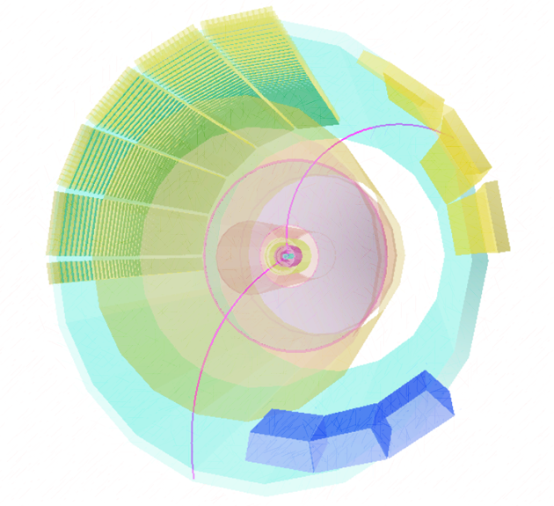
Contents
Ultra-peripheral physics potential
ALICE results on ultra-peripheral Pb-Pb collisions (UPC):
  J/ѱ at forward rapidity:
  Phys. Lett. B718 (2013) 1273
  J/ѱ at central rapidity
  ρ⁰ at central rapidity
Prospects of pA UPC
Summary

Slide 3
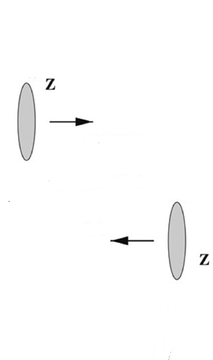
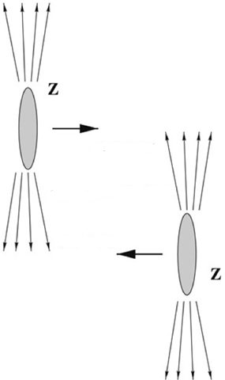
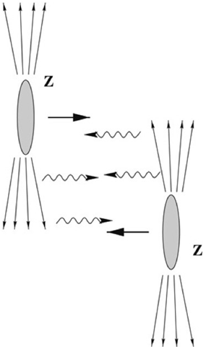
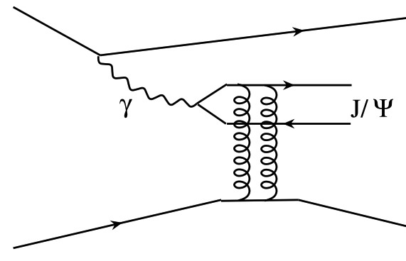
LHC as a γPb collider
b
R
Coherent vector meson production:
photon couples coherently to all nucleons
⟨ p_{T}⟩ ~ 1/R_{Pb} ~ 60 MeV/c
no neutron emission in ~80% of cases
Incoherent vector meson production:
photon couples to a single nucleon
⟨ p_{T}⟩ ~ 1/R_{p} ~ 450 MeV/c
target nucleus normally breaks up
Ultra-peripheral (UPC) collisions: b > 2R
→ hadronic interactions strongly suppressed
High photon flux ~ Z²
→ well described in Weizsäcker-Williams approximation
→ high σ for γ-induced reactions
  e.g. exclusive vector meson production
Recent review on UPC physics: Phys. Rept. 458 (2008) 1-171

Slide 4
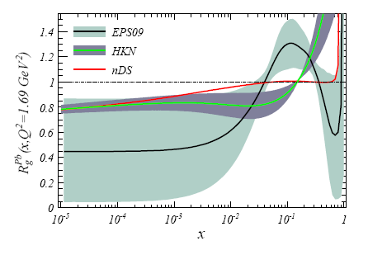
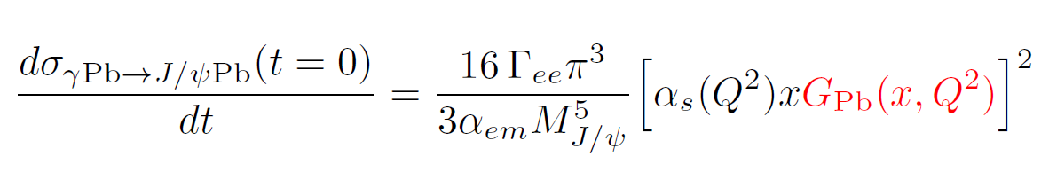
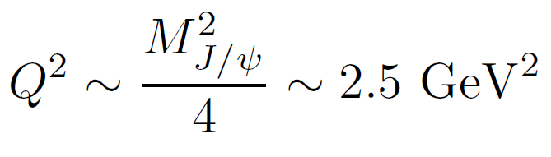
Why UPC in ALICE?
Why UPC?
Quarkonia photoproduction allows to study the gluon density G(x; Q²) in Pb
LO pQCD: forward coherent photoproduction cross section is proportional to the squared gluon density:
Nuclear gluon shadowing factor vs x
Bjorken x ~ 10⁻² – 10⁻⁵ accessible at LHC
Quarkonium photoproduction in UPC is a direct tool to measure nuclear gluon shadowing!
Why ALICE?
Large pseudorapidity coverage: -4.0 < η < 5.1 + ZDC calorimetry
Trigger on J/ψ with p_{T} down to 0 MeV/c both at forward and central rapidity
Low pile-up

Slide 5
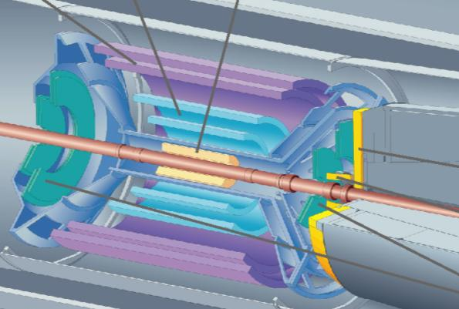
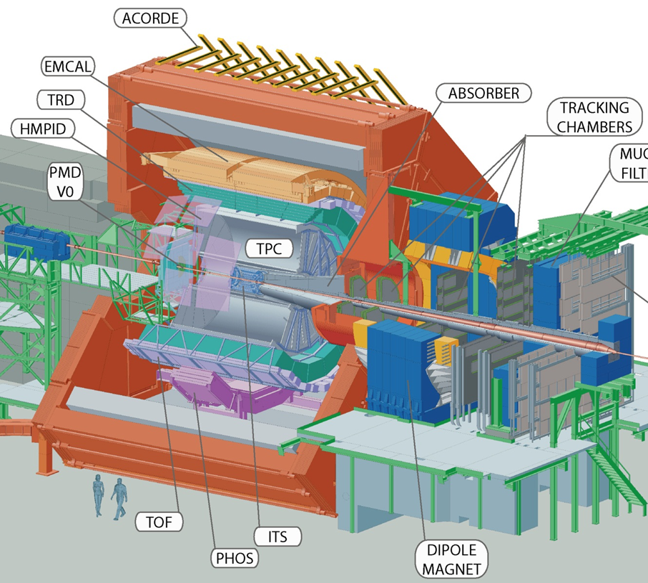
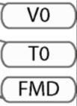
UPC J/ψ at forward rapidity
UPC forward trigger:
single muon trigger with p_{T} > 1 GeV/c (-4 < η < -2.5)
hit in VZERO-C (-3.7 < η < -1.7)
no hits in VZERO-A (2.8 < η < 5.1)
Integrated luminosity ~ 55 μb⁻¹
Offline event selection:
Beam gas rejection with VZERO
Hadronic rejection with ZDC and SPD
Track selection:
muon tracks: -3.7 < η < -2.5
matching with the trigger
radial position for muons at the end of absorber: 17.5 < R_{abs}< 89.5 cm
p_{T} dependent DCA cut
opposite sign dimuon: -3.6 < y < -2.6

Slide 6
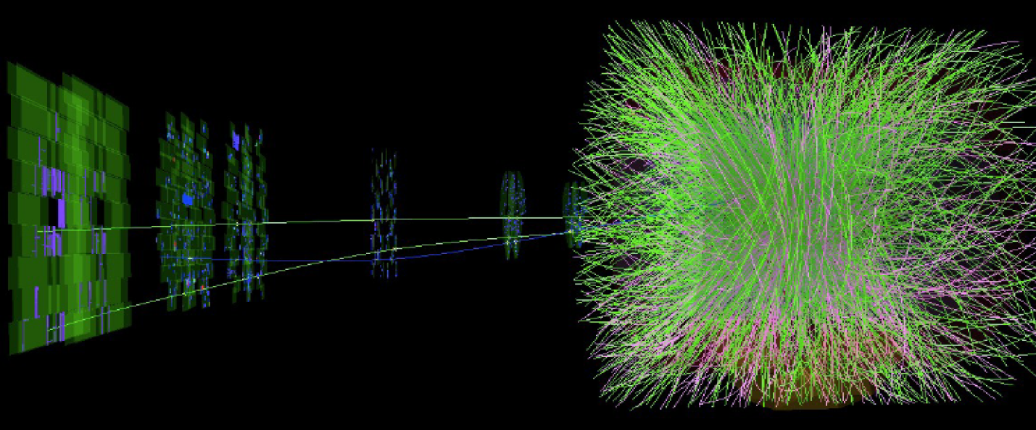
From typical hadronic PbPb collision…

Slide 7
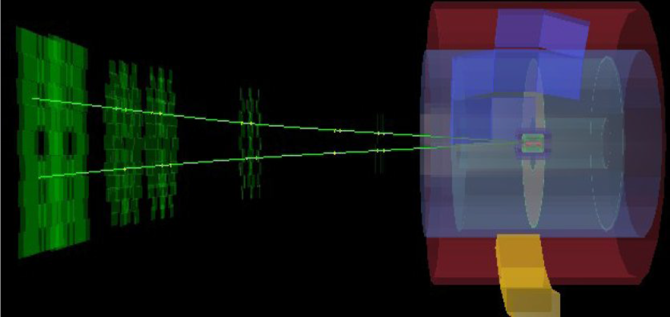
… to exclusive J/ψ

Slide 8
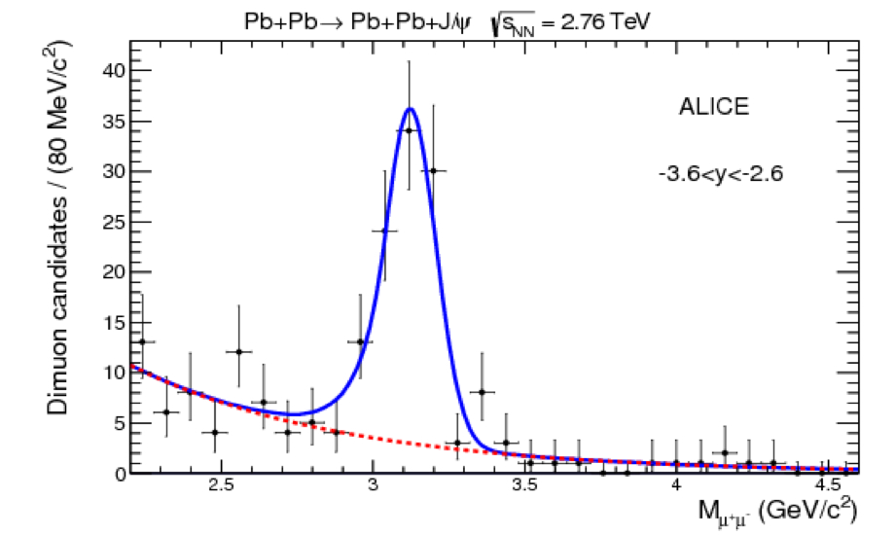
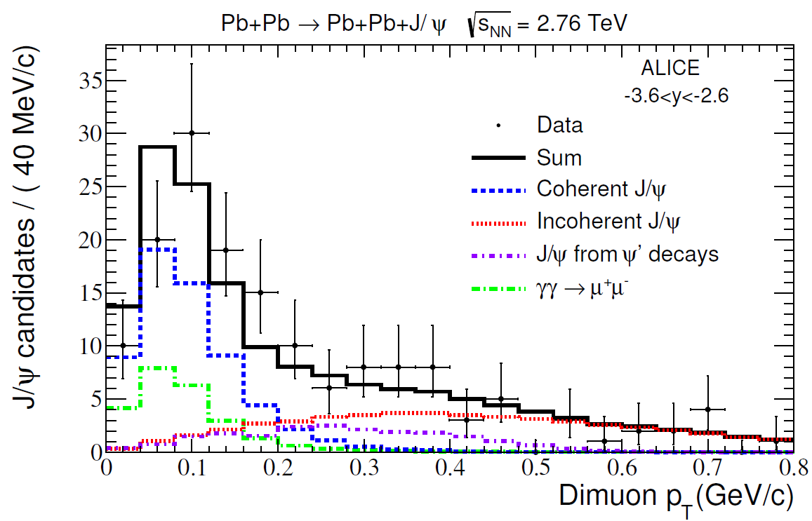
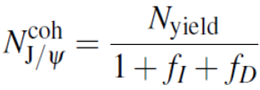

Invariant mass and p_{T} distributions
Invariant mass distribution:
p_{T}< 0.3 GeV/c
Clean spectrum: only 2 like-sign events
Signal shape fitted to a Crystal Ball shape
Background fitted to an exponential
Exponential shape compatible with expectations from γγ →μμ process
Four contributions in the p_{T} spectrum:
Coherent J/ψ
Incoherent J/ψ
J/ψ from ψ' decays
γγ →μμ
a)
b)
f_{I} = 0.12 $\begin{matrix}+ 0.14 \\ −0.04\end{matrix}$ - fraction of incoherent J/ψ in fig a.
f_{D} = 0.11 ± 0.06 - fraction of J/ψ from ψ' decays in fig a.

Slide 9

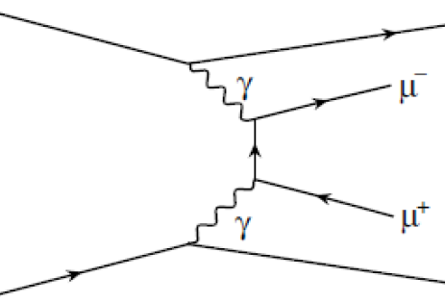
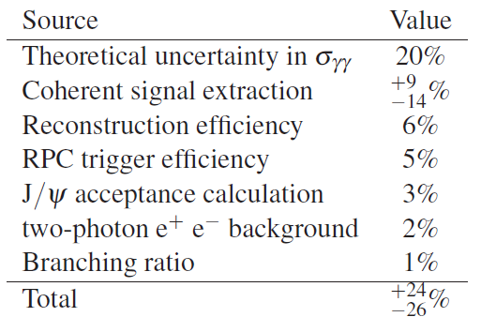
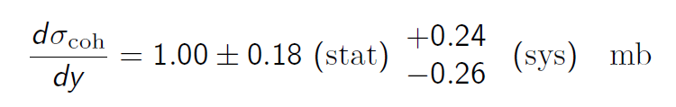
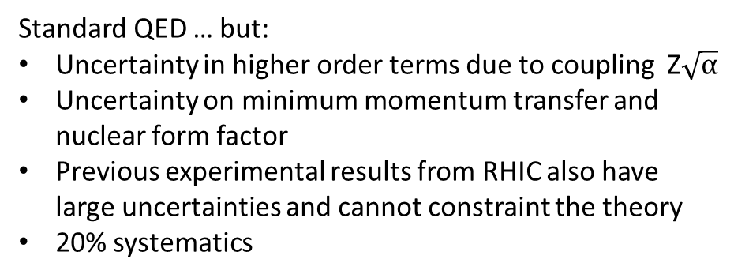
Coherent J/ψ cross section at forward rapidity
QED continuum pair production used for normalization:
Standard QED … but:
Uncertainty in higher order terms due to coupling Z$\sqrt{\text{α}}$
Uncertainty on minimum momentum transfer and nuclear form factor
Previous experimental results from RHIC also have large uncertainties and cannot constraint the theory
20% systematics
-3.6 < y < -2.6
ALICE collaboration. Phys. Lett. B718 (2013) 1273

Slide 10
UPC J/ψ at central rapidity
UPC central barrel trigger:
2 ≤ TOF hits ≤ 6 (|η| < 0.9)
+ back-to-back topology (150° ≤ ϕ ≤ 180°)
≥2 hits in SPD (|η| < 1.5)
no hits in VZERO (C: -3.7 < η < -1.7, A: 2.8 < η < 5.1)
Integrated luminosity ~ 20 μb⁻¹
Offline event selection:
Offline check on VZERO timing
Hadronic rejection with ZDC
Track selection:
Two tracks: |η| < 0.9
≥ 70 TPC clusters, ≥ 1 SPD clusters
p_{T} dependent DCA cut
opposite sign dilepton
|y| < 0.9, 2.2 < M_{inv} < 6 GeV/c²
dE/dx in TPC compatible with e/μ

Slide 11
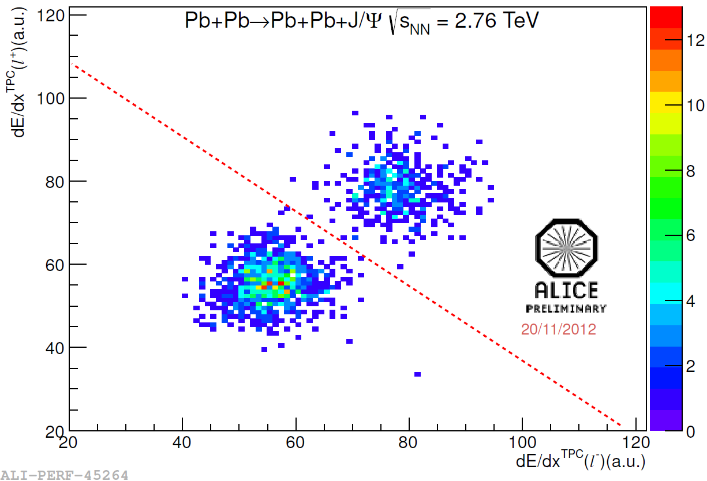
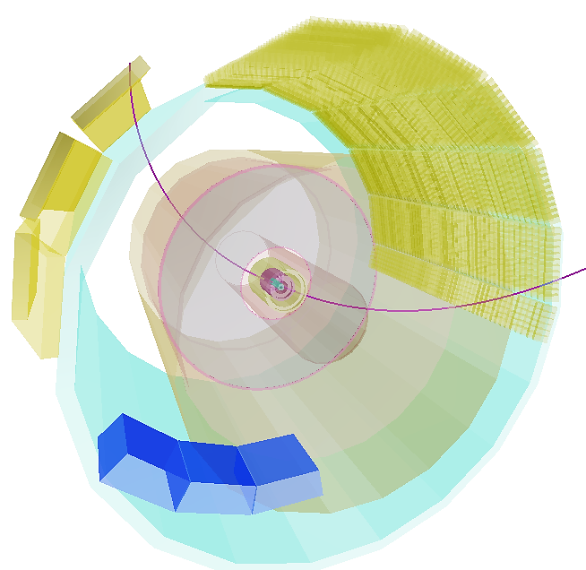
dE/dx selection in TPC
electrons
EMCAL
muons
dE/dx in TPC compatible with e/μ energy loss
Cross-checked with E/p in EMCAL
±2% systematics due to e/μ separation

Slide 12
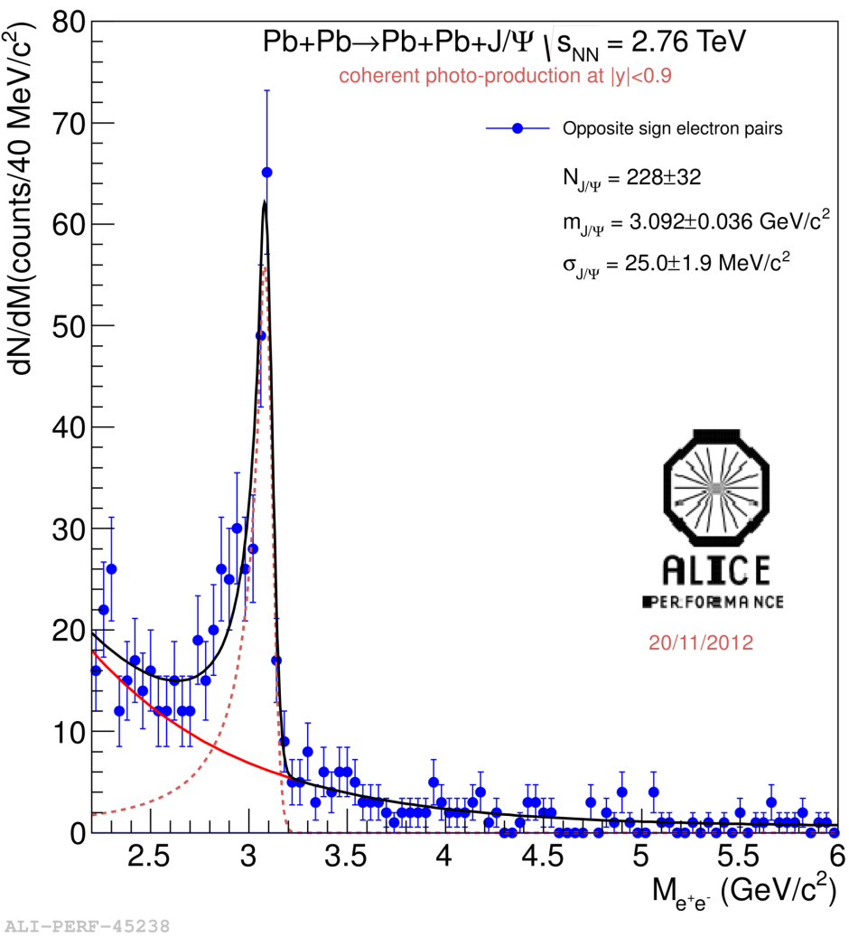
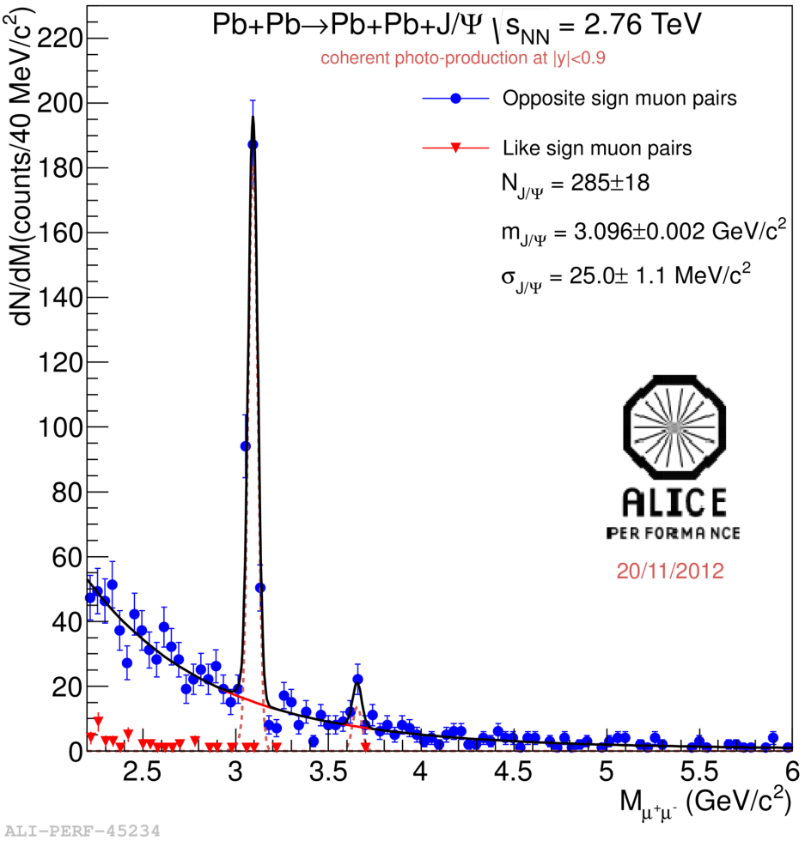
Coherent J/ψ
coherent enriched sample
dielectrons
p_{T} < 300 MeV/c
dimuons
p_{T} < 200 MeV/c

Slide 13
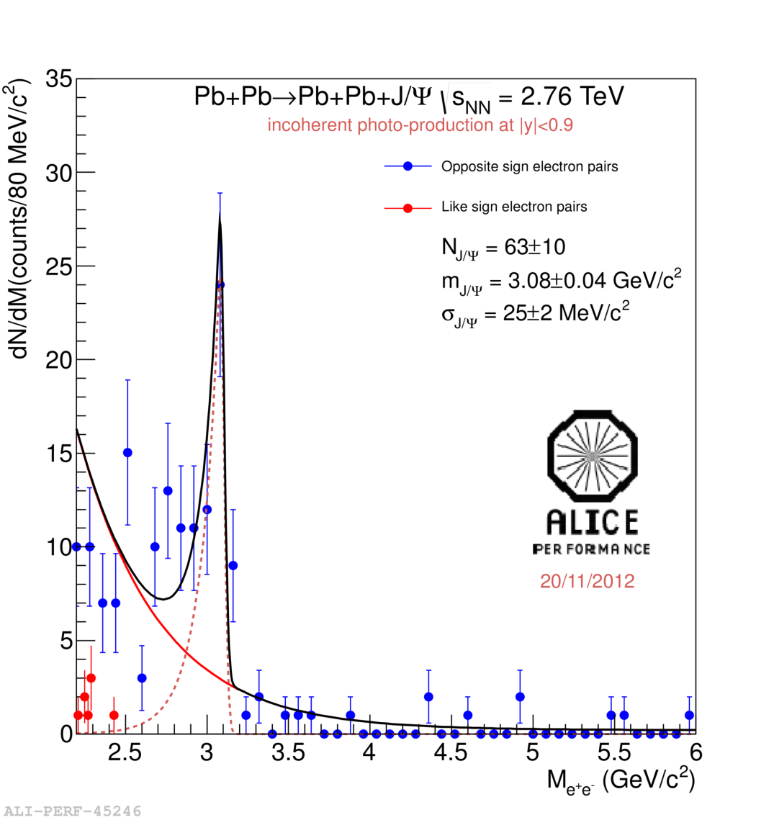
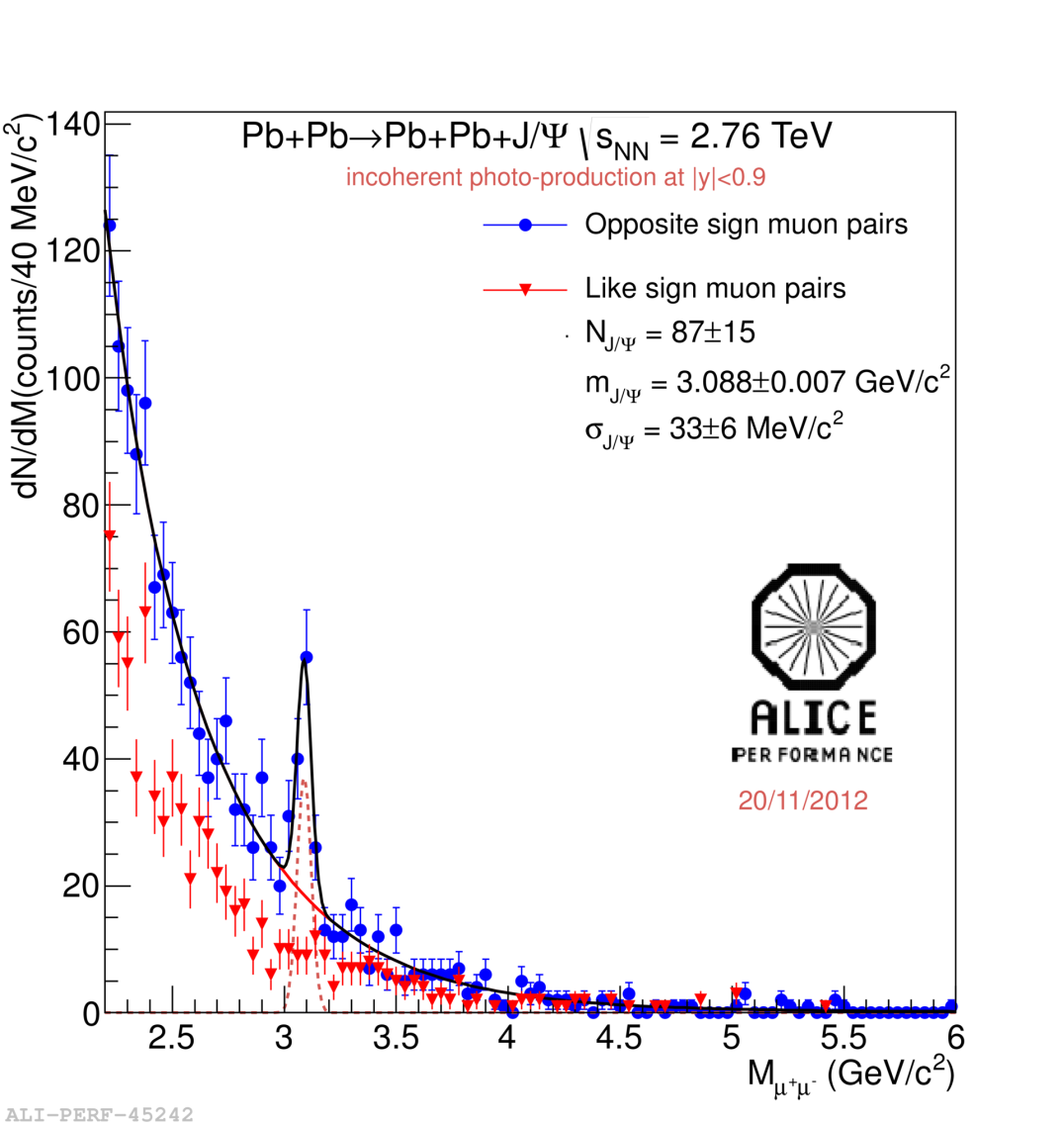
Incoherent J/ψ
incoherent enriched sample
dielectrons
p_{T} > 300 MeV/c
dimuons
p_{T} > 200 MeV/c

Slide 14
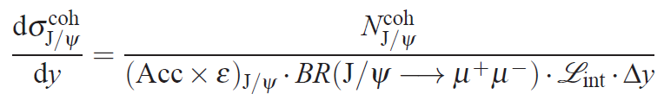
p_{T} distributions
6 components in the dilepton p_{T} spectrum:
coherent J/ψ
incoherent J/ψ: f_{I}
feed-down from coherent and incoherent ψ’: f_{D}
continuum γγ →ee(μμ) from the fit to invariant mass
hadronic J/ψ events constrained for p_{T}> 1.1 GeV/c

Slide 15
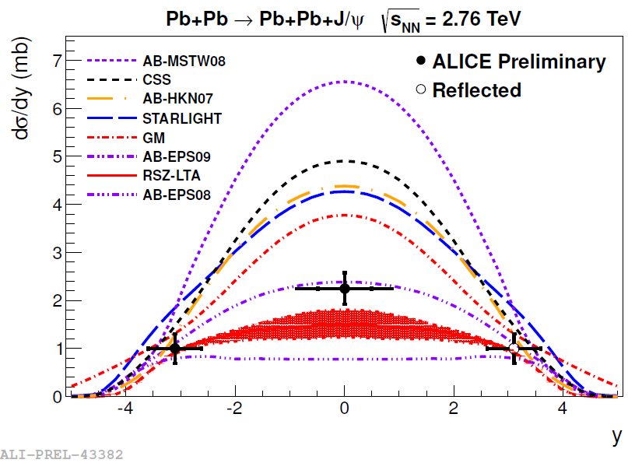
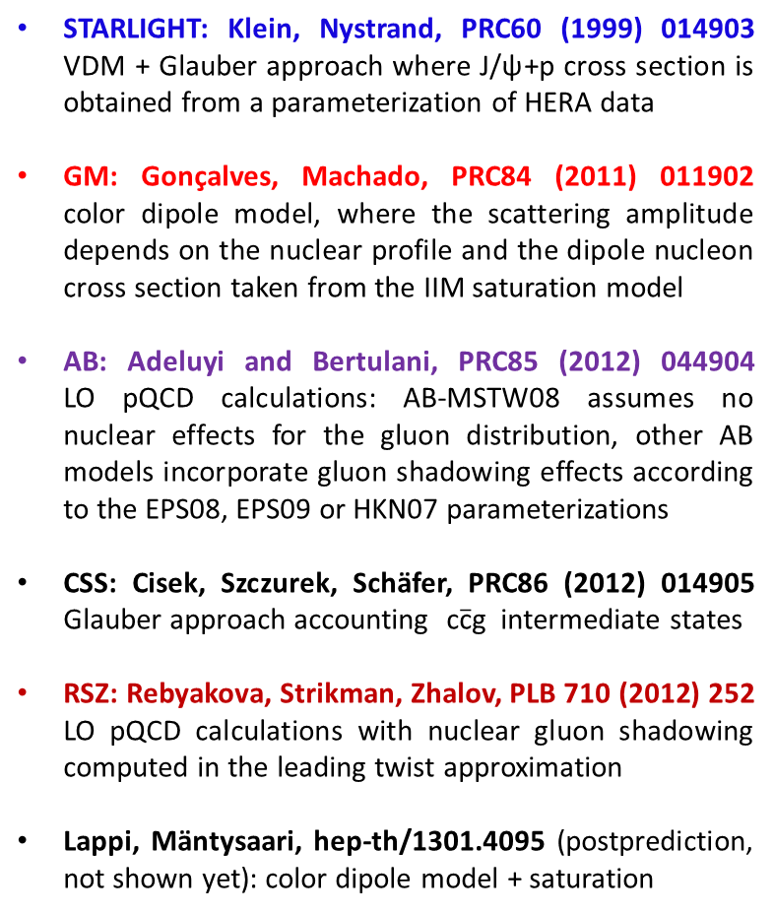
Coherent J/ψ: comparison to models
STARLIGHT: Klein, Nystrand, PRC60 (1999) 014903 VDM + Glauber approach where J/ψ+p cross section is obtained from a parameterization of HERA data
GM: Gonçalves, Machado, PRC84 (2011) 011902
color dipole model, where the scattering amplitude depends on the nuclear profile and the dipole nucleon cross section taken from the IIM saturation model
AB: Adeluyi and Bertulani, PRC85 (2012) 044904
LO pQCD calculations: AB-MSTW08 assumes no nuclear effects for the gluon distribution, other AB models incorporate gluon shadowing effects according to the EPS08, EPS09 or HKN07 parameterizations
CSS: Cisek, Szczurek, Schäfer, PRC86 (2012) 014905
Glauber approach accounting $\text{c}\overline{\text{c}}\text{g}$ intermediate states
RSZ: Rebyakova, Strikman, Zhalov, PLB 710 (2012) 252
LO pQCD calculations with nuclear gluon shadowing computed in the leading twist approximation
Lappi, Mäntysaari, hep-th/1301.4095 (postprediction,
not shown yet): color dipole model + saturation
x ~ 10⁻²
x ~ 10⁻³
Good agreement with models which include nuclear gluon shadowing.
Best agreement with EPS09 shadowing
(shadowing factor ~0.6 at x ~ 10⁻³, Q² = 2.5 GeV²)
+ incoherent J/ψ cross section and σ(γγ→µμ) … will be published soon…

Slide 16
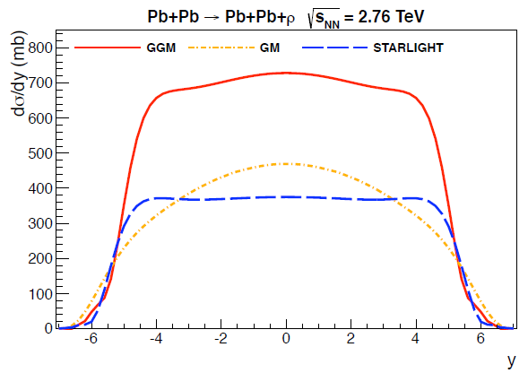
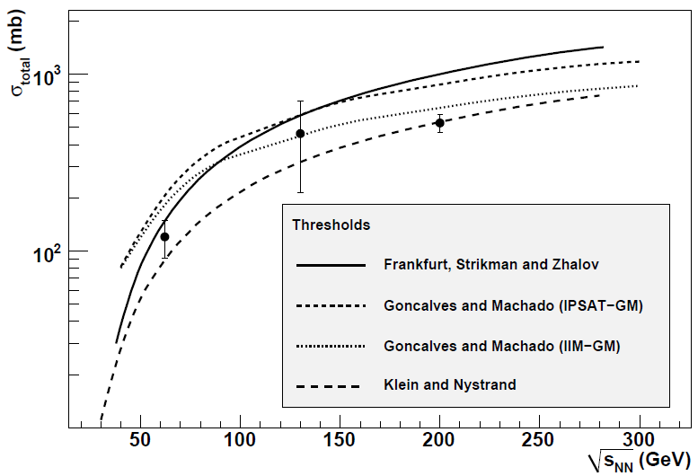
ρ⁰ photoproduction in PbPb
STAR: Phys. Rev. C85 (2012) 014910
720 mb
470 mb
380 mb
GGM: Frankfurt, Strikman, Zhalov, Phys. Lett. B 537 (2002) 51; Phys. Rev. C 67(2003) 034901
Generalized Vector Meson Dominance Model in the Gribov-Glauber approach.
Includes nondiagonal transitions γ → ρ’ → ρ
σ_{ρN} from Donnachie-Landshoff model, in agreement with HERA and lower energy data.
GM: Gonçalves, Machado, Phys. Rev. C 84 (2011) 011902
Based on the color dipole model in combination with saturation from a CGC model.
STARLIGHT: Klein, Nystrand, Phys. Rev. C 60 (1999) 014903, http://starlight.hepforge.org/
Uses experimental data on σ_{ρN} cross section.
Glauber model neglecting the elastic part of total cross section.

Slide 17
ρ⁰→ π⁺π⁻ at central rapidity
UPC central barrel trigger:
≥2 hits in TOF (|η| < 0.9)
≥2 hits in SPD (|η| < 1.5)
no hits in VZERO (C: -3.7 < η < -1.7, A: 2.8 < η < 5.1)
Integrated luminosity (2010 data) ~ 0.2 μb⁻¹
Offline event selection:
Offline check on VZERO timing
Hadronic rejection with ZDC
Track selection:
Track quality cuts
Vertex |v_{z}| < 10 cm
opposite sign ππ pair:
  |y| < 0.5
  p_{T} < 150 MeV/c
dE/dx in TPC compatible with π

Slide 18
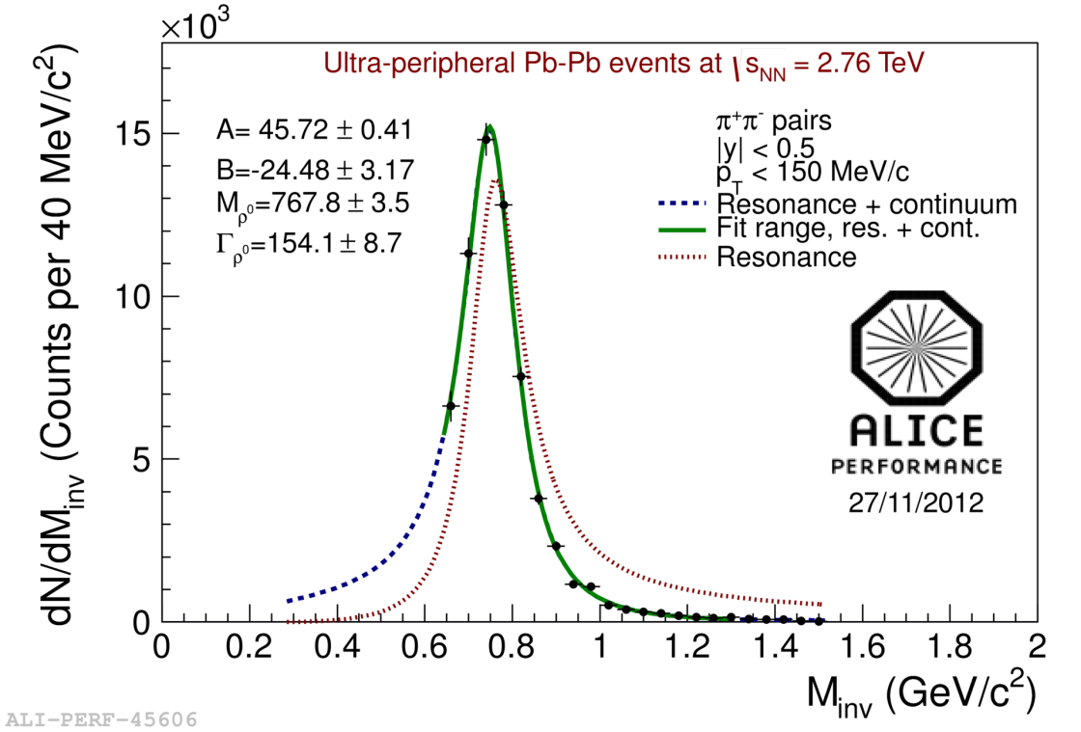
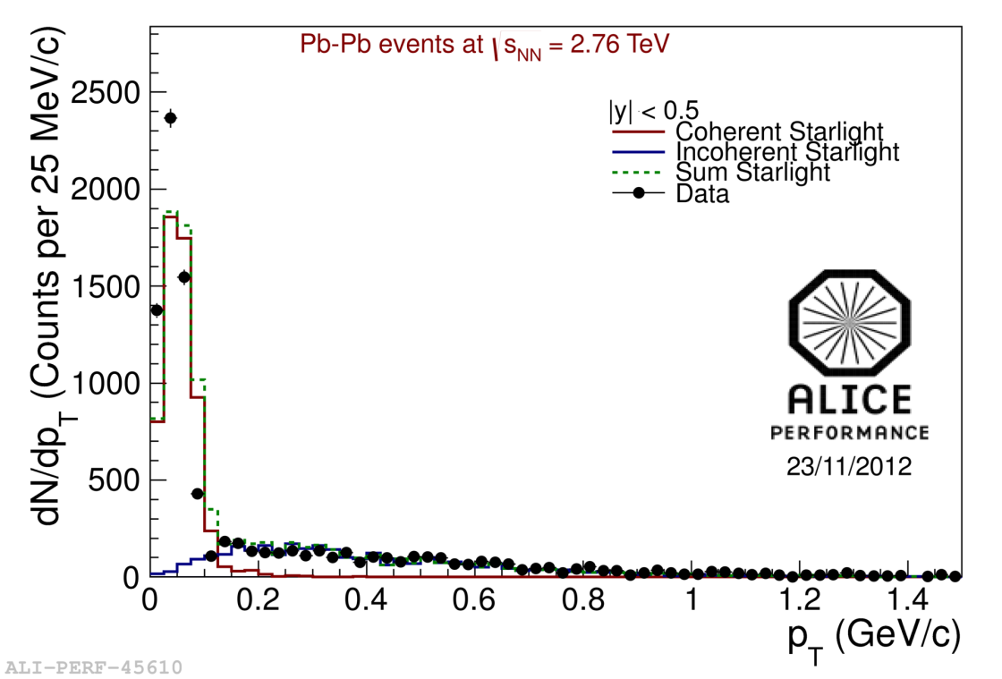
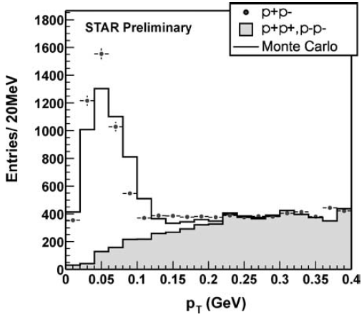
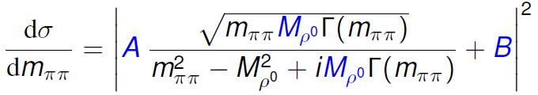
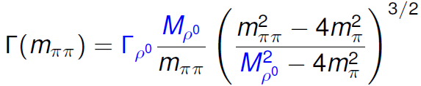
Invariant mass and p_{T} spectra
STAR
Annu. Rev. Nucl. Part. Sci. 55 (2005) 271
coherent/incoherent template-pair-p_{T} distributions from STARLIGHT
7 % contribution from incoherent events with pair-p_{T} < 150 MeV/c
p_{T} distribution in Starlight broader than in data (similar trend in STAR)
A - amplitude of the Breit-Wigner function
B - amplitude of the non-resonant ππ production
The absolute cross section will be released soon

Slide 19
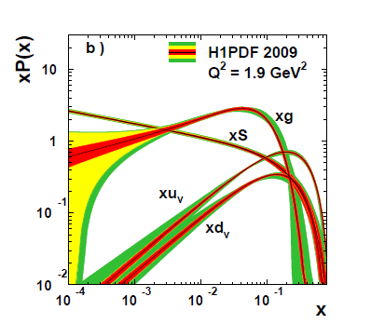

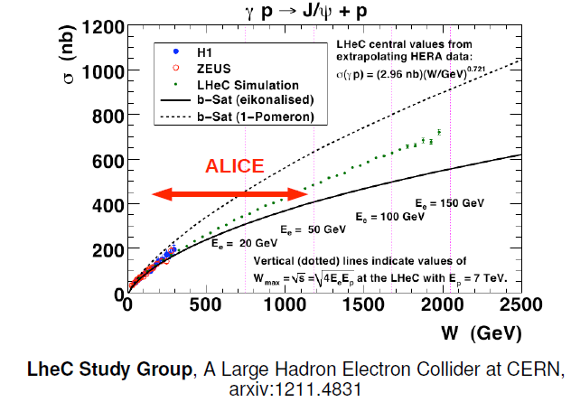
pA UPC potential
High flux from Pb
Quarkonium photoproduction on p
Allows to study gluon PDFs in proton up to very small x (~10⁻⁵):
Gluon PDF up to x~10⁻⁴ from J/ψ photoproduction at HERA.
UPC J/ψ production measured in CDF at midrapidity (x~10⁻³)
LHCb: exclusive J/ψ in pp @ 7 TeV at forward rapidity
(hep-ex/1301.7084). Sensitive to x ~ 10⁻⁵
No two fold ambiguity: small contribution from
J/ψ produced on Pb can be removed by p_{T} cut
3 options in ALICE:
Forward: both muons in the muon arm
Central: Both muons/electrons in the barrel
Semi-forward: one muon in the muon arm,
second in the barrel
Wide x coverage with ALICE: 10⁻² -10⁻⁵

Slide 20
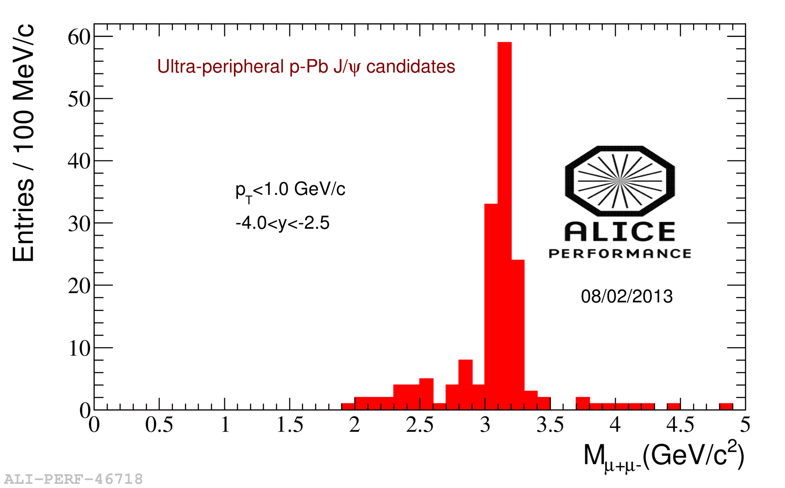
pA appetizer

Slide 21
Conclusions and outlook
The LHC is an effective γA (and γp) collider
Quarkonium photoproduction in UPC is the most promising tool to measure gluon shadowing effects. Bjorken x up to 10⁻⁵ accessible
ALICE measured J/ψ photoproduction in ultra-peripheral Pb-Pb collisions @ 2.76 TeV both at forward and central rapidities
→ Coherent cross section in good agreement with EPS09 parameterization
ρ⁰→ π⁺π⁻ measured in PbPb UPC at central rapidity. Cross section will be released soon
Measurement of J/ψ photoproduction up to TeV scale in pA UPC is under way

Slide 22
Backup

Slide 23
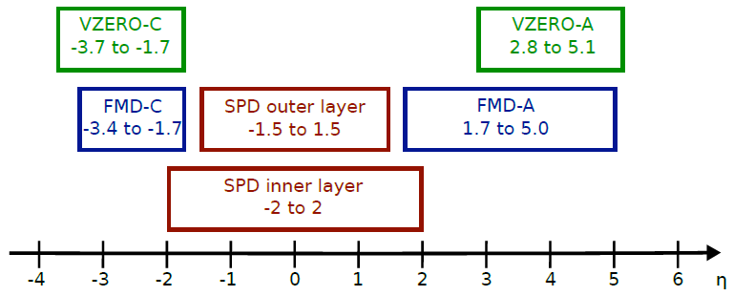
ALICE pseudorapidity coverage

