Slide 1
TOTEM
Status of Roman Pot CONSOLIDATION & UPGRADE PROGRAM
TOTEM RP 210/220 m stand alone (special runs)
TOTEM&CMS (low β*&high luminosity)
RP integration of tracking/timing detectors
RP – horizontal insertion at low β

Slide 2
Overview
Presentation of TOTEM RP consolidation & upgrade plans in different meetings:
1) CMS-TOTEM (management) meeting on 5.10.2012
2) LTEX meeting on 8.11.2012
3) 1st LHC workshop on Collider Experiment Interface on 30.11.2012
+ several CMS-TOTEM technical meetings

Slide 3
Roman Pot consolidation & upgrade strategy
Upgrade of RP detector system at 210m
- Remove RP147m and relocation at 210m
- Installation of additional RPs (horizontal) at 210m
- Integration of timing and pixel detectors in horizontal RPs
Guideline:
Reinstallation of RP 147m stations at 210m
Re-use of RP 147m infrastructure as much as possible (motor, cables etc.)
The new horizontal RPs could be installed during LS1 and equipped immediately/successively with new tracking & timing detectors.
The present 220m stations must not be affected (touched) by any upgrade activity, until the high beta special runs after LS1 are finished.
(Research Board approved stand alone program of TOTEM at full LHC energy)
The timing detectors are installed downstream relative to the tracking detectors. (high material budget).
Depending on the running scenario after LS1 (physics high β*/low β*, calibration, alignment), relevant RPs are inserted or retracted (parking position).

Slide 4
Present RP installation at IP5
TOTEM RP-147m (near-far)
TOTEM RP-220m (near-far)
Near
2 vertical RP
top/bottom
1 horizontal RP
Far
2 vertical RP
top/bottom
1 horizontal RP
Near
2 vertical RP
top/bottom
1 horizontal RP
Far
2 vertical RP
top/bottom
1 horizontal RP
outgoing
beam
Q6
~ 1.5 m
~ 5m
CMS ip5
~ 220 m

Slide 5
Remarks on Roman Pot detectors
The TOTEM physics program at high β*, special runs and p-A will be performed with the RP detectors at +/- 220m and relocated RP detectors from +/- 147m in the region of +/- 210m.
Possible additional RP detectors in the region of
+/- 210m from IP5 are presently discussed in the framework of “detector upgrade studies” by TOTEM in collaboration with CMS
(related to diffractive physics at low β* and high luminosities)

Slide 6
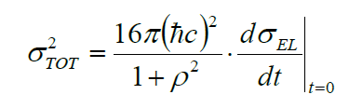
Main goals of TOTEM experiment
- Measurement of total cross section
Forward multiplicity
Diffractive physics
(soft& hard diffraction, jets)
TOTEM detectors integrated in CMS (T1, T2)
TOTEM detectors integrated in LHC (RP)
Using luminosity from CMS
Luminosity independent
ρ parameter from compete fit
TOTEM (stand alone)
TOTEM&CMS at low/highβ*, special runs
TOTEM&CMS at low β* and high luminosity

Slide 7
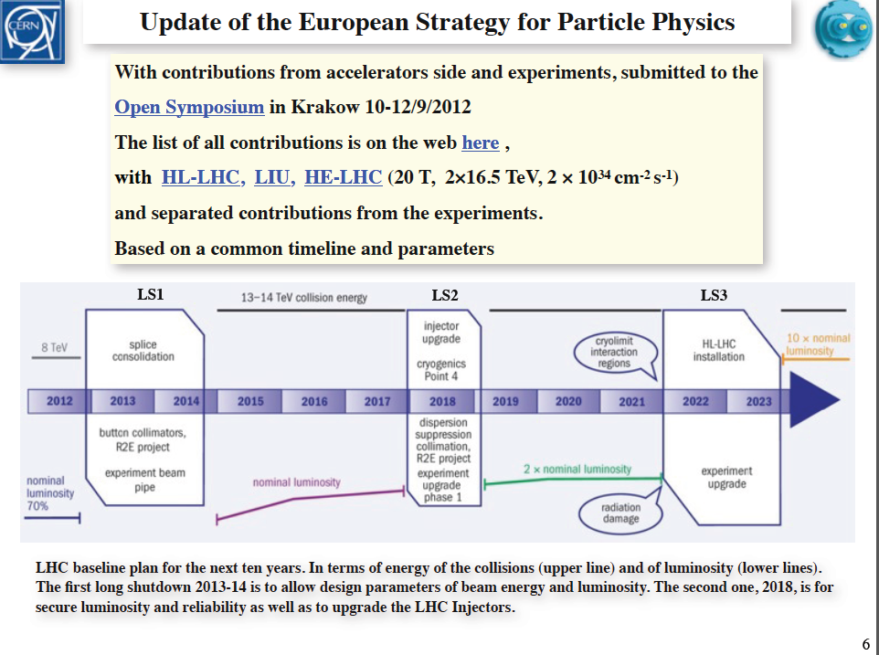
LHC operation
TOTEM operation beyond LS2 in special runs – high β
Water cooled cables
TOTEM operation with RP +/- 220 - and +/-210m after LS2 in special runs

Slide 8
Roman Pot upgrade overview (schematic)
Existing TOTEM RP-220m (near-far)
New horizontal RP
equipped with pixel
tracking detectors
New horizontal RP
equipped with
timing detectors
New
New
1 horizontal RP
TRACKING
Detector
1 horizontal RP
TRACKING
Detector
Near
2 vertical RP
top/bottom
1 horizontal RP
1 horizontal RP
TIMING Detector
1 horizontal RP
TIMING
Detector
Far
2 vertical RP
top/bottom
1 horizontal RP
outgoing
beam
shielding
TCL-6
Q6
~ 5-10 m
~ 5m
CMS ip5
~ 220 m

Slide 9
Roman Pot (schematic-phase 1)
CALIBRATION & Alignment -RUNNING with high β* & low luminosity
Possibility to test new timing & tracking detectors in the LHC environment –>
Tests in combination with existing RP detectors
Existing TOTEM RP-220m (near-far)
New horizontal RP
equipped with pixel
tracking detectors
New horizontal RP
equipped with
timing detectors
New
New
1 horizontal RP
TRACKING
Detector
1 horizontal RP
TRACKING
Detector
Near
2 vertical RP
top/bottom
1 horizontal RP
1 horizontal RP
TIMING Detector
1 horizontal RP
TIMING
Detector
Far
2 vertical RP
top/bottom
1 horizontal RP
outgoing
beam
shielding
TCL-6
Q6
~ 5-10m
~ 5m
CMS ip5
~ 220 m

Slide 10
Roman Pot (schematic-phase 1)
PHYSICS-RUNNING with low beta* & high luminosity horizontal and vertical RPs (far) are retracted (parking position) & vertical RPs (near) are retracted (parking position) horizontal RP near inserted
Existing TOTEM RP-220m (near-far)
New horizontal RP
equipped with pixel
tracking detectors
New horizontal RP
equipped with
timing detectors
ver
t
hor
i
z
ver
t
outgoing beam
1 horizontal RP
TRACKING
Detector
1 horizontal RP
TRACKING
Detector
hor
I
z
1 horizontal RP
TIMING Detector
1 horizontal RP
TIMING
Detector
optional
optional
shielding
TCL-6
Q6
~ 5-10m
~ 5m
CMS ip5
~ 220 m

Slide 11
Roman Pot (schematic-phase 1)
PHYSICS-RUNNING with high β* & low luminosity
NEW installed horizontal RPs are retracted (parking position)
Existing TOTEM RP-220m (near-far)
New horizontal RP
equipped with pixel
tracking detectors
New horizontal RP
equipped with
timing detectors
1 horizontal RP
TRACKING
Detector
1 horizontal RP
TRACKING
Detector
1 horizontal RP
TIMING Detector
1 horizontal RP
TIMING
Detector
Near
2 vertical RP
top/bottom
1 horizontal RP
Far
2 vertical RP
top/bottom
1 horizontal RP
outgoing beam
shielding
TCL-6
Q6
~ 5-10m
~ 5m
CMS ip5
~ 220 m

Slide 12
Roman Pot (schematic-phase 2)
PHYSICS-RUNNING with low β* & high luminosity
ALL horizontal RPs are inserted
Existing TOTEM RP-220m (near-far)
New horizontal RP
equipped with
timing detectors
New horizontal RP
equipped with pixel
tracking detectors
1 horizontal RP
TRACKING
PIXEL
Detector
1 horizontal RP
TRACKING
PIXEL Detector
1 horizontal RP PIXEL
Detector
2 vertical Rp
tracking
1 horizontal RP
TIMING Detector
1 horizontal RP
TIMING
Detector
1 horizontal RP TIMING
Detector
2 vertical RP
tracking
outgoing
beam
shielding
TCL-6
Q6
~ 5m-10m
~5m
CMS ip5
~ 220 m

Slide 13
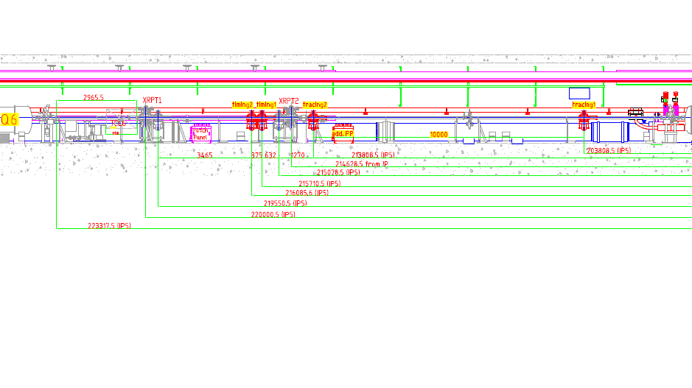
Integration study of new horizontal
RPs at 200m
Sector 4/5

Slide 14
Work packages –> Roman Pot installation
(CMS, PH-DT, EN-CV, BE-ABP-ICE, LTEX)
WP1-T: removal of RP@147m
(Radio protection, RP stockage, machining of flanges)
WP2-T: transfer of supplies from 147m -> 220m
(motor power lines, patch panel, LV, + new HV)
WP3-T: installation of new fibres
WP4-T: RP@147m motor & mechanics
(preparation for reuse at 220m, adaptation of mechanics, installation of motors etc.)
WP5-T: Flanges – interface to LHC
(adaptation of thin window, rotation by 90° for timing detector, flanges, beam-pipe )
WP6-T: beam-pipe
WP7-T: LHC Impedance study
(impedance study – RP was approved for highest luminosities -> RP rotated by 90°, concentration at 220m)

Slide 15
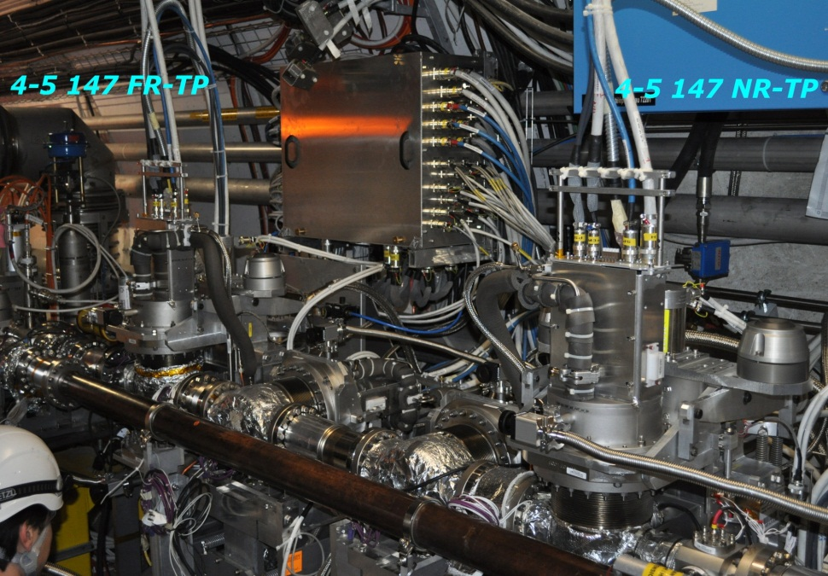
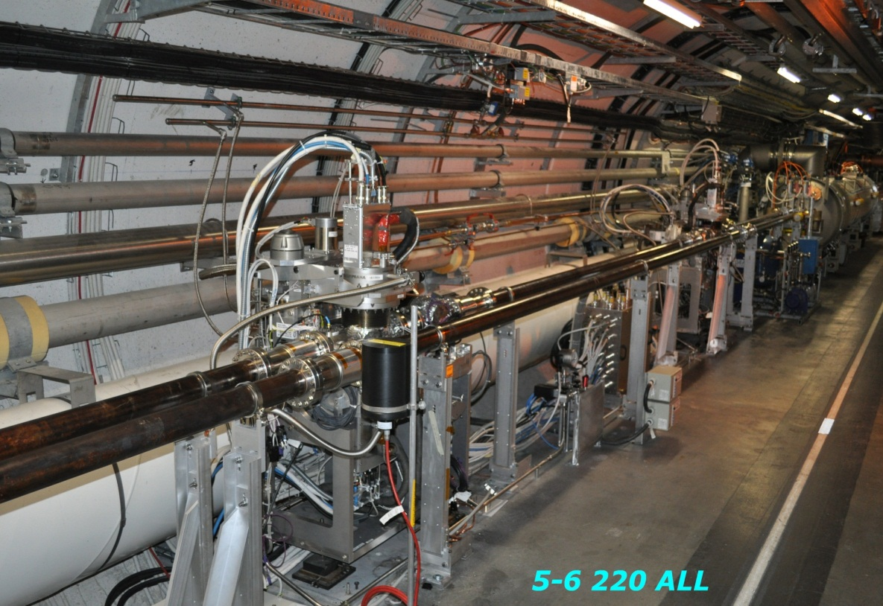
Roman Pot at 147m & 220m
patch panel
Position of new RPs
Relocation of RPs & patch panel from 147m to 200m
patch panel
(relocated from 147m)

Slide 16
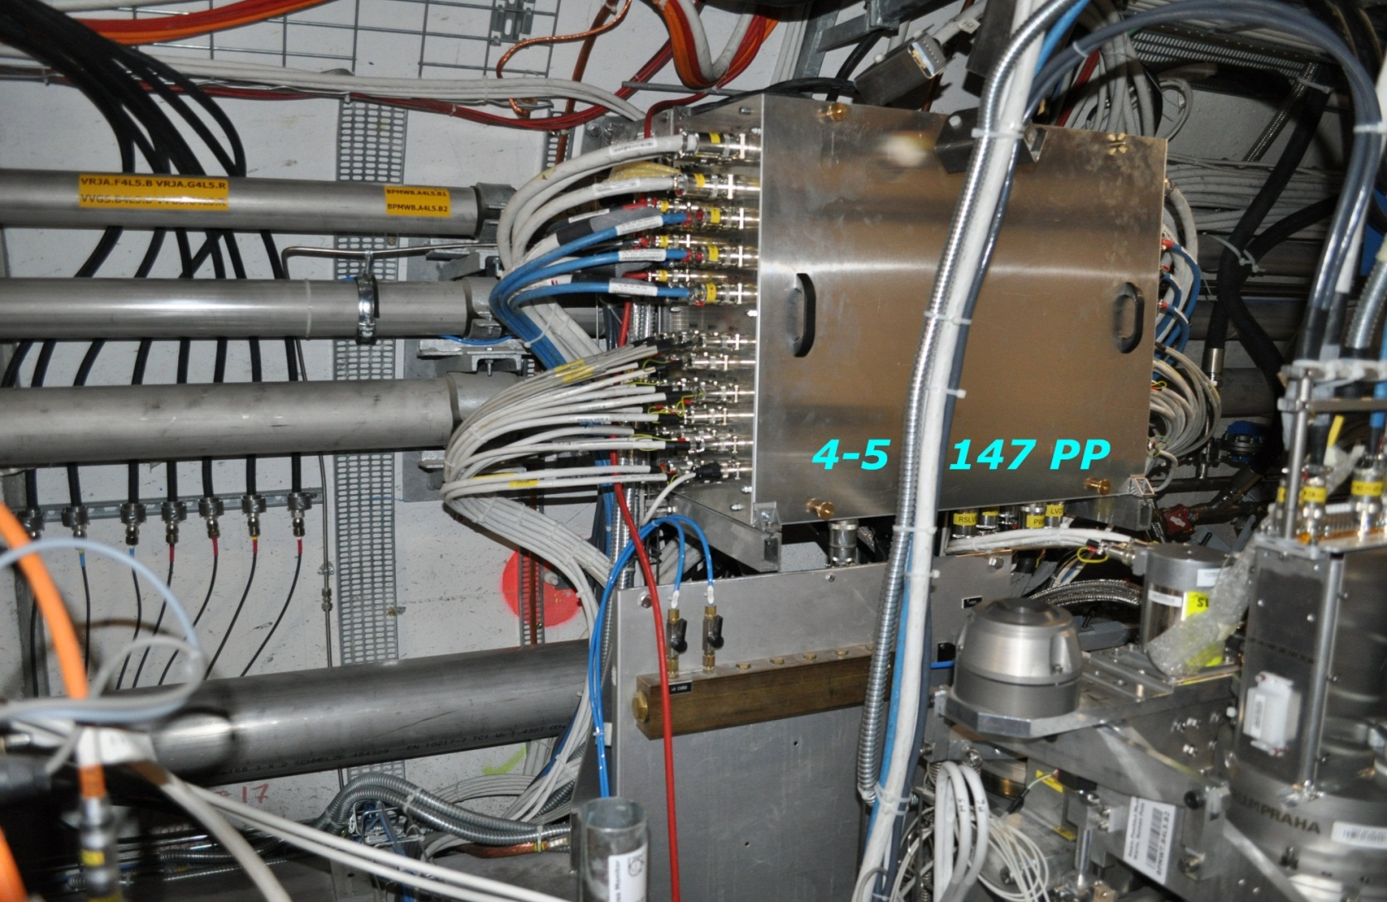
Patch panel at 147m

Slide 18
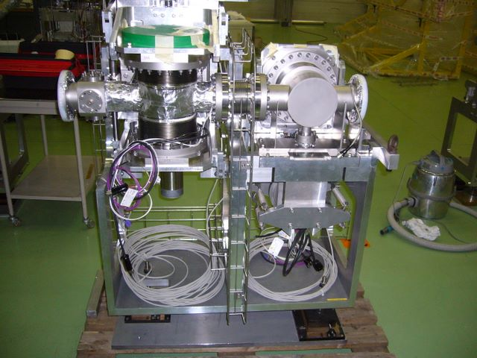
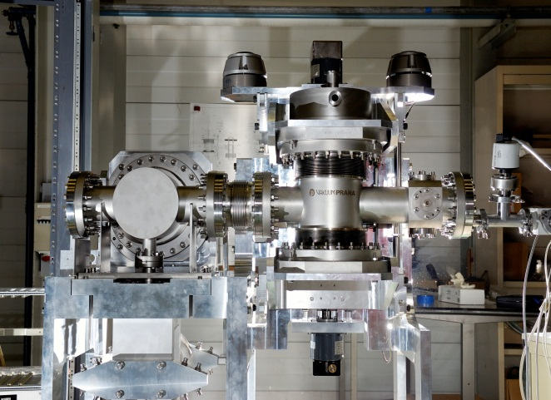
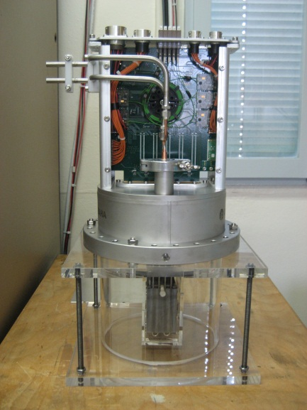
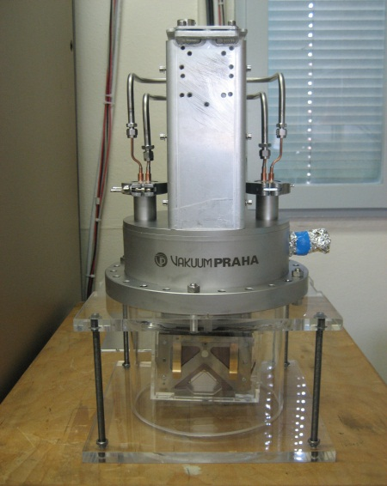
Roman Pot & detector package
Temporary location of RP 147m components in H8 TOTEM test beam line after dismounting

Slide 19
Work packages –> Detector Sensor
CMS-TOTEM
WP1-D: Si Pixel
(prototype test, integration & preamp, readout)
WP2-D: Timing-Detector
(prototype test)
WP3-D: Timing-TDC
WP4-D: Timing-Clock distribution
WP5-D: Readout board interface to CMS

Slide 20
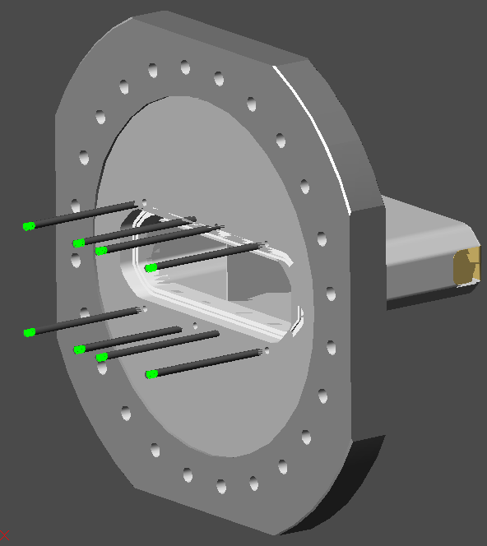
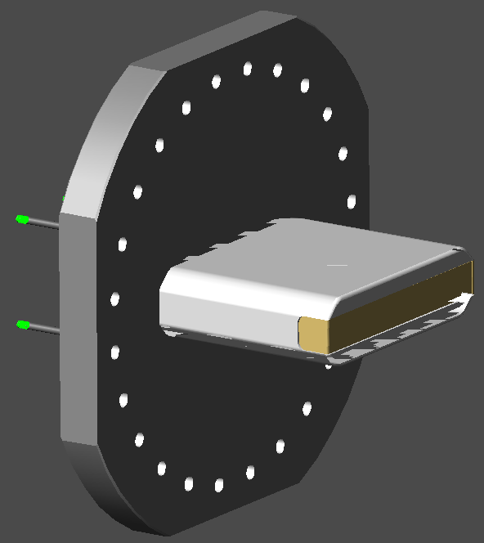
Possible housing for timing detector
Impedance not favorable
Flange size big enough to integrate the timing detector

Slide 21
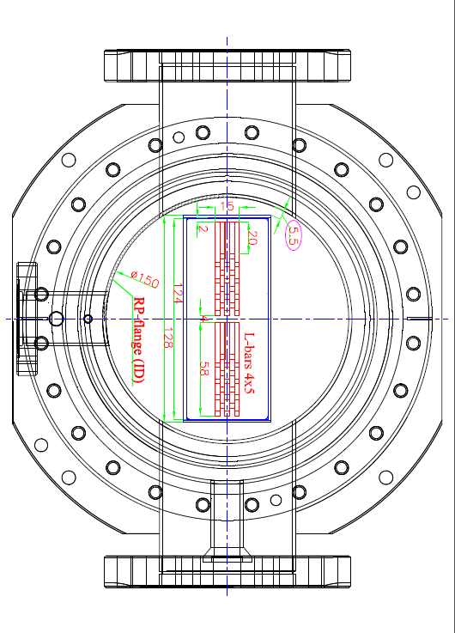
Roman Pot (rotated by 90°)
Integration of Cherenkov timing detector

Slide 22
Integration study of C-timing detector in RP (CMS-TOTEM)

Slide 23
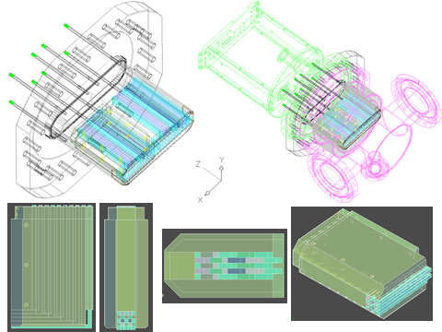
Horizontal RP with Cherenkov timing detector

Slide 24
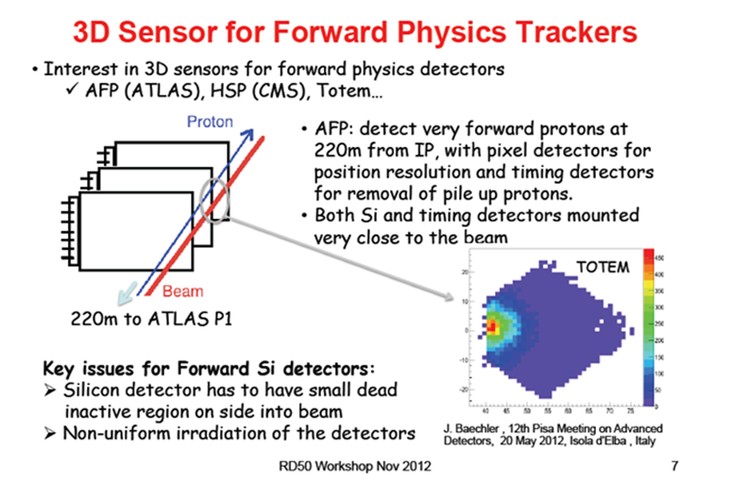
TOTEM-RP study of 3D sensors
TOTEM-RD50 (G. Pellegrini) [IBL – CNM]

Slide 25
Work packages –> Optimization
CMS-TOTEM
WP1-O : optimal position of new RPs
WP2-O: optimal shape & size of sensors
(pixel size, adaptation, radiation zone)
WP3-O: particle timing – vertex reconstruction
WP4-O: detector position
(calibration, alignment)
WP5-O: Material budget
(detector performance, machine protection)

Slide 26
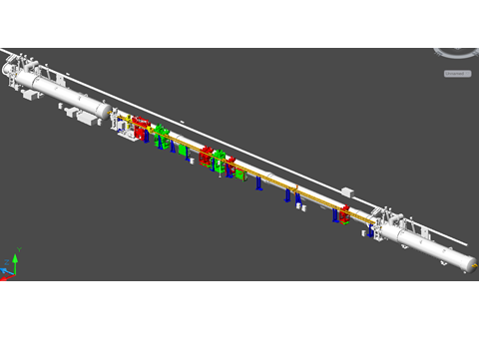
RP Integration study

Slide 27
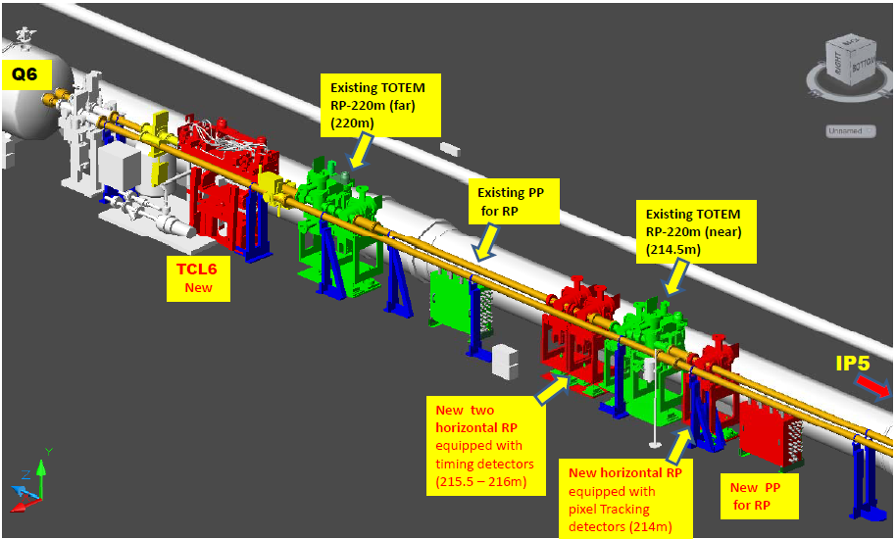
Integration study of TCL6 and
Roman Pots

Slide 28
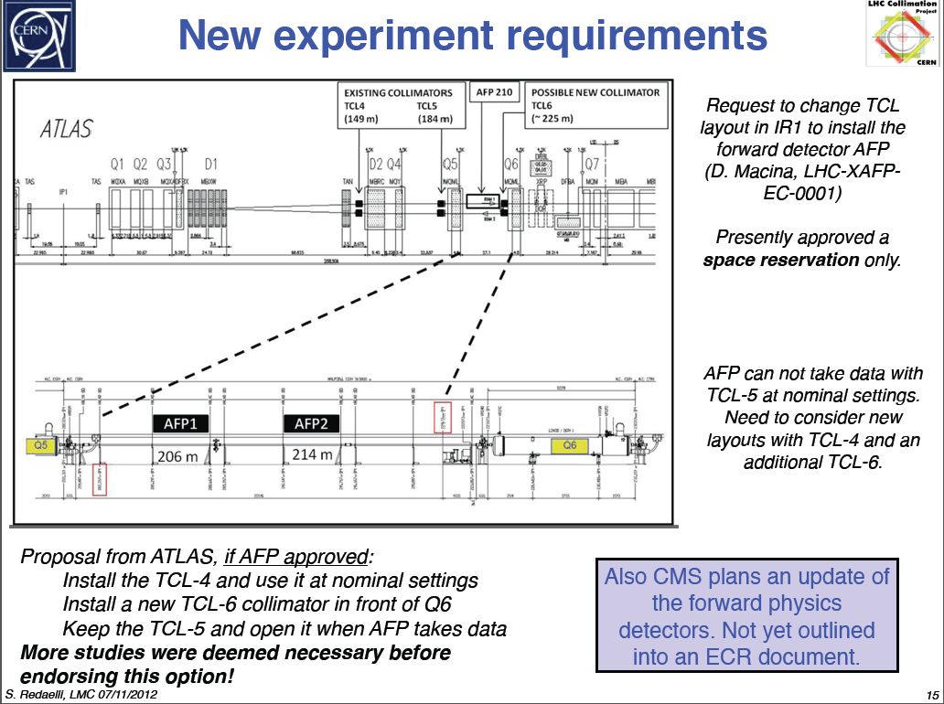
COLLIMATOR requirements for forward physics

Slide 29
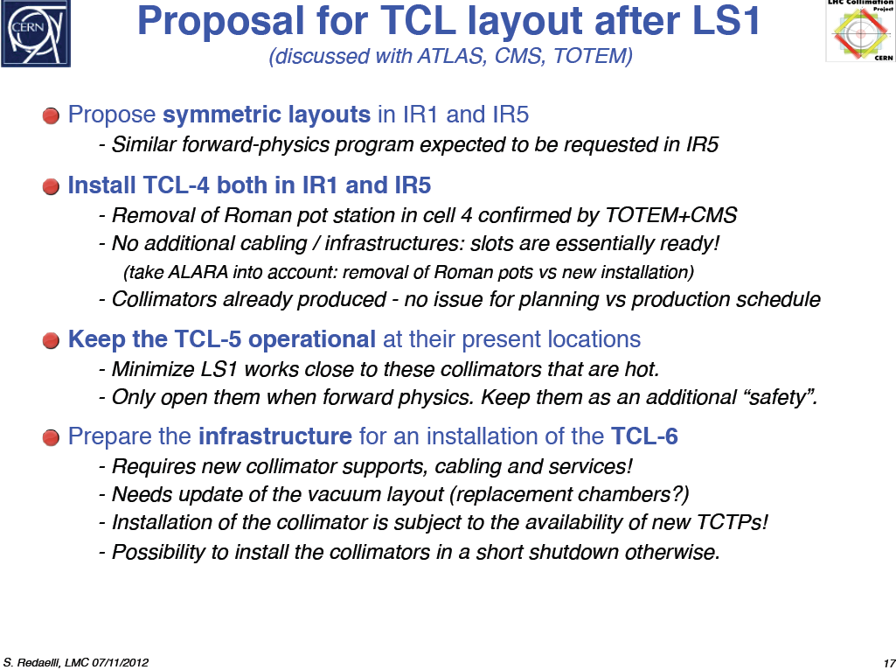
COLLIMATOR
TCL4 & TCL6

Slide 30
RP-TOTEM <-> LHC
In 2011 and 2012 specific RP tests & insertions were performed at standard LHC settings to study:
Roman Pot <-> LHC : RP heating & beam stability
Roman Pot detector : rates & background
Observations during low β* run (2012):
[LHC-MPP M. DEILE, December 2012]
Insertion of RP horizontal at 220m ->

Slide 31
List of Insertions at β* = 0.6 m
Date | Pots involved | min. dist. | Observations, Result | Consequence
16.10. | all V all H | 12 σ 30 σ | no problem dump on XRPH.A6R5.B1 (slow losses, 5s) | no UFO activity
05.11. | all H | 30 σ | dump on XRPH.A6R5.B1 (slow losses, 5s) | no UFO activity
14.11. | all H | 32mm ~ 270 σ | dump on XRPH.A6R5.B1 (fast losses) | UFO activity in 6L5
16.11. | H, not A6R5.B1 | 14 σ ∼ 2mm | no problem, beams separated by 4σ | slow losses (5s) in each ramp until conditioning (heat up) of beam screen in Q6
(*)
(*) The (fast) UFOs in 6L5 were later found to originate from TCL5 [Tobias]

Slide 32
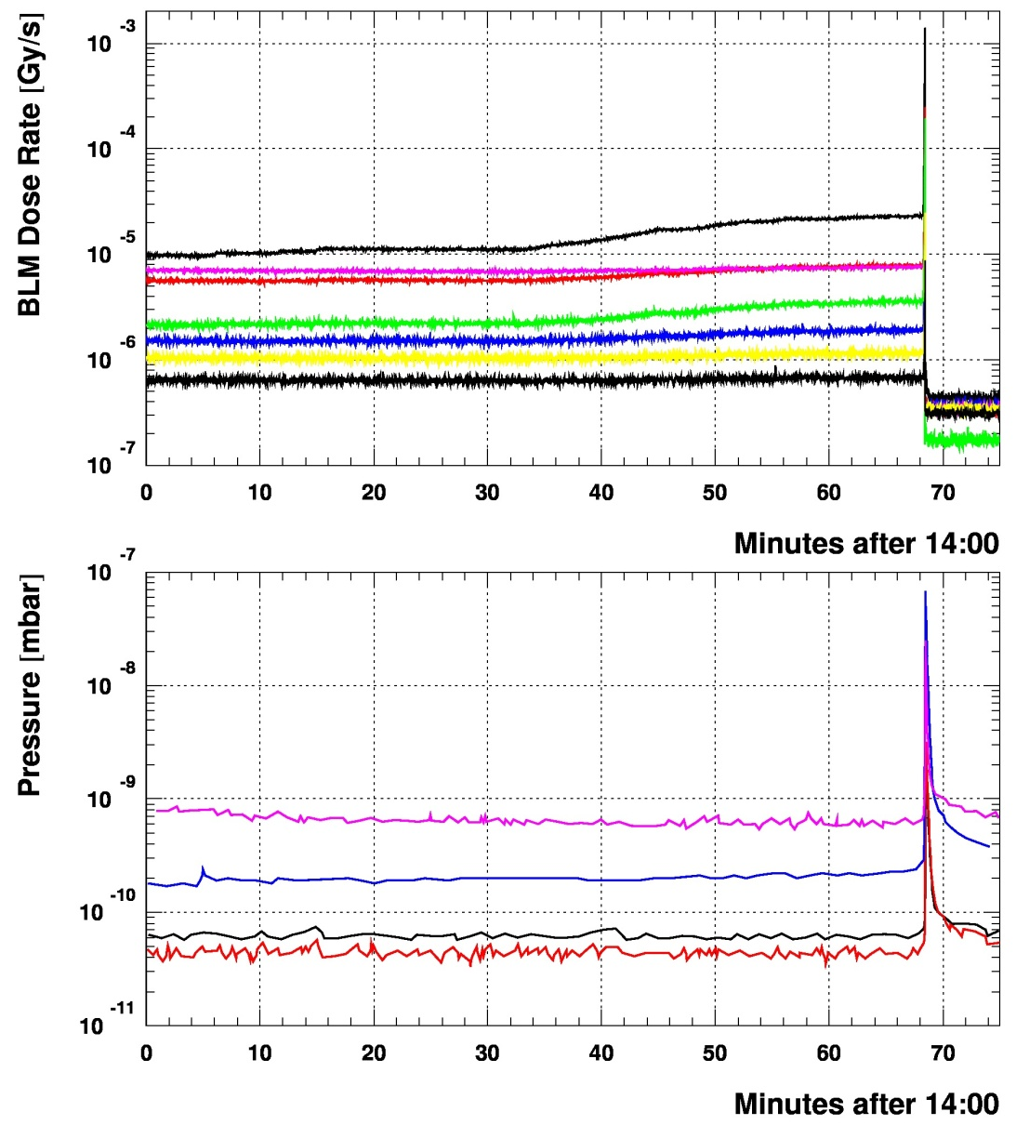
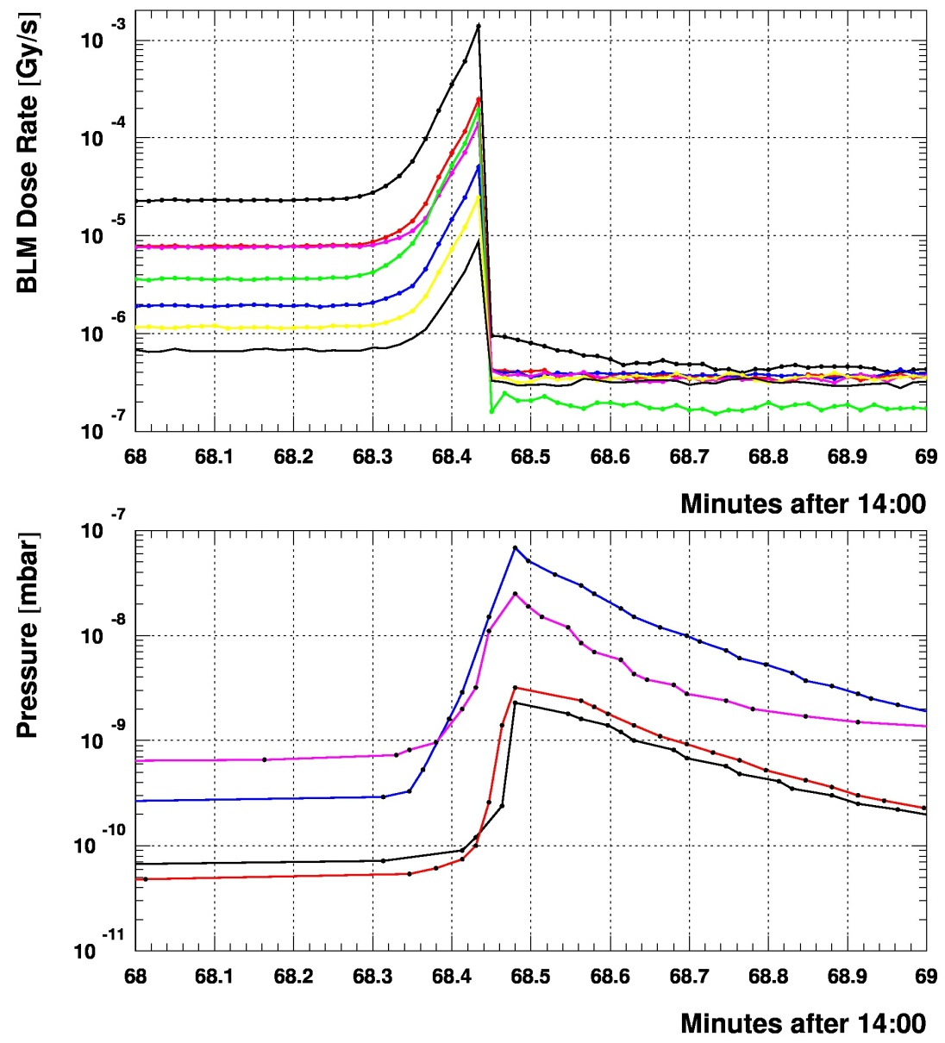
Comparison BLMs & Beam Vacuum
05.11.2012
Sector 5-6
BLMEI.06R5.B1E10_XRP
BLMQI.06R5.B1E30_MQML
BLMQI.06R5.B1E10_XRP_MQML
BLMQI.06R5.B2I30_MQML
BLMQI.06R5.B1E20_MQML
BLMQI.06R5.B2I20_MQML
BLMQI.06R5.B2I10_MQML
VGPB.235.6R5.B.PR (4 m downstream of Far: Q6 entrance)
VGI.77.6R5.B.PR (6 m upstream of Near)
VGPB.2.6R5.B.PR (14 m upstream of Near: Q5 exit)
VGPB.4.6R5.B.PR (14 m upstream of Near: Q5 exit)
Note: no pressure increase in any gauge further upstream (cell 5R5).

Slide 33
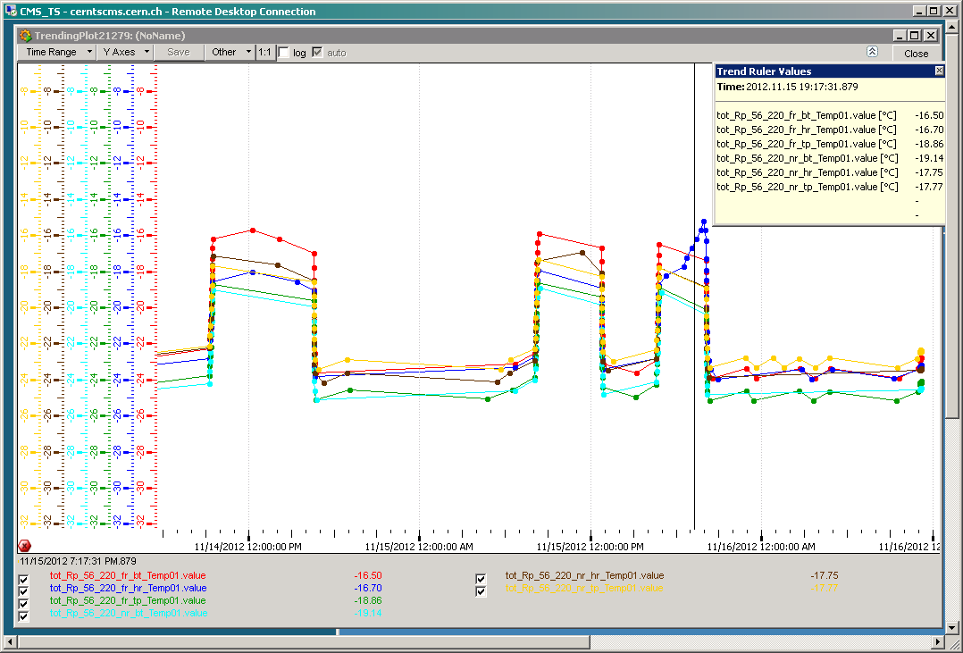
Temperature Sensors on Detector Hybrid Boards: Sector 5-6 (Beam 1)
dump at 13:52
other pots in garage
56-220-F-H moving towards beam

Slide 34
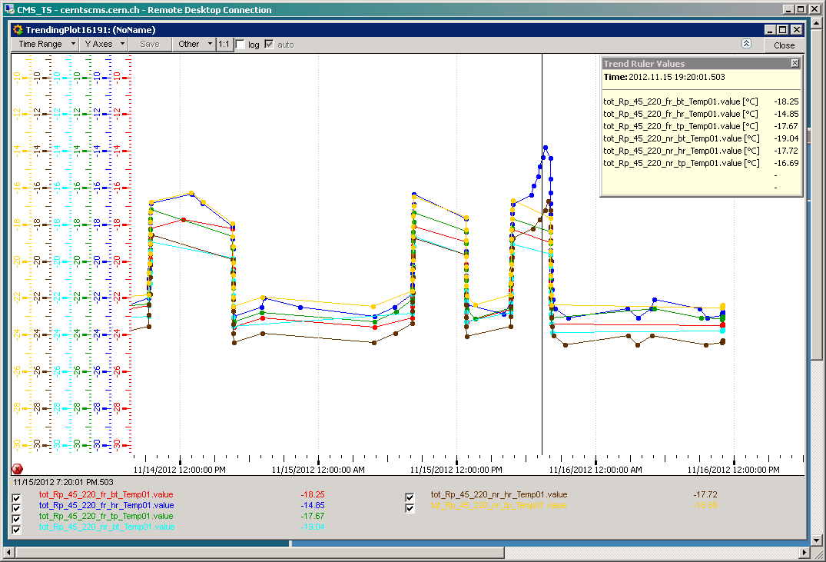
Temperature Sensors on Detector Hybrid Boards: Sector 4-5 (Beam 2)
dump at 13:52
other pots in garage
45-220-F-H moving towards beam
45-220-N-H moving towards beam
Run mode
Run mode
Readout chips in
run mode
Readout chips in sleep mode
Sleep mode
Sleep mode
Main temperature effect from chips changing to run mode; small additional increase (3 deg.) from pots moving very close to
the beam. UFOs cannot be resolved.

Slide 35
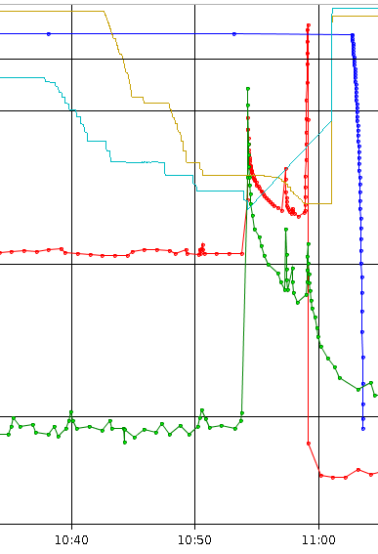
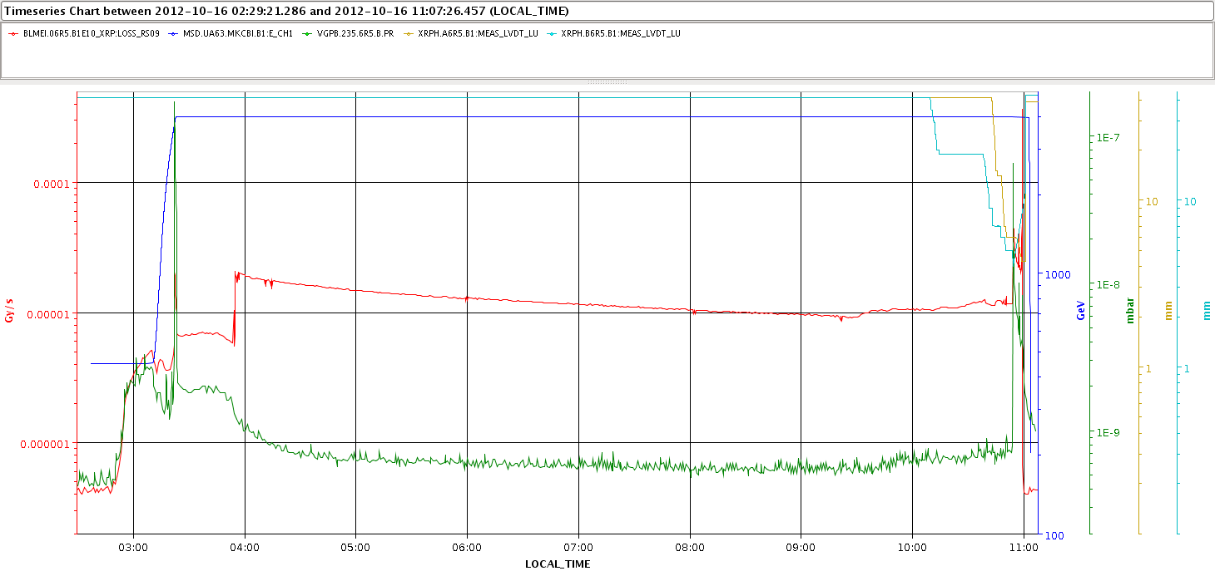
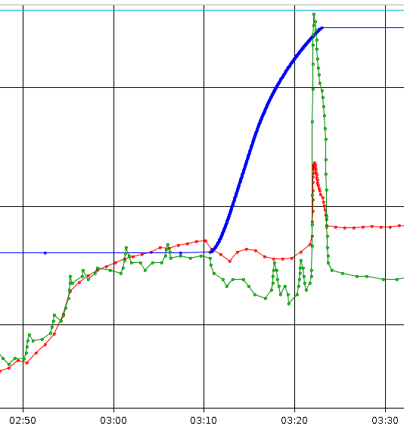
Fill 3188 with RP Insertion, Cell 6R5 _
BLM and vacuum spike,
no dump

Slide 36
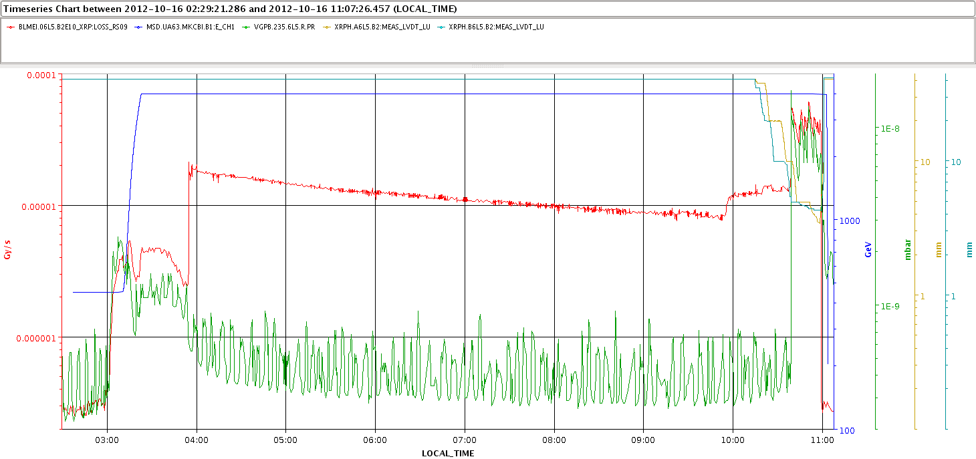
Fill 3188 with RP Insertion, Cell 6L5

Slide 37
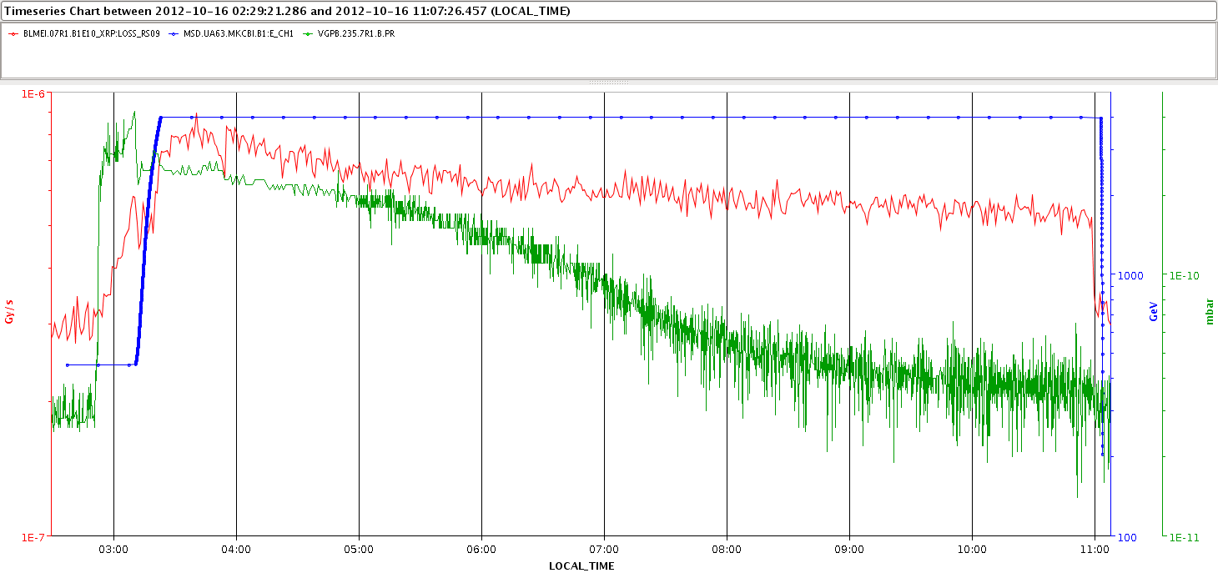
Fill 3188, Cell 7R1 (ALFA)
slight vacuum degradation at injection,
no spike in ramp

Slide 38
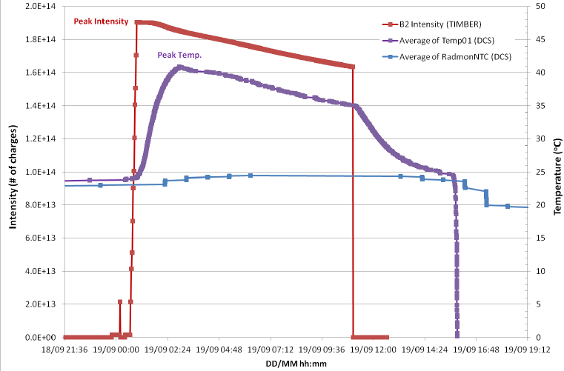
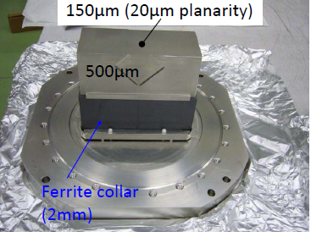
EM coupling of RP
(RP in garage position)
The temperature in the Roman Pot increases due to the EM coupling with the LHC
-> cooling of RPs is mandatory when LHC beam is injected
-> modification of evaporative cooling system by integrating a safety mode to operate above dew point in case of vacuum problem
Cooling of RP was switched off

Slide 39
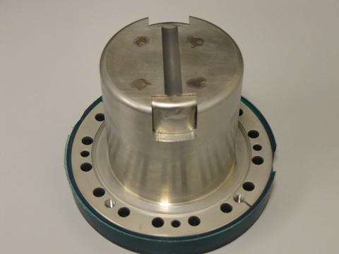
RP optimization
RP optimization ongoing –highest priority
Ferrite treatment during LS1
TOTEM – RP
OLD TOTEM RP prototype

Slide 40
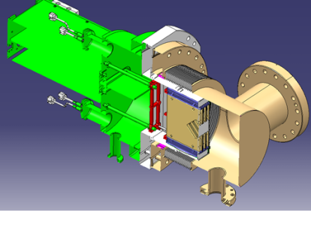
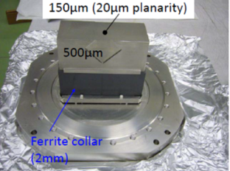
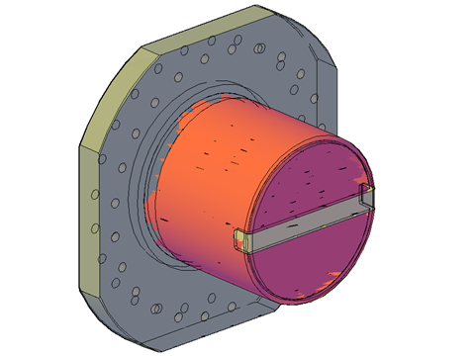
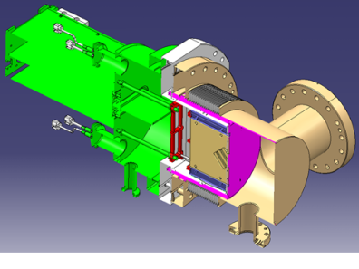
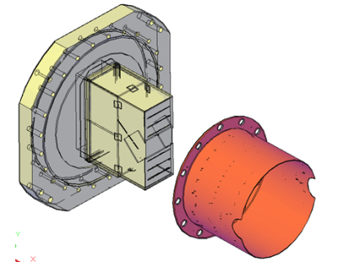
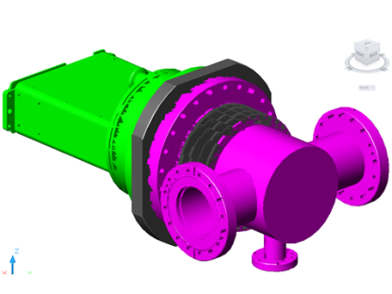
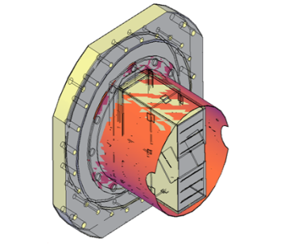
Optimization of RF characteristics
(first preliminary results B. Salvant, BE-ABP-ICE)
Present RP housing
result with ferrite
Study of new RP housing
Study of possible RF shielding
for existing RP
result without ferrite
Study is ongoing
Not all issues are solved yet !

Slide 41
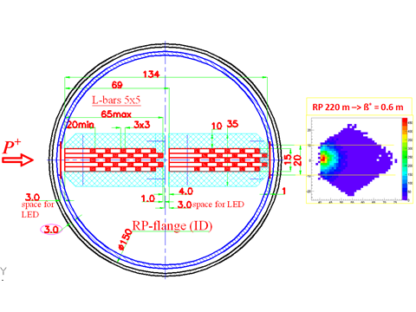

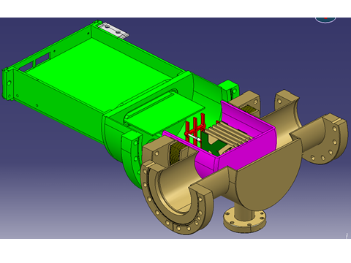
Integration study: cylindrical pot with timing/tracking detector

Slide 42







Roman Pot detector system study of combination: Si strip- Si pixel- timing (schematic)
RP - 200m
RP + 200m
CMS ip5
SHOWER
beam halo
pileup bunch crossing
tracking
timing
PIXEL
detector
40 MHz-VFAT
Si-strip detector
trigger
double arm coincidence
trigger

Slide 43
Conclusion (1)
TOTEM has confirmed the complete dismounting of RP 147m stations during LS1 (as early as possible)
The removal of the RPs at +/- 147m allows the installation of TCL4
The RPs of +/- 147m will be reinstalled in the +/- 210 m region
TOTEM has proposed to install additional horizontal RPs around +/-210m of ip5 during LS1
These new horizontal RP detectors will allow tracking & timing at low β* and high luminosity
Integration studies were performed by TOTEM and CMS to integrate a “Cherenkov “timing detector in a (horizontal) RP
The re-use of motor and infrastructure (patch panel, cooling) was studied
Impedance studies for the horizontal RPs are ongoing
Studies are ongoing to improve the RP geometry (RF, material budget)

Slide 44
Conclusion (2)
The developments of Roman pots as ‘carriers’ for tracking and timing detectors with the potential to approach the LHC beam to very close distances are ongoing.
The combination of the existing TOTEM RPs (alignment, trigger) with new RPs, equipped with tracking and timing detectors is under study.

