Slide 1
Cosmic-ray session summary
David Berge
12. Feb 2013

Slide 2
Recall our goals
Identify areas connecting cosmic-ray physics and physics done with collider detectors
Compile a list of measurements that are most important for understanding air shower
We need a common sense for what’s needed, and should try to establish a way to achieve this (future activities!)

Slide 3
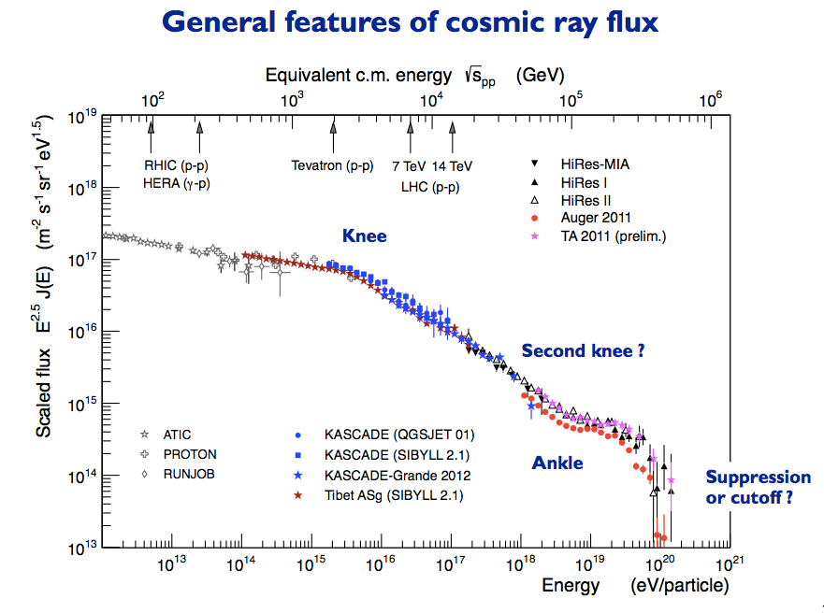
Science questions very brief
R.Engel

Slide 4
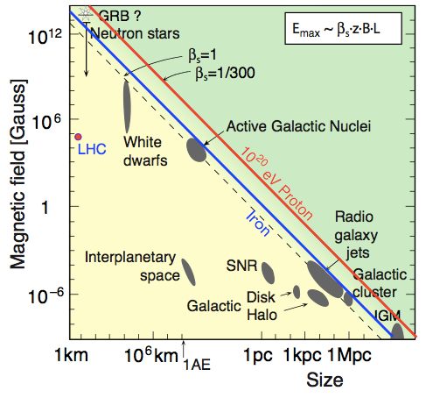
Science questions very brief
R.Engel

Slide 5
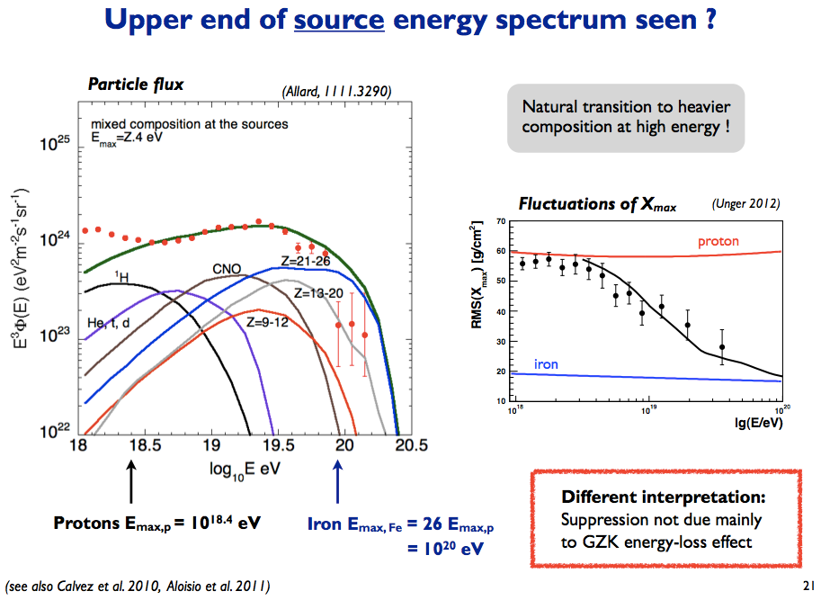
Science questions very brief
R.Engel

Slide 6
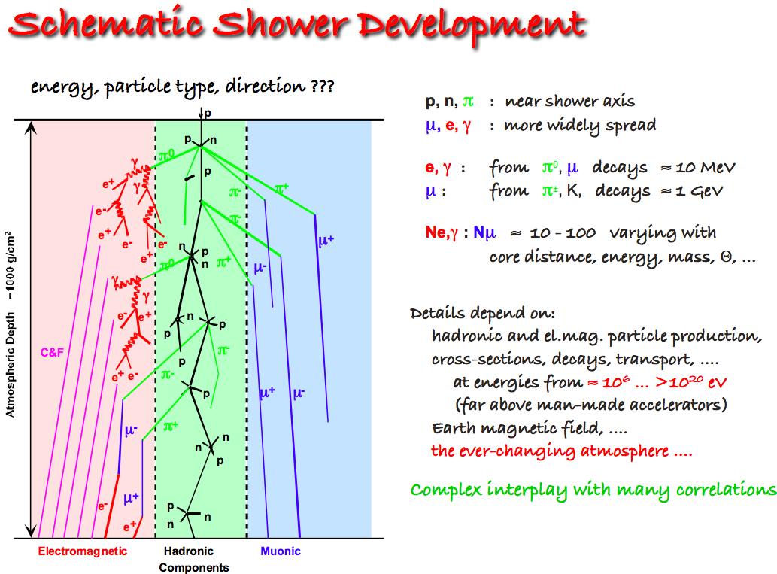
Measuring type and energy of primary particles
J.Knapp

Slide 7
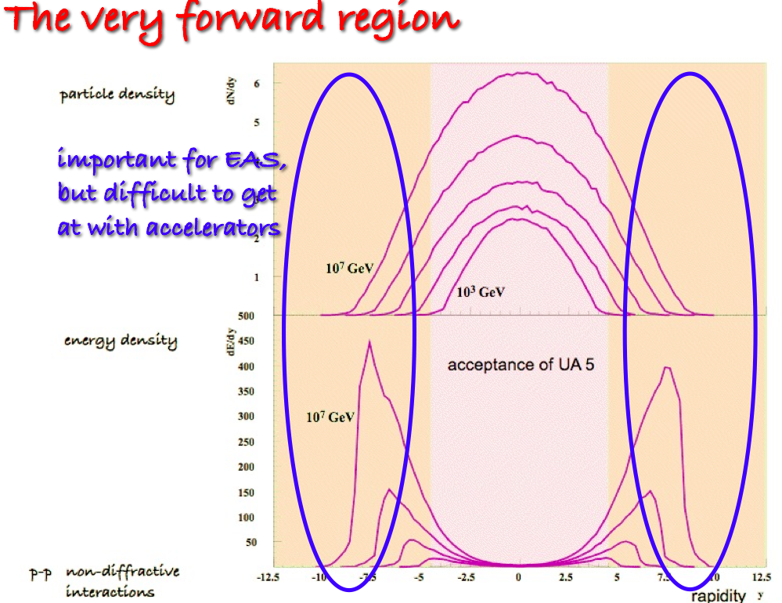
Measuring type and energy of primary particles
J.Knapp

Slide 8
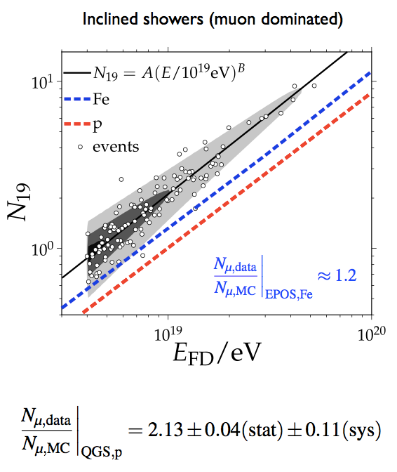
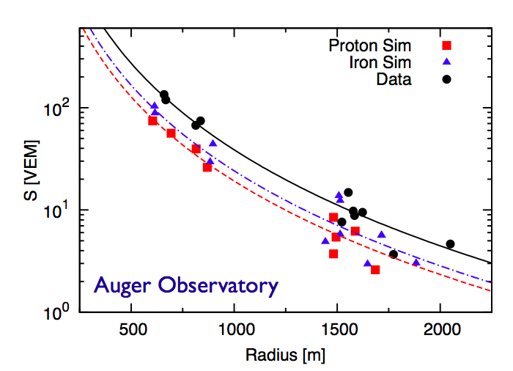
Muon excess measured by Auger
/ N_{muons}
Cosmic-ray experiments measure primary particle energies via muon numbers on ground and fluorescence light (electrons/positrons excite nitrogen molecules, these de-excite by emitting photons).
20-100% more muons measured than predicted!
Energy from fluorescence light
R.Engel

Slide 9
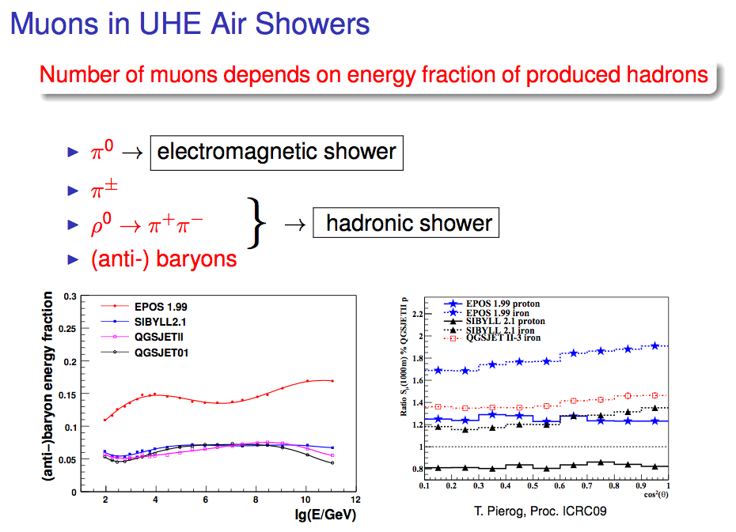
Muon excess measured by Auger
M.Unger

Slide 10
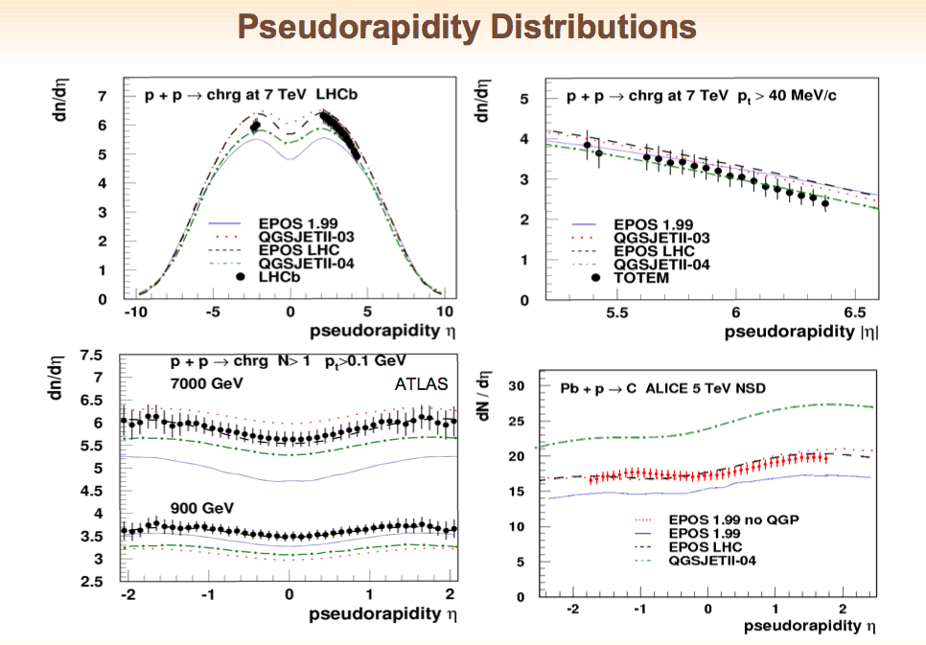
Cosmic-ray MC generators ‘challenging’ collider MC
Particularly important in view of 13 TeV running after shutdown…
T.Pierog

Slide 11
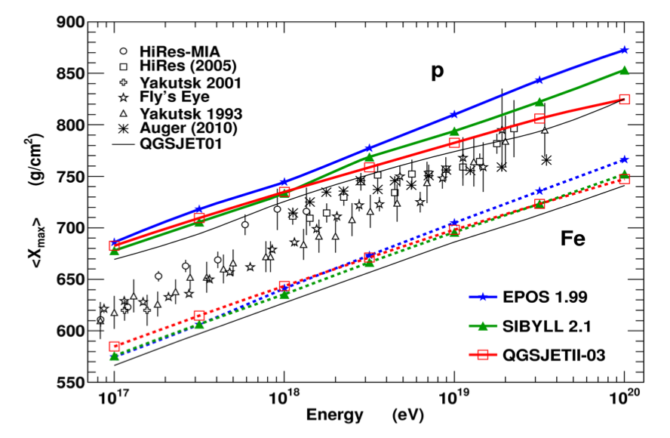
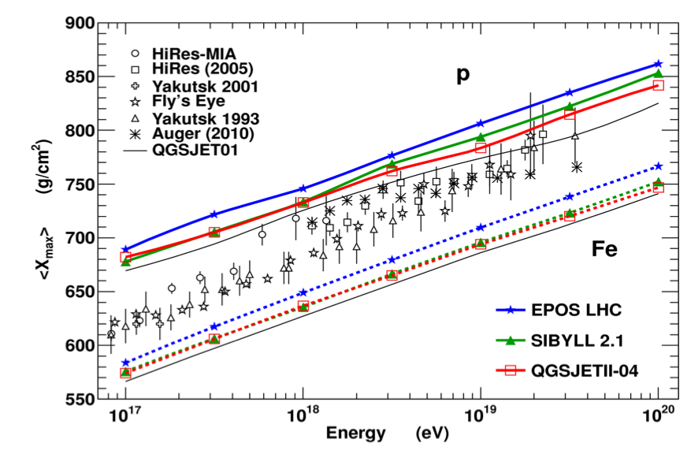
LHC impact on shower MC
T.Pierog
Pre-LHC
Post-LHC
Lots of helpful measurements exist, many more can be done with existing data, one example of measurements that could, but cannot yet, be done: light ions

Slide 12
Light ions LHC running (Django Manglunki)
In many ways light ions like Oxygen and Nitrogen should be collided with protons to connect to air-shower physics
Rough informal feasibility study suggests that this is technically possible
  Oxygen for example easier as it’s already used for preparation of Pb beam
  A few weeks of commissioning, parasitically
  A case for forming a science case within a mixed community of LHC and CR physicists (LHC forward detectors in particular)
Clear and strong interest formulated a couple of times, to be followed up

Slide 13
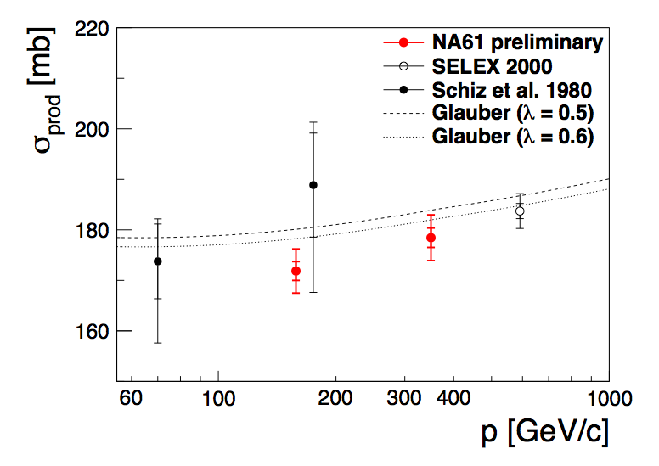
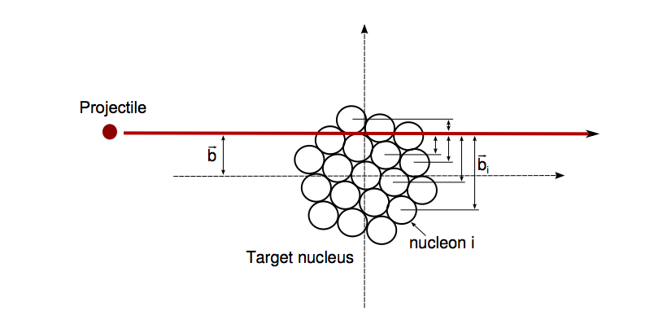
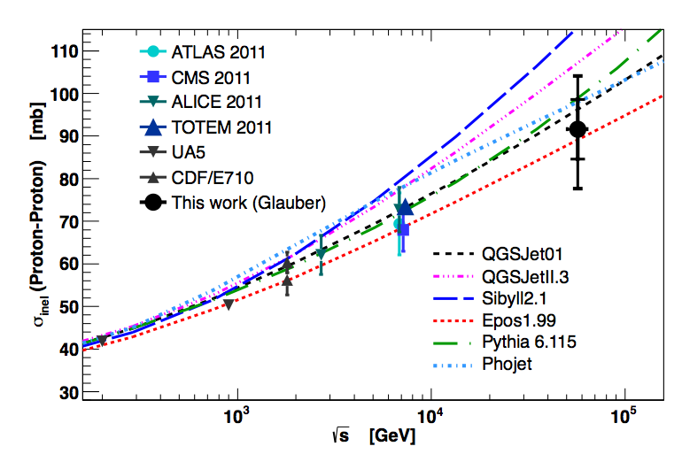
NA61: low-energy πC, pC, etc
M.Unger, p-
Glauber model: geometric model
R.Ulrich
Auger, arXiv:1208.1520

Slide 14
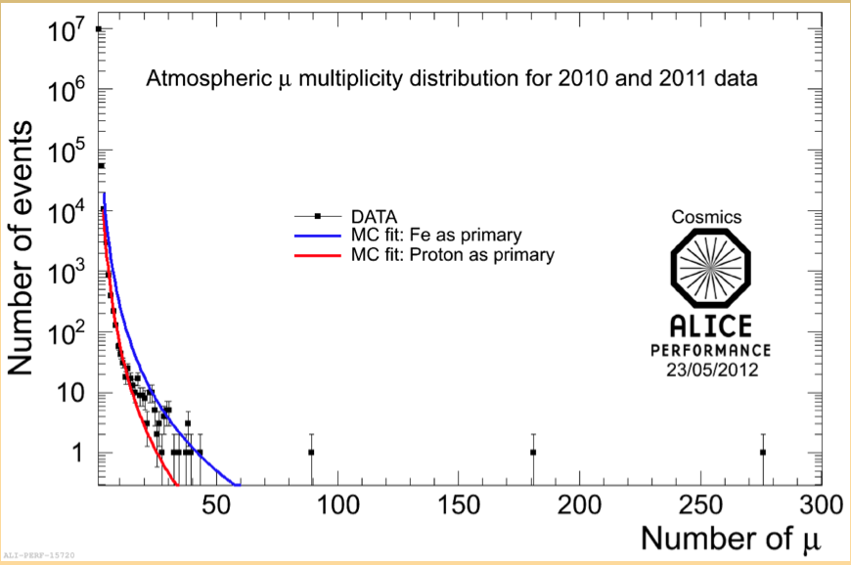
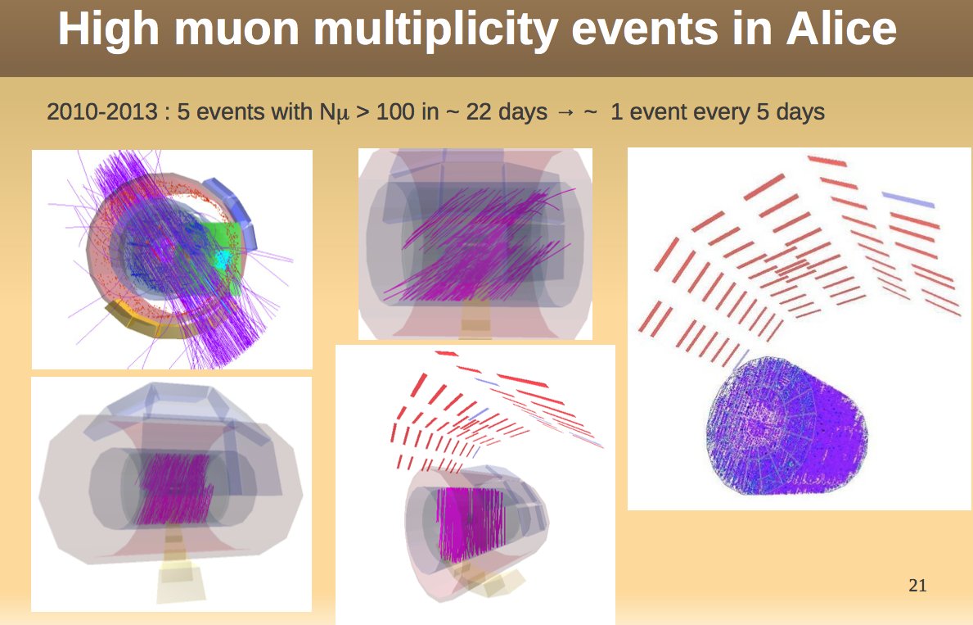
Muon bundles
Seen in LEP, seen now by LHC experiments, cosmic muon bundles at surprisingly large multiplicities.
Different type of interface between collider and cosmic-ray experiments…
Surface air-shower counters being discussed for ATLAS.
B.Alessandro

Slide 15
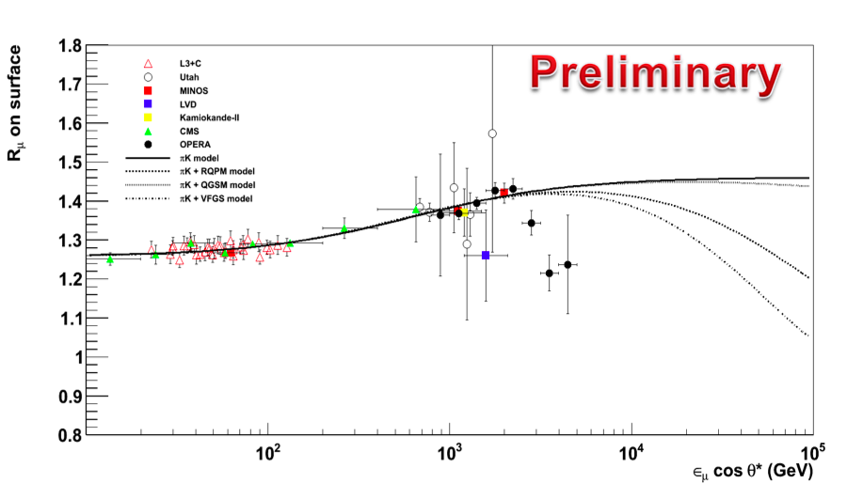
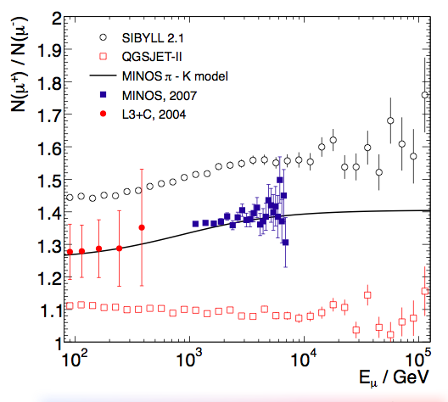
OPERA muon charge ratio
N.Mauri, OPERA
Models do not produce sharp drop (even when including charm), A. Fedynitch

Slide 16
Future activities – discussion
Interactions are important but not sufficient, need common approach
  List of actions helps, but is usually not enough
Most (all?) of our resources focused on LHC mainstream physics
  Example: ATLAS trigger detectors for soft charged particles will disappear
LHC In-house versus Invasion
Extend to generic astroparticle physics discussions?
  Dark matter of course
  Much more sensitive
  Combination of LHC measurements, and LHC with others

