Slide 1

Central Exclusive Higgs Production: Theory
Jeff Forshaw

Slide 2
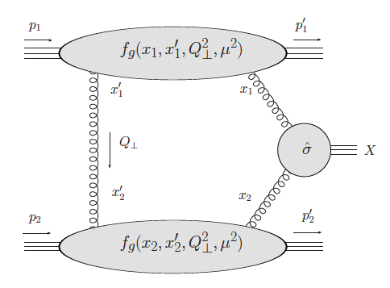
Most recent predictions
arXiv:1301.2552
arXiv:1011.3653
No Sudakov derivative
arXiv:1211.2105
No Sudakov derivative
Higher scale in Sudakov
arXiv:1011.5842
Agreed uncertainty of a factor 3

Slide 3
How things changed since my 2005 HERA/LHC
review (2 fb):
Correction to the Sudakov factor
New data & suggestion of a lower gap survival
New parton distributions
Higgs discovery
Coughlin & JRF
arXiv:0912.3280

Slide 4
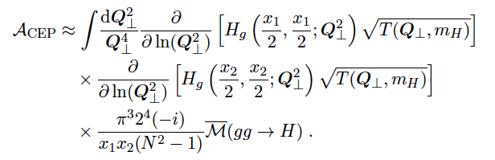
Key elements in the calculation

Slide 5



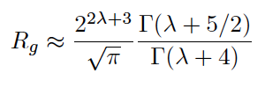
Shuvaev et al, hep-ph/9902410

Slide 6


Tim Coughlin PhD
thesis
Inclusive Higgs K-factor

Slide 7
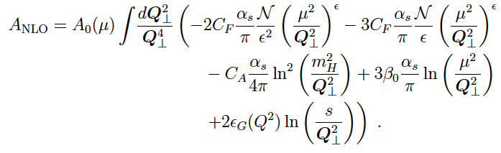
Diagrams (a) plus (g), (h), (m) – (p) generate
the Sudakov double logarithm (Feynman gauge).

Slide 8
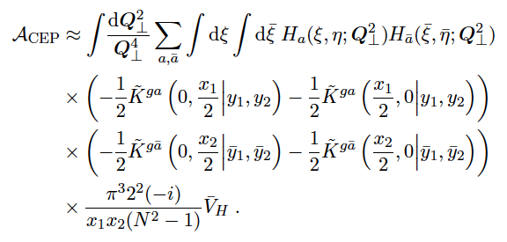
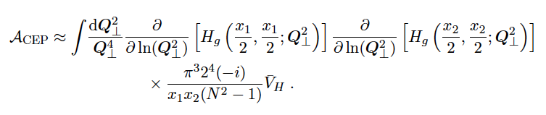
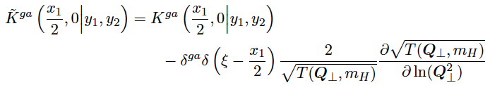
Collinear emissions:
Beware the last rung
If we ignore tilde over splitting kernel, K:
But, correct expression is
This is just Dokshitzer, Diakanov & Troyan (Physics Reports 58, 269 (1980))

Slide 9
Off-diagonal parton densities
Some uncertainty from off-diagonality: not well quantified.
Also uncertainty inherent in gluon pdf, e.g.

Slide 10
Scale and PDF dependence of the cross section (fb)
 | default | m_{H} | m_{H}/4 | 2Q | Q/2
CTEQ6L | 0.9 | 0.8 | 1.3 | 1.5 | 0.5
CT10 | 0.3 | 0.3 | 0.4 | 0.4 | 0.2
MSTW2008LO | 0.4 | 0.4 | 0.6 | 0.6 | 0.3
MSTW2008NLO | 0.3 | 0.3 | 0.4 | 0.4 | 0.2
NNPDF21LO (0.13) | 0.4 | 0.4 | 0.6 | 0.6 | 0.3
NNPDF23NLO | 0.3 | 0.2 | 0.4 | 0.4 | 0.2
GJR08LO | 1.0 | 0.9 | 1.3 | 1.4 | 0.6
1% gap survival
Preliminary

Slide 11
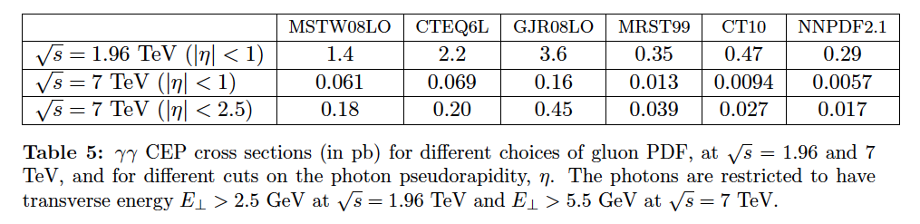
CDF di-photon data favour a large cross section:
From Harland-Lang, Khoze, Ryskin & Stirling arXiv:1204.4803

Slide 12
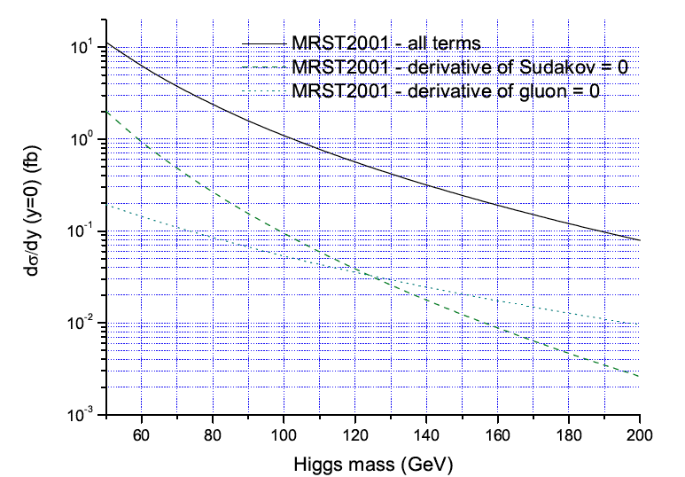
The derivative of the Sudakov matters
From hep-ph/0508274

Slide 13

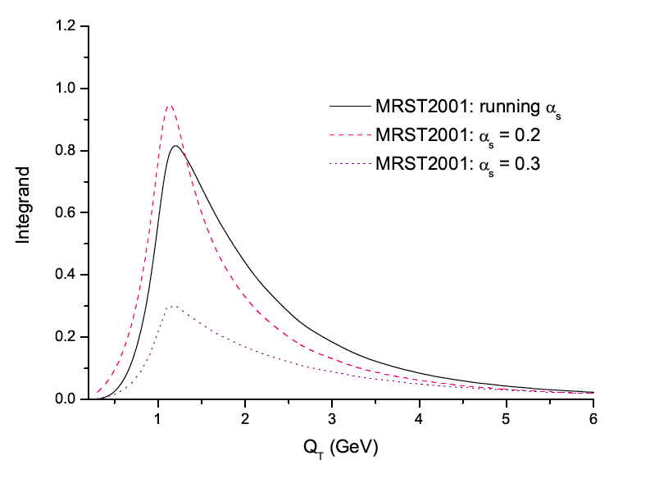
Infra-red sensitivity
From hep-ph/0508274

Slide 14
The pQCD part of the calculation is under
“reasonable” control (off-diagonal gluon uncertainty dominates).
Need a good model of factorization breaking
exchanges (a.k.a. gap survival). Central production
of other high-mass systems (di-photons & dijets) will really help us to understand it.
Correct treatment of Sudakov and TOTEM data pull cross section down.
Higher order corrections and CDF data push
cross section up.
Nobody is claiming a cross section above 2 fb.

