Slide 1
The LCC Organisation
ICFA
Program Advisory Committee
Linear Collider Board
Directorate – Lyn Evans
Deputy (Physics) –
Hitoshi Murayama
ILC – Mike Harrison
CLIC – Steinar Stapnes
Physics & Detectors – Hitoshi Yamamoto

Slide 2
Future LC objectives
Strongly support the Japanese initiative to construct a linear collider as a staged project in Japan
Prepare CLIC machine and detectors as an option for a future high-energy linear collider at CERN
Further improve collaboration between CLIC and ILC machine experts
Move towards a “more normal” structure of collaboration in the detector community to prepare for the construction of two high-performance detectors

Slide 3
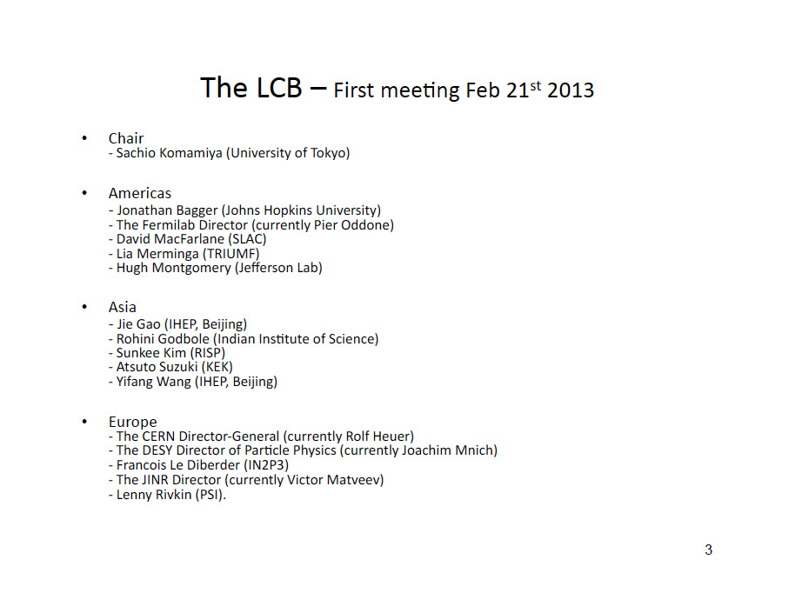

Slide 4
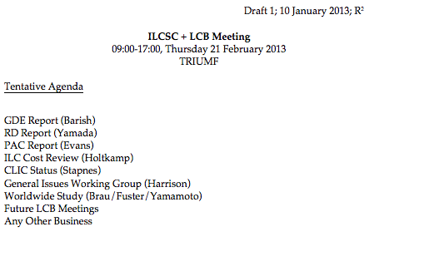
LCB meeting TRIUMF
Outline:
CDR but much shorter than before
CLIC workshop highlights
Energy frontier motivation – open day plus strategy
High Gradient Day
Detector and Physics studies (IB)
Some key challenges 2013-2016(7)

