Slide 1

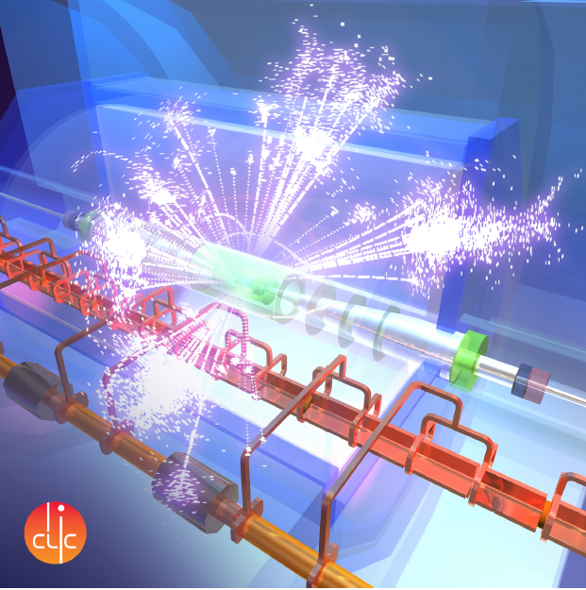
CLIC detector & physics study
MoC, Snowmass input….
Lucie Linssen, CERN
on behalf of the CLIC detector and physics study

Slide 2

Organisation of CLIC detector and physics study
Pre-collaboration structure, based on a “Memorandum on Cooperation”
http://lcd.web.cern.ch/LCD/Home/MoC.html
Light-weight collaborative structure => partners join on “best effort” basis
Organisation resembling most particle physics experiments
Central body is the Institute Board

Slide 3
Members signing MoC
Partners who have already joined:
Belarus: NC PHEP Minsk;
Czech Republic: Academy of Sciences Prague;
Denmark: Aarhus Univ.;
Germany: MPI Munich;
Israel: Tel Aviv Univ.;
Norway: Bergen Univ.;
Romania: Inst. of Space Science;
Serbia: Vinca Inst. Belgrade;
Spain: Spanish LC network;
UK: Cambridge Univ. + Oxford Univ. + Birmingham Univ.;
USA: Argonne lab;
CERN
Discussions ongoing with ~8 additional partners:
Annecy, Edinburgh, Krakow (2*), Oslo, Bucharest, Athens, Santiago de Chile

Slide 4
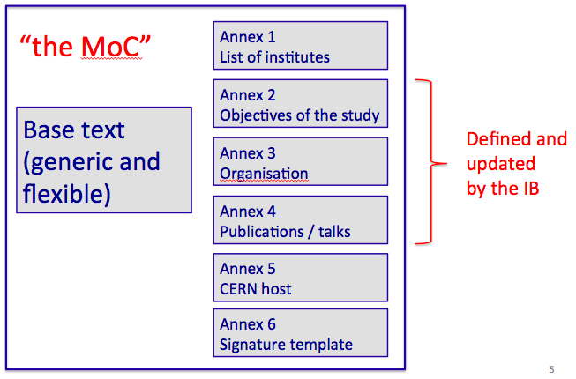
First informal IB meeting
First “informal” Institute Board meeting held on 29/1
As other Partners are still joining => too early to establish full structure and hold lections
Next meeting => end of April 2013
Early priority of the IB:
Set up publication rules and speakers bureau
Preparation of CLIC physics input to USA Snowmass process

Slide 5
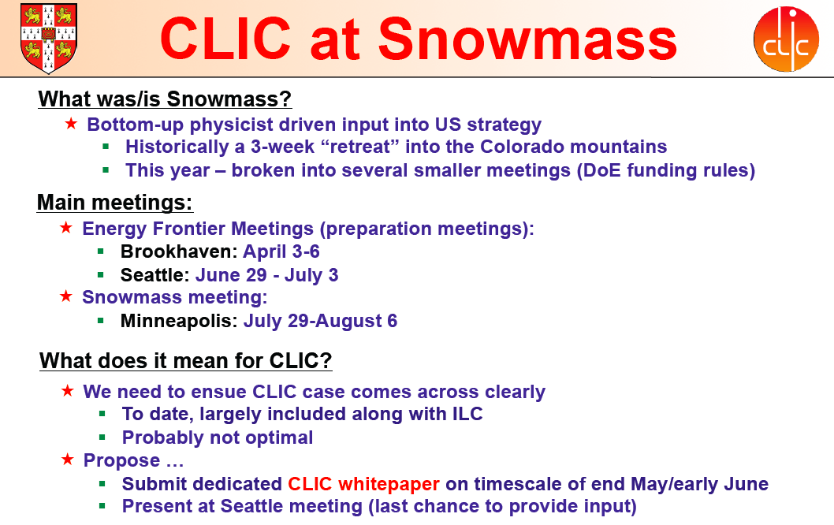
CLIC physics => Snowmass

Slide 6
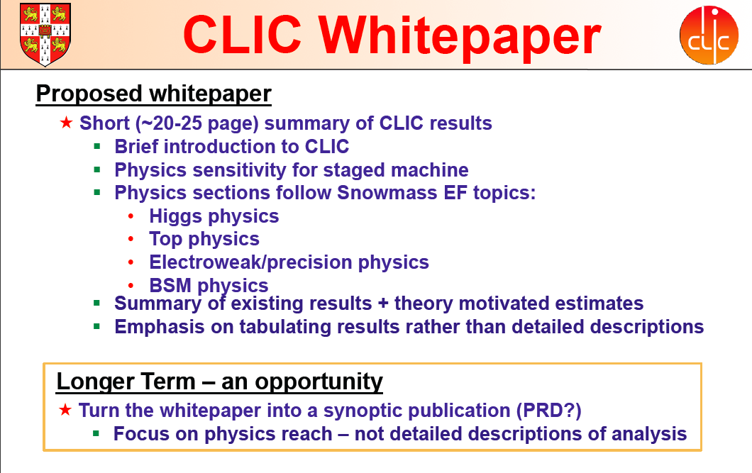
=> Following the wish of the IB members => Use the new MoC situation to have an “author list” for the CLIC physics paper

Slide 7
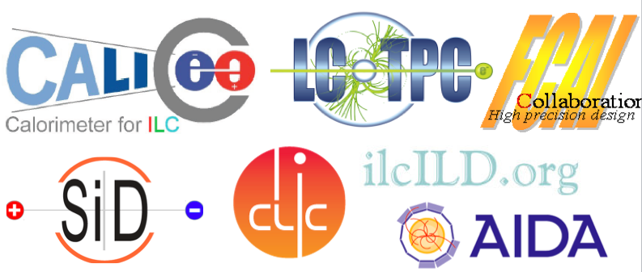
plans for the phase 2013-2016
Further exploration of the physics potential
Complete picture of Higgs prospects at ~350 GeV, ~1.4 TeV, ~3 TeV
Discovery reach for BSM physics
Sensitivity to BSM through high-precision measurements
Detector Optimisation studies
Optimisation studies linked to physics (e.g aspect ratio, forward region coverage);
Interplay between occupancies and reconstruction;
Interplay between technology R&D and simulation models.
Technology demonstrators
Many common developments with ILC
Complemented with CLIC requirements
cf. LHC
results
Drives the CLIC staging strategy

