Slide 1
Integration issues in the tunnel and
Impact on general LHC systems
Space requirements
Radiation levels
Existing/missing infrastructure and associated equipments
Interferences with Single Event Errors mitigation works
Installation planning
Illustrated by IR phase-1 upgrade case,
Extension to other LHC upgrades as:
Modification of the matching sections
Additional collimators
Upgrade/consolidation of the RF system
Summary
Underground service galleries at Pt1 & Pt5
LHC Performance workshop – Chamonix 2010 Sylvain Weisz – DG/PRG

Slide 2
Forewords
The presentation will not address the integration aspects nor planning impacts of:
Works related to the consolidation/repair of potentially faulty bus-bar interconnects or to the implementation of the improved machine protection systems;
Completion of some installations that are part of the LHC baseline and already prepared to occur during the forthcoming shut downs (Ex installation of 2 dilution kickers at Pt6, in addition to the 8 already in place).
LHC Performance workshop – Chamonix 2010 Sylvain Weisz – DG/PRG

Slide 3
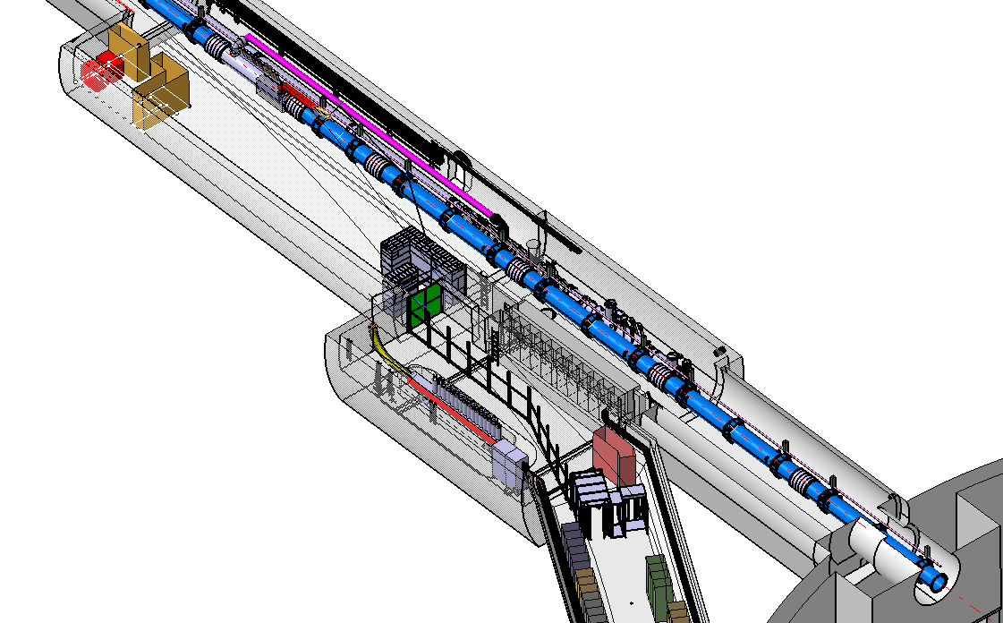
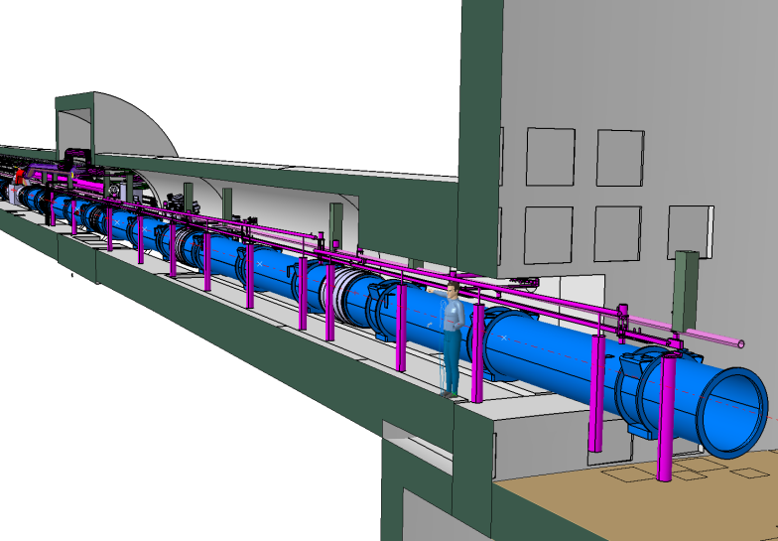
Space requirements for the new triplet _{(1/2)}
Integrations along the beam line are well advanced at Pt 1 & 5:
Yvon Muttoni, Alparslan Tursun, Stefan Maridor
Integration work started in 2008: although the project was in a mature state (CDR edited as LHC Project Report 1163 – 12/11/2008), it took ~1year to settle many "details" that are essential for the integration in the LHC tunnel.
Pt5
Pt1
LHC Performance workshop – Chamonix 2010 Sylvain Weisz – DG/PRG

Slide 4
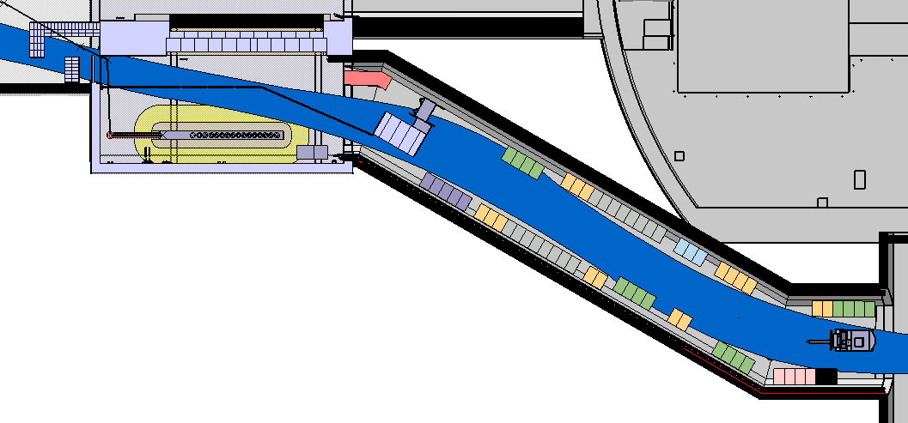
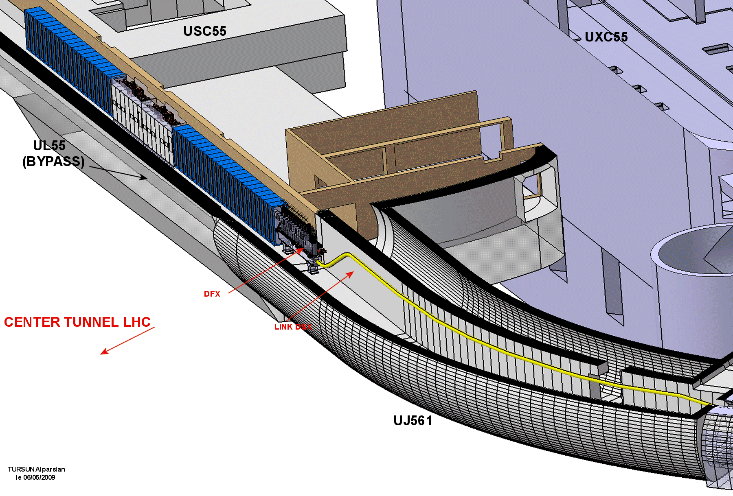
Space requirements for the new triplet _{(2/2)}
Integration of supply, control, quench protection systems still on-going:
Yvon Muttoni, Alparslan Tursun, Stefan Maridor
➔ Racks in the UL14/16 are in the passage area, need to be remove to leave way to magnet convoys – Control racks on 3rd floor of US15
➔ No complete solution for Pt5 right, space available does not allow to fit all racks required (Power converter, energy extraction & control)
➔ Note that heat load inventories have not been done yet, some air cooling units may be required …
Pt1
Pt5
LHC Performance workshop – Chamonix 2010 Sylvain Weisz – DG/PRG

Slide 5
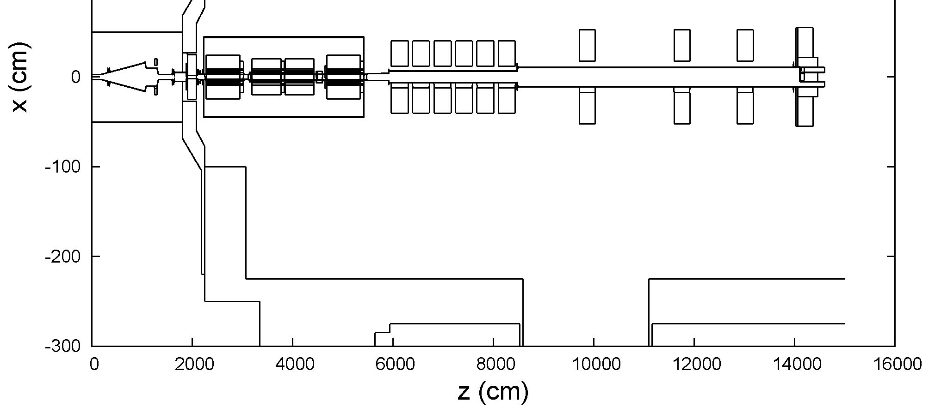
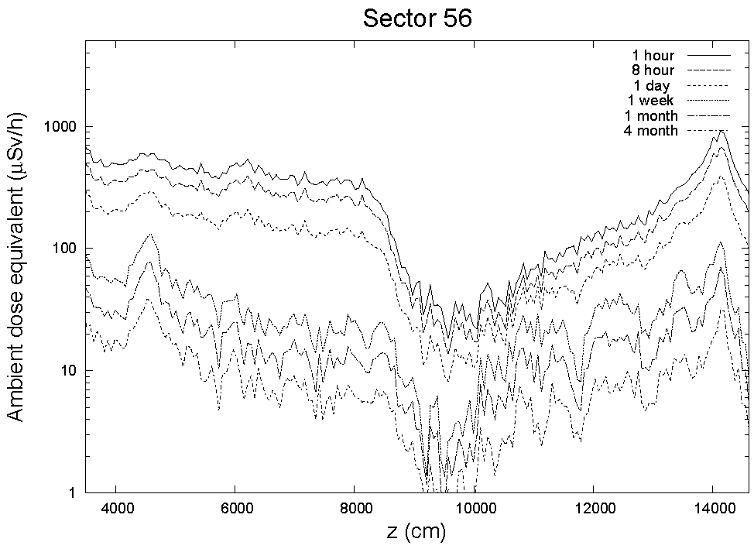
Radiation levels in the triplet region _{(1/2)}
Fluka simulation of residual dose rate:
Pt5 with all field maps (CMS, Q1/2/3 & D1)
and nominal yearly rate (10⁷ s, 10⁹ int./s)
Markus Fuerstner, Stefan Roesler
Aisle
Triplet
TAN
50 µSv/h
(limited stay area threshold)
➔ Need to wait ~2 weeks to start preparation work along the triplet.
LHC Performance workshop – Chamonix 2010 Sylvain Weisz – DG/PRG
Notes:
The residual dose rates in 1.5m distance from the beam line.
In the upper right corner the blue line visualizes where the dose rate was scored from the beginning of the Q2 until the TAN
- In the vertical axis the residual dose rate is plotted and on the horizontal the distance to the IR5.
- In order to get a feeling for the dose rates I indicated the dose rate limit above which dose planning is necessary.
Only after 4 month the residual dose rate is everywhere in a distance of 1.5 meter below the 50 muSv/h limit

Slide 6
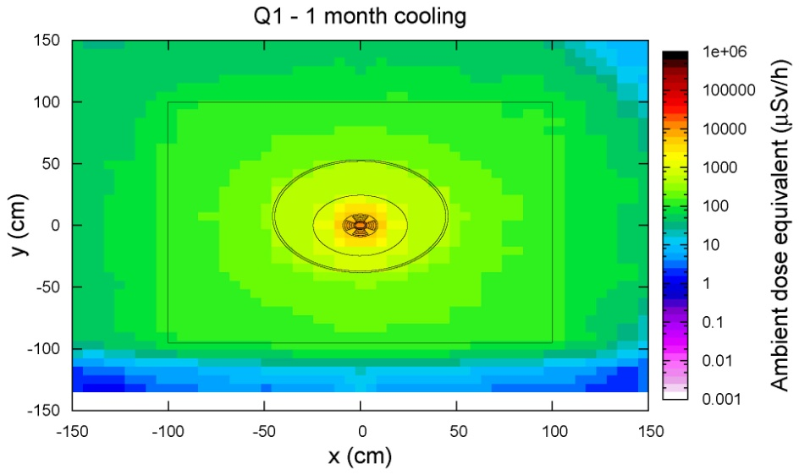
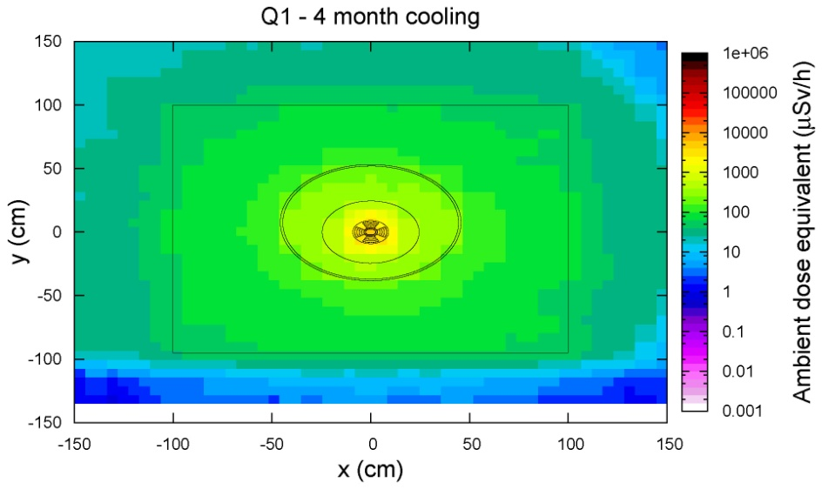
Radiation levels in the triplet region _{(2/2)}
Activation of the Q1 assembly after 1 year at nominal conditions
Markus Fuerstner, Stefan Roesler
➔ Disconnection and handling in a high radiation area (> 100 µSv/h)
➔ Work to be done by radiation workers, type III DIMR required (maximum)
➔ Dedicated tooling and protection must be developed,
with consequences on ability to carry work in parallel.
~0.6 mSv/h
~0.25 mSv/h
LHC Performance workshop – Chamonix 2010 Sylvain Weisz – DG/PRG
Notes:
On this slide the residual dose rates of the first quadrupol are shown for the same cooling rates as before.
The plots are showing as well the cross section through the Q1 and the tunnel
The dose rate was averaged along the length of the Q1.
This is the cross-section of the tunnel. The color plot is as well a cut perpendicular to beam line through the Q1. Here the dose rates range from 2 mSv/h to 0.25 mSv/h after 4 month cooling.

Slide 7
Existing/missing infrastructure and associated equipment
Modification of the cryogenic distribution, addition of extension lines
Dismantling, modification and re-installation of the survey system
Replacement of the TAS, TAN, handling of very active components
Modifications of the beam pipe and vacuum system
Removal and re-installation of the BLM’s
New beam instrumentation, installation of associated services
Rerouting of cable trays, pipes, etc…
(Only the routing of the DSX cold link has been studied so far)
➔ Most of these works accompany the upgrade of the triplets and must be done during the same extended shut down;
➔ Handling of activated material will again require extensive preparation, contracts with external firms could need some revision
LHC Performance workshop – Chamonix 2010 Sylvain Weisz – DG/PRG
Notes:
On this slide the residual dose rates of the first quadrupol are shown for the same cooling rates as before.
The plots are showing as well the cross section through the Q1 and the tunnel
The dose rate was averaged along the length of the Q1.
This is the cross-section of the tunnel. The color plot is as well a cut perpendicular to beam line through the Q1. Here the dose rates range from 2 mSv/h to 0.25 mSv/h after 4 month cooling.

Slide 8
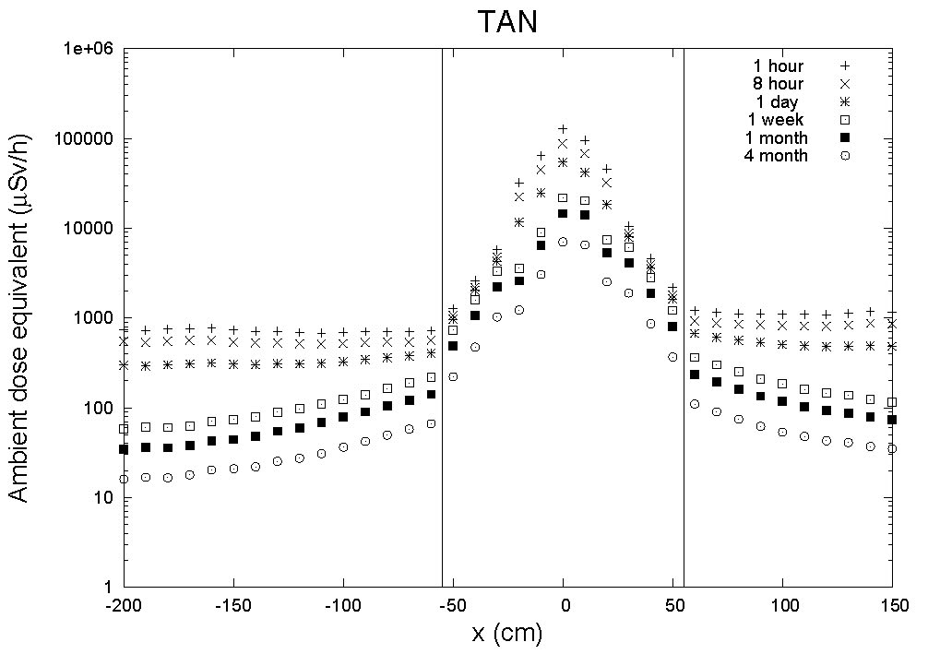
Some comments about the TAN
The TAN’s need to be replaced
to account for a different beam
separation with the new triplet.
Inner cores of the TAN’s are
among the most activated
material in the LHC:
10-100 mSv range remains
after nominal beams for
several months.
Additional handling at Pt5:
TAN’s must be lifted at Pt4/6
➔ Case for a study of an adjustable TAN, to be installed
as soon as possible
➔ It is a warm element, that could be replaced during any
shut down
Markus Fuerstner, Stefan Roesler
LHC Performance workshop – Chamonix 2010 Sylvain Weisz – DG/PRG
Notes:
The residual dose rates in 1.5m distance from the beam line.
In the upper right corner the blue line visualizes where the dose rate was scored from the beginning of the Q2 until the TAN
- In the vertical axis the residual dose rate is plotted and on the horizontal the distance to the IR5.
- In order to get a feeling for the dose rates I indicated the dose rate limit above which dose planning is necessary.
Only after 4 month the residual dose rate is everywhere in a distance of 1.5 meter below the 50 muSv/h limit

Slide 9
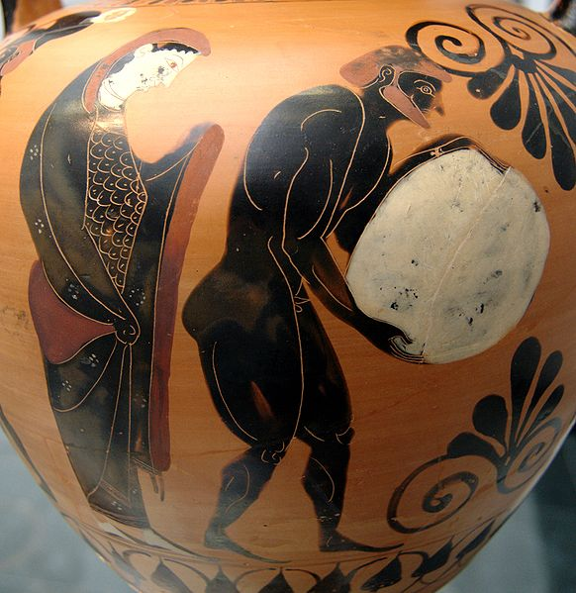
Interferences with SEE mitigation work
SEE mitigation works around Pt1 and Pt5 will occur to cope with the increase of luminosity toward nominal conditions.
(see presentations from Markus Brugger and Roberto Losito)
Such works clearly get some priority since they directly impact on the overall efficiency of the LHC.
Additional shielding and equipment relocation will modify the local environment and the underground integration needs to be revised accordingly.
It is then quite adventurous to advance
important installation/modification of
services associated to the IR phase-1
upgrade.
Persephone supervising Sisyphus
pushing his rock in the Underworld
LHC Performance workshop – Chamonix 2010 Sylvain Weisz – DG/PRG
Notes:
On this slide the residual dose rates of the first quadrupol are shown for the same cooling rates as before.
The plots are showing as well the cross section through the Q1 and the tunnel
The dose rate was averaged along the length of the Q1.
This is the cross-section of the tunnel. The color plot is as well a cut perpendicular to beam line through the Q1. Here the dose rates range from 2 mSv/h to 0.25 mSv/h after 4 month cooling.

Slide 10
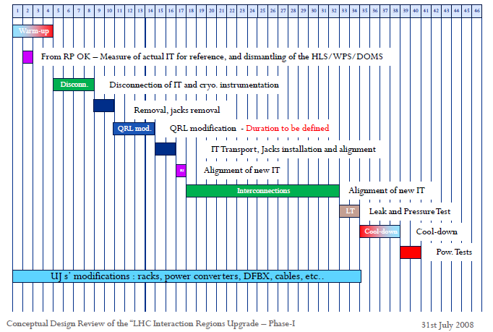
Installation planning
Katy Foraz – Preliminary schedule
9 months for 1 triplet
Sylvain Weisz – DG/PRG

Slide 11
Modification of the matching sections Pt1 & Pt5 _{(1/2)}
All specifications should be fixed as soon as possible to start the integration work
Will involve work in high radiation area and handling of activated elements
Infrastructure will require modifications: cryogenic distribution and DSL powering links
Installation/modification of the control and powering equipment in the RR’s will need to cope with SEE mitigation developments
➔ Activities are very similar to the installation of the new triplets;
➔ Should minimize successive modifications of the MS, search a solution also valid for the phase-2 upgrade of the triplet
LHC Performance workshop – Chamonix 2010 Sylvain Weisz – DG/PRG

Slide 12
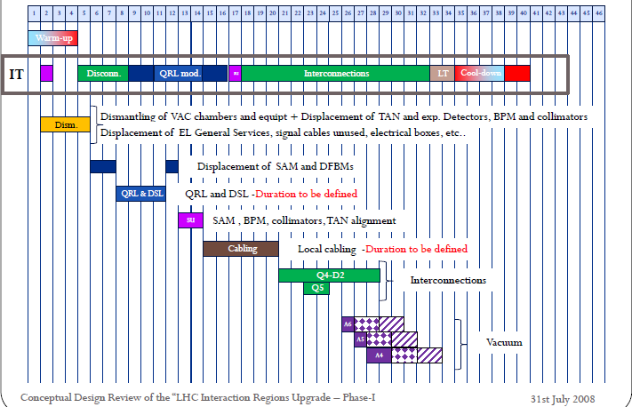
Modification of the matching sections Pt1 & Pt5 _{(2/2)}
Katy Foraz – Preliminary schedule
Only a draft version, many task duration need to be consolidated
Lots of activities involve the same expertise’s as those required for the installation of the new triplets
Global duration for the 4 matching sections, together with the installation of the new triplets, will obviously depend on the resources (teams and tooling) we can requisite to work in parallel
Intense and tightly dependant co-activities always carry some risk of slippage: planning contingency must be envisaged
Access points are limited (PM15, PM56), basically no material access at Pt5, need to transport from Pt4 or Pt6
LHC Performance workshop – Chamonix 2010 Sylvain Weisz – DG/PRG

Slide 13
Additional collimators _{(1/2)}
Ralf’s shopping list (see precedent presentation):
Installation of 2 TCLP collimators at Pt1/5: collimators available, infrastructure prepared
➔ could be installed during normal shut down, to be coordinated with TOTEM for Pt5
Installation of 30 "advanced phase II" collimators at Pt3/7: infrastructure prepared, R&D prototyping ongoing
➔ could be installed during normal shut downs as they become available
Installation of cold collimators in DS at Pt3/7 ➔ see next
Installation of cold collimators in DS at Pt2 ➔ see next
Installation of 2 additional warm collimators at Pt1/5: associated to lower β* optics, new infrastructure required
➔ could be integrated and installed together with the modification of the matching sections
Installation of cold collimators in DS at Pt1/5 ➔ see next
LHC Performance workshop – Chamonix 2010 Sylvain Weisz – DG/PRG

Slide 14
Additional (cold) collimators _{(2/2)}
All specifications should be fixed as soon as possible to start the integration work (Ex impact on injection at Pt2, DFBA’s displacement)
Will involve work in high radiation area and handling of activated elements (Ex at Pt3/7)
Infrastructure will require modifications: cryogenic distribution and powering lines for quadrupoles and DFBA’s displacements
Installation/modification of the control and powering equipment in the RR’s will need to cope with SEE mitigation developments
➔ Problematic very similar to the installation of the new triplets or modification of the matching sections
➔ Rearrangement of the magnets in dispersion suppressors requires the same expertise’s as in these two cases: cutting lines, handling/transport, survey, interconnects, tests
➔ Such activities would hardly fit inside a normal 4-5 months shut down (under investigation – J.P. Tock)
➔ Global duration for the 2/4/6/10 DS’s, will obviously depend on what we also want to implement during the extended shut down and on the resources we can requisite…
LHC Performance workshop – Chamonix 2010 Sylvain Weisz – DG/PRG

Slide 15
Upgrade/consolidation of the RF system
Installation of 200 MHz capture cavities: space has been reserved for 4 cavities on each beam
➔ the ACN’s could be installed during a normal shut down
Installation of additional transverse damping and feedback: space has been reserved for one additional module per ring
➔ the ADT’s could be installed during a normal shut down
Installation of RF dedicated 4.5K cooling capacity: requires a new underground refrigerator cold box and cryogenic distribution
➔ no integration yet, corresponding space probably available in UX45
➔ installation during a single normal shut down quite challenging, but it could span over consecutive shut downs
Crab Cavity at Pt4: no space available if 200 MHz capture cavities + additional dampers are installed; cavity temperature (2K or 4.5K) has a strong impact on the modification of the cryogenic distribution
➔ need a more mature proposal to evaluate integration issues
LHC Performance workshop – Chamonix 2010 Sylvain Weisz – DG/PRG

Slide 16
Summary
Space available underground just fits the needs of the LHC baseline: any modification/upgrade encounters strict limitations at Pt1 and Pt5 where there are no service galleries (UA’s).
The installation of the triplet upgrade phase-1 at Pt1 and Pt5 will probably require a ~1year extended shut down.
Foreseen SEE mitigation works interfere with the present layout of services associated to the new triplet: it actually precludes early preparation that could reduce substantially the down time period.
There are still many unknowns concerning the modifications of the matching section and the installation of cold collimators: precise specifications are required to start the integration process and propose a sound planning for underground interventions.
LHC Performance workshop – Chamonix 2010 Sylvain Weisz – DG/PRG

Slide 17
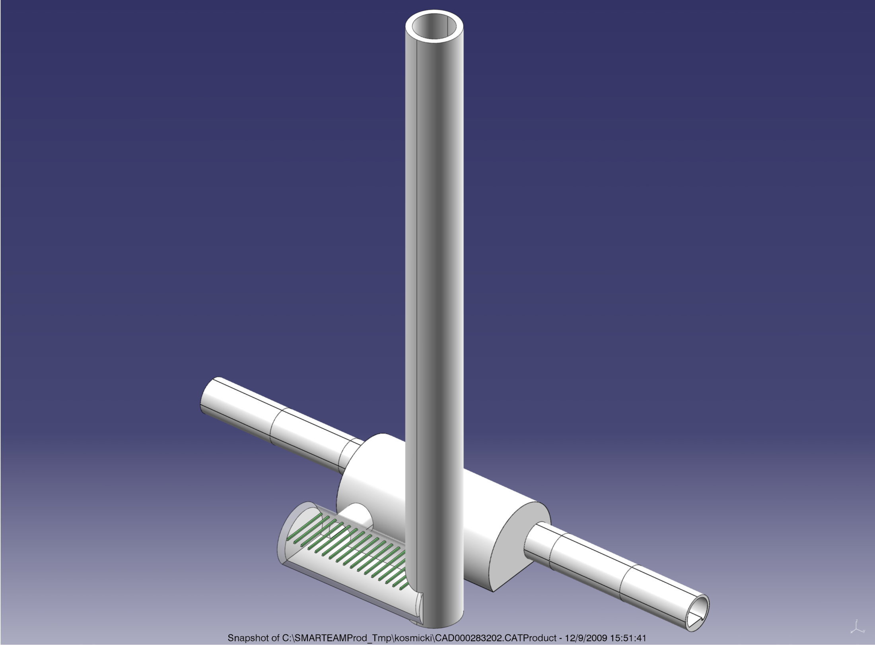
Underground service galleries at Pt1 & Pt5
New shafts on both sides of Pt1 and Pt5 already mentioned on Tuesday to provide alternate paths for He release
Shafts and caverns close to the RR’s at Pt1/5 where also mentioned yesterday to relocate SEE sensitive equipment
John Osborne GS-SEM
LHC Performance workshop – Chamonix 2010 Sylvain Weisz – DG/PRG

Slide 18
Underground service galleries at Pt1 & Pt5
26%
Estimate accuracy +/-20%

Slide 19
Underground service galleries at Pt1 & Pt5
CE work = 2 years

Slide 20
Space for the evolution of the high luminosity insertions
New shafts on both sides of Pt1 and Pt5 already mentioned on Tuesday to provide alternate paths for He release
Shafts and caverns close to the RR’s at Pt1/5 where also mentioned yesterday to relocate SEE sensitive equipment
It could be the "seed" for service galleries at Pt1/5
John Osborne GS-SEM
LHC Performance workshop – Chamonix 2010 Sylvain Weisz – DG/PRG

Slide 21
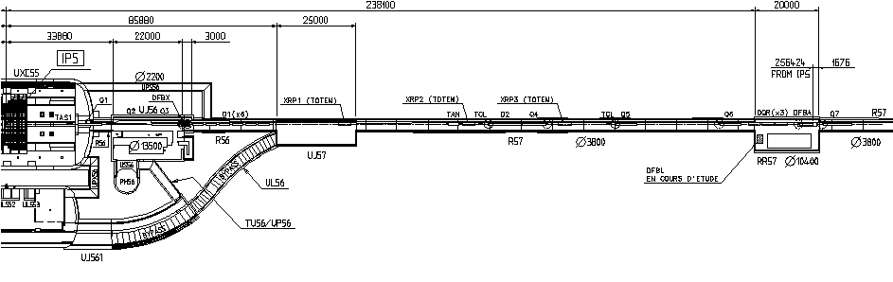



Space for the evolution of the high luminosity insertions
UA57
It is clearly a very important investment
But can we do without it? Long term SEE mitigation, IR upgrade phase-1 & phase-2, local Crab Cavity with dogleg, additional cryogenics, etc…
Should be discussed at the mid-April workshop that Roberto announced yesterday?
LHC Performance workshop – Chamonix 2010 Sylvain Weisz – DG/PRG

