Slide 1
Current Limitations and Plans for CRYO System
(arc and insertions)
3rd HL-LHC Parameter and Lay-out Committee
Rob van Weelderen,
Cryogenic Group, Technology Department, CERN
based on 2nd HL-LHC -- LARP meeting in Frascati (Nov 2012) of Laurent Tavian
with the contribution of K. Brodzinski, G. Ferlin, U. Wagner

Slide 2
Content
Overall HL-LHC layout
Local and global cryo-limitation in Sectors
Specific Inner Triplet cryo-limitations
Cryogenic layout proposals at:
    Point 1 and Point 5
    Point 4
    Point 7
Specific studies and tests
Schedule and conclusion

Slide 3
Overall HL-LHC layout
HL-LHC cryo-upgrade:
  2 new cryoplants at P1 and P5 for high luminosity insertions
  1 new cryoplant at P4 for SRF cryomodules
  New cooling circuits at P7 for SC links and deported current feed boxes
  Cryogenic design support for cryo-collimators and 11 T dipoles at P3 and P7

Slide 4
Sector heat loads: local limitation
(valves, HX, piping,…)
Synchrotron radiation →
Image current →
Beam gas scattering →
Resistive heating →

Slide 5
Sector heat loads: global limitation
Load transfer from 1.9 K to 4.6-20 K refrigeration
Installed
(as specified)
~1 W/m per aperture available for e-cloud
→ ~20 % lower than local
limitation (OK !)

Slide 6
Specific present IT cryo-limitations
Point (status 25.03.2010) | Present Cryogenic power available for secondaries (W) | After LS1 Cryogenic power available for secondaries (W)
L1 | 147 | 270
R1 | 270 | 270
L2 | 147 | 270
R2 | 270 | 270
L5 | 270 | 270
R5 | 147 | 270
L8 | 147 | 270
R8 | 270 | 270
Present Inner Triplets have limitations for extraction of secondaries due to:
Collapsed and repaired, with lower capacity, HeII two-phase heat exchanger (will not be consolidated)
Erroneous mounting of passive heating strips for excess liquid evaporation (will be consolidated in LS1)

Slide 7
Main components at Point 1 and 5
(& quench buffers)
Ground level
Shaft
Cavern
?
?
?
?
Continuous
cryostat
Matching section
Inner triplet
Matching section
Continuous
cryostat
?: For Q5, Q6 and probable Q7+ ? 1.9 K or 4.5 K operation
will influence the cryo QRL interface significantly
(1.9 K needs 2 jumpers with present QRL design hardware)

Slide 8
P1 & P5 layout 1: Matching section cooled with sector cryoplants
Q5, Q6 and probable Q7+ ? 1.9 K or 4.5 operation
S81 or S45
P1 or P5
S12 or S56
Note: Cryo for Sector- and LSS-powering are combined except for IT & D1

Slide 9
P1 & P5 layout 2: Matching section cooled with inner triplet cryoplants
Q5, Q6 and probable Q7+ ? 1.9 K or 4.5 operation
S81 or S45
P1 or P5
S12 or S56
Note: Cryo for Sector- and LSS-powering are as well separated
(links and DFBA / DFBX leads re-arrangement)

Slide 10
LSS specific magnet cryo-layout issues
Stand-alone magnets 1.9 K cooling QRL interface requires more space than 4.5 K cooling in with present QRL / jumpers / Service modules design (either 2 service modules, twin-DFBX-like module, both with QRL extensions)
D2-Crab cavities-Q4 layout would need 3 jumpers if Crab cavities cryostat are kept independent (cold / warm transition) from neighbouring magnets
IT cooling arrangement under study with TE-MSC-LMF, TE-MSC-CMI (# of jumpers, D1 and/or CP conduction cooled, link cooling, phase-separator placing, piping sizing, beam-screen)
In the light of the above, adapting the existing QRL to the HL-LHC LSS needs might be possible but looks increasingly difficult

Slide 11
Comparison of layouts at P1 and P5
 | Advantage | Drawback
Layout 1: MS with sector | Corresponds to the CtC baseline (minor modification on the existing QRL, i.e. only new jumper extensions foreseen)… | …but reuse of existing QRL if the new MS layout largely differ from the existing one (operating temperature and/or new equipment (D2, CC, Q4, Q5, Q6? Q7+?…)) could be also expensive and space consuming… …and maybe not feasible!
Layout 2: MS wit IT | Optimisation of the distribution and space with respect to the HL-LHC need. Allow the upgrade of “A” boxes during LS2 Complete sectorization of MS + IT allowing mechanical intervention without warm-up of the two adjacent sectors (but interconnection, if any, must be designed accordingly) | Increase of the CtC (~1 km of compound transfer line with ~20 service modules) → additional cost (8-10 MCHF tbc)
Layout 2 as future baseline? Decision needed

Slide 12
Interconnection for partial redundancy
Present redundancy baseline w/o interconnection (IB) in between cryoplants !
“Partial” redundancy: - cold standby during technical and Xmas stops
- low beam-intensity operation in case of major breakdown on the new cryoplant (full nominal redundancy not possible)
- what about redundancy with detector cryogenics ?
Cost increase

Slide 13
Interconnection box (IB)
Up to 10 cryogenic valves to be integrated in the tunnel (space ?)
→ Volume in between valves used as controlled volume for safe cryo-consignation
→ Valve DNs depend on the level of needed redundancy

Slide 14
Space requirement in caverns and shafts
Shaft requirement→ In addition to the 3 SC links:
- 1 compound cryoline (~DN500)
- 3 warm recovery lines (~DN100-150)
Cavern requirement:
- 1 cold compressor box

Slide 15
Minimum CCB requirement in cavern
Best for cavern integration
Double CC train
Single CC train
500 W HX
Depending of the
total cooling capacity and
operating temperature
Global or distributed ?
(500 W max size for distributed HX !)

Slide 16
Number of cold compressor trains
LHC sector
Present HL-LHC
Requirement (tbc)

Slide 17
Minimum size of cold compressor box (CCB)
~5.5 m
~1.6 m
+ electrical cabinets in protected area for instrumentation, AMB controllers and variable-frequency drives
(~0.6 x ~2.7 x ~2.2 m³)
→ Ground level installation of cabinets under study with 150 m of cabling (today: 25 m max)
~6 m

Slide 18
P4 Layout: new cryogenics for SRF module
S34
P4
S45
With interconnection for partial redundancy
(Accepted as baseline)

Slide 19
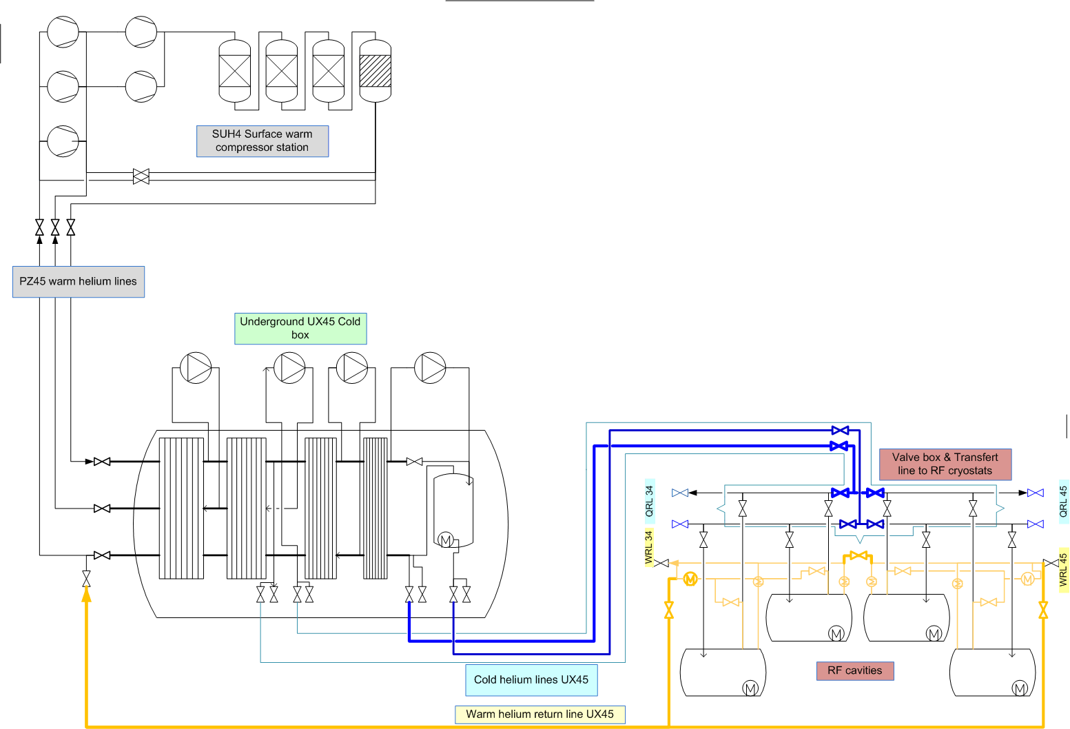
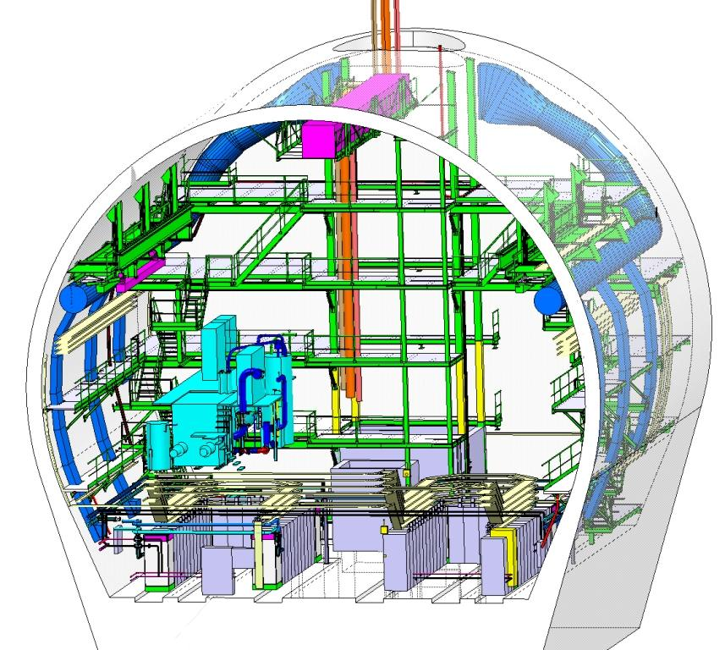
P4 cryogenic process & flow diagram
UCB:
6-7 kW @ 4.5 K
cryoplant (tbc)
UX45

Slide 20
P7 Layout: Deported current feed boxes
  New cooling circuits for SC links and deported current feed boxes
  Extension of the warm recovery lines to the TZ76
  Cryogenic design of new SC links and current feed boxes.
TZ76
S67
S78

Slide 21
Specific cryogenic studies and tests
(or what differ from LHC design ?)
Cooling circuits for large heat deposition:
  on 1.9 K cold masses up to 10 W/m
  → heat extraction from SC cables and quench energy margin
  → Generic heat flow in magnet cross section
  on beam-screens up to 13-20 W/m (image current effect ?)
Cooling of HTS SC links and current feed boxes
Cooling and pressure relief of crab-cavities
Validation tests on SC link, crab-cavities, magnets, beam screens…
Reactivation of the Heat Load Working Group
Quench containment and recovery (cold buffering ?)
Large-length cable (150 m) for cold-compressor controls and drives
Large capacity (750-1500 W) sub-cooling heat exchangers
Larger turndown capacity factor on 1.8 K refrigeration cycle: up to 10?
From users to cryogenic infrastructure

Slide 22
Schedule
P7
P1&P5
(type A)
P1&P5
(type X)
: Freeze of heat load requirement

Slide 23
Conclusion
Several HL-LHC cryogenic layouts have been presented with alternatives for cooling sectorization and redundancy → decision needed for main sectorization option, additional study needed on detailed options
Preliminary heat load estimate is defined :
→ local and global limitation for sector cryogenics are compatible with the proposed HL-LHC beam parameter.
→ the HLWG to refine and follow the heat load inventory have to be reactivated.
Specific cryogenic studies and tests are defined → some of them have already started
Integration study of new underground equipment must be done to validate:
→ layout and interface requirements of all LSS magnet systems as function of their operation temperature
→ the possible reuse of part of the existing distribution system (QRL)
→ the underground space availability for the cold compressor boxes at P1 and P5

