Slide 1
Including the Hour-Glass Effect in the HL-LHC parameter list
S. Fartoukh,
3rd HL-LHC PLC meeting 18/01/2013

Slide 2
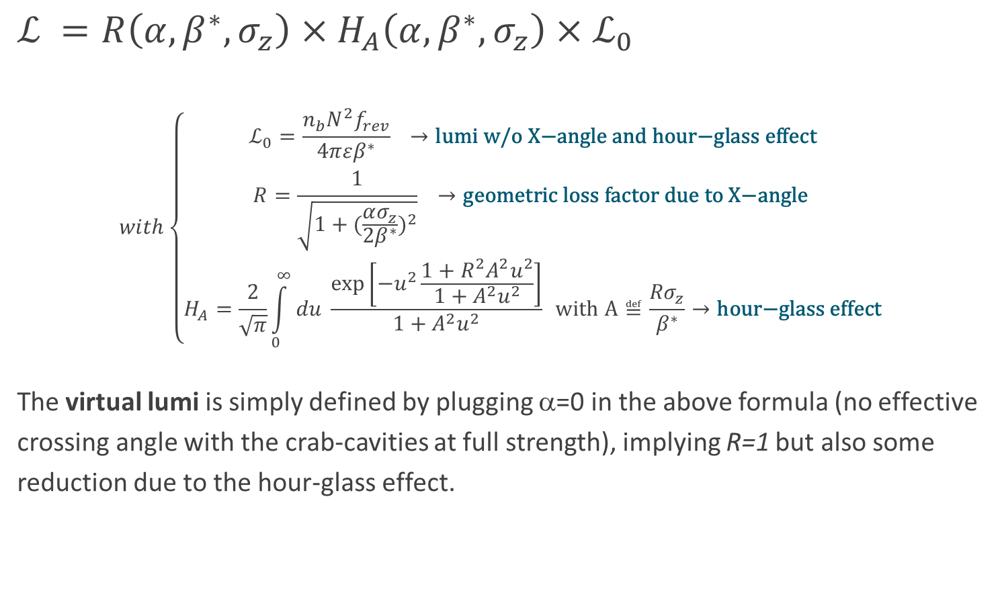
The Lumi Formula
... with X-angle and hour-glass effect (for round beams)
$ℒ =R\left(α,β^{∗},σ_{z}\right)×H_{A}\left(α,β^{∗},σ_{z}\right)$ $×ℒ_{0}$
$$with\left\{\begin{aligned}ℒ_{0}=\frac{n_{b}N^{2}f_{rev}}{4πεβ^{∗}} →\text{lumi} \text{w}\text{/}\text{o} \text{X}\text{−}\text{angle} \text{and} \text{hour}\text{−}\text{glass} \text{effect} \\ R=\frac{1}{\sqrt{1+{(\frac{ασ_{z}}{2β^{∗}})}^{2}}} →\text{geometric} \text{loss} \text{factor} \text{due} \text{to} \text{X}\text{−}\text{angle} \\ H_{A}=\frac{2}{\sqrt{π}}\int_{0}^{∞}{du \frac{\text{exp}\left[−u^{2}\frac{1+R^{2}A^{2}u^{2}}{1+A^{2}u^{2}}\right]}{1+A^{2}u^{2}}} \text{with} \text{A}≝\frac{{Rσ}_{z}}{β^{∗}}→\text{hour}\text{−}\text{glass} \text{effect}\end{aligned}\right.$$
The virtual lumi is simply defined by plugging α=0 in the above formula (no effective crossing angle with the crab-cavities at full strength), implying R=1 but also some reduction due to the hour-glass effect.

Slide 3
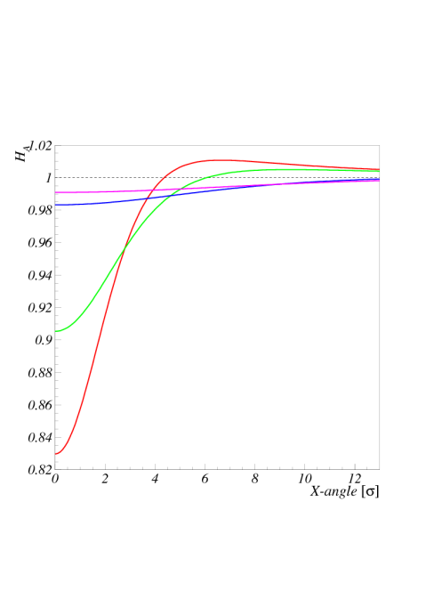
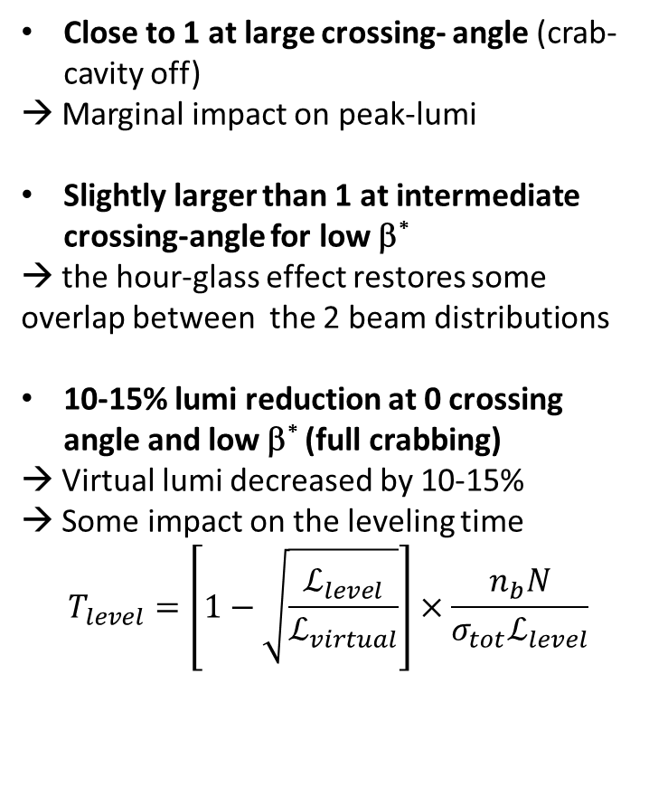
The coefficient H_{A} as a function of the effective X-angle (with c.c.) for various β*
Close to 1 at large crossing- angle (crab-cavity off)
→ Marginal impact on peak-lumi
Slightly larger than 1 at intermediate crossing-angle for low β*
→ the hour-glass effect restores some
overlap between the 2 beam distributions
10-15% lumi reduction at 0 crossing angle and low β* (full crabbing)
→ Virtual lumi decreased by 10-15%
→ Some impact on the leveling time
$$T_{level}=\left[1−\sqrt{\frac{ℒ_{level}}{ℒ_{virtual}}}\right]×\frac{n_{b}N}{σ_{tot}ℒ_{level}}$$
β*=55 cm
β*=40 cm
β*=15 cm
β*=10 cm

Slide 4
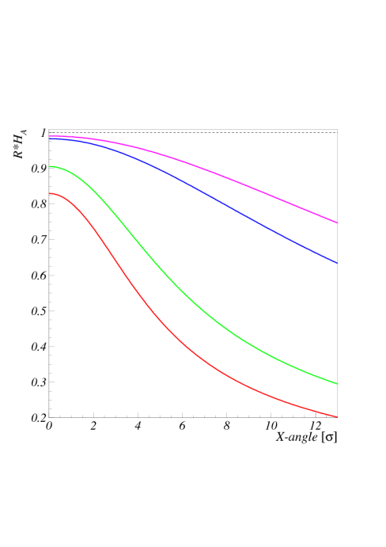
The full reduction R×H_{A} as a function of the effective X-angle for various β*
We always loose with crossing angle
β*=55 cm
β*=40 cm
β*=15 cm
β*=10 cm

Slide 5
Proposed (slight) modifications & complements to the PLC parameter table
Parameter | nominal​ | 25ns​ | 50ns
N_{b} | 1.15E+11 | ​2.2E+11 | ​3.5E+11
n_{b} | ​2808 | ​2808 | ​1404
N_{tot} | 3.2E+14 | 6.2E+14 | 4.9E+14
beam current [A] | ​0.58 | 1.11 1.12 | 0.89
x-ing angle [μrad]​ | 300 | 590 | 590
beam separation [σ] | 9.9 | 12.5 | 11.4
β* [m] | 0.55 | ​0.15 | ​0.15
ε_{n} [μm]​ | 3.75 | ​2.50 | 3
ε_{L} [eVs]​ | 2.51 | ​2.51 | ​2.51
energy spread​ | ​1.20E-04 | ​1.20E-04 | ​1.20E-04
bunch length [m] | ​7.50E-02 | ​7.50E-02 | ​7.50E-02
IBS horizontal [h] | ​80 -> 106 | 18.5 | 17.2
IBS longitudinal [h] | 61 -> 60 | 20.4 | 16.1
Piwinski parameter | ​0.68 | 3.12 | 2.85
Reduction factor 'R1*H1‘ at full crossing angle (no crabbing) | 0.828 ​0.83 | 0.306 ​0.305 | 0.333 0.331
Reduction factor ‘H0‘ at zero crossing angle (full crabbing) | 0.991 | 0.905 | 0.905
beam-beam / IP without Crab Cavity | 3.1E-03 | ​3.3E-03 | 4.7E-03
beam-beam / IP with Crab cavity | 3.8E-03 | 1.1E-02 | 1.4E-02
Peak Luminosity without levelling [cm⁻² s⁻¹] | 1.0E+34 | 7.4E+34 | 8.5E+34
Virtual Luminosity: Lpeak*H0/R1/H1 [cm⁻² s⁻¹] | 1.2E+34 | 21.9 24E+34 | 23.1 26E+34
Events / crossing without levelling | ​19 -> 28 | 210 | 475
Levelled Luminosity [cm⁻² s⁻¹] | - | ​5E+34 | 2.50E+34
Events / crossing (with leveling for HL-LHC) | *​19 -> 28 | 140 | 140
Leveling time [h] (assuming no emittance growth) | - | 9.0 | 18.3

