Slide 1

Top quark physics
1
W. Verkerke (Nikhef),
Representing ATLAS, CMS, CDF & D0
Rencontres de Blois 2013

Slide 2
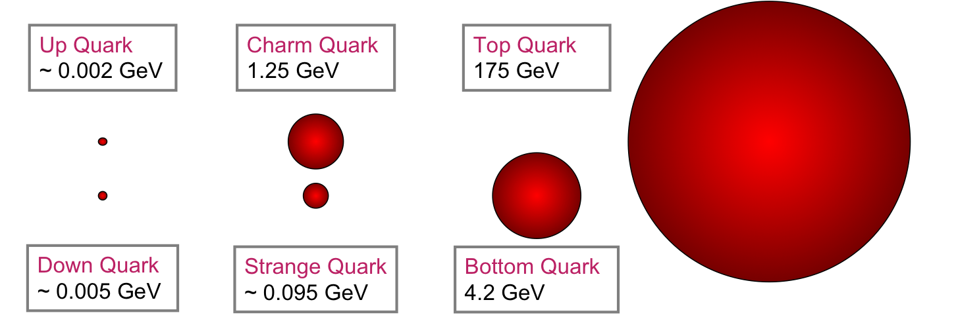
Top quark physics - Introduction
2
Large mass, short life time make top quark
interesting object for study:
Short life time → No hadronization into bound states:
  Can study many properties of ‘bare’ top quark and its production mechanism (couplings, spin correlations etc…)
Large mass → Favored decay product of many NP particles
  Modifications of top production may be indicative of new physics
173

Slide 3
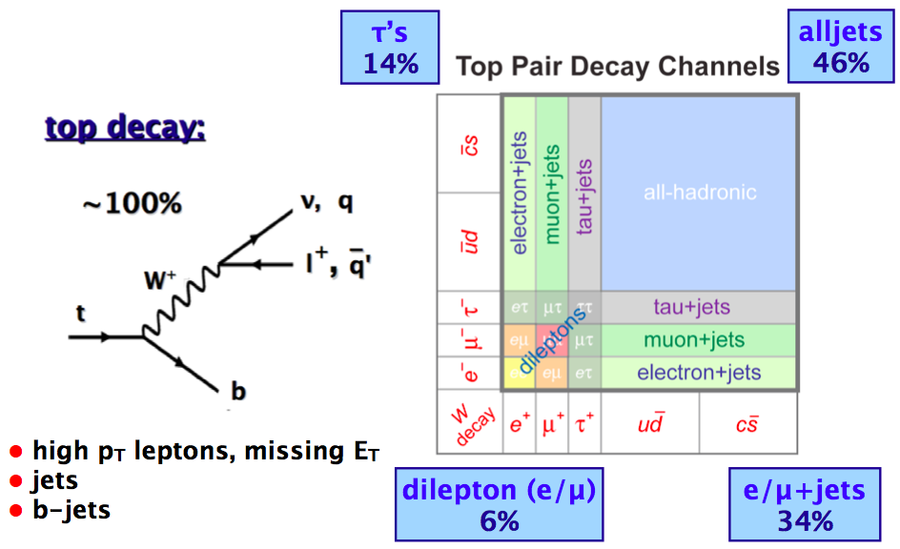
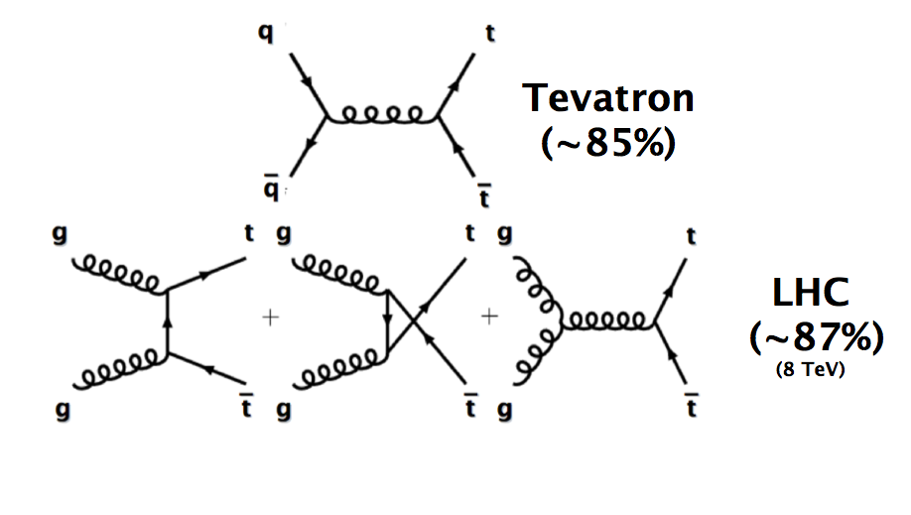
Top quark (pair) production & decay
3
Dominant production:
QCD pair production
Decay: weak interaction

Slide 4


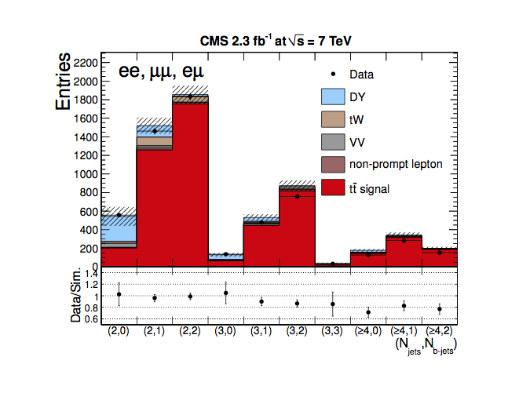
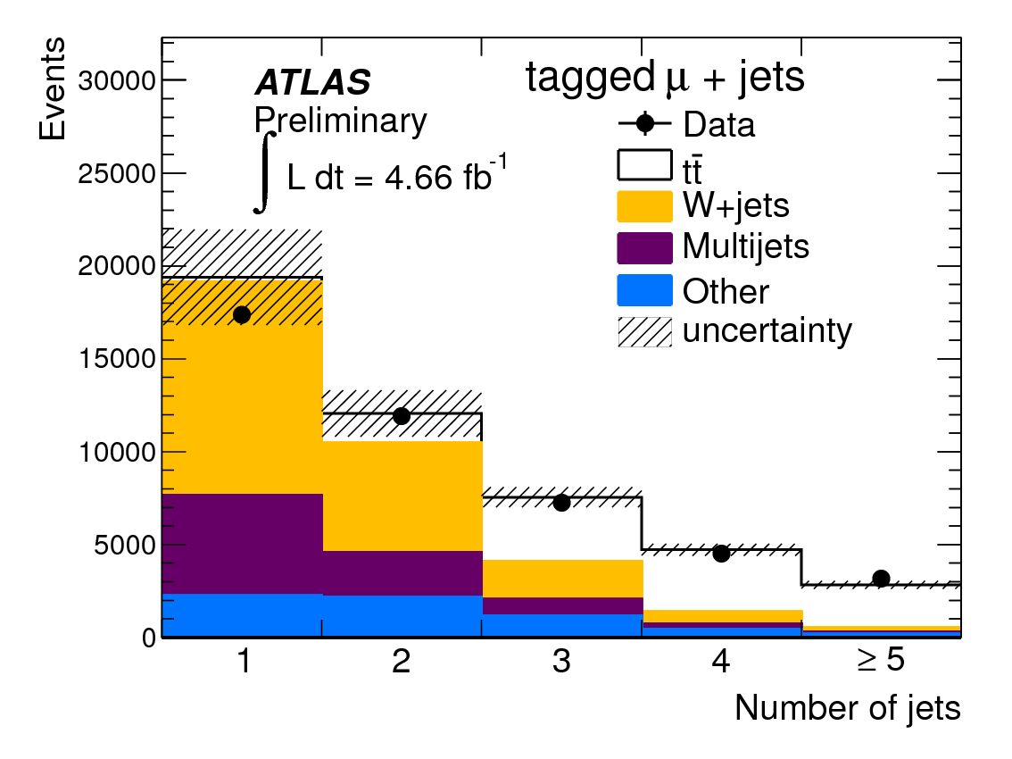
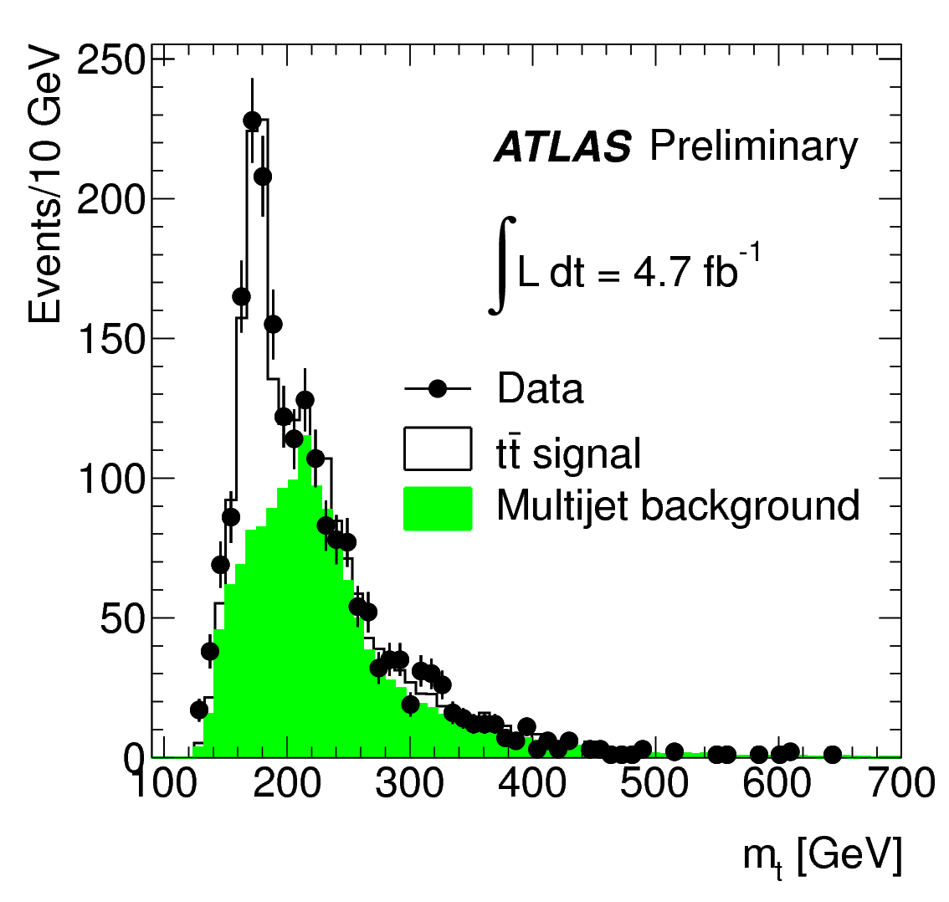
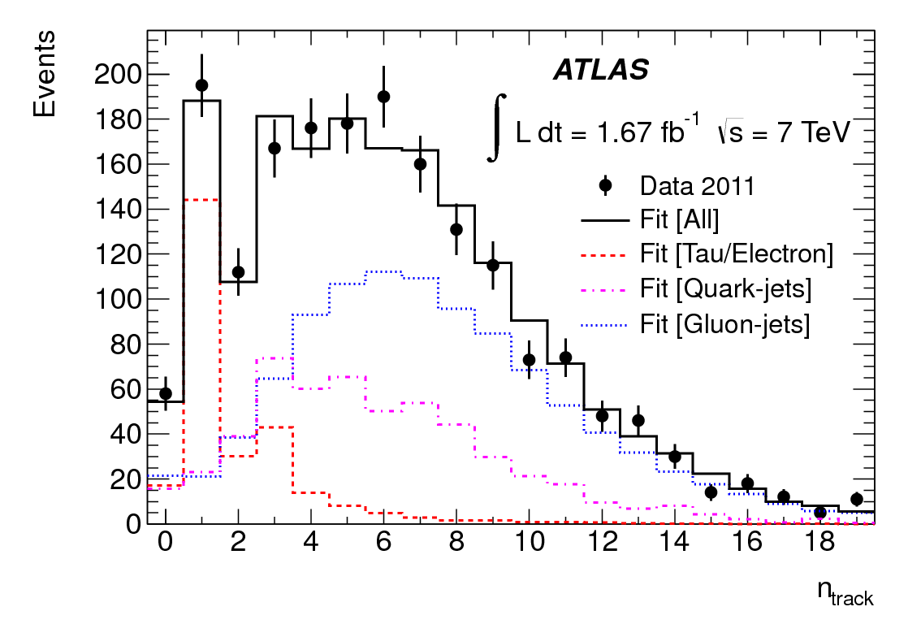
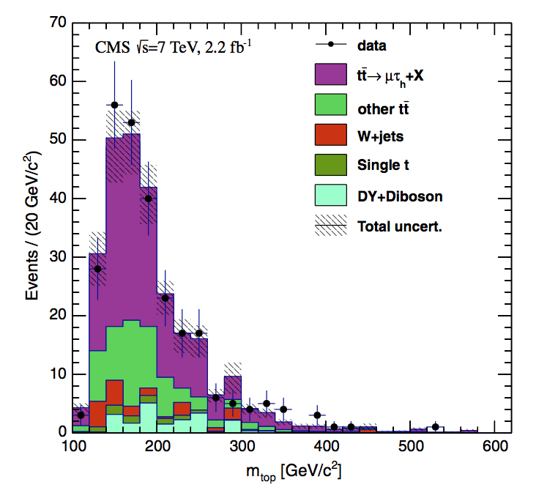
Top quark pair production – reconstructed decay modes
4
Lepton(e/μ) + jets
Dilepton(e/μ)
ATLAS-CONF-2012-155
JHEP 11 (2012) 067
signal
All hadronic
ATLAS-CONF-2012-031
signal
signal
τ+ jets
Dilepton(τ + e/μ)
EPJC 73 3 (2012) 2328
PRD 85 (2012) 11207
signal
signal

Slide 5
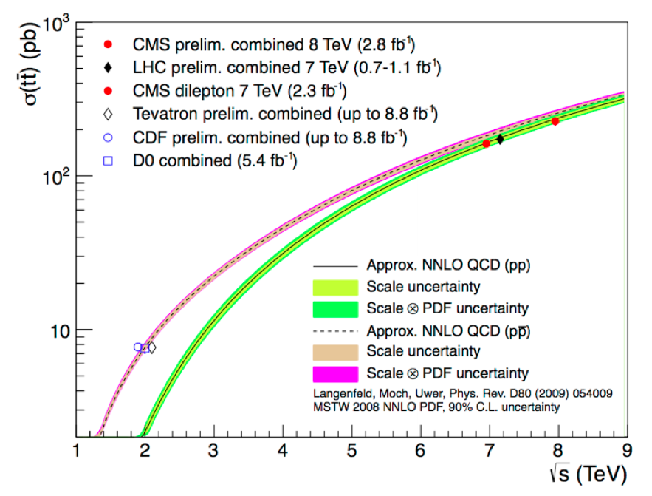


Top quark pair production – inclusive cross-section
5
Inclusive cross-section versus center-of-mass energy √s
CMS PAS TOP-12-007
ATLAS-CONF-2012-049
LHC at 8 TeV
ATLAS prelim. 8 TeV (5.8 fb⁻¹)
CMS dilepton
4.1% precision
Tevatron
combination
5.4%
uncertainty
JHEP 11 (2012) 067
LHC combination
at 7 TeV:
5.8% precision
DØ Note 6363
ATLAS-CONF-2012-134
CMS PAS TOP-12-003
Exp | σ (pb)
Tevatron comb | 7.62 ± 0.42
LHC comb 7 TeV | 173.3 ± 10.1
CMS dilepton 7 TeV | 161.9 ± 2.5 ±^{5.1}_{5.0} ±3.6
ATLAS l+jets 8 TeV | 232 ± 2 ± 31 ± 9
CMS lj & ll 8 TeV | 227 ± 3 ± 11 ± 10

Slide 6
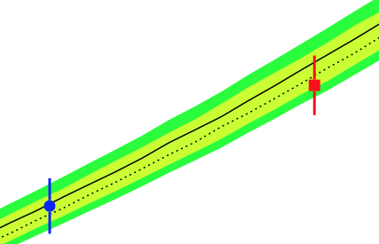
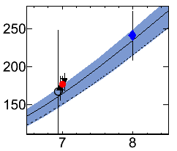
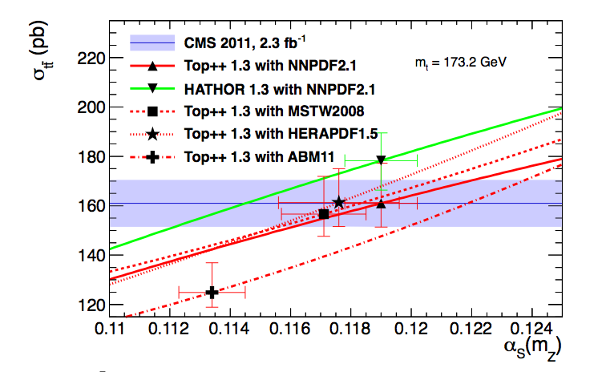
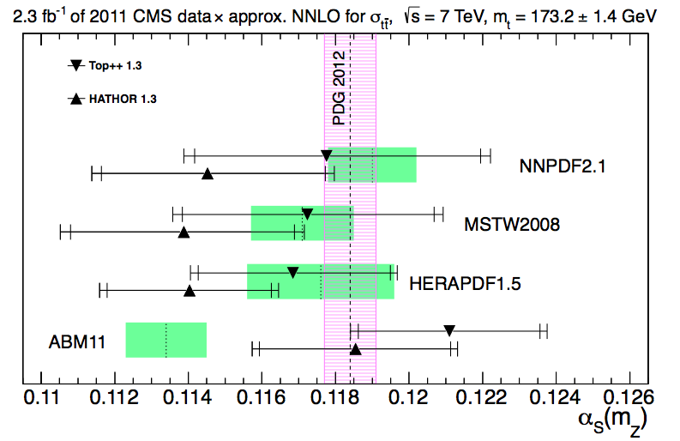
Inclusive cross-section uncertainties
6
Experimental uncertainties on inclusive cross-section
now comparable to theoretical uncertainties
Confront measured cross-sections with NNLO predictions to make inference on α_{strong}
CMS PAS TOP-12-022

Slide 7
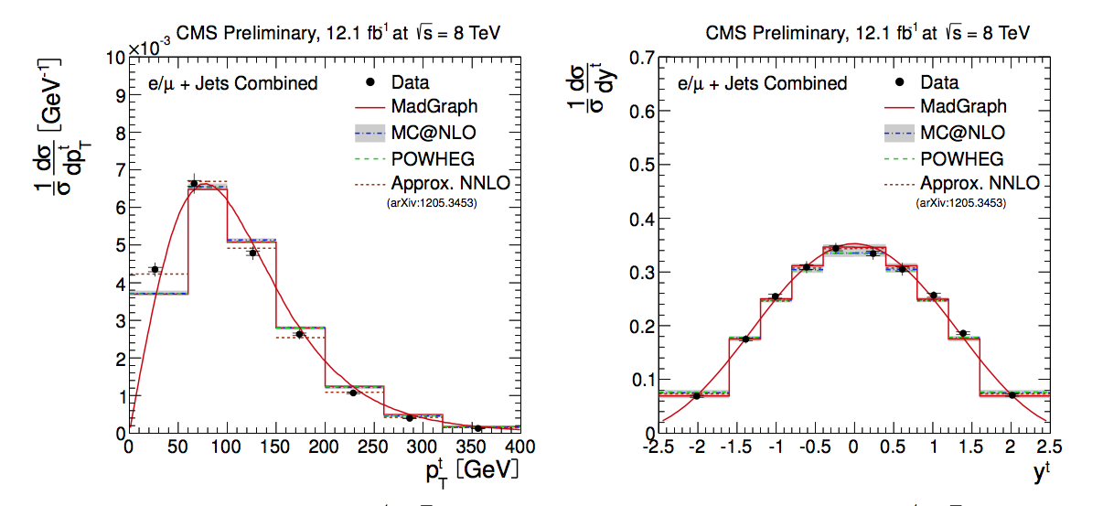
Top quark pair production – differential cross-sections
7
Differential cross-sections in top kinematics
dσ/dy_{t}
dσ/dp_{T}(t)
CMS-PAS-TOP-12-027
(systematic limited in most bins)

Slide 8
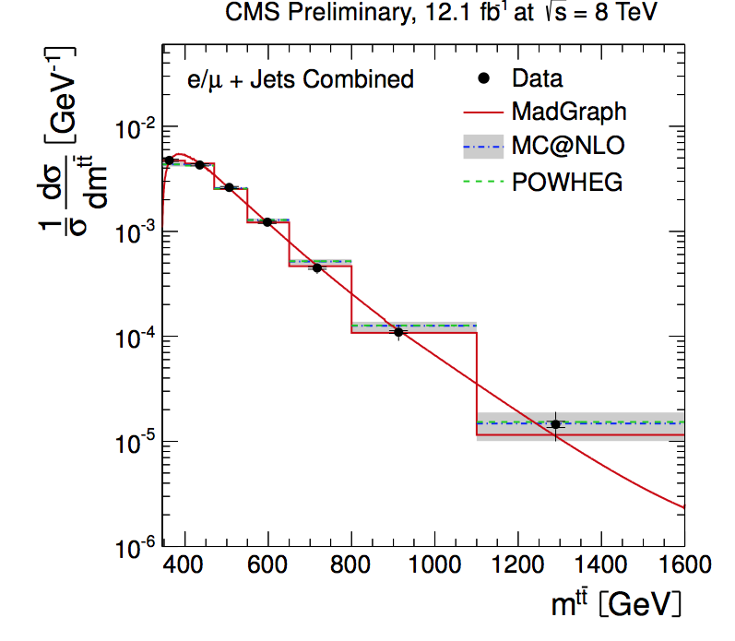
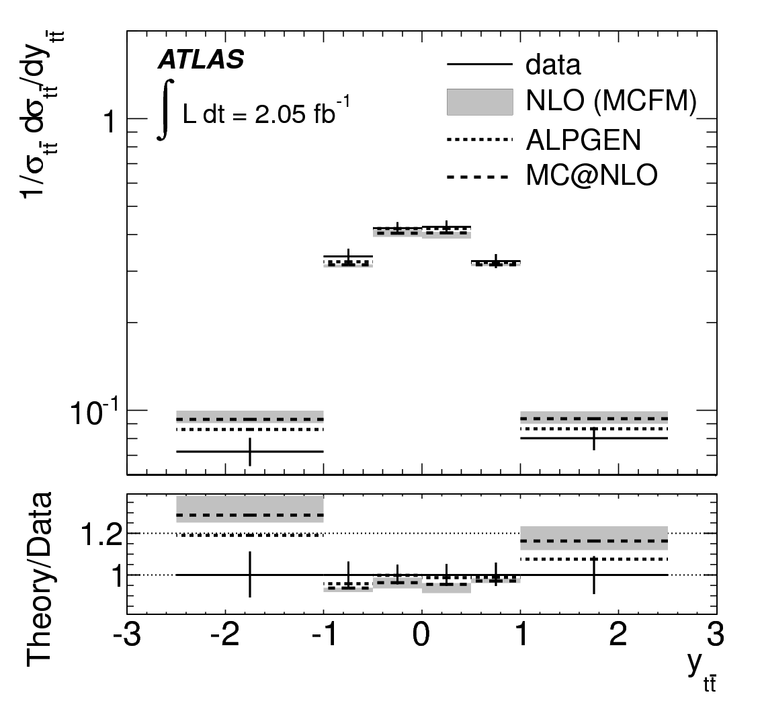
Top quark pair production – differential cross-sections
8
Differential cross-sections in kinematics of tt system
dσ/dm(tt)
dσ/dy(tt)
CMS-PAS-TOP-12-027
EPJC (2013) 73 2261
√s=7TeV
(at 7 and 8 TeV, systematic limited in most bins)

Slide 9
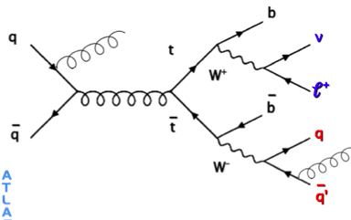
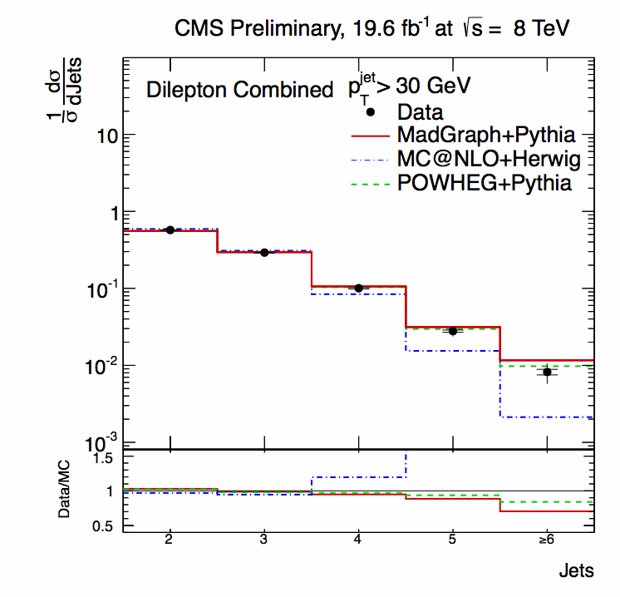
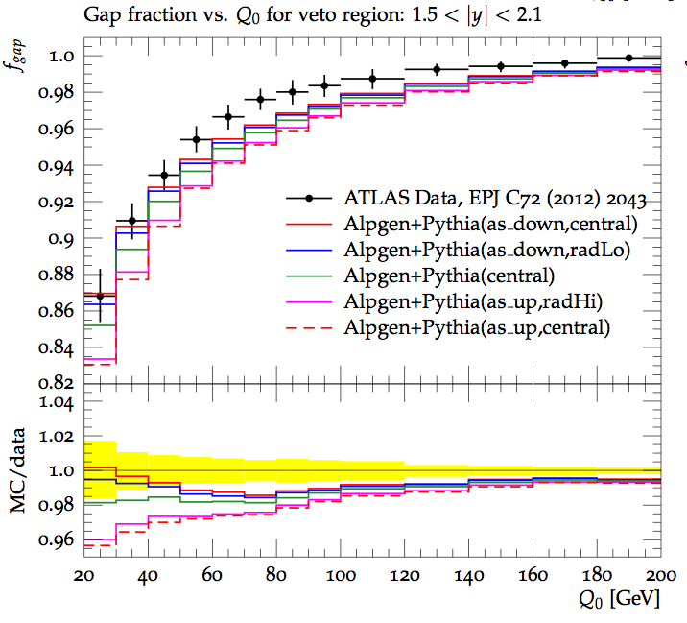
Top with associated jets
9
tt+jets: testing QCD theory
and (showering) generators
dσ/dN_{jet}
σ(tt no jets p_{T}>Q₀ & a<|y_{jet}|<b)
σ(tt)
CMS-PAS-TOP-12-041
ATL-PHYS-PUB-2013-005
Ratio → Cancellation of systematics

Slide 10
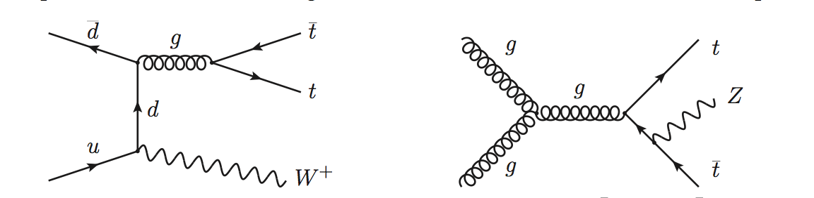
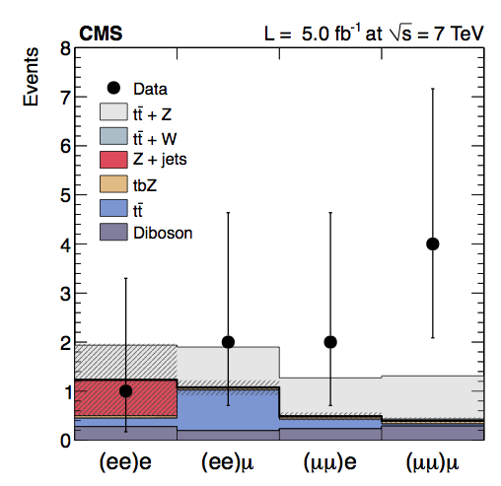
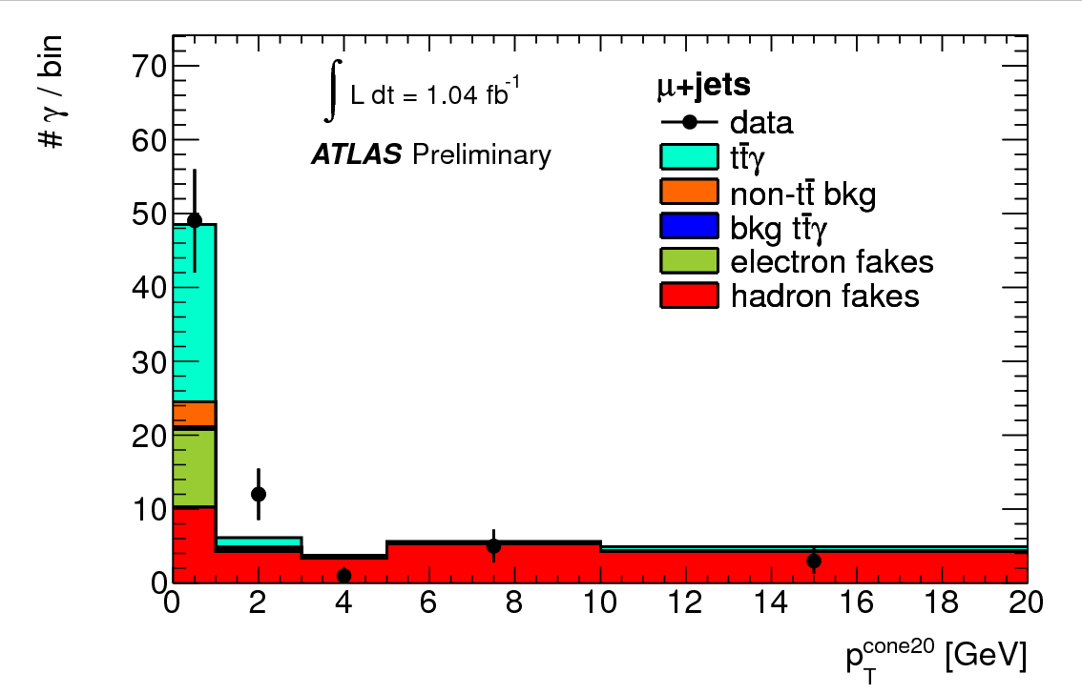
Top pair production with associated Z,γ and W
10
Evidence for processes with O(pb) cross-section…
Z,γ
p_{T}(γ)>8 GeV
ttZ: 3.3σ
ttγ: 2.7σ
CERN-PH-EP-2013-033 → PRL
ATLAS-CONF-2012-126
ATLAS-CONF-2011-153
p_{T}(γ)>8 GeV
+
3.0σ

Slide 11
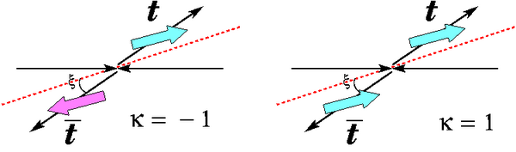
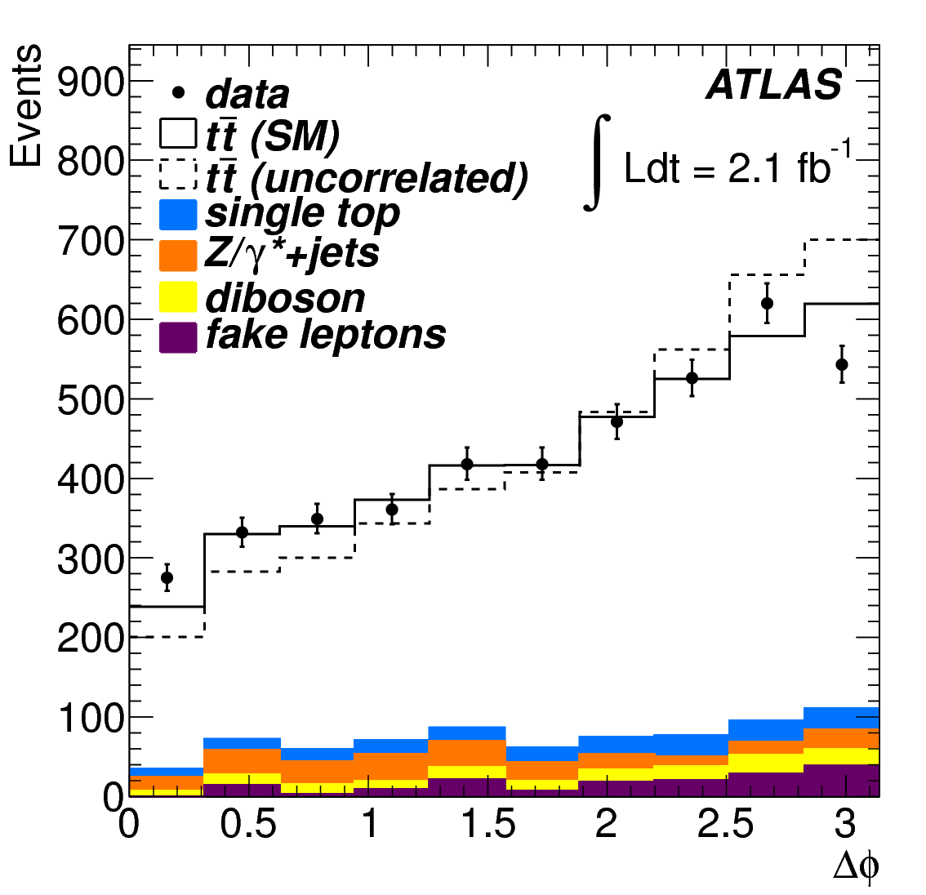
tt spin correlations
11
-
-
Spins of t and t are predicted to be correlated in SM.
  Can be measured from t decay products due to short life time
  LHC: azimuthal angle between leptons (Mahlon & Parke)
Fit to
5.1σ
PRL 108 212001 (2012)
CMS-PAS-TOP-12-004
3.1σ
PRL 108 (2012) 032004

Slide 12
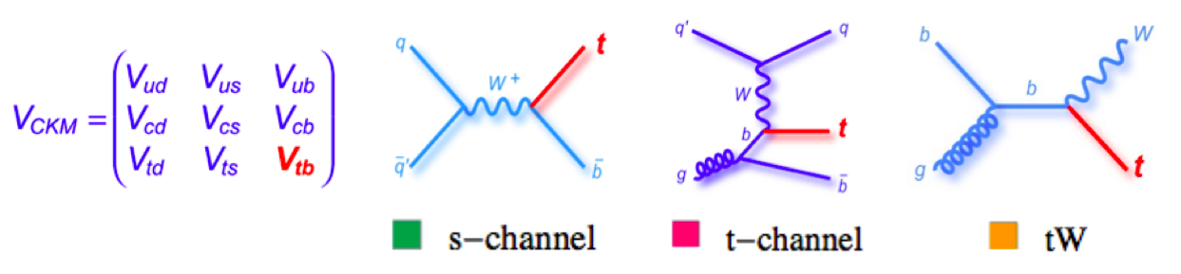
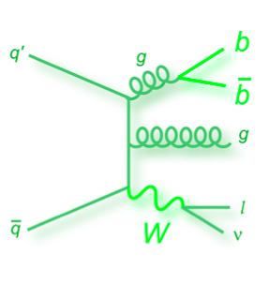
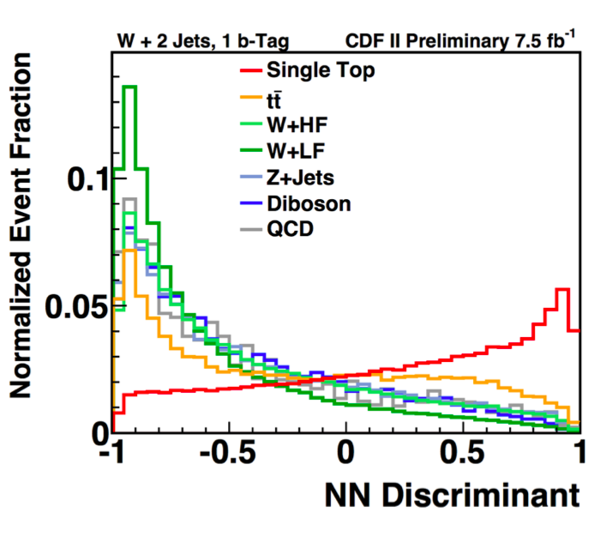
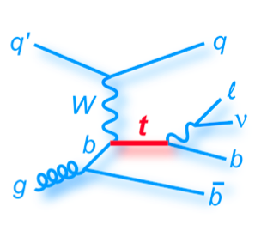
Single top production
12
Production of top quark through EW interaction
Difficult background from W + (HF) jets → MVA techniques
SM LHC (7 TeV) 5 pb 65 pb 16 pb
SM Tevatron 1 pb 2.2 pb 0.3 pb
CDF Note 10793
Measured separately and together at Tevatron (NB: CDF: σ(s-chan)=1.81 ^{+0.63}_{-0.58} )

Slide 13
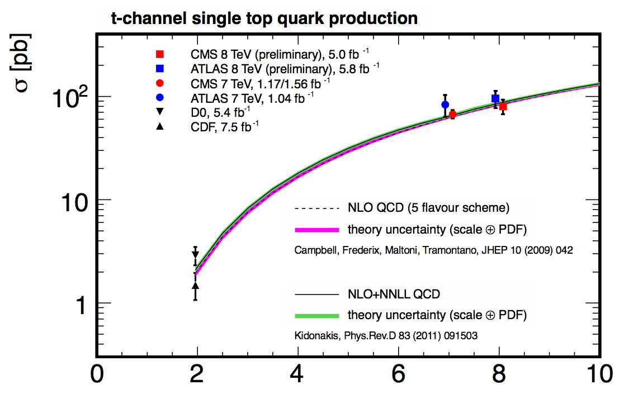
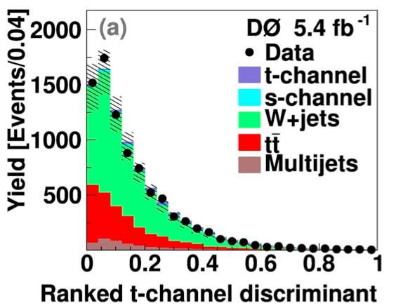
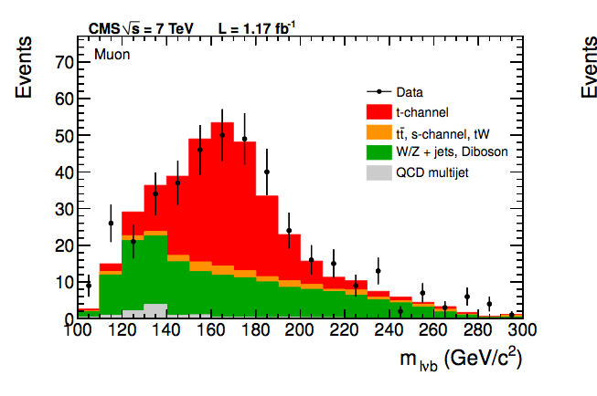
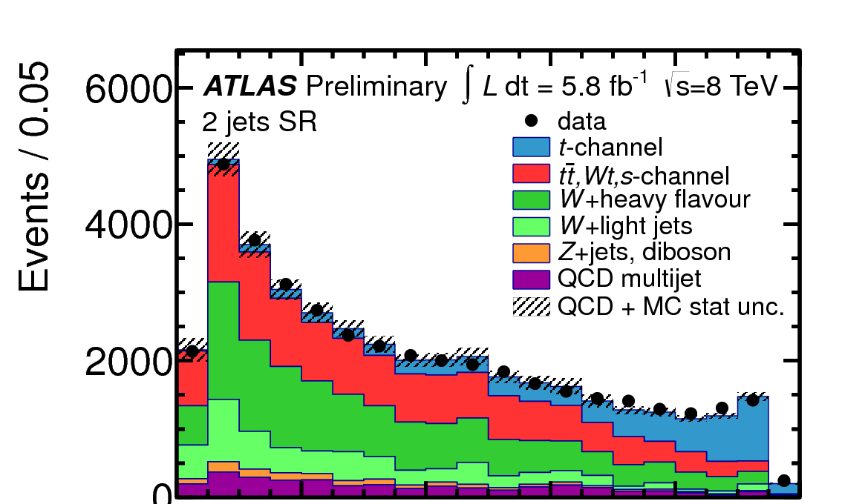
t-channel single top production versus √s
13
CMS@7TeV:
~9% uncertainty
~20%
uncertainty
PLB 705 (2011) 313
CDF Note 10793
PLB 717 (2012) 330-350
JHEP 12 (2012) 035
ATLAS-CONF-2012-132
CMS-PAS-TOP-12-011
Experiment | σ (pb)
D0 (t-chan) | 2.90 ± 0.59
CDF (t-chan) | 1.49 ± ^{0.47}_{0.42}
ATLAS 7 TeV | 83 ± 3 ± ²⁰₁₉
CMS 7 TeV | 67.2 ± 6.1
ATLAS 8 TeV | 95 ± 18
CMS 8 TeV | 80.1 ± 5.7 ± 12

Slide 14
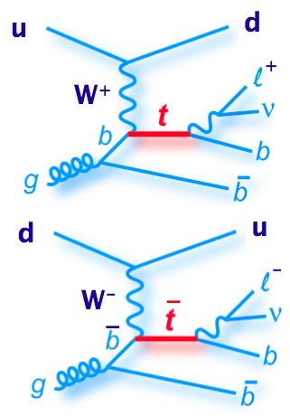
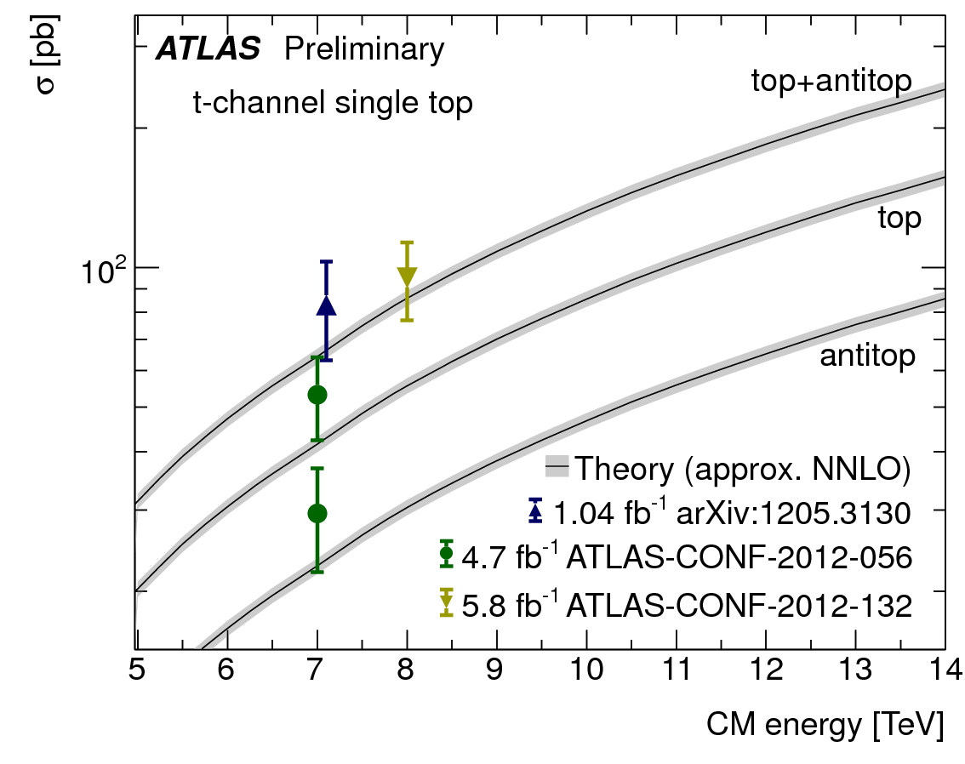
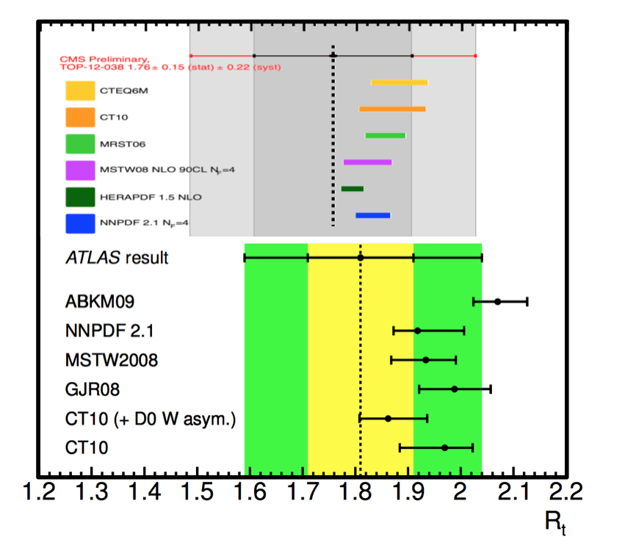
Single top production t-channel by charge
14
Ratio top/anti-top
production reflects
quark content of proton
√s=8 TeV
√s=7 TeV
CMS-PAS-TOP-12-038
ATLAS-CONF-2012-056

Slide 15
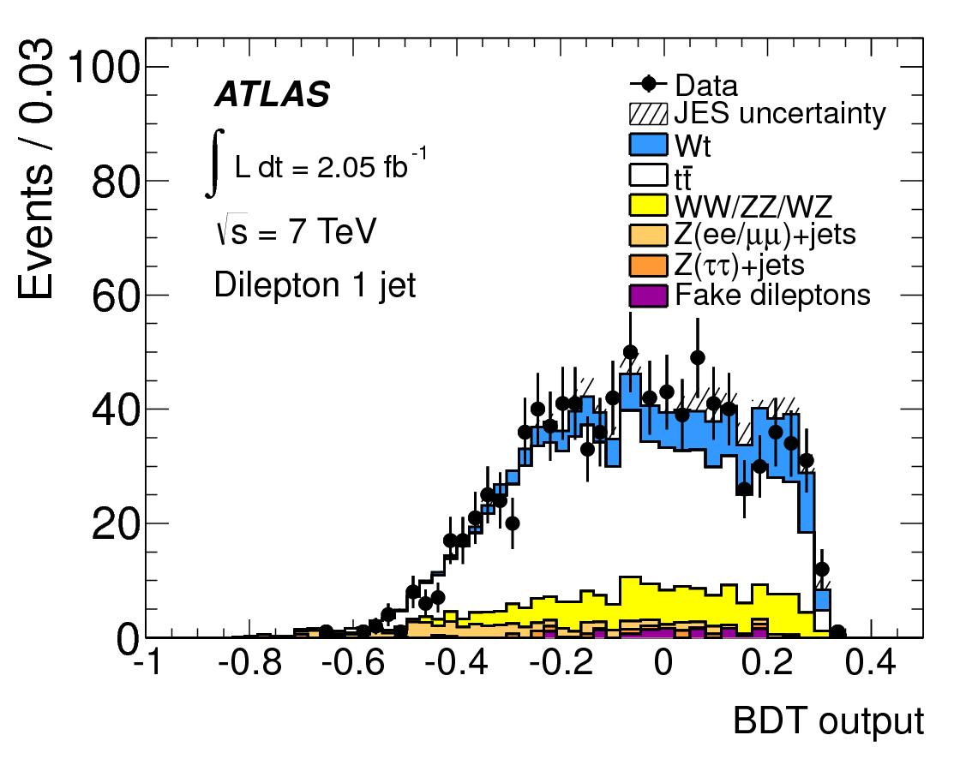
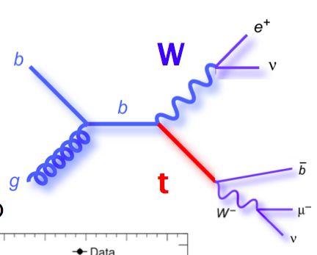
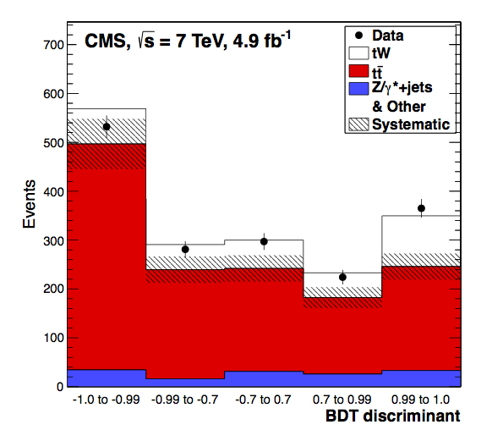
Observation of W-t associated production
15
Single top production in association with W boson recently observed at 4σ level
PLB 716 (2012) 142
(3.3σ significance)
l⁺
CERN-PH-EP-2012-266
Submitted to PRL
l⁻
(4.0σ significance)

Slide 16
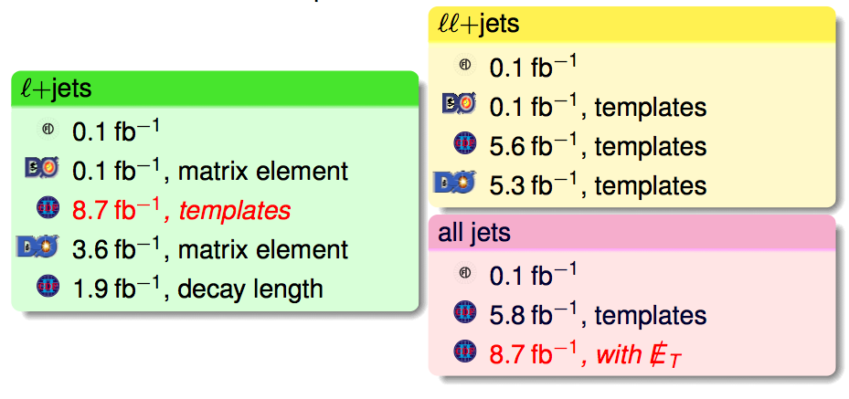
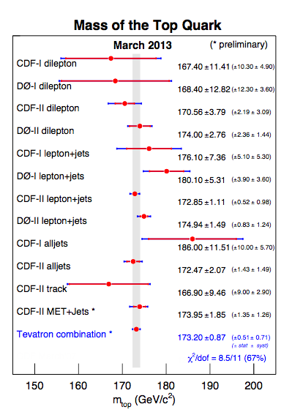
Top quark mass measurements
16
Tevatron combined top mass measurement
still the worlds best
Now includes 2 new CDF result on full run-II data
PRL 109 152003 & CDF note 10810
m(t) = 173.20 ± 0.51 ± 0.71 GeV
= 173.20 ± 0.87 GeV

Slide 17
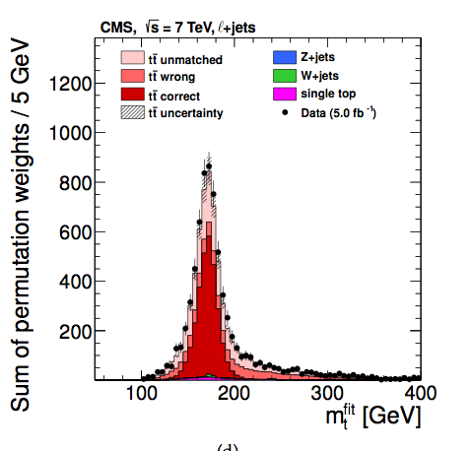
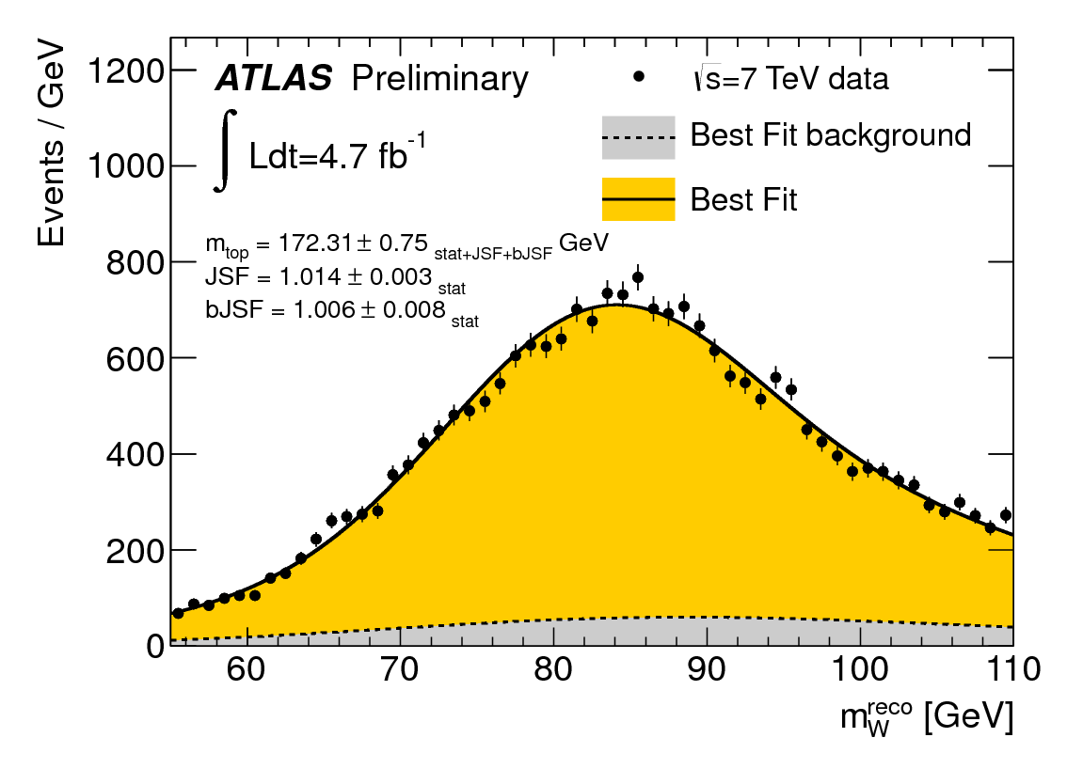
But LHC is making progress…
17
Best single ATLAS result (new! - 3D template fit m_{W},m_{t},R_{lb})
Best single CMS result (ideogram method)
m(t)= 172.31 ± 0.23 (stat) ± 0.27 (JSF) ± 0.67 (bJSF) ± 1.35 (syst) GeV
Now measured
from data
m(t)= 173.49 ± 0.43 (stat+JES) ± 0.98 (syst) GeV
ATLAS-CONF-2013-046
JHEP 12 (2012) 105

Slide 18
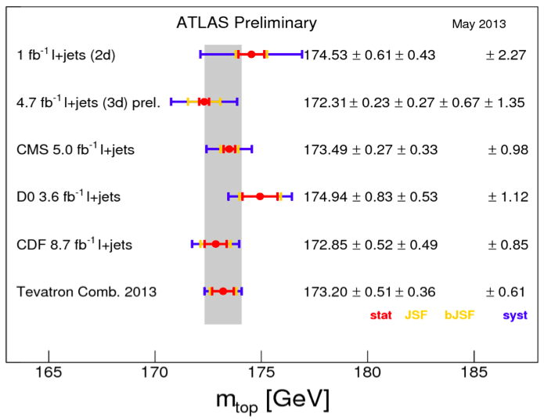
But LHC is making progress…
18
best ATLAS
Work towards LHC mass combination on going
  Common treatment of modeling uncertainties
  (e.g. hadronisation) will be important
Also: CMS Measurement of m(t) – m(t)
→ test of CPT theorem
best CMS
best D0
best CDF
CMS-PAS-TOP-12-031

Slide 19
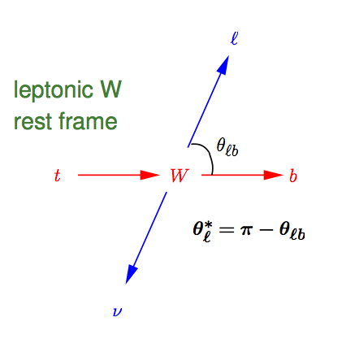
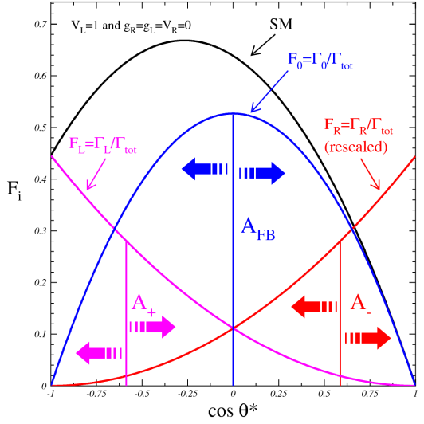
V-A structure of Wtb vertex and anomalous couplings
19
Effective Lagrangian for Wtb vertex
Various couplings result in different angular distributions of W bosons (e.g. polarization)
Vector couplings
Tensor couplings
CKM matrix element V_{tb} ~ 1
Anomalous couplings (all ≈0 in SM)
  NNLO SM prediction
  W boson polarization
  ( 68.5 ± 0.5 )% long.,
  ( 31.1 ± 0.5 )% LH,
  ( 0.17 ± 0.01 )% RH

Slide 20
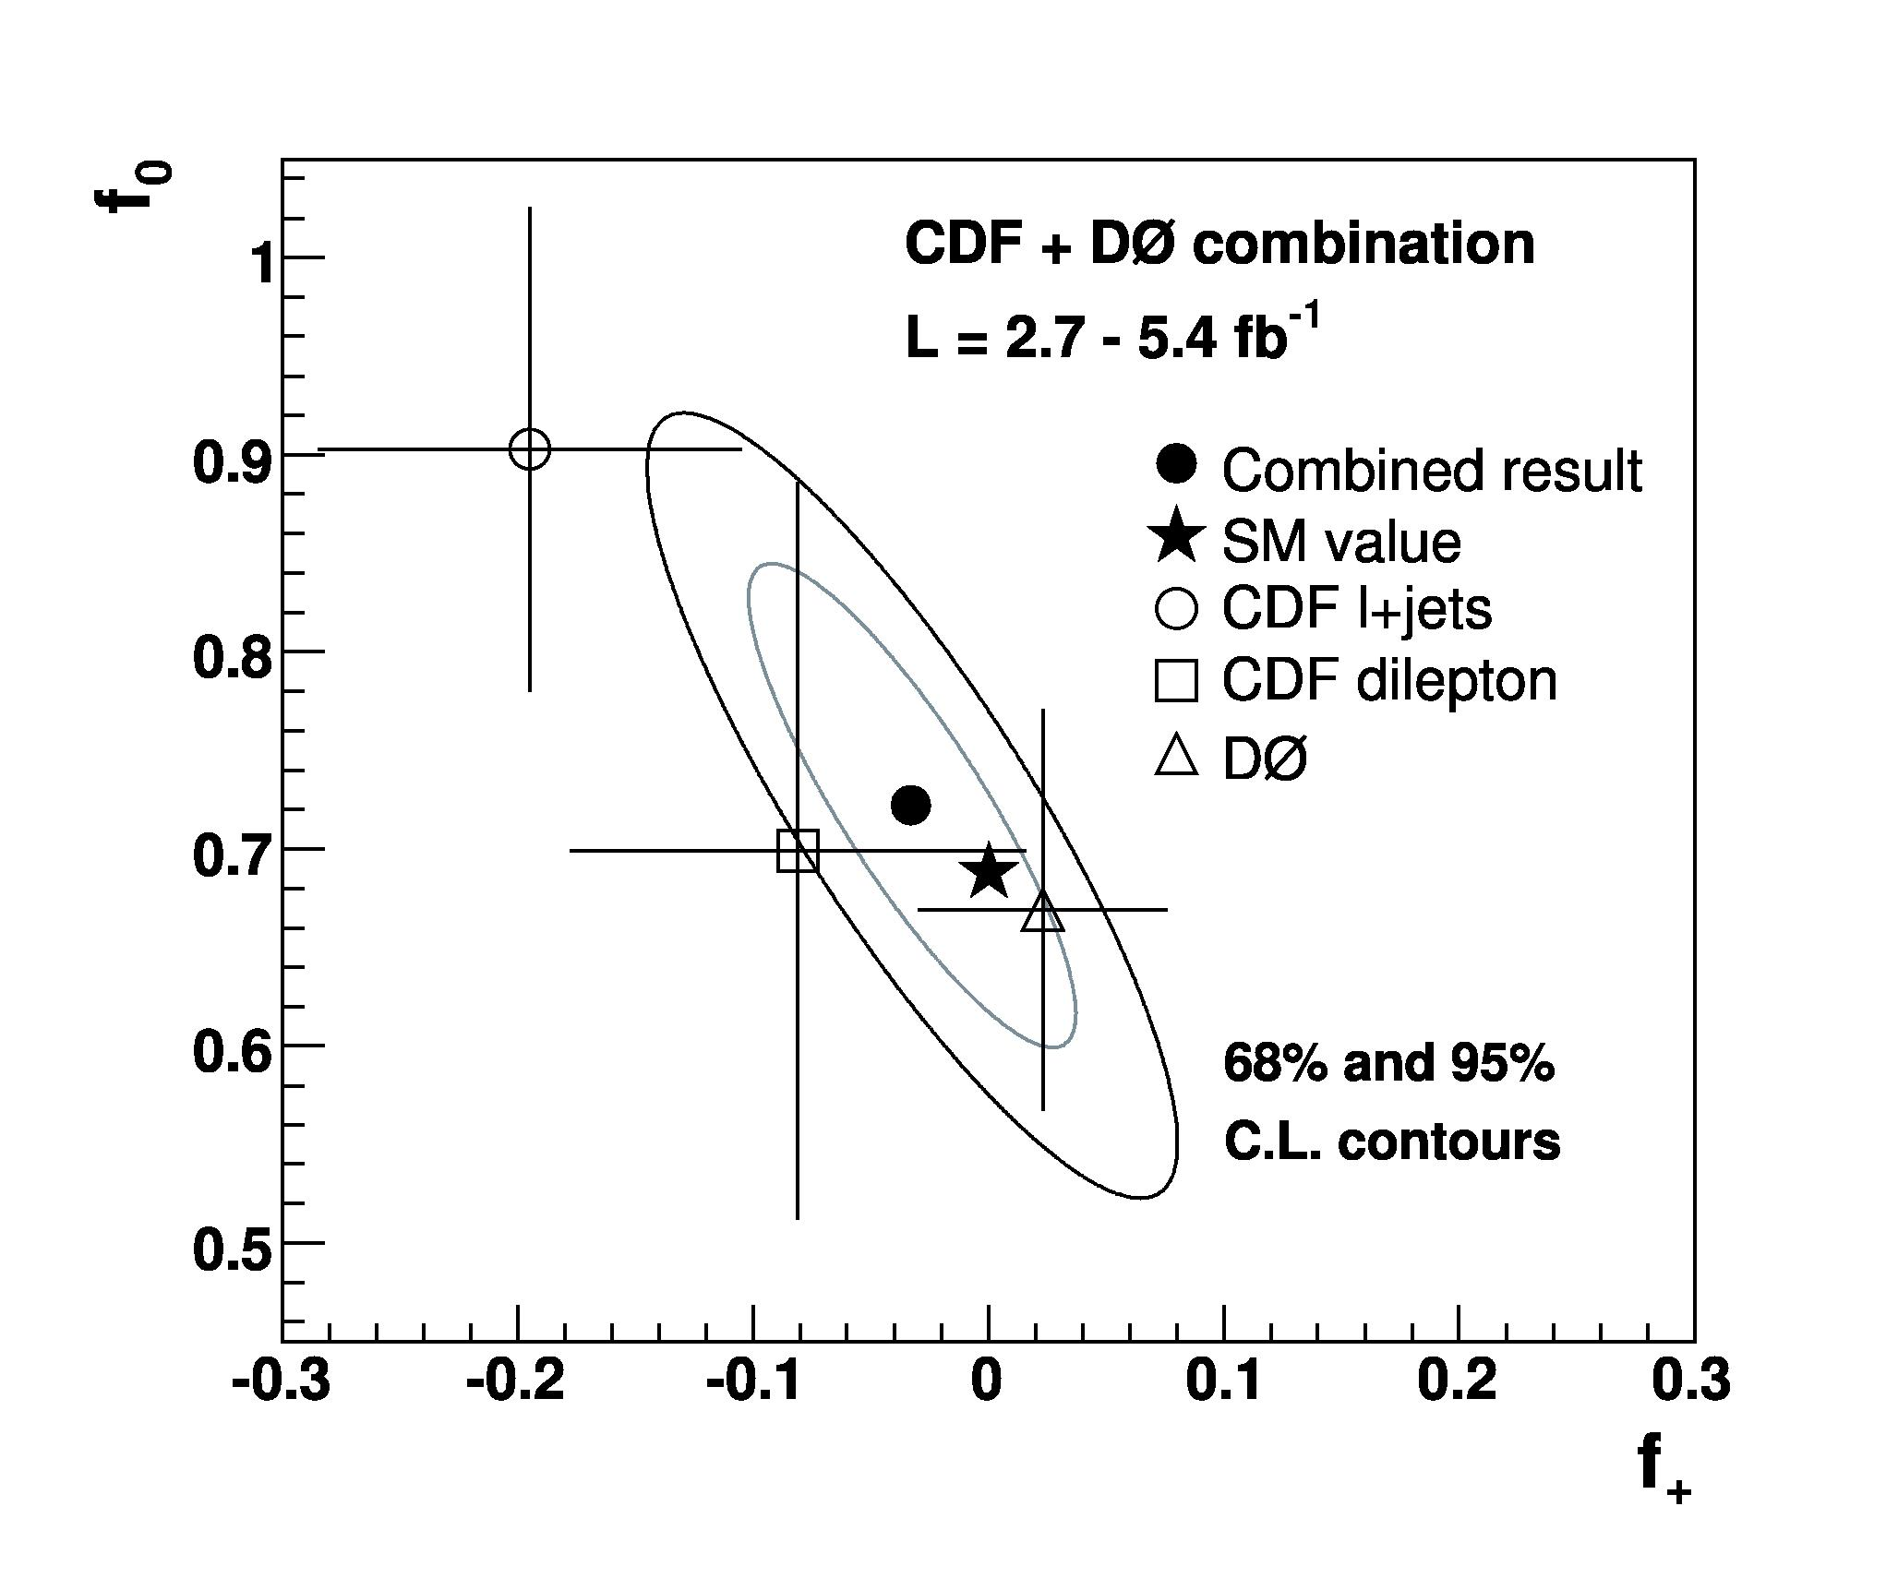
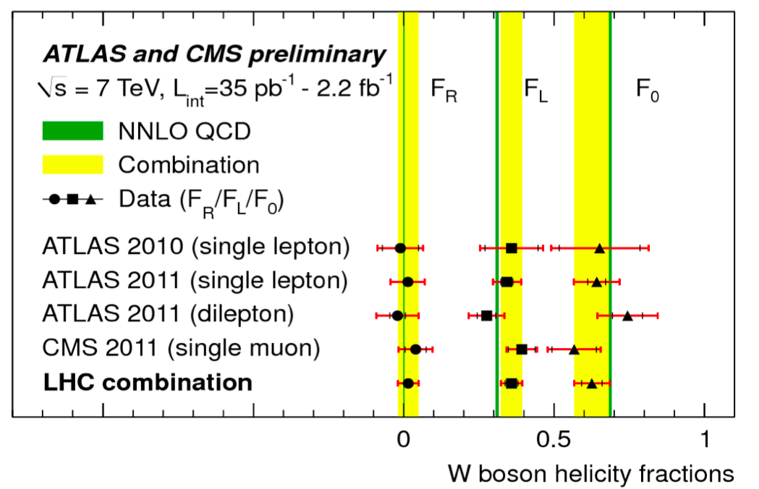
W Polarization measurement in ttbar production
20
Combined LHC measurement is most precise result
LHC combination
ATLAS-CONF-2013-033 / CMS PAS TOP-12-025
Tevatron comb.
PRD 85 , 091104 (2012)
NB: Latest CMS dilepton measurement not in LHC combination
CMS-PAS-TOP-12-015

Slide 21
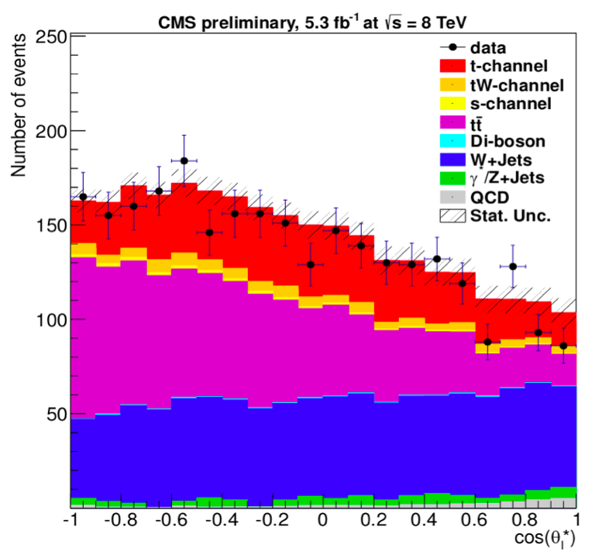
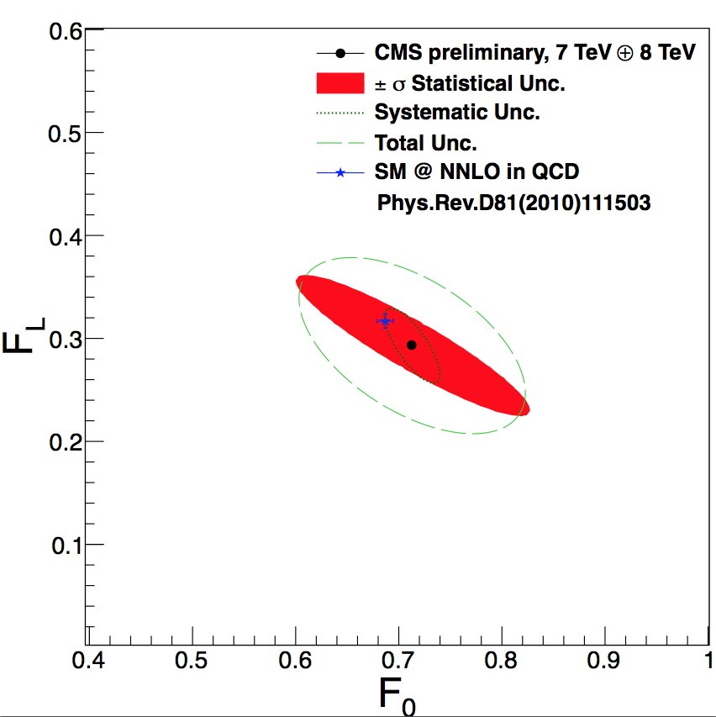
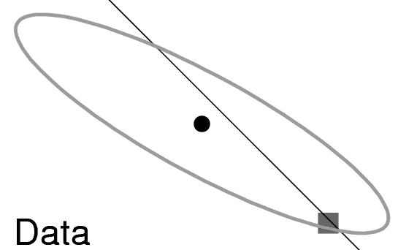
W polarization in single top production
21
First measurement by CMS of W production
in t-channel single top production → consistent with SM
CMS-PAS-TOP-12-020
tt LHC
combination

Slide 22


Interpretation in terms of anomalous couplings
22
Interpretation in terms of anomalous couplings
CMS
single top

Slide 23


A_{FB} in t-channel single top production
23
Additional information in imaginary component of g_{R} from single top production (NB: Im(g_{R}) ≠ 0 → CPV)
  Define angle θ_{N} using the normal N w.r.t the top spin direction
  Possible because t-channel top production is ~90% polarized
ATLAS-CONF-2013-032
Assumed top polarization

Slide 24


Measurement of R_{b} = Br(W→tb)/Br(W→tq)
24
In the SM: V_{tb} ≈ 1 → R_{b} ≈ 1
Measure R_{b} (and |V_{tb}|) from counting b-jets in tt events
CMS-PAS-TOP-12-035
Best Tevatron result
R=0.86±0.05 (ll),
combination with (lj) yields
R=0.90±0.04 (ll+lj)
(Requiring V_{tb}≤1)
PRL 107 (2011) 121802

Slide 25


Limits on FCNC couplings qg→t and t→Zq
25
qg→t: Search for single top production from qg fusion
  Decay signature very similar to W+(HF)jets
t→qZ: Search for tt → W(→lv)b+qZ(→ll) (=lll+X)
PLB 712 (2012) 351
ATLAS-CONF-2011-154
CMS-PAS-TOP-037

Slide 26






New physics tt production → resonances in m(tt)
26
Top pair production can be enhanced by NP particles decaying into tt pairs (e.g. Z’ or Kaluza-Klein gluon)
Search for broad or narrow resonance in m(tt)
l+jets
dilepton
all hadronic
ATLAS-CONF-2013-052
ATLAS-CONF-2011-123
JHEP01(2013)116
CMS-PAS-B2G-12-006
CERN-PH-EP-2012-324→PRD
CMS-PAS-B2G-12-005

Slide 27

NB: Highly boosted tops collimate into single jets
27
Special techniques for top reconstruction at high m(tt)…

Slide 28




Mass limits on NP particles decaying into tt
28
Mass limits depend assumed new physics
and its properties, but generally in 1-2 TeV range
l+jets - g_{KK}
l+jets – Z’ (10% width)
CERN-PH-EP-2013-032→PRD
CMS-PAS-B2G-12-006
all hadronic - g_{KK}
all hadronic – Z’ (10% width)
JHEP01(2013)116
CMS-PAS-B2G-12-005

Slide 29

New physics in tt production → A_{FB} and A_{C}
29
NP decaying into tt can also modify t and t angular distributions → Look for FB or charge asymmetries
Need to full reconstruction of
tt system to obtain y(t) and y(t),
alternatively look at y(l)
Unfolding to parton level always needed
Δy=y_{t}-y_{t}
Δ|y|=|y_{t}|-|y_{t}|

Slide 30



New physics in tt production → A_{FB} and A_{C}
30
A_{FB}
A_{C}
Channel | A_{C}
ATLAS l+jets | -1.8 ± 3.6%
CMS l+jets | 0.4 ± 3.7%
ATLAS dilepton | 5.7 ± 2.8%
CMS dilepton | 5.0 ± 4.3%
ATLAS comb. | 2.9 ± 2.8%
SM(MC@NLO) | 0.6 ± 0.2%
All latest results consistent with SM within ~2.5σ

Slide 31



New physics decaying into tt → top polarization
31
New physics may also affect polarization of top quarks in pair production (expect no polarization in SM at tree level)
CMS-PAS-TOP-12-016
ATLAS-CONF-2012-133

Slide 32



Many other NP→tt searches…
32
Heavy vector-like top
(t’ → tH)
  t’ mass limits in the
  range 600 – 800 GeV
Excited states
(t* → tg, b* → tW)
  t* / b* Mass limits
  around 800 GeV
Heavy vector bosons
(W’/ϕ → tb / tq )
  W’/ϕ mass limits in
  1-2 TeV range
ATLAS-CONF-2013-018
Phys. Lett. B 721 (2013) 171-189
CMS-PAS-B2G-12-014
ATLAS-CONF-2013-050
PLB 718 (2013) 1229-1251

Slide 33
Summary
33
Top production measurements are in precision era
  Pair production cross-section uncertainty O(5%) level at LHC and Tevatron,
  |V_{tb}| from single top at 5% level (LHC)
  Observation of rare associated production (ttV,ttγ)
  with O(1) pb cross-sections at 3σ level
  Many differential cross-sections now measured
Many top property measurements entering precision realm
  Top mass uncertainty now at 0.5% (0.87 GeV, Tevatron), LHC catching up.
  Top coupling measurements: W helicity fractions have O(5%) uncertainty
  Limits on many FCNC couplings now O(10⁻⁴)
  But also several new measurements facilitated by abundant LHC samples
New physics decaying into top quark (pairs) not yet seen
  Large machinery developed looking into many signatures, reusable in 2015
Most top physics measurements systematics dominated
  Work & time needed to unlock the potential of the full run-1 LHC samples
-

