Slide 1
Neutrino-Nucleus QE Scattering
GTG
Los Alamos Nat. Lab.

Slide 2
Aim of this Talk
I hope to convince you that :
Present day neutrino event generators for .2 > E_{ν} > ~ 2 GeV are inadequate
These generators use 40 year old nuclear physics, produce wrong cross sections, assign incorrect neutrino energies, with a possible serious impact on the determination of neutrino oscillation parameters.
Nucleon – Nucleon interactions are ignored. Mean field (eg. Fermi Gas) momentum distributions for nucleons in a nucleus are seriously wrong.
For A≥ 12 20% of the nucleons are involved in short range correlations (SRC). These SRC typically generate nucleon momenta much greater than the Fermi momentum.
Meson exchange + current conservation, gives rise to two body nucleonic weak currents that enhance the transverse vector cross section. The evidence for this has been around for 20 years but for the most part ignored.
The physics to improve the CCQE sector in event generators is in hand.

Slide 3
Why is QES Important?
Experiments investigating neutrino oscillations employ
QES(CCQE) neutrino-nucleus interactions.
For 0.3<E_{ν}< 3.0 GeV it is the dominant interaction.
CCQE is assumed to be readily calculable, experimentally
identifiable, allowing assignment of the neutrino energy.
Some 40 calculations published since 2005
Relevant neutrino oscillation period:
1.27Δm_{ij}²(ev²)× (L_{ν}(km)/E_{ν}(GeV))
Δm₂₃²=10⁻³ L(10³)/E(1) LBNE
Δm_{2S}²=1 L(1)/E(1) SBNE

Slide 4
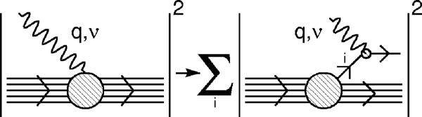
Quasi-elastic Scattering on Nuclei
In the Impulse Approximation, CCQE is just the charge changing scattering off independent single nucleons incoherently summed over all nucleons in the nucleus.
If the nucleon is assumed to be at rest, the neutrino energy inferred from the muon energy and angle is:
m=nucleon mass, E_{μ}=detected muon energy, m_{μ}=mass of the muon,
S= average separation energy
This inferred neutrino energy is uncertain by

Slide 5
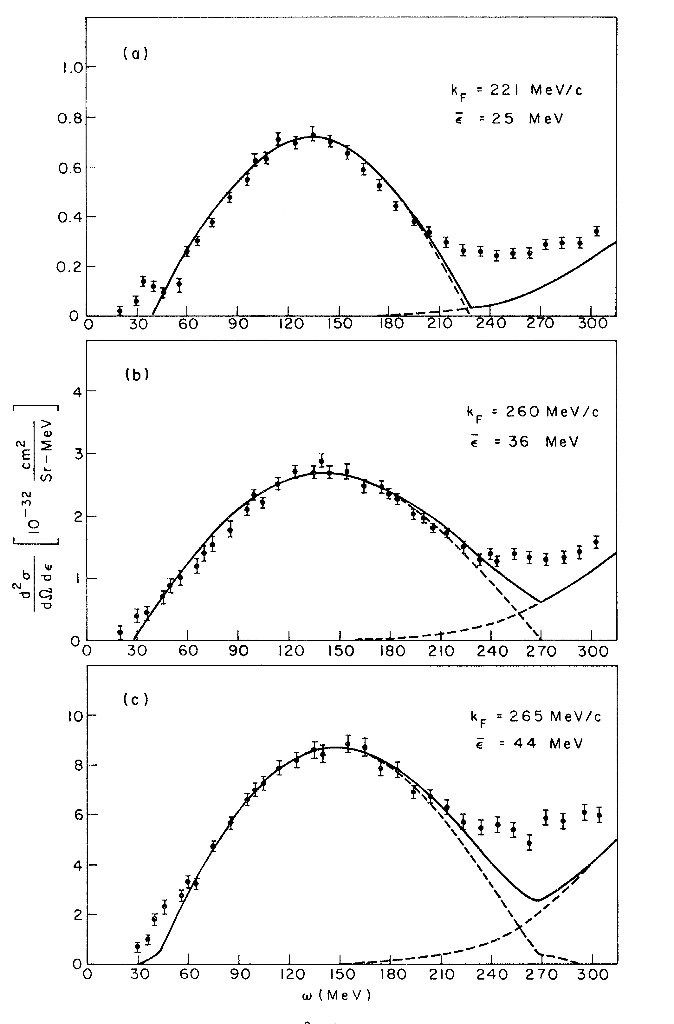
Quasi-Elastic Scattering in Nuclear Physics originated with
Electron-Nucleus Scattering
Moniz et al PRL 1971
Impulse Approximation
C
Simple Fermi Gas: 2 parameter , S_{E}, p_{F}
Ni
Pb
V_{N}=4π/3(1.2)³A 10⁻³⁹cm³ p_{F}=250MeV/c

Slide 6
electron-Nucleus QES
Quasi-Elastic Electron Scattering:
Heart of the nuclear problem

Slide 7
Scaling in Electron Quasi-elastic Scattering (1)
The energy given up by the electron, to a nucleon with initial momentum
T_{N} is the final kinetic energy of the struck nucleon, E_{s} the separation energy of the struck nucleon, E_{R} the recoil kinetic energy of the nucleus. is the 3 momentum transferred to the nucleon by the scattered electron.
Instead of presenting the data as a function of q and ω, it can be expressed in terms of the single variable y
The scaling function F(y,q) is formed from the measured cross section at 3- momentum transfer q, dividing out the incoherent single nucleon contributions at that three momentum transfer.

Slide 8
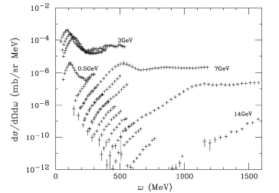
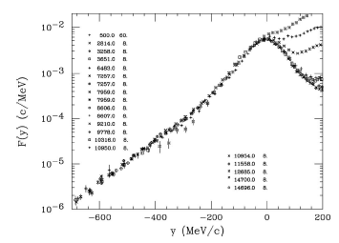
Scaling in Electron Quasi-elastic Scattering (2)
³He
Raw data
Scaled
At y =(ω²+2mω)^{1/2} - q =0 ω=Q²/2m scattering off nucleon at rest
y <0 smaller energy loss
y >0 greater energy loss
Excuses (reasons) for failure y > 0: meson exchange, pion production, tail of the delta.

Slide 9
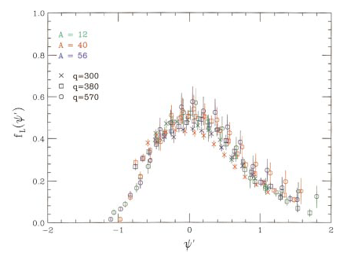
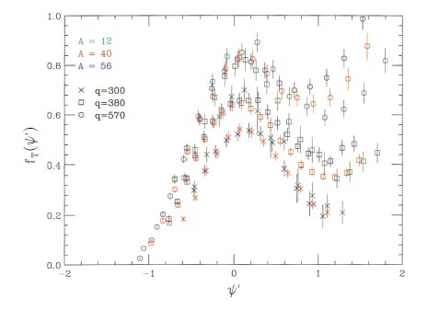
Separating Scaling into its Longitudinal and Transverse Responses Phys. Rev. C60, 065502 (1999)
Longitudinal
Intergal under curve ~1
Transverse
Transverse
Dimensionless scaling variable:
allows comparing different nuclei: superscaling
The responses are normalized so that in a Relativistic Fermi Gas:
satisfies the expected Coulomb sum rule, but its asymmetry in indicates an energy loss greater than impulse approximation scattering off a single nucleon.
shows clear enhancement for q > 300 MeV/c

Slide 10
Neutrino –Nucleon Cross Section
While inclusive electron scattering and CCQE neutrino experiments
are very different, the lepton-nucleon hardly changes.
Neutrino (+), Anti-Neutrino(-) Nucleon CCQE Cross Section
Charged lepton mass=0
The f₁ and f₂ are isovector vector form factors that come from electron scattering. g₁ is the isovector axial form factor fixed by neutron beta decay at Q²=0, with a dipole form, 1.27/(1+Q²/M_{A}²)²; M_{A}=1.02±.02

Slide 11

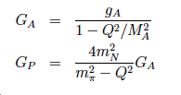

More Familiar Representation
Nucleon one body current!!

Slide 12
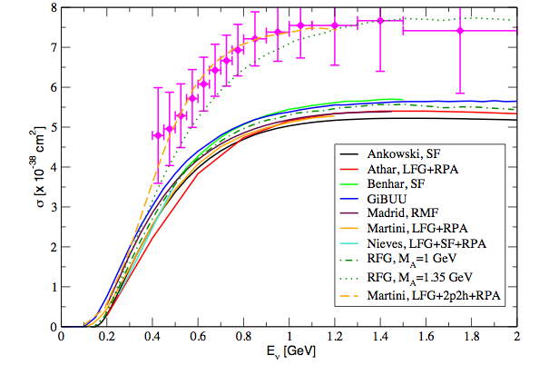
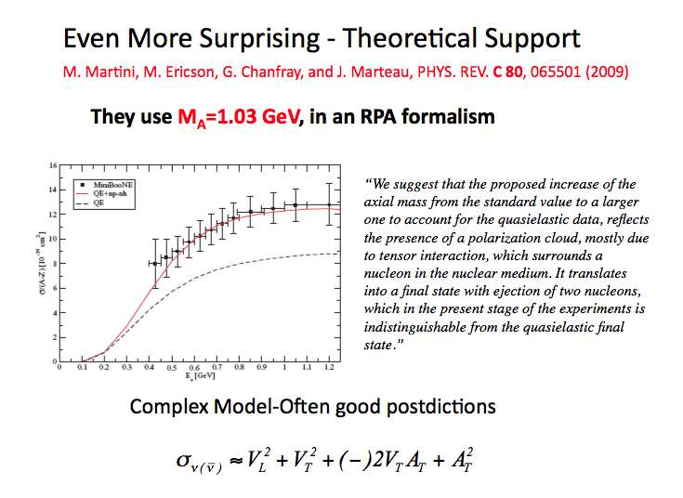
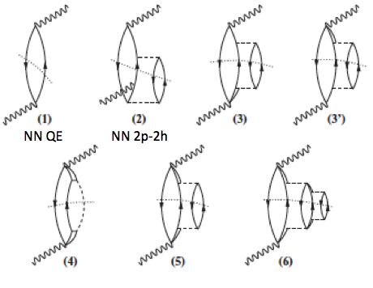
What did MB Observe? CCQE
MiniBooNE
MB fits the observed Q² distribution and crosssection by increasing M_{A} to 1.35 GeV
Theory
consensus
Some RPA p-h diagrams
from Martini et al
Particle lines crossed by ….. are put on shell

Slide 13
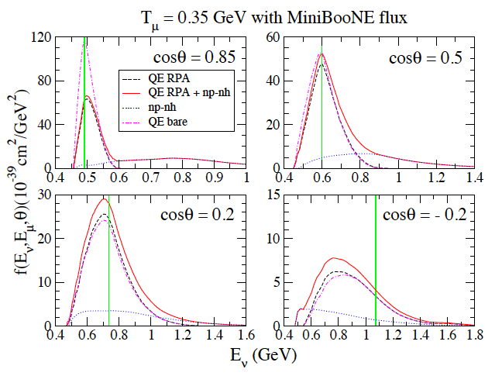
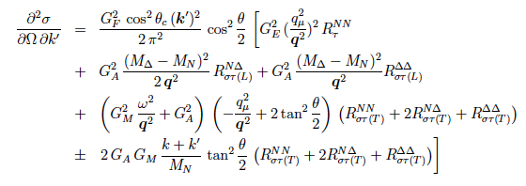
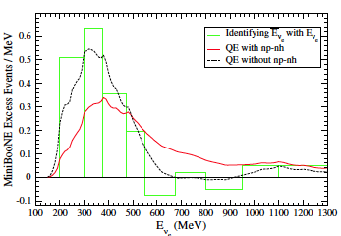
Enhancement Uncertainty in Assigned E_{ν}
Martini et al: arXiv 1211.1523, Phys.Rev. D85, 093012
Multiparticle final states, RPA , formalism somewhat opaque
Impact on neutrino energy assignment

Slide 14
Looks like there are problems!
Can we do better? Yes.
Much of the physics that is needed is already out there.

Slide 15

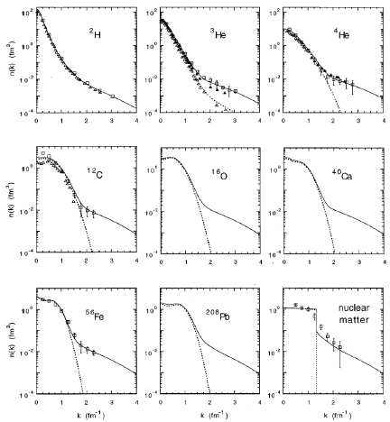
Momentum Distribution in Nuclei
The momentum distributions are similar for k > 1.5fm⁻¹
Actual distribution requires multiplication
by 4πk²dk.
High momentum tails look like deuteron!!
Mostly due to tensor force, ΔL=2,T=0,S=1
L=0
n(k)(fm3)
Fermi Gas
L=2
This correlation is neglected when treating the nucleus as an ensemble of free nucleons
In a mean field.
k(fm⁻¹)

Slide 16

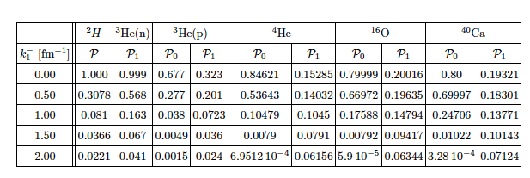
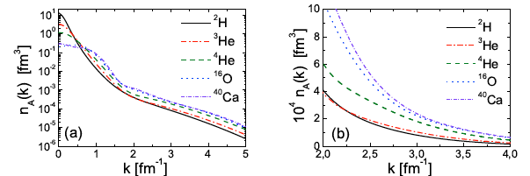
Recent Calculation of Nucleon Momentum Distributions using Realistic Interactions
arXiv 1211.0134, Alvioli, degli Atti, et al.

Slide 17
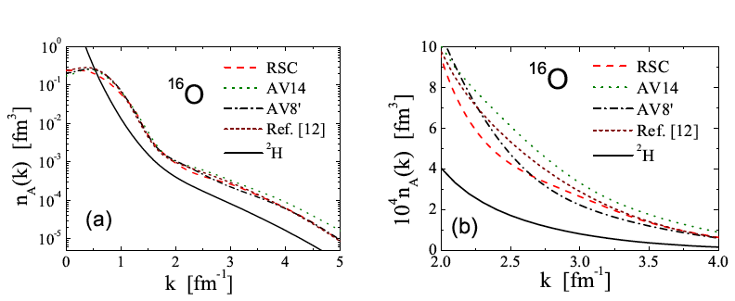
Differences Produced by Different Interactions
Don’t forget k²dk

Slide 18
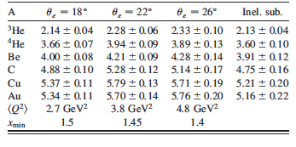
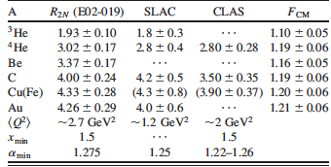
For 40 years theorists maintained there were high momentum components in the nuclear wave function due to short range nucleon-nucleon correlations.
Some manifestations are the deuteron quadruple moment (SR tensor force), depletion of shell model orbits, saturation of nuclear matter (short range repulsion).
“Direct evidence” has been hard to come by until middle of last decade. PRL 90 042301 ¹²C(p,2p+n), PRL 99,072501 (e,e’p)
A(e,e’)

Slide 19
Energy Transfer (ω)
In Mean Field:
In 2 body Correlation assuming p_{CM}=0:
Correlated partner

Slide 20
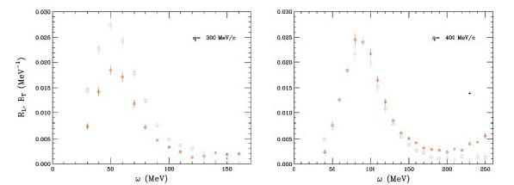
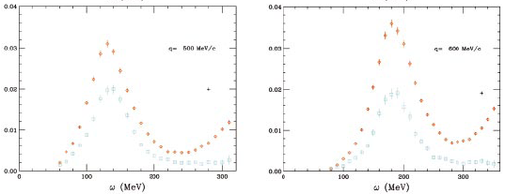
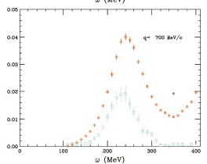
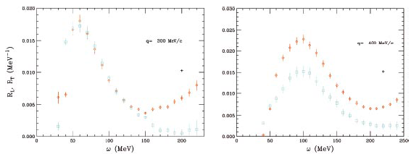
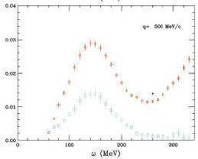
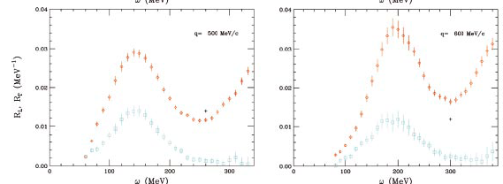
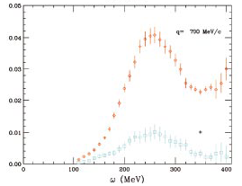
Carlson et al Phys. Rev. C65 024002 (2002)
Longitudinal and Transverse Response Functions from ³He and ⁴He from (e,e’) Quasi-elastic Scattering
³He
q=500MeV/c
q=600MeV/c
q=700MeV/c
q=300MeV/c
q=400MeV/c
ω(MeV) ω(MeV) ω(MeV) ω(MeV) ω(MeV)
⁴He
q=300MeV/c
q=400MeV/c
q=500MeV/c
q=600MeV/c
q=700MeV/c
ω(MeV) ω(MeV) ω(MeV) ω(MeV) ω(MeV)

Slide 21
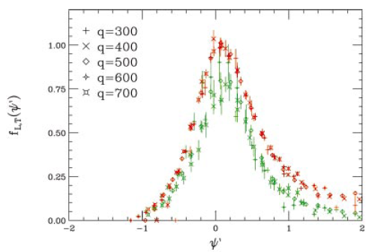
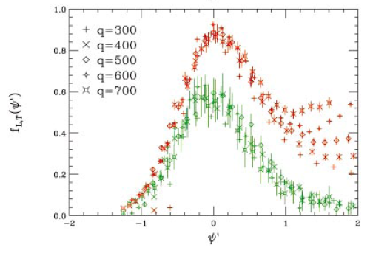
³He and ⁴He Longitudinal and Transverse Scaled Response Functions
Phys. Rev. C65 024002 (2002)
³He
⁴He
Note : Change in f_{T}/f_{L} and shift to higher values of
between ³He and ⁴He,

Slide 22
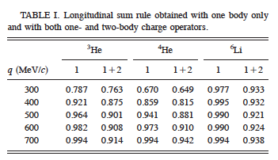
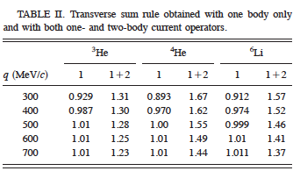
⁴He Longitudinal and Transverse e,e’ QE Response
(definition of Euclidian response function,τ)
(mode of calculation)
(scaled response presented below)
Results of calculation; Uses 2 & 3 body NN force, includes 2 body current operators.

Slide 23




One and Two Body EM Currents and Charges
One-body current and charge:
Continuity eq.:
Two-body current:
N’_{i} N’_{j}
N’_{i} N’_{j}
N’_{i} N’_{j}
π
π
π
N_{i} N_{j}
N_{i} N_{j}
N_{i} N_{j}

Slide 24
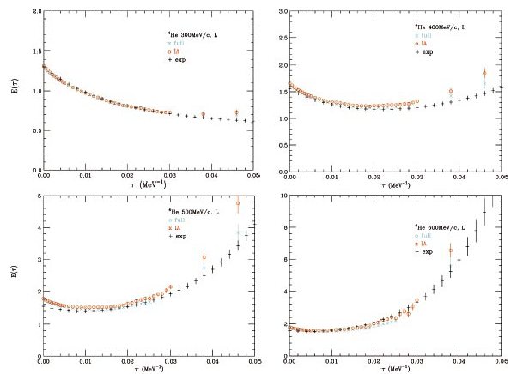
⁴He EuclidianLongitudinal Response: Calculated versus Data
Sum rule

Slide 25
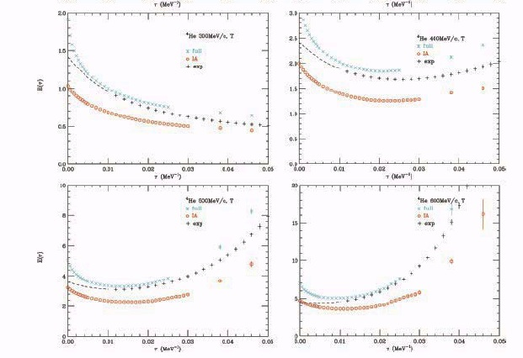
⁴He Transverse Response Calculated Versus Data

Slide 26
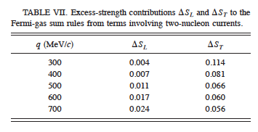
More from
Fermi Gas= plane wave initial and final states
Plane wave initial and final
states don’t work!!

Slide 27
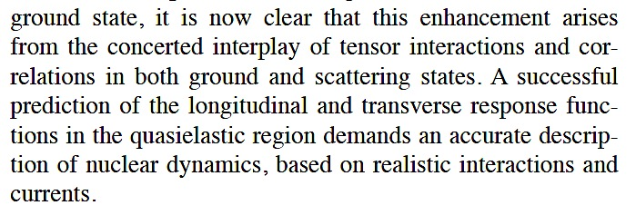
Potentially Bad News!!
Conclusion from Phys. Rev. C65 024002 (2002)
“
“
If true, how could all this be put into event generators??

Slide 28
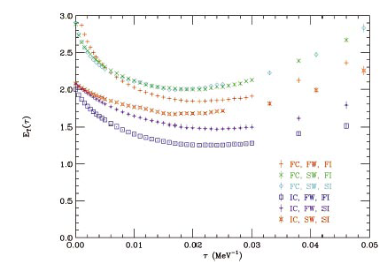
⁴He
FC=Full Current
SC=Simple Current
q=400MeV/c

Slide 29
What Can be Done?
Use better momentum distributions for nuclei
Have a good model for energy loss in collision
In Mean Field:
In 2 body Correlation assuming p_{CM}=0:
With established, use the measured response functions, f_{L}(ψ’) and f_{T}(ψ’) to account for all the neglected nuclear physics.
Assume only the traverse vector response is enhanced
The new momentum distribution, the new recipe for the energy loss, and enhanced transverse vector response will produce a higher apparent Q²,more yield and higher incident neutrino energy.

Slide 30
With a known flux (??) of neutrinos one can then calculate the probability of a charged lepton with energy E_{L} and angle θ created by a neutrino with energy E_{ν.} Thus achieving a better representation of data and a more reliable estimate of neutrino energy and its uncertainty.
Note: Carlson, Schiavilla et al. say they will have computed the ν_{μ}+¹²C CCQE cross-section by summer 2013 for ν energies up to 2GeV with the full approach used in PR C65 024002. This can be compared both to MiniBooNE data and serve to test the simpler approaches suggested here.

Slide 31
Concluding Remarks
Better nucleon momentum distributions and a set of consistent 2-body currents should yield a better description of CCQE and NCE.
It also provides a foundation to incorporate improvements in theory and new data particularly from electron scattering.
Note all the theory addressed has been inclusive-lepton only
Better cross sections will put greater emphasis on better neutrino flux determinations. Role for ²H? Phys. Rev. C 86, 035503 (2012)
These improvements are probably needed for reliable extensions of generators into the resonance region.
Realization of the full capability of LAr detectors will require dealing with FSI-a difficult and messy task.

Slide 32
Supplemental Slides

Slide 33


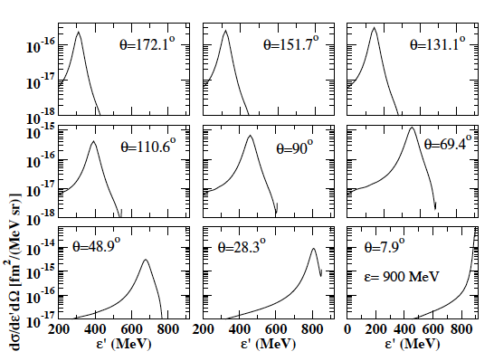
ν-²H Scattering (Theory)
Phys. Rev. C 86, 035503 (2012)
Calculated Lepton Energies for 900 MeV incident Neutrinos
nucleon at rest

Slide 34
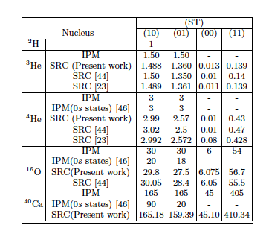

Slide 35
In Somewhat More Detail
Take the nucleon momentum distributions as in arXiv 1211.0134
A neutrino of energy E_{ν} imparts momentum q to one of the nucleons using one-body current.
The energy loss (ω) in mean field sector is standard:
The energy loss in the correlated sector is:
With q and ω, ψ’ is obtained. The resulting R_{VL}(ψ’) should be asymmetric in ψ’ due to the increased energy loss when scattering off correlated nucleons.
The calculated value for R_{VT}(ψ’) must be modified to account for neglected physics. The calculated one-body response must be enhanced by a factor R_{VT}(ψ’) x R_{VL}(ψ’) (R_{T,V}(ψ’)/R_{L}(ψ’)) where the latter ratio is say the one shown in PR C 65 024002.

Slide 36
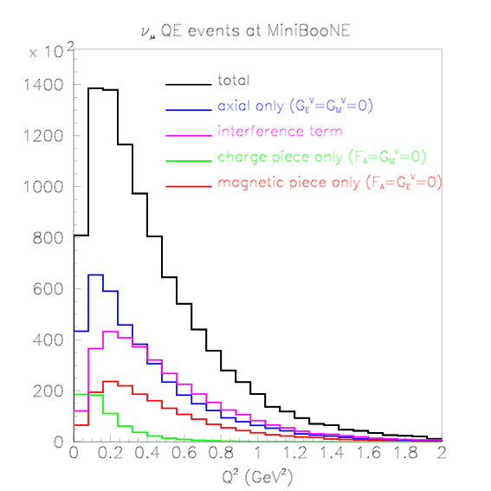
NUANCE Breakdown of the QE Contributions to the MB Yields
I will assume that only the Transverse Vector Response is effected by 2-n currents!!

Slide 37
Simple Model for Momentum Distribution in ¹²C
Fermi Gas
k(fm⁻¹)≈.197 GeV/c
N(k)/0.1fm⁻¹
High Momentum Tail due to SRC

Slide 38
What’s the Energy Loss in Collisions With High Momentum Tail?
p
-p
Different from FG

Slide 39
It is impossible to capture all effects of the strong, short range N-N force with a mean field.
For 40 years theorists maintained there were high momentum components in the nuclear wave function due to short range nucleon-nucleon correlations.
Some manifestations are the deuteron quadruple moment (SR tensor force), depletion of shell model orbits, saturation of nuclear matter (short range repulsion).
“Direct evidence” has been hard to come by until middle of last decade. PRL 90 042301 ¹²C(p,2p+n), PRL 99,072501 (e,e’p), PRL 108 092502

Slide 40
x=2
y=-.5
y=-.1
y=0, x=1,Q²=2mω
y=.1
y=.5
Space like
x=0, Q²=0, y=q((1+q/m)^{1/2}-1)
q (GeV/c)
x=Q²/2mω
Q²=q²-ω²
y=(ω²+2mω)^{1/2}-q
Time like
ω (GeV)

Slide 41
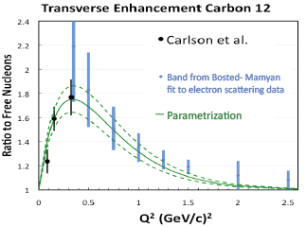
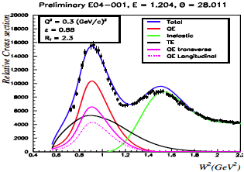
Why is the effect of correlations so evident in MB?
Bodek et al Eur,Phys.J C71 1726 (2011); preliminary data from JUPITER coll. At JLAB (unpub.)

Slide 42
What physics is required to Calculate “CCQE” scattering from Nuclei?
“CCQE” events are those in which the weak interaction vertex creates only nucleons. Such events may have lepton energy transfer well beyond that inferred from the charged lepton momentum as the incident neutrino energy is unknown*.
Need an initial state momentum distribution of nucleons in the nucleus.
Need an effective model for the energy transfer for momentum transfer .
Need the vector and axial vector form factors for nucleons at momentum transfer .
Need to know that nucleon structure not altered in nucleus. (y scaling)
Need the nuclear response for transfer , likely using y scaling.
With the above one can calculate for a flux of neutrinos , where each is associated with an .

Slide 43
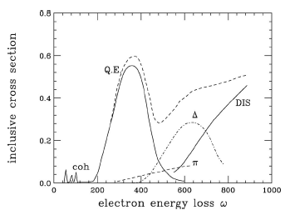
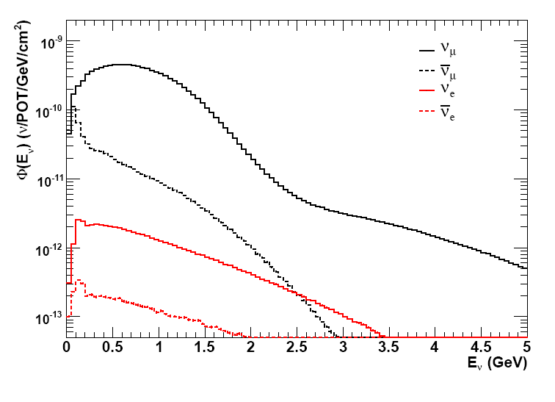

Contrast of e-N with ν-N Experiments
Electron
Electron Beam ΔΕ/E ~10⁻³
Scattered electron
Magnetic Spectograph
Neutrino
MiniBooNE Flux
MiniBooNE Detector
mineral oil
Don’t know E_{ν} !!!
Neutrino Beam ΔE/<E>~1
l ⁻
What’s ω ???
What’s q ????
Very Different Situation from inclusive electron scattering!!

Slide 44
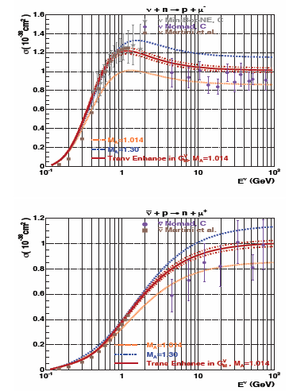
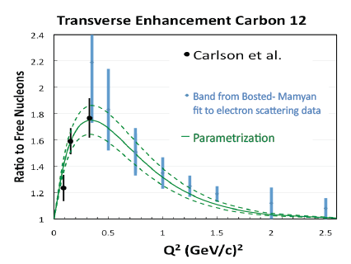
Bodek et al: Eur. Phys. J. C71 (2011) 1726, much influenced by Carlson et al: PR C65 024002
Motivated by Carlson et al, Bodek et al. more correctly assigned the enhancement to the transverse vector response. In impulse approximation,
Without addressing any dynamics Bodek et al. create the enhancement via increasing V_{T} as a function of Q², using Q²=4E_{ν}E_{l}sin²θ/2

Slide 45


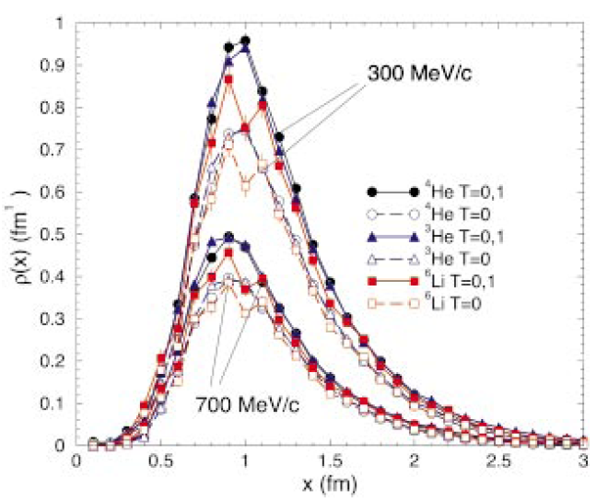
2-body contribution
2-body density
2-body current
x=pair separation

Slide 46
Some Observations
In mean field models f_{L}(ψ’) would be symmetric about ψ’ =0, The asymmetric shift to more positive values of ψ’ is due to the larger energy loss associated with the SRC pairs.
The enhancement of f_{T}(ψ’) becomes large for q >300MeV/c.
The large 2-body enhancement of f_{T}(ψ’) requires adequate treatment of the initial and final nucleon states as well as 2-body currents.
This is the likely source of the of the larger than expected MB cross section and the fact that the enhancement is associated with large energy loss indicate that its effects should be included when assigning incident neutrino energies.

