Slide 1
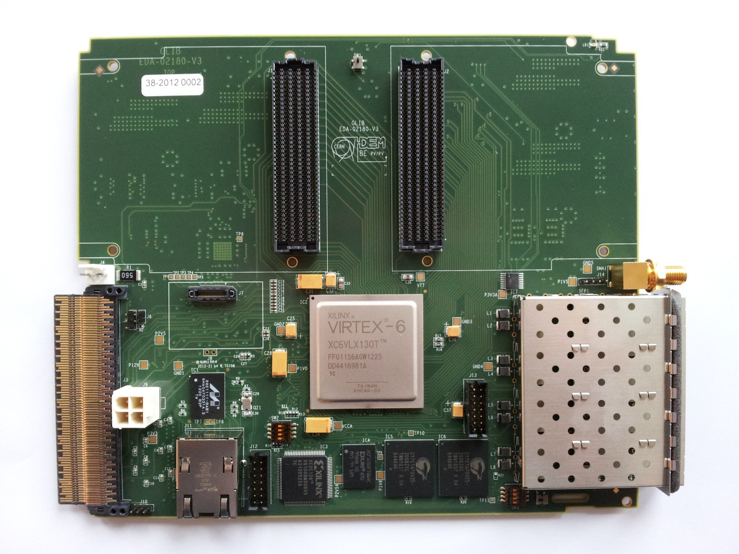

PH-ESE Electronics Seminars
GLIB: Gigabit Link Interface Board,
a flexible optical link interface module for the rad-hard GBT link
Paschalis Vichoudis
[on behalf of the GLIB team]
12/03/2013
PH-ESE-BE

Slide 2
Outline:
Introduction
Hardware
Firmware
Production
Summary/Outlook
PH-ESE-BE

Slide 3
Outline:
Introduction
Hardware
Firmware
Production
Summary/Outlook
PH-ESE-BE

Slide 4
Introduction
(1 of 6)
The team
  Sophie Baron
  Manoel Barros Marin
  Manoel Barros Marin
  Vincent Bobillier
  Stefan Haas
  Magnus Hansen
  Markus Joos
  Francois Vasey
  Paschalis Vichoudis
Acknowledgments
  Greg Iles (IC), Dave Newbold (Bristol), Jean-Pierre Cachemiche (CPPM), Eric Hazen (Boston)
  Colleagues from: PH-ESE-BE opto, xTCA evaluation project, CNRS Strasburg, Fermilab et al.
PH-ESE-BE

Slide 5
Introduction
(2 of 6)
What is the Gigabit Link Interface Board (GLIB)
  General purpose FPGA based board (Xilinx VLX130T-1).
  Multi-Gigabit serial communication links (up to 5Gb/s).
  Flexible:
  Evaluation platform (Benchtop operation).
  Trigger/DAQ system (Crate operation).
  Upgradable:
  Mezzanine cards, pluggable optics.
  Compatibility with higher capacity FPGAs.
Our main motivation
  Provide a development platform for the GBT/Versatile Link system.
PH-ESE-BE

Slide 6
Introduction
(3 of 6)
Interconnection systems for High Energy Physics (HEP) experiments
  Current generation:
  New generation:
PH-ESE-BE

Slide 7
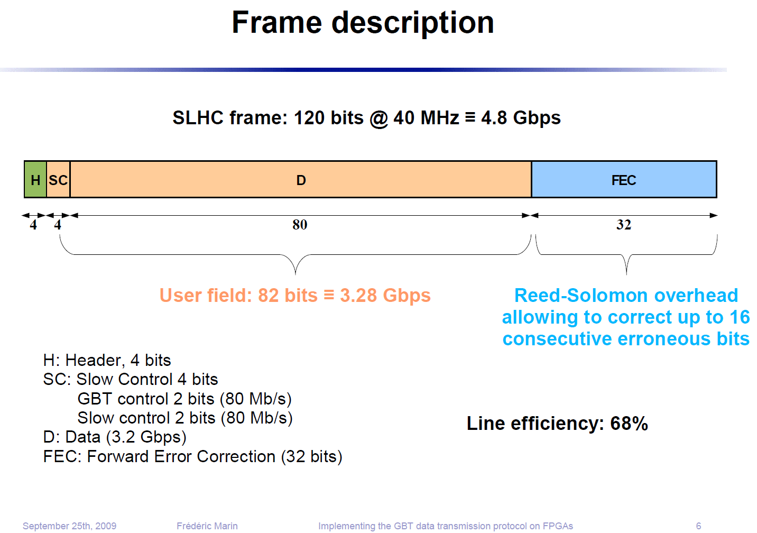
Introduction
(4 of 6)
GBT frame
PH-ESE-BE

Slide 8
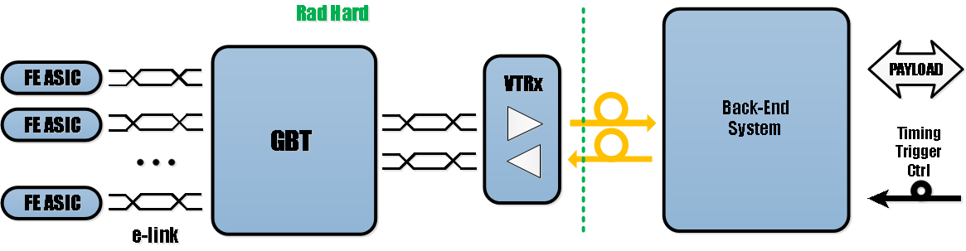
Introduction
(5 of 6)
GBT, Versatile Link and e-Link in new generation HEP interconnects
PH-ESE-BE

Slide 9
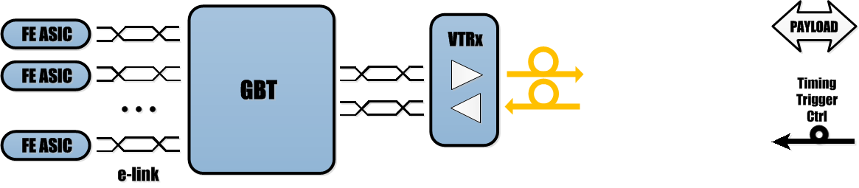
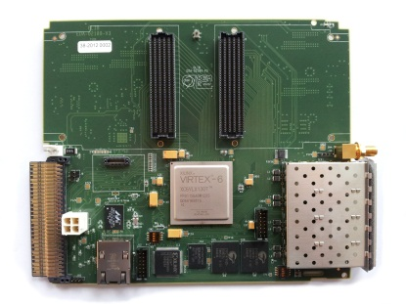
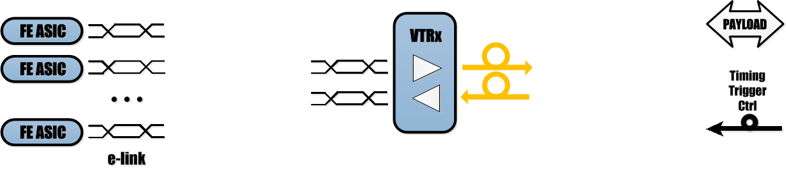

Introduction
(6 of 6)
Where does GLIB fit in future HEP systems?
  Baseline configuration:
  Intermediate Prototyping Configuration:
PH-ESE-BE

Slide 10
Outline:
Introduction
Hardware
Firmware
Production
Summary/Outlook
PH-ESE-BE

Slide 11
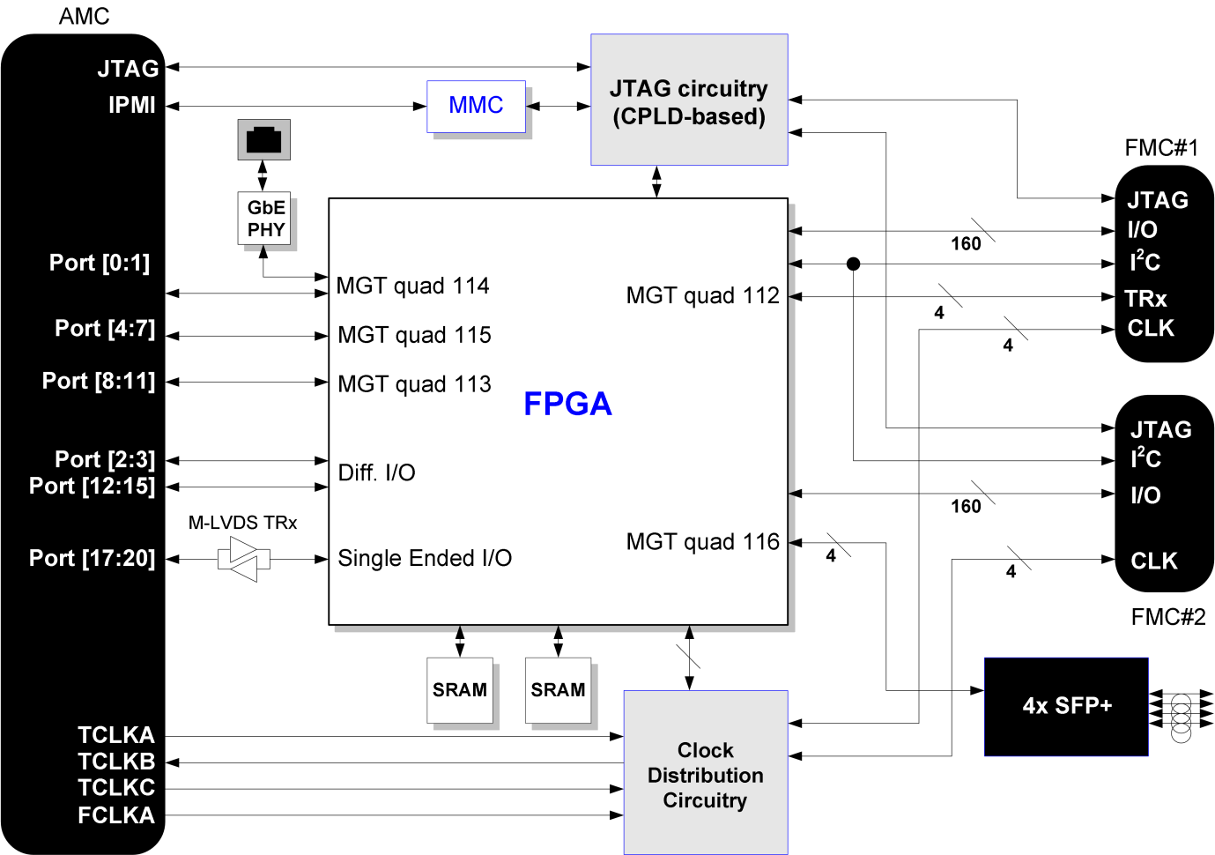
Hardware
(1 of 12)
Block Diagram
PH-ESE-BE

Slide 12
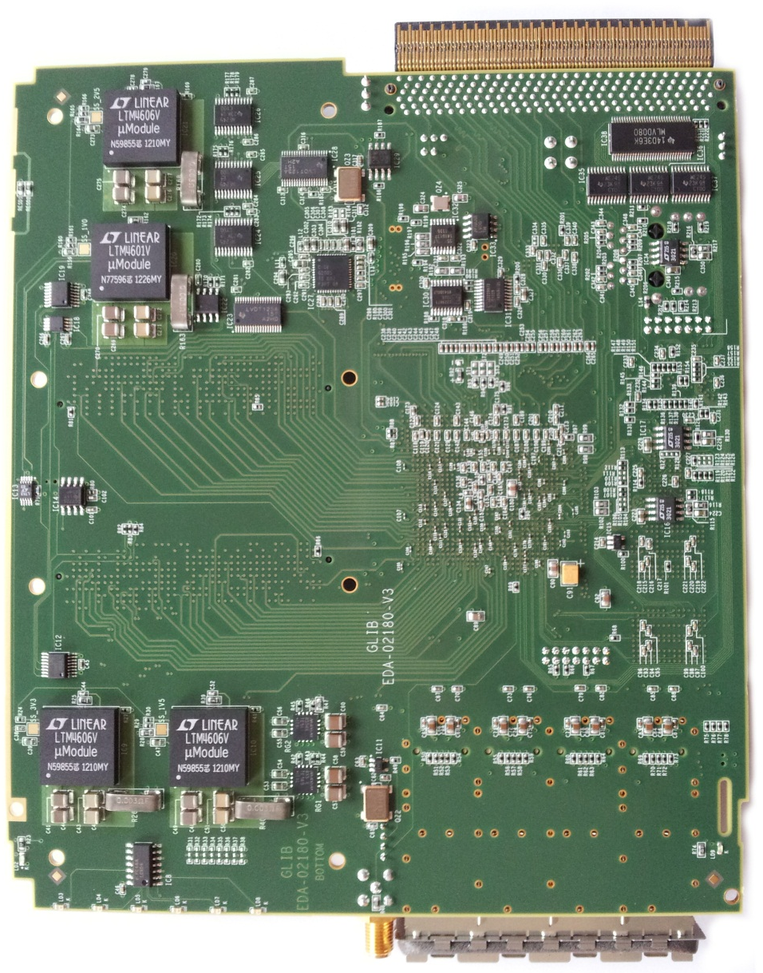

Hardware
(2 of 12)
The board
148mm
SFP+ x 4
SRAM
x 2
Clock Synthesizer
(CDCE62005)
180mm
FMC x 2
FPGA
FLASH
CPLD
MMC
GbE
PWR
AMC
PH-ESE-BE

Slide 13


Hardware
(3 of 12)
GLIB on a bench
SFP+ x 4
SRAM
x 2
FMC x 2
FPGA
FLASH
CPLD
JTAG
USB
GbE
MMC
GbE
PWR
AMC
PH-ESE-BE

Slide 14
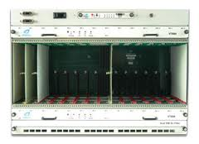
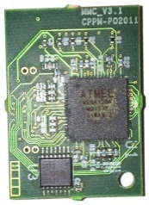
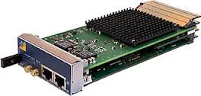
Hardware
(4 of 12)
uTCA crate
GLIB in a crate
SFP+ x 4
SRAM
x 2
FMC x 2
FPGA
FLASH
CPLD
MMC
MMC
GbE
PWR
MCH
AMC
GTX
CLK & I/O
PWR
I2C
PH-ESE-BE

Slide 15
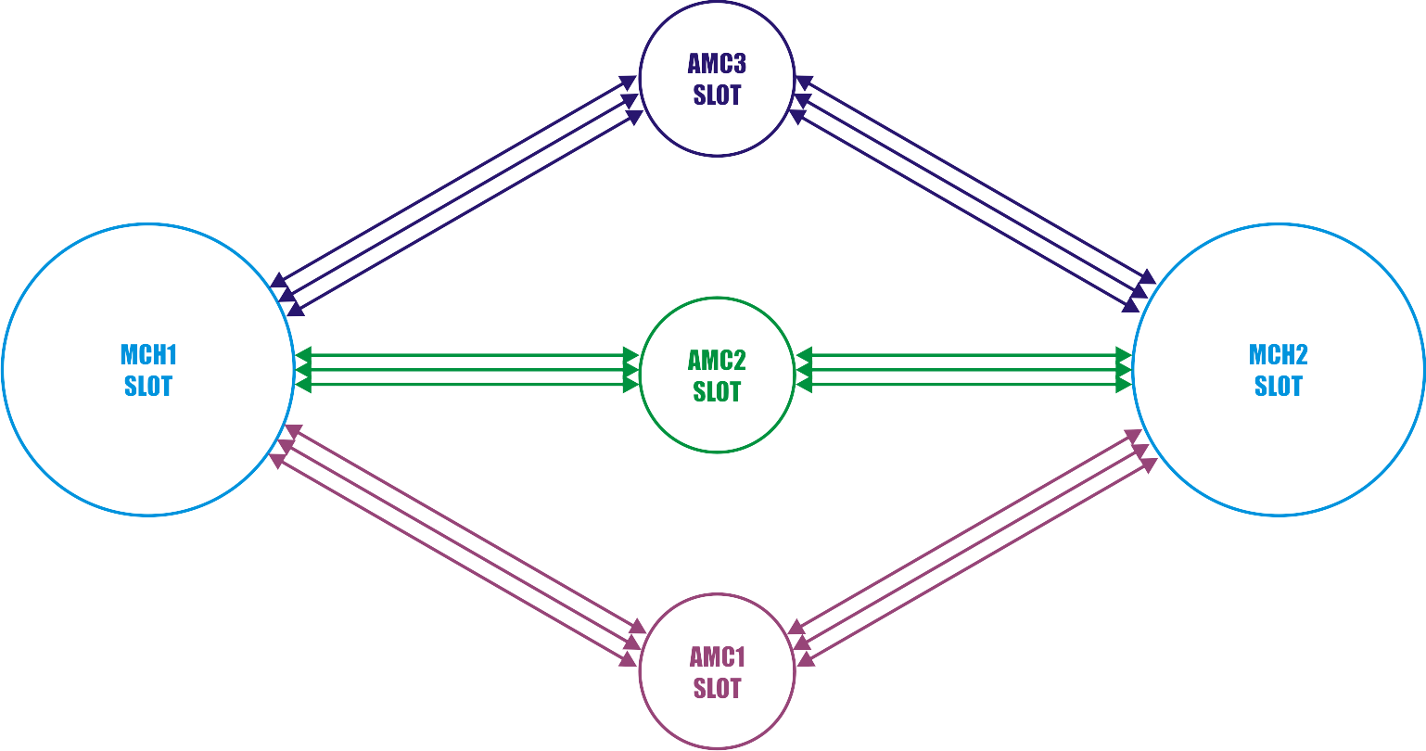
Hardware
(5 of 12)
GLIB in a crate (I)
Dual Star Topology Example (logical)
PH-ESE-BE

Slide 16
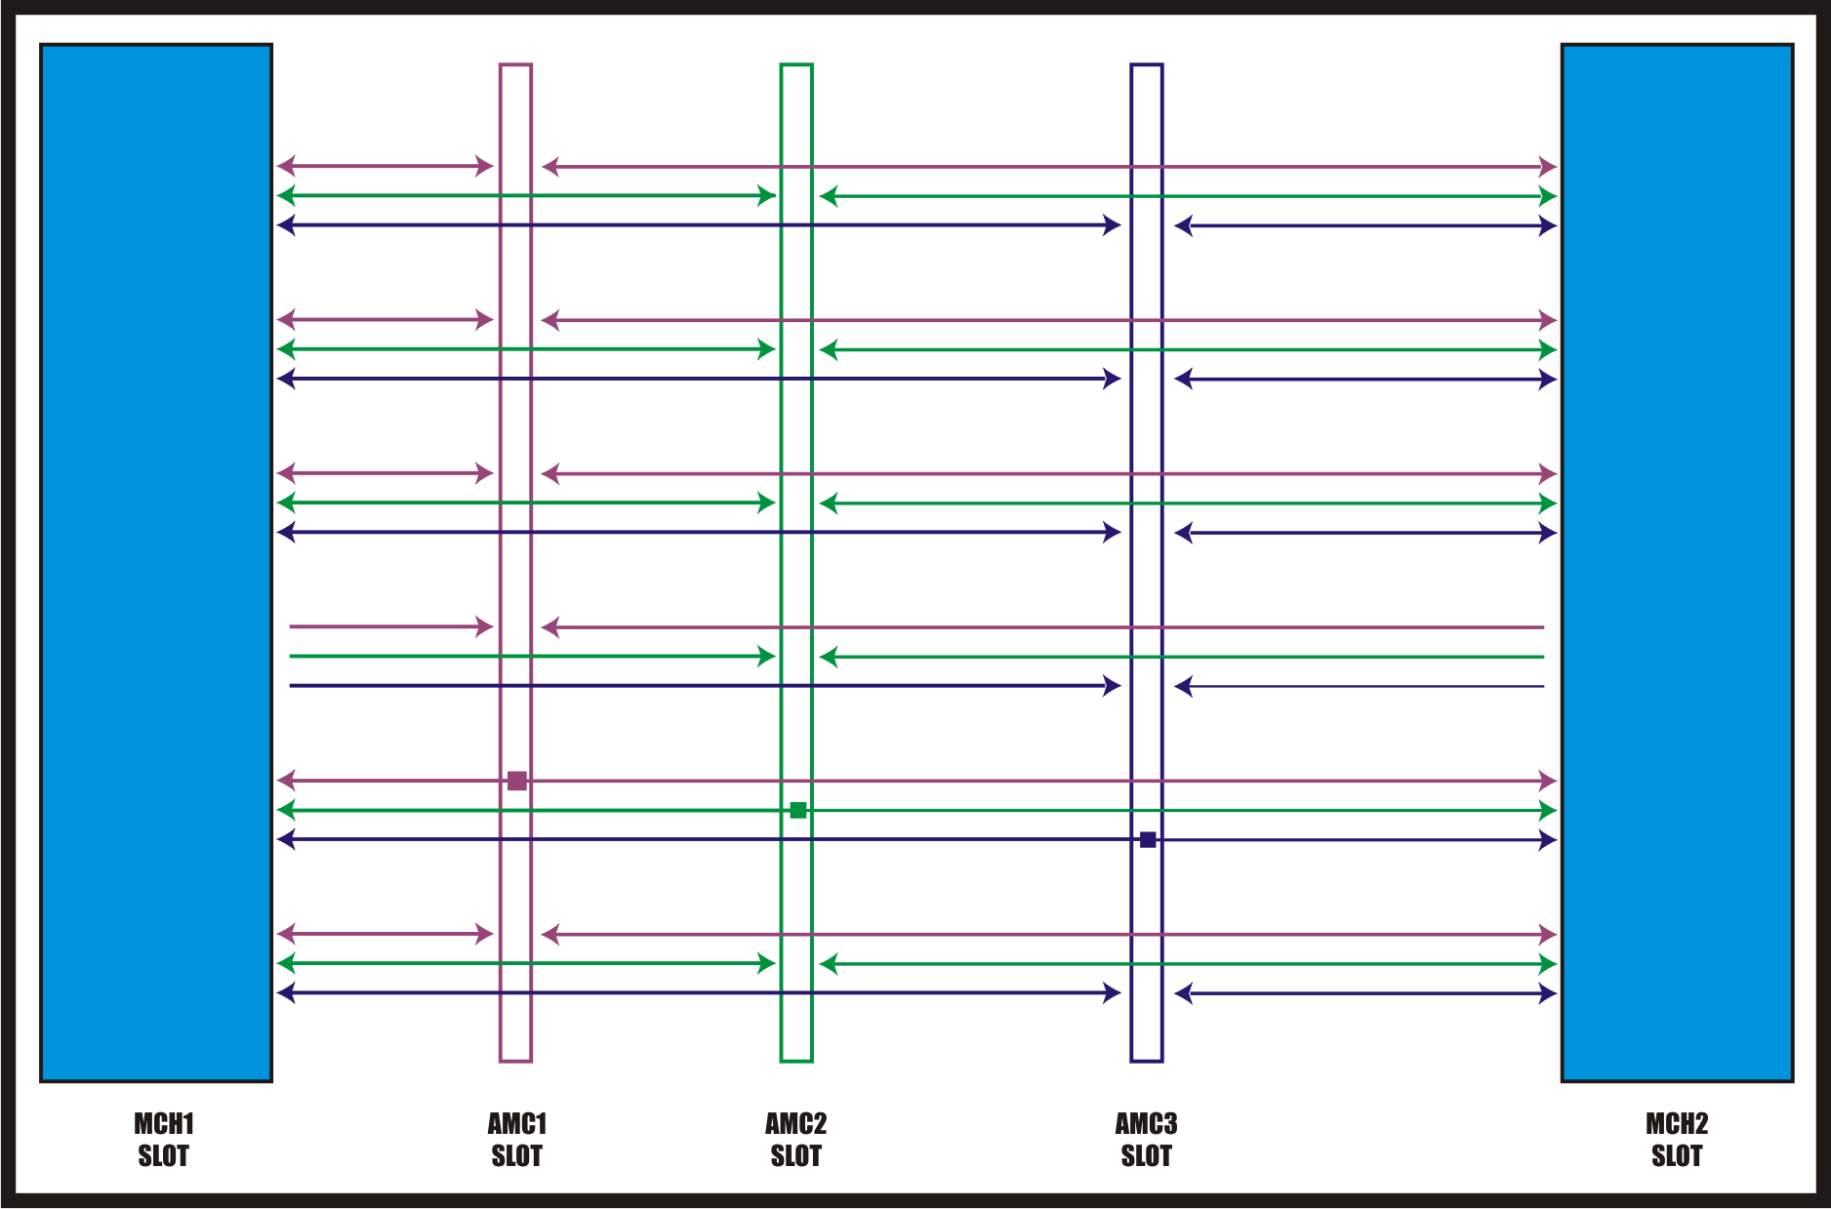
Hardware
(6 of 12)
GLIB in a crate (II)
Dual Star Topology Example (physical)
PH-ESE-BE

Slide 17
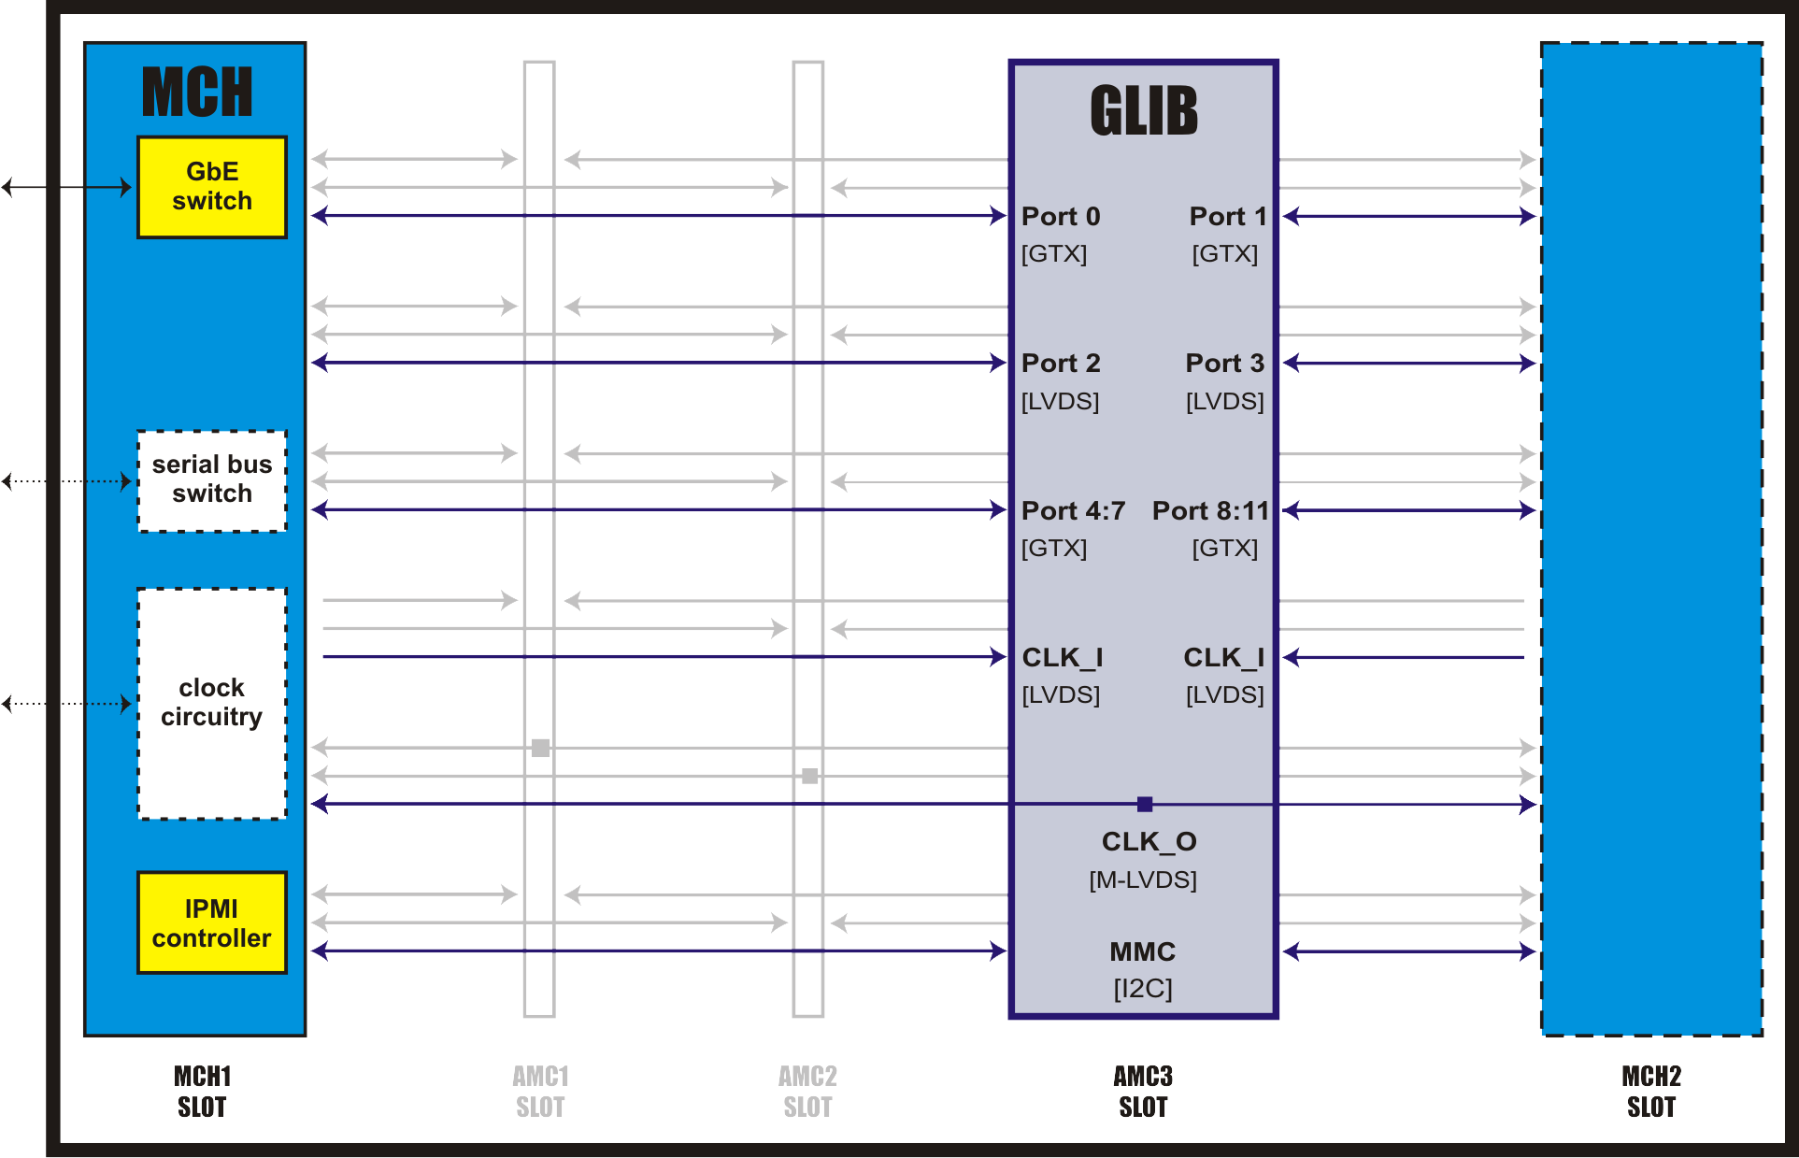
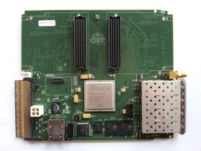
Hardware
(7 of 12)
GLIB in a crate (III)
1.25Gb/s
up to 5Gb/s
up to 20Gb/s
up to 20Gb/s
PH-ESE-BE

Slide 18
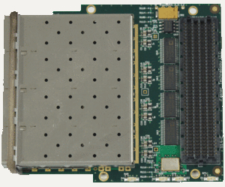
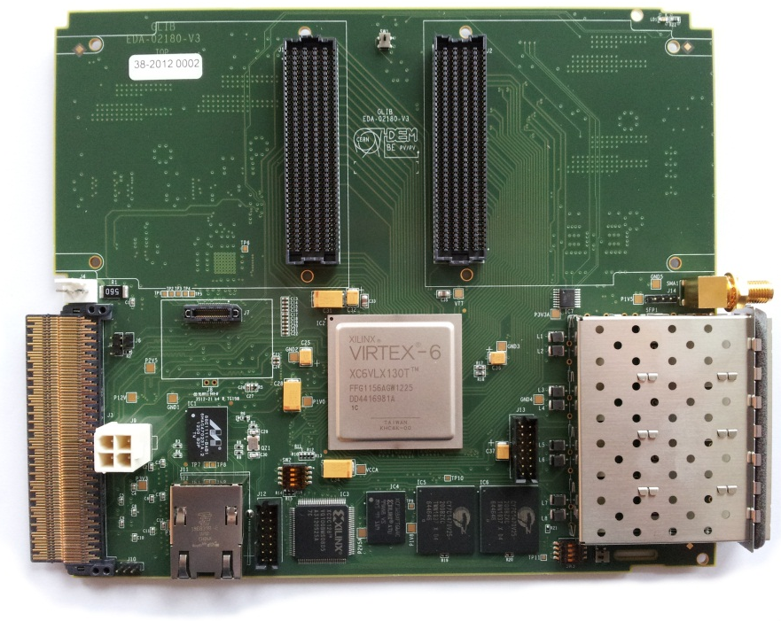
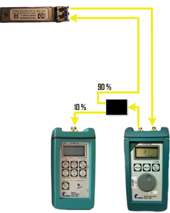
Hardware
(8 of 12)
Prototyping: High speed serial links (I)
Optical links characterization:
  Optical Modulated Amplitude (OMA) calculation.
FT FM-S14
  Test setup.
90 %
10 %
PH-ESE-BE

Slide 19



Hardware
(9 of 12)
Prototyping: High speed serial links (II)
Optical links characterization*
  Optical Modulated Amplitude (OMA) calculation.
  Test setup.
  Optical sensitivity.
  Bit Error Rate
* Lane rate: 5 Gbps
Test pattern: PRBS-31
PH-ESE-BE

Slide 20
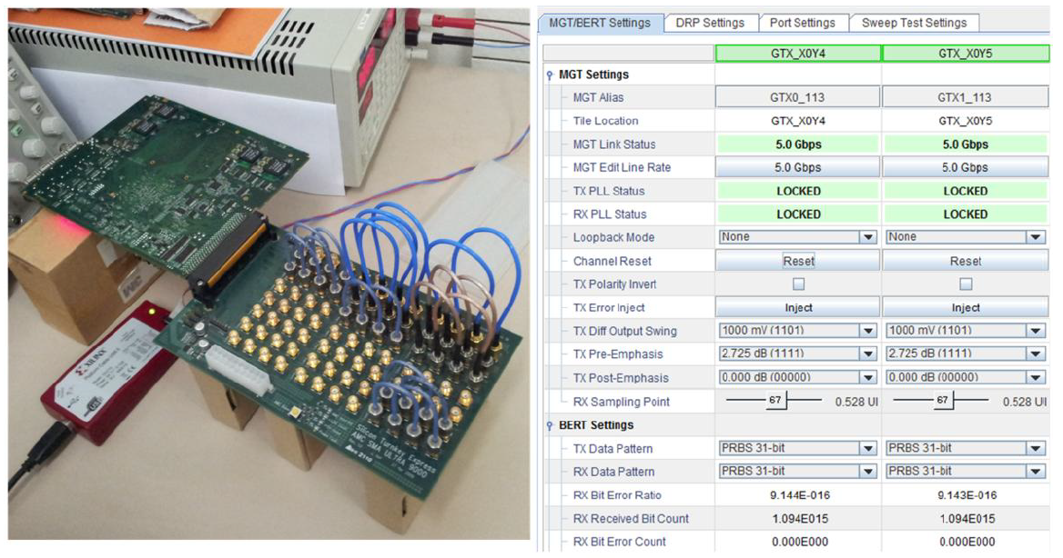
Hardware
(10 of 12)
Prototyping: High speed serial links (III)
Electrical links test.*
Chipscope iBERT
Test setup
Silicon Turnkey Express
AMC SMA ULTRA 9000
* Lane rate: 5 Gbps
Test pattern: PRBS-31
2.5 days running with no errors
PH-ESE-BE

Slide 21

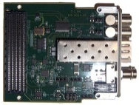
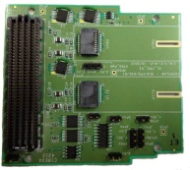
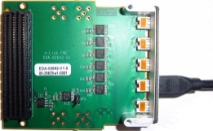
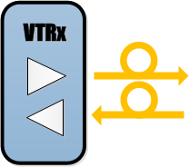
Hardware
(11 of 12)
The GLIB ecosystem (I)
  Baseline configuration:
TTC FMC
  Intermediate Prototyping Configuration:
PH-ESE-BE

Slide 22
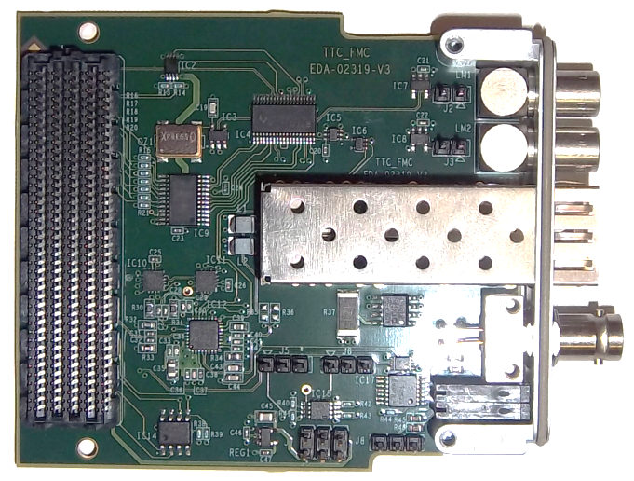

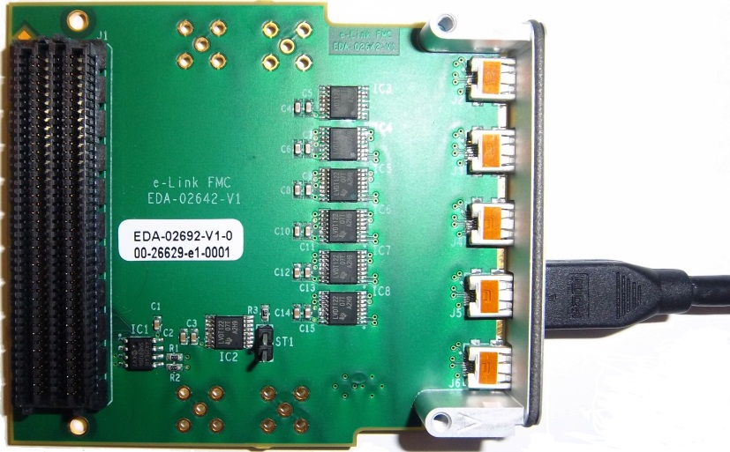
Hardware
(12 of 12)
The GLIB ecosystem (II)
TTC FMC
VERSATILE LINK FMC
e-Link FMC
PH-ESE-BE

Slide 23
Outline:
Introduction
Hardware
Firmware
Production
Summary/Outlook
PH-ESE-BE

Slide 24
Firmware
(1 of 27)
Is GLIB firmware typical?
Typical firmware is developed for a very specific application, that is not the case with GLIB.
Why?
Development platform, not an end product.
  The GLIB team is not the end developer/user.
How?
  General purpose firmware, not bounded to specific applications.
  Reference designs.
  GLIB support for various applications.
This is a big CHALLENGE
PH-ESE-BE

Slide 25
Firmware
(2 of 27)
Architecture
PH-ESE-BE

Slide 26
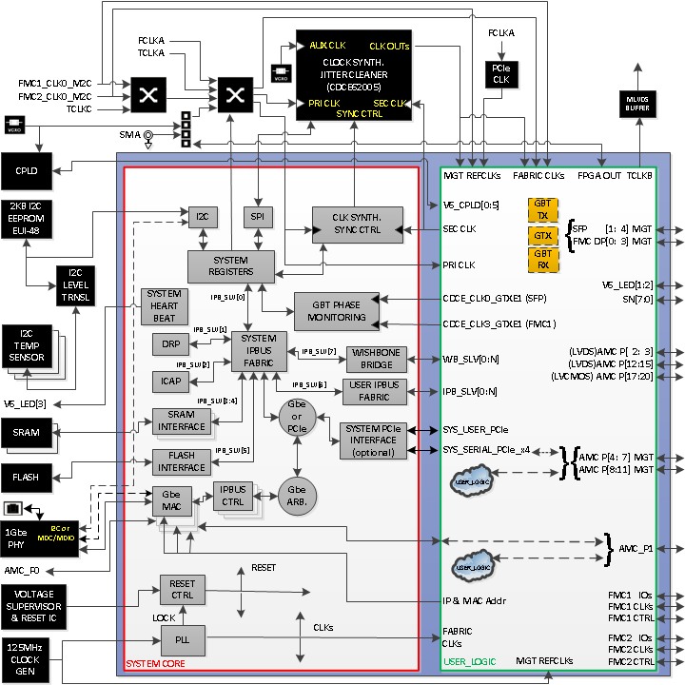

Firmware
(3 of 27)
Block Diagram
PH-ESE-BE

Slide 27
Firmware
(4 of 27)
Reference Designs
INFRASTRUCTURE
“bench_empty”
“crate_empty”
“crate_pcie”
GBT-BASED
“bench_gbt_fpga”
“bench_vtrx”
PH-ESE-BE

Slide 28
Firmware
(5 of 27)
Reference Designs
INFRASTRUCTURE
“bench_empty”
“crate_empty”
“crate_pcie”
GBT-BASED
“bench_gbt_fpga”
“bench_vtrx”
PH-ESE-BE

Slide 29
Firmware
(6 of 27)
Infrastructure Ref Design
“bench_empty”
PH-ESE-BE

Slide 30
Firmware
(7 of 27)
Infrastructure Ref Design
“crate_empty”
PH-ESE-BE

Slide 31

Firmware
(8 of 27)
Infrastructure Ref Design
“crate_pcie” (I)
PH-ESE-BE

Slide 32
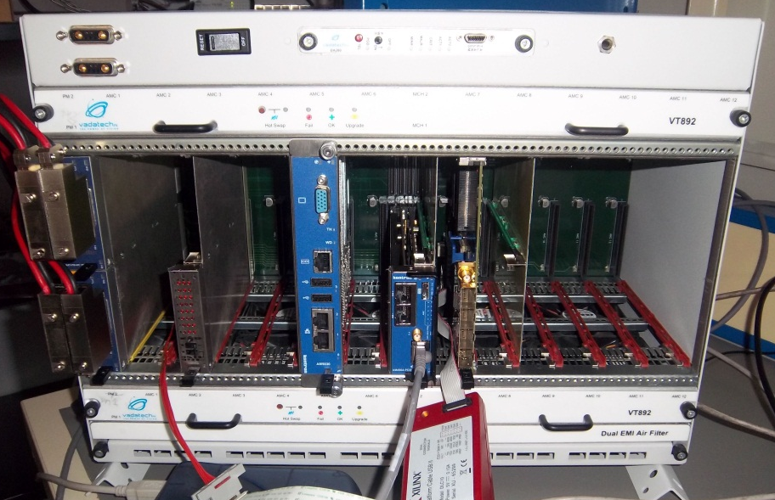

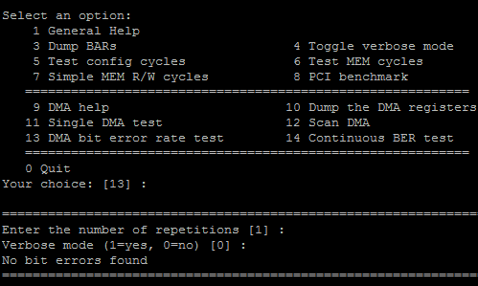
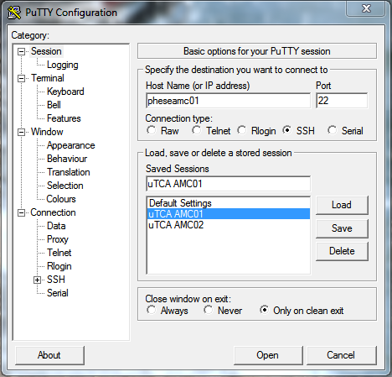
Firmware
(9 of 27)
Infrastructure Ref Design
“crate_pcie” (II)
AMC CPU terminal
PuTTY
GLIBscope PCIe software
PC for Crate
Management
PH-ESE-BE

Slide 33
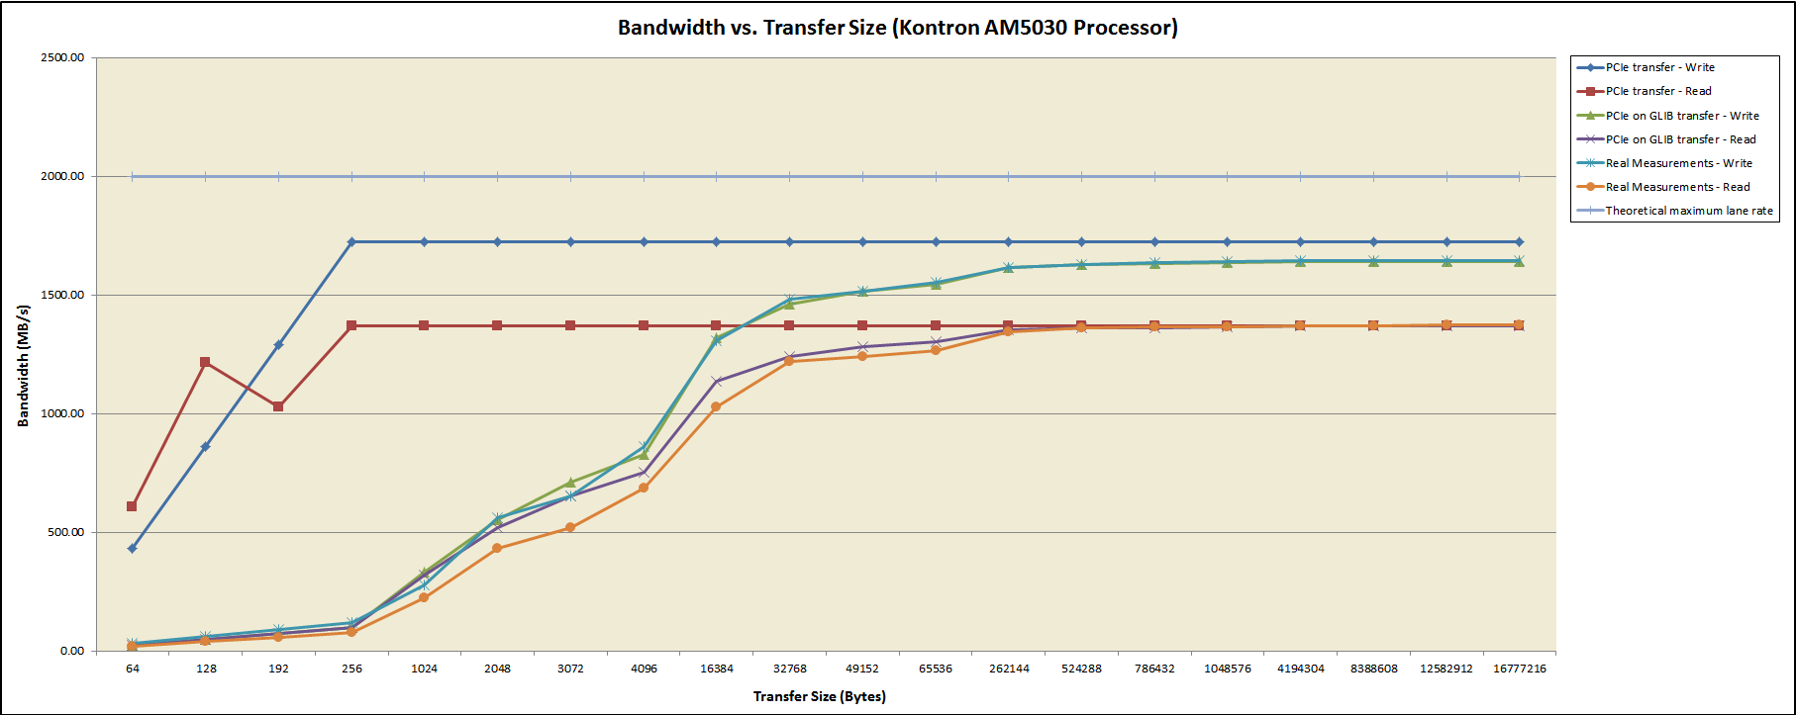
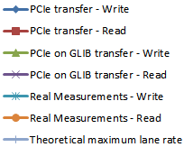
Firmware
(10 of 27)
Infrastructure Ref Design
“crate_pcie” (III)
PCIe x4 v2.0
Maximum Rate (theoretical)
PCIe Write (GLIB System model)
PCIe Write (GLIB System measurements)
PCIe Write (Xilinx Link model)
PCIe Read (GLIB System model)
PCIe Read (GLIB System measurements)
PCIe Read (Xilinx Link model)
PH-ESE-BE

Slide 34
Firmware
(11 of 27)
Reference Designs
INFRASTRUCTURE
“bench_empty”
“crate_empty”
“crate_pcie”
GBT-BASED
“bench_gbt_fpga”
“bench_vtrx”
PH-ESE-BE

Slide 35
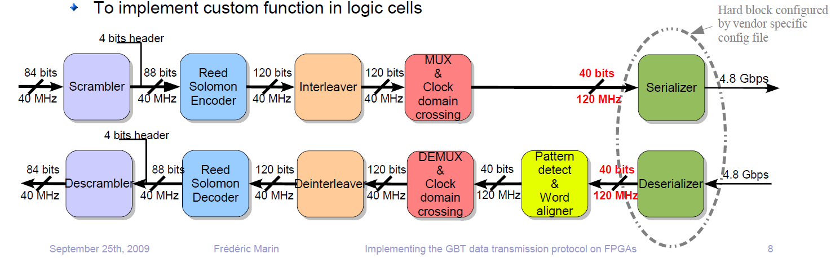
Firmware
(12 of 27)
GBT protocol in FPGA
Will be referred to as “GBT ENCODER”
Will be referred to as “GBT DECODER”
  S. Baron et al. “Implementing the GBT data transmission protocol in FPGAs” TWEPP-2009
PH-ESE-BE

Slide 36
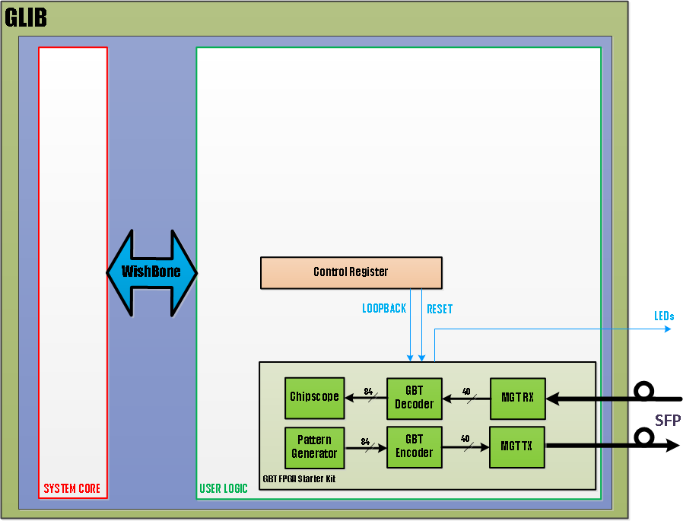
Firmware
(13 of 27)
Infrastructure Ref Design
“bench_gbt_fpga”
PH-ESE-BE

Slide 37
Firmware
(14 of 27)
Alternative GBT protocol in FPGA
20b@240MHz
20b@240MHz
Why 20b@240MHz? Optimized for Virtex6
- Natural Width of GTX
- Lower latency
- Fewer clock resources
37

Slide 38
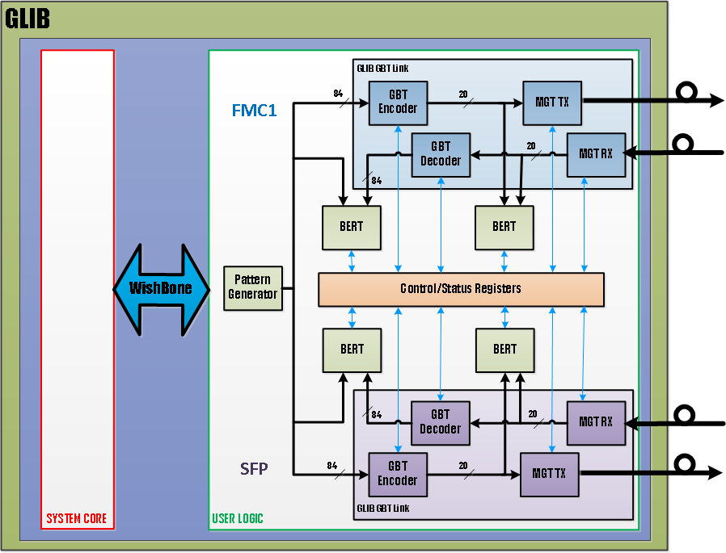
Firmware
(15 of 27)
Infrastructure Ref Design
“bench_vtrx”
PH-ESE-BE

Slide 39
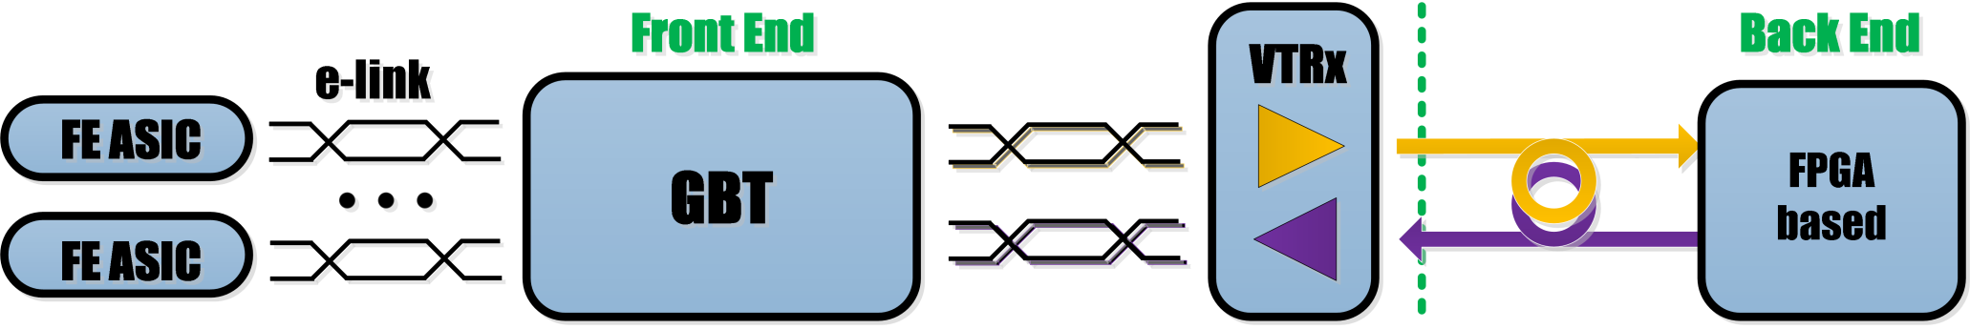
Firmware
(16 of 27)
“bench_vtrx”
fixed latency considerations (I)
Upstream
Downstream
Fixed Latency requirements?
Experimental Systems Direction FPGA part involved
Front End Control Downstream GTX Transmission
Data Readout None
Trigger Processing Upstream (?) GTX Reception
Other BE systems (FPGA-to-FPGA) have similar requirements (e.g. PON)
PH-ESE-BE

Slide 40
Firmware
(17 of 27)
“bench_vtrx”
fixed latency considerations (II)
Typical recipe: avoid elastic buffers in GTX.
Is that enough?
PH-ESE-BE

Slide 41
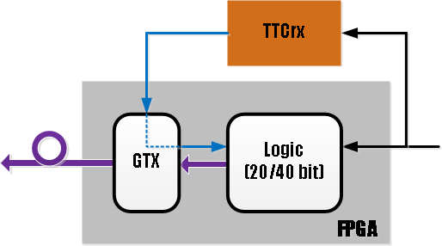
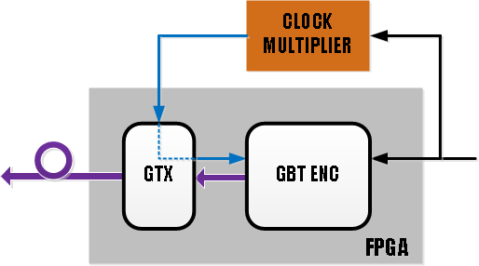
Firmware
(18 of 27)
“bench_vtrx”
fixed latency considerations (III)
Downstream: yes
but ..
- GTX ref clk for GBT link : 240MHz (20bit) or 120MHz (40bit)
- Ref clk not delivered by the TTC, it has to be generated locally
TTC clk
TTC clk x3 (x6)
GOL
TTC clk
GBT
COTS clock multipliers do not guarantee in-to-out phase
PH-ESE-BE

Slide 42
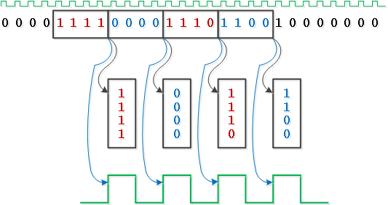
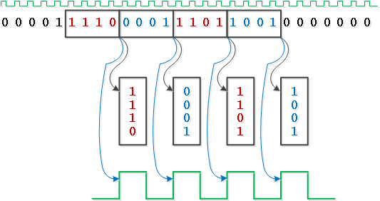
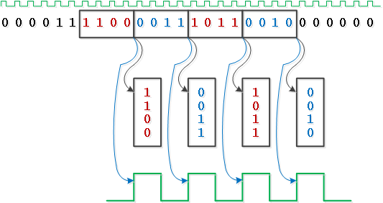
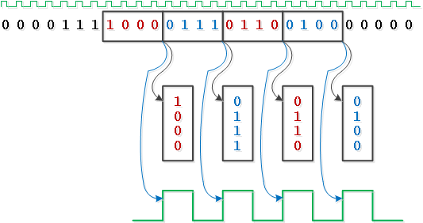
Firmware
(19 of 27)
“bench_vtrx”
fixed latency considerations (IV)
Upstream: certainly NOT
“built-in” uncertainty of Rx Recovered clock
Example of 4-bit Deserializer, locking to data at a random time
Serial In
Parallel Out
Rx Recovered Clock
PH-ESE-BE

Slide 43
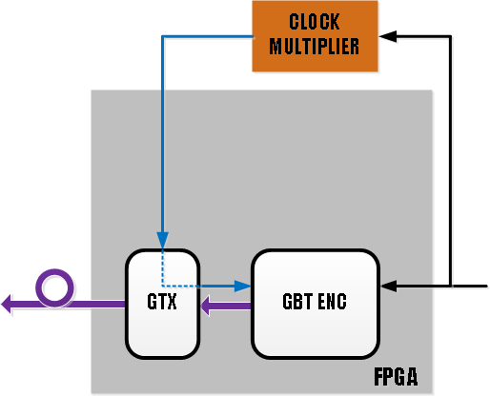
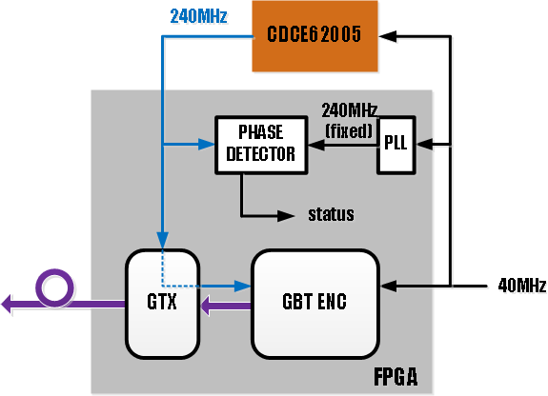
Firmware
(20 of 27)
“bench_vtrx”
fixed latency enhancements (I)
Downstream:
PH-ESE-BE

Slide 44
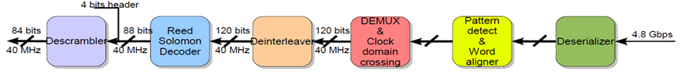
Firmware
(21 of 27)
“bench_vtrx”
fixed latency enhancements (II)
Upstream:
Rx Slide=> PMA Mode
20 bits
240 MHz
20 bits
240 MHz
Number of
Bit-shifts
Performed
Aligned
Flag
Rx Slide ctrl
PH-ESE-BE

Slide 45
Firmware
(22 of 27)
“bench_vtrx”
fixed latency enhancements (III)
demonstration setup
20
Pattern
Detect
Rx Rec Clk
Rx Detect Flag
1m fibre
Tx Clk
Pattern
Detect
20
Tx Detect Flag
demonstration video
PH-ESE-BE

Slide 46
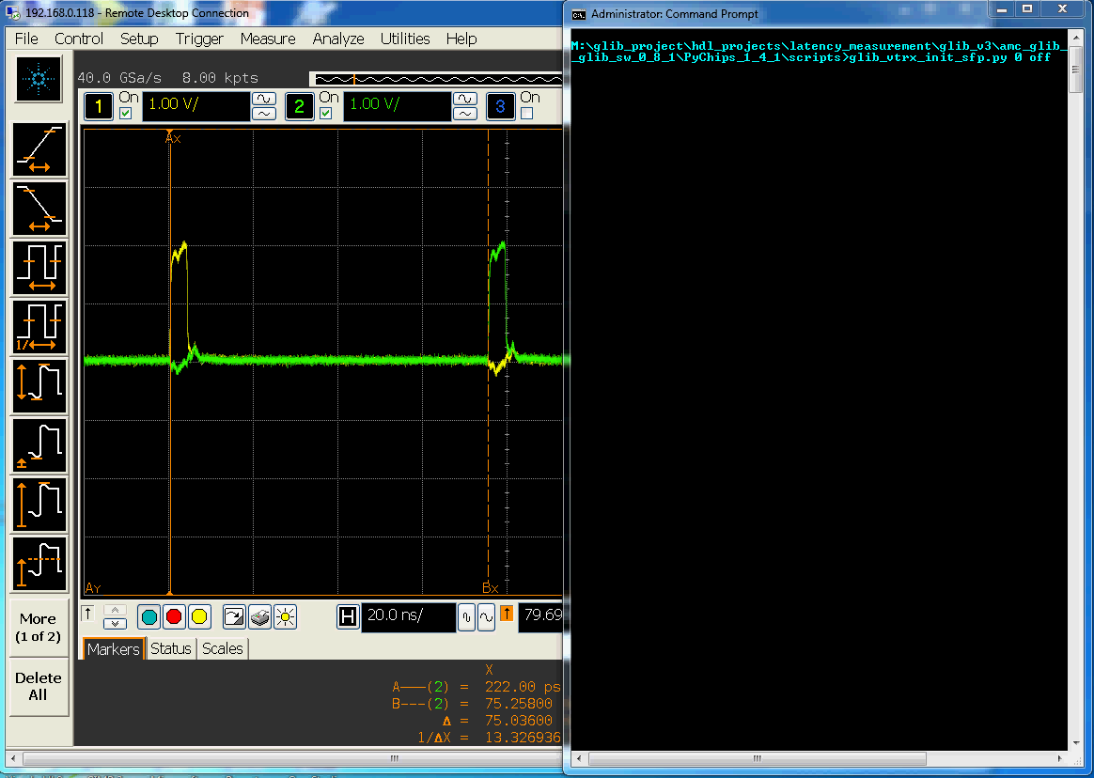
Firmware
(23 of 27)
Tx Detect Flag
Rx Detect Flag
PH-ESE-BE

Slide 47
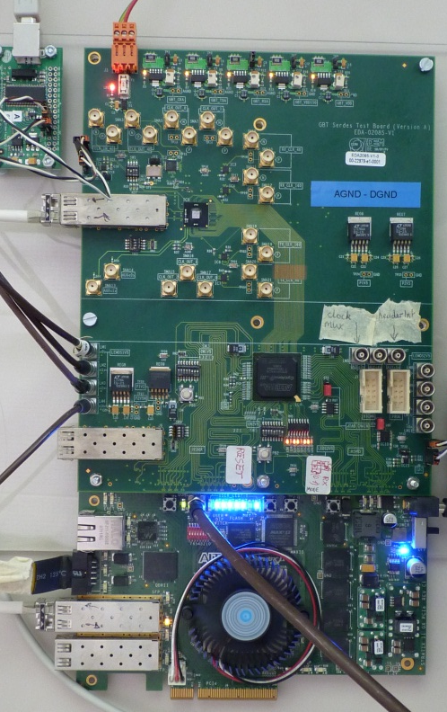
Firmware
(24 of 27)
“bench_vtrx”
test setups (I)
GBT
SERDES
PH-ESE-BE

Slide 48

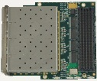

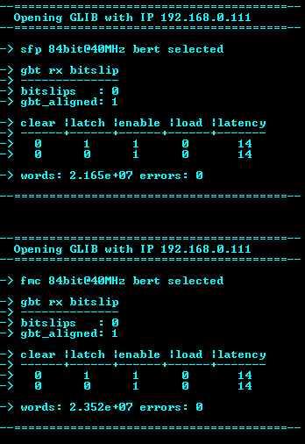
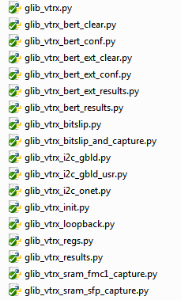
Firmware
(25 of 27)
“bench_vtrx”
test setups (II)
PH-ESE-BE

Slide 49
Firmware
(26 of 27)
“bench_vtrx”
test setups (III)
“Front-End”
“Back-End”
CLK
Generator
“Front-End”
“Back-End”
TTCci
CNRS, Strasburg
PH-ESE-BE

Slide 50
Firmware
(27 of 27)
“bench_vtrx”
test setups (IV)
PH-ESE-BE Opto
PH-ESE-BE

Slide 51
Outline:
Introduction
Hardware
Firmware
Production
Summary/Outlook
PH-ESE-BE

Slide 52
Production
(1 of 3)
Test architecture
PH-ESE-BE

Slide 53
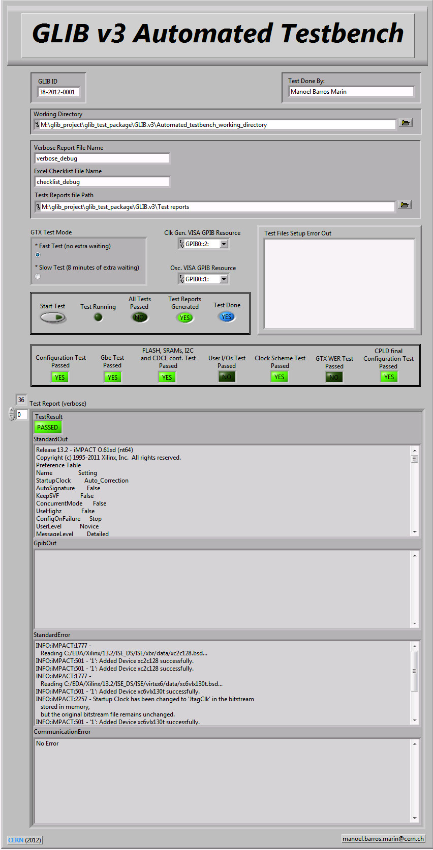

Production
(2 of 3)
Test software
Test GUI
PH-ESE-BE

Slide 54


Production
(3 of 3)
Test reports
Verbose report
Checklist
PH-ESE-BE

Slide 55
Summary
  GLIB is an FPGA-based board for users of high-speed optical links in high energy physics experiments.
  Platform for GBT-based link developments.
OS-style Firmware Architecture
  Development platform, not an end product.
  The GLIB team is not the end developer/user.
  Various Reference designs
  Software start-up kit available.
  Advanced user support, including SVN repository, documentation, test packages
  Fully automated production test bench
  Enhanced connectivity via auxiliary boards
  GLIB interest group became a large community (over 20 teams)
PH-ESE-BE

Slide 56
Outlook
Next Steps
  Develop a demo μTCA system based on GLIB.
  Produce TTC & e-Link FMC.
  Test interface with the new GBTX ASIC.
  Update GLIB firmware/software & documentation.
  Develop a higher density e-Link FMC + AMC adapter.
  Improve PCIe performance.
  Produce additional batches (on request).
PH-ESE-BE

Slide 57


Appendix A: GLIB community
PH-ESE-BE

Slide 58



Appendix B: Timeline
GLIB
GLIB
April 2013
Second production series (20 pcs)
December 2012
First production series (40 pcs)
September 2012
Pre-production
June 2012
Final prototype
August 2011
Second prototype
January 2011
First prototype
Born
Spec Approval
Born on September 13, 2010
PH-ESE-BE
Paschalis.Vichoudis@cern.ch

Slide 59

Resource Usage
PH-ESE-BE

Slide 60



CMS Software
PyChips
GLIBscope
PH-ESE-BE

Slide 61

Java Software
Glibgui
PH-ESE-BE

Slide 62



GLIB Development Kit
PH-ESE-BE

Slide 63

SVN Distribution
PH-ESE-BE

Slide 64


Support
  Means of support for the user
  Contact with the GLIB team.
  Test firmware/software.
  Documentation with test procedures.
PH-ESE-BE

Slide 65
GLIB “FE” operation concept
CLK GENERATOR
OSCILLATOR
CLK SYNTH &
JITTER
CLEANER
CLK SYNTH &
JITTER
CLEANER
SELECT
INCLK
MGT REFCLK
MGT REFCLK
RX RECCLK
GBT Tx
MGT Tx
MGT
Rx
GBT Rx
GBT Rx
MGT
Rx
MGT Tx
GBT Tx
“BACK-END” GLIB
“FRONT-END” GLIB
PH-ESE-BE
Notes:
65

Slide 66
Frame Latency
(1 of 3)
Setup
84
Pattern
Detect
Rx Frame Clk
Rx Frame Flag
1m fibre
Tx Frame Clk
Pattern
Detect
84
Tx Frame Flag
PH-ESE-BE
66

Slide 67

Frame Latency
(2 of 3)
Rx Gearbox with Registers
Tx FrameFlag
Rx Frame Flag
PH-ESE-BE
67

Slide 68

Frame Latency
(3 of 3)
Rx Gearbox with RAM
Tx FrameFlag
Rx Frame Flag
PH-ESE-BE
68

Slide 69



Phase Detector
Concept: Detection of 4 possible phase differences (0,90,180,270º) based on monitoring flag statistics
(percentage of logical ‘1’s over the total number of test cycles)
Circuitry
Theory
0º
90º
180º
270º
Percentage
0% 25% 50% 75%
Practice
0º
90º
180º
270º
Percentage
four distributions (due to metastability, routing etc) easy to distinguish in few hundred μs
PH-ESE-BE
69

Slide 70


Production setup
Test setup
ApisSys AF101 boards on GLIB
Test setup
PH-ESE-BE
70

Slide 71

Multiboot/Safe FPGA configuration
(1 of 3)
Standard FPGA configuration:
  Correct FPGA image:
  Corrupted or incorrect FPGA image:
PH-ESE-BE

Slide 72



Multiboot/Safe FPGA configuration
(2 of 3)
Multiboot/Safe FPGA configuration:
  Internal Configuration Access Port (ICAP) approach:
+ Fallback & Power cycle
- Slow for PCIe ( > 100 ms)
PH-ESE-BE

Slide 73

Multiboot/Safe FPGA configuration
(3 of 3)
Multiboot/Safe FPGA configuration:
  Revision Select (RS[1:0]) pins approach:
+ Fast enough for PCIe ( < 100 ms)
- Only Fallback
PH-ESE-BE

