Slide 1
TFC update
and
TFC simulation testbench
LHCb Electronics Upgrade Meeting
14 February 2012
Federico Alessio
Richard Jacobsson

Slide 2
Outline
Modifications in SOL40-TELL40 protocol
First version of S-ODIN firmware
  Block diagram
  Latency
  Plans
TFC simulation testbench
  Requirements
  Status
  Plans
2

Slide 3
The upgraded physical readout slice
Common electronics board for upgraded readout system: Marseille’s ATCA board with 4 AMC cards
  S-ODIN → AMC card
  LLT → AMC card
  TELL40 → AMC card
  LHC Interfaces → specific AMC card
3

Slide 4
Latest S-TFC protocol to TELL40
We will provide the TFC decoding block for the TELL40: VHDL entity with inputs/outputs
«Extended» TFC word to TELL40 via SOL40:
→ 64 bits sent every 40 MHz = 2.56 Gb/s (on backplane)
→ packed with 8b/10b protocol (i.e. total of 80 bits)
→ no dedicated GBT buffer, use ALTERA GX simple 8b/10b encoder/decoder
MEP accept command when MEP ready:
Take MEP address and pack to FARM
No need for special address, dynamic
Constant latency after BXID
THROTTLE information from each TELL40 to SOL40:
  no change: 1 bit for each AMC board + BXID for which the throttle was set
    16 bits in 8b/10b encoder
    same GX buffer as before (as same decoder!)
4

Slide 5
S-TFC protocol to FE, no change
TFC word on downlink to FE via SOL40 embedded in GBT word:
→ 24 bits in each GBT frame every 40 MHz = 0.98 Gb/s
→ all commands associated to BXID in TFC word
Put local configurable delays for each TFC command
  GBT does not support individual delays for each line
  Need for «local» pipelining: detector delays+cables+operational logic (i.e. laser pulse?)
    DATA SHOULD BE TAGGED WITH THE CROSSING TO WHICH IT BELONGS!
TFC word will arrive before the actual event takes place
  To allow use of commands/resets for particular BXID
  Accounting of delays in S-ODIN: for now, 16 clock cycles earlier + time to receive
  Aligned to the furthest FE (simulation, then in situ calibration!)
TFC protocol to FE has implications on GBT configuration and ECS to/from FE
  see specs document!
5

Slide 6
SODIN firmware v1r0
SODIN firmware v1r0 in preparation
  first version ready now
  has been rewritten completely wrt to current ODIN:
    obviously kept same philosophy (from Richard’s successes)
      handling of destinations of MEPs will be the same
      data bank from sw point of view will look the same as current ODIN (see EDMS #704084)
SODIN v1r0 will be available for mini-DAQ
  with basics features described in our specs documents
    (see LHCb-PUB-2012-001 and LHCb-PUB-2012-017)
  Your FE must cope with them … !
6

Slide 7
SODIN firmware v1r0 – block diagram
7

Slide 8
SODIN firmware v1r0 – latency
Latency in ODIN =
# clock cycles between LLT yes and output of TFC word
Entirely programmable
  3 buffers/pipelines to allow to change it at different stages
    TAE half window (to change TFC word in the past…)
    TAE/NZS buffer
    Output buffer
  Allows to change delays later on…
  Minimum latency =
  max half window TAE + 7 clk cycles for internal processing
    Decided for max 31 consecutive TAE events (15 half window)
    Simulated latency = 22 clock cycles
      (see picture later)
8

Slide 9
SODIN firmware v1r0 – plans
1. SODIN v1r0 is the version for the mini-DAQ (AMC + AMC_TP from Marseille)
- first version based on final version, but smaller, simpler and robust
      to be expanded in collaboration with sub-detectors/TELL40
- being finalized now using simulation testbench (see later)
2. Will need to be validated with the hardware
- ~2 weeks/1 month of tests with Marseille’s AMC + LLI + QSYS
3. Will need some kind of control system for it
- to be organized, but supposedly based on PVSS (ops, sorry WinCC…)
- hence, WinCC panels and scripts similar to current PVSS ODIN
4. SOL40 v1r0 fw will be done in parallel
- and packaged together with SODIN for the mini-DAQ
Generally we should aim at a first version v1r0 for each fw in the mini-DAQ
  A robust basic first version for each fw so that FE ppl can develop and test their FE → availability early on after hardware is ready!
9

Slide 10
TFC simulation testbench
Revived old simulation done in 2009
see http://indico.cern.ch/conferenceDisplay.py?confId=71146
attached to this agenda too
Generic simulation testbench for the TFC development
  Using VisualElite from Mentor Graphics, but can be done also in ModelSim
  Synthesizable “clock-level fidel” simulation of SODIN and SOL40
    Emulation of other components
  Based on “configurable parameters” to easily test the system
  Easy to implement components to test various protocols/buffer occupancies/logical blocks
  Easy to include real TELL40 logic, FE logic, GBTs…
    Already implemented FE, TELL40, LLT, LHC filling scheme emulations
    Emulate behavior of FARM and control system (high-level emulation)
  NB: will be needed anyway for the development and maintenance of SODIN and SOL40 fw!
10

Slide 11
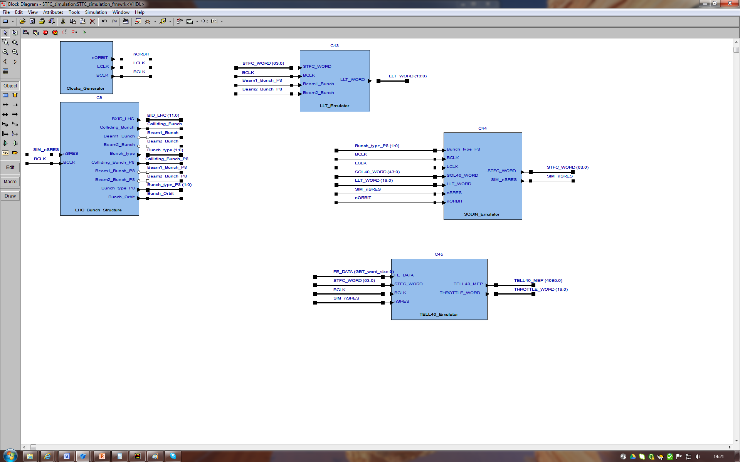
Example - SODIN
11

Slide 12
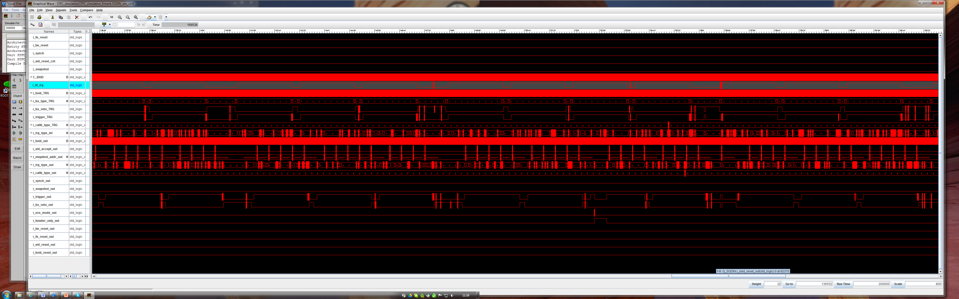
Example - SODIN
12

Slide 13
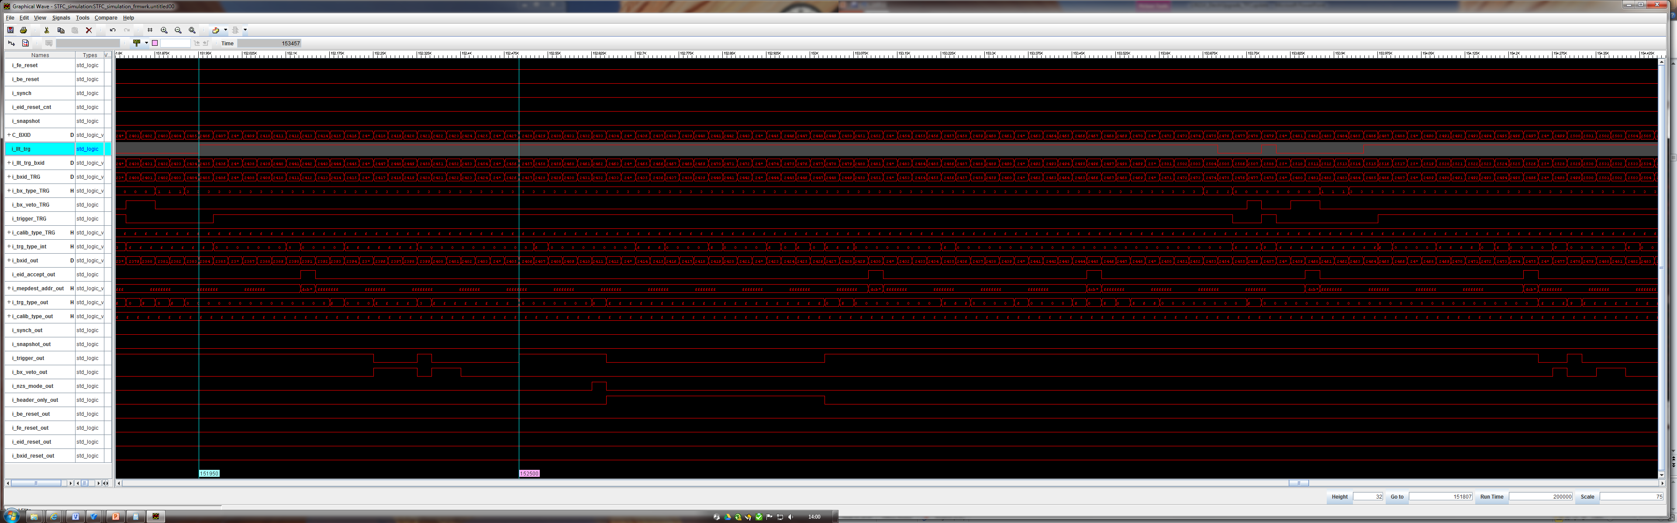
Example - SODIN
13

Slide 14
TFC simulation testbench - plans
Plan to expand it including:
- SOL40 fw
- TELL40 emulation
      eventually replaced by synthesizable TELL40 fw
- FE generic channel emulation
      eventually this can be replaced by real FE code
      → here formal request to FE people to provide their own code ☺
    GBT and GBT-SCA emulations
      GBT already available (since 2008, thanks to Marseille)
      GBT-SCA discussion with PH-ESE to be done
NB 1: simulation of buffers, logic and protocols can easily be done here
- at clock-level
NB 2: does not exclude/compete with simulation with QSYS/ModelSim
- aims at integrating it (by including GBT-SCAs, FE codes …)
14

Slide 15
Qs & As?
15

Slide 16
System and functional requirements
Bidirectional communication network
Clock jitter, and phase and latency control
  At the FE, but also at TELL40 and between S-TFC boards
Partitioning to allow running with any ensemble and parallel partitions
LHC interfaces
Events rate control
Low-Level-Trigger input
Support for old TTC-based distribution system
Destination control for the event packets
Sub-detectors calibration triggers
S-ODIN data bank
  Infomation about transmitted events
Test-bench support
16

Slide 17
The S-TFC system at a glance
S-ODIN responsible for controlling upgraded readout system
Distributing timing and synchronous commands
Manages the dispatching of events to the EFF
Rate regulates the system
Support old TTC system: hybrid system!
STORAGE
SOL40 responsible for interfacing FE+TELL40 slice to S-ODIN
Fan-out TFC information to TELL40
Fan-in THROTTLE information from TELL40
Distributes TFC information to FE
Distributes ECS configuration data to FE
Receives ECS monitoring data from FE
DATA
DATA
17

Slide 18
S-TFC concept reminder
18

Slide 19
Partitioning
Partitioning is assured by having:
Many instances of S-ODIN inside main FPGA
  Only one is the LHCb Master
Switching is done inside main FPGA
  Simply ensure that TFC information are sent to right output
TFC+ECSInterface «interfaces» S-ODIN with partitioned FE+TELL40 slice(s)
  Logical distribution of TFC+ECSInterfaces in TELL40s crates
  Important to respect the «logical concept» of partitioning
    Should not span over different sub-systems with same TFC+ECSInterface…
    → Need at least one dedicated TFC+ECSInterface for each sub-system
19

Slide 20
«BX VETO»
@ 40 MHz
S-ODIN vetoes the readout of an event
Based on filling scheme
Used to control the rate of readout while < 30MHz
INDEPENDENT FROM LLT DECISION!
FE can use this info to recuperate time for processing events
Only header for vetoed events
Flexible packing of data into GBT frame
20

Slide 21
Sending a «LLTyes»
@ 40 MHz
S-ODIN receives decisions from LLT Special triggers
S-ODIN aligns and applies priority scheme on trigger types
S-ODIN sends out a “LLTyes” to TELL40 at
a fixed latency wrt BXID!
Rate regulation
(next slide)
21
Notes:
HOW TO USE VETO BIT IN FE

Slide 22
Rate regulation
@ 40 MHz
TELL40 raises the throttle bit
SOL40 compiles a
throttle word with BXID
and sends it to S-ODIN
S-ODIN rejects event(s) until throttle is released
→ In practice: the subsequent “LLTyes”(s) become “LLTno”(s)!
MEP request scheme
(next slide)
22

Slide 23
S-TFC readout control sequences
“BXID” and “BXID Reset”
Every TFC word carries a BXID for synchronicity checks of the system
A BXID Reset is sent at every turn of the LHC (orbit pulse)
  Should only reset the internal bunch counter of the FE
“FE RESETS”
Bit set for one clock cycle in TFC word
Reset of FE operational logic for data processing, formatting, transmission…
  Should not touch the internal bunch counter
  FE electronics should be back asap:
    S-ODIN will ensure no data is being accepted during the FE reset process
    wait to the slowest by setting Header Only bit, i.e. no data is recorded at FE
  Reset TELL40 data input logic: the same bit is sent to TELL40 for same BXID
“HEADER ONLY”
Idling the system: only header (or few bits) in data word if this bit is set
  Multiple purposes: set it during reset sequence, during NZS transmission, during TAE mode…
“BX VETO”
Based excusively on filling scheme, processing of that particular event is inhibited
  Only header (or few bits) in data word if this bit is set
  Allows “recuperating” buffer space in a LHC-synchronous way if taken into account
23

Slide 24
S-TFC readout control sequences
“CALIBRATION TYPE” COMMAND
Used to take data with special trigger pulses (periodic, calibration)
  Dedicated 4 bits: i.e. 4 different calibration commands possible
  Dynamic association to be used for calibration and monitoring
    Absolute need of delays to account for each individual delay in the detectors
  S-ODIN overrides LLT decision at TELL40
    Periodic or calibration higher priority (but lower rate, max 11.245kHz each!)
“NZS MODE”
Read out (all) FE channels non-zero suppressed
  Packing of full set of bits in many consecutive GBT frames:
  Needs buffering at FE (same buffer as data or different buffer?)
Possible to have also multi-NZS readout: consecutive NZS events
  S-ODIN will take care of setting Header Only bit for a defined set of clock cycles later to allow recuperating buffer space (programmable as well, to the slowest of the detector)
What are the sub-detector requests in term of NZS?
What do you need and what do you want to do?
“SNAPSHOT”
Read out all status and counter registers in a “latched” way
  Latch monitoring registers on snapshot bit, which is set periodically (programmable) and also single shot
  When snapshot bit is received, send all data via ECS field in TFC on best effort
24

Slide 25
Timing distribution
From TFC point of view, we ensure constant:
LATENCY: Alignment with BXID
FINE PHASE: Alignment with best sampling point
Some resynchronization mechanisms envisaged:
Within TFC boards
With GBT
  No impact on FE itself
Loopback mechanism:
re-transmit TFC word back
allows for latency measurement + monitoring of TFC commands and synchronization
25

Slide 26
Example of readout mechanism
This scheme implies that the GBT bandwidth is exploited to its maximum:
Pack of events consecutively independently from GBT boundaries
Needs buffering to keep events stored waiting to be sent off
Header needs more information than just BXID
  length of word, type of word…
Needs a well-defined truncation scheme and boundaries

Slide 27
How to decode TFC in FE chips?
FE electronic block
Use of TFC+ECS GBTs in FE is 100% common to everybody!!
dashed lines indicate the detector specific interface parts
please pay particular care in the clock transmission: the TFC clock must be used by FE to transmit data, i.e. low jitter!
  Kapton cable, crate, copper between FE ASICs and GBTX
27

Slide 28
The TFC+ECS GBT
Clock[7:0]
External clock reference
FE
Module
E – Port
These clocks should be the main clocks for the FE
8 programmable phases
4 programmable frequencies (40,80,160,320 MHz)
e-Link
GBTX
Phase - Shifter
CLK Reference/xPLL
FE
Module
E – Port
E – Port
ePLLRx
GBTIA
DEC/DSCR
E – Port
CDR
data-down
data-up
Phase – Aligners + Ser/Des for E – Ports
CLK Manager
clock
80, 160 and 320 Mb/s ports
GBLD
SCR/ENC
SER
FE
Module
E – Port
ePLLTx
E – Port
E – Port
one 80 Mb/s port
Control Logic
Configuration
(e-Fuses + reg-Bank)
GBT – SCA
Used to:
sample TFC bits
drive Data GBTs
drive FE processes
E – Port
JTAG
I2C Slave
I2C Master
data
I2C (light)
control
clocks
JTAG port
I2C port
28

Slide 29
The TFC+ECS GBT protocol to FE
→ TFC protocol has direct implications in the way in which GBT should be used everywhere
  24 e-links @ 80 Mb/s dedicated to TFC word:
    use 80 MHz phase shifter clock to sample TFC parallel word
  TFC bits are packed in GBT frame so that they all come out on the same clock edge
    We can repeat the TFC bits also on consecutive 80 MHz clock edge if needed
Leftover 17 e-links dedicated to GBT-SCAs for ECS configuring and monitoring (see later)
29

Slide 30
Words come out from GBT at 80 Mb/s
In simple words:
Odd bits of GBT protocol on rising edge of 40 MHz clock (first, msb),
Even bits of GBT protocol on falling edge of 40 MHz clock (second, lsb)
30

Slide 31
TFC decoding at FE after GBT
This is crucial!!
we can already specify where each TFC bit will come out on the GBT chip
this is the only way in which FE designers still have minimal freedom with GBT chip
  if TFC info was packed to come out on only 12 e-links (first odd then even), then decoding in FE ASIC would be mandatory!
  which would mean that the GBT bus would have to go to each FE ASIC for decoding of TFC command
there is also the idea to repeat the TFC bits on even and odd bits in TFC protocol
  would that help?
  FE could tie logical blocks directly on GBT pins…
31

Slide 32
Now, what about the ECS part?
Each pair of bit from ECS field inside GBT can go to a GBT-SCA
  One GBT-SCA is needed to configure the Data GBTs (EC one for example?)
  The rest can go to either FE ASICs or DCS objects (temperature, pressure) via other GBT-SCAs
    GBT-SCA chip has already everything for us: interfaces, e-links ports ..
      → No reason to go for something different!
    However, «silicon for SCA will come later than silicon for GBTX»…
      → We need something while we wait for it!
32

Slide 33
Now, what about the ECS part?
Note that:
Many FE chips can be connected to same GBT-SCA
  Provided they use the same bus (and same protocol)
  Provided we have a proper addressing scheme at the FE side (and its mapping)
Or (viceversa) many GBT-SCAs can be connected to the same FE chip
  If needed to have more than 80 Mb/s for each FE chip ECS… (really?!? )
To make this work, the only thing we need is to be able to:
  .. drive the right FE chip at the right address ..
  .. with the right GBT-SCA ..
  .. with the right protocol for the chosen bus ..
    SOL40 will do that in the most flexible way possible
      driving the GBT-SCA through the downlink
    → ECS (control pc) must provide:
      the mapping of the FE
      the mapping of GBT-SCA
33

Slide 34
SOL40 encoding block to FE!
Protocol drivers build GBT-SCA packets with addressing scheme and bus type for associated GBT-SCA user busses to selected FE chip
Basically each block will build one of the GBT-SCA supported protocols
Memory Map with internal addressing scheme for GBT-SCA chips + FE chips addressing, e-link addressing and bus type: content of memory loaded from ECS
34

Slide 35
Usual considerations …
TFC+ECSInterface has the ECS load of an entire FE cluster for configurating and monitoring
34bits @ 40 MHz = 1.36Gb/s on single GBT link
  ~180 Gb/s for full TFC+ECSInterface (132 links)
  Single CCPC might become bottleneck…
  Clara & us, December 2011
How long to configure FE cluster?
  how many bits / FE?
  how many FEs/ GBT link?
  how many FEs / TFC+ECSInterface?
→ Numbers to be pinned down soon + GBT-SCA interfaces and protocols.
35

Slide 36
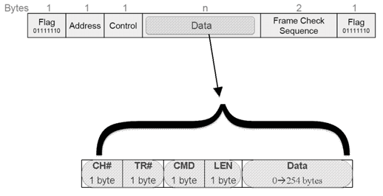
Extra slide - GBT-SCA Packet
Easy: the GBT-SCA has everything set up (on paper…)
Only thing is to build proper protocol
FE designer selects the bus + addressing scheme, we built a generic entity in SOL40 to drive it.
36

Slide 37
Clock distribution and phase/latency control
1. FPGA to FPGA transceivers
Special studies on latency and phase alignment
    (see next for preliminary tests)
→ control of fine phase and latency
→ minimize jitter
37

Slide 38
Clock distribution and phase/latency control
2. ATCA backplane
Does the job for us
→ control of latency
jitter and fine phase less of an issue
Effectively is an FPGA-to-FPGA link on backplane dedicated lines
To be checked: jitter on backplane!
38

Slide 39
Clock distribution and phase/latency control
3. at the FE: GBT
Does the job for us
control of fine phase + latency at the FE + minimize jitter
No problem in ECS monitoring
Simply decoding GBT protocol in SOL40 FPGA
  → No need of fine phase or latency control for ECS.
39

Slide 40
Latency and phase control
Investigate with ALTERA and Jean-Pierre two years ago
Trick is to use the bitslip management already in FPGA
  Issue: need 8b/10b encoding
Set a reference value
Bitslip the word by the difference between the measured value and the reference value to re-align the words
First implementation seems to work
Stress tests various clock loss/recovering situations
Estimation of maximum delay in recovering

Slide 41
Event Destination and Farm Load Control
The current system operates in a powerful mixture of push and pull protocol
controlled by ODIN :
Asynchronous pull mechanism
“Push” driven by trigger type
  and destination command
→ Note: LHCb-PUB-2011-023
4 years faultless operation
Similar proposal for upgrade
→ Comments in backup
41

Slide 42
Event Destination and Farm Load Control
Central FPGA based implementation
  Extreme reliability, flexibility, speed, controllable latencies
Central event packing control
  Different trigger types and destination types
  Variable MEP packing factor
Dynamic rate regulation as function of farm rate capacity
  Accounts for statistical variations in processing time
Dynamic handling of farm nodes in-flight
  Processing blockages, failures, interventions
  All impacts on rate capacity handled automatically
  As soon as nodes are recovered, included automatically in-flight by event request mechanism
Minimal event loss and accurate dead-time counting
Contrary to conventional pull scheme, this is robust against event request packet losses
42

Slide 43
Event Destination and Farm Load Control
Buffer requirement trivia
Readout boards: ~1.5 MEPs per link
Network: Some naïve assumptions
  Rate: 30 MHz
  MEP packing factor 10 → 3 MHz MEPs and 3 MHz MEP Requests
  → Current ODIN can handle 1.8 MHz of MEP Requests (ODIN <-> FARM is 1 GbE…)
  Event size 100 kB → 1 MB / MEP
  Farm nodes 5000 → 600 MEPs/node/s → 1.7ms / MEP
  Switch subunit sharing resources: 50 links / subunit → 100 subunit
  30 kHz of MEPs per switch subunit
  Every 1.7ms, 50 MEPs to juggle with → <buffer> = O(“50 MB”)
  True need of memory depends on statistical variation of HLT processing time and “local farm derandomizer”
Farm nodes: few MEPs in local derandomizing buffer
In our view, this looks like a straight-forward implementation…

Slide 44
S-ODIN data bank
S-ODIN transmits a data bank for each accepted event in a MEP
Run number, event identifier, orbit number, bunch identifier, UTC time, event type, trigger mask, bunch crossing information
+
S-ODIN data bank and LLT data bank is merged
(reminder: LLT is in same board as new S-ODIN)
Info about timestamp, trigger type, bxid, trigger decision…
  Mostly like now
Will need at least 10GbE connection directly to FARM
  what about 40GbE…? ☺
  has to allow bandwidth partitioning as well
    In fact «several» 10GbE (n*10GbE…),
  reduced bank size for local tests
    No LLT for instance
44

Slide 45
Old TTC system support and
running two systems in parallel
We already suggested the idea of a hybrid system:
  reminder: L0 electronics relying on TTC protocol
  part of the system runs with old TTC system
  part of the system runs with the new architecture
How?
Need connection between S-ODIN and ODIN (bidirectional)
→ use dedicated RTM board on S-ODIN ATCA card
In an early commissioning phase ODIN is the master, S-ODIN is the slave
    S-ODIN task would be to distribute new commands to new FE, to new TELL40s, and run processes in parallel to ODIN
    ODIN tasks are the ones today + S-ODIN controls the upgraded part
      In this configuration, upgraded slice will run at 40 MHz, but positive triggers will come only at maximum 1.1MHz…
        Great testbench for development + tests + apprenticeship…
        Bi-product: improve LHCb physics programme in 2015-2018…
3. In the final system, S-ODIN is the master, ODIN is the slave
  → ODIN task is only to interface the L0 electronics path to S-ODIN and to
  provide clock resets on old TTC protocol
45

Slide 46
TFC fits well on xTCA and Marseille hardware
TFC development work at CERN apart from hardware testing and high level control
All FPGA code (TFC logic including trigger, link protocols, board control)
Special mezzanine(s) (Clock reception, LHC Interfaces, TTC, etc)
Relay logic for TFC+FE Interface including optional ODIN logic for stand-alone activities
Challenges:
  TFC+ECSInterfaces with optional ODIN need to be ready and produced in quantities before any SD test setup
  Validation of clock phase control and reproducibility of latency and jitter
  Validation of tranmission protocols S-ODIN+SOL40 and SOL40+FE
    Go for 8b/10b decoder to start with
      Simple, as part of the ALTERA decoding
    Validate GBT with TFC+ECS to FE information
Considerations
In ATCA Dual Star technology, boards in Hub1 and Hub2 talks to all the boards in the crate
  TFC+ECSInterface as Hub1 board
S-ODIN located near the LHC interfaces (clock, machine timing and control information).
  Bi-directional fibres connections to TFC Interface
If no backplane, BE connection via TFC+ECSInterface must be done via fibres
  How many receivers/transmitter per mezzanine/ how many mezzanines?
46

Slide 47
S-ODIN on Marseille’s ATCA board
47

Slide 48
TFC+ECSInterface on Marseille’s ATCA board
48

Slide 49
Clock distribution and phase/latency control
First preliminary tests on phase/latency control using:
Marseille’s first AMC prototype with ALTERA Stratix IV
Marseille’s first Stratix IV low level interfaces (will need re-validation on Stratix V!) → Nios + board resources interfaces + thanks to Marseille team!
8b/10b protocol: no problem
Using «word alignment» from Altera GX buffer + «deterministic latency»
Simply add Ctrl word for the 8b/10b encoder: 2bits more
Full reproducibility upon power-up and resets and reconfiguration
FPGA-to-FPGA GBT protocol: ok, but needs special frame alignment
No deterministic latency if no special words are sent!
Needs a special word (10 bits minimum) at power-up/after reset/after reconfiguration for the GX buffer to realign to the beginning of the frame + «deterministic latency»
  First preliminary tests were ok, but needs more validation under stress tests!
49

Slide 50

Lab work and planned (first) tests
Some lab work has already started:
Set up a S-TFC test stand at the pit
Get Marseille’s AMC board first prototype
  First version of firmware with GBT protocol in it (developed in Marseille)
  First version of control software in NIOS (developed in Marseille)
    One word of acknowledgment for the work done by Jean-Pierre and Frederic Hachon in Marseille
Get acquainted with the hardware
Send first trigger words
  8b/10b protocol: using ALTERA features
  GBT protocol: not possible to use ALTERA features
Stress tests to validate latency control
Stress tests to validate phase control
Implement first version of TFC+ECS firmware with functionalities presented here
  Including first simple version of S-ODIN
Develop first single-AMC test stand board with firmware + software to control the hardware
  Need dedicated simulation framework
    Already developed in 2009 (see https://indico.cern.ch/conferenceDisplay.py?confId=65307)
    Needs mostly adaptations …
  Work to control (software) the single AMC card
Done!
Done!
Done!
Done!
Done (but will need revalidation on Stratix V + more tests!)
50

